Slide 1
LOSE-LESS DATA COMPRESSION
CS210 PPROJECT
- Hardik Bansal
C.S.E.
12279

Slide 2
Data Compression
Encoding of data into fewer bit of memory.
Using different arithmetic tools like:
  Soting
  Hash Tables
  Tries
  String Matching.
Decoding re-constructs the required data.

Slide 3
Types of Compression
Lossless Data Compression: No loss of data while encoding.
  Huffman Encoding.
  LZ77,LZW,LZSS etc.
  Burrows Wheeler.
Lossy Data Compression: Some information is lost during compression.
  Transform Coding.
  Scalar and Vector Quantization.

Slide 4
Important Terms
Entropy:entropy represents the randomness or disorder of message s ∈ S(set of possible message). We define self information
  i(s) = log2 (1/p(s)).
It represent number of bit, we should use to encode information. Roughly, more probable information must have less number of bits than information with less probability.

Slide 5
Important Terms
It is on the basis of entropy we decide how much information we can compress.
Help us design algorithms.
Information | Bits/Char
General bits per char | 8
Entropy | 4.5
Entropy (group of 8) | 2.4
Can be reached | 1.3

Slide 6
Where do we use Compression?
Nowadays we use it everywhere:
  JPEG image (lossy data compression)
  ZIP, GZIP , ZIP.
  Mp4

Slide 7
Lose-Less Data Compression
Data can be recovered completely.
Implemented two algorithms
  Huffman Encoding: Based on Prefix Codes.
  LZ77: Based on string repetition or we can say string entropy.

Slide 8
Huffman Encoding
Prefix Codes: A preﬁx code is a special kind of uniquely decodable code in which no bit-string is a preﬁx of another one, for example {(a, 1),(b, 01),(c, 000),(d, 001)}.
Used in order to avoid ambiguity to decode encoded string.

Slide 9
Property
We define la(C) = ∑(p(s)l(w))
H(S) ≤ la(C)
la(C) ≤ H(S) + 1 .
Here H(s) is average based on self information
seen earlier

Slide 10
Huffman Coding
The basic idea in Huffman coding is to assign short codewords to those input blocks with high probabilities and long codewords to those with low probabilities
Greedy Algorithm is used to assign weightages to different character based on their count in the document.
I implented it using Min-Heap as data structure.
Most predominantly used algorithm to compress

Slide 11
Implementaion
Start with a forest of trees, one for each message. Each tree contains a single vertex with weight wi = pi.
Select two trees with the lowest weight roots (w1 and w2).
Combine them into a single tree by adding a new root with weight w1+w2, and making the two trees its children. It does not matter which is the left or right child, but our convention will be to put the lower weight root on the left if w1 not equal to w2
Repeat until only a single tree remains

Slide 12
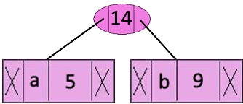
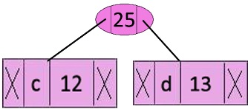
Example
a | b | c | d | e | f
5 | 9 | 12 | 13 | 16 | 45
c | d | Internal node | e | f
12 | 13 | 14 | 16 | 15
Internal node | e | Internal node | f
14 | 16 | 25 | 45

Slide 13
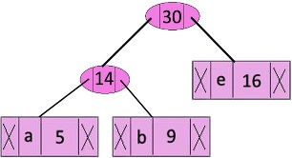
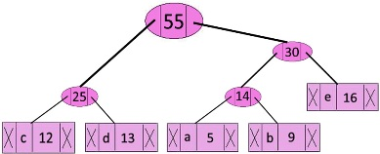
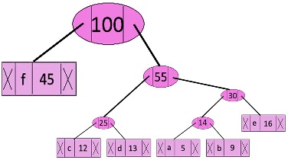
Internal node | Internal node | f
25 | 30 | 45
f | Internal node
45 | 55

Slide 14
Analysis
Time Complexity of Huffman Algorithm is O(nlogn) where each iteration takes order (logn) time to determine the cheapest weight and there would be O(n) iterations, so in total it would lead to O(nlogn) solution.

Slide 15
Result (Huffman)

