Slide 1

SGU AI-THON
AAPDA SETU
One Platform. Every Disaster. Every Stage.
Presented by Team Semicolon Squad — Hardik Dagar · Ananya Shree · Akshara Gupta · Divyansh Bhardwaj

Slide 2





THE TEAM
semicolon squad
Hardik Dagar
HD · Leader
Ananya Shree
AS · Member
Akshara Gupta
AG · Member
Divyansh Bhardwaj
DB · Member

Slide 3
PROBLEM STATEMENT
PS3 — DISASTER RESPONSE INTELLIGENCE PLATFORM
Every Disaster Is Handled In Silos
The Broken System
Who Is Affected & Why It Matters
Prediction systems don't communicate with citizens in real time.
Citizens have no direct way to signal they're stuck during a disaster.
Hospitals don't share inventory status with disaster coordinators.
Local officials have no direct channel to request resources from central government.
Citizens in flood / earthquake / tsunami-prone zones with no direct rescue channel.
Field officials & NDRF-SDRF teams without a live, unified view of the ground situation.
Hospitals isolated from disaster coordination despite being critical responders.
Existing approaches stop at prediction — leaving response and coordination manual and slow.

Slide 4



PROPOSED SOLUTION
A Unified, Multi-Disaster Intelligence Platform
Aapda Setu bridges citizens, field officials, and central authorities across the entire disaster lifecycle — predicting risk, guiding rescue, and coordinating resources.
01 — BEFORE
02 — DURING
03 — RESOURCE
Prediction & Awareness
ML-based disaster risk prediction at district/ward level; automated multilingual alerts to citizens & officials.
Response & Rescue
Live shelter/hospital map; one-tap SOS with geo-location; official dashboard ranking requests by urgency.
Coordination
Live hospital & official inventory tracking; direct escalation channel to central/state authorities.

Slide 5






KEY FEATURES
Six Features. One Platform.
Risk Prediction
Multilingual Alerts
ML model predicts flood/earthquake/tsunami risk at district/ward level.
Automated early-warning alerts in regional languages, before disaster strikes.
One-Tap SOS
Live Ops Dashboard
Citizens raise a geo-tagged rescue alert instantly from their phone.
Officials see all SOS requests, ranked by urgency & density, on a live map.
Hospital Inventory
Resource Escalation
Real-time visibility into beds, oxygen, medicines, and ambulances.
Officials raise auto-filled resource requests directly to central/state authorities.

Slide 6
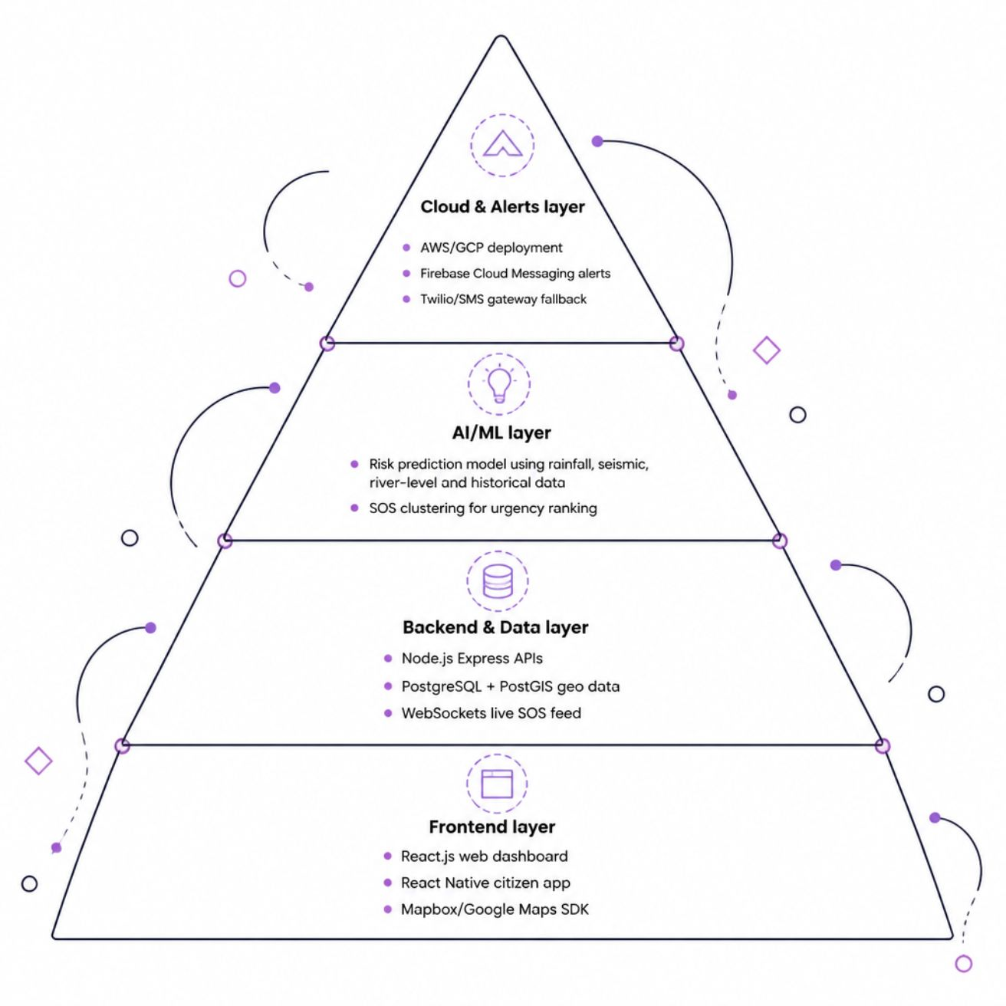
TECH STACK & ARCHITECTURE
Built on Modern, Scalable Infrastructure
Frontend
React.js (web dashboard)
React Native (citizen app)
Mapbox / Google Maps SDK
Backend & Data
Node.js (Express) APIs
PostgreSQL + PostGIS (geo data)
WebSockets for live SOS feed
AI / ML
Risk prediction model (rainfall, seismic, river-level, historical data)
SOS clustering for urgency ranking
Cloud & Alerts
AWS / GCP deployment
Firebase Cloud Messaging (alerts)
Twilio / SMS gateway fallback

Slide 7


HOW IT WORKS
END-TO-END FLOW ACROSS THE DISASTER LIFECYCLE
From Prediction to Government Escalation
Data Sources
ML Risk Engine
Alerts & Map
Citizen SOS
Prediction → Citizen Action → Rescue Coordination → Resource Visibility → Government Escalation
Core Innovation: Most systems stop at prediction. Aapda Setu closes the full loop — one platform, four connected roles (citizens, officials, hospitals, government) — across all disaster types.

Slide 8

IMPACT & FEASIBILITY
Impact Across All Stakeholders
Citizens
Officials
Faster alerts, clear shelter guidance, a direct rescue signal when stuck.
Live situational awareness enables prioritized, data-driven rescue dispatch.
Hospitals
Government
Integrated into disaster response instead of operating in isolation.
Faster, data-backed resource escalation — replacing manual phone coordination.
Feasibility & Scalability
MVP built on real historical flood data; framework is disaster-agnostic.
Modular services (prediction, SOS, inventory, escalation) scale independently.
Scales district → state → national by adding data feeds.
Role-based access for citizen / official / hospital / authority tiers.
Uses existing public data sources — low data-acquisition cost.

Slide 9
FUTURE SCOPE
The Roadmap Ahead
01
02
03
Extended Risk Models
NDMA Integration
Offline SOS Mode
Extend risk models to earthquake & tsunami with dedicated datasets.
Integrate with NDMA / state disaster management data feeds.
Offline / low-connectivity SOS mode for network-hit disaster zones.
04
05
Predictive Pre-Positioning
Voice-Based Alerts
Predictive resource pre-positioning based on risk forecasts.
Multi-language voice-based alerts for accessibility.

Slide 10

Thank You
Before it strikes, during the chaos, after the call for help — Aapda Setu bridges every gap.
AAPDA SETU
One Platform. Every Disaster. Every Stage.
Team Semicolon Squad
Hardik Dagar · Ananya Shree · Akshara Gupta · Divyansh Bhardwaj
Designed by Divyansh Bhardwaj

