Slide 1


NAUT IQ
SMART INDIA HACKATHON 2026
IP-SAKTI SAHAYAK
Problem Statement ID: 26045
Problem Statement Title
Multilingual, source-cited AI assistant for Ayurveda intellectual-property and regulatory guidance
Theme :
MedTech / BioTech / HealthTech
PS Category :
Software
Team ID :
To be assigned
Team Name :
Naut IQ
AYUNEX
Product interface for IP-SAKTI
Notes:
Content adapted from the supplied 26045_SIH_NAUT_IQ_Enhanced.pptx and docs/IP-SAKTI_DETAILED_IDEA.md. Proposed capabilities and pilot targets, not claims of achieved performance. Layout inspiration: supplied SIH26169 - FINAL.pdf. The reference supplies the requested colours and format. The SIH logo is retained as event identification. Product copy describes IP-SAKTI and user-supplied AYUNEX screenshots. AYUNEX branding comes from the user-supplied interface screenshots. Team ID remains unassigned.

Slide 2

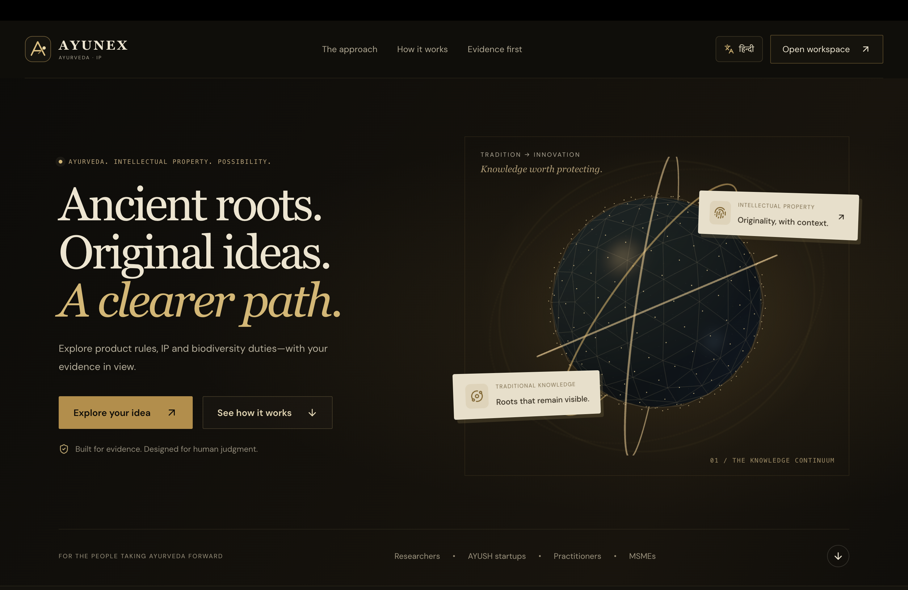
NAUT IQ
PROBLEM AND SOLUTION
Product facts, independent assessments and source-linked next steps
THE PROBLEM
1
2
3
4
5
01
Which product and labelling rules apply?
ASK
CONFIRM
ASSESS
VERIFY
PREPARE
Query and
context
Relevant
product facts
Regulation,
IP and ABS
Provisions
and dates
Cited
case brief
02
Which IP rights and prior knowledge matter?
03
What access and benefit-sharing duties arise?
04
What changes in the target export market?
PROPOSED SOLUTION
Relevant questions
Create a Passport only when product facts matter.
Separate assessments
Review regulation, IP and ABS independently.
Dated official sources
Keep India and export-market guidance distinct.
Evidence before answers
Verify material claims and flag gaps for human review.
Notes:
Content adapted from the supplied 26045_SIH_NAUT_IQ_Enhanced.pptx and docs/IP-SAKTI_DETAILED_IDEA.md. Proposed capabilities and pilot targets, not claims of achieved performance. Layout inspiration: supplied SIH26169 - FINAL.pdf. The reference supplies the requested colours and format. The SIH logo is retained as event identification. Product copy describes IP-SAKTI and user-supplied AYUNEX screenshots. Original user screenshot: AYUNEX landing page. Full screenshot embedded unchanged as a separate image over an original generated laptop frame. General questions bypass Product Passport. Output coverage continues on the workflow and features slides.

Slide 3
NAUT IQ
SYSTEM WORKFLOW
Relevant facts first. Evidence checks before the final answer.
USER QUESTION
OFFICIAL PROVISIONS
EVIDENCE CHECK
Language, jurisdiction and as-of date
Search exact terms and meaning. Check effective dates, scope and exceptions.
Does each material claim have sufficient support?
GENERAL INFORMATION
Supported
Retrieve relevant sources without a Passport
CITED ACTION PLAN
Classification, next steps, forms, sources and unresolved questions
INDEPENDENT ASSESSMENTS
PRODUCT QUESTION
Regulatory route
IP opportunities
ABS / traditional-knowledge duties
Ask relevant facts and confirm extracted details
Insufficient support
MISSING OR CONFLICTING
One retrieval retry, then partial guidance or human review
FACTS THAT MAY CHANGE A PRODUCT ASSESSMENT
Intended use / claims
Ingredients / resource origin
Formula / processing changes
Applicant / market / prior disclosure
Unknown facts remain unresolved. A product category does not establish patentability or ABS clearance.
Notes:
Content adapted from the supplied 26045_SIH_NAUT_IQ_Enhanced.pptx and docs/IP-SAKTI_DETAILED_IDEA.md. Proposed capabilities and pilot targets, not claims of achieved performance. Layout inspiration: supplied SIH26169 - FINAL.pdf. The reference supplies the requested colours and format. The SIH logo is retained as event identification. Product copy describes IP-SAKTI and user-supplied AYUNEX screenshots. Product and general-information paths are alternatives. Product assessment requires relevant confirmed facts. Every final response passes the evidence gate. Retrieval repair is limited to one attempt.

Slide 4
NAUT IQ
TECHNICAL APPROACH
ARCHITECTURE
TECHNOLOGY STACK
USER EXPERIENCE
LANGUAGE ACCESS
Next.js / TypeScript / Tailwind
BHASHINI adapter
Voice after validation
Guided questions and evidence views. Hindi text first.
DOMAIN RULES
EVIDENCE STORAGE
FastAPI / Pydantic / decision tables
Versioned official provisions
Private cases outside corpus
Confirm facts and assess regulation, IP and ABS separately.
RETRIEVAL AND ANSWERS
MODEL SELECTION
PostgreSQL FTS / pgvector / BGE-M3
Benchmark the generator
and reranker before selection
Retrieve versioned provisions. Qwen3-8B remains a candidate.
VERIFICATION AND DELIVERY
DELIVERY BOUNDARIES
Typed evidence checks
Verify claims, then return sources, forms and unresolved issues.
One backend and one worker initially.
Add a graph database or extra agents only if evaluation demonstrates a benefit.
PLATFORM SUPPORT
Docker Compose, object storage, role-based access and audit logs
Notes:
Content adapted from the supplied 26045_SIH_NAUT_IQ_Enhanced.pptx and docs/IP-SAKTI_DETAILED_IDEA.md. Proposed capabilities and pilot targets, not claims of achieved performance. Layout inspiration: supplied SIH26169 - FINAL.pdf. The reference supplies the requested colours and format. The SIH logo is retained as event identification. Product copy describes IP-SAKTI and user-supplied AYUNEX screenshots. Proposed stack, not a statement of achieved performance or complete implementation. BHASHINI access and data handling require validation. https://arxiv.org/abs/2402.03216

Slide 5
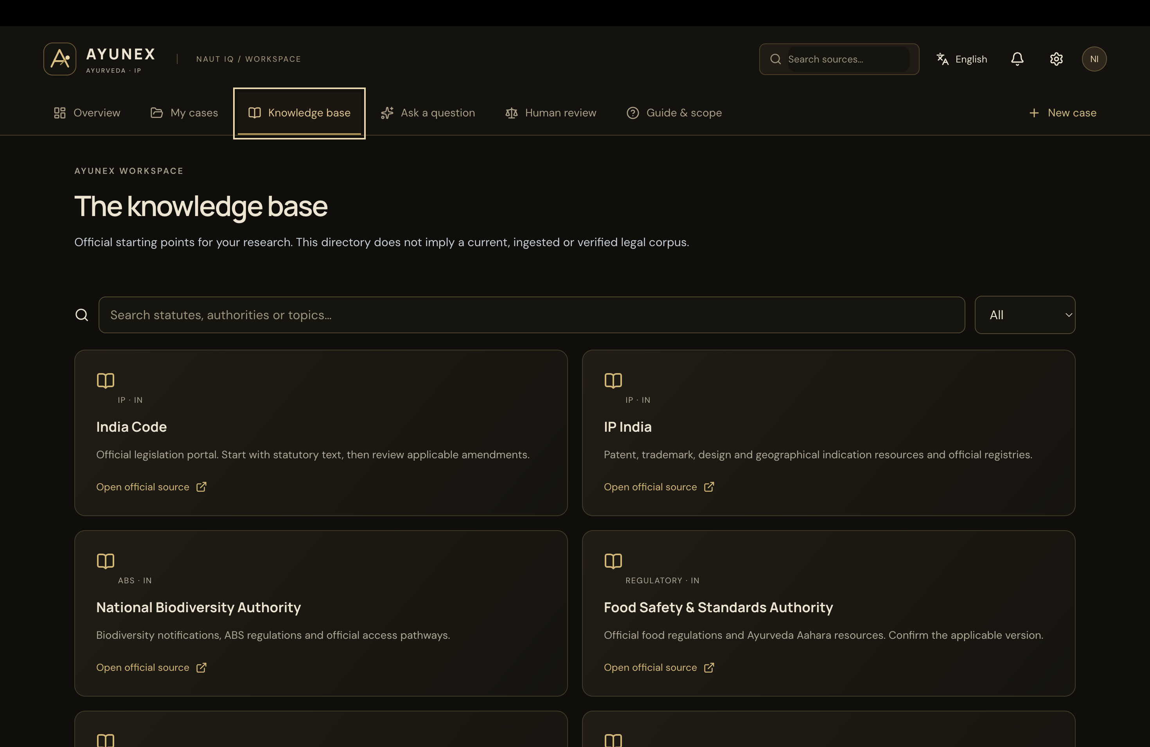
NAUT IQ
KEY FEATURES AND INNOVATION
Relevant questions, inspectable evidence and a clear path through uncertainty
WHAT MAKES THE APPROACH USEFUL
AYUNEX KNOWLEDGE DIRECTORY
01 Relevant questions
General queries bypass the Passport. Ask only for facts that change a product assessment.
02 Separate legal pathways
Regulation, IP and ABS keep their own conditions. Unknown facts remain visible.
03 Inspectable evidence
Link material claims to exact provisions, versions, dates and jurisdictions.
04 Human review when needed
Preserve facts and evidence. Flag unsupported sections and unresolved questions.
Information and preparation support
Legal decisions require qualified expert review.
Official-source directory, not an ingested or verified legal corpus.
Notes:
Content adapted from the supplied 26045_SIH_NAUT_IQ_Enhanced.pptx and docs/IP-SAKTI_DETAILED_IDEA.md. Proposed capabilities and pilot targets, not claims of achieved performance. Layout inspiration: supplied SIH26169 - FINAL.pdf. The reference supplies the requested colours and format. The SIH logo is retained as event identification. Product copy describes IP-SAKTI and user-supplied AYUNEX screenshots. The screenshot is a source directory, not evidence of a verified production corpus. Original user-supplied knowledge-base image embedded unchanged. Claim-verification design is proposed. https://aclanthology.org/2023.emnlp-main.398/

Slide 6
NAUT IQ
FEASIBILITY AND VIABILITY
BUILD AND VALIDATE
PRACTICAL CONTROLS
01 Reviewed foundation
Changing law
Official provisions, versioned rules and 30 expert-reviewed cases.
Curator approval, effective dates and regression tests.
02 Working demonstrator
Incomplete or incorrect answers
Two product journeys, general queries and verifiable citations.
Claim checks, one repair attempt and human review.
03 Tested expansion
Confidential product details
About 150 base cases, then Hindi and one export market.
Minimum data collection, scoped access and redacted logs.
PILOT ACCEPTANCE TARGETS (AWAITING VALIDATION)
95%
Citation support
90%
Required-abstention recall
Check whether the cited evidence
supports the material claim.
Check whether cases needing abstention
are correctly flagged.
Dependencies
Qualified reviewers and permitted source access are prerequisites. Targets require testing before release.
Notes:
Content adapted from the supplied 26045_SIH_NAUT_IQ_Enhanced.pptx and docs/IP-SAKTI_DETAILED_IDEA.md. Proposed capabilities and pilot targets, not claims of achieved performance. Layout inspiration: supplied SIH26169 - FINAL.pdf. The reference supplies the requested colours and format. The SIH logo is retained as event identification. Product copy describes IP-SAKTI and user-supplied AYUNEX screenshots. 30 reviewed cases and about 150 base cases are planned coverage. 95% citation support and 90% required-abstention recall are acceptance targets, not reported results. Source permissions and reviewer availability are prerequisites.

Slide 7
NAUT IQ
IMPACT AND BENEFITS
Expected benefits for the Ayurveda community
BENEFICIARY | EXPECTED BENEFIT | USEFUL DELIVERABLE
Startups and MSMEs | Clearer next steps before spending on filings, licences or export preparation. | A preparation checklist with obligations and open questions.
Practitioners and researchers | Plain-language explanations that can be inspected and discussed with experts. | Source-linked guidance with facts and provision references.
Cultivators and TK holders | Earlier visibility of resource-origin and benefit-sharing questions. | A sourcing record and unresolved biodiversity checkpoints.
IP facilitators | A structured case instead of an unorganised conversation. | Confirmed facts, evidence and issues ready for professional review.
HOW THE PILOT WILL ASSESS BENEFIT
Guidance quality
Review effort
Language accessibility
Expert review of correctness, citation support and uncertainty handling.
Compare the work needed to prepare and review a structured case.
Check comprehension and usability across English and Hindi journeys.
Notes:
Content adapted from the supplied 26045_SIH_NAUT_IQ_Enhanced.pptx and docs/IP-SAKTI_DETAILED_IDEA.md. Proposed capabilities and pilot targets, not claims of achieved performance. Layout inspiration: supplied SIH26169 - FINAL.pdf. The reference supplies the requested colours and format. The SIH logo is retained as event identification. Product copy describes IP-SAKTI and user-supplied AYUNEX screenshots. Expected benefits require pilot validation. No claims of measured savings, guaranteed compliance, patent grants or successful market entry. TK means traditional knowledge.

Slide 8
NAUT IQ
RESEARCH AND REFERENCES
OFFICIAL SOURCES FOR THE PROPOSED CORPUS
RESEARCH SUPPORTING THE DESIGN
01
India Code and IP India
05
ALCE, Gao et al. (2023)
Patents Act, rules and amendments
Answer generation with supporting citations
indiacode.nic.in / ipindia.gov.in
aclanthology.org/2023.emnlp-main.398
02
CDSCO and FSSAI
06
LegalBench-RAG (2024)
Product definitions and Ayurveda Aahara
Evaluation of precise legal retrieval
cdsco.gov.in / fssai.gov.in
arxiv.org/abs/2408.10343
03
National Biodiversity Authority
07
BGE-M3 (2024)
Biodiversity framework and ABS regulations
Multilingual text embeddings
nbaindia.nic.in
arxiv.org/abs/2402.03216
04
WIPO and TKDL
08
IndicTrans2, Gala et al. (2023)
Treaty resources and traditional knowledge
Translation across Indian languages
wipo.int / tkdl.res.in
arxiv.org/abs/2305.16307
SOURCE HANDLING
Retain provision versions and effective dates. Review access permissions before ingestion.
Notes:
Content adapted from the supplied 26045_SIH_NAUT_IQ_Enhanced.pptx and docs/IP-SAKTI_DETAILED_IDEA.md. Proposed capabilities and pilot targets, not claims of achieved performance. Layout inspiration: supplied SIH26169 - FINAL.pdf. The reference supplies the requested colours and format. The SIH logo is retained as event identification. Product copy describes IP-SAKTI and user-supplied AYUNEX screenshots. Sources carried forward from the user’s deck; this redesign is not a legal currency audit. Additional official destinations: https://www.ipindia.gov.in/ https://fssai.gov.in/ https://www.tkdl.res.in/ https://bhashini.gov.in/ . Research supports individual design choices, not a proven best complete system.

