Slide 1

Diabetes Onset Prediction
Using Machine Learning
An end-to-end Predictive Analytics / KDD project on the Pima Indians Diabetes Dataset
Hardik Jain
Student ID 23070521056 | Predictive Analytics (CA-3)
768
patients
Start presentation ›
5
models compared
GitHub repository
Open in Colab
Project report (PDF)
0.809
final ROC-AUC
Academic project: a screening-support model, not a medical diagnostic tool.
Notes:
Good morning. My project predicts whether a patient is likely to have diabetes from routine diagnostic measurements. I followed the complete KDD process, from defining the problem to interpreting the final model. It is an academic screening model, not a diagnostic tool.
Interactive deck: 'Start presentation' opens a clickable agenda; every slide has Agenda / Prev / Next buttons; the Model Explorer lets you drill into each model. The buttons at the bottom open the GitHub repository, the notebook in Google Colab and the PDF report (internet needed).

Slide 2












Interactive Agenda: click any topic
01
Problem Statement
02
Motivation & Objectives
03
Dataset
04
KDD Workflow
05
Data Understanding & EDA
06
Preprocessing & SMOTE
07
Models Used
08
Evaluation Metrics
09
Results & Comparison
10
Model Explorer
11
Interpretation (SHAP)
12
Conclusion & Future Scope
Quick links:
GitHub repo
Open in Colab
Report (PDF)
Viva Q&A
‹ Title
Next ›
Notes:
This is the navigation hub. Each tile jumps straight to that part of the talk, and every slide has an Agenda button to come back here. In a normal run I simply press Next; during questions I can jump to any topic. The Model Explorer (tile 10) opens a detail slide for each of the five models, and the Viva Q&A button opens prepared answers.

Slide 3
Problem Statement
Type 2 diabetes often develops unnoticed for years
Task: predict Outcome (0 = no diabetes, 1 = diabetes) from 8 routine measurements
Output: a class and a probability, used to flag patients for clinical testing
Supervised binary classification on imbalanced, partly incomplete data
Screening support, not a medical diagnosis
8 inputs
Pregnancies
Glucose
Risk %
Blood pressure
Skin thickness
Insulin
BMI
ML model
Formally: given X = (x₁ … x₈), learn f(X) → ŷ ∈ {0, 1} and estimate P(y = 1 | X)
Pedigree function
Age
‹ Prev
Agenda
Next ›
Notes:
Formally, the input is a vector of eight measurements and the output is a class label plus a probability. I framed it as a screening problem, which matters later: in screening, missing a diabetic patient is worse than raising a false alarm, so recall gets special attention.

Slide 4



Motivation & Objectives
Why it matters
Objectives
Early detection
Earlier testing and intervention can reduce complications
Clean the data: treat impossible zeros as missing
1
2
Explore how each measurement relates to diabetes
Low-cost inputs
Uses measurements hospitals already record
3
Build a leak-free pipeline (fit on training data only)
Realistic data problems
Hidden missing values and class imbalance to handle correctly
4
Compare 5 models with imbalance-aware metrics
5
Select a model with a recall-aware rule, then explain it with SHAP
‹ Prev
Agenda
Next ›
Notes:
My objectives were not only to get a good score, but to do every step correctly: no information from the test set may leak into training, the model is chosen with a clear rule, and I can explain why the model makes its predictions.

Slide 5
Dataset: Pima Indians Diabetes
768
8
34.9 %
48.7 %
patients (Pima Indian women aged 21+)
diagnostic features + Outcome
diabetic (268 of 768)
of Insulin values missing (zeros)
‹ Prev
Agenda
Next ›
Notes:
At first glance the data looks clean: there are no NaNs. But describe() shows zeros for glucose, blood pressure and BMI, which is impossible for a living person. These zeros are missing values in disguise; almost half of the insulin values are missing. I treated them as NaN instead of deleting rows, which would have thrown away half the data. The classes are imbalanced: about 65 / 35.

Slide 6
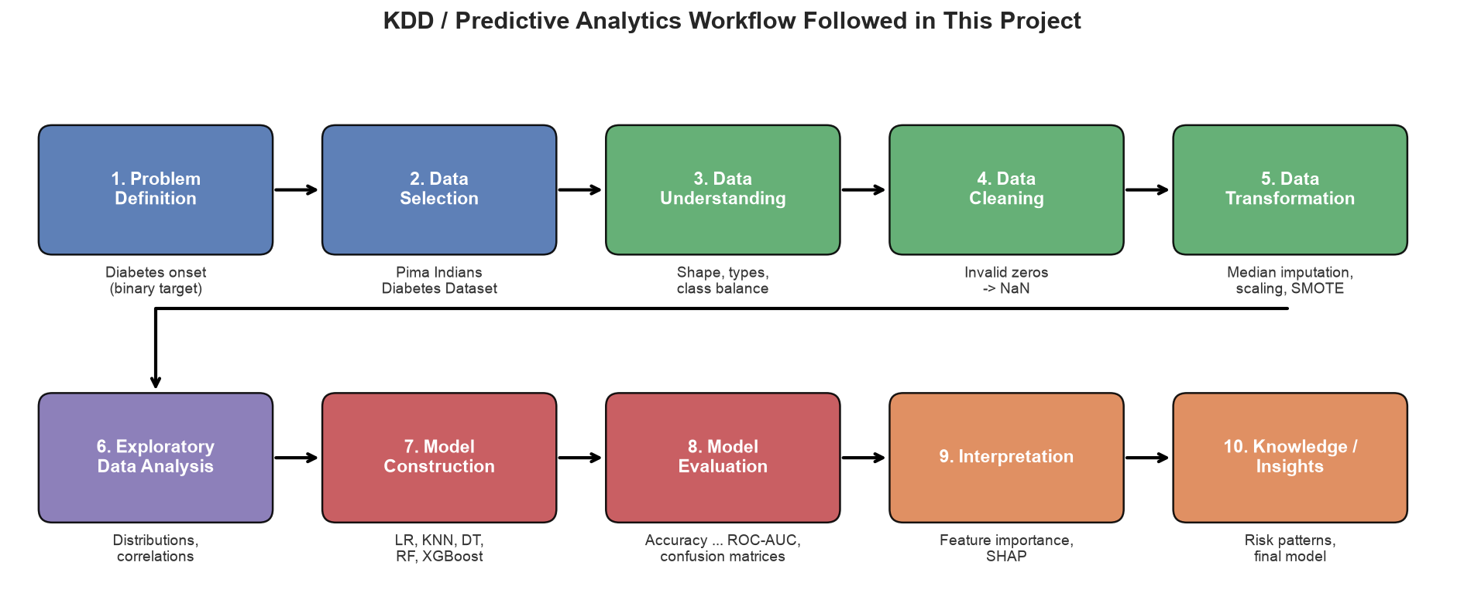
KDD / Predictive Analytics Workflow
‹ Prev
Agenda
Next ›
Notes:
This diagram is the backbone of the project. Each box is a section of my notebook: data cleaning is the zero-to-NaN step, transformation is imputation, scaling and SMOTE, and interpretation is feature importance and SHAP.

Slide 7
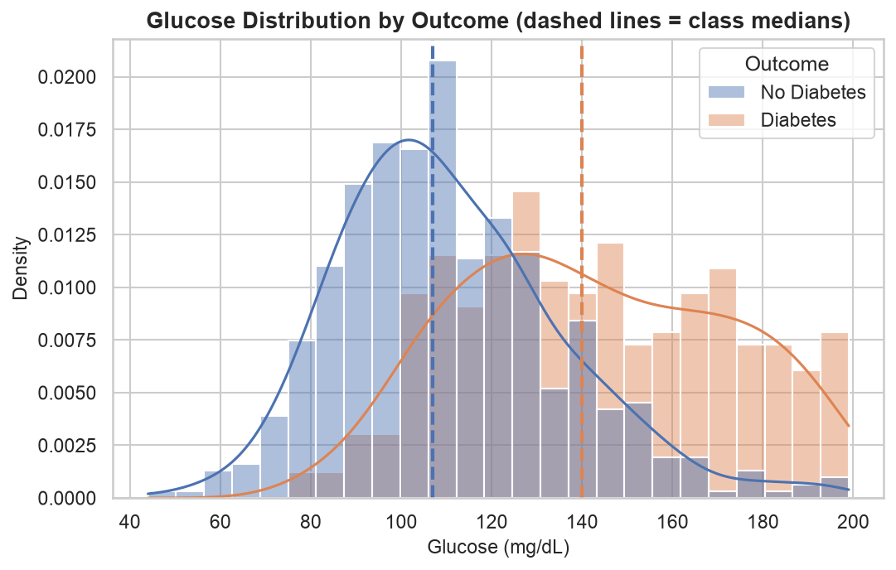




Data Understanding & EDA
Glucose separates best
Median 140 vs 107 mg/dL, r = 0.49
BMI is higher
Median 34.3 vs 30.1 kg/m², r = 0.31
Diabetic patients are older
Median age 36 vs 27 years
Moderate correlations
SkinThickness–BMI 0.65, Glucose–Insulin 0.58
Open correlation heatmap ›
Associations in this sample, not causal effects
‹ Prev
Agenda
Next ›
Notes:
The glucose plot shows two clearly shifted distributions, so glucose is the strongest single signal. Still, the curves overlap, so no single threshold separates the classes. Correlations between features are moderate, so I kept all eight features. I am careful to call these associations; the data cannot prove that anything causes diabetes. (Click 'Open correlation heatmap' to show the full matrix.)

Slide 8
Preprocessing & SMOTE: a Leak-Free Pipeline
Zeros → NaN
Stratified 80/20 split
Median imputation
Standard scaling
SMOTE (train only)
Classifier
Steps 3–5 are learned from the 614 training rows only, inside one imblearn pipeline (re-fitted in every CV fold)
614 / 154
train / test rows, both ~35 % diabetic
Never resampled
the test set keeps its real 100 / 54 split
0.57 → 0.72
cross-validated recall of Logistic Regression with SMOTE
‹ Prev
Agenda
Next ›
Notes:
The key idea is leakage prevention. I split before fitting anything, so medians, scaling parameters and SMOTE's synthetic samples come only from training data. SMOTE sits inside an imbalanced-learn pipeline, so during cross-validation it only touches the training folds. My quick experiment showed why it matters: without imbalance handling, Logistic Regression's recall was only 0.57, so it missed over 40 % of diabetic patients; with SMOTE it rose to 0.72.

Slide 9





Five Models, Simple to Complex
Logistic Regression
Linear, interpretable baseline
max_iter = 1000
K-Nearest Neighbors
Instance-based (distance)
k = 15 neighbours
Decision Tree
Rule-based tree
max_depth = 5, min_samples_leaf = 5
Random Forest
Bagging ensemble
300 trees, min_samples_leaf = 2
XGBoost
Gradient-boosting ensemble
200 trees, depth 3, lr 0.05
Click for details ›
Click for details ›
Click for details ›
Click for details ›
Click for details ›
Same pipeline for every model | random_state = 42 | no tuning on the test set
‹ Prev
Agenda
Next ›
Notes:
I chose five models from different families, from simple to complex. Scaling is essential for Logistic Regression and KNN; tree models don't need it, but I kept one consistent pipeline. I used sensible fixed settings rather than a big hyperparameter search, which keeps the project explainable and avoids overfitting to a small dataset. Each card is clickable and opens that model's detail slide.

Slide 10
Evaluation Metrics
Accuracy
Share of correct predictions
(TP + TN) / all
Confusion matrix
Predicted −
Predicted +
Actual −
TN
correct: no diabetes
FP
false alarm → extra test
Precision
Of those flagged, how many are diabetic
TP / (TP + FP)
Recall
Of diabetic patients, how many are caught
TP / (TP + FN)
Actual +
FN
missed diabetic patient
TP
diabetic patient caught
F1 score
Balance of precision and recall
2PR / (P + R)
ROC-AUC
Ranking quality across all thresholds
area under ROC
In screening, FN is the costliest error, so recall matters most; precision keeps false alarms in check
‹ Prev
Agenda
Next ›
Notes:
A model that always says 'no diabetes' gets 65 % accuracy, which shows why accuracy alone is not enough. A false negative means a diabetic patient is missed and may not be referred; a false positive leads to an extra test. So I focus on recall and ROC-AUC, while still checking precision so the model doesn't flag everyone. Every model was evaluated with 5-fold cross-validation on the training data and once on the untouched test set.

Slide 11
Results: Test-Set Comparison
Final model
Random Forest
Recall 0.741 (40 of 54 caught)
ROC-AUC 0.809 (CV 0.829)
Precision 0.615, specificity 0.75
Recall ≥ 0.70 in both CV and test, highest overall score
XGBoost had the best test scores, but its cross-validated recall (0.687) failed the 0.70 screening rule
Open the Model Explorer ›
‹ Prev
Agenda
Next ›
Notes:
No model wins every metric. XGBoost has the best test AUC, but its cross-validated recall is below 0.70. Logistic Regression is best in cross-validation but worst on test recall. Random Forest is consistently first or second in both evaluations and meets the recall requirement, so I chose it. With only 154 test patients, consistency is more trustworthy than one high score. The chart is a native PowerPoint chart, so values can be read on hover.

Slide 12
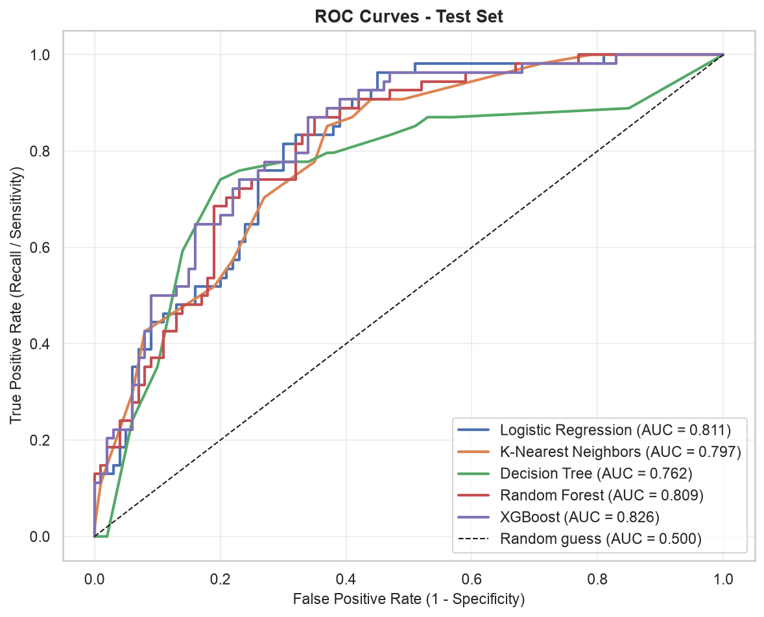
Model Explorer: click a model
Logistic Regression
ROC-AUC 0.811 | Recall 0.648 | FN 19
Rule failed
K-Nearest Neighbors
ROC-AUC 0.797 | Recall 0.778 | FN 12
Eligible
Decision Tree
ROC-AUC 0.762 | Recall 0.778 | FN 12
Rule failed
Random Forest
ROC-AUC 0.809 | Recall 0.741 | FN 14
Selected
XGBoost
ROC-AUC 0.826 | Recall 0.741 | FN 14
Rule failed
‹ Prev
Agenda
Next ›
Notes:
This is the interactive part: each card opens a detail slide with that model's metrics, confusion matrix and the reason it was or wasn't selected; each detail slide has a button back to this explorer. The ROC curves show all models far above the random diagonal, with Random Forest, Logistic Regression and XGBoost almost overlapping.

Slide 13
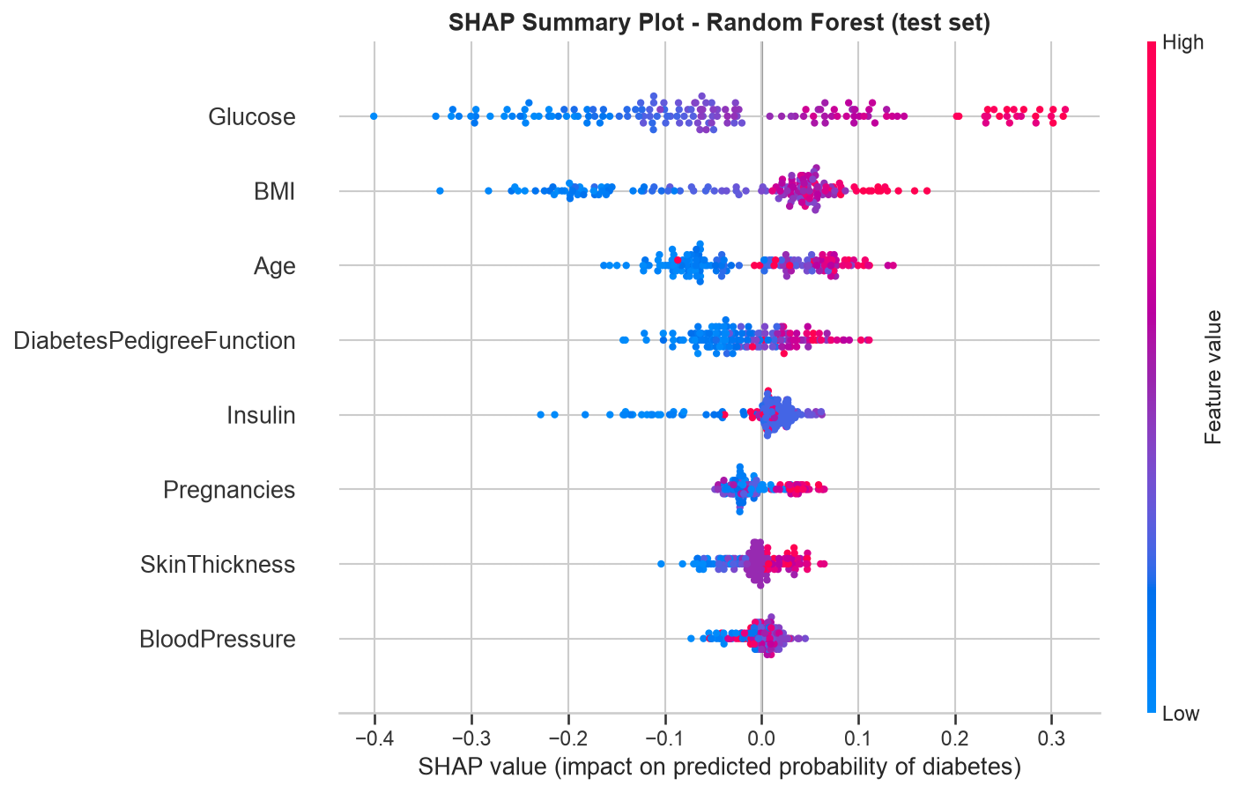
Interpretation: What Drives the Predictions?
Glucose dominates: high values push risk up by up to ~30 points
BMI, Age, pedigree form the next tier
Four methods agree; this explains the model, not biology
All-model feature importance ›
‹ Prev
Agenda
Next ›
Notes:
In the SHAP plot, each dot is a test patient. Red dots are high values; dots on the right push the prediction toward diabetes. For glucose, all the red dots are on the right, so high glucose raises the predicted risk by up to about 30 percentage points. Four different interpretation methods agree on the ranking, which makes it convincing, but SHAP explains the model, not human biology.

Slide 14
Conclusion & Future Scope
0.741
0.809
0.747
Future scope
Larger, diverse datasets
Random Forest recall
Random Forest ROC-AUC
Random Forest accuracy
External validation
Leak-free, reproducible KDD pipeline; all 5 models clearly beat chance (AUC 0.76–0.83)
Glucose, BMI, Age and pedigree function are the key predictors
Limitations: small, narrow, historical dataset; imputed values; no external validation
Hyperparameter tuning
Calibration & thresholds
Drift monitoring
Thank you. Questions?
Academic screening demonstration, not a diagnostic tool
Viva Q&A
GitHub repo
Open in Colab
Agenda
Notes:
To conclude: the project shows that routine measurements carry real predictive signal for diabetes, with glucose clearly dominant. Random Forest gave the best balance of catching diabetic patients and avoiding false alarms. The biggest limitation is the data: 768 Pima women from decades ago. Before any real use, the model would need external validation, calibration and a carefully chosen threshold. Thank you, I'm happy to take questions. (Viva Q&A opens prepared answers.)

Slide 15
Model Explorer | Logistic Regression
Linear, interpretable baseline
max_iter = 1000
Not selected
Best cross-validated ROC-AUC (0.843)
But the lowest test recall: missed 19 of 54 diabetic patients
Fails the recall ≥ 0.70 rule on the test set
0.708
0.574
0.648
0.609
0.811
Accuracy
Precision
Recall
F1
ROC-AUC
Test set (154 patients) | specificity 0.74 | 5-fold CV ROC-AUC 0.843 ± 0.020, CV recall 0.724
Confusion matrix (test)
Predicted −
Predicted +
Actual −
74
TN
26
FP
Overall score: 0.7036 (mean of 5 metrics, CV + test)
Actual +
19
FN
35
TP
‹ Model Explorer
‹ XGB
Agenda
KNN ›
Notes:
Logistic Regression: Linear, interpretable baseline (max_iter = 1000). Test accuracy 0.708, precision 0.574, recall 0.648, F1 0.609, ROC-AUC 0.811; it caught 35 of 54 diabetic patients with 26 false alarms. Verdict: Not selected. Best cross-validated ROC-AUC (0.843); But the lowest test recall: missed 19 of 54 diabetic patients; Fails the recall ≥ 0.70 rule on the test set. (Hidden slide: reached from the Model Explorer; use the buttons to move between models or go back.)

Slide 16
Model Explorer | K-Nearest Neighbors
Instance-based (distance)
k = 15 neighbours
Eligible, not selected
Highest recall: misses only 12 diabetic patients
But the most false alarms (35) and the lowest precision (0.55)
Lower overall score than Random Forest
0.695
0.545
0.778
0.641
0.797
Accuracy
Precision
Recall
F1
ROC-AUC
Test set (154 patients) | specificity 0.65 | 5-fold CV ROC-AUC 0.820 ± 0.045, CV recall 0.790
Confusion matrix (test)
Predicted −
Predicted +
Actual −
65
TN
35
FP
Overall score: 0.7054 (mean of 5 metrics, CV + test)
Actual +
12
FN
42
TP
‹ Model Explorer
‹ LR
Agenda
DT ›
Notes:
K-Nearest Neighbors: Instance-based (distance) (k = 15 neighbours). Test accuracy 0.695, precision 0.545, recall 0.778, F1 0.641, ROC-AUC 0.797; it caught 42 of 54 diabetic patients with 35 false alarms. Verdict: Eligible, not selected. Highest recall: misses only 12 diabetic patients; But the most false alarms (35) and the lowest precision (0.55); Lower overall score than Random Forest. (Hidden slide: reached from the Model Explorer; use the buttons to move between models or go back.)

Slide 17
Model Explorer | Decision Tree
Rule-based tree
max_depth = 5, min_samples_leaf = 5
Not selected
Readable if/else rules and high test recall
Lowest ROC-AUC: a shallow tree gives only a few distinct probabilities
Cross-validated recall 0.687 fails the 0.70 rule
0.727
0.583
0.778
0.667
0.762
Accuracy
Precision
Recall
F1
ROC-AUC
Test set (154 patients) | specificity 0.70 | 5-fold CV ROC-AUC 0.762 ± 0.013, CV recall 0.687
Confusion matrix (test)
Predicted −
Predicted +
Actual −
70
TN
30
FP
Overall score: 0.6835 (mean of 5 metrics, CV + test)
Actual +
12
FN
42
TP
‹ Model Explorer
‹ KNN
Agenda
RF ›
Notes:
Decision Tree: Rule-based tree (max_depth = 5, min_samples_leaf = 5). Test accuracy 0.727, precision 0.583, recall 0.778, F1 0.667, ROC-AUC 0.762; it caught 42 of 54 diabetic patients with 30 false alarms. Verdict: Not selected. Readable if/else rules and high test recall; Lowest ROC-AUC: a shallow tree gives only a few distinct probabilities; Cross-validated recall 0.687 fails the 0.70 rule. (Hidden slide: reached from the Model Explorer; use the buttons to move between models or go back.)

Slide 18
Model Explorer | Random Forest
Bagging ensemble
300 trees, min_samples_leaf = 2
SELECTED final model
Recall ≥ 0.70 in both cross-validation (0.715) and test (0.741)
First or second on most metrics in both evaluations
Highest overall score (0.727): balanced and stable
0.747
0.615
0.741
0.672
0.809
Accuracy
Precision
Recall
F1
ROC-AUC
Test set (154 patients) | specificity 0.75 | 5-fold CV ROC-AUC 0.829 ± 0.025, CV recall 0.715
Confusion matrix (test)
Predicted −
Predicted +
Actual −
75
TN
25
FP
Overall score: 0.7272 (mean of 5 metrics, CV + test)
Actual +
14
FN
40
TP
‹ Model Explorer
‹ DT
Agenda
XGB ›
Notes:
Random Forest: Bagging ensemble (300 trees, min_samples_leaf = 2). Test accuracy 0.747, precision 0.615, recall 0.741, F1 0.672, ROC-AUC 0.809; it caught 40 of 54 diabetic patients with 25 false alarms. Verdict: SELECTED final model. Recall ≥ 0.70 in both cross-validation (0.715) and test (0.741); First or second on most metrics in both evaluations; Highest overall score (0.727): balanced and stable. (Hidden slide: reached from the Model Explorer; use the buttons to move between models or go back.)

Slide 19
Model Explorer | XGBoost
Gradient-boosting ensemble
200 trees, depth 3, lr 0.05
Not selected
Best test accuracy, precision, F1 and ROC-AUC
But cross-validated recall 0.687 is below the 0.70 rule
Strong on one split, less consistent across folds
0.753
0.625
0.741
0.678
0.826
Accuracy
Precision
Recall
F1
ROC-AUC
Test set (154 patients) | specificity 0.76 | 5-fold CV ROC-AUC 0.822 ± 0.030, CV recall 0.687
Confusion matrix (test)
Predicted −
Predicted +
Actual −
76
TN
24
FP
Overall score: 0.7171 (mean of 5 metrics, CV + test)
Actual +
14
FN
40
TP
‹ Model Explorer
‹ RF
Agenda
LR ›
Notes:
XGBoost: Gradient-boosting ensemble (200 trees, depth 3, lr 0.05). Test accuracy 0.753, precision 0.625, recall 0.741, F1 0.678, ROC-AUC 0.826; it caught 40 of 54 diabetic patients with 24 false alarms. Verdict: Not selected. Best test accuracy, precision, F1 and ROC-AUC; But cross-validated recall 0.687 is below the 0.70 rule; Strong on one split, less consistent across folds. (Hidden slide: reached from the Model Explorer; use the buttons to move between models or go back.)

Slide 20
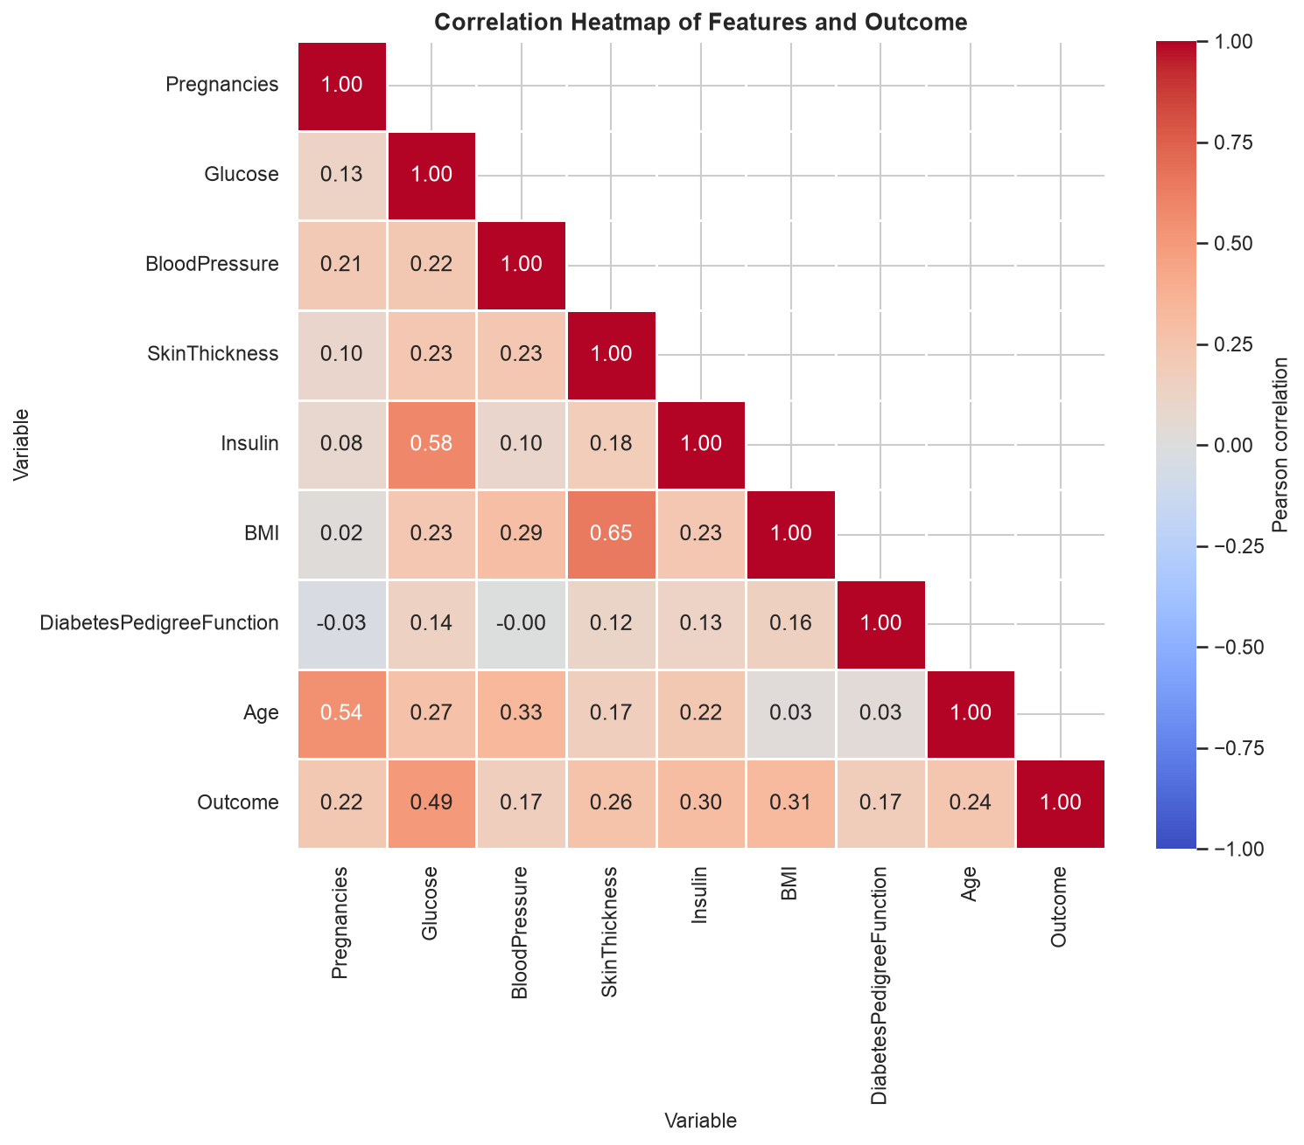
Drill-down: Correlation Heatmap
Glucose has the strongest link with Outcome (0.49)
BMI 0.31, Insulin 0.30, SkinThickness 0.26, Age 0.24
Strongest feature pairs: SkinThickness–BMI 0.65, Glucose–Insulin 0.58, Pregnancies–Age 0.54
Moderate, so no feature was removed for multicollinearity
Pairwise-complete correlations after zeros → NaN
‹ Back to EDA
Agenda
Notes:
Drill-down from the EDA slide. Glucose correlates most strongly with the outcome; feature-feature correlations are moderate, so all eight features were kept. Correlation is computed after replacing invalid zeros with NaN. Use 'Back to EDA' to return.

Slide 21
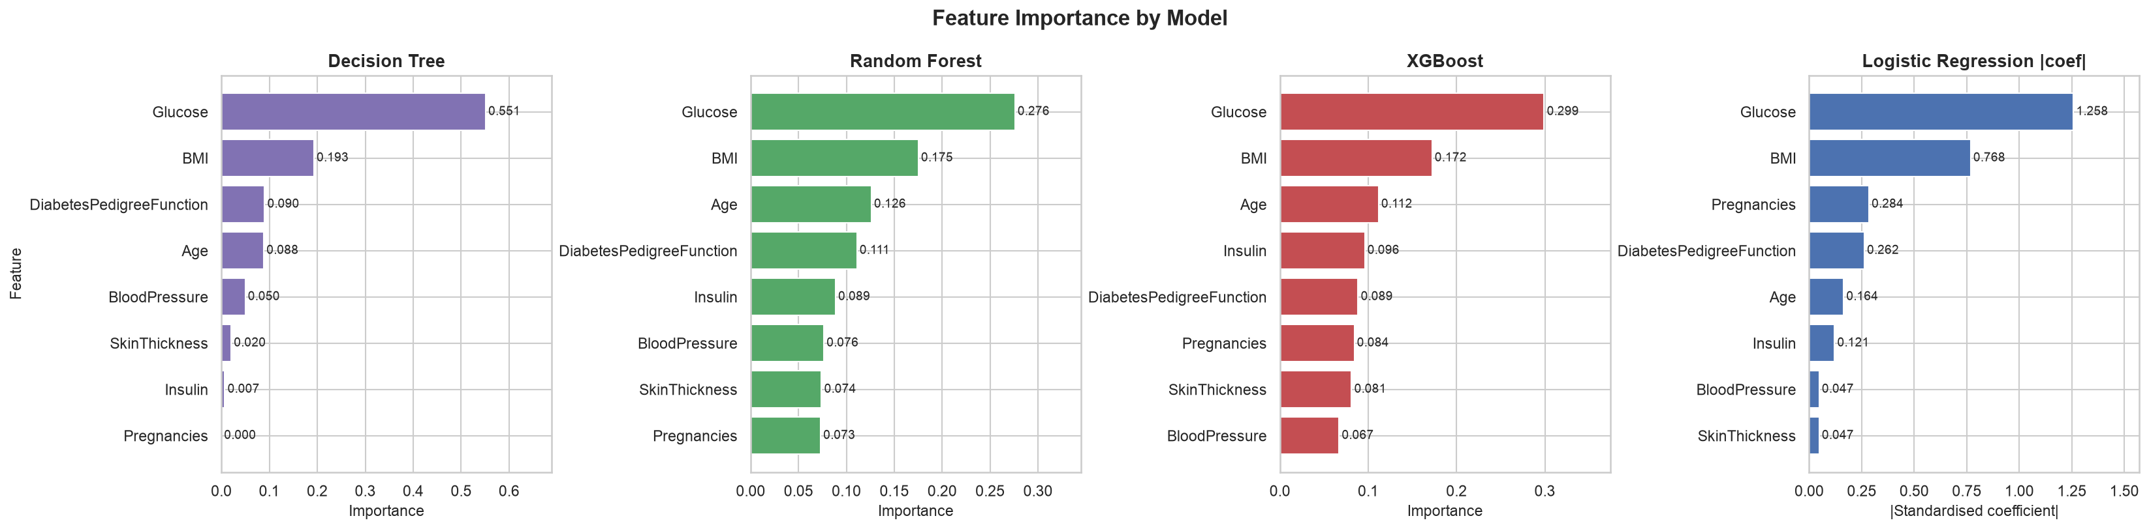
Drill-down: Feature Importance in Every Model
Glucose is #1 in all four models
DT 0.551 | RF 0.276 | XGB 0.299 | LR |coef| 1.258
BMI is consistently #2
RF 0.175 | XGB 0.172 | LR |coef| 0.768
Importance ≠ causation
Impurity importance favours continuous features and is shared between correlated ones
‹ Back to Interpretation
Agenda
Notes:
Drill-down from the interpretation slide: impurity-based importance of the three tree models and absolute standardised coefficients of Logistic Regression. All agree glucose is the most important feature and BMI the second. Importance shows how much a model relies on a feature, not causation.

Slide 22
Viva Q&A: Prepared Answers
Q: Why not drop rows with zeros?
It would remove about half the data (Insulin is 48.7 % missing); median imputation keeps all 768 rows.
Q: Why the median, not the mean?
Insulin and SkinThickness are right-skewed; the median is robust to outliers.
Q: Why split before imputation and SMOTE?
Otherwise test information leaks into training and scores become optimistic.
Q: Why is the test set not resampled?
It must reflect the real class distribution of future patients.
Q: Why scale tree models?
Not needed for trees, but it keeps one pipeline and gives SMOTE comparable distances.
Q: Why not XGBoost (best test AUC)?
Its cross-validated recall (0.687) failed the screening rule; RF was consistent.
Q: What does ROC-AUC 0.809 mean?
An 80.9 % chance a random diabetic patient is ranked above a random non-diabetic one.
Q: Does SHAP prove glucose causes diabetes?
No. It explains how the model uses features, which reflects associations.
‹ Back to Conclusion
Agenda
Notes:
Hidden slide with prepared answers for likely viva questions; reachable from the agenda and the conclusion slide.

