Slide 1
UNIQUE
Nishi Gandhi :002786676
Hardik Joshi: 002767912
Ayush Patel: 002747232

Slide 2
Problem Statement
Recent cardiac arrest patients have trouble performing physical activity.
The majority of people find it difficult to perform physically demanding housework, yet they cannot afford to employ assistance due to their medical costs and other obligations.

Slide 3
Proposed Solution
Hospital is a user-friendly software that connects heart patients, volunteers, doctors, and donors.
Volunteers are local high school students who will assist heart patients with physically demanding duties such as snow shoveling.
Use a sensor gadget to monitor the heart patient's data and send him alerts.
The program allows the advising doctor to watch the patient's data and advise prescription modifications.
Donors can utilize the app to make contributions.

Slide 4
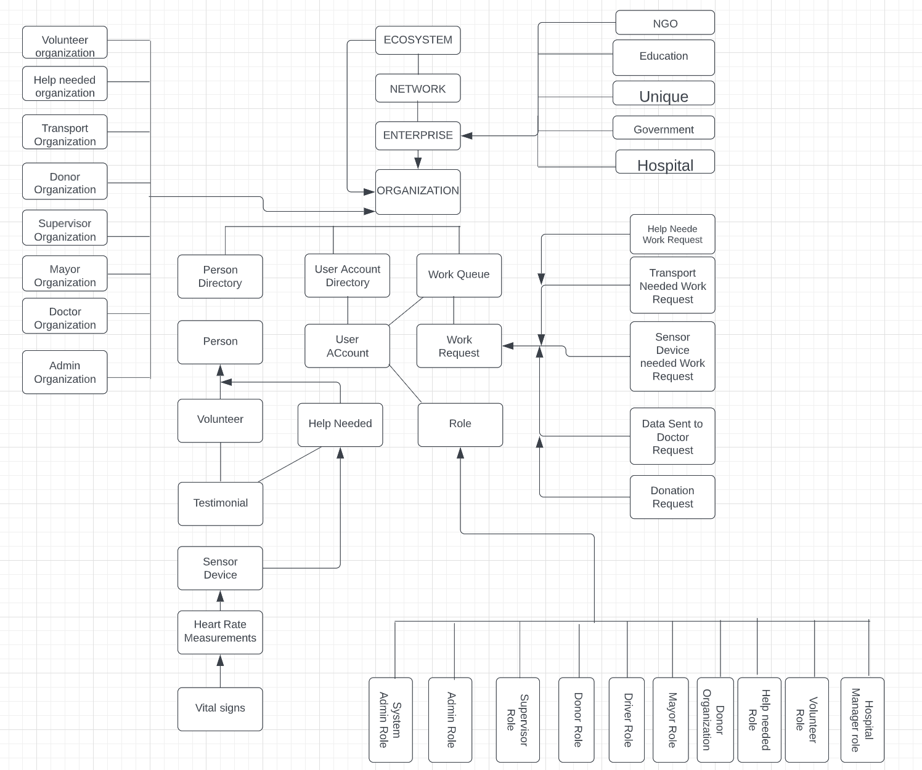
Object Model

Slide 5
Primary Roles
Volunteer Job: The volunteer's duty is to fulfill the Patient’s request with the assistance of the Transport Organization.
Patient’s Position: The Patient’s role raises many demands, including requests to Volunteer for assistance, donors for a sensor gadget, and doctors for advice or new medication.
The supervisor is accountable for authorizing the volunteer, Patient and doctor registration requests.

Slide 6
Primary Roles Continued
Doctor's Role: The Patient vital data tracked with a sensor gadget to the doctor for analysis. The doctor may respond with advice or new medications.
Donor Role: The donor role entails making donations by processing sensing device requests or sending money directly to the heart aid corporate account.
Unique Manager Role: The manager's role is to ensure that the system is functioning properly and to identify needs by analyzing data using Business Intelligence techniques

Slide 7
Application Characteristics
Sign up as a Help Needed, Volunteer, or Doctor on the registration page.
Whenever a volunteer signs up for the application, an email containing the user name and password is sent to the registered email address.
When the account is enabled or approved by the supervisor, an email is sent to the Volunteer, Patient, and Doctor.

