Slide 1
CMSC 605 · FINAL PROJECT
Flood Segmentation
from Sentinel-1 SAR
Binary flood mapping from radar imagery using deep learning,
evaluated on the Sen1Floods11 benchmark (11 countries, 446 hand-labelled chips)
Hardik Kamboj · University of Maryland
U-Net (ResNet-34) · SegFormer (MiT-B2) · Live Streamlit demo

Slide 2
Floods: A Slow-Moving Catastrophe
More people are exposed to flooding than to any other natural hazard
1.81 B
$ 82 B
11 %
people exposed to
flood risk worldwide
average annual
flood-related losses
of all natural-disaster
deaths come from floods
What makes floods uniquely hard
Floods evolve over hours, span hundreds of square kilometres, and their boundaries shift as the event unfolds. Roads close, ground crews can't reach the worst-hit areas, and decisions about evacuations and resources have to be made before anyone has a complete picture.
Flood Segmentation from Sentinel-1 SAR · Sen1Floods11
2

Slide 3
Why Pixel-Level Flood Detection Matters
A water mask is the foundation of every downstream emergency-response decision
01
Emergency response
02
Evacuation planning
Direct rescue teams to flooded zones, identify cut-off communities, prioritise where to send boats and helicopters.
Know which roads are passable, which neighbourhoods to clear, and how the flood front is moving in near-real time.
03
Damage assessment
04
Long-term planning
Quantify affected built-up area, croplands, and infrastructure within hours of the event for insurance and aid.
Build a global archive of past inundations to inform flood-risk maps, zoning, and climate-adaptation policy.
All four pipelines start with the same question: which pixels are flooded?
Flood Segmentation from Sentinel-1 SAR · Sen1Floods11
3

Slide 4
Remote Sensing — Eyes from Orbit
Earth-observing satellites turn flood mapping from a field-survey problem into an image-processing one
How a satellite image becomes a flood map
OPTICAL · the obvious choice
1
Acquire
Sentinel-2 & Landsat
Satellites image the same patch of ground every few days at 10–30 m resolution.
2
Pre-process
Passive sensors that record reflected sunlight in the visible and near-infrared bands. They produce the colourful, photograph-like imagery most people recognise — high spatial detail and intuitive interpretation, with a 5–10 day revisit time at the equator.
Calibrate, geo-reference, and tile each scene into 512×512 chips.
3
Segment
A model labels every pixel as flood or non-flood — producing a binary water mask.
Why people reach for optical first
4
Deliver
Familiar — looks like a photograph
Excellent spatial detail (10 m / pixel)
Free & global (Copernicus, USGS)
Masks feed downstream tools: damage maps, evacuation, insurance triage.
Flood Segmentation from Sentinel-1 SAR · Sen1Floods11
4

Slide 5
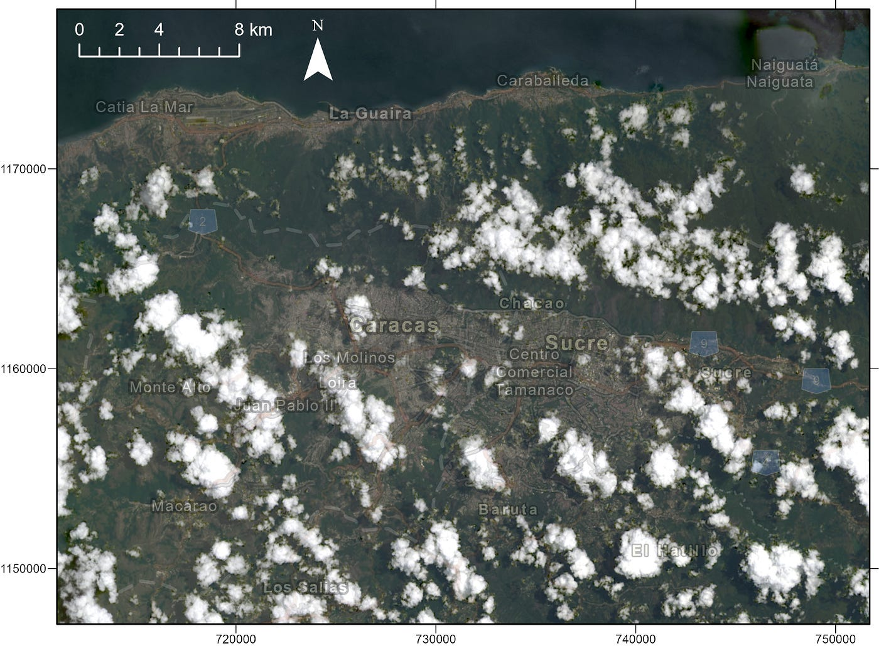
The Catch — Optical Can't See Through Clouds
And floods come bundled with the exact storms that produce cloud cover
Three failure modes for optical
Clouds block the view
Storm systems = cloud cover = useless pixels exactly when you need them.
Night is invisible
Passive sensors need sunlight; half the planet is dark at any moment.
Persistent in tropics
In equatorial regions, useful clear-sky revisits can be days or weeks apart.
Sentinel-2 RGB · Caracas, Venezuela
Flood Segmentation from Sentinel-1 SAR · Sen1Floods11
5

Slide 6
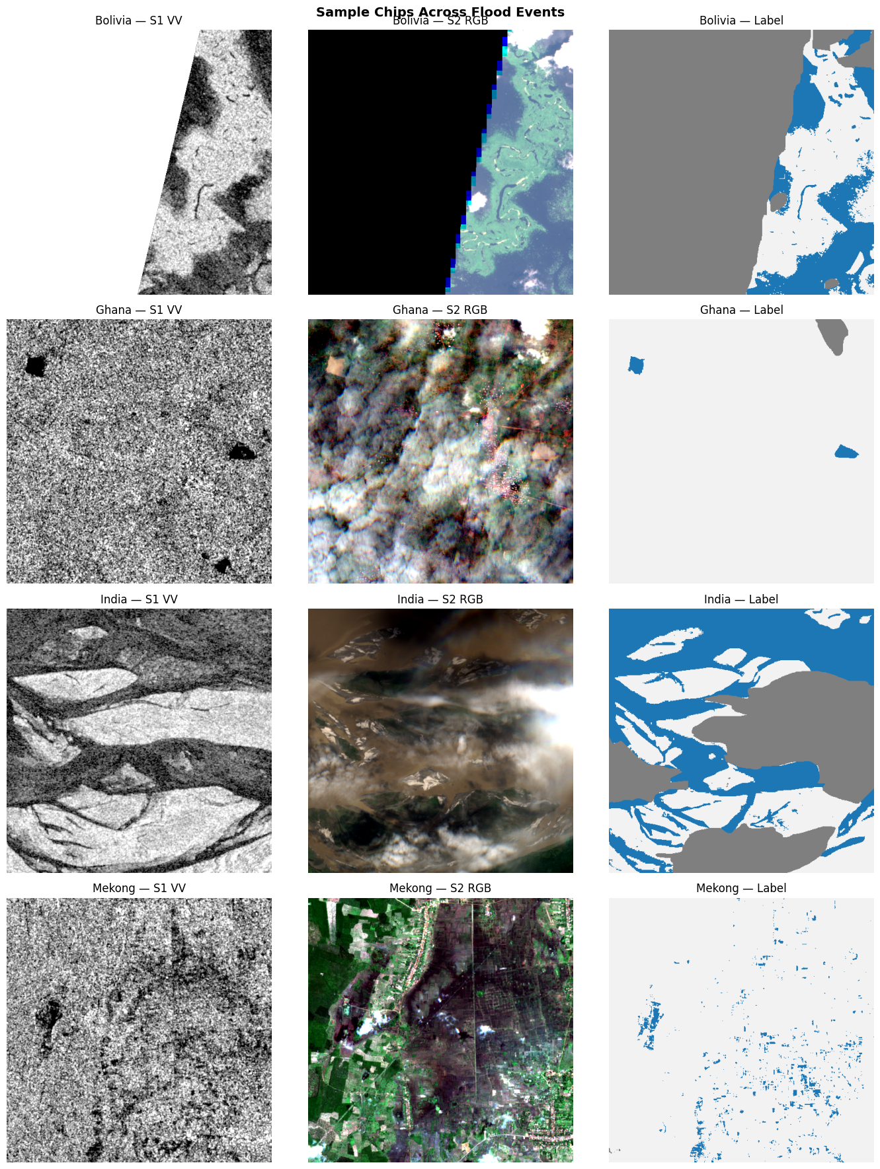
SAR — A Different Kind of Sensor
Active microwave radar that doesn't depend on sunlight or clear skies
Synthetic Aperture Radar
SAR sends its own microwave pulse and listens for the echo. The strength of the return ("backscatter") depends on the surface roughness and dielectric properties — not on the sun.
Optical
SAR
Wavelength
Visible / NIR
Microwave (5.4 GHz)
Source
Reflected sunlight
Radar transmits its own pulse
Cloud cover
Blocks the signal
Penetrates clouds & light rain
Day / night
Day only
24 / 7
Smooth water = mirror. Radar pulses bounce away from the satellite, so flooded pixels appear darker than land.
Same chip, three views — SAR (left), optical (centre), flood label (right)
Flood Segmentation from Sentinel-1 SAR · Sen1Floods11
6

Slide 7
Dataset: Sen1Floods11
446 hand-labelled chips spanning 11 countries and four continents
446
Training set · 10 countries
hand-labelled chips
11
Train · 252
Val · 89
Test · 90
countries / 4 continents
Test chips are spread across 10 different countries so models are evaluated on broad geographic distribution.
512²
pixel chips @ 10 m
Held-out test set · Bolivia · 15 chips
An entire country is removed from training and never shown to the model until final evaluation. Performance on Bolivia answers the real question: does the model work in places it has never seen?
2-band
SAR input (VV + VH)
Flood Segmentation from Sentinel-1 SAR · Sen1Floods11
7

Slide 8
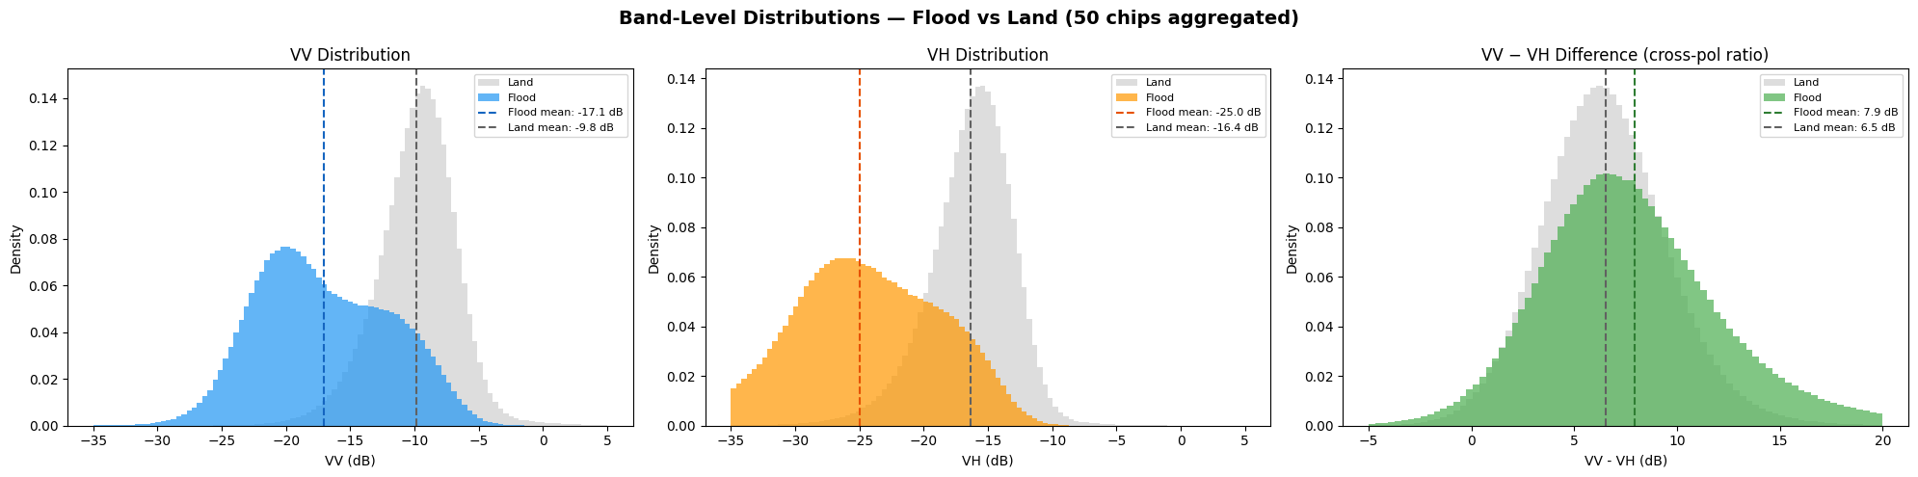
EDA — Flood and Land Are Separable
Aggregated across 50 chips, the VV / VH distributions for flood vs land barely overlap
−7.3 dB
−8.6 dB
Caveat
VV mean separation
VH mean separation
Distributions overlap
Flood pixels average ~−17 dB on VV, dry land ~−10 dB. The gap is large enough that even a fixed threshold works as a baseline.
Cross-pol VH adds an independent signal — particularly useful for separating flood from wet vegetation and rough soil.
Tails of flood and land overlap, and shift slightly across countries — a fixed rule will always misclassify some pixels.
Flood Segmentation from Sentinel-1 SAR · Sen1Floods11
8

Slide 9
Modelling — Step 1: A Classical Threshold
Use the EDA finding directly: pick a VV threshold that splits flood from land
What it can't do
Method · fixed VV threshold
No spatial context
VV < −13.45 dB → flood
VV ≥ −13.45 dB → non-flood
Decides each pixel in isolation, ignoring shape and connectivity.
Fixed cutoff
Same threshold for every country — terrain shifts mean systematic errors.
Threshold chosen by sweeping values on the training set and picking the one that maximises F1.
No texture cues
Misses the speckle pattern that distinguishes flood from low-bias urban shadow.
Why bother?
Zero parameters, zero training time
Sets a strong floor any deep model must beat
Confirms that the SAR signal alone carries most of the information
Floor not ceiling
Beats nothing on the harder cases. We need a learned model.
Flood Segmentation from Sentinel-1 SAR · Sen1Floods11
9

Slide 10
Modelling — Step 2: Deep Networks
Two architectures, same 252-chip training set, mixed-precision training
CNN
TRANSFORMER
U-Net
SegFormer
ResNet-34 encoder · segmentation-models-pytorch
MiT-B2 backbone · HuggingFace Transformers
ImageNet-pretrained ResNet-34 backbone
Symmetric encoder–decoder with skip connections
Batch 32 · Adam @ 3 × 10⁻³ · A100 GPU
Combined Dice + BCE loss · 24.4 M params
Hierarchical Mix-Transformer encoder
Lightweight all-MLP decoder
Batch 16 · AdamW @ 6 × 10⁻⁵ · L4 GPU
Global self-attention from layer 1 · 27.3 M params
Shared tricks · Dice + BCE with invalid-pixel masking · AMP (fp16) · gradient clipping (max-norm 1.0) · early stopping
Flood Segmentation from Sentinel-1 SAR · Sen1Floods11
10

Slide 11
Results — Held-out Test Set
90 chips across 10 countries · IoU is the headline metric
Model
IoU
F1
Precision
Recall
Accuracy
Best model
U-Net (ResNet-34)
0.6456
0.7847
0.8166
0.7551
0.9482
SegFormer
SegFormer (MiT-B2)
0.6680
0.8009
0.8111
0.7910
0.9508
0.668
Highlighted row = best result. Evaluation excludes invalid (label = −1) pixels.
test IoU
Reading the numbers
SegFormer takes the lead on every metric except precision, where U-Net is a hair ahead.
Both deep models clear an IoU of 0.64 — comfortably better than what the threshold rule alone would deliver. The two architectures are within 2 points of each other, which suggests the gap between U-Net and SegFormer is not the most interesting part of the story. The next slide is.
Flood Segmentation from Sentinel-1 SAR · Sen1Floods11
11

Slide 12
Generalisation — The Bolivia Test
Same models, completely unseen country · this is where the story gets interesting
U-Net (ResNet-34)
SegFormer (MiT-B2)
Test
Bolivia
−16.5
Test
Bolivia
+ 1.5
0.6456
0.4808
0.6680
0.6828
IoU points lost
IoU points gained
Local convolutions over-fit the training distribution. A new country shifts the look of the imagery enough to cost double-digit IoU.
Bolivia IoU actually exceeds test IoU. Global self-attention captures wider spatial context that travels across geographies.
Why does SegFormer travel better?
Multi-head self-attention reasons about distant pixels jointly — flooded river, surrounding terrain, and neighbouring vegetation all influence each prediction. CNN receptive fields stay local and miss the wider context.
Flood Segmentation from Sentinel-1 SAR · Sen1Floods11
12

Slide 13
LIVE DEMO · CONCLUSION
Try it yourself — three models, side-by-side
Artefacts
STREAMLIT · LIVE
Sen1Floods11 Segmentation Demo
GITHUB
Project repo
• 12 curated test chips — best, worst, and average cases across 7 countries
• Upload any _S1Hand.tif chip from Sen1Floods11
• Side-by-side threshold / U-Net / SegFormer predictions and error maps
• Live IoU, F1, Precision, Recall for direct head-to-head comparison
HUGGINGFACE
U-Net weights
HUGGINGFACE
SegFormer weights
hardikkamboj-sen1floods11-segmentation-appapp-jni2fg.streamlit.app
Hardik Kamboj · University of Maryland · CMSC 605

