Slide 1
Extensible Markup Language
XML

Slide 2
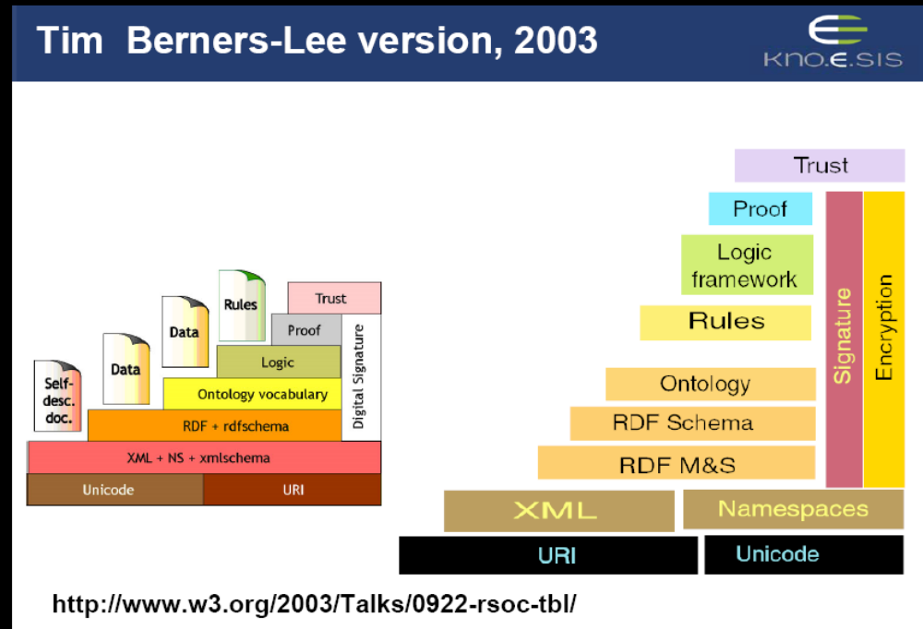

Slide 3
An HTML Example
<h2>Database System Concepts </h2>
<i>by <b>Korth</b> and
<b>Silberschatz</b></i>
<br>McGraw Hill 2010<br>
ISBN 978 007 1289597
http://www.w3schools.com/tags/

Slide 4
The Same Example in XML
<book>
<title>Database System Concepts</title>
<author>Korth</author>
<author>Silberschatz</author>
<publisher>McGraw Hill</publisher>
<year>2010</year>
<ISBN>978 007 1289597</ISBN>
</book>

Slide 5
HTML versus XML: Similarities
Both use tags (e.g. <h2> and </year>)
Tags may be nested (tags within tags)
Human users can read and interpret both HTML and XML representations quite easily
… But what about machines?

Slide 6
Problems with Automated Interpretation of HTML Documents
An intelligent agent trying to retrieve the names
of the authors of the book
Authors’ names could appear immediately after the title
or immediately after the word by
Are there two authors?
Or just one, called “Korth and Silberschatz”?

Slide 7
HTML vs XML: Structural Information
HTML documents do not contain structural information: pieces of the document and their relationships.
XML more easily accessible to machines because
  Every piece of information is described.
  Relations are also defined through the nesting structure.
  E.g., the <author> tags appear within the <book> tags, so they describe properties of the particular book.

Slide 8
HTML vs XML: Structural Information (2)
A machine processing of the XML document would be able to deduce that
  the author element refers to the enclosing book element
  rather than by proximity considerations
XML allows the definition of constraints on values
  E.g. a year must be a number of four digits

Slide 9
HTML vs XML: Formatting
The HTML representation provides more than the XML representation:
  The formatting of the document is also described
Τhe main use of an HTML document is to display information: it must define formatting
XML: separation of content from display
  same information can be displayed in different ways

Slide 10
HTML vs XML: Another Example
In HTML
<h2>Relationship force-mass</h2>
<i> F = M × a </i>
In XML
<equation>
<meaning>Relationship force-mass</meaning>
<leftside> F </leftside>
<rightside> M × a </rightside>
</equation>

Slide 11
HTML vs XML: Different Use of Tags
In both, tags are used
HTML tags define display: color, lists …
XML tags not fixed: user definable tags
XML meta markup language: language for defining markup languages

Slide 12
XML Vocabularies
Web applications must agree on common vocabularies to communicate and collaborate
Communities and business sectors are defining their specialized vocabularies
  mathematics (MathML)
  bioinformatics (BSML)
  human resources (HRML)
  News (NewsML)

Slide 13
XML Overview
Introduction
Description of XML
Structuring
  DTDs
  XML Schema
Namespaces
Accessing, querying XML documents: XPath
Transformations: XSLT
http://www.w3.org/TR/2006/REC-xml11-20060816/

Slide 14
The XML Language
An XML document consists of
a prolog
a number of elements
XML Tutorial:
  http://www.javacommerce.com/displaypage.jsp?name=prolog.sql&id=18238

Slide 15
Prolog of an XML Document
The prolog consists of
an XML declaration and
an optional reference to external structuring documents
XML Declaration:
<?xml version="1.0" encoding="UTF-16“ standalone=“no”?>
Reference to external structuring documents can be found in local file or URL use ‘system’ otherwise if both a local name and a URL is used then use ‘PUBLIC’
<!DOCTYPE book SYSTEM "book.dtd">

Slide 16
XML Elements
The “things” the XML document talks about
  E.g. books, authors, publishers
An element consists of:
  an opening tag
  the content
  a closing tag
<lecturer>David Billington</lecturer>

Slide 17
XML Elements (2): Tags
Tag names can be chosen almost freely.
The first character must be a letter, an underscore, or a colon
No name may begin with the string “xml” in any combination of cases
  E.g. “Xml”, “xML”

Slide 18
Content of XML Elements
Content may be text, or other elements, or nothing
<lecturer>
<name>David Billington</name>
<phone> +61 − 7 − 3875 507 </phone>
</lecturer>
If there is no content, then the element is called empty; it is abbreviated as follows:
<lecturer/> for <lecturer></lecturer>

Slide 19
XML Attributes
An empty element is not necessarily meaningless
  It may have some properties in terms of attributes
An attribute is a name-value pair inside the opening tag of an element
<lecturer name="David Billington" phone="+61 − 7 − 3875 507"/>

Slide 20
XML Attributes: An Example
<order orderNo="23456" customer="John Smith"
date="October 15, 2002">
<item itemNo="a528" quantity="1"/>
<item itemNo="c817" quantity="3"/>
</order>

Slide 21
The Same Example without Attributes
<order>
<orderNo>23456</orderNo>
<customer>John Smith</customer>
<date>October 15, 2002</date>
<item>
<itemNo>a528</itemNo>
<quantity>1</quantity>
</item>
<item>
<itemNo>c817</itemNo>
<quantity>3</quantity>
</item>
</order>

Slide 22
XML Elements vs Attributes
Attributes can be replaced by elements
When to use elements and when attributes is a matter of taste
But attributes cannot be nested

Slide 23
Further Components of XML Docs
Comments
  A piece of text that is to be ignored by parser
  <!-- This is a comment -->
Processing Instructions (PIs) are info for applications
  Start and end with <? PI ?>
  Define procedural attachments
  <?stylesheet type="text/css" href="mystyle.css"?>
  Version declaration is a form of PI

Slide 24
Well-Formed XML Documents
Syntactically correct documents
Some syntactic rules:
  Only one outermost element (called root element)
  Each element contains an opening and a corresponding closing tag
  Tags should not overlap
    <author><name>Lee Hong</author></name>
  Attributes within an element have unique names
  Element and tag names must be permissible

Slide 25
The Tree Model of XML Documents:
An Example
<email>
<head>
<from name="Michael Maher"
address="michaelmaher@cs.gu.edu.au"/>
<to name="Grigoris Antoniou"
address="grigoris@cs.unibremen.de"/>
<subject>Where is your draft?</subject>
</head>
<body>
Grigoris, where is the draft of the paper you promised me last week?
</body>
</email>

Slide 26
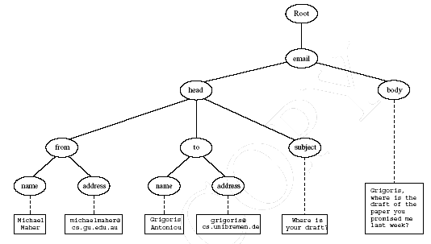
The Tree Model of XML Documents:
An Example (2)

Slide 27
The Tree Model of XML Docs
The tree representation of an XML document is an ordered labeled tree:
  There is exactly one root
  There are no cycles
  Each non-root node has exactly one parent
  Each node has a label.
  The order of elements is important
  … but the order of attributes is not important

Slide 28
Lecture Outline
Description of XML
Structuring
  DTDs
  XML Schema
Namespaces
Accessing, querying XML documents: XPath
Transformations: XSLT

Slide 29
Structuring XML Documents
Define all the element and attribute names that may be used
Define the structure
  what values an attribute may take
  which elements may or must occur within other elements
If such structuring information exists, the document can be validated

Slide 30
Structuring XML Dcuments (2)
An XML document is valid if
  it is well-formed
  respects the structuring information it uses
There are two ways of defining the structure of XML documents:
  DTDs (the older and more restricted way)
  XML Schema (offers extended possibilities)

Slide 31
DTD: Element Type Definition
<lecturer>
<name>David Billington</name>
<phone> +61 − 7 − 3875 507 </phone>
</lecturer>
DTD for above element (and all lecturer elements):
<!ELEMENT lecturer (name,phone)>
<!ELEMENT name (#PCDATA)>
<!ELEMENT phone (#PCDATA)>

Slide 32
The Meaning of the DTD
The element types lecturer, name, and phone may be used in the document
A lecturer element contains a name element and a phone element, in that order (sequence)
A name element and a phone element may have any content
In DTDs, #PCDATA is the only atomic type for elements

Slide 33
DTD: Disjunction in Element Type Definitions
We express that a lecturer element contains either a name element or a phone element as follows:
  <!ELEMENT lecturer (name|phone)>
A lecturer element contains a name element and a phone element in any order.
  <!ELEMENT lecturer((name,phone)|(phone,name))>

Slide 34
Example of an XML Element
<order orderNo="23456"
customer="John Smith"
date="October 15, 2002">
<item itemNo="a528" quantity="1"/>
<item itemNo="c817" quantity="3"/>
</order>

Slide 35
The Corresponding DTD
<!ELEMENT order (item+)>
<!ATTLIST order orderNo ID #REQUIRED
customer CDATA #REQUIRED
date CDATA #REQUIRED>
<!ELEMENT item EMPTY>
<!ATTLIST item itemNo ID #REQUIRED
quantity CDATA #REQUIRED
comments CDATA #IMPLIED>

Slide 36
Comments on the DTD
The item element type is defined to be empty
+ (after item) is a cardinality operator:
  ?: appears zero times or once
  *: appears zero or more times
  +: appears one or more times
  No cardinality operator means exactly once

Slide 37
Comments on the DTD (2)
In addition to defining elements, we define attributes
This is done in an attribute list containing:
  Name of the element type to which the list applies
  A list of triplets of attribute name, attribute type, and value type
Attribute name: A name that may be used in an XML document using a DTD

Slide 38
DTD: Attribute Types
Similar to predefined data types, but limited selection
The most important types are
  CDATA, a string (sequence of characters)
  ID, a name that is unique across the entire XML document
  IDREF, a reference to another element with an ID attribute carrying the same value as the IDREF attribute
  IDREFS, a series of IDREFs
  (v1| . . . |vn), an enumeration of all possible values
Limitations: no dates, number ranges

Slide 39
DTD: Attribute Value Types
#REQUIRED
  Attribute must appear in every occurrence of the element type in the XML document
#IMPLIED
  The appearance of the attribute is optional
#FIXED "value"
  The attribute value is fixed
"value"
  This specifies the default value for the attribute

Slide 40
Referencing with IDREF and IDREFS
<!ELEMENT family (person*)>
<!ELEMENT person (name)>
<!ELEMENT name (#PCDATA)>
<!ATTLIST person id ID #REQUIRED
mother IDREF #IMPLIED
father IDREF #IMPLIED
children IDREFS #IMPLIED>

Slide 41
An XML Document Respecting the DTD
<family>
<person id="bob" mother="mary" father="peter">
<name>Bob Marley</name>
</person>
<person id="bridget" mother="mary">
<name>Bridget Jones</name>
</person>
<person id="mary" children="bob bridget">
<name>Mary Poppins</name>
</person>
<person id="peter" children="bob">
<name>Peter Marley</name>
</person>
</family>

Slide 42
XML Entities
An XML entity can play the role of
  a placeholder for repeatable characters
  a section of external data
  a part of a declaration for elements
  We can use the entity reference &thisyear instead of the value " 2007 "
  <!ENTITY thisyear " 2007 " >

Slide 43
A DTD for an Email Element
<!ELEMENT email (head,body)>
<!ELEMENT head (from,to+,cc*,subject)>
<!ELEMENT from EMPTY>
<!ATTLIST from name CDATA #IMPLIED
address CDATA #REQUIRED>
<!ELEMENT to EMPTY>
<!ATTLIST to name CDATA #IMPLIED
address CDATA #REQUIRED>

Slide 44
A DTD for an Email Element (2)
<!ELEMENT cc EMPTY>
<!ATTLIST cc name CDATA #IMPLIED
address CDATA #REQUIRED>
<!ELEMENT subject (#PCDATA)>
<!ELEMENT body (text,attachment*)>
<!ELEMENT text (#PCDATA)>
<!ELEMENT attachment EMPTY>
<!ATTLIST attachment
encoding (mime|binhex) "mime"
file CDATA #REQUIRED>

Slide 45
Interesting Parts of the DTD
A head element contains (in that order):
  a from element
  at least one to element
  zero or more cc elements
  a subject element
In from, to, and cc elements
  the name attribute is not required
  the address attribute is always required

Slide 46
Interesting Parts of the DTD (2)
A body element contains
  a text element
  possibly followed by a number of attachment elements
The encoding attribute of an attachment element must have either the value “mime” or “binhex”
  “mime” is the default value

Slide 47
XML Schema
Significantly richer language for defining the structure of XML documents
Its syntax is based on XML itself
  not necessary to write separate tools
Reuse and refinement of schemas
  Expand or delete already existent schemas
Sophisticated set of data types, compared to DTDs (which only supports strings)

Slide 48
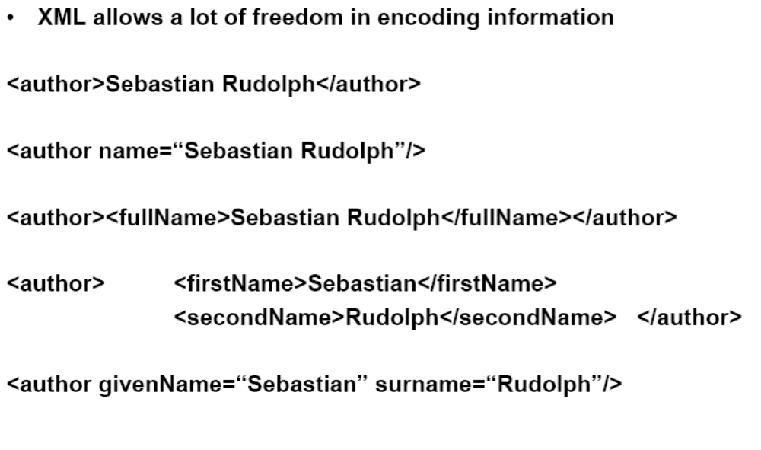
XML Schema

Slide 49
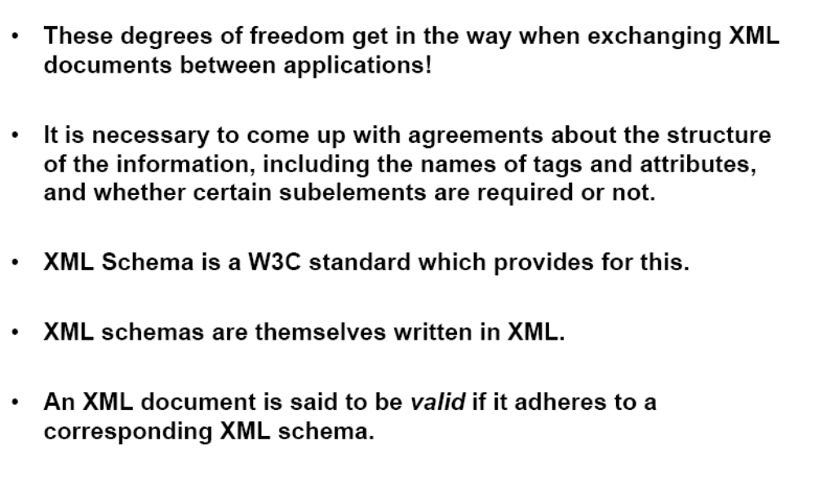
XML Schema

Slide 50
XML Schema (2)
An XML schema is an element with an opening tag like
<schema "http://www.w3.org/2000/10/XMLSchema"
version="1.0">
Structure of schema elements
  Element and attribute types using data types

Slide 51
Element Types
<element name="email"/>
<element name="head" minOccurs="1" maxOccurs="1"/>
<element name="to" minOccurs="1"/>
Cardinality constraints:
minOccurs="x" (default value 1)
maxOccurs="x" (default value 1)
Generalizations of *,?,+ offered by DTDs

Slide 52
Attribute Types
<attribute name="id" type="ID“ use="required"/>
< attribute name="speaks" type="Language"
use="default" value="en"/>
Existence (optional /implied): use="x", where x may be optional or required
Default value (fixed/default): use="x" value="...", where x may be default or fixed

Slide 53
Data Types
There is a variety of built-in data types
  Numerical data types: integer, Short
  String types: string, ID, IDREF, CDATA
  Date and time data types: time, Month
There are also user-defined data types
  simple data types, which cannot use elements or attributes
  complex data types, which can use these

Slide 54
Data Types (2)
Complex data types are defined from already existing data types by defining some attributes (if any) and using:
  sequence, a sequence of existing data type elements (order is important)
  all, a collection of elements that must appear (order is not important)
  choice, a collection of elements, of which one will be chosen

Slide 55
A Data Type Example
<complexType name="lecturerType">
<sequence>
<element name="firstname" type="string"
minOccurs="0“ maxOccurs="unbounded"/>
<element name="lastname" type="string"/>
</sequence>
<attribute name="title" type="string" use="optional"/>
</complexType>
Element in xml document declared to be of type ‘lecturerType’ may have title attribute, it may include any number of first name elements and must include exactly one last name

Slide 56
Data Type Extension
Already existing data types can be extended by new elements or attributes. Example:
<complexType name="extendedLecturerType">
<extension base="lecturerType">
<sequence>
<element name="email" type="string"
minOccurs="0" maxOccurs="1"/>
</sequence>
<attribute name="rank" type="string" use="required"/>
</extension>
</complexType>

Slide 57
Resulting Data Type
<complexType name="extendedLecturerType">
<sequence>
<element name="firstname" type="string"
minOccurs="0" maxOccurs="unbounded"/>
<element name="lastname" type="string"/>
<element name="email" type="string"
minOccurs="0" maxOccurs="1"/>
</sequence>
<attribute name="title" type="string" use="optional"/>
<attribute name="rank" type="string" use="required"/>
</complexType>

Slide 58
Data Type Extension (2)
A hierarchical relationship exists between the original and the extended type
  Instances of the extended type are also instances of the original type
  They may contain additional information, but neither less information, nor information of the wrong type

Slide 59
Data Type Restriction
An existing data type may be restricted by adding constraints on certain values
Restriction is not the opposite from extension
  Restriction is not achieved by deleting elements or attributes
The following hierarchical relationship still holds:
  Instances of the restricted type are also instances of the original type
  They satisfy at least the constraints of the original type

Slide 60
Example of Data Type Restriction
<complexType name="restrictedLecturerType">
<restriction base="lecturerType">
<sequence>
<element name="firstname" type="string"
minOccurs="1" maxOccurs="2"/>
</sequence>
<attribute name="title" type="string"
use="required"/>
</restriction>
</complexType>

Slide 61
Restriction of Simple Data Types
<simpleType name="dayOfMonth">
<restriction base="integer">
<minInclusive value="1"/>
<maxInclusive value="31"/>
</restriction>
</simpleType>

Slide 62
Data Type Restriction: Enumeration
<simpleType name="dayOfWeek">
<restriction base="string">
<enumeration value="Mon"/>
<enumeration value="Tue"/>
<enumeration value="Wed"/>
<enumeration value="Thu"/>
<enumeration value="Fri"/>
<enumeration value="Sat"/>
<enumeration value="Sun"/>
</restriction>
</simpleType>

Slide 63
XML Schema: The Email Example
<element name="email" type="emailType"/>
<complexType name="emailType">
<sequence>
<element name="head" type="headType"/>
<element name="body" type="bodyType"/>
</sequence>
</complexType>

Slide 64
XML Schema: The Email Example (2)
<complexType name="headType">
<sequence>
<element name="from" type="nameAddress"/>
<element name="to" type="nameAddress"
minOccurs="1" maxOccurs="unbounded"/>
<element name="cc" type="nameAddress"
minOccurs="0" maxOccurs="unbounded"/>
<element name="subject" type="string"/>
</sequence>
</complexType>

Slide 65
XML Schema: The Email Example (3)
<complexType name="nameAddress">
<attribute name="name" type="string" use="optional"/>
<attribute name="address" type="string" use="required"/>
</complexType>
Similar for bodyType

Slide 66
XML Link
http://www.xmlmaster.org/en/article/d01/c07/

Slide 67
Namespaces
An XML document may use more than one DTD or schema
Since each structuring document was developed independently, name clashes may appear
The solution is to use a different prefix for each DTD or schema
  prefix:name

Slide 68
An Example
<vu:instructors xmlns:vu="http://www.vu.com/empDTD"
xmlns:gu="http://www.gu.au/empDTD"
xmlns:uky="http://www.uky.edu/empDTD">
<uky:faculty uky:title="assistant professor"
uky:name="John Smith"
uky:department="Computer Science"/>
<gu:academicStaff gu:title="lecturer"
gu:name="Mate Jones"
gu:school="Information Technology"/>
</vu:instructors>

Slide 69
Namespace Declarations
Namespaces are declared within an element and can be used in that element and any of its children (elements and attributes)
A namespace declaration has the form:
  xmlns:prefix="location"
  location is the address of the DTD or schema
If a prefix is not specified: xmlns="location" then the location is used by default

Slide 70
Addressing and Querying XML Documents
In relational databases, parts of a database can be selected and retrieved using SQL
  Same necessary for XML documents
  Query languages: XQuery, XQL, XML-QL
The central concept of XML query languages is a path expression
  Specifies how a node or a set of nodes, in the tree representation of the XML document can be reached

Slide 71
XPath
XPath is core for XML query languages
Language for addressing parts of an XML document.
  It operates on the tree data model of XML
  It has a non-XML syntax

Slide 72
Types of Path Expressions
Absolute (starting at the root of the tree)
  Syntactically they begin with the symbol /
  It refers to the root of the document (situated one level above the root element of the document)
Relative to a context node

Slide 73
An XML Example
<library location="Bremen">
<author name="Henry Wise">
<book title="Artificial Intelligence"/>
<book title="Modern Web Services"/>
<book title="Theory of Computation"/>
</author>
<author name="William Smart">
<book title="Artificial Intelligence"/>
</author>
<author name="Cynthia Singleton">
<book title="The Semantic Web"/>
<book title="Browser Technology Revised"/>
</author>
</library>

Slide 74
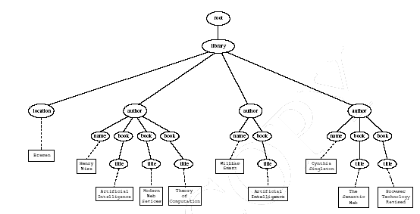
Tree Representation

Slide 75
Examples of Path Expressions in XPath
Address all author elements
/library/author
Addresses all author elements that are children of the library element node, which resides immediately below the root
/t1/.../tn, where each ti+1 is a child node of ti, is a path through the tree representation

Slide 76
Examples of Path Expressions in XPath (2)
Address all author elements
//author
Here // says that we should consider all elements in the document and check whether they are of type author
This path expression addresses all author elements anywhere in the document

Slide 77
Examples of Path Expressions in XPath (3)
Address the location attribute nodes within library element nodes
/library/@location
The symbol @ is used to denote attribute nodes

Slide 78
Examples of Path Expressions in XPath (4)
Address all title attribute nodes within book elements anywhere in the document, which have the value “Artificial Intelligence”
//book/@title="Artificial Intelligence"

Slide 79
Examples of Path Expressions in XPath (5)
Address all books with title “Artificial Intelligence”
/book[@title="Artificial Intelligence"]
Test within square brackets: a filter expression
  It restricts the set of addressed nodes.
Difference with query 4.
  Query 5 addresses book elements, the title of which satisfies a certain condition.
  Query 4 collects title attribute nodes of book elements

Slide 80
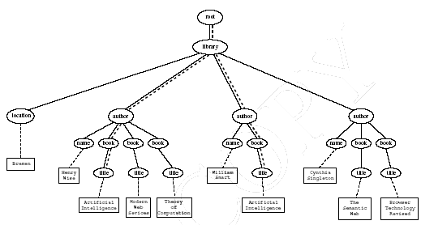
Tree Representation of Query 4

Slide 81
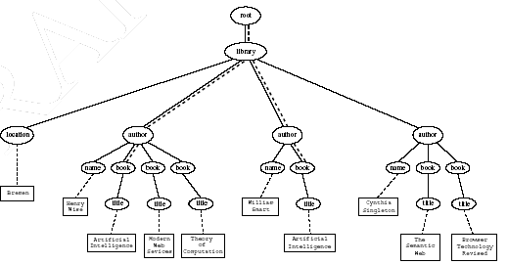
Tree Representation of Query 5

Slide 82
General Form of Path Expressions
A path expression consists of a series of steps, separated by slashes
A step consists of
  An axis specifier,
  A node test, and
  An optional predicate

Slide 83
General Form of Path Expressions (2)
An axis specifier determines the tree relationship between the nodes to be addressed and the context node
  E.g. parent, ancestor, child (the default), sibling, attribute node
  // is such an axis specifier: descendant or self

Slide 84
General Form of Path Expressions (3)
A node test specifies which nodes to address
  The most common node tests are element names
  E.g., * addresses all element nodes
  comment() addresses all comment nodes

Slide 85
General Form of Path Expressions (4)
Predicates (or filter expressions) are optional and are used to refine the set of addressed nodes
  E.g., the expression [1] selects the first node
  [position()=last()] selects the last node
  [position() mod 2 =0] selects the even nodes
XPath has a more complicated full syntax.
  We have only presented the abbreviated syntax

Slide 86
Displaying XML Documents
<author>
<name>Grigoris Antoniou</name>
<affiliation>University of Bremen</affiliation>
<email>ga@tzi.de</email>
</author>
may be displayed in different ways:
  Grigoris Antoniou Grigoris Antoniou
  University of Bremen University of Bremen
  ga@tzi.de ga@tzi.de

Slide 87
Style Sheets
Style sheets can be written in various languages
  E.g. CSS2 (cascading style sheets level 2)
  XSL (extensible stylesheet language)
XSL includes
  a transformation language (XSLT)
  a formatting language
  Both are XML applications
How to display XML document? XML has no formatting information
Can be presented in various ways when different stylesheets are applied to it

Slide 88
XSL Transformations (XSLT)
XSLT specifies rules with which an input XML document is transformed to
  another XML document
  an HTML document
  plain text
The output document may use the same DTD or schema, or a completely different vocabulary
XSLT can be used independently of the formatting language

Slide 89
XSLT (2)
Helps to move data and metadata from one XML representation to another
XSLT is chosen when applications that use different DTDs or schemas need to communicate
XSLT can be used for machine processing of content without any regard to displaying the information for people to read.
In the following we use XSLT only to display XML documents

Slide 90
XSLT Transformation into HTML
<?xml version=“1.0” encoding=“UTF-16”?>
<xsl:stylesheet version=“1.0”
Xmlns:xsl=http://www.w3.org/1999/XSL/Transform>
<xsl:template match="/author">
<html>
<head><title>An author</title></head>
<body bgcolor="white">
<b><xsl:value-of select="name"/></b><br />
<xsl:value-of select="affiliation"/><br />
<i><xsl:value-of select="email"/></i>
</body>
</html>
</xsl:template>
</xsl:stylesheet>

Slide 91
Style Sheet Output
<html>
<head><title>An author</title></head>
<body bgcolor="white">
<b>Grigoris Antoniou</b><br>
University of Bremen<br>
<i>ga@tzi.de</i>
</body>
</html>

Slide 92
Observations About XSLT
XSLT documents are XML documents
  XSLT resides on top of XML
The XSLT document defines a template
  In this case an HTML document, with some placeholders for content to be inserted
xsl:value-of retrieves the value of an element and copies it into the output document
  It places some content into the template

Slide 93
A Template
<html>
<head><title>An author</title></head>
<body bgcolor="white">
<b>...</b><br>
...<br>
<i>...</i>
</body>
</html>

Slide 94
Auxiliary Templates
We have an XML document with details of several authors
It is a waste of effort to treat each author element separately
In such cases, a special template is defined for author elements, which is used by the main template

Slide 95
Example of an Auxiliary Template
<authors>
<author>
<name>Grigoris Antoniou</name>
<affiliation>University of Bremen</affiliation>
<email>ga@tzi.de</email>
</author>
<author>
<name>David Billington</name>
<affiliation>Griffith University</affiliation>
<email>david@gu.edu.net</email>
</author>
</authors>

Slide 96
Example of an Auxiliary Template (2)
<xsl:template match="/">
<html>
<head><title>Authors</title></head>
<body bgcolor="white">
<xsl:apply-templates select="authors"/>
<!-- Apply templates for AUTHORS children -->
</body>
</html>
</xsl:template>

Slide 97
Example of an Auxiliary Template (3)
<xsl:template match="authors">
<xsl:apply-templates select="author"/>
</xsl:template>
<xsl:template match="author">
<h2><xsl:value-of select="name"/></h2>
Affiliation:<xsl:value-of
select="affiliation"/><br>
Email: <xsl:value-of select="email"/>
<p>
</xsl:template>

Slide 98
Multiple Authors Output
<html>
<head><title>Authors</title></head>
<body bgcolor="white">
<h2>Grigoris Antoniou</h2>
Affiliation: University of Bremen<br>
Email: ga@tzi.de
<p>
<h2>David Billington</h2>
Affiliation: Griffith University<br>
Email: david@gu.edu.net
<p>
</body>
</html>

Slide 99
Explanation of the Example
xsl:apply-templates element causes all children of the context node to be matched against the selected path expression
  E.g., if the current template applies to /, then the element xsl:apply-templates applies to the root element
  I.e. the authors element (/ is located above the root element)
  If the current context node is the authors element, then the element xsl:apply-templates select="author" causes the template for the author elements to be applied to all author children of the authors element

Slide 100
Explanation of the Example (2)
It is good practice to define a template for each element type in the document
  Even if no specific processing is applied to certain elements, the xsl:apply-templates element should be used
  E.g. authors
In this way, we work from the root to the leaves of the tree, and all templates are applied

Slide 101
Processing XML Attributes
Suppose we wish to transform to itself the element:
<person firstname="John" lastname="Woo"/>
Wrong solution:
<xsl:template match="person">
<person firstname="<xsl:value-of select="@firstname">"
lastname="<xsl:value-of select="@lastname">"/>
</xsl:template>

Slide 102
Processing XML Attributes (2)
Not well-formed because tags are not allowed within the values of attributes
We wish to add attribute values into template
<xsl:template match="person">
<person
firstname="{@firstname}"
lastname="{@lastname}"/>
</xsl:template>

Slide 103
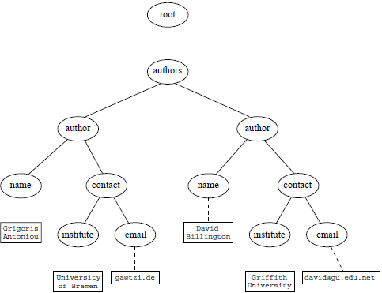
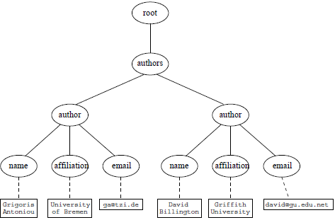
Transforming an XML Document to Another

Slide 104
Transforming an XML Document to Another (2)
<xsl:template match="/">
<?xml version="1.0" encoding="UTF-16"?>
<authors>
<xsl:apply-templates select="authors"/>
</authors>
</xsl:template>
<xsl:template match="authors">
<author>
<xsl:apply-templates select="author"/>
</author>
</xsl:template>

Slide 105
Transforming an XML Document to Another (3)
<xsl:template match="author">
<name><xsl:value-of select="name"/></name>
<contact>
<institution>
<xsl:value-of select="affiliation"/>
</institution>
<email><xsl:value-of select="email"/></email>
</contact>
</xsl:template>

Slide 106
Summary
XML is a metalanguage that allows users to define markup
XML separates content and structure from formatting
XML is the de facto standard for the representation and exchange of structured information on the Web
XML is supported by query languages

Slide 107
Think About…
The nesting of tags does not have standard meaning
The semantics of XML documents is not accessible to machines, only to people
Collaboration and exchange are supported if there is underlying shared understanding of the vocabulary
XML is well-suited for close collaboration, where domain- or community-based vocabularies are used
  It is not so well-suited for global communication.

