Slide 1
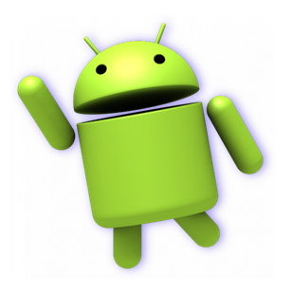
To-Do List Application
Mobile Application Development

Slide 2
TEAM PRESENTATION
Hardik Mori | 21SOECE13047 | SRS, Creation of Wireframe in Figma, Activity Diagram, DFD Level 0, E-R Diagram
Umang Baraiya | 21SOECE13004 | SRS, Creation of Wireframe in Figma, Class Diagram, Sequence Diagram
Janvi Ghodasara | 21SOECE13020 | SRS, Creation of Wireframe in Figma, Flowchart, Use-Case Diagram
Krupa Bhalani | 20SOECE11004 | SRS, Creation of Wireframe in Figma, DFD Level 1 & 2

Slide 3
Project Requirement
Often times we need to save something written on a paper. Just clicking on the picture is not enough as it can blur the details written.
“Remind me to read this book after 10 days”, Can you remember this line for me till the 10th day, the answer is NO because in today’s scenario every person busy with their work and forget to remember their own small task then why they can remember your job.
This To-Do List android project help you to remember all your personal responsibility from the first day to the last day and forced to remind you again and again to remember your task.

Slide 4
Scope of project
To-Do List is a practical organizing tool for all types of users. It can be used as a to-do manager, for common users or business-oriented users, as it has the capability to work as a plain manager, in which user’s tasks can be saved and organized in form, or as a professional to-do manager, which offers extra features like saving multiple comments for each task and timers, that compute the time spent on each task. Also, tasks can be sorted according to their attributes like creation time, due date, etc.

Slide 5
Hardware & Software Requirements for Developer
Software Requirements
Hardware Requirements
Android SDK
Adobe xd
Figma
Laptop Ram : 8GB min
Android version : 5.0 (Lollipop)

Slide 6
Hardware & Software Requirements for User
Software Requirements
Hardware Requirements
Android 5.0+
SmartPhone (min 2GB)

Slide 7
External Library
For Calendar
implementation 'com.applandeo:material-calendar-view:1.7.0'

Slide 8
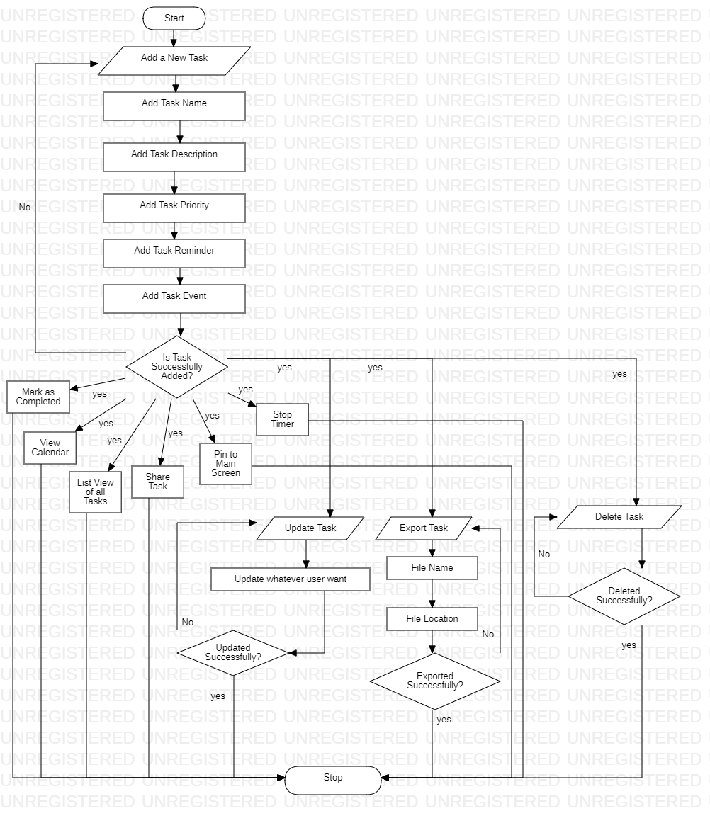
Flowchart

Slide 9
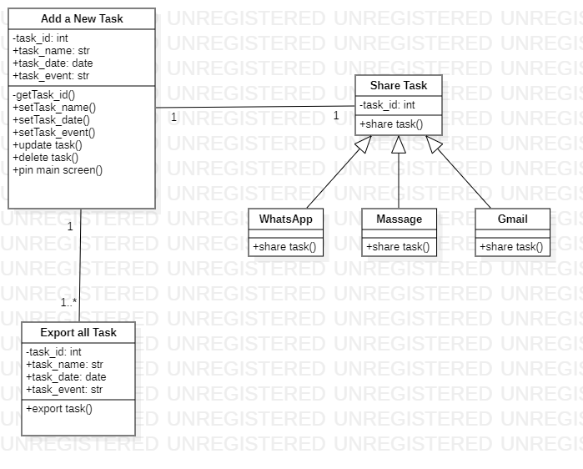
Class Diagram

Slide 10
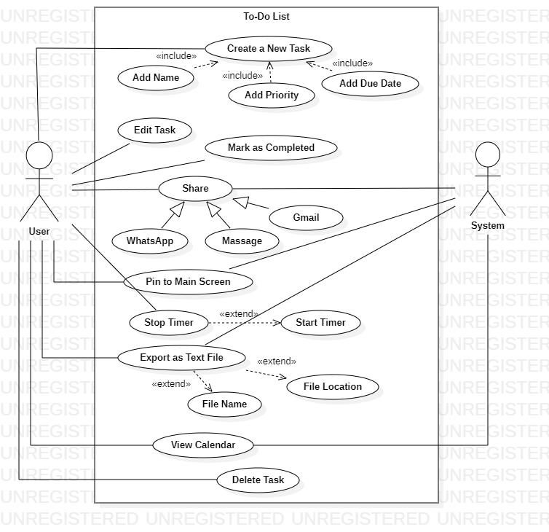
Use-Case Diagram

Slide 11
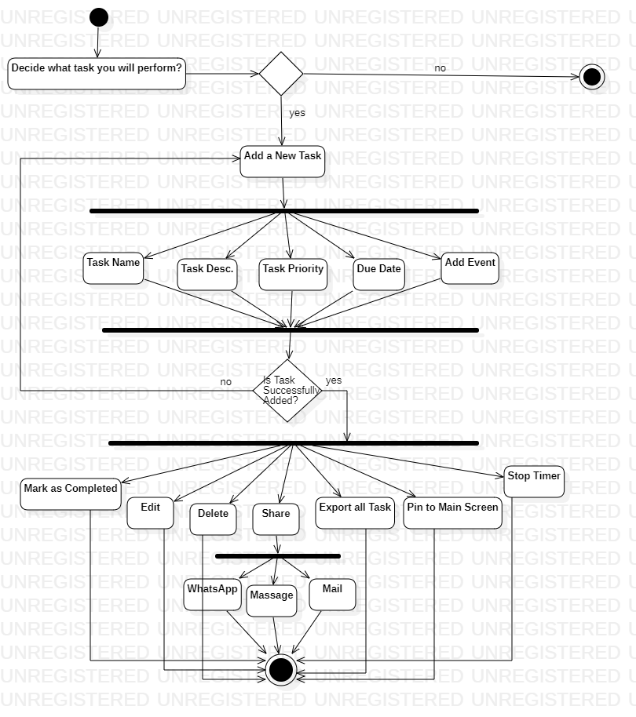
Activity Diagram

Slide 12
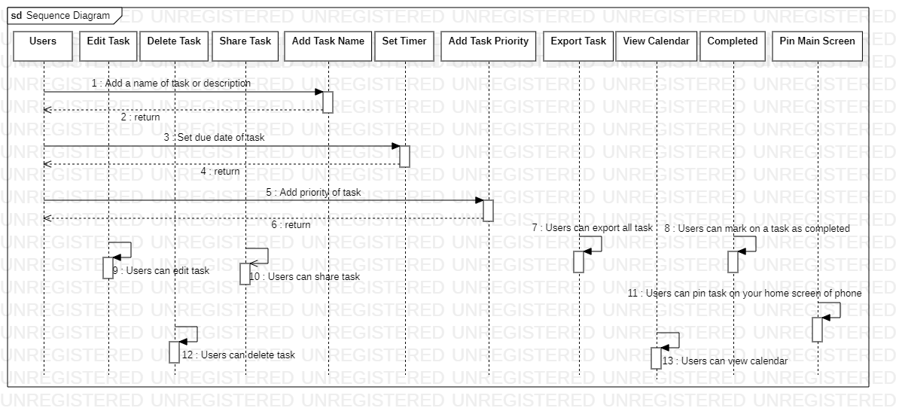
Sequence Diagram

Slide 13
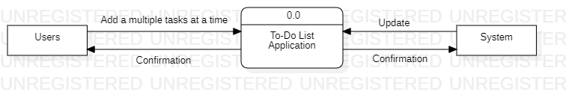
DFD Level-0

Slide 14
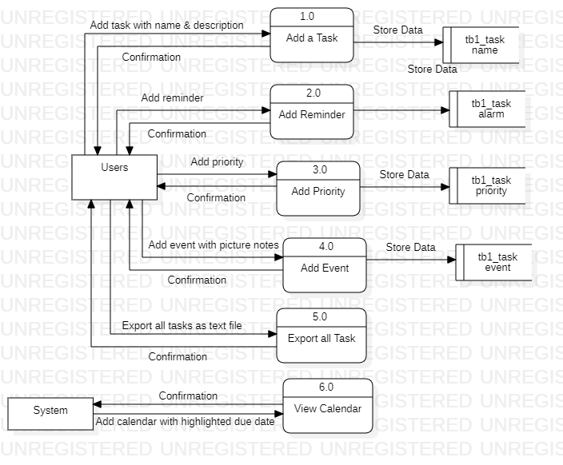
DFD Level-1

Slide 15
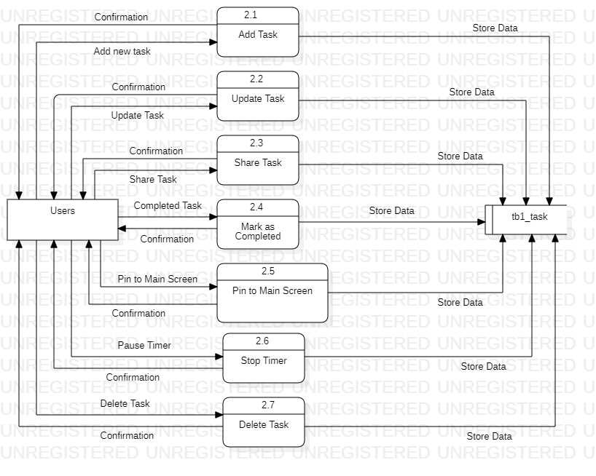
DFD level-2

Slide 16

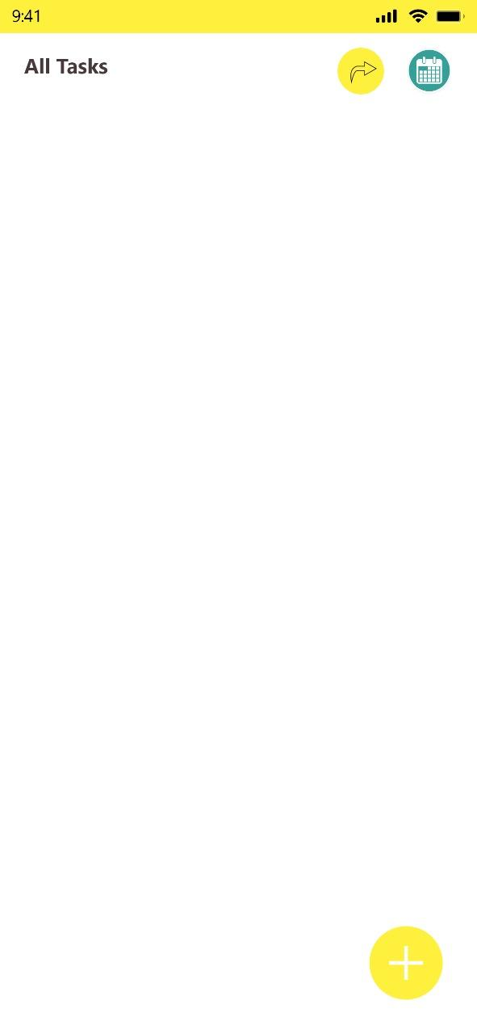
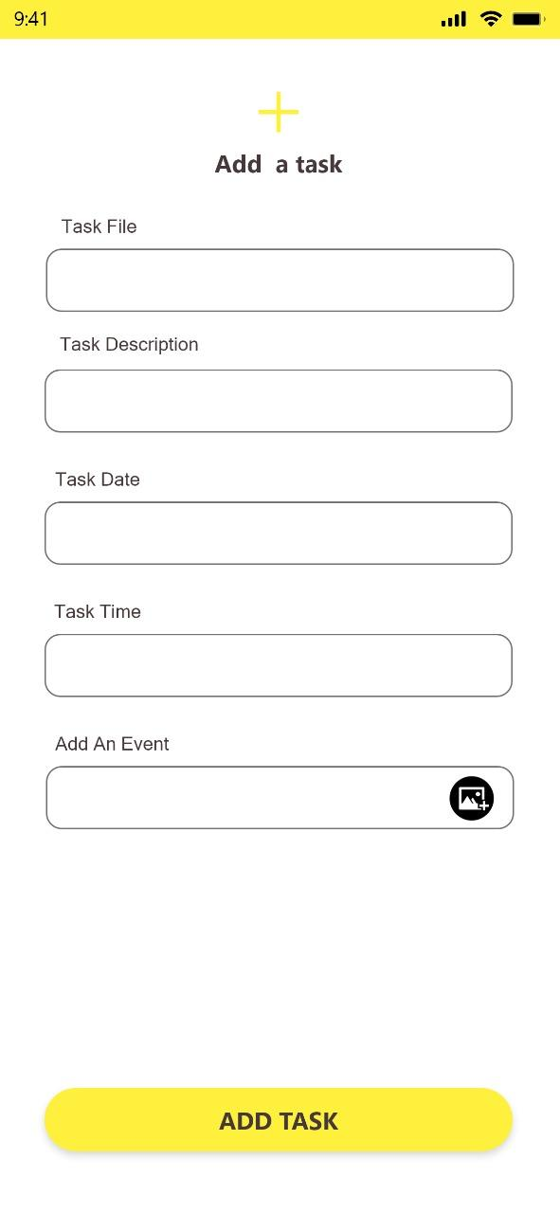
Wire-Frame

Slide 17
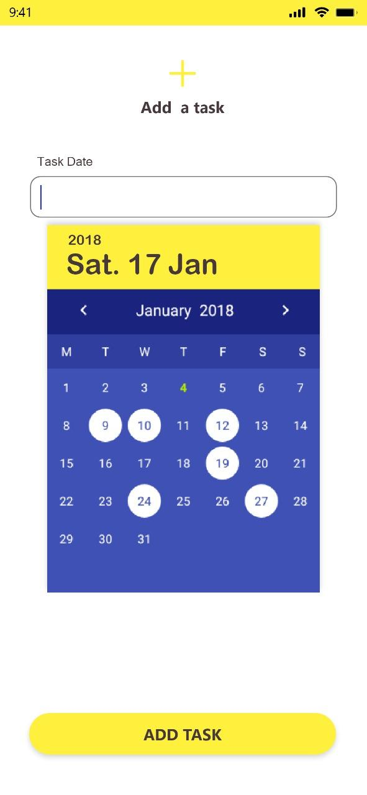
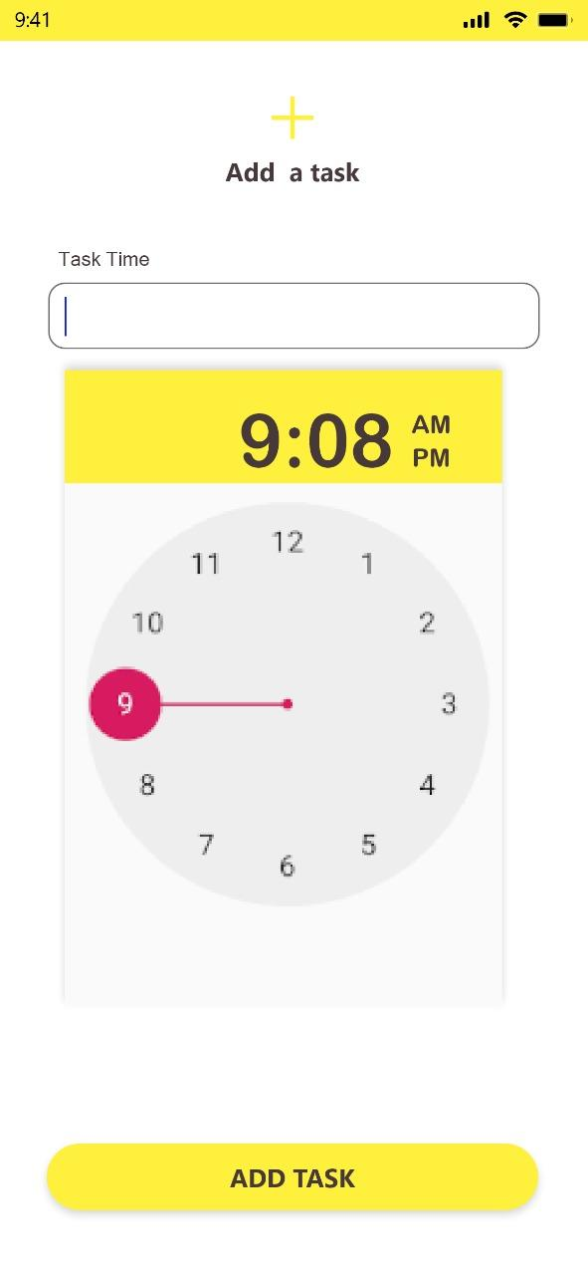
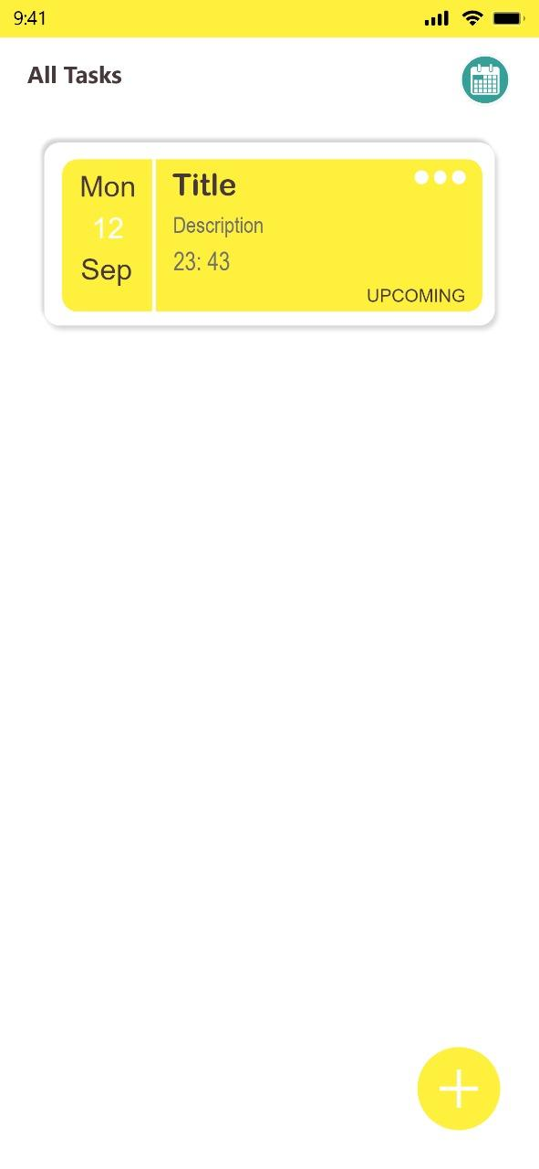

Slide 18
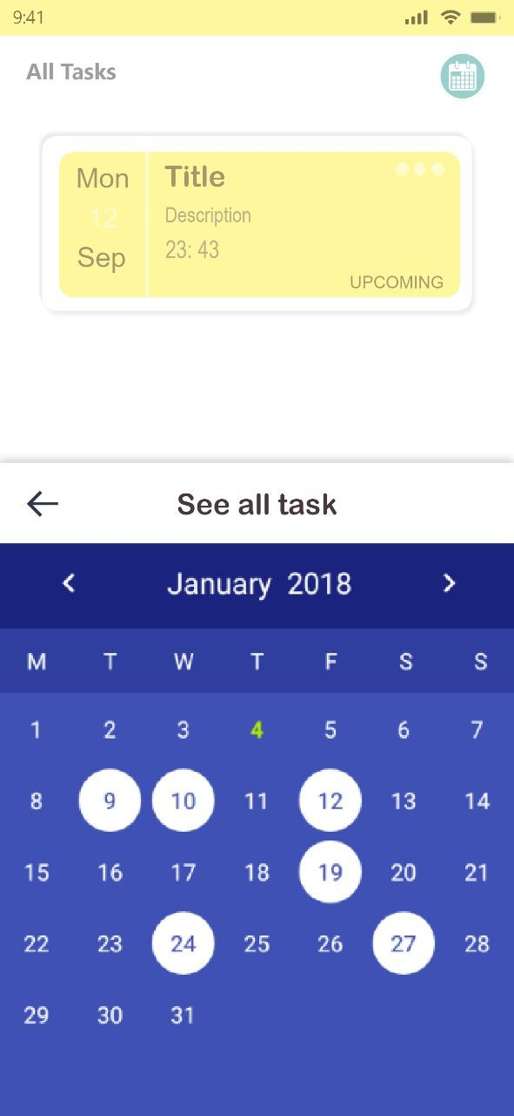
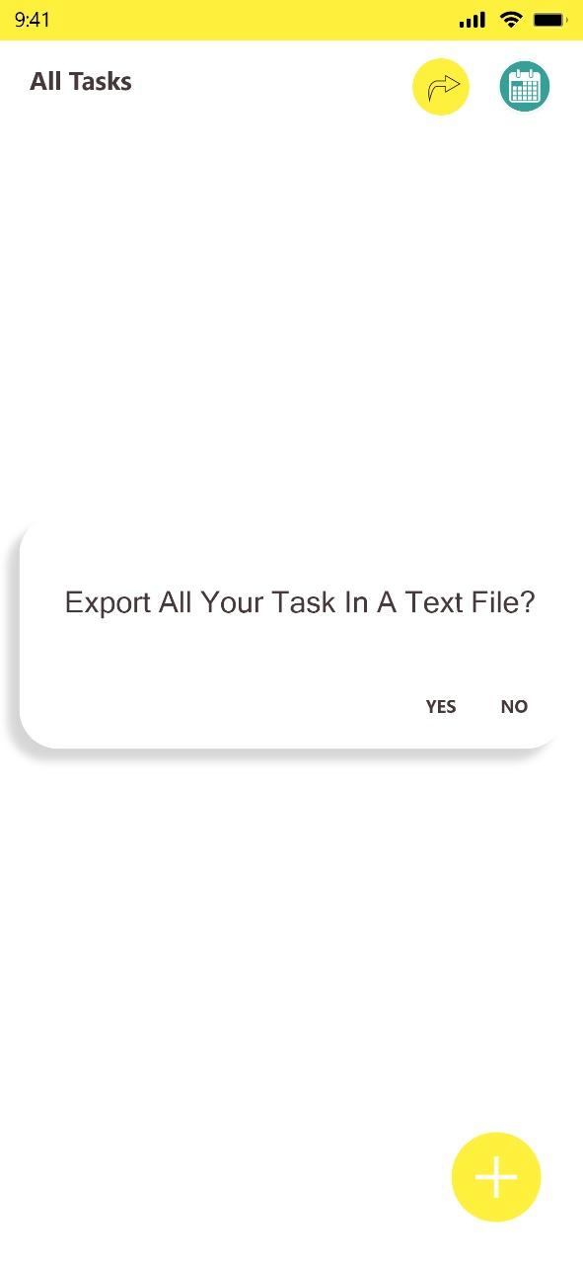
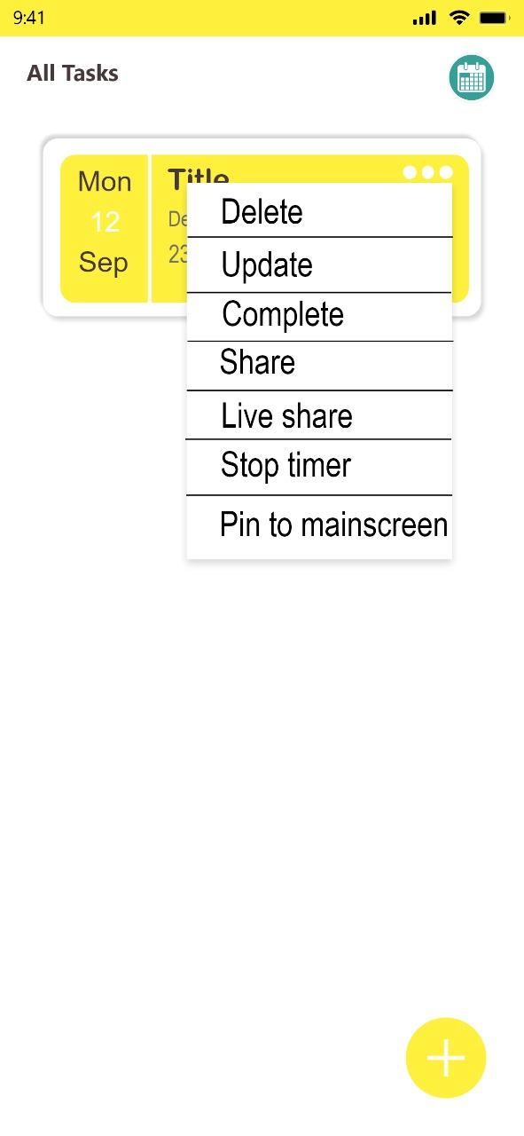

Slide 19
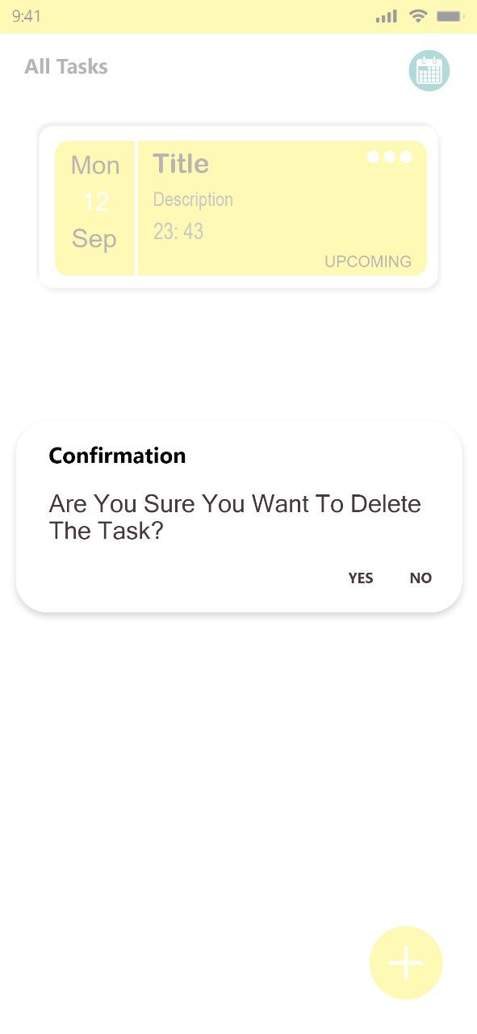
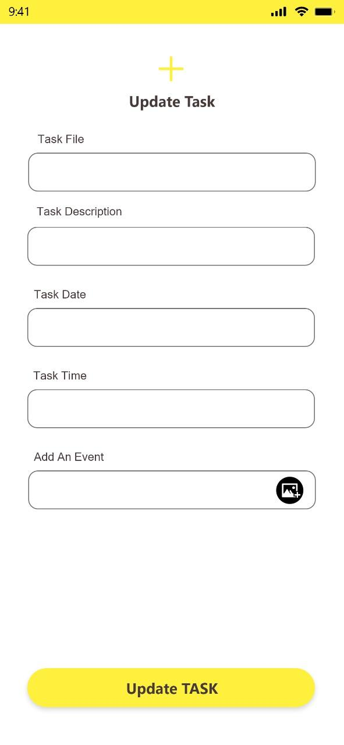
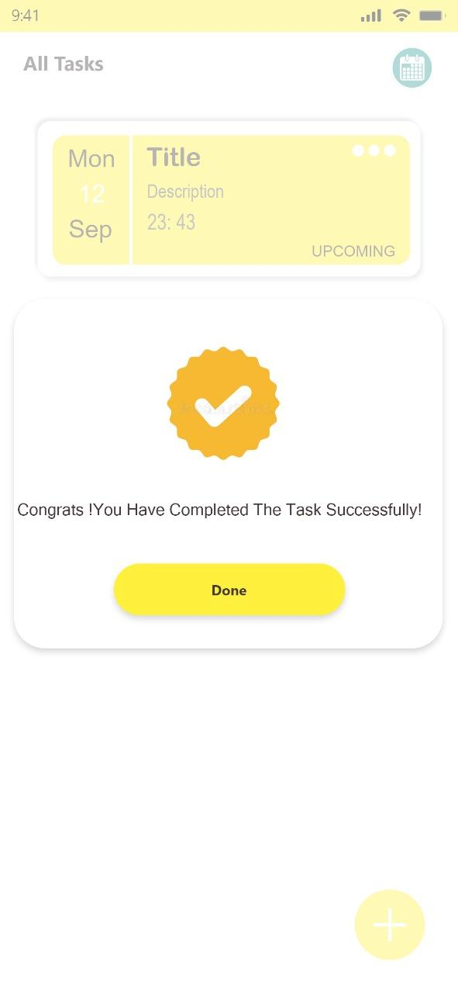
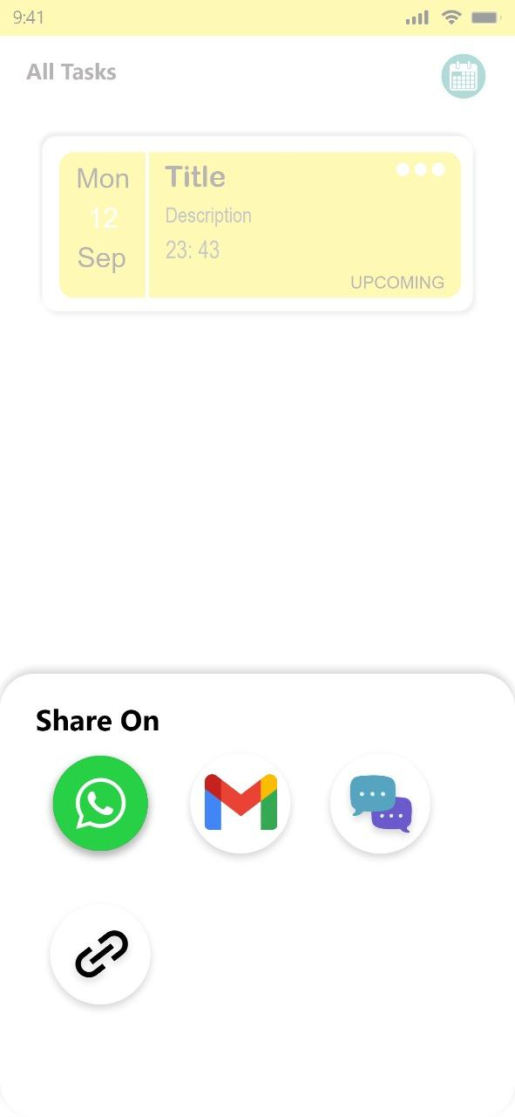

Slide 20
A splash screen is mostly the first screen of the app when it is opened. It is a constant screen which appears for a specific amount of time, generally showing for the first time when the app is launched.
In our To-Do List Application, In the splash screen we are displaying our app logo.
Background of our splash screen is yellow and the screen in the center displays our app logo.

Slide 21
After the splash screen this is the first layout of our application.
In this layout users can view all their tasks in a list view.
Users can add all their tasks with the help of (+) button.
Users export all their tasks in a text file with the help of export (-->) button.
Users view the calendar of the current month with the help of the calendar button.
It is the main layout of our application with white background.

Slide 22
Whenever users click on (+) button then users can redirect to this add task screen.
For add tasks users must enter Task File (Name of Task), Task Description, Task Date (Due date of task), Task Time (Due time of task), and Add An Event In this layout.
According to Task Date and Task Time reminders will be generated.
In the Event attribute users can add picture notes also.
Whenever users click on the ADD TASK button Task will be added to your app in the list view.

Slide 23
In the previous Screen whenever users click on the TextBox of Task Date and Task Time this type of Screen will be displayed.
With the help of this type of Screen users can easily set the due date and due time of their tasks. and it is also attractive for the users.

Slide 24
All Tasks will be displayed here. or In this layout users can view all their tasks in a list view.
This is the home screen of To-Do List App.
In added tasks using the menu users can update, delete, share, add in home screen, etc.
Whenever users have multiple tasks in their app, then users give priority on their tasks. Whatever task users need first task Just select and move up and down (just like drag & drop).

Slide 25
Choosing “Show Calendar”, the system must show the Calendar with highlighted date, whatever due date of task for current month.
In this one button is also there for returning back to the home page (See all task).

Slide 26
Whenever users Choose “Export tasks to Text” and a dialog box shows up, like this layout.
Users can see these text file in the phone storage of their phone. Here the To-Do List folder will be generated, and in this folder these text file will be saved.

Slide 27
Whenever users add tasks, users can perform operations like Delete, Update, Complete, Share, Live share, Stop timer, Pin to main screen using the menu (...) shown in this layout.

Slide 28
If users want to delete the selected task then If the user answers positively means users click on YES button, then this task will be deleted. For this answer tost will be generated.

Slide 29
Users can also edit the file name, description, redefine the due date, reset due time, edit event, set the task as a new name, complete, edit the task timer, and delete a note.

Slide 30
Choose “Task: Complete” and a dialog box shows up, like this layout.
This dialog box has a beautiful message “Congrats! You Have Completed The Task Successfully!”.
For reaction one “Done” button is also there.

Slide 31
Whenever users click on Share or Live share option this type of layout will be displayed.
Users can three ways to direct Share or Live share their tasks, WhatsApp, Gmail, and Message.
Users can also copy link and Share or Live Share whatever other way users want.
Whenever users only Share the task whatever ways, it forms an image view only.
Whenever users Live share tasks whatever ways, it forms a link type. and using these link both users are editing that task.

Slide 32
Functionality
Creating new tasks.
Updating existing tasks and their attributes, like notes, priority, due date.
Delete tasks.
Start and pause a task timer.
Mark a task as completed.
Export all tasks in a txt file.
Pin on the main screen.
Sharing Tasks.
Add picture notes.

Slide 33
Functional Requirements
Internet
Read write external storage

Slide 34
Non Functional Requirements
Availability: Sharing, Updating, Deleting will available easily inside the application.
Usability: The application satisfies the maximum number of Users needs.
Correctness: The alarm should be played at a time.

Slide 35
Future Enhancement
To create a subtask indent a task below another one.
The Recycle Bin is a location where deleted tasks are temporarily stored, Recycle Bin allows users to recover tasks that were deleted.
At a time Users can share multiple tasks whatever way users can wish.

Slide 36
THANKS!
Any questions?

