Slide 1

RSS Reader
Wiki: https://github.com/paceuniversity/CS6392015team5/wiki
Presented by: Hardik Patel
Ritesh Pathak
Tianyu Wang
Yi Chan

Slide 2
Description
RSS (Rich Site Summary), often called Really Simple Syndication
Uses a family of standard web feed formats
Create a personal news feed and read websites in a clean and intuitive format
Subscribe many feeds and keep updates with the sources

Slide 3
Research
Background
RSS stands for really simple syndication.
RSS is an easy way to follow website’s updates and content so that users might not have to visit your site daily for any kind of updates.
Keep contents concentration
Notes:
Frequently, users find it's time consuming to surf websites because they have experienced so much advertisement and unwanted information at one time.

Slide 4
Research
Background
RSS feeds enable publishers to syndicate data automatically. A standard XML file format ensures compatibility with many different machines/programs.
RSS feeds also benefit users who want to receive timely updates from favorite websites or to aggregate data from many sites.
There are many similar RSS applications right now, such as Feedly, Reeder, Readability etc.

Slide 5


Goal
Our goal is to provide an easy and fast way to read useful information through a mobile device with clear and nice view of layout on it.
We believe through this project, we could have a deep understanding on the Android development and related technologies.
We will use Android Studio to develop our project.

Slide 6
Description of Users
Users who like reading online feed and their favorite topics, and article.
Once users have searched a website by URL, the searching RSS feed and organizing article process will be carried out in background.
It provides an easily accessible method for users to search and read articles they need, and to save time for users to look for their interest articles.

Slide 7
Technologies
The RSS reader will run as an android mobile phone application.
We will practice technologies:
Fragment
ListView
ArrayAdapter
Parse XML in Android
AsyncTask HTTP Request

Slide 8
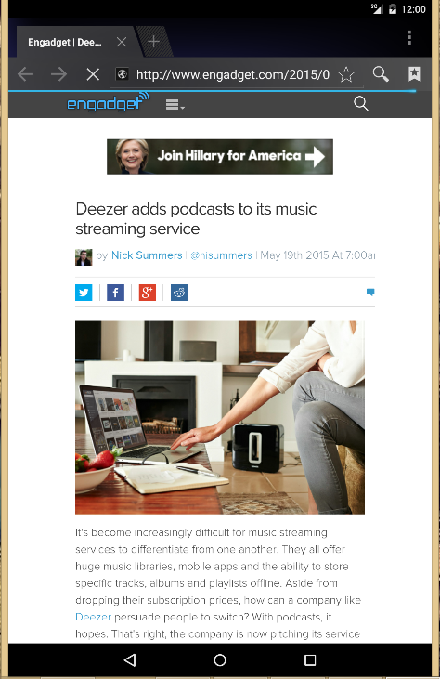
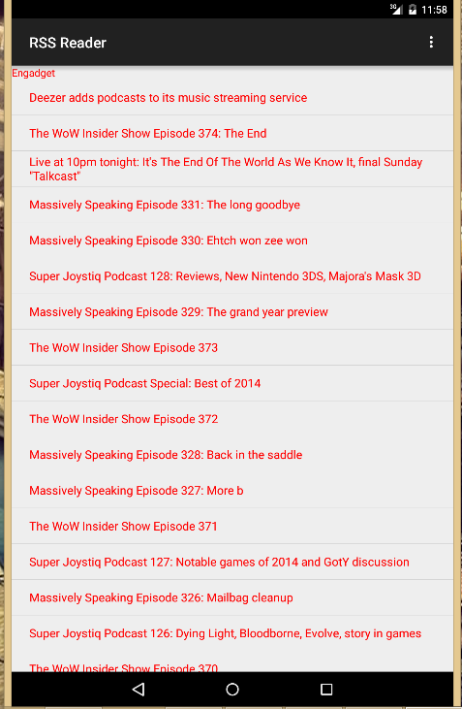
Screenshots

Slide 9
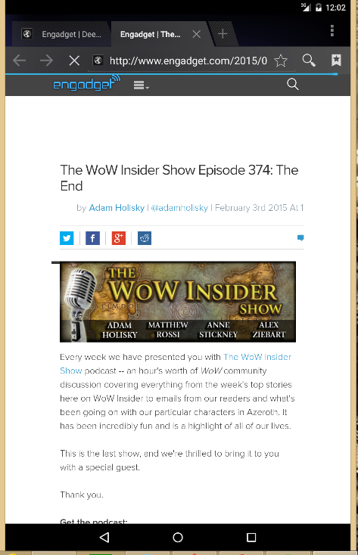
SCREEN SHOTS

Slide 10
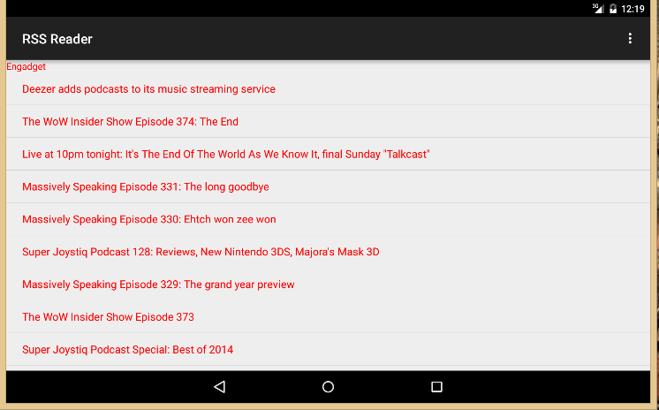
SCREEN SHOTS

Slide 11
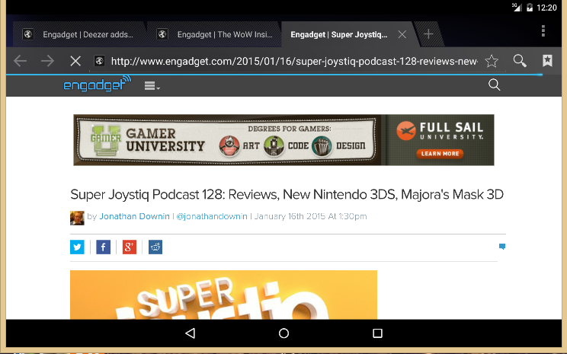
SCREEN SHOTS

Slide 12
Status of the development
Main Program
AsyncTask Support
Add user input URL function
Add drag-refresh function
Add WebView function
Improve UI

Slide 13
Problems encountered
ListView Font Color in Fragment
Understanding the algorithm in Phrasing RSS Xml
XMLPull
SAX

Slide 14
References
http://java.dzone.com/articles/building-rss-reader-android-0
https://androidresearch.wordpress.com/2013/06/01/creating-a-simple-rss-application-in-android-v2/
http://jmsliu.com/1390/rss-reader-app-android-tutorial-1-listview-and-arrayadapter.html

Slide 15
THANK YOU!

Slide 16
QUESTIONS????

