Slide 1
THEMIS:
A Mutually Verifiable Billing System
for the Cloud Computing Environment
Presented by:
Kapadia Nishit
Patel Hardik
Prem Kumar
Biru Kumar
Guided by: Mrs. Pooja H.
Dept of CSE
J.S.S Academy Of Technical Education

Slide 2
Aim
Introduction
System Analysis
System Requirements

Slide 3
Aim:
A secure and non obstructive billing system called THEMIS as a remedy for the limitations in the terms of security capabilities or computational overhead.
The System uses a novel concept of a cloud notary authority for the supervision of billing.

Slide 4
Introduction:
With a wide spread adoption of cloud computing, the ability to record and account for the usage of cloud resources in a credible and verifiable way has become critical for cloud service providers and users alike.
The success of such a billing system depends on several factors:
The billing transaction must have integrity and no repudiation capabilities.
The billing transaction must be non obstructive and have a minimal computation cost.
The service level agreement (SLA) monitoring should be provided in a trusted manner.

Slide 5
Further more to provide a forgery-resistive SLA monitoring mechanism we devised a SLA monitoring module enhanced with a trusted platform module(TPM), called S-Mon.
This work has been under taken on a real cloud computing service called iCubeCloud.

Slide 6
System Analysis:
Existing System:
The billing systems with limited security concerns and micropayment -
Based billing system require a relatively low level of computational complexity .
These systems are inadequate in terms of transaction integrity , nonrepudiation and trusted SLA monitoring.
The existing system uses the public key infrastructure(PKI)-based billing transactions.

Slide 7
Drawback in Existing System:
Existing billing systems are limited in terms of security capability or computational overhead.
Maximum computation cost.
No trusted SLA monitoring.

Slide 8
THEMIS
The cloud notary authority generates mutually verifiable bill with binding information.
It is useful to resolve future disputes between a user and a cloud service provider in a computationally efficient way.
Monitor module which continuously monitors all the log activities of the CSP and the user.
This system has minimum transaction latency.

Slide 9
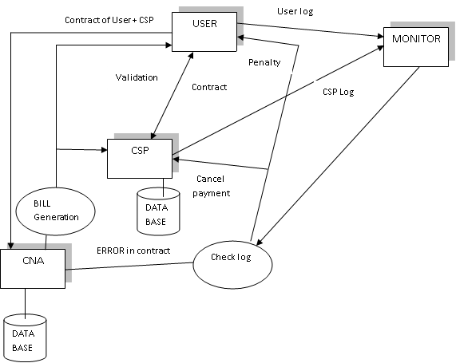
System Architecture

Slide 10
System Requirements:
Hardware:
PROCESSOR : PENTIUM IV 2.6 GHz, Intel Core 2 Duo.
RAM : 512 MB DD RAM.
MONITOR : 15” COLOR
HARD DISK : 40 GB

Slide 11
System Requirements:
Software:
Front End : J2EE(JSP,SERVLET), STRUTS.
Back End : MS SQL 05
Operating System : Windows 07
IDE : Net Beans, Eclipse

Slide 12
Modules
User Interface Design
Cloud Service Provider
User
Cloud Notary Authority (CNA)
Monitor
Action against SLA violation.

Slide 13
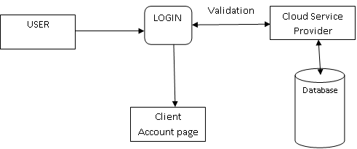
User Interface Design

Slide 14
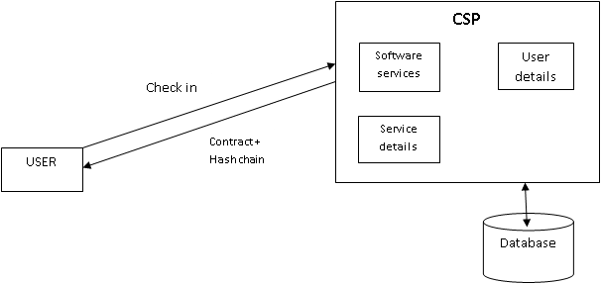
Cloud Service Provider

Slide 15
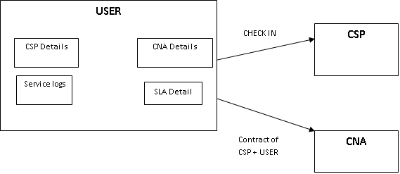
User

Slide 16
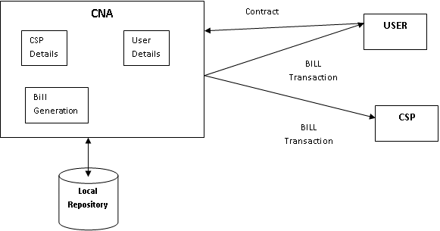
Cloud Notary Authority (CNA)

Slide 17
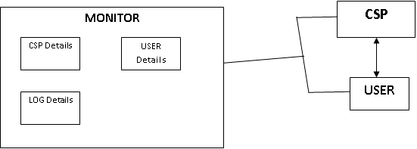
Monitor

Slide 18
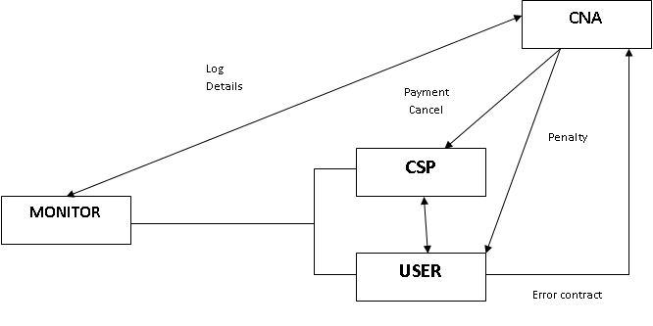
Action against SLA violation

Slide 19
THANK YOU

