Slide 1


Minor Project -2
ConvergeHub – A Collaborative App
Presented by:
Uday Surothiya (B-1 CCVT) R2142220683
Hardik Rai (B-2 CCVT) R2142220787
Priyanshu Chauhan (B-2 CCVT) R2142220605
Manav Rajput (B-1 CCVT) R2142220565
Guided by:
Dr. Avita Katal
School of Computer Science

Slide 2
Content
Introduction
Problem Statement
Motivation
Objectives
Area of application
Data Collection & Input Format
Technology Stack
Swot analysis
Pert Chart
References

Slide 3
1. Introduction
In today's fast-changing business world, organizations need a platform that will facilitate smooth communication and collaboration to be competitive. This solution is designed to address these needs by providing an integrated, real-time communication system that centralizes messaging, secure file sharing, and organized project channels. It helps to eliminate dependency on traditional email methods, promoting greater transparency, quicker decision-making, and improved workflow management.
The platform is designed to simplify and optimize everyday tasks, allowing teams to focus on innovation and achieving organizational goals. With robust security features and a scalable architecture, it adapts to the dynamic needs of businesses, empowering them to respond efficiently to changing demands, enhance collaboration, and drive productivity across all levels. This approach ensures organizations can meet new challenges with agility while maintaining a high level of operational excellence.

Slide 4
2. Problem statement
Effective communication and collaboration are key to productivity, yet many businesses rely on fragmented tools like emails and disconnected platforms, leading to inefficiencies. Our project addresses this by developing a unified platform that integrates real-time messaging, file sharing, and task management, streamlining workflows and enhancing team collaboration.

Slide 5
3. Motivation
The development of ConvergeHub is driven by several key motivations that address the growing need for efficient and secure communication tools:
Growing Need for Instant Communication:
In today’s fast-paced world, the demand for real-time messaging in both personal and professional settings is increasing rapidly. ConvergeHub aims to meet this demand by providing a platform that enables instant communication, ensuring that users can stay connected without delays.
Centralized Communication Platform:
Many organizations and individuals rely on multiple tools for communication, leading to fragmentation and inefficiency. ConvergeHub offers a single, unified platform that centralizes all communication needs, making interactions more seamless and organized.
Smooth and Efficient Messaging:
The application is designed to deliver messages in real-time, ensuring that users can communicate without interruptions. This feature is particularly important for teams and individuals who rely on timely communication to achieve their goals.
Strong Security and Privacy:
With the increasing concerns around data privacy and security, ConvergeHub incorporates advanced security measures to protect user data. Features such as encrypted communication and role-based access control ensure that conversations remain private and secure.
Enhanced Productivity and Collaboration:
ConvergeHub’s user-friendly interface and robust features are designed to improve teamwork and collaboration. By streamlining communication and task management, the platform helps users work more efficiently and effectively, ultimately enhancing productivity.

Slide 6
4. Objectives
Develop an integrated platform for real-time messaging, file sharing, and structured communication channels.
Optimize workflow management by centralizing communication and task tracking.
Ensure secure collaboration with encrypted communication and role-based access control.
Provide a user-friendly interface to enhance adoption and usability.
Enable seamless remote collaboration across multiple devices and locations.

Slide 7
5. Area of Application
The ConvergeHub platform is designed to cater to a wide range of applications, making it a versatile tool for both personal and professional use. Below are the key areas where the application can be effectively utilized:
Seamless Personal Connectivity: ConvergeHub enables individuals to maintain real-time communication with friends and family effortlessly. Whether it’s sharing updates, photos, or videos, the platform ensures that personal connections remain strong and uninterrupted.
Efficient Team Collaboration: The platform facilitates smooth interaction among teams and project managers, enabling effective workflow coordination. By centralizing communication, ConvergeHub helps teams stay aligned, share files securely, and manage tasks efficiently, thereby enhancing productivity.
Academic Engagement: ConvergeHub supports students and educators in managing discussions, assignments, and group projects seamlessly. It provides a structured environment for academic collaboration, allowing users to share resources, discuss ideas, and track progress in real-time.
Corporate Communication Hub: The application empowers professionals to organize meetings, streamline discussions, and oversee work tasks efficiently. It serves as a centralized communication hub for corporate teams, ensuring that all stakeholders are on the same page and can collaborate effectively, regardless of their location.

Slide 8
6. Technical concepts & algorithm used
Frontend: React.js
Backend: Node.js with Express.js
Database: MongoDB or Firebase
Real-time Communication: WebSockets (Socket.io)
Authentication: JWT & OAuth (Google, GitHub)
Deployment: Docker, AWS, Firebase Hosting
File Storage: AWS S3 / Firebase Storage
Security: Encryption, and OAuth login
Monitoring: Firebase Analytics, MongoDB Atlas Monitoring

Slide 9
7. Swot analysis
Strengths – Seamless Real-Time Collaboration – Uses WebSockets & OT for smooth messaging.
Weakness – High Development Complexity – Requires expertise in WebSockets, OT, and cloud deployment.
Opportunity – Rising Demand for Remote Collaboration – Increasing need for efficient team communication tools.
Threats – Strong Market Competition – Established players like Slack, Teams, and Discord dominate the industry.

Slide 10
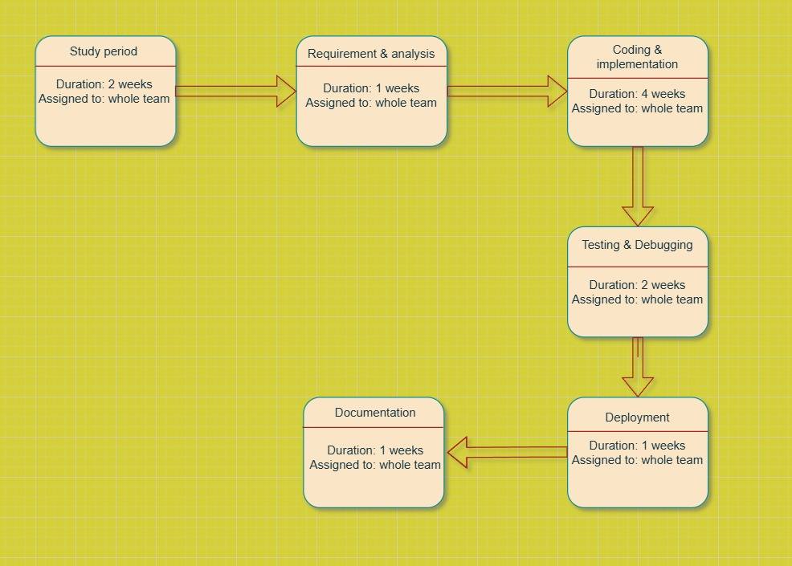
8. Pert Chart

Slide 11
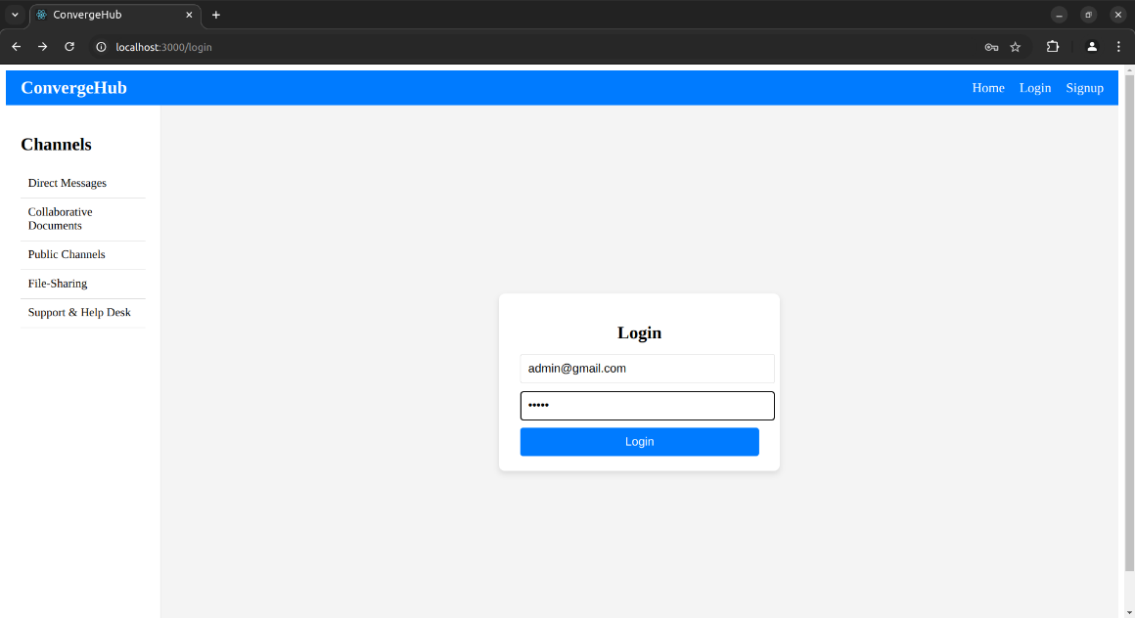
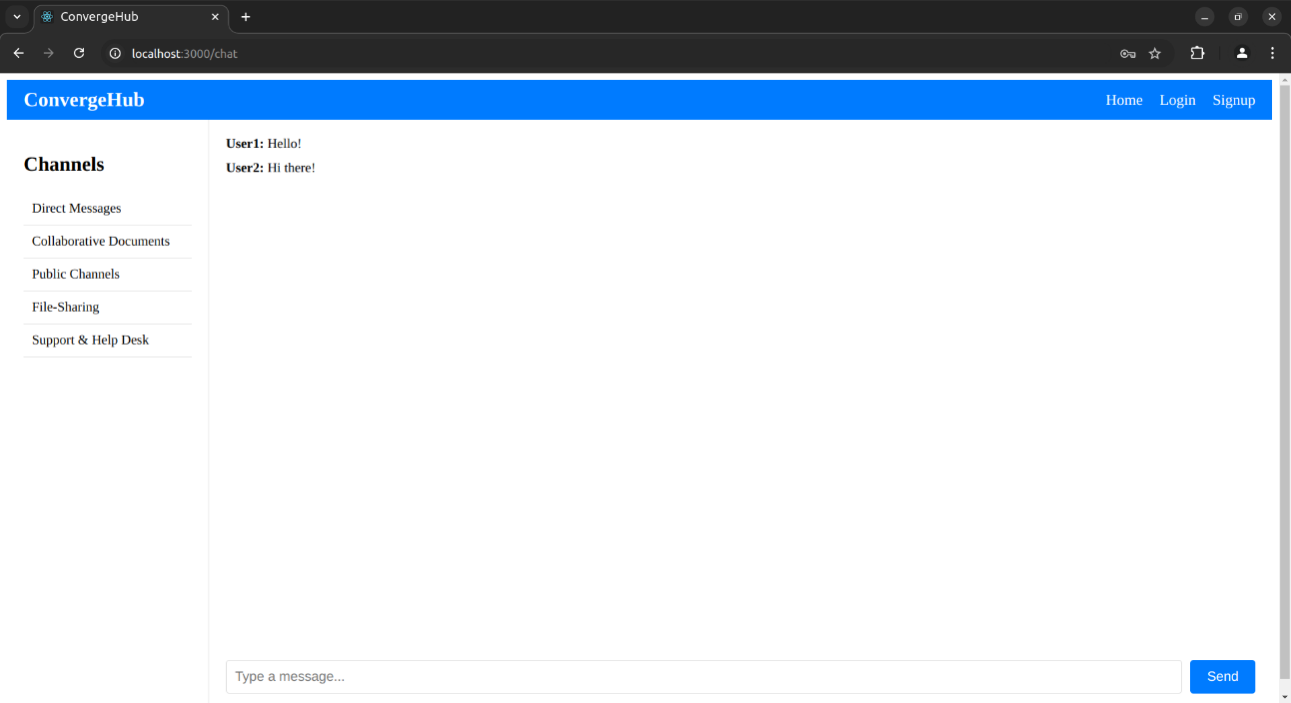
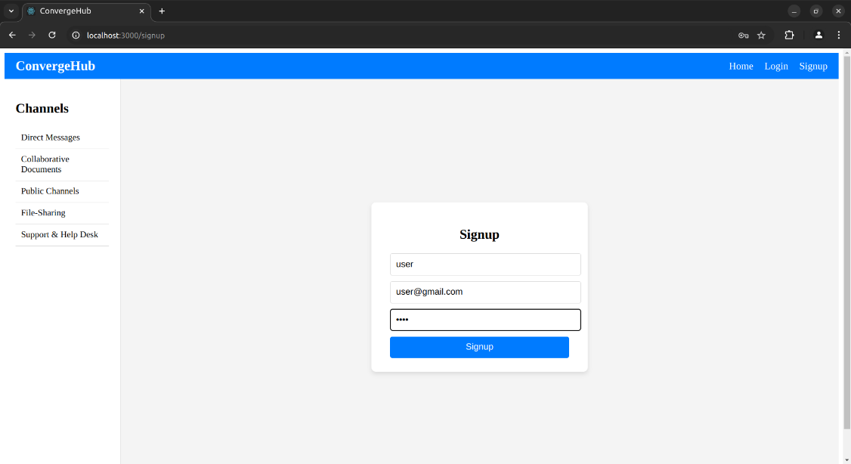
8. Frontend
Login Page →
Signup Page →
← Post Login

Slide 12
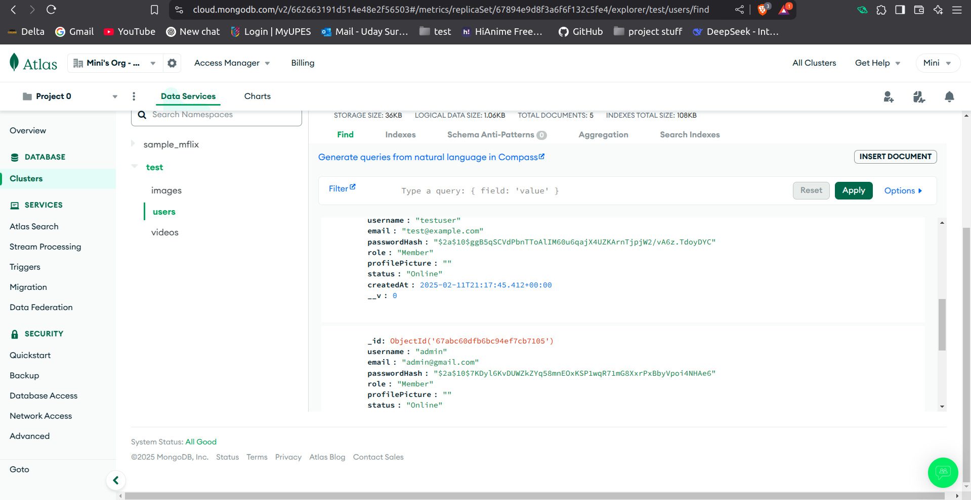
8. Backend
Collection where Data is stored

Slide 13
9. References
Moorthy, M., Poovarasan, S., Sathish, V., Sasikala, K., & Gayathri, G. (2024). Unified collaborative learning platform using MERN stack and cloud environment. International Research Journal of Modernization in Engineering Technology and Science, 171, 829–836.
Reddy, D. M. K., Nawaz, S. A., Naga Durga, T. C., Surya, P., & Sajid Ameer, S. (2024). Design and implementation of a cloud-native application for collaborative learning. International Journal for Research in Applied Science & Engineering Technology (IJRASET), 12(3), 2112-2123. https://doi.org/10.22214/ijraset.2024.59296
Jackson, V., van der Hoek, A., & Prikladnicki, R. (2022). Collaboration tool choices and use in remote software teams: Emerging results from an ongoing study. Proceedings of the 15th International Conference on Cooperative and Human Aspects of Software Engineering (CHASE'22), Pittsburgh, PA, USA. https://doi.org/10.1145/3528579.3529171
Schubert, P., & Williams, S. P. (2021). Enterprise collaboration platforms: An empirical study of technology support for collaborative work. Procedia Computer Science, 196, 305–313. https://doi.org/10.1016/j.procs.2021.12.018
Chandrasekar, L. R. (2009). The impact of collaboration tools on student engagement. Memorial University.

Slide 14
Thank You

