Slide 1

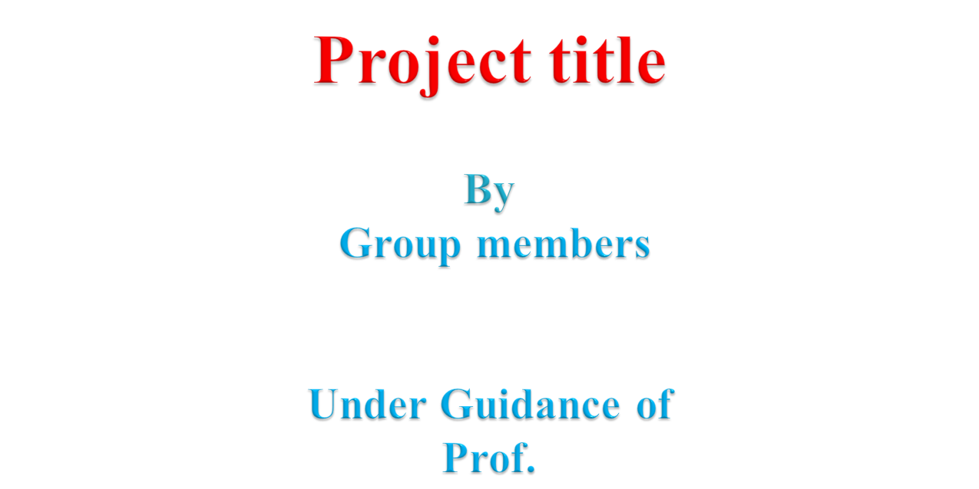
Smart Billing Cart
By
Hardik Hemant Rawat (125A2047)
Shivraj Morde (125A2033)
Ismail Mohammed (125A2052)
Pranav Anand (125A2062)
Under Guidance of
Dr. Swati Rane
SIES GST, Nerul
Date:
Notes:
<number>

Slide 2

Introduction (discuss need of your project)
Methodology (Algorithm/Flowchart)
System Architecture (detailed Block diagram/Circuit diagram)
Hardware requirement
Hardware Results (showing complete work)
Applications
Conclusion
References
SIES GST, Nerul
Date:
2

Slide 3
Introduction
Need of the project
Shoppers wait in billing queues even to pay for 2-3 items
Counter billing is slow, needs staff at every till and is open to errors
Checking at the exit that a customer has really paid is done by eye
Smart carts in IEEE work need an RFID tag on every product or a screen on the cart
Our solution: SmartCart
Shopper scans the barcode already printed on each pack with their own phone
Bill is paid from an in-app SmartCart Wallet (topped up by cash or UPI)
A Raspberry Pi camera checks a signed, one-time exit pass before the shopper leaves
Live at smartcart-gkrx.onrender.com
SIES GST, Nerul
Date:
3

Slide 4
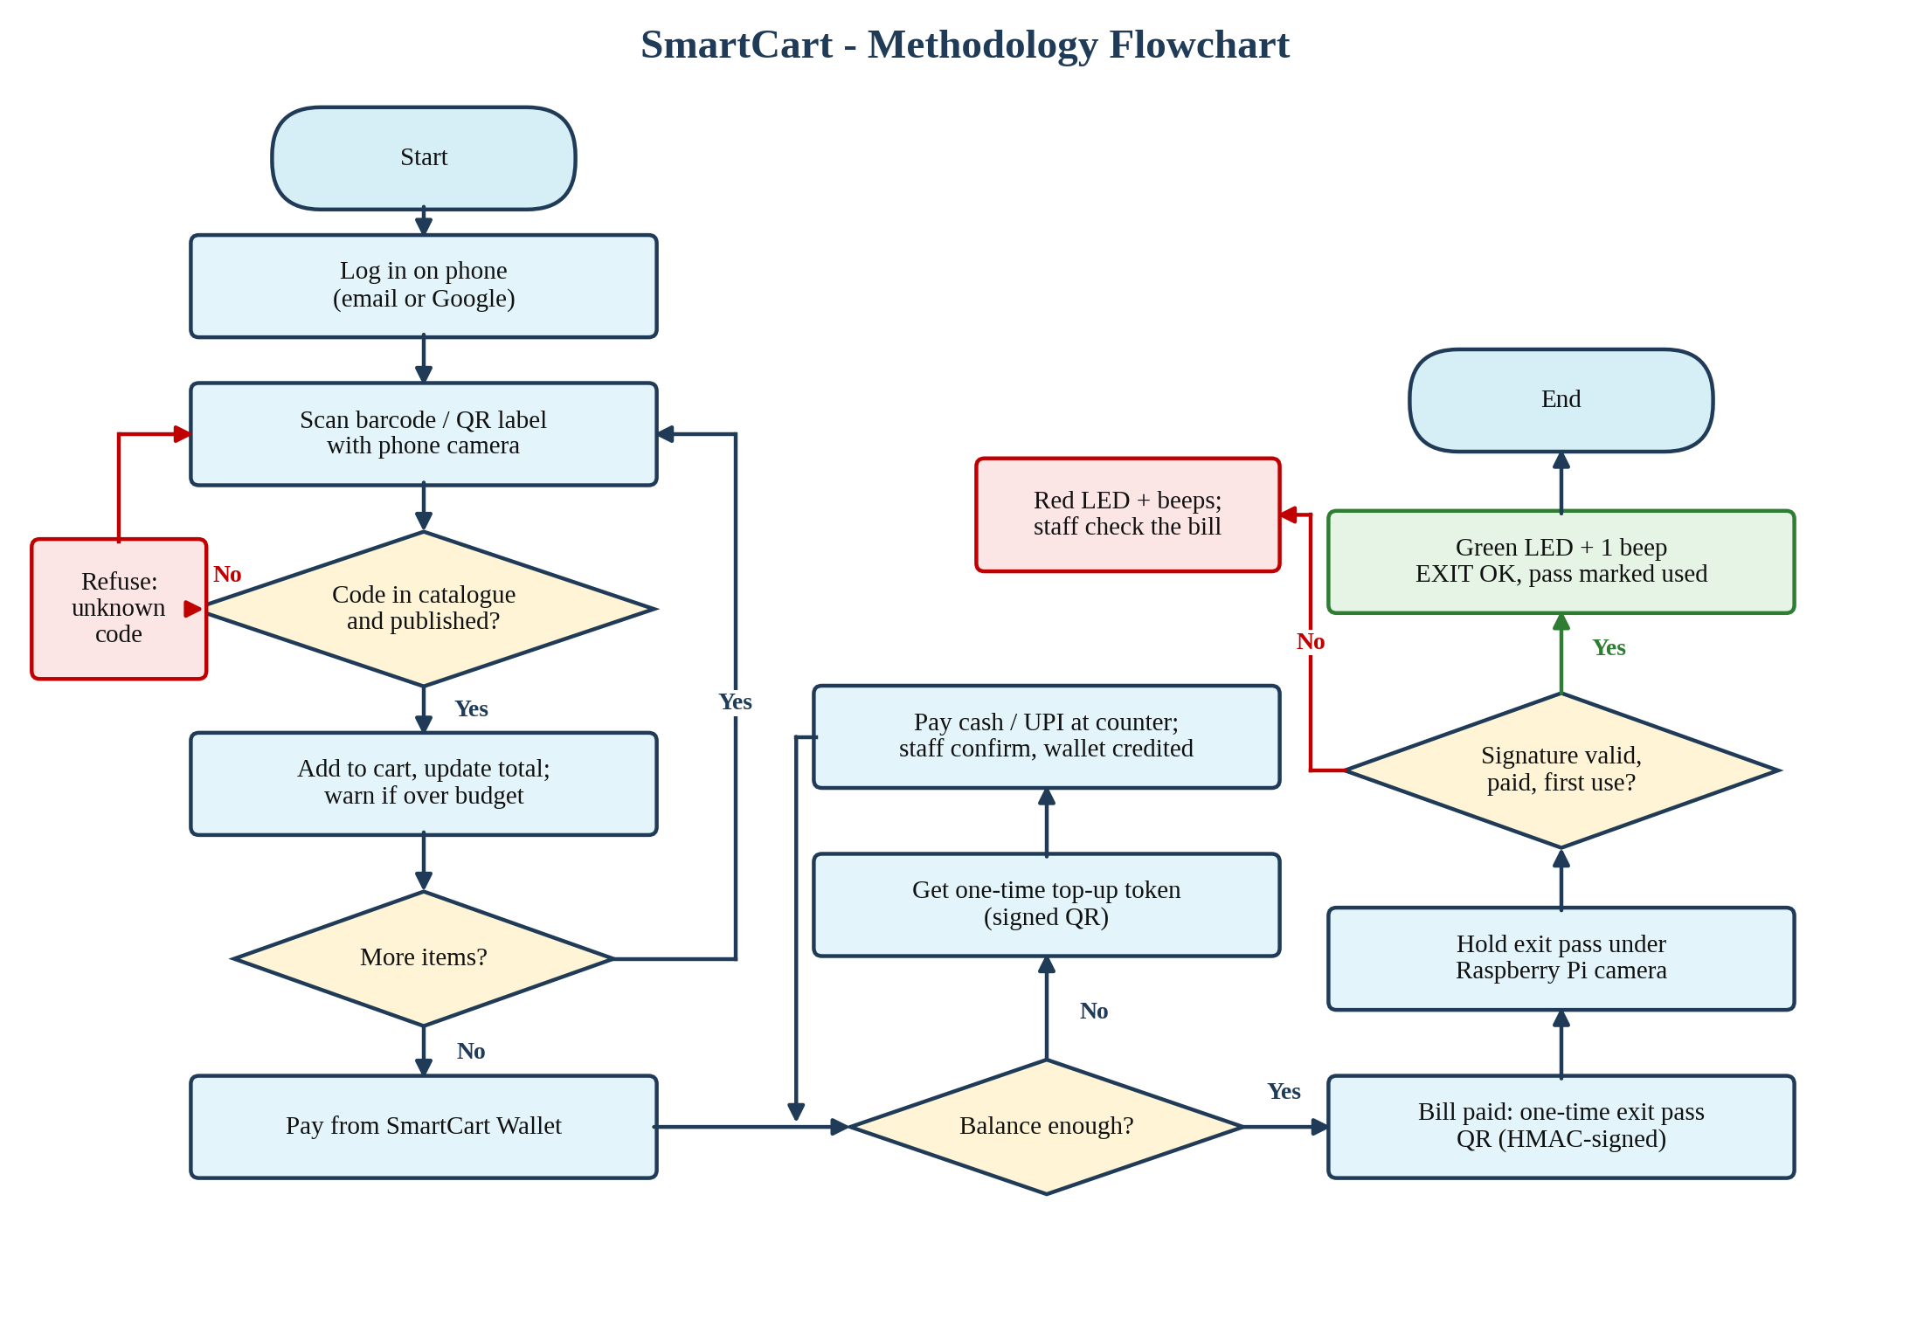
Methodology
SIES GST, Nerul
Date:
4

Slide 5
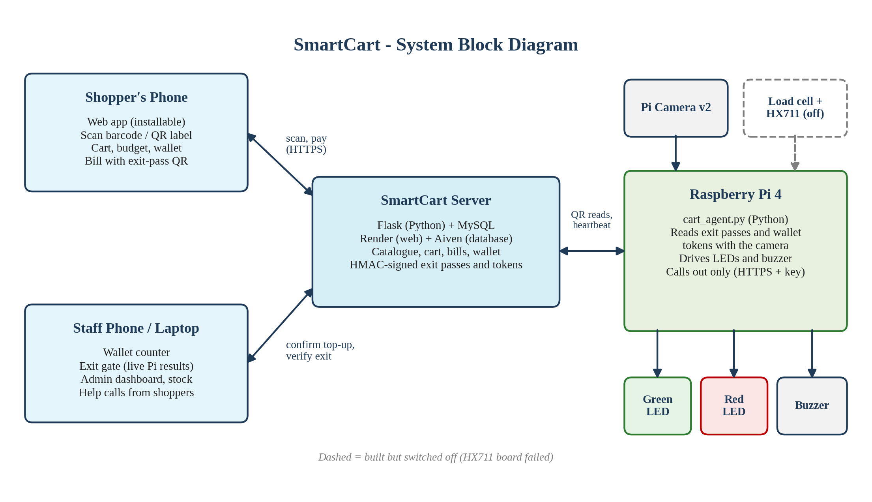
System Architecture - Block Diagram
SIES GST, Nerul
Date:
5

Slide 6
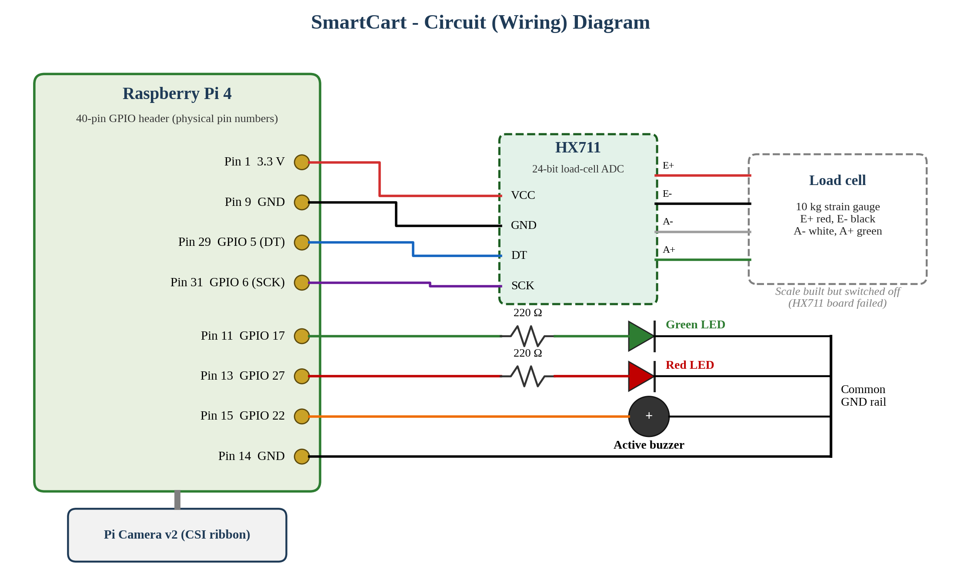
System Architecture - Circuit Diagram
SIES GST, Nerul
Date:
6

Slide 7
Hardware Requirement
Component | Specification | Purpose
Raspberry Pi 4 Model B | Quad-core ARM, Wi-Fi, 40-pin GPIO | Runs the cart / exit-gate program
Pi Camera v2 | 8 MP, CSI ribbon | Reads exit-pass and wallet-token QR codes
Load cell + HX711 | 10 kg strain gauge, 24-bit ADC | Item weight check (built, switched off)
Green and red LEDs | 5 mm, with 220 Ω resistors | OK / stop signal
Active buzzer | 3.3 V | Beep for OK / alert
microSD card + power supply | Raspberry Pi OS, 5 V 3 A USB-C | Storage and power for the Pi
Smartphone | Camera + web browser | Shopper scans items and pays
Software: Python 3, Flask, MySQL 8, HTML/CSS/JavaScript, Raspberry Pi OS; hosted on Render + Aiven
SIES GST, Nerul
Date:
7

Slide 8
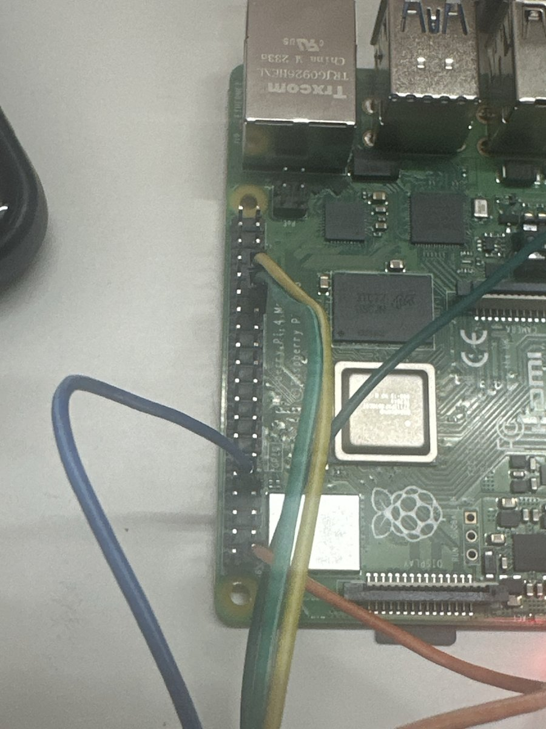
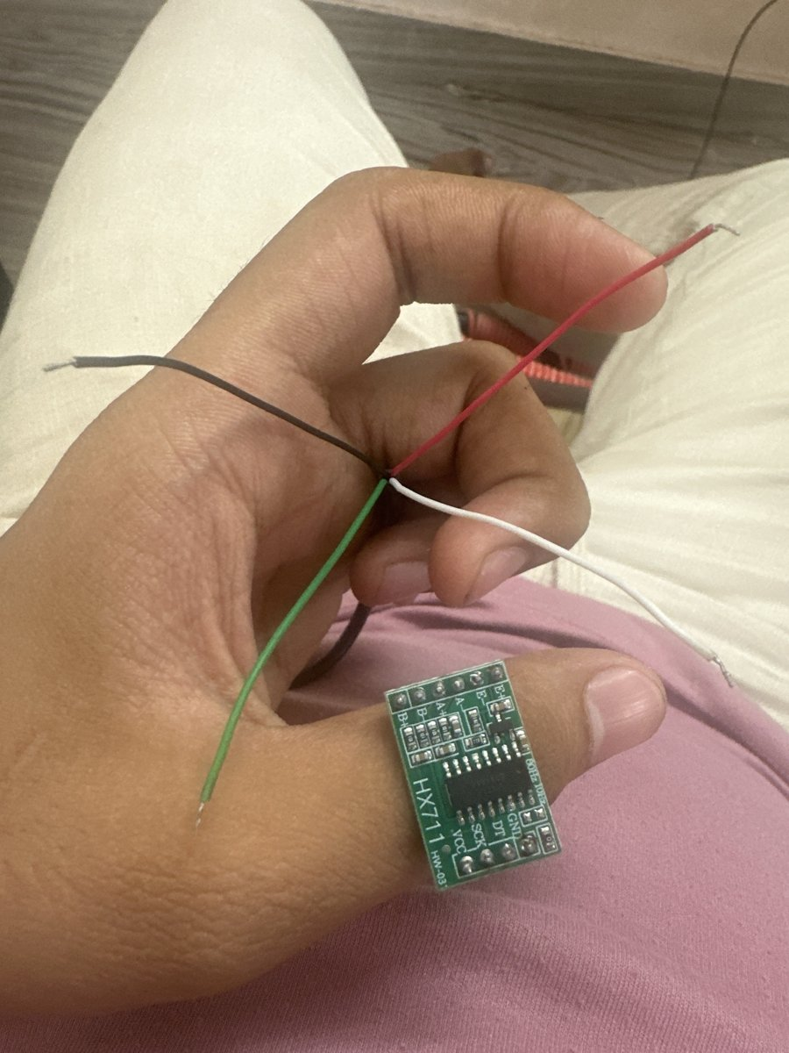
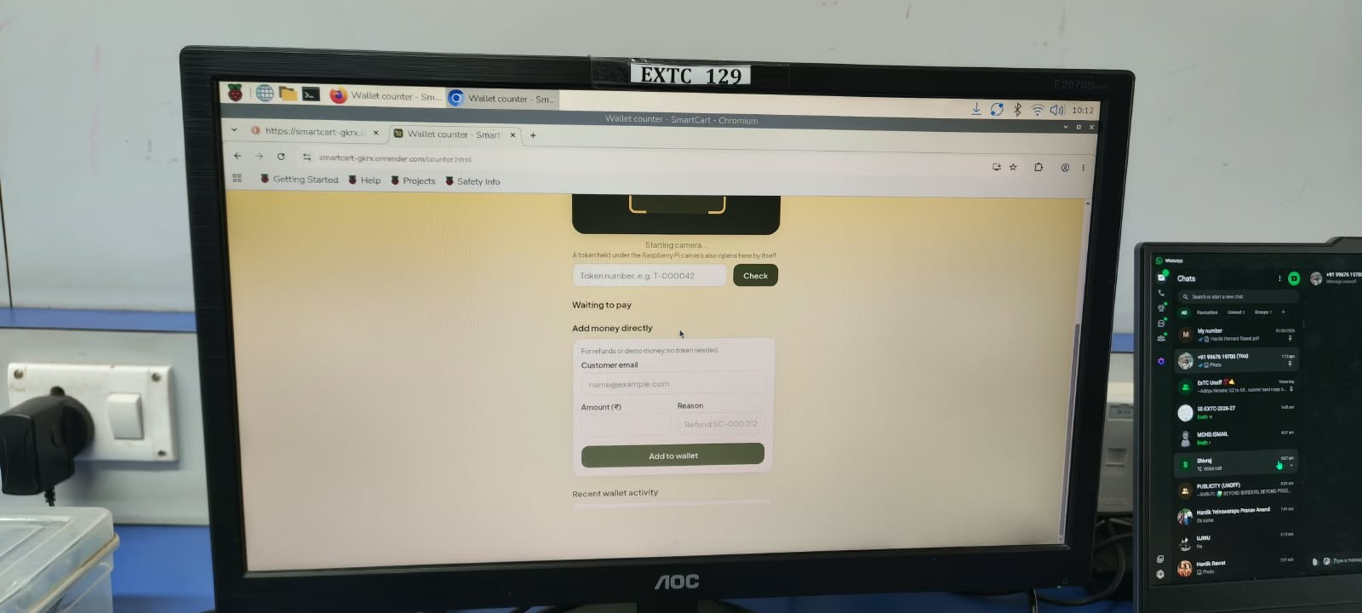
Hardware Results (1/2)
SmartCart Wallet counter on the Pi's own display (lab EXTC 129)
Pi 4 GPIO wiring
HX711 + load cell wires
SIES GST, Nerul
Date:
8

Slide 9
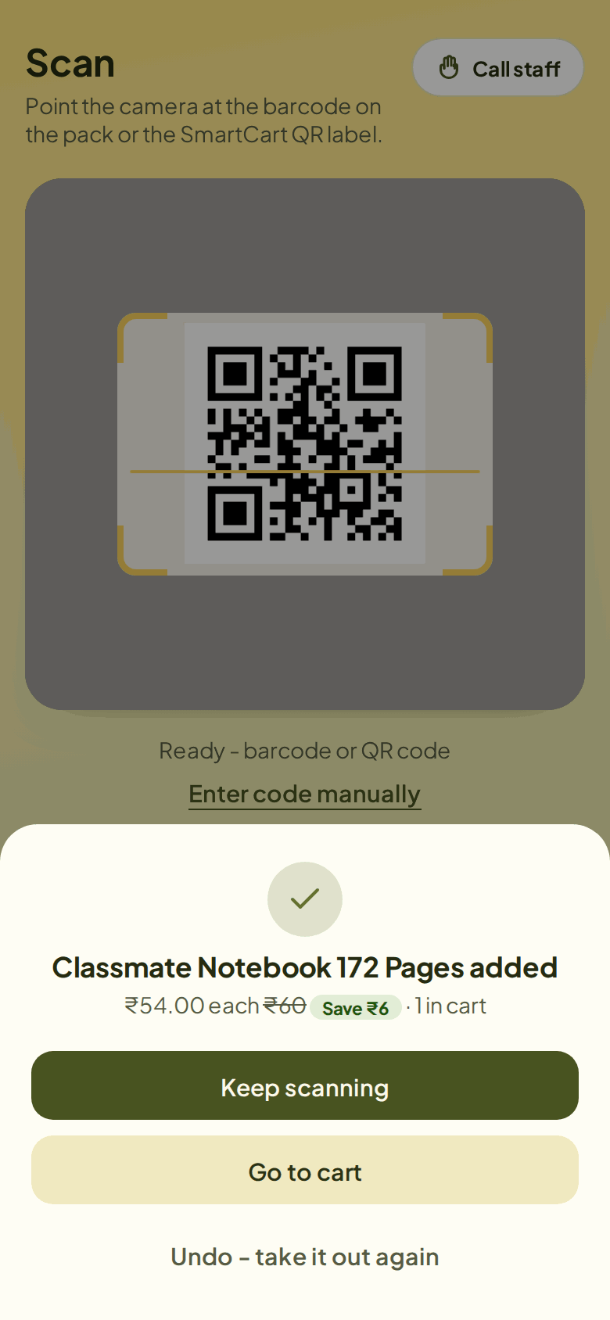
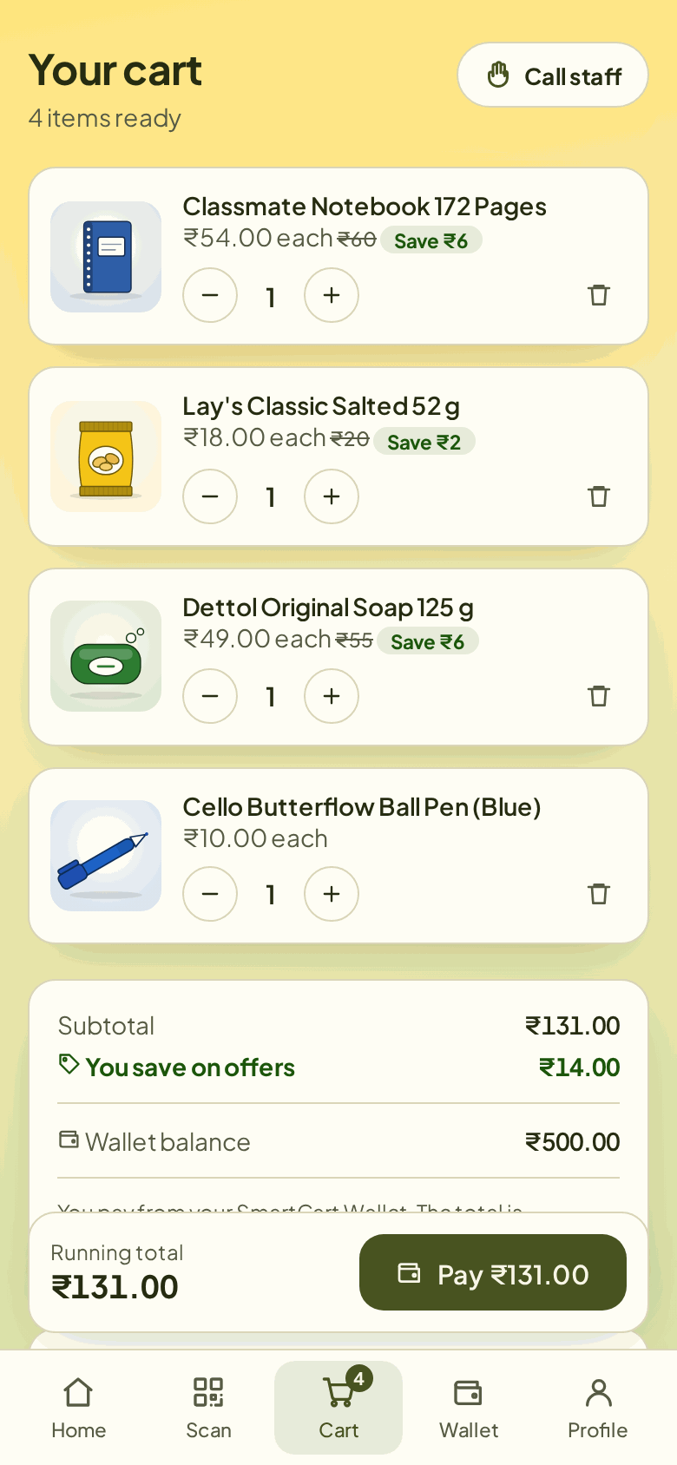
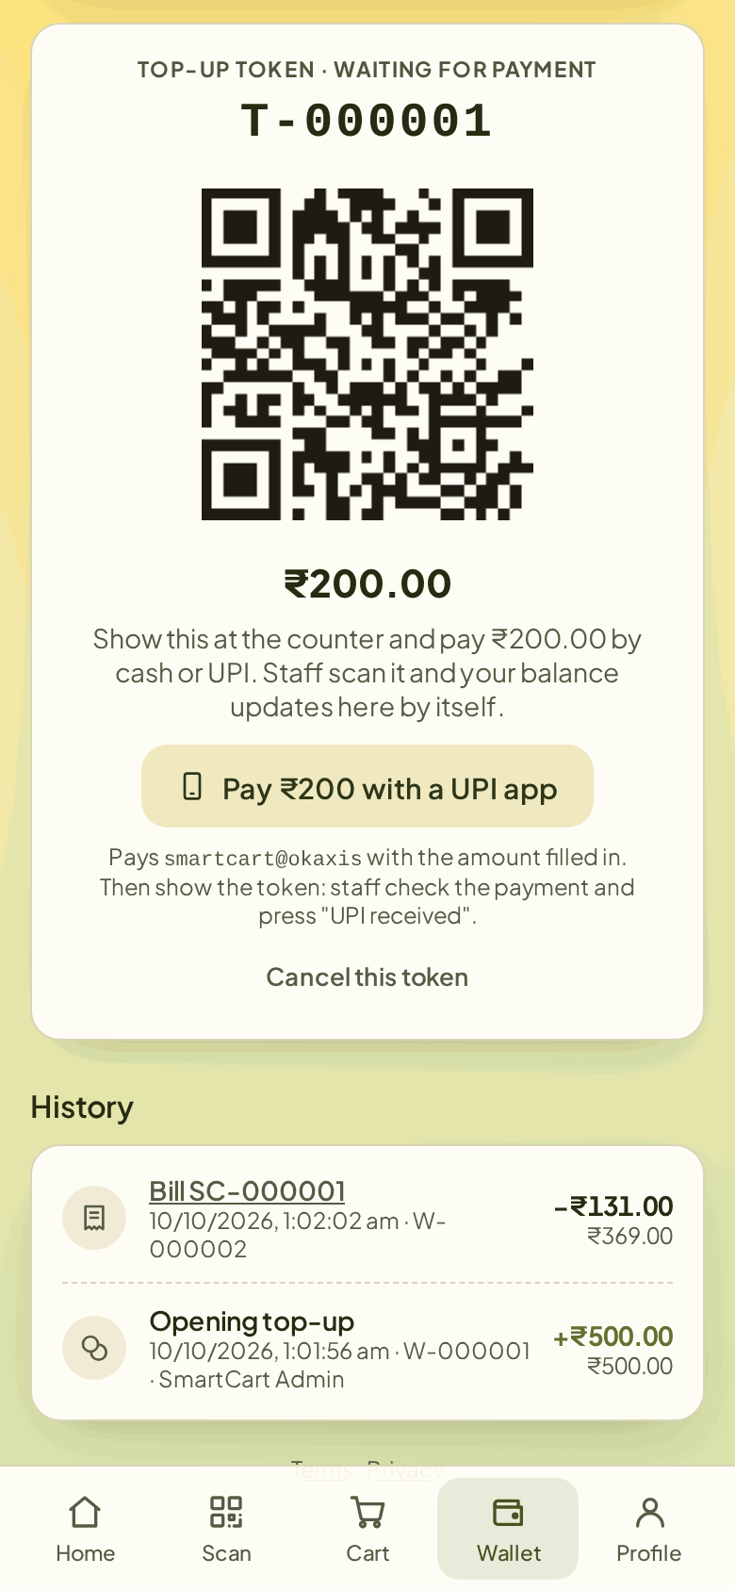
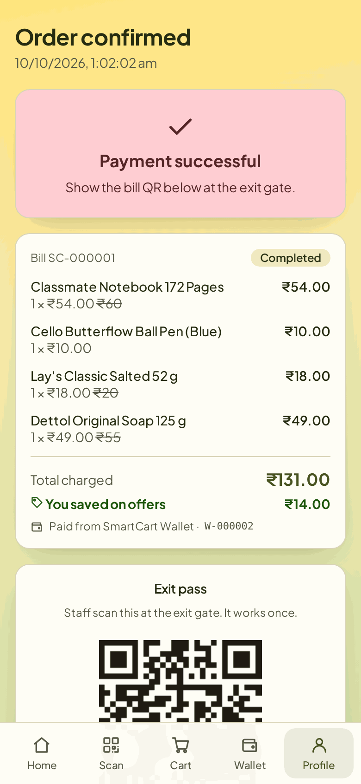
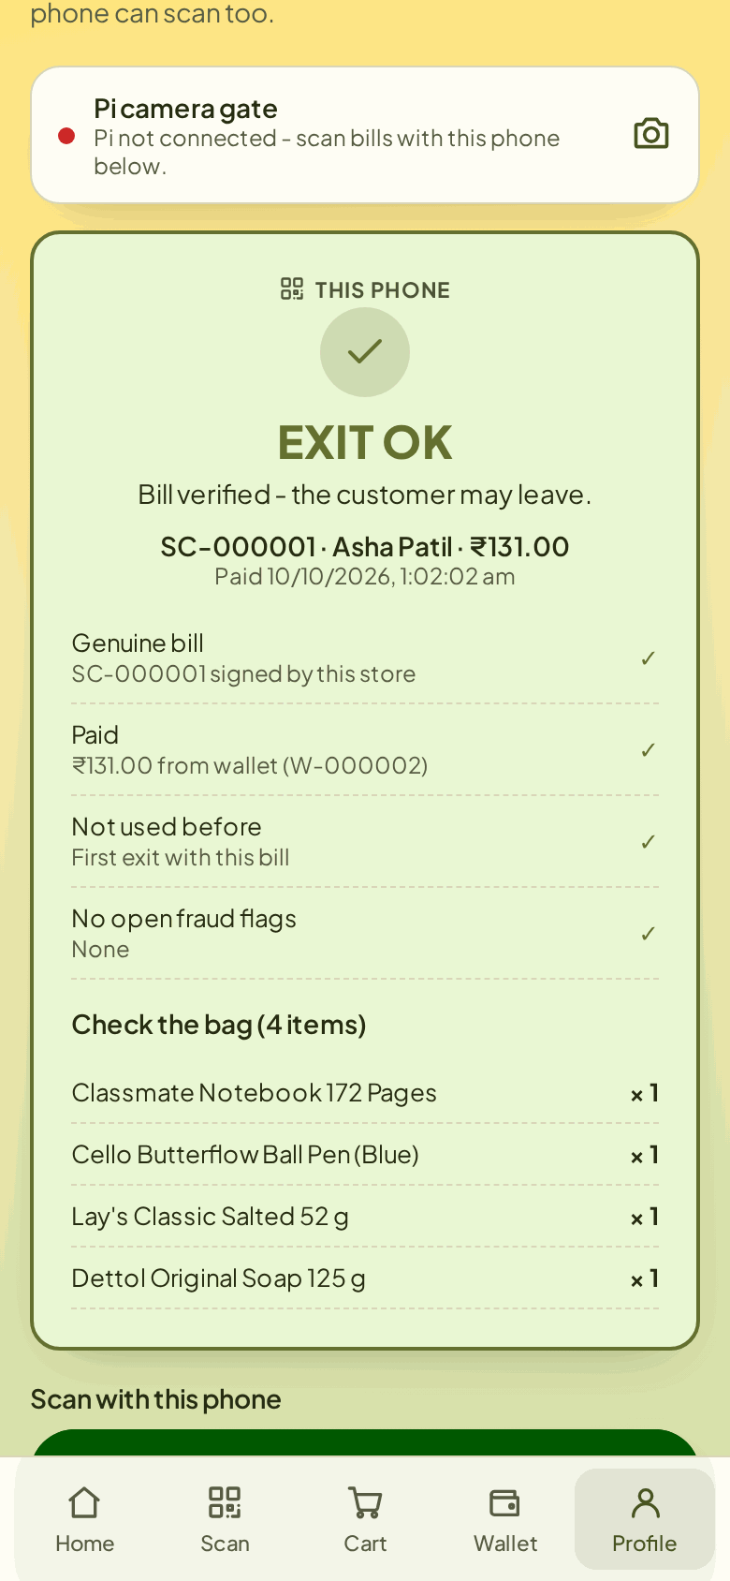
Hardware Results (2/2)
Scan adds the item
Cart + offers
Wallet top-up token
Bill + exit pass
Exit gate: OK
Exit gate and wallet-token reading run on the Pi camera; weight check switched off (HX711 failed)
SIES GST, Nerul
Date:
9

Slide 10
Applications
Neighbourhood general stores and kiranas: shoppers bill themselves, no queue
Supermarkets: scan-and-go lanes without RFID tags on every product
College canteens and campus stores: students pay from a prepaid wallet
Stationery and electronics-parts shops: QR labels for loose items
Pharmacies and small retail chains: signed exit pass replaces bill checking by eye
Events and exhibitions: pop-up stalls run from a phone and one Raspberry Pi
SIES GST, Nerul
Date:
10

Slide 11
Conclusion
Built a working self-checkout: phone scanning, wallet payment and a Pi-camera exit gate
Uses the barcodes already printed on packs: no RFID tags, unlike most IEEE carts
Exit passes are HMAC-signed and work once: screenshots and reused bills are refused
Weight check is built but switched off; no timing or accuracy tests yet
Future scope
Fit a working HX711 and measure accuracy over 100+ trials
Weigh the bag at the exit; direct UPI gateway payment
Lower-cost ESP32 version of the cart electronics
SIES GST, Nerul
Date:
11

Slide 12
References
[1] M. Kumar et al., "Intelligent Shopping Trolley with Automated Billing using Raspberry Pi," Proc. ICSTCEE, 2023, doi: 10.1109/ICSTCEE60504.2023.10585242.
[2] N. Ibrahim et al., "Smart Shopping Cart: A Raspberry Pi-Based System for Reducing Supermarket Checkout Delays," Proc. 3SCEA, 2026, pp. 1100-1109, doi: 10.1109/3SCEA68071.2026.11602934.
[3] M. Shahroz et al., "IoT-Based Smart Shopping Cart Using Radio Frequency Identification," IEEE Access, vol. 8, pp. 68426-68438, 2020, doi: 10.1109/ACCESS.2020.2986681.
[4] R. Nishitha et al., "IoT Based Automatic Billing System Using Barcode Scanner by Android Device and Monitoring Unregistered Barcode by RFID," Proc. RTEICT, 2019, pp. 15-20, doi: 10.1109/RTEICT46194.2019.9016698.
[5] M. H. Walid et al., "The Smart Cart with Automatic Billing and Anti-Theft," Proc. ICEECE, 2026, doi: 10.1109/ICEECE71300.2026.11709931.
[6] SmartCart project source code: github.com/hardikrawat910-byte/smart-billing-cart
SIES GST, Nerul
Date:
12

