Slide 1

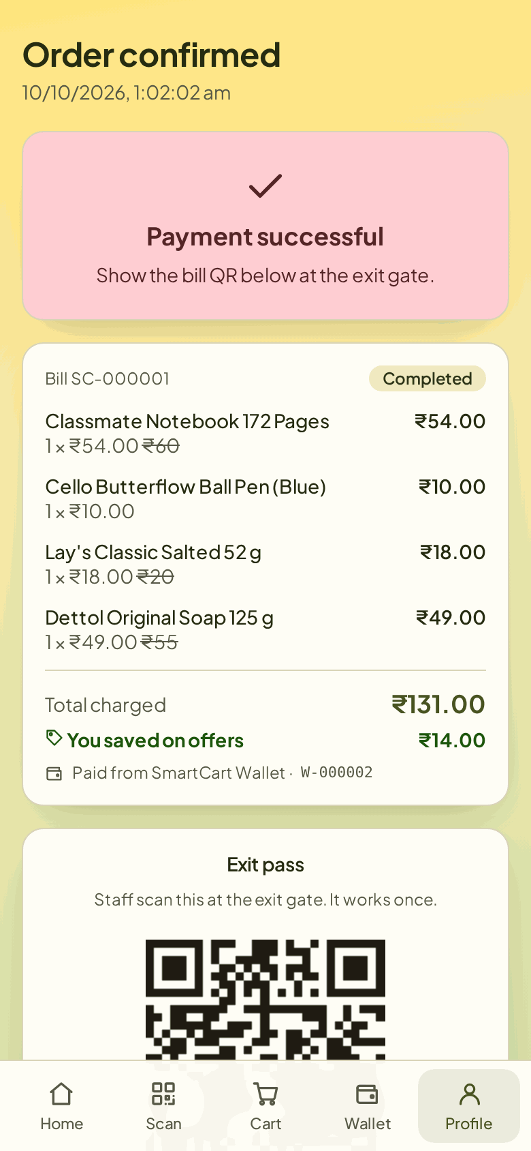
MINI PROJECT · SE EXTC · 2026–27
Smart Billing Cart
Tag-free self-checkout with phone scanning, wallet payment and a camera-verified exit pass
Hardik Hemant Rawat 125A2047
Shivraj Morde 125A2033
Ismail Mohammed 125A2052
Pranav Anand 125A2062
Project Guide & HOD
Dr. Swati Rane
Mini Project Coordinator
Prof. Pratibha Joshi
Department of Electronics and Telecommunication, SIES Graduate School of Technology, Nerul, Navi Mumbai

Slide 2
Billing queues are the slowest part of shopping
01 INTRODUCTION
Need of the project
Objectives
Customers queue at the counter even for two or three items
Manual billing needs a cashier at every till and is open to mistakes
Exit checks are done by eye and can be fooled by a copied bill
Published smart carts need an RFID tag on every product or a screen on every cart
1
Scan the barcode already printed on each pack with the shopper's own phone
2
Pay inside the app from a prepaid SmartCart Wallet topped up by cash or UPI
3
Give every paid bill a signed, one-time exit pass checked by a Raspberry Pi camera
4
Give staff a wallet counter, exit gate and sales dashboard

Slide 3
Five IEEE carts, none with all three of our features
01 INTRODUCTION · LITERATURE SURVEY
Work | Item identification | Payment | Exit / anti-theft | Measured results
Kumar et al., 2023 [1] | QR code, USB camera on cart | Counter or mobile | None | None reported
Ibrahim et al., 2026 [2] | Barcode + YOLO11s on Pi | At cashier | None | Chart only
Shahroz et al., 2020 [3] | RFID tag on every item | Android app | None | None reported
Nishitha et al., 2019 [4] | Barcode on Android phone | OTP, bank or card | RFID gate at exit | Items sent per network type
Walid et al., 2026 [5] | RFID tag on every item | Payment-gateway link | Load-cell weight check | 91.7% anti-theft
SmartCart (ours) | Shopper's phone, existing barcode | In-app wallet | Signed one-time pass, Pi camera | Server tests (slide 10)
Gap: the papers either tag every product, send the shopper to a cashier, or have no exit check.

Slide 4
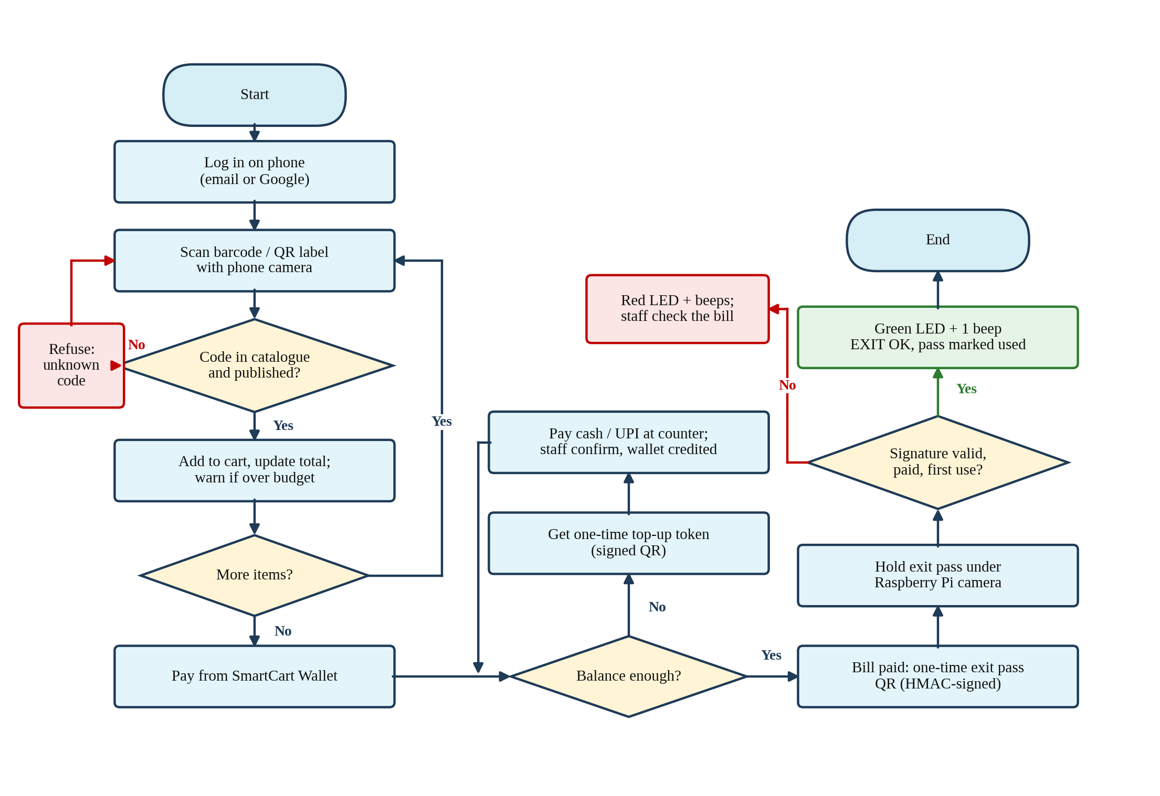
Scan, pay, show the pass, leave
02 WORKING PRINCIPLE
Scan
Phone camera reads EAN/UPC/Code 128 barcodes and QR labels; codes not in the catalogue are refused
Pay
Bill is taken from the SmartCart Wallet; a short balance is refused
Exit pass
Paid bill shows an HMAC-signed, one-time QR
Verify
Pi camera reads it; green LED + beep, or red LED + beeps

Slide 5
Money moves only when staff confirm; a pass works only once
02 WORKING PRINCIPLE · WALLET AND EXIT PASS
Result | Meaning | Pi signal
EXIT OK | Genuine, paid, first use | Green + 1 beep
ALREADY USED | Screenshot or second person | Red + 2 beeps
INVALID | Fake or edited QR | Red + long beep
HOLD | Open flagged scans | Red flashing + 3 beeps
Token read | Opens on staff counter | Green double blink
Signed exit pass
s = HMAC-SHA256(K, order ‖ user)
(first 64 bits)
QR = SCBILL-<order>-<s>
K is the server's secret; the phone and the Pi never see it
Server checks the signature, that the bill is paid, and that it was never used
Top-up tokens (SCTOP-…) are signed the same way and credited exactly once

Slide 6
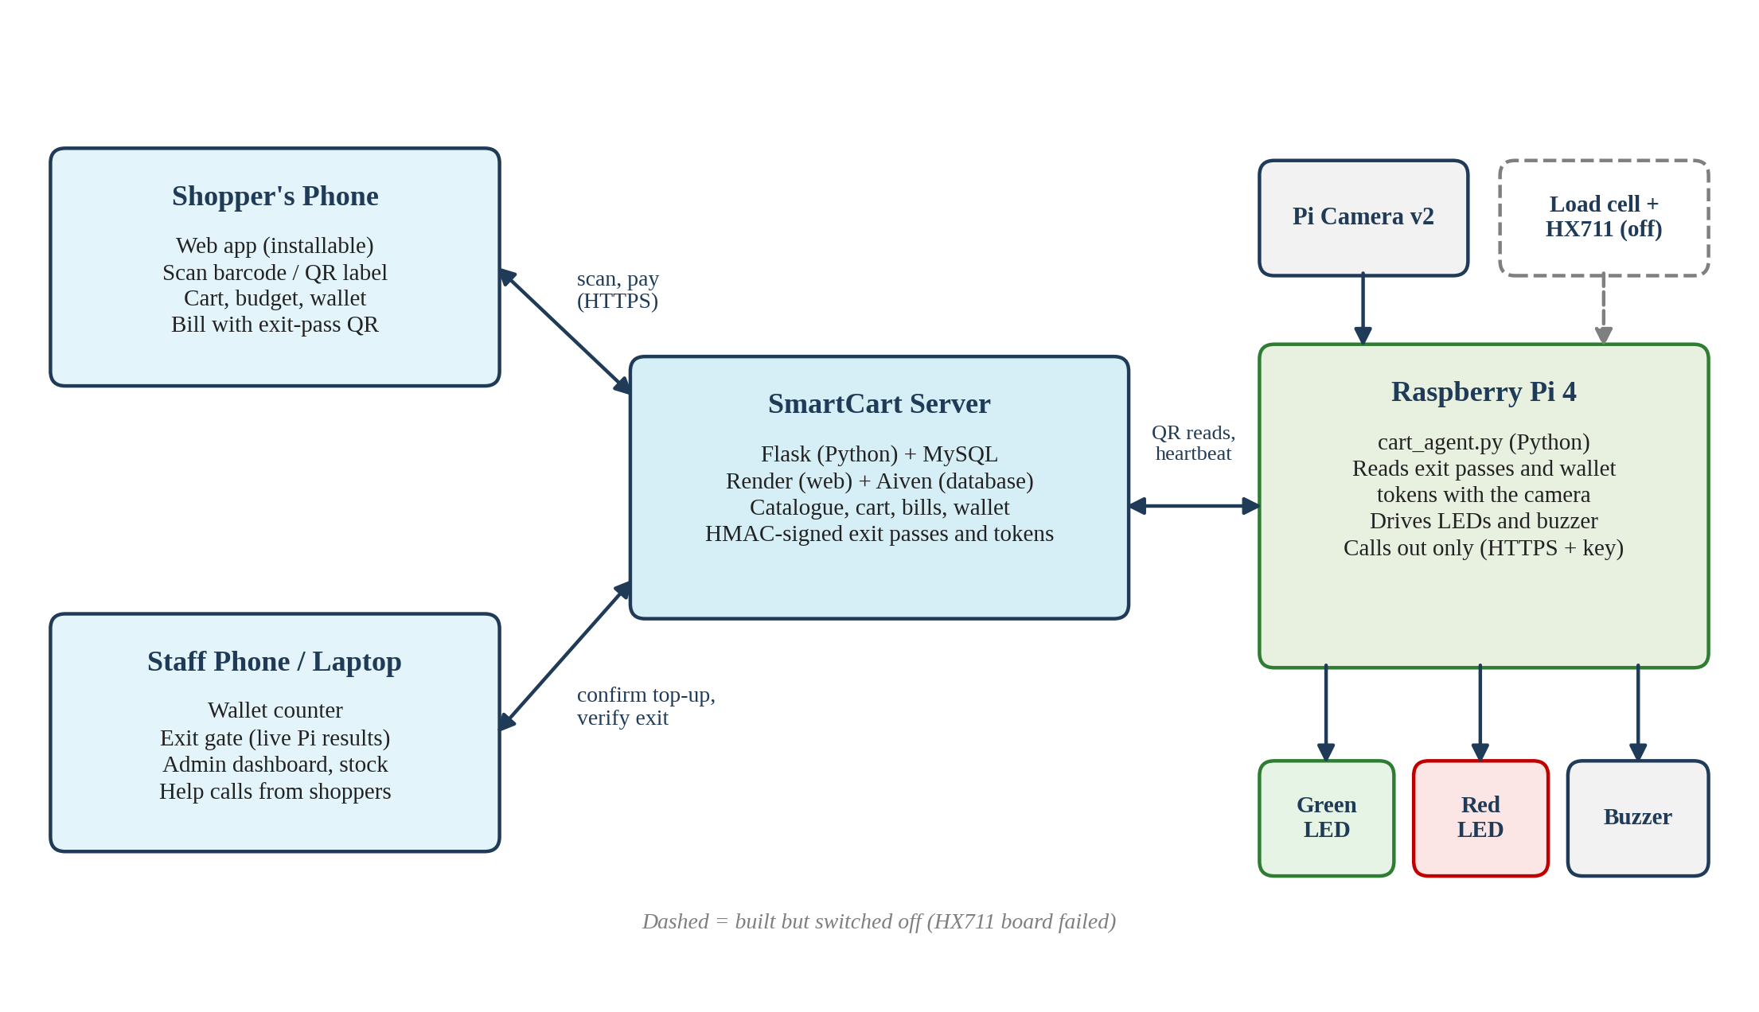
The Pi only calls out; the server decides every check
03 CIRCUIT DESCRIPTION · BLOCK DIAGRAM
Phone, staff devices and the Pi all talk to one Flask + MySQL server over HTTPS. Dashed: load cell and HX711, built but switched off.

Slide 7
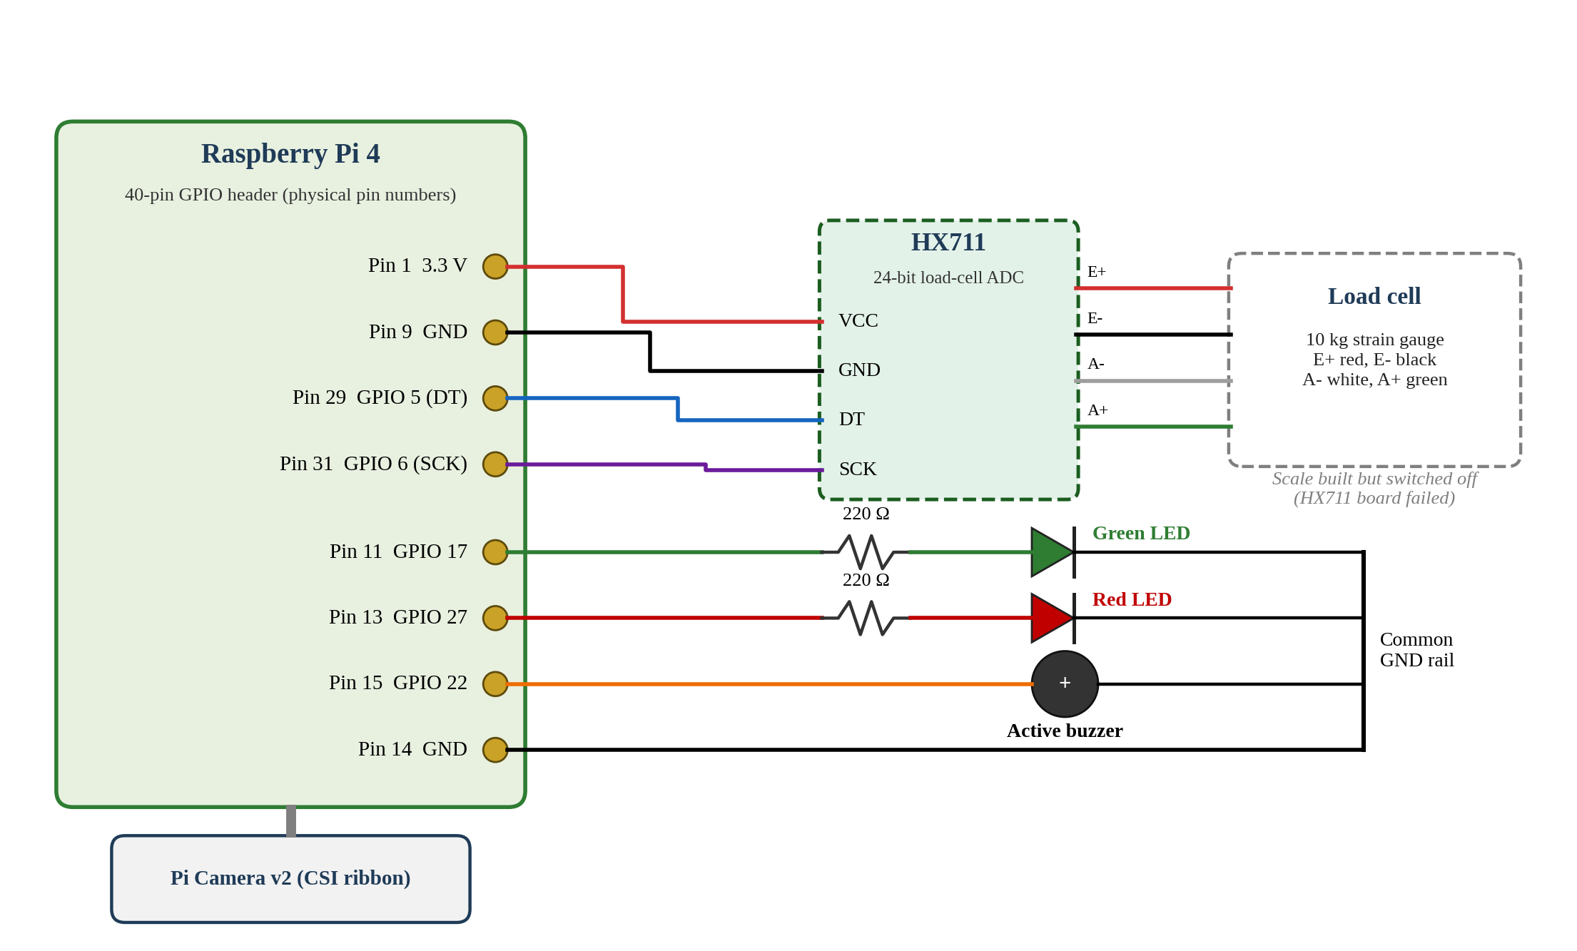
Two LEDs, a buzzer and the HX711 on the Pi's GPIO header
03 CIRCUIT DESCRIPTION · WIRING
Part | Pin | GPIO
HX711 VCC | 1 | 3.3 V
HX711 GND | 9 | GND
HX711 DT | 29 | GPIO 5
HX711 SCK | 31 | GPIO 6
Green LED | 11 | GPIO 17
Red LED | 13 | GPIO 27
Buzzer | 15 | GPIO 22
Common GND | 14 | GND
LEDs through 220 Ω resistors; camera on the CSI ribbon port.

Slide 8
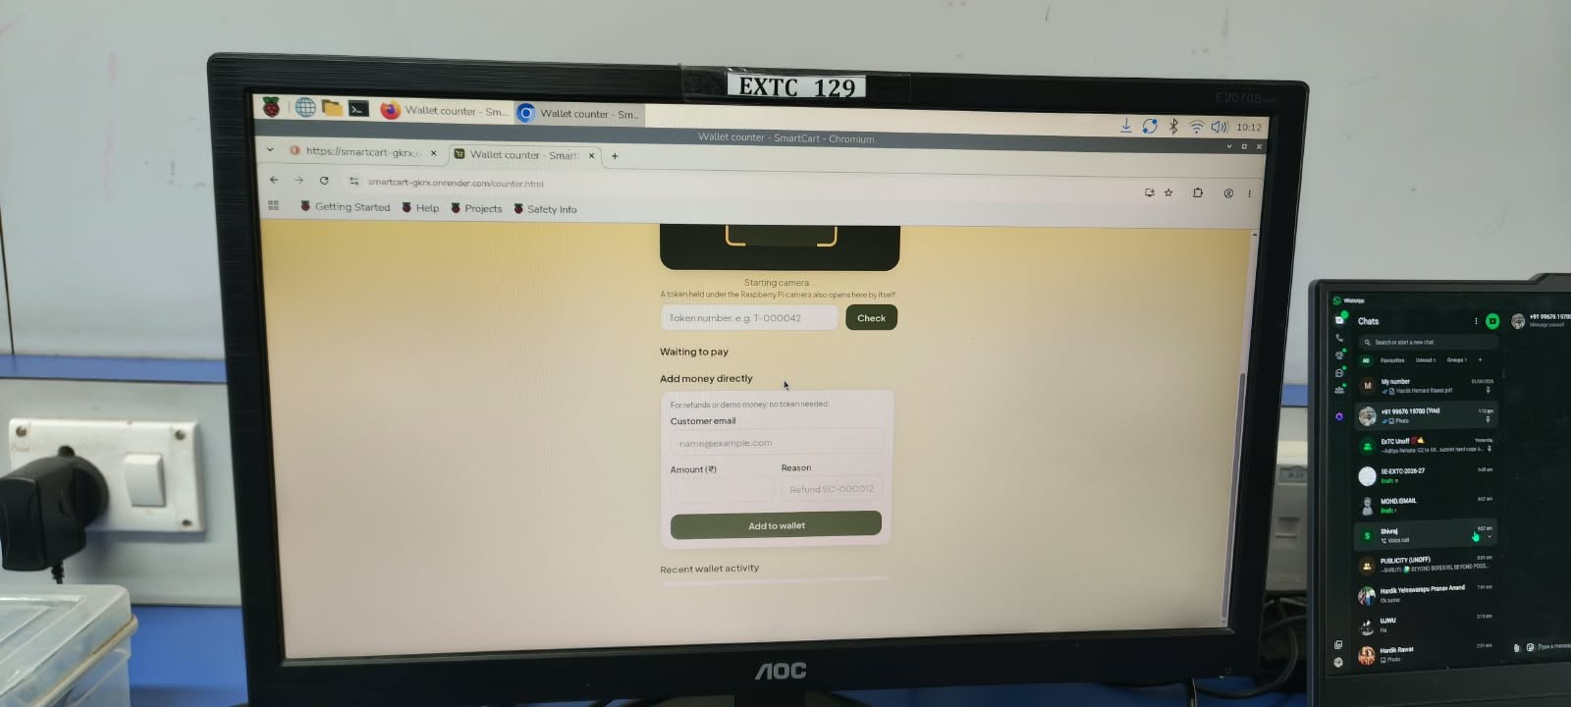
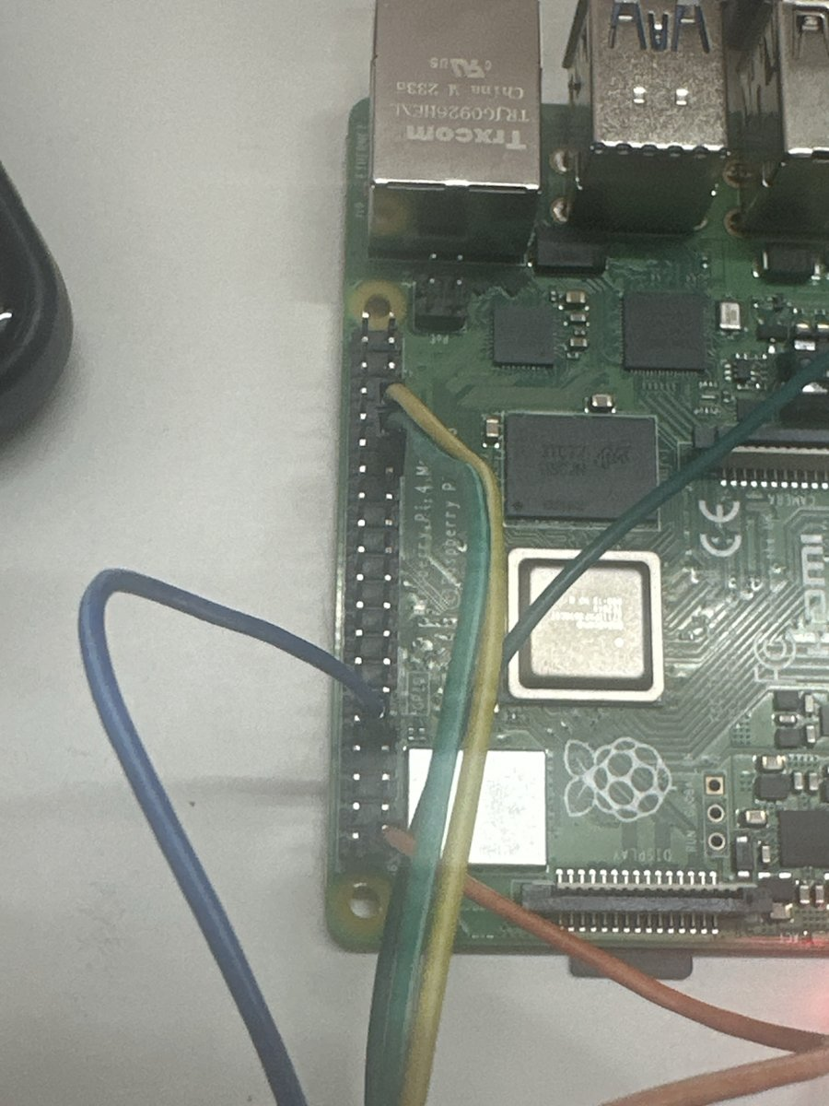
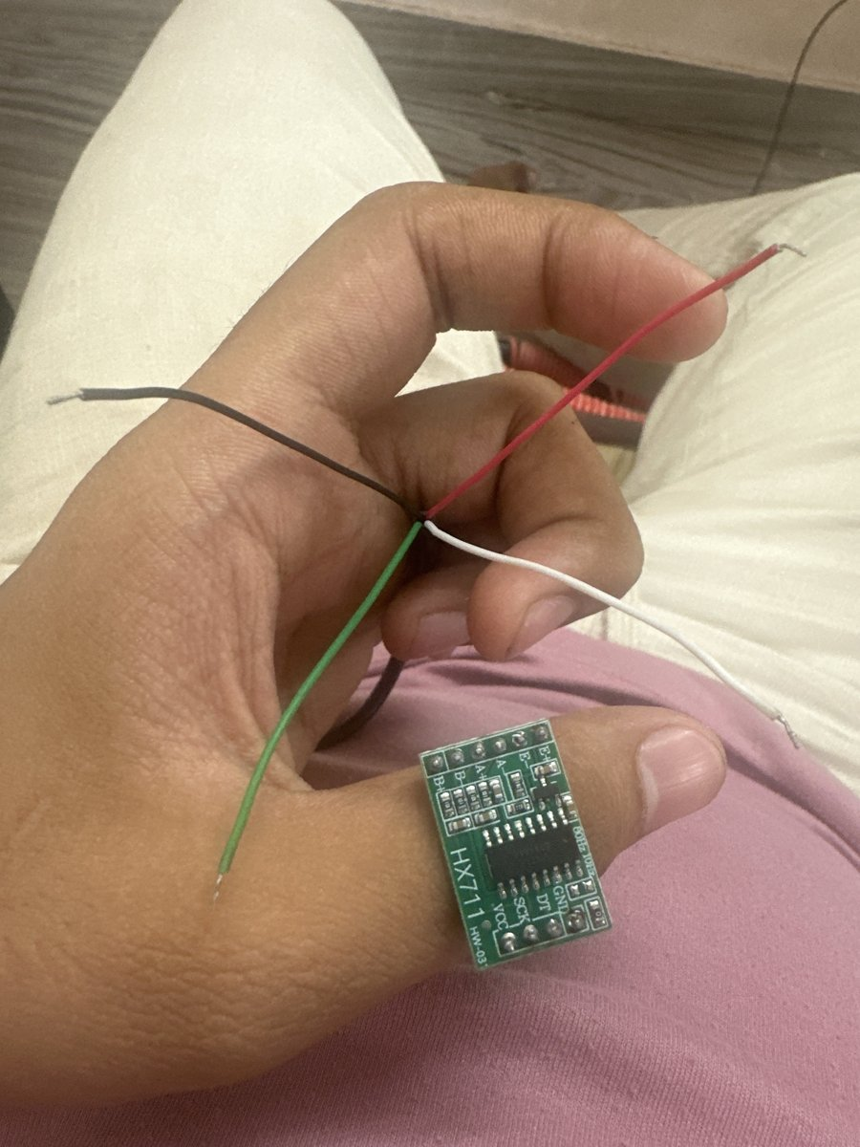
One Raspberry Pi with a camera replaces three ESP32 boards
04 COMPONENT DESCRIPTION
Component | Specification | Role
Raspberry Pi 4 Model B | Quad-core Cortex-A72, Wi-Fi, 40-pin GPIO | Runs the exit-gate program
Pi Camera v2 | 8 MP Sony IMX219, CSI | Reads passes and tokens
Load cell + HX711 | 10 kg bridge, 24-bit ADC | Weight check (switched off)
Green / red LED | 5 mm, 220 Ω resistors | OK / stop signal
Active buzzer | 3.3 V | Audible result
Shopper's phone | Camera + browser | Scanner and wallet
SmartCart wallet counter on the Pi's own display, lab EXTC 129

Slide 9
Three programs, one server holding every secret
05 SOFTWARE DESCRIPTION
Server
Website
Raspberry Pi
Python, Flask, SQLAlchemy
MySQL 8 with row locks
Catalogue cached in memory
Render + Aiven hosting
Plain HTML, CSS, JavaScript
Installs as an app (PWA)
Shopper: shop, scan, cart, wallet
Staff: counter, exit gate, dashboard
cart_agent.py in Python
Picamera2 + pyzbar QR decoding
lgpio for LEDs, buzzer, HX711
Outgoing HTTPS + device key only
Security
HMAC-signed, one-time passes and tokens
Hashed passwords, 15-min lockout
Rate limits per user and address
Content-Security-Policy on every page
No secrets in the code

Slide 10
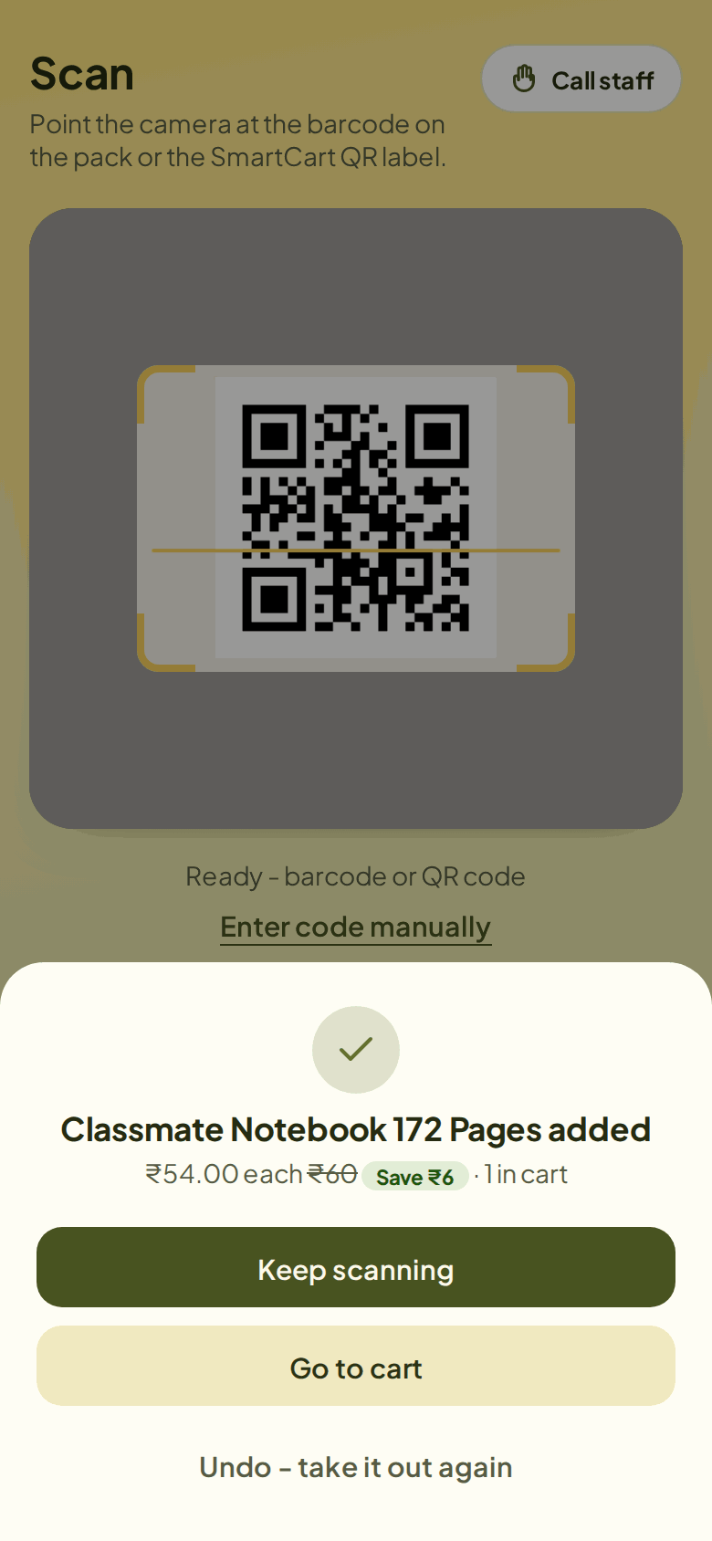
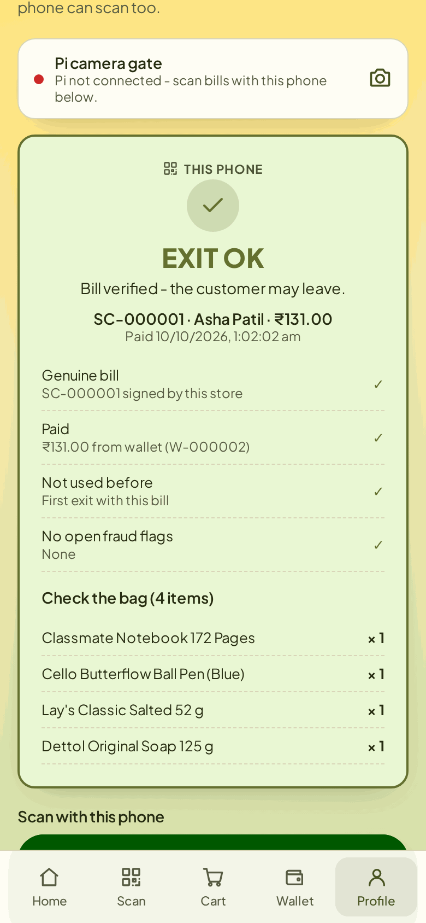
Every forged, edited or reused pass was refused in testing
05 SOFTWARE DESCRIPTION · RESULTS
360 / 360
90 / 90
forged or edited passes refused
second use of a genuine pass refused
300 / 300
50 / 50
unknown or mistyped barcodes refused
edited top-up tokens refused; each credited once
Server processing time (ms) | Median | 95th pct.
Scan an item (n = 300) | 9.8 | 13.3
Checkout from wallet (n = 90) | 19.1 | 25.1
Verify pass via Pi endpoint (n = 90) | 10.2 | 12.9
Scan
Bill + exit pass
Exit gate
Measured in-process on a 2-core test server with MySQL 8, rate limiting off; network and Pi camera time not included.

Slide 11
What we do better than the papers, and where we fall short
06 ADVANTAGES · 07 DISADVANTAGES
Advantages
Disadvantages
No product tags: uses barcodes already printed on packs
Pay in the app: no cashier queue, staff confirm top-ups
Verified exit: signed, one-time pass read by a Pi camera
Low cost: one Pi at the exit, no computer on each cart
Staff tools: counter, exit gate, sales and stock dashboard
Weight check off: HX711 board failed, so unscanned items are not caught
Pass proves payment, not the bag: staff still check the bag by eye
No in-store trial yet: results are server tests, not shoppers
Needs a phone and internet; free hosting wakes in ~30 s
Top-up needs staff: no payment gateway yet

Slide 12
Six steps that close the gaps
08 SCOPE
01
02
03
Fix the scale
In-store trial
Weigh the bag
Fit a working HX711, set a tolerance per product and measure accuracy
Time scan, payment and exit over 100+ real shoppers
Compare the bag's weight with the bill at the exit gate
04
05
06
UPI gateway
Recognise products
ESP32 version
Clear top-ups and bills without staff confirmation
Small YOLO model on the Pi camera, as in [2]
Lower-cost cart electronics for semester 4

Slide 13
Self-checkout without tags or a computer on every cart
09 CONCLUSION
1
Works end to end
Phone scanning, wallet payment and a Pi-camera exit gate, live at smartcart-gkrx.onrender.com
2
Secure by design
Every forged, edited and reused pass was refused in testing; money moves only after staff confirm
3
Honest gap
The weight check is off and there is no in-store trial yet: both are the next steps

Slide 14
References
10 REFERENCES
[1] M. Kumar et al., “Intelligent Shopping Trolley with Automated Billing using Raspberry Pi,” Proc. ICSTCEE, 2023, doi: 10.1109/ICSTCEE60504.2023.10585242.
[2] N. Ibrahim et al., “Smart Shopping Cart: A Raspberry Pi-Based System for Reducing Supermarket Checkout Delays,” Proc. 3SCEA, 2026, pp. 1100–1109, doi: 10.1109/3SCEA68071.2026.11602934.
[3] M. Shahroz et al., “IoT-Based Smart Shopping Cart Using Radio Frequency Identification,” IEEE Access, vol. 8, pp. 68426–68438, 2020, doi: 10.1109/ACCESS.2020.2986681.
[4] R. Nishitha et al., “IoT Based Automatic Billing System Using Barcode Scanner by Android Device and Monitoring Unregistered Barcode by RFID,” Proc. RTEICT, 2019, pp. 15–20, doi: 10.1109/RTEICT46194.2019.9016698.
[5] M. H. Walid et al., “The Smart Cart with Automatic Billing and Anti-Theft,” Proc. ICEECE, 2026, doi: 10.1109/ICEECE71300.2026.11709931.
[6] H. Krawczyk, M. Bellare and R. Canetti, “HMAC: Keyed-Hashing for Message Authentication,” RFC 2104, IETF, 1997.
Project code and live demo: github.com/hardikrawat910-byte/smart-billing-cart · smartcart-gkrx.onrender.com

