Slide 1

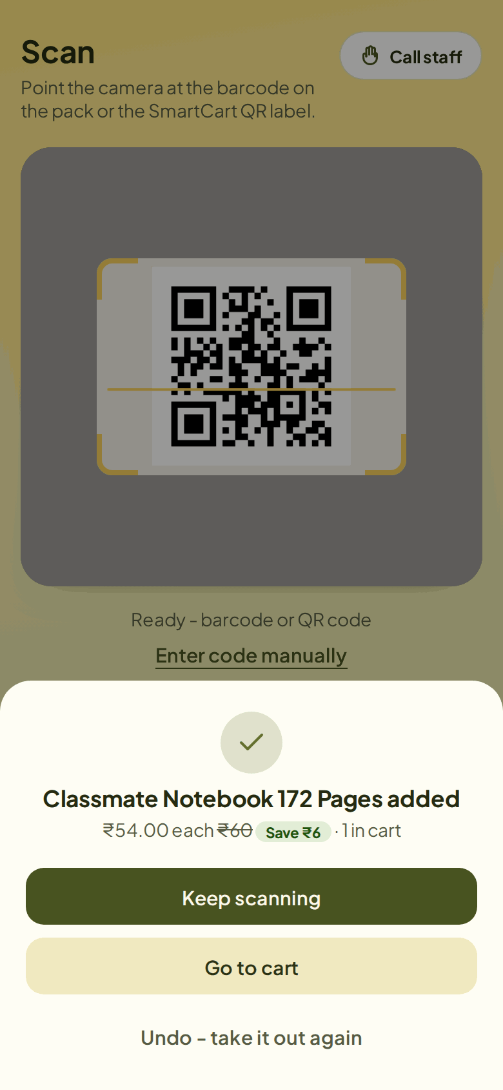
SKILL LAB · PYTHON PROJECT · SE EXTC 2026–27
Smart Billing Cart
A self-checkout system written in Python: a Flask web server for shoppers and staff, and a Raspberry Pi program that checks bills at the exit
Hardik Hemant Rawat 125A2047
Shivraj Morde 125A2033
Ismail Mohammed 125A2052
Pranav Anand 125A2062
Guide
Dr. Swati Rane
Department of Electronics and Telecommunication, SIES Graduate School of Technology, Nerul, Navi Mumbai

Slide 2
Billing queues are the slowest part of shopping
01 PROBLEM
The problem
What our Python project does
Customers queue at the counter even for two or three items
Every till needs a cashier, and manual billing has mistakes
Exit checks are done by eye and can be fooled by a copied bill
1
Shopper scans the barcode on each pack with their phone
2
Pays from an in-app SmartCart Wallet
3
Gets a signed, one-time exit pass (QR code)
4
A Raspberry Pi camera checks the pass at the exit

Slide 3
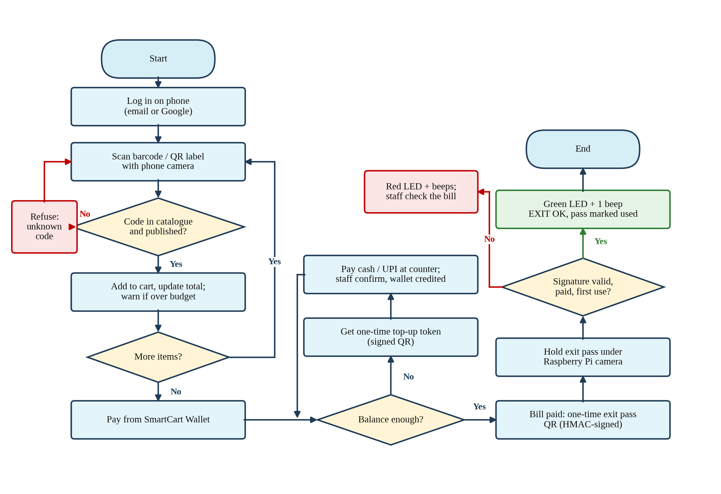
Scan, pay, show the pass, leave
02 HOW IT WORKS
Scan
Phone camera reads the barcode; codes not in the catalogue are refused
Pay
Bill is taken from the wallet; a short balance is refused
Exit pass
Paid bill shows an HMAC-signed, one-time QR
Verify
Pi camera reads it: green LED + beep, or red LED + beeps

Slide 4
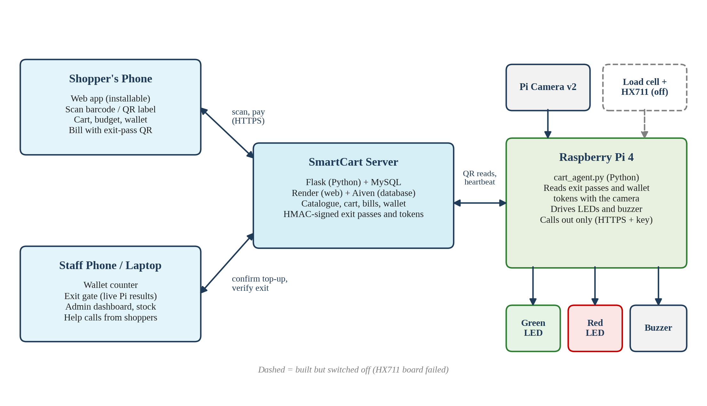
Two Python programs talk over HTTPS
03 SYSTEM ARCHITECTURE
The server (Flask) and the Pi program (cart_agent.py) are both Python; the phone only runs the web pages the server sends. Dashed: scale built but switched off.

Slide 5
Well-known Python libraries do the heavy lifting
04 PYTHON LIBRARIES
Server (backend/)
Raspberry Pi (pi/cart_agent.py)
Library | Used for
Flask 3.1 | Web server, pages and JSON API
Flask-SQLAlchemy / SQLAlchemy 2.1 | Database models (ORM)
PyMySQL | Connects to MySQL 8
Flask-JWT-Extended | Login tokens
hmac + hashlib | Signs exit passes and tokens
Pillow | Shrinks product photos
Gunicorn | Production server on Render
Library | Used for
Picamera2 | Captures frames from Pi Camera v2
pyzbar | Decodes QR codes
lgpio | Drives LEDs, buzzer, HX711
urllib.request | HTTPS calls to the server
threading | Lights and camera run side by side
configparser | Reads cart_agent.ini settings

Slide 6
About 4,900 lines of Python in two programs
05 CODE STRUCTURE
File | Lines | What it does
backend/app.py | 130 | Starts Flask, registers routes, security headers
backend/models.py | 496 | 14 database tables as SQLAlchemy classes
backend/routes/ (11 files) | 1,912 | API: auth, scan, cart, orders, wallet, exit gate, admin…
backend/services.py | 349 | HMAC signing, barcode helpers, shared checks
backend/security.py | 173 | Rate limits, Content-Security-Policy
backend/cache.py | 195 | Keeps the catalogue in memory
backend/seed.py | 300 | Creates tables and 48 store products
pi/cart_agent.py | 1,113 | Pi program: 12 classes (camera, QR, lights, scale, server)

Slide 7
14 tables, defined as Python classes
06 DATABASE
Shop
Cart and orders
Wallet
Hardware and safety
User
Product
ProductImage
Setting
CartItem
Order
OrderItem
ShoppingListItem
WalletTransaction
TopupRequest
HardwareReading
FlaggedTransaction
CartAlert
HelpRequest
Money changes only inside a database row lock, and every change is logged with the balance after it
Prices are always read from the Product table, never taken from the phone

Slide 8
Ten lines of Python sign every bill
07 KEY CODE · SIGNED EXIT PASS
Secret key
backend/services.py
Only the server knows it; the phone and the Pi never see it
def _bill_signature(order):
message = f"smartcart-bill:{order.id}:{order.user_id}".encode()
key = current_app.config["JWT_SECRET_KEY"].encode()
return hmac.new(key, message, hashlib.sha256).hexdigest()[:16]
def bill_code(order):
return f"SCBILL-{order.id}-{_bill_signature(order)}"
def bill_signature_ok(order, signature):
return hmac.compare_digest(_bill_signature(order), signature)
64-bit signature
Changing one character of the QR makes it invalid
Safe comparison
compare_digest takes the same time whether the guess is close or not
One use only
The order records its first exit, so a reused bill is refused

Slide 9
The Pi reads a QR, asks the server, and lights up
07 KEY CODE · RASPBERRY PI PROGRAM
Main classes
pi/cart_agent.py (main loop, shortened)
codes = self.qr.decode(self.camera.gray_frame()) # pyzbar
for code in codes:
if not code.upper().startswith(("SCBILL-", "SCTOP-")):
continue # not a bill or a token
status, payload = self.server.check_bill(code)
result = payload.get("result") # ok/used/invalid
self.lights.show(result) # LEDs + buzzer
PiCamera frames from Pi Camera v2
QrReader pyzbar decoding
Server HTTPS + device key
Lights LED and beep patterns (own thread)
HX711, Scale load-cell reading
Agent ties it all together
Starts by itself at power-on (systemd) and sends a heartbeat every 30 s so staff see it online.

Slide 10
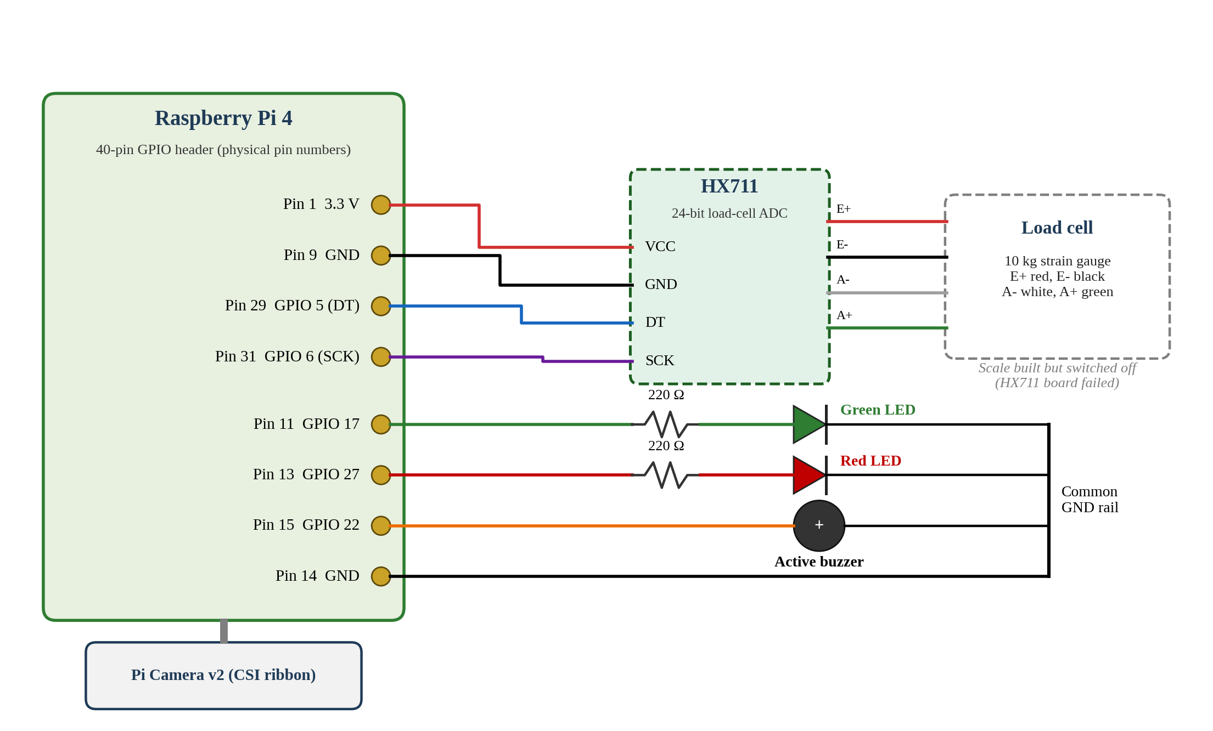
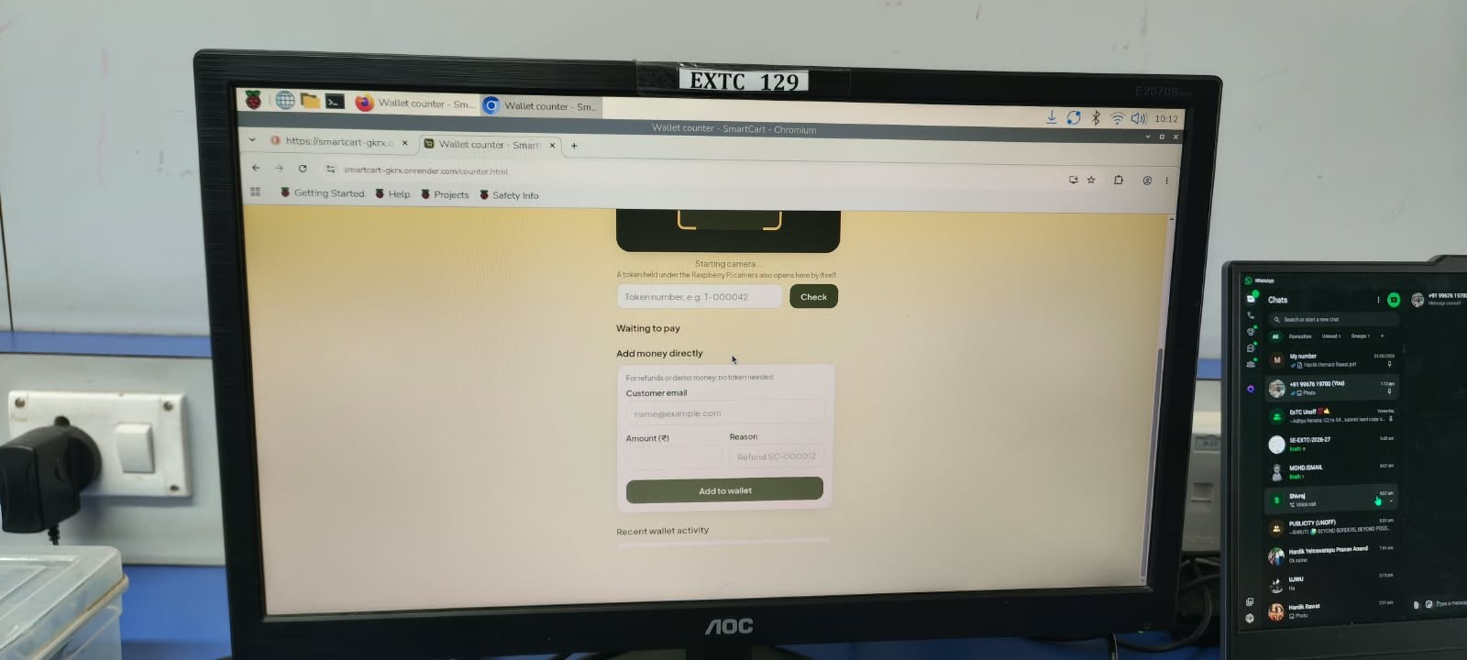
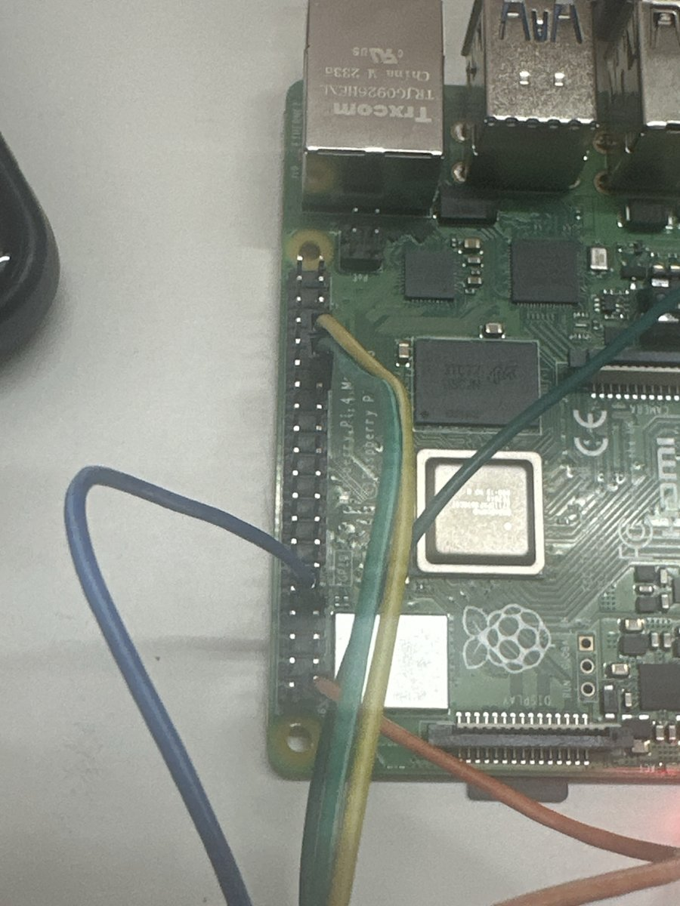
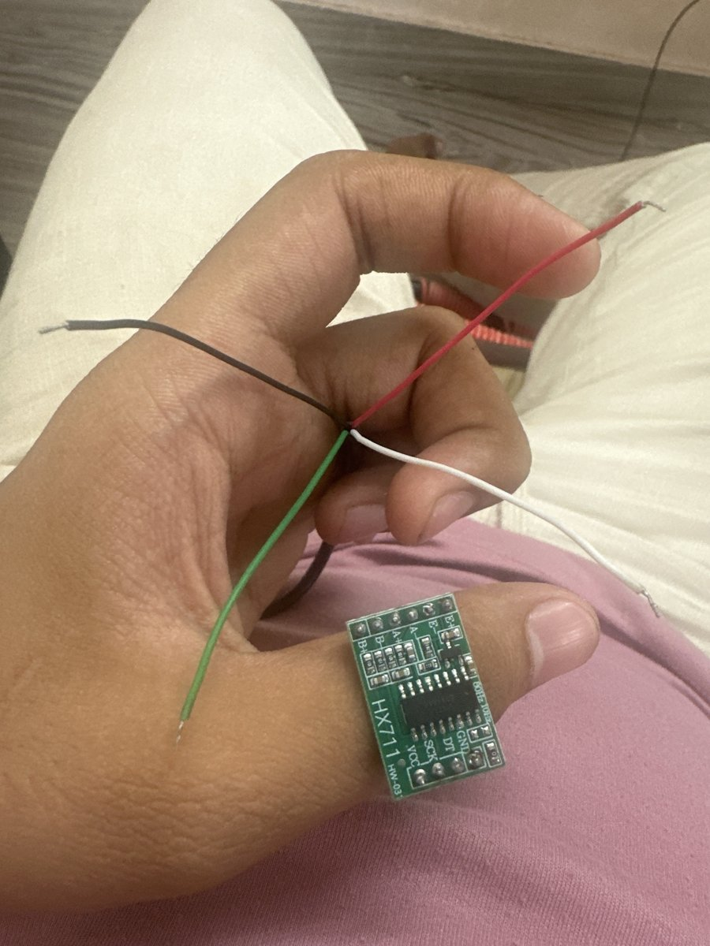
Raspberry Pi 4, Pi Camera v2, two LEDs and a buzzer
08 HARDWARE
Our software running on the Pi's own display, lab EXTC 129

Slide 11
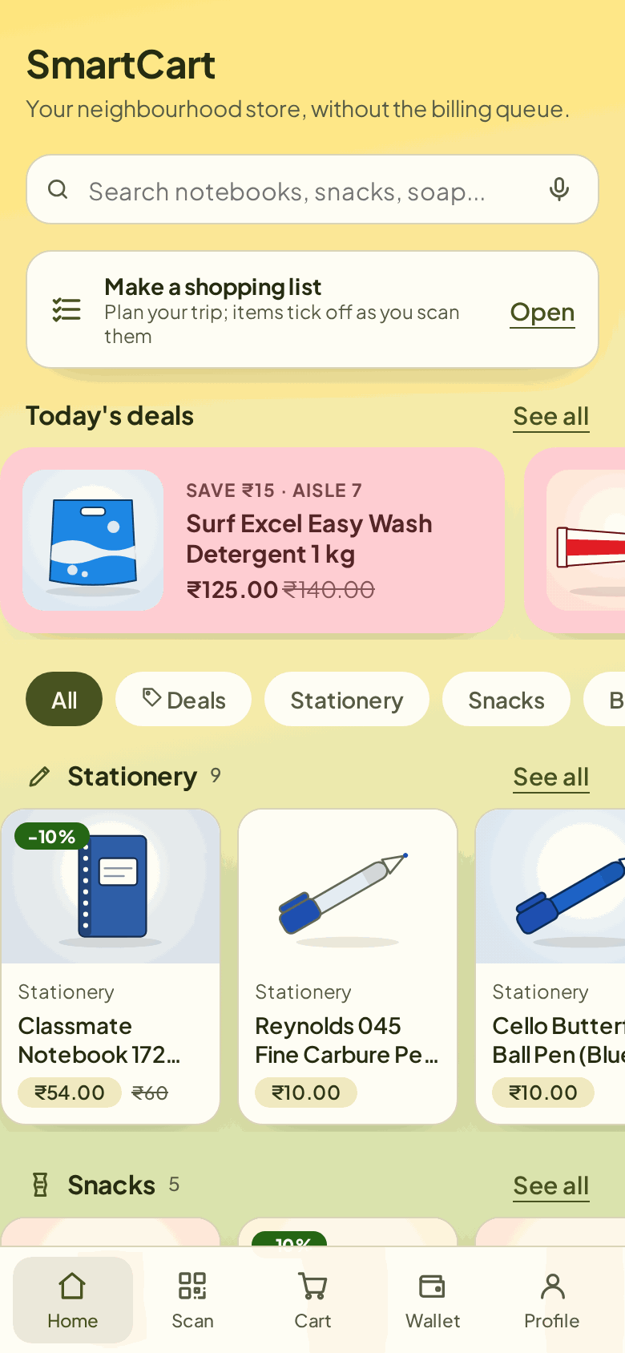
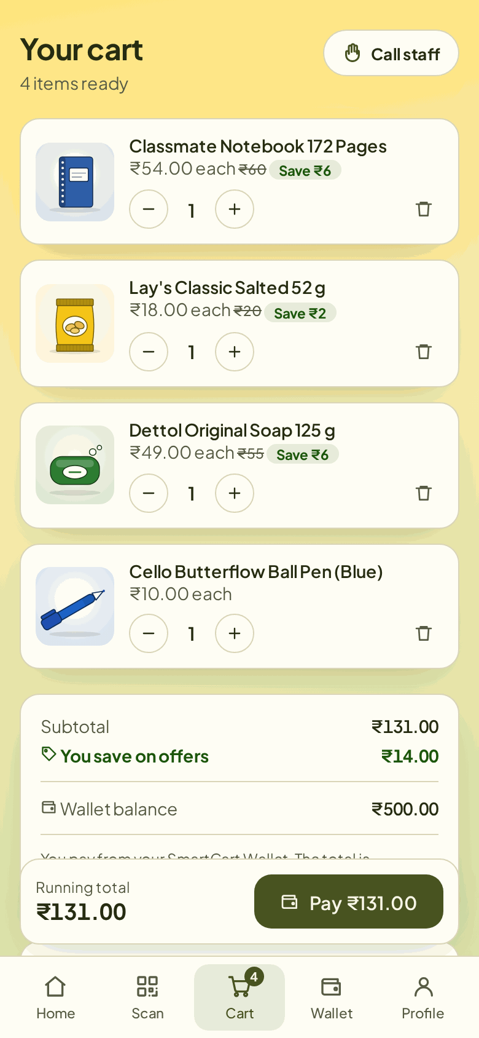
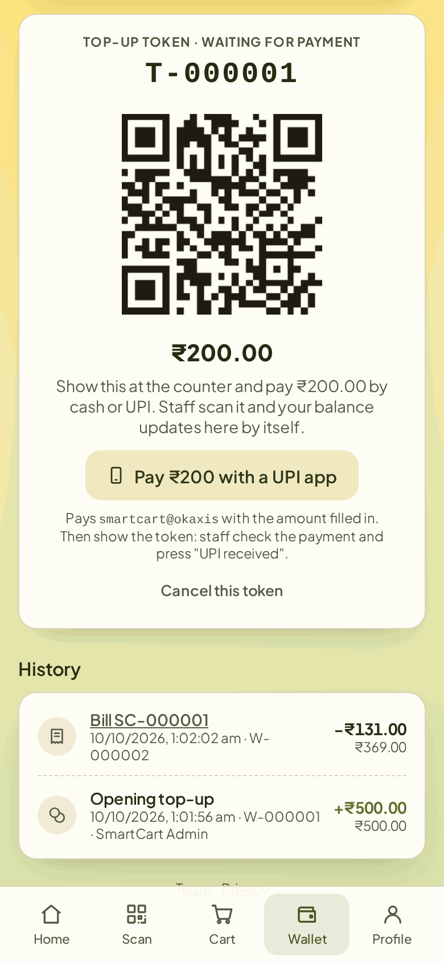
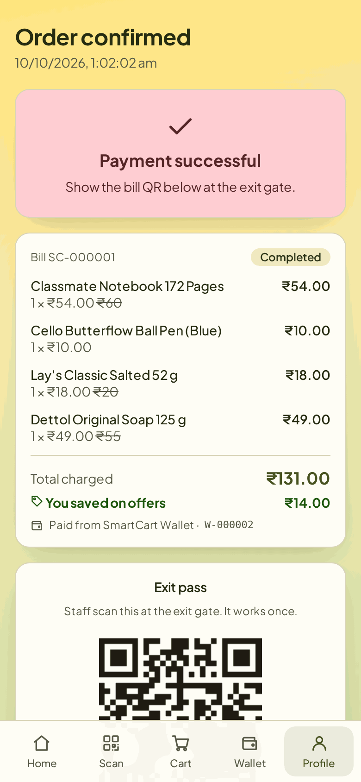
From scan to exit on the shopper's phone
09 WORKING SOFTWARE · SHOPPER
Shop
Scan
Cart + offers
Wallet top-up
Bill + exit pass

Slide 12
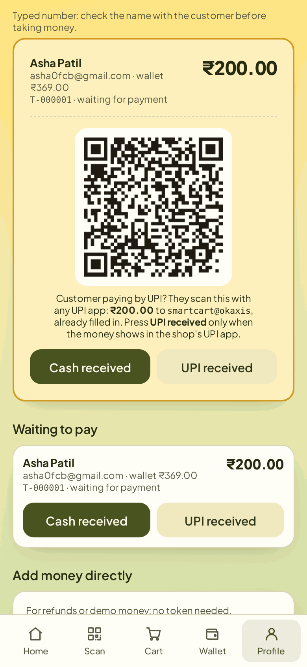
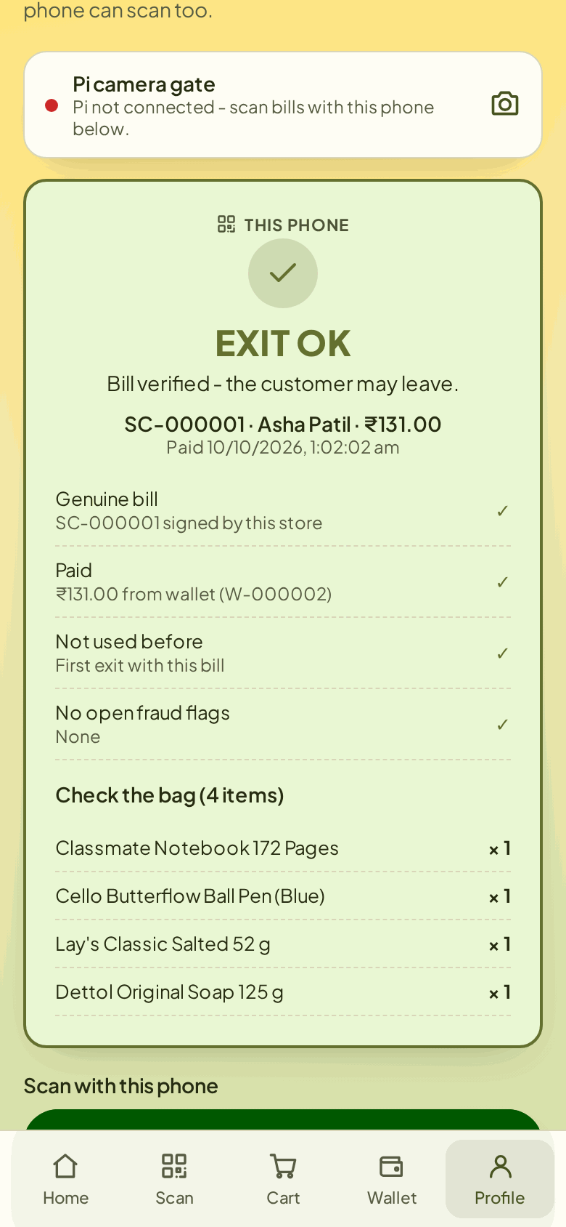
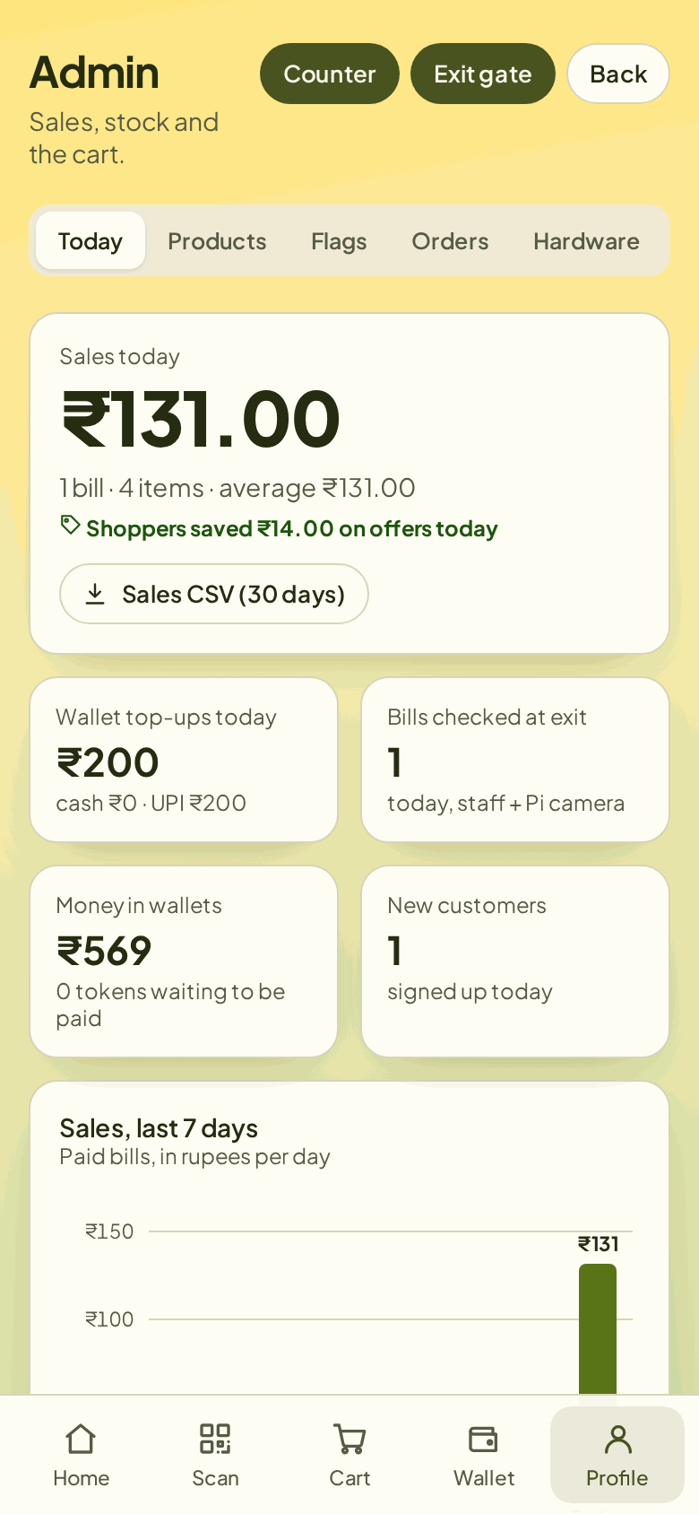
Staff confirm payments and watch the exit gate
09 WORKING SOFTWARE · STAFF
Wallet counter
Exit gate: OK
Admin dashboard

Slide 13
Every forged, edited or reused pass was refused
10 TESTING
19 Python test scripts drive the real server with Flask's test client
They create shoppers, scan, pay, and attack the exit gate with fake passes
Run before every release; the v2.9.0 suites passed 52 of 52 checks
360 / 360
90 / 90
forged or edited exit passes refused
second use of a genuine pass refused
Server time (ms) | Median | 95th pct.
Scan an item (n = 300) | 9.8 | 13.3
Checkout from wallet (n = 90) | 19.1 | 25.1
Verify exit pass (n = 90) | 10.2 | 12.9
300 / 300
50 / 50
unknown or mistyped codes refused
edited top-up tokens refused
Measured on a 2-core test server with MySQL 8; network and camera time not included.

Slide 14
What went wrong, what we learned, what is next
11 CHALLENGES AND CONCLUSION
Challenges
What we learned
Next steps
HX711 board never answered, so the weight check is switched off
College asked for a Raspberry Pi: rewrote the ESP32 design in a day
Camera scanning broke in Firefox and on the Pi's browser; fixed in v2.8.5
Flask blueprints keep a large API organised
HMAC signing makes QR codes safe to show on a phone
Automated Python tests catch bugs before a demo
Replace the HX711 and turn the weight check back on
Time the full scan-to-exit flow on the Pi
Port the cart electronics to ESP32 (semester 4)
Live demo: smartcart-gkrx.onrender.com · Code: github.com/hardikrawat910-byte/smart-billing-cart

