Slide 1
E-Banking Security
By-
Namrata Devadiga 1311077
Hardik Jain 1311087
Harshad Kothari 1311094
TE Computers
Mentor: Prof. Smita Sankhe
Group: C43

Slide 2
1.
INTRODUCTION

Slide 3
Growth of e-banking
Rise in frauds
Integrative abuses of resources
Hacking of data eg. Credit card details

Slide 4
2.
EXISTING SYSTEM

Slide 5
Enter credit card details directly
Data is encrypted and sent to the server
OTP generation
Master password
Fails to prevent hacking of credit card details

Slide 6
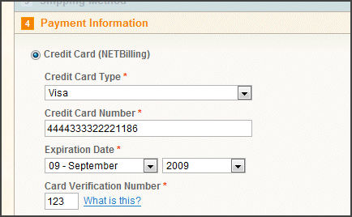
Existing payment module

Slide 7
3.
PROPOSED SYSTEM

Slide 8
Cryptography for data and image encoding.
Steganography
Android application for data and image encryption
Data Mining w.r.t. Spending behaviour of the card holder
Location verification

Slide 9
4.
SCOPE

Slide 10
Fraud prevention and detection using cryptography, steganography and behaviour mining techniques.
The system is divided into 3 modules as follows:

Slide 11
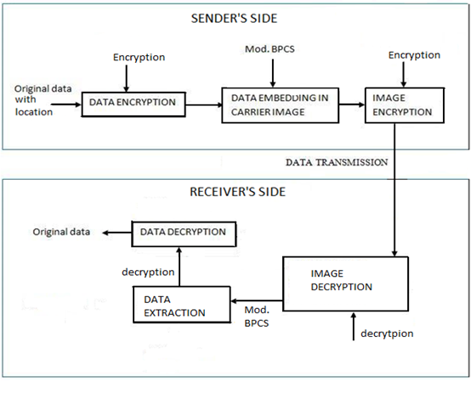
Step 1: Data and image encryption/decryption

Slide 12
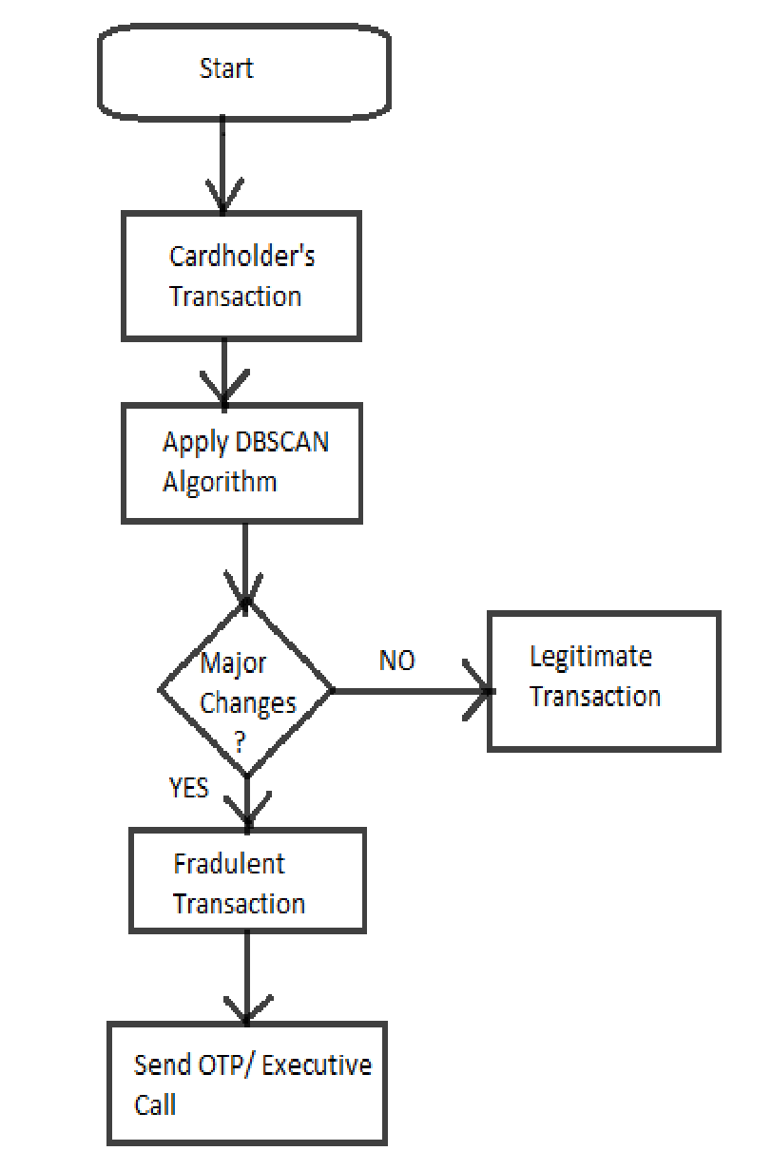
Step 2: Data Mining
using DBSCAN

Slide 13
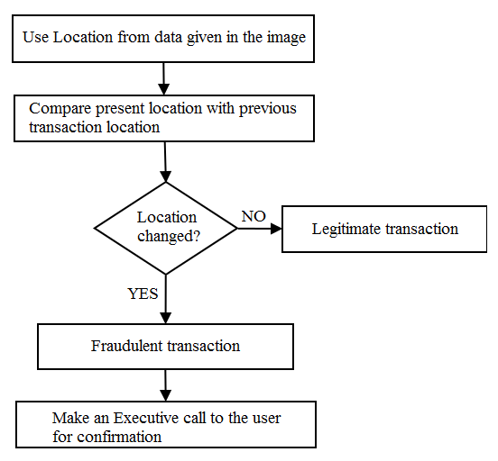
Step 3: Location Verification

Slide 14
5.
HARDWARE REQUIREMENT

Slide 15
Server m/c
i3 processor (4th generation)
50GB hard disk
1GB RAM
Working Internet connection
User device
1GB RAM
Dual Core processor
GPS enabled
Net connectivity

Slide 16
6.
SOFTWARE REQUIREMENT

Slide 17
Server machine
Windows 7
Android Software Development Kit (SDK)
SQL/Oracle Server
SMS gateway
User device
Android v4.1 and above

Slide 18
7.
USE CASE

Slide 19
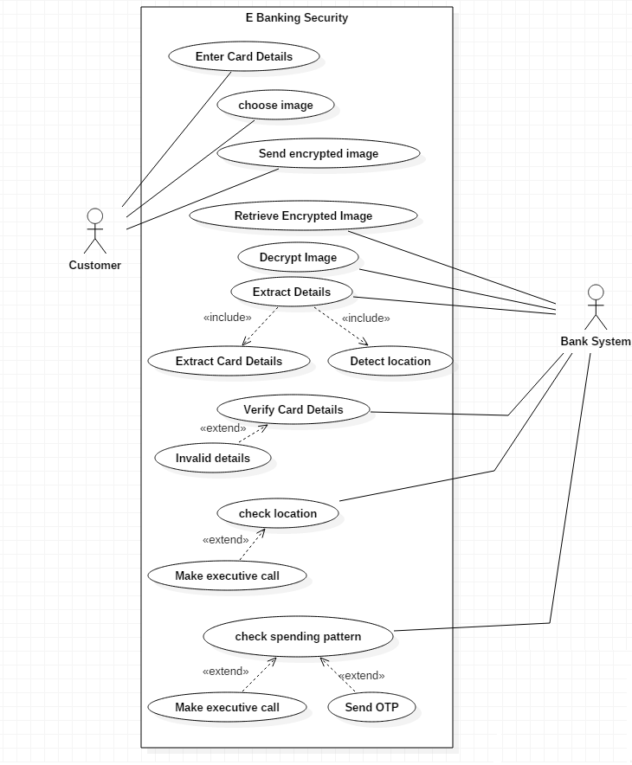

Slide 20
8.
CLASS DIAGRAM

Slide 21
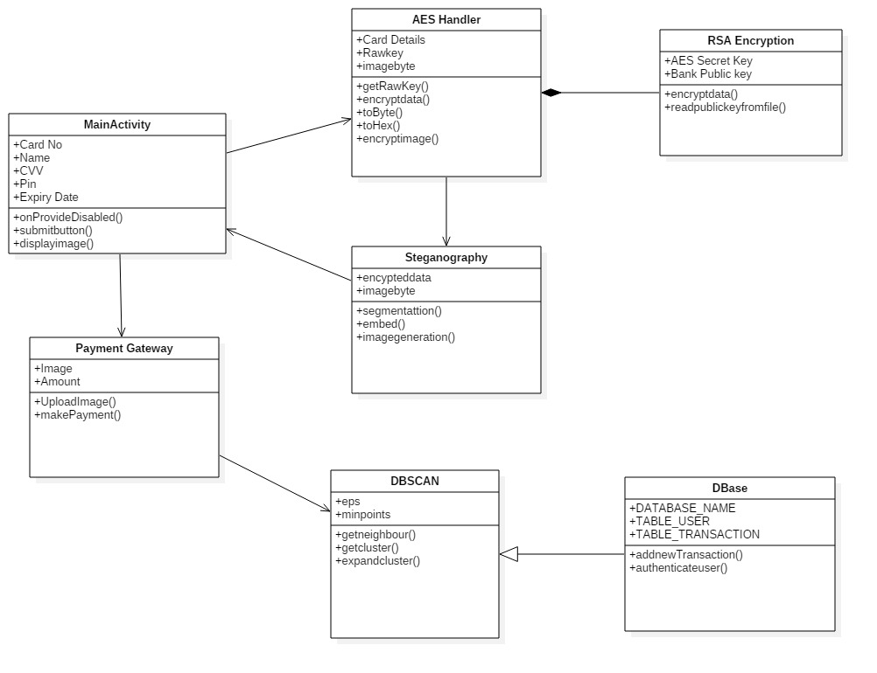

Slide 22
9.
ER DIAGRAM

Slide 23
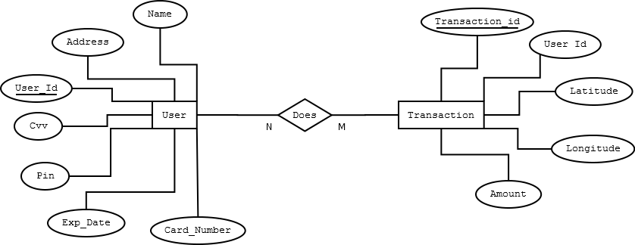

Slide 24
10.
DFD DIAGRAM

Slide 25
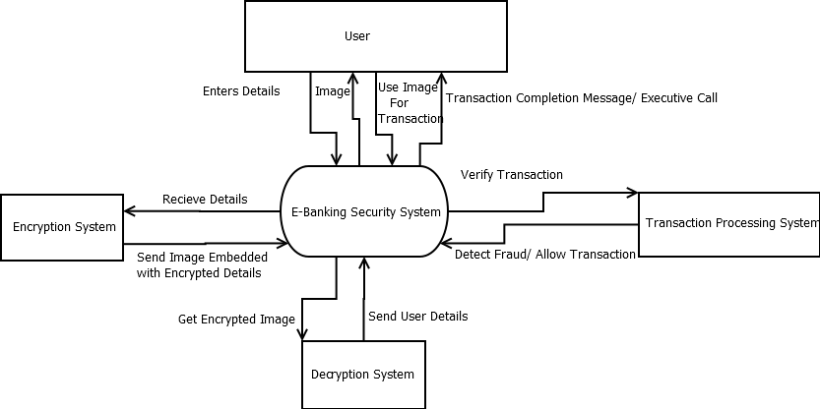

Slide 26
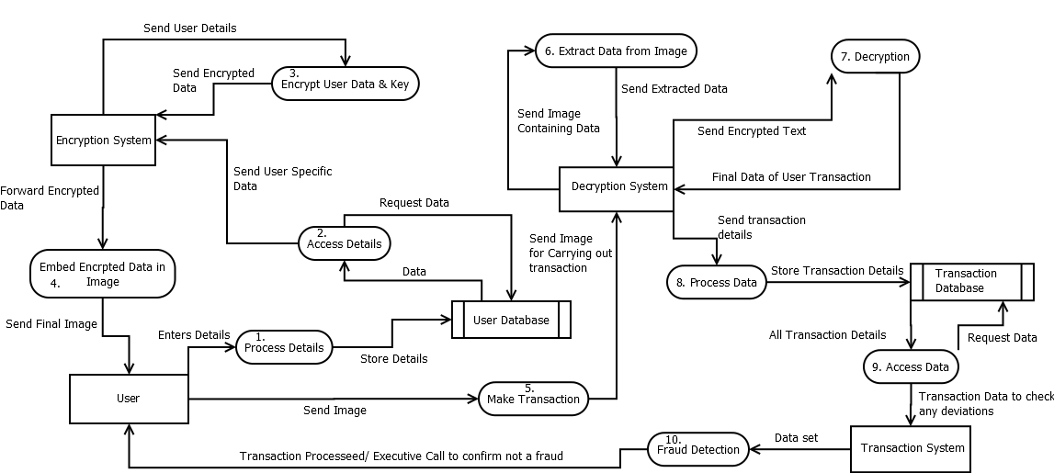

Slide 27
11.
ALGORITHMS

Slide 28
11.1 AES

Slide 29
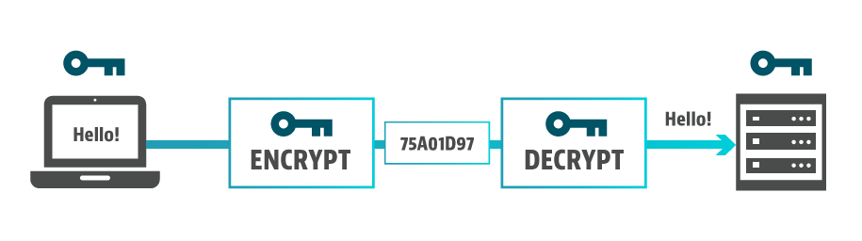
Advanced Encryption Standard Algorithm
Private-key (Symmetric Key) Encryption Algorithm
Three versions – 10/12/14 rounds each having different cipher key size of 128/192/256 bits respectively.
Encrypt and Decrypt Text and Image

Slide 30
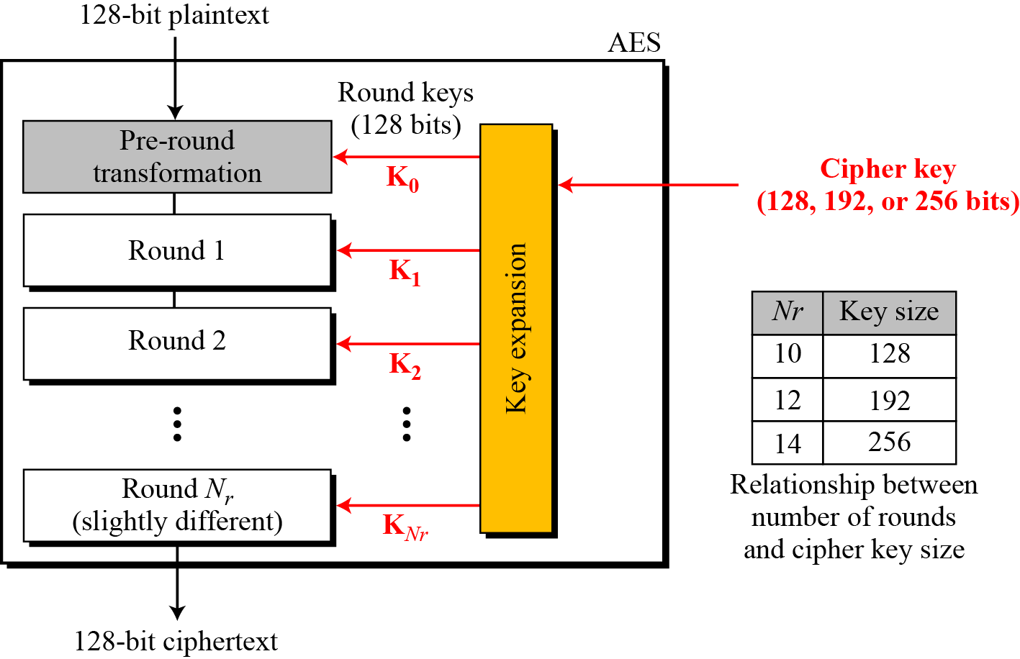
General Design of AES

Slide 31
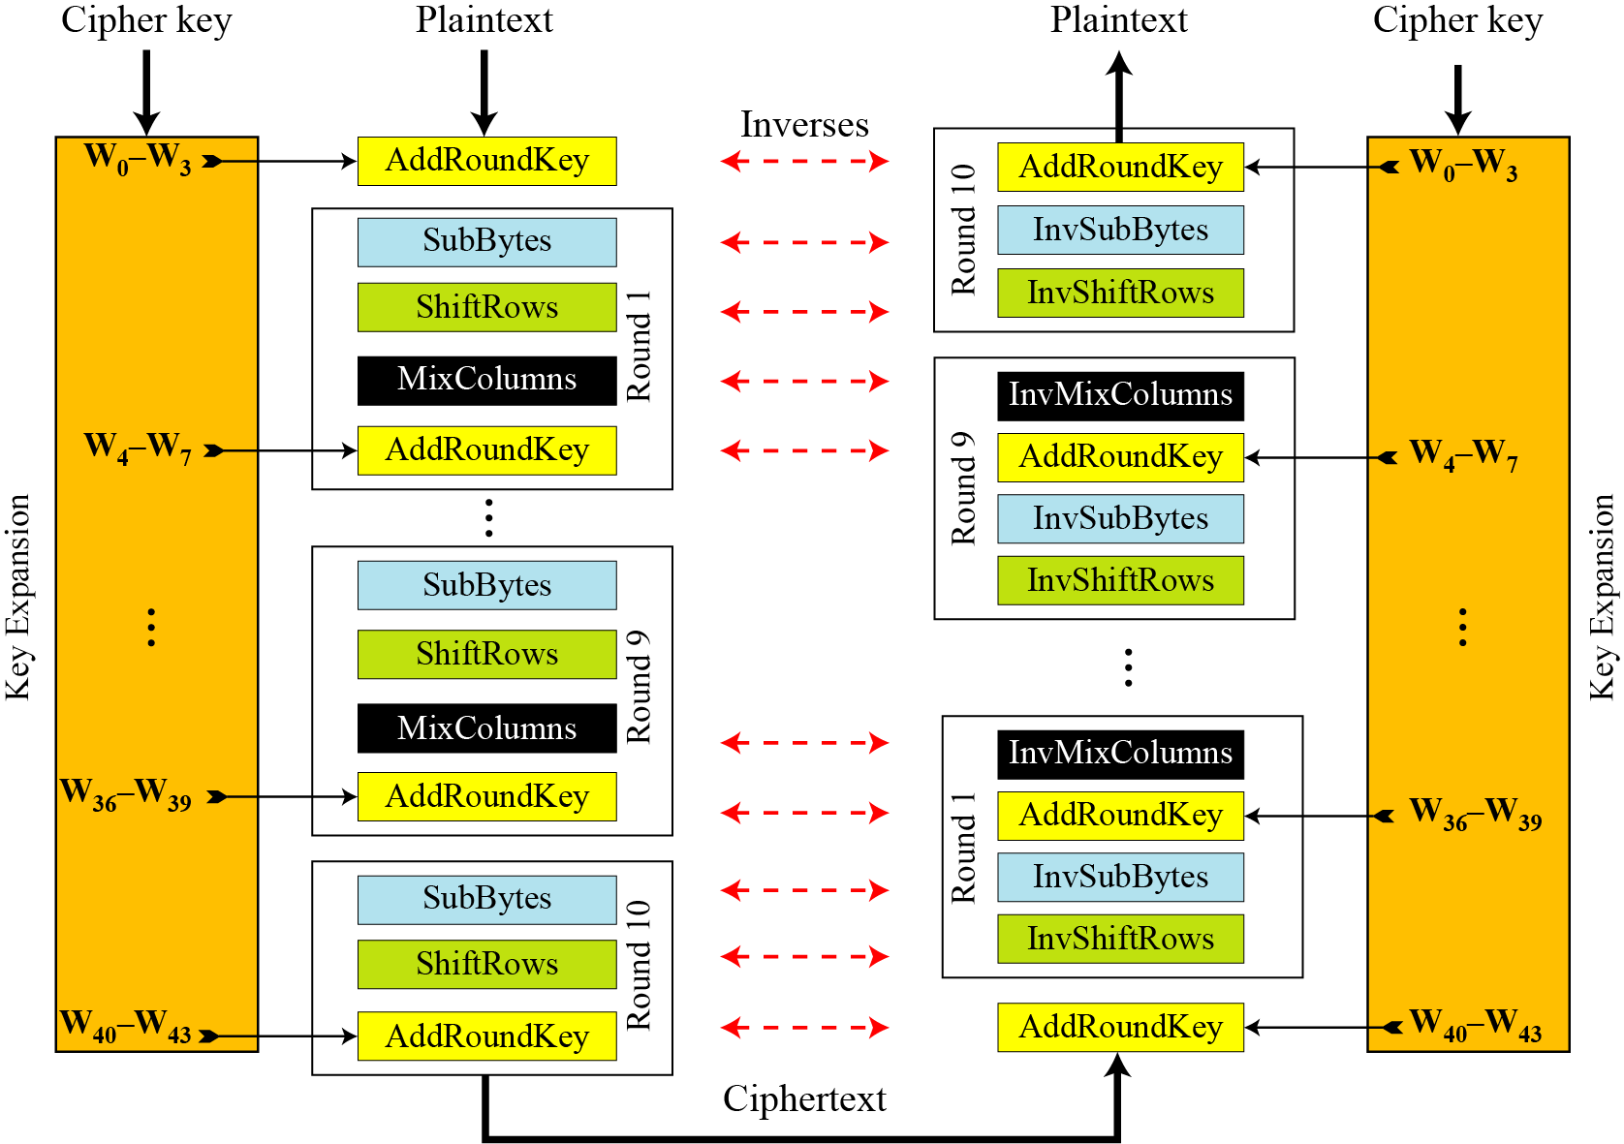
ALGORITHM

Slide 32
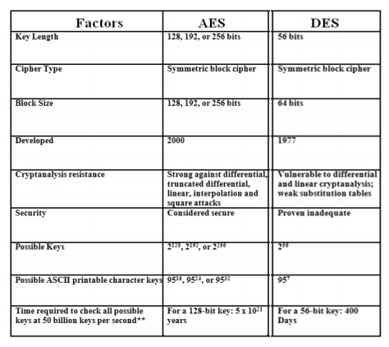
Comparison between AES and DES algorithm for data encryption

Slide 33
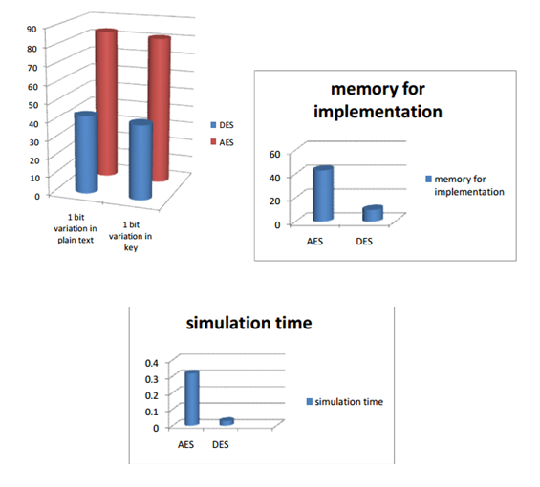

Slide 34
11.2 RSA

Slide 35
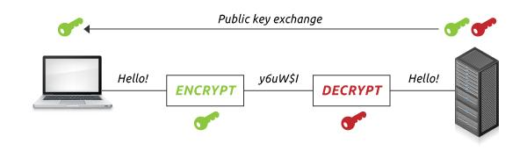
Rivest-Shamir-Adleman Algorithm
Public-key (Asymmetric Key) Encyption Algorithm
Key Size – 2048 Bit
Encrypt and Decrypt Text and Image

Slide 36
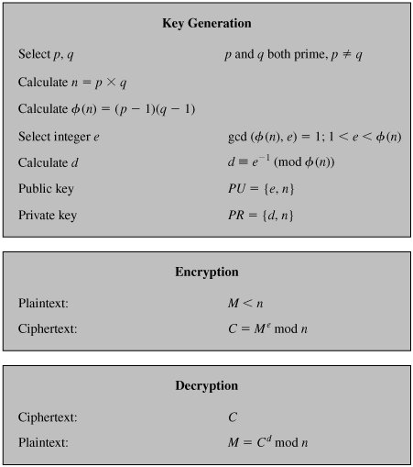
ALGORITHM

Slide 37
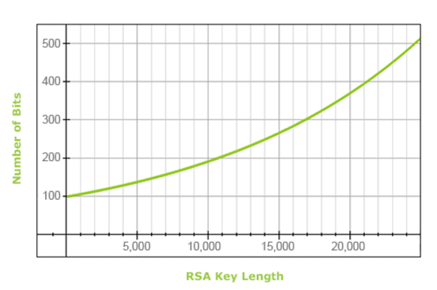
RSA KEY LENGTH
With increasing RSA key length the security also increases.
RSA 1024 bit -> 80 bits of Strength
RSA 2048 bit -> 112 bits of Strength

Slide 38
Features of RSA 2048
2048 bit RSA key has a strength of 112 bits: i.e., there are theoretically 2¹¹²possibilities to crack the private key.
If you were able to magically factor a 1024-bit key in 10 seconds (which is totally unrealistic in every way possible), then it would take around 1,200 years to factor a 2048-bit key.
4096 bit handshakes are indeed significantly slower in terms of CPU usage than 2048 bit handshakes.

Slide 39
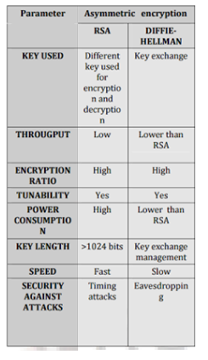
Comparison of Public Key Algorithm
Both RSA and Diffie-Hellman are both public key systems.
The nature of the Diffie-Hellman key exchange, however, makes it susceptible to man-in-the-middle (MITM) attacks, since it doesn't authenticate either party involved in the exchange.

Slide 40
11.3 BPCS

Slide 41
Bit Plane Complexity Segmentation Algorithm
Embedding information in an image
Divides image into segments and calculates complexity.
Higher information hiding capacity (approx 50%) when compared to other steganography algorithms (LSB).
Embeds data in both MSB and LSB of the images based on complexity.

Slide 42
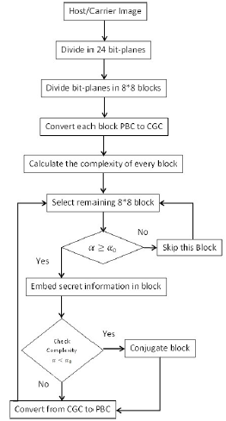
Flow Chart

Slide 43
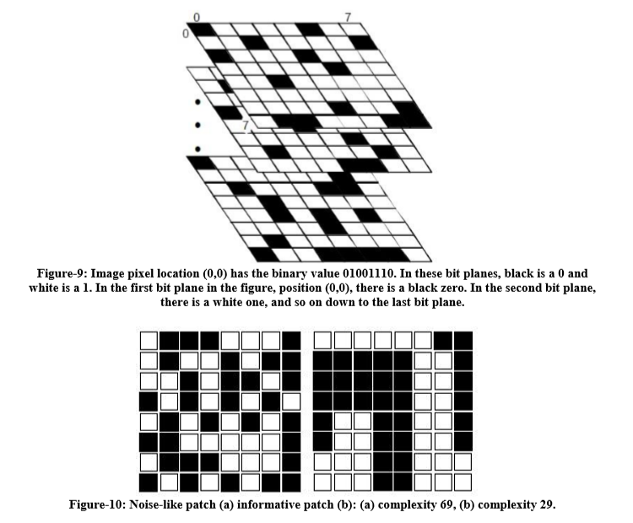

Slide 44
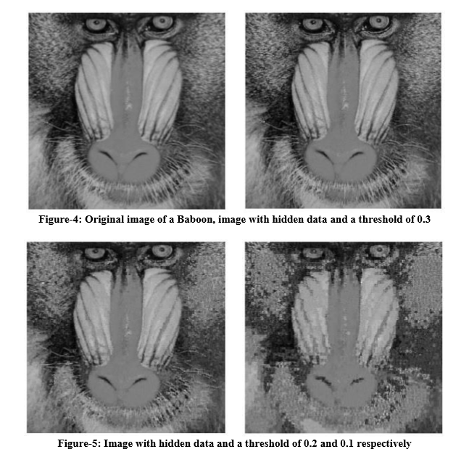

Slide 45
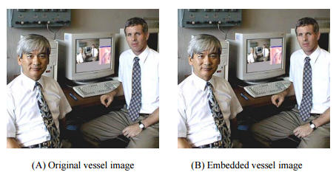

Slide 46
11.4 DB-SCAN

Slide 47
DBSCAN is an acronym for Density-Based Spatial Clustering of Application with Noise.
It is a density based clustering algorithm.
DBSCAN algorithm has the ability to efficiently handle the noisy data even in the dynamic environment where the data are changed randomly.
DBSCAN clustering discovers new clusters of arbitrary shape depends on its radius eps( ) and Minpts(minimum number of points).
There is no need to predefine the number of clusters.
Complexity O(n^2) where n is no. of data points.

Slide 48
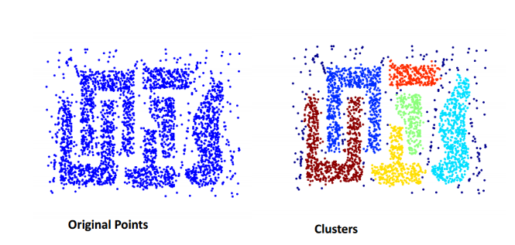
Set of data for which DBSCAN works well

Slide 49
Key Terms to be known for DBSCAN
Neighborhood – Objects within a radius of  from an object.
“High density” - ε-Neighborhood of an object contains at least MinPts of objects.
A point is a core point if it has more than a specified number of points (MinPts) within Eps
A border point has fewer than MinPts within Eps, but is in the neighborhood of a core point.
A noise point is any point that is neither a core point nor a border point.
An object q is directly density-reachable from object p if p is a core object and q is in p’s €-neighborhood.

Slide 50
Algorithm
Let X = {x1, x2, x3, ..., xn} be the set of data points. DBSCAN requires two parameters: ε (eps) and the minimum number of points required to form a cluster (minPts).
Start with an arbitrary starting point that has not been visited.
Extract the neighborhood of this point using ε.
If there is sufficient neighborhood around this point then clustering process starts and point is marked as visited else this point is labeled as noise.
If a point is found to be a part of the cluster then its ε neighborhood is also the part of the cluster and the above procedure from step 2 is repeated for all ε neighborhood points. This is repeated until all points in the cluster are determined.
A new unvisited point is retrieved and processed, leading to the discovery of a further cluster or noise.
This process continues until all points are marked as visited.

Slide 51
Difference Between K means clustering and DBSCAN
K Means Clustering | DBSCAN
Works with clusters of spherical shape. | Works with clusters of arbitrary shape.
No notion to deal with noise points. | Can separate noise points from normal data points.
Pre-defined number of clusters. | No pre-defined number of clusters.
Complexity O(n) | Complexity O(n^2)

Slide 52
12.
SUGGESTIONS

Slide 53
Use a different algorithm for data encryption and clustering.
Sychronized key generation on client and server side.
Time Stamp for image.

Slide 54
13.
PROJECT PLAN

Slide 55
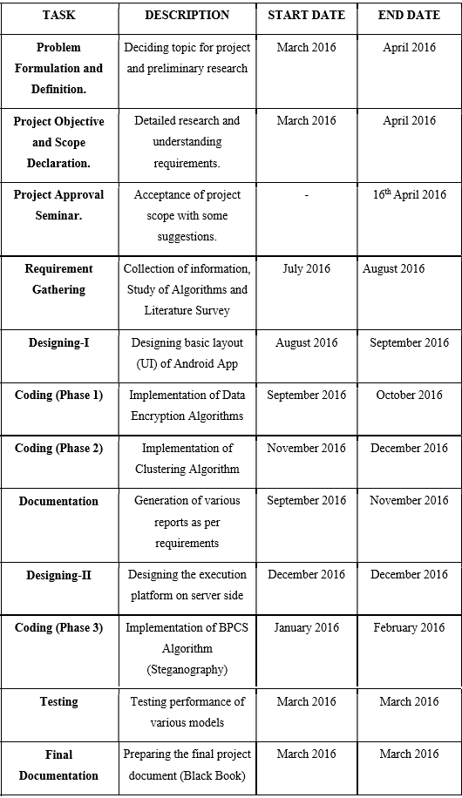

Slide 56
14.
SCREENSHOTS

Slide 57
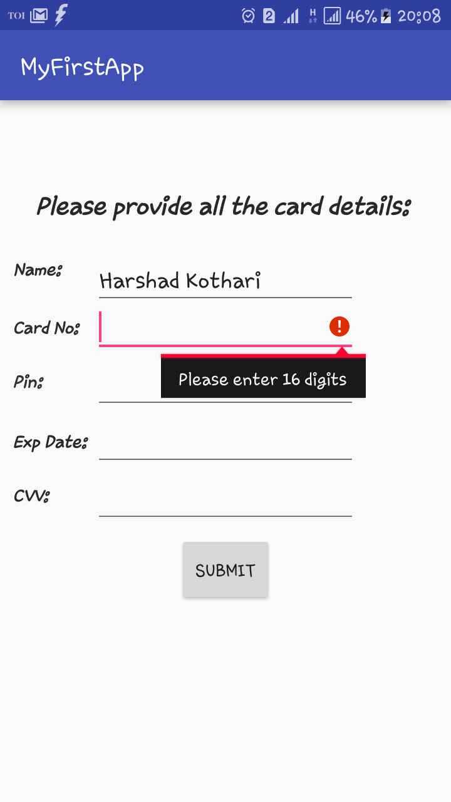
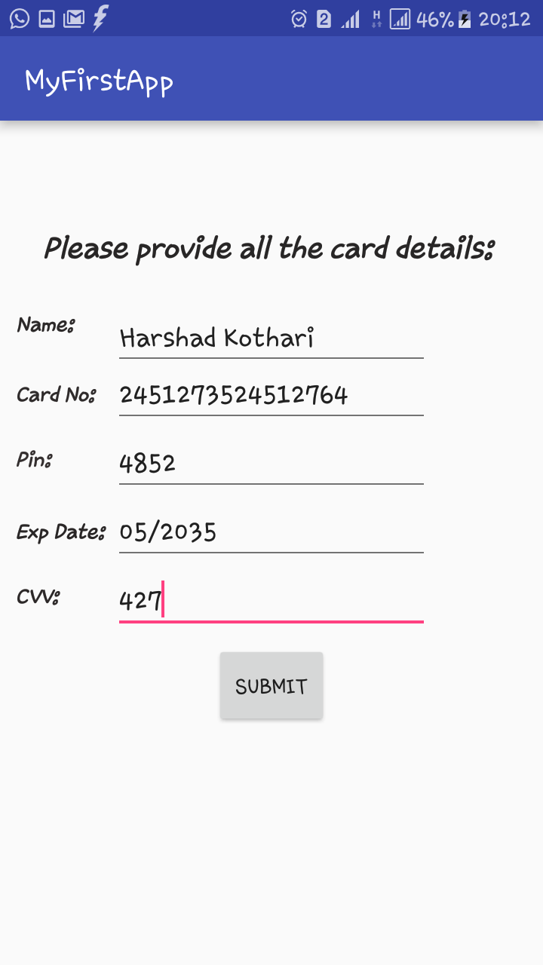

Slide 58
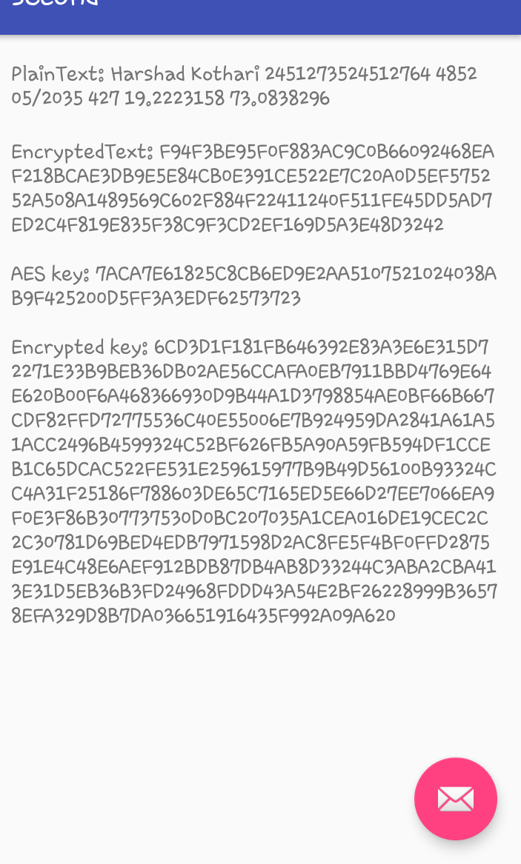

Slide 59
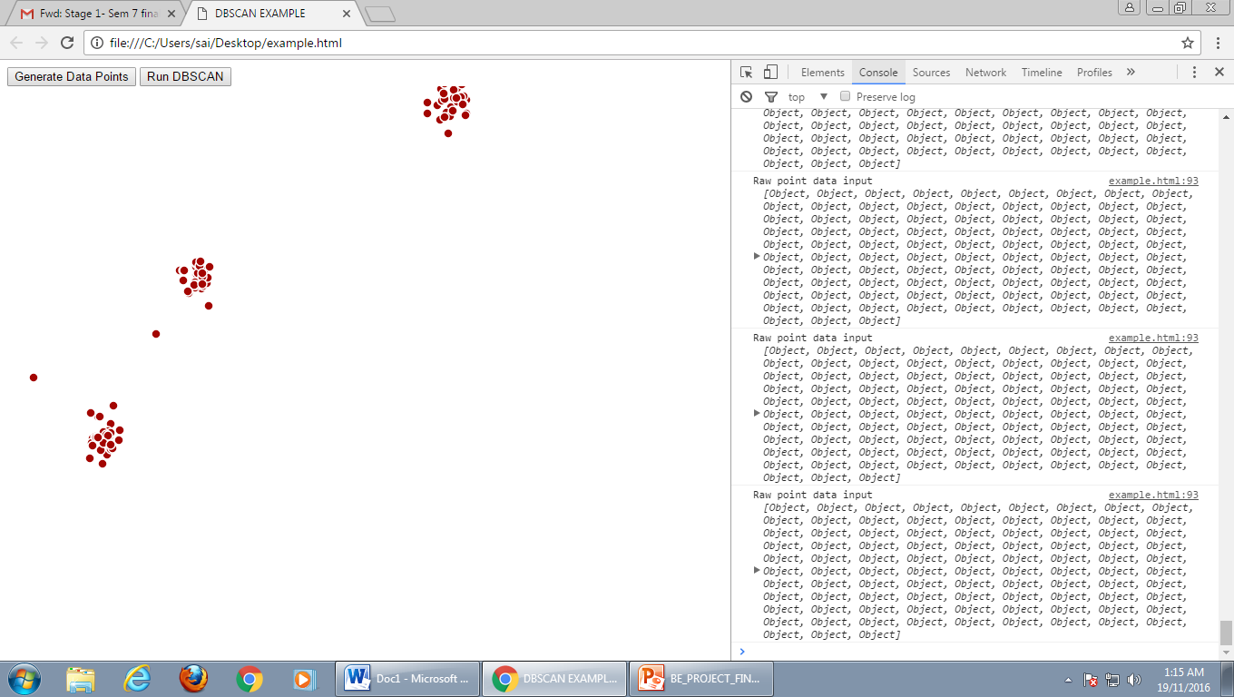

Slide 60
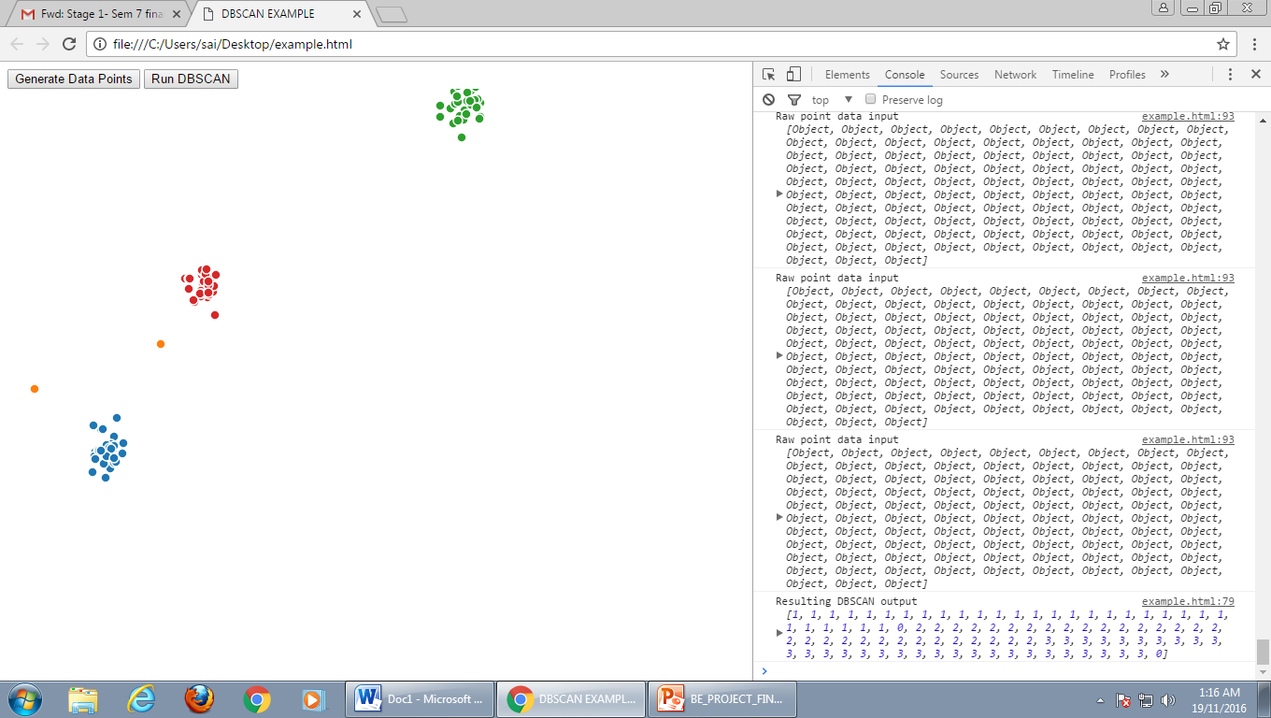

Slide 61
15.
CONCLUSION

Slide 62
As the need for security in online transactions has increased manifold with increased threats and attempts to steal user’s data for fraudulent transactions, it is important to upgrade security mechanisms accordingly from time to time.
Thus, our system recognizes the vulnerabilities or threats in the existing system and uses latest technologies to implement and combat such threats to give more and more security to each and every user and keeps attackers away.

Slide 63
16.
REFERENCES

Slide 64
1. Mandeep Singh, Perminderpal Singh, Rajan Kumar “Fraud Detection By Monitoring User Behaviour And Activities” International Conference on Computer and Intelligent Systems May 30-31, 2014.
2. Vaishali, Abhishek Kajal “Increasing Data Hiding Capacity of Carrier Image Using BPCS Steganography” International Journal of Science and Research (IJSR) Volume 4, Issue 5, May 2015.
3. Rituraj Rusia, Munendra Kumar Mishra, R. K. Tiwari “More Advanced Steganography Using BPCS” International Journal of Computer Engineering and Applications, Volume VII, Issue II, Part II, August 2014.
4. Arshia Azam, Rumana Firdous, F. Asma Begum “High Security Image Steganography Using RSA Algorithm” Journal of Innovation in Electronics and Communication, Vol 4, July-Dec ’14.

Slide 65
4. Arshia Azam, Rumana Firdous, F. Asma Begum “High Security Image Steganography Using RSA Algorithm” Journal of Innovation in Electronics and Communication, Vol 4, July-Dec ’14.
5. Shengxuan Hao, Xiaofeng Zhou, Hong Song “A New Method for Noise Data Detection Based on DBScan and SVDD ” 5th Annual IEE International Conference on Cyber Technology, June 8-12, 2015.
6. Iyer Aurobind Venkatkumar, Sanatkumar Jayantibhai Kondhol Shardaben “Comparative Study of Data Mining Clustering Algorithms” International Conference on Data Science and Engineering, August, 2016.

Slide 66
THANKYOU!

