Slide 1



Department of Artificial Intelligence & Data Science
Academic Year 2025-26
KumbhRakshak: Safety and Decision Support for Nashik-Trimbakeshwar
Hardik Sedani T8-70
Shubham Vishwakarma T5-13

Slide 2
Outline of Presentation
Introduction
Problem statement/definition
      Project Objectives
      Literature Survey
      Findings and Research Gap
      Prototype Screenshots
      Software /Hardware requirement
      System design
System implementation
Results
Future Scope
References

Slide 3
Introduction
KumbhRakshak: Nashik-Trimbakeshwar Safety Prototype
The 2027 Simhastha will need clear place context and timely information across ghats, routes and facilities.
KumbhRakshak brings monitoring signals and response tools into one command-centre website.
What the Platform Shows
An illustrative 3D guide links Nashik and Trimbakeshwar landmarks to the relevant crowd, map, camera, shelter and incident portals.
The present build is a demonstration with simulated operational data. It is not an official navigation or emergency-response system.

Slide 4
Problem Definition
The Core Problem
Crowd, camera, social and field signals arrive through separate channels during a large gathering.
Without place context, users may struggle to identify which facility or portal is relevant to a situation.
Unverified claims can add confusion, while response decisions still require evidence and human review.
Problem Statement
How can one understandable interface connect locations, signals and response workflows for the Nashik-Trimbakeshwar Kumbh?

Slide 5
Project Objectives
Primary Objective
Build a clear decision-support prototype for operators and project reviewers, centered on Nashik and Trimbakeshwar.
Specific Objectives
Explain key landmarks and portals through an interactive 3D place guide.
Show crowd pressure, camera observations and incident information together.
Review social claims with available evidence before any public response.
Support shelter, resource and advisory workflows in one website.
Distinguish simulated data and schematic locations from verified field information.

Slide 6
Literature Survey
Author(s) / Year | Study | Key Finding
Aishwarya & Vinay (2025) | Role of social media and its impact on Maha Kumbh Mela | Facebook, X, Instagram and YouTube help organisers share updates, schedules and safety instructions, boosting participation.
Verma & Bains (2025) | Security & surveillance strategies, Maha Kumbh Mela 2025 | Proposes a risk-assessment and stakeholder-coordination framework for crowd safety at mega religious gatherings.
Kumbh Twitter Study (2020) | Motivations & experiences — insights from Twitter analytics | Analysed ~49,500 tweets from Kumbh 2019 to mine pilgrim sentiment and experience via network/content analytics.
Tiwari & Chowdhary (2022) | Technology and crowd management: Kumbh case study | Mobile apps and smart tech improve headcounts, monitoring, multilingual info-sharing and safety at Kumbh scale.
JMIR Infodemiology (2025) | Impact of misinformation on social media in disasters | Misinformation during disasters spreads mainly via X, Facebook and WhatsApp; pre-emptive debunking limits its reach.
Simon et al. (2016) | Computers in Human Behaviour | Documents how WhatsApp rumours spread uncontrollably during a real search-and-rescue operation.

Slide 7
Findings of Literature Survey
What the Literature Confirms
Kumbh studies describe the difficulty of managing large pedestrian flows and coordinating safety teams.
Crowd research shows the value of zone-level observation and forecasting for early review.
Social-media studies also show that fast-moving rumours can complicate a real incident response.
The Gap We Address
KumbhRakshak demonstrates a place-linked interface that brings monitoring, claim review and response tools together. Field validation remains necessary.

Slide 8
Software /Hardware requirement
Software Requirements
Simulation: timeline and example incident injections and OpenStreetMap landmark links and Three.js
Backend: Python 3.12, FastAPI and WebSockets
Data: Firestore adapter with in-memory demo mode
Frontend: Next.js, React, Tailwind CSS
AI modules: vision, text clustering, risk and forecasting
Mapping: Mapbox GL
Packaging: Docker and Docker Compose
Tools: Git, GitHub and VS Code
Hardware Requirements
Demo machine: modern CPU, 8-16 GB RAM and SSD
GPU optional for local camera-model inference
Permissioned CCTV or video feeds needed for a real pilot
Reliable network and secure server for deployment
Official GIS and facility data required before field use

Slide 9
System design
Place &
Camera Signals
Social &
Field Reports
Event & Claim
Review
Risk
Scoring
Human
Decision
Portal &
Advisory
Data Flow
Place, camera and public-report inputs are organized into location-linked views.
The system groups observations and presents claims with supporting or missing evidence.
Risk indicators support review; a human operator remains responsible for any action.
Approved information can then be displayed in the dashboard and advisory workflow.

Slide 10
System implementation
Implemented Prototype Modules
3D place guide: schematic Nashik and Trimbakeshwar scenes with portal links.
Overview dashboard: feature guide, situation indicators and incident review.
Simulation: a 16-step timeline and manual demo-event injections.
Crowd portal: example 15, 30 and 60-minute forecasts and holding-area views.
Other portals: camera, incident, shelter, resource and public-report workflows.
Claim scanner: a demo interface for evidence review; real feeds require integration.
Tech Stack in Practice
Next.js frontend, FastAPI backend, WebSockets and an in-memory demo database.

Slide 11
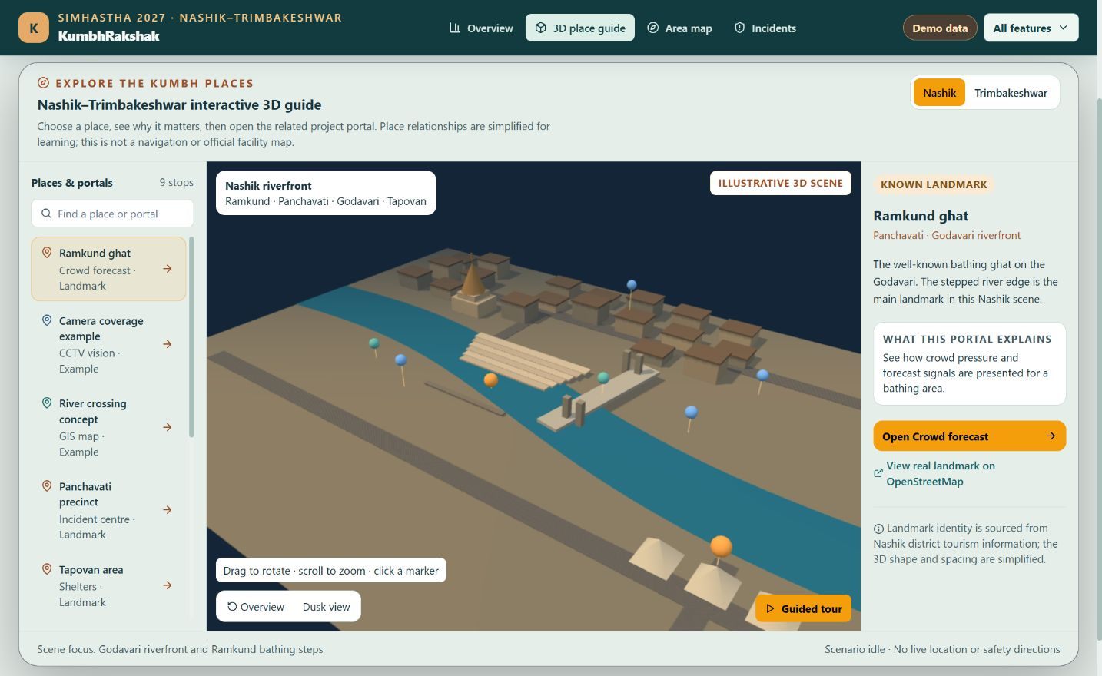
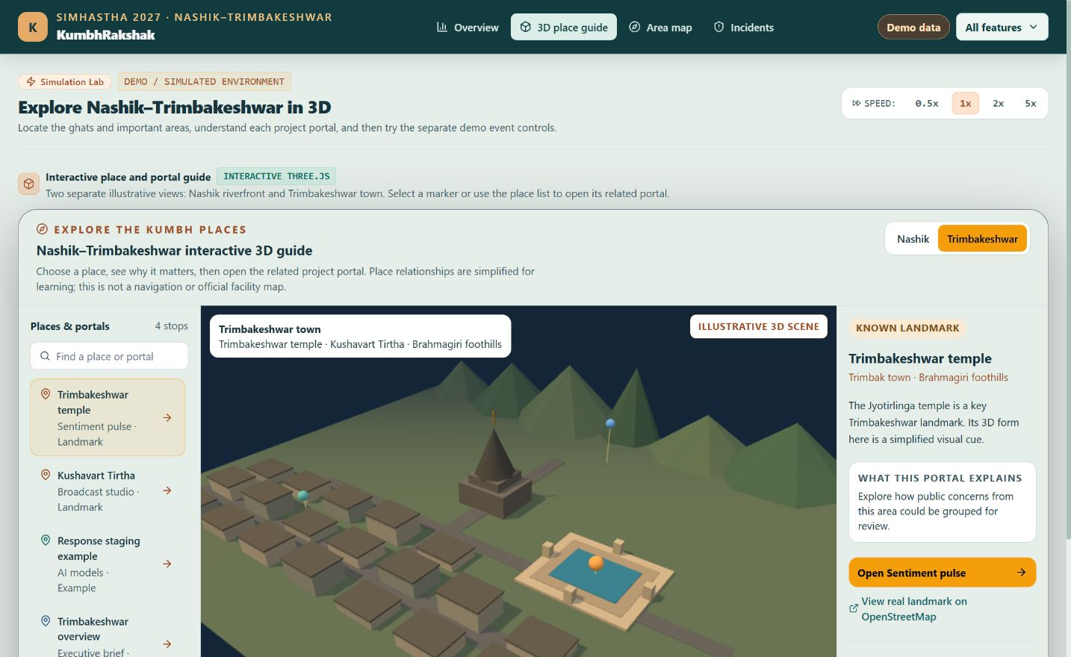
3D Place Guide
Nashik riverfront: Ramkund and portal links
Trimbakeshwar: separate landmark scene
Notes:
Screenshots captured from the local KumbhRakshak demo on 3 October 2026. Both 3D scenes are schematic and must not be used as an official site plan or emergency route.

Slide 12
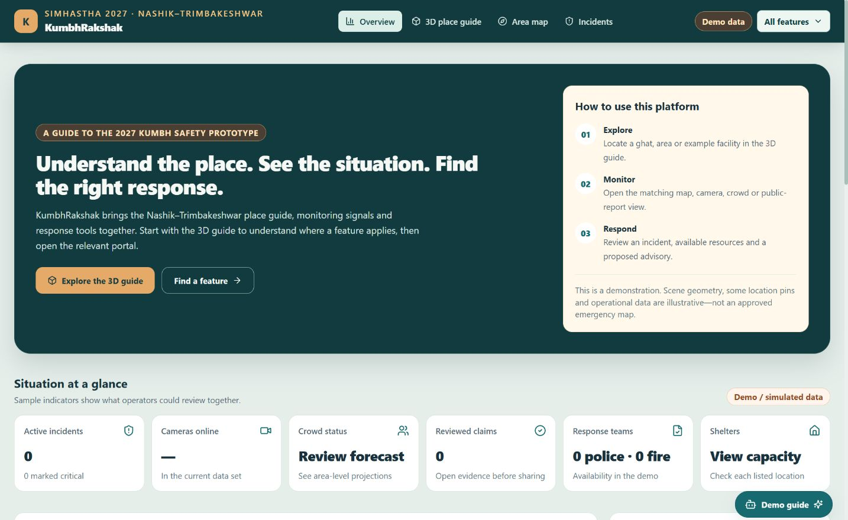
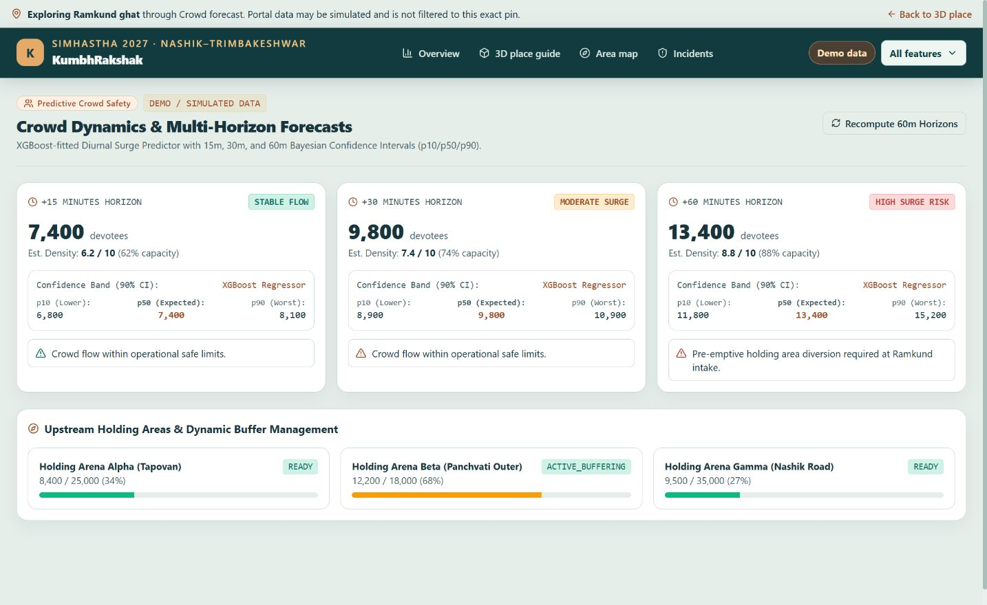
Prototype Website Screens
Overview and feature guide
Crowd portal: illustrative forecast values
Notes:
Screenshots captured from the local KumbhRakshak demo on 3 October 2026. Dashboard indicators and forecast values shown are simulated, not measured field data.

Slide 13
Results
Demonstrated Outcomes (Prototype)
The local simulation starts, pauses and accepts a test fire event with telemetry logging.
The 3D Nashik guide links Ramkund to its crowd portal; Trimbakeshwar has a separate scene.
The crowd page shows example 15, 30 and 60-minute forecast cards.
The overview explains how to explore, monitor and respond across the available portals.
Six core backend tests passed in the local demo environment.
Scope of Current Results
These are software-demo results. Locations, event values and forecasts are illustrative, with no field-performance claim.

Slide 14

Future Scope
Prioritised Roadmap
Replace schematic pins with approved 2027 GIS, ghat and facility coordinates.
Integrate permissioned CCTV, incident feeds and validated crowd counts.
Measure false alerts, model accuracy and response latency with local operators.
Add audit logs, access control and human approval for public advisories.
Test multilingual and low-connectivity guidance with pilgrims and volunteers.
Run a staged pilot before any operational or emergency use.

Slide 15
References
[1] Nashik District Administration. Ramkund Nashik: official landmark information.
[2] Nashik District Administration. Kushavart Tirtha, Trimbakeshwar: official landmark information.
[3] Kanaujiya, A.K. & Tiwari, V. (2022). Crowd management and security at Prayagraj Kumbh Mela 2019. National Academy Science Letters.
[4] Tiwari, S. & Chowdhary, R. (2022). Technology and crowd management: Kumbh case study.
[5] JMIR Infodemiology (2025). Narrative review of disaster misinformation on social media.
[6] KumbhRakshak project code and local demo, accessed 3 October 2026.
Notes:
Reference links for slide 15:
https://nashik.gov.in/en/tourist-place/ramkund-nashik/
https://nashik.gov.in/en/tourist-place/kushavart-tirtha-trimbakeshwar/
https://link.springer.com/article/10.1007/s40009-022-01114-w
https://github.com/hardiksedani/mahakumbh_projects

Slide 16
Thank You

