Slide 1



Department of Artificial Intelligence & Data Science
Academic Year 2025-26
KumbhRakshak: Safety and Decision Support for Nashik-Trimbakeshwar
Hardik Sedani T8-70
Shubham Vishwakarma T5-13

Slide 2
Outline of Presentation
Introduction
Problem statement/definition
      Project Objectives
      Literature Survey
      Findings and Research Gap
      Features & Screenshots
      Software /Hardware requirement
      System design
System implementation
Results
Future Scope
References

Slide 3
Introduction
KumbhRakshak: Nashik-Trimbakeshwar Safety Prototype
The 2027 Simhastha will need clear place context and timely information across ghats, routes and facilities.
KumbhRakshak brings monitoring signals and response tools into one command-centre website.
What the Platform Shows
An illustrative 3D guide links Nashik and Trimbakeshwar landmarks to the relevant crowd, map, camera, shelter and incident portals.
The present build is a demonstration with simulated operational data. It is not an official navigation or emergency-response system.

Slide 4
Problem Definition
The Core Problem
Crowd, camera, social and field signals arrive through separate channels during a large gathering.
Without place context, users may struggle to identify which facility or portal is relevant to a situation.
Unverified claims can add confusion, while response decisions still require evidence and human review.
Problem Statement
How can one understandable interface connect locations, signals and response workflows for the Nashik-Trimbakeshwar Kumbh?

Slide 5
Project Objectives
Primary Objective
Build a clear decision-support prototype for operators and project reviewers, centered on Nashik and Trimbakeshwar.
Specific Objectives
Explain key landmarks and portals through an interactive 3D place guide.
Show crowd pressure, camera observations and incident information together.
Review social claims with available evidence before any public response.
Support shelter, resource and advisory workflows in one website.
Distinguish simulated data and schematic locations from verified field information.

Slide 6
Literature Survey
Author(s) / Year | Study | Key Finding
Aishwarya & Vinay (2025) | Role of social media and its impact on Maha Kumbh Mela | Facebook, X, Instagram and YouTube help organisers share updates, schedules and safety instructions, boosting participation.
Verma & Bains (2025) | Security & surveillance strategies, Maha Kumbh Mela 2025 | Proposes a risk-assessment and stakeholder-coordination framework for crowd safety at mega religious gatherings.
Kumbh Twitter Study (2020) | Motivations & experiences — insights from Twitter analytics | Analysed ~49,500 tweets from Kumbh 2019 to mine pilgrim sentiment and experience via network/content analytics.
Tiwari & Chowdhary (2022) | Technology and crowd management: Kumbh case study | Mobile apps and smart tech improve headcounts, monitoring, multilingual info-sharing and safety at Kumbh scale.
JMIR Infodemiology (2025) | Impact of misinformation on social media in disasters | Misinformation during disasters spreads mainly via X, Facebook and WhatsApp; pre-emptive debunking limits its reach.
Simon et al. (2016) | Computers in Human Behaviour | Documents how WhatsApp rumours spread uncontrollably during a real search-and-rescue operation.

Slide 7
Findings of Literature Survey
What the Literature Confirms
Kumbh studies describe the difficulty of managing large pedestrian flows and coordinating safety teams.
Crowd research shows the value of zone-level observation and forecasting for early review.
Social-media studies also show that fast-moving rumours can complicate a real incident response.
The Gap We Address
KumbhRakshak demonstrates a place-linked interface that brings monitoring, claim review and response tools together. Field validation remains necessary.

Slide 8
Software / Hardware Requirements
Software Requirements
Frontend: Next.js, React, Tailwind CSS and Three.js
Backend: Python 3.12, FastAPI and WebSockets
Data: Firestore adapter with in-memory demo mode
Mapping: Mapbox GL and OpenStreetMap landmark links
AI modules: vision, text clustering, risk and forecasting
Simulation: timeline and example incident injections
Packaging: Docker and Docker Compose
Tools: Git, GitHub and VS Code
Hardware Requirements
Demo machine: modern CPU, 8-16 GB RAM and SSD
GPU optional for local camera-model inference
Permissioned CCTV or video feeds needed for a real pilot
Reliable network and secure server for deployment
Official GIS and facility data required before field use

Slide 9
System Design
Place &
Camera Signals
Social &
Field Reports
Event & Claim
Review
Risk
Scoring
Human
Decision
Portal &
Advisory
Data Flow
Place, camera and public-report inputs are organized into location-linked views.
The system groups observations and presents claims with supporting or missing evidence.
Risk indicators support review; a human operator remains responsible for any action.
Approved information can then be displayed in the dashboard and advisory workflow.

Slide 10
System Implementation
Implemented Prototype Modules
3D place guide: schematic Nashik and Trimbakeshwar scenes with portal links.
Overview dashboard: feature guide, situation indicators and incident review.
Simulation: a 16-step timeline and manual demo-event injections.
Crowd portal: example 15, 30 and 60-minute forecasts and holding-area views.
Other portals: camera, incident, shelter, resource and public-report workflows.
Claim scanner: a demo interface for evidence review; real feeds require integration.
Tech Stack in Practice
Next.js frontend, FastAPI backend, WebSockets and an in-memory demo database.

Slide 11
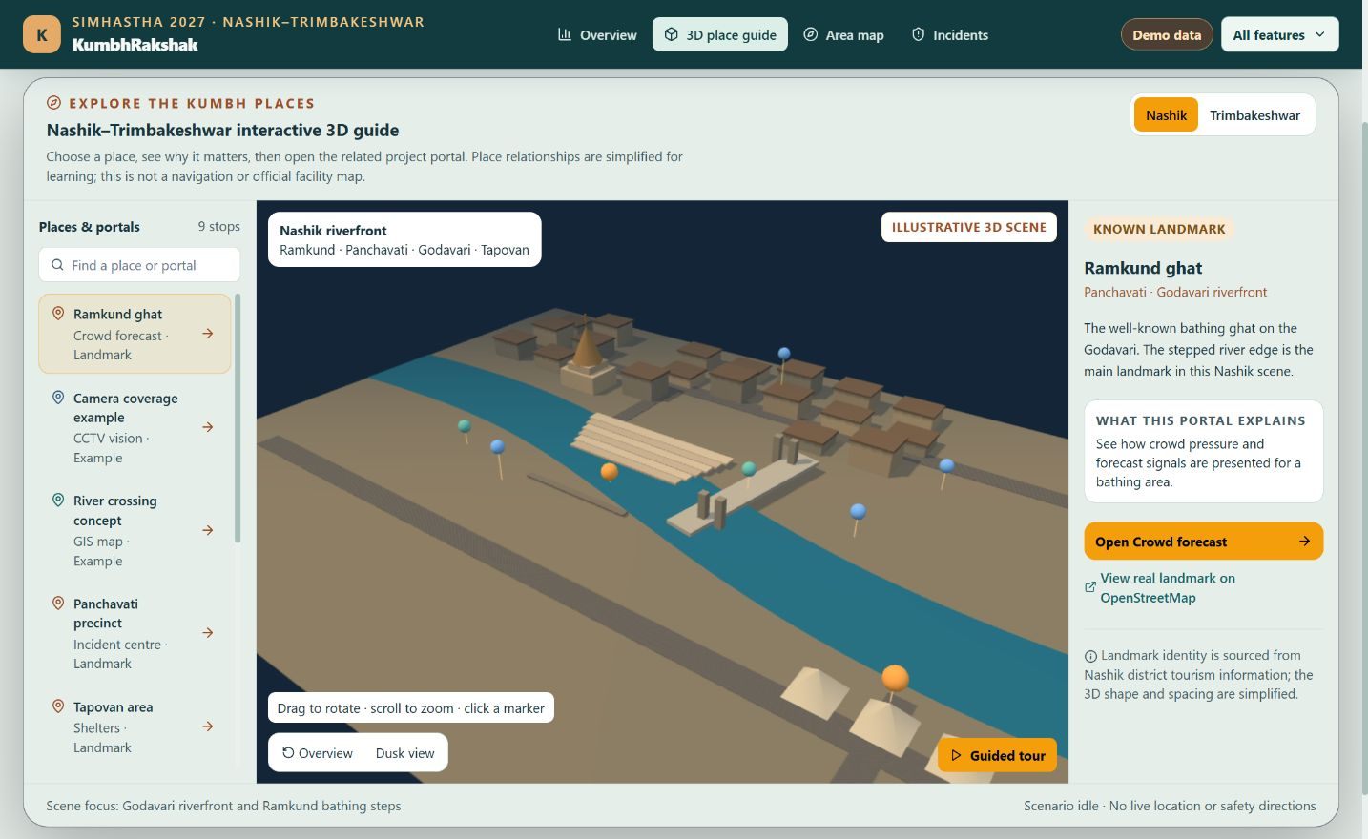
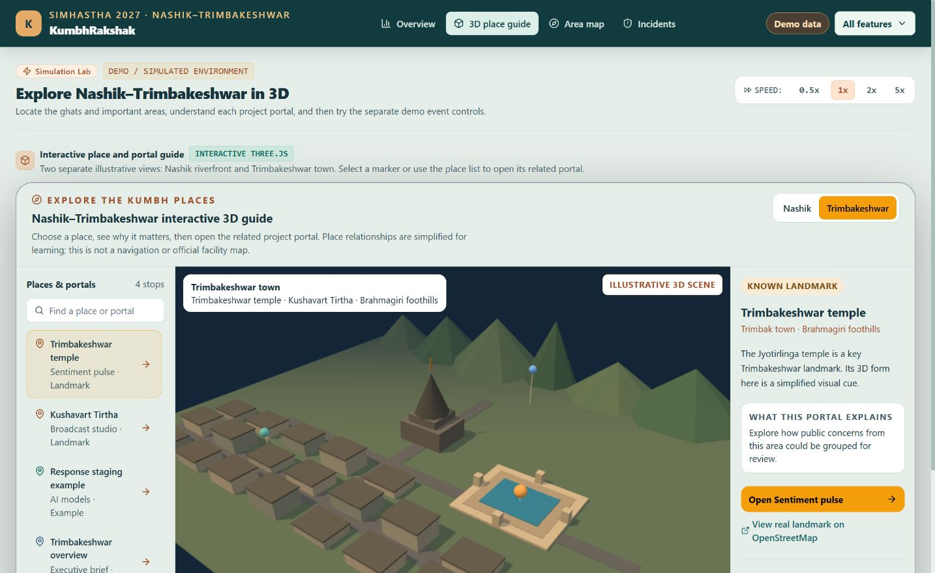
3D Place Guide
Nashik riverfront: Ramkund and portal links
Trimbakeshwar: separate landmark scene
Notes:
Screenshots captured from the local KumbhRakshak demo on 3 October 2026. Both 3D scenes are schematic and must not be used as an official site plan or emergency route.

Slide 12
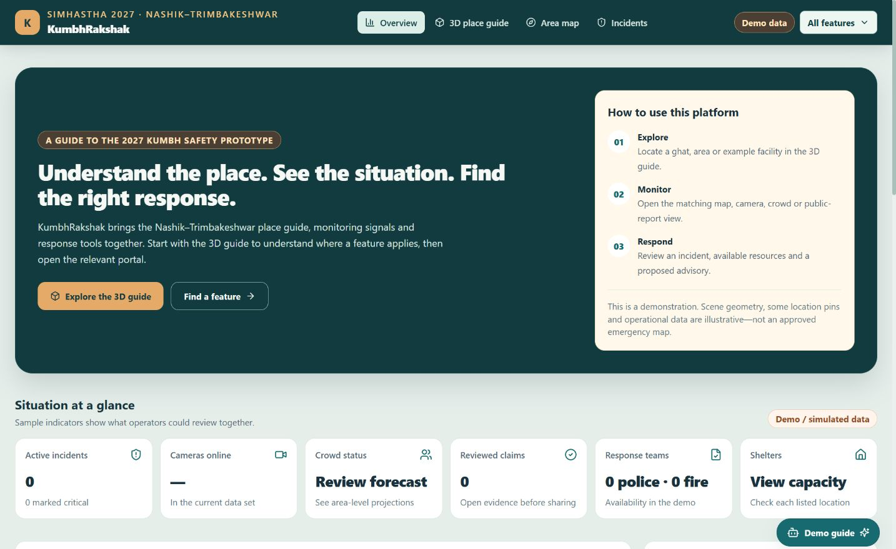
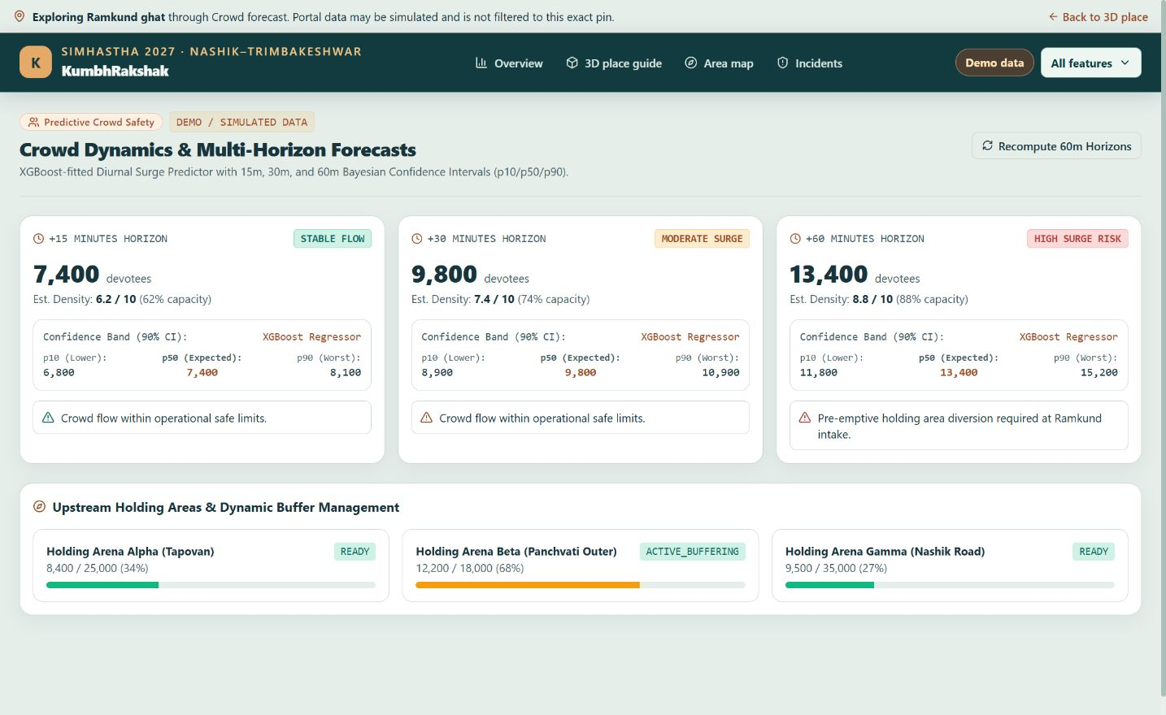
Prototype Website Screens
Overview and feature guide
Crowd portal: illustrative forecast values
Notes:
Screenshots captured from the local KumbhRakshak demo on 3 October 2026. Dashboard indicators and forecast values shown are simulated, not measured field data.

Slide 13
Complete Feature Map
Explore
Respond
Overview dashboard
Incident list, detail and evidence graph
3D Nashik-Trimbakeshwar place guide
Response resources and dispatch review
Area map with camera and incident markers
Multilingual broadcast studio
Shelters and holding capacity
Understand and assist
Monitor
AI model registry and executive brief
Camera vision and crowd forecasts
Lost-person assistance demo
Public reports and claim verification
Command copilot
Sentiment pulse
16-step simulation and scenario lab
Notes:
Feature inventory checked against frontend/components/ui.tsx NAV_GROUPS and the frontend/app routes on 3 October 2026. The additional tools appear on the dashboard and simulation page.

Slide 14
Place & Monitoring Portals
3D place guide and map
Crowd portal
Two scenes explain Nashik and Trimbakeshwar.
15, 30 and 60-minute forecast cards
Click a place to open its linked feature portal.
Holding-area buffer and surge indicators
Area map shows camera and incident context.
Values are simulated for the current demo.
Shelter and camera views
Operator overview
Shelters show listed capacity and occupancy.
KPIs, place signals and incident alerts
Camera grid opens observation and event views.
Feature guide explains every portal.
3D landmarks are explanatory. Approved 2027 GIS is needed before operational use.
Notes:
Portal behavior checked against frontend/app/simulation, map, shelters, cameras and crowd. Camera and forecast outputs are demo or model-dependent; the 3D geometry and facility pins are illustrative.

Slide 15
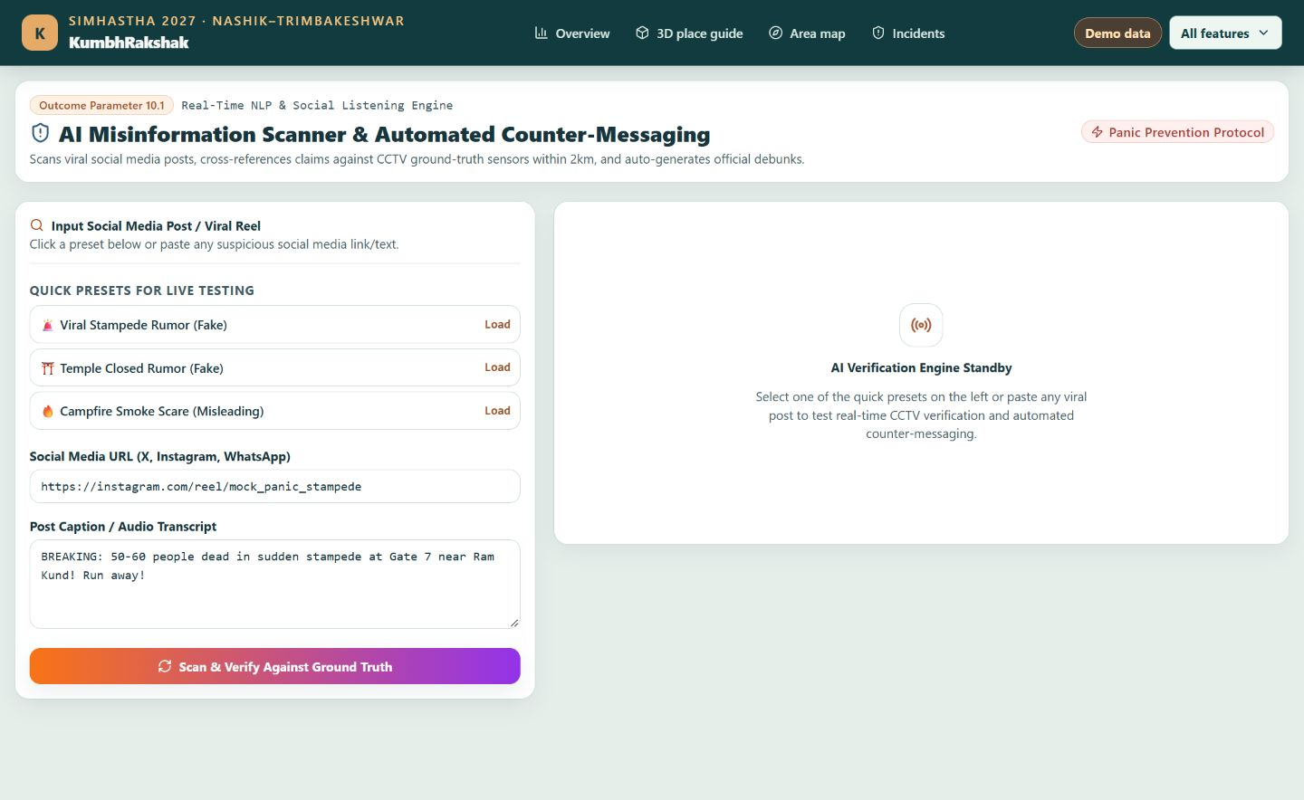
Social Intelligence
Public reports
Mock social feed with status filters and triage
Claim verification
Review location, camera evidence and uncertainty
Sentiment pulse
Public-concern trends and emerging issues
Broadcast studio
Draft Hindi, Marathi, Gujarati and English advisories
Actual portal screenshot. Feed and verification cases are demo data; no external advisory is published.
Notes:
The screenshot is the local claim-scanner UI, captured 3 October 2026. See frontend/app/social, verify, sentiment and broadcast, and backend/app/api/social_sim_routes.py. The feed is mocked and publishing buttons are preview-only.

Slide 16
Incident Response Features
Incident review
Human-controlled response
List and detail pages show severity, risk and evidence.
Recommendation and confirmation are separate steps.
Evidence graph links reports, cameras and actions.
Dispatch decisions can be recorded in an audit trail.
Resources and shelters
Additional assistance
Review available teams and nearest-unit suggestions.
Lost-person demo uses clothing and sighting attributes.
Check shelter capacity and overflow pressure.
Alerts, advisories and copilot support operator review.
The platform does not autonomously send field teams or publish a public alert.
Notes:
Checked against frontend/app/incidents, resources, shelters, broadcast, frontend/components/LostPersonRadar.tsx, and backend/app/api/routes.py plus v1_routes.py. Dispatch remains human-authorized.

Slide 17
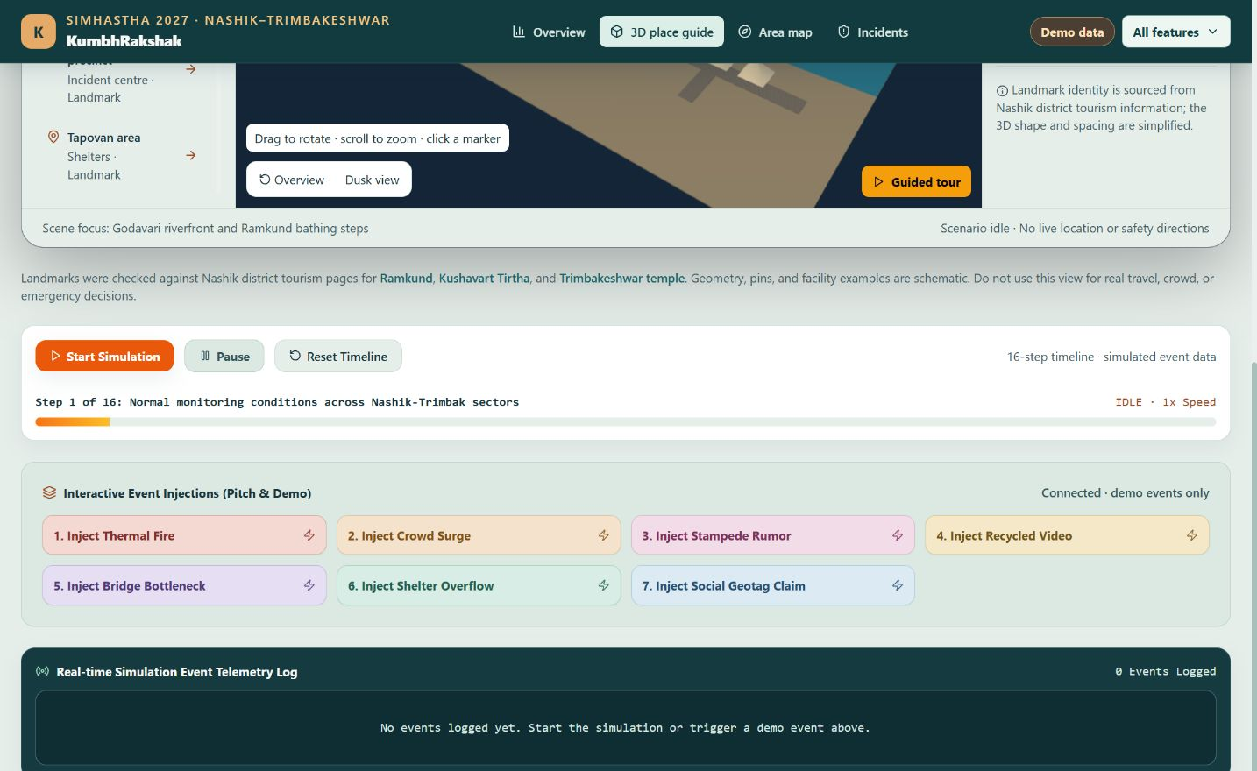
Simulation & Scenario Lab
16-step timeline
Start, pause, resume, reset and speed controls
Seven demo injections
Fire, crowd surge, rumor and recycled video
Bottleneck, shelter overflow and geotag claim
Event telemetry
Scenario updates appear in the live demo log.
All scenario events are simulated. The 3D place guide remains separate from the event timeline.
Notes:
Actual local website screenshot captured 3 October 2026. See frontend/app/simulation/page.tsx and backend/app/simulation/engine.py. Event injections require the demo backend.

Slide 18
AI Modules & Prototype Status
Processing modules
Operator tools
Camera-event and fire/smoke heuristics
AI model registry and status view
Crowd forecasting and explainable risk scoring
Executive brief and readiness summary
Social triage, clustering and recycled-media checks
Command copilot with guided demo prompts
Claim-evidence comparison for human review
Platform engineering
Field-use boundary
FastAPI, Next.js and WebSocket updates
No live Kumbh CCTV or official 2027 site plan
Firestore adapter with in-memory demo fallback
Mock social feed; no automatic dispatch or posting
Notes:
Checked against backend/app/ai, backend/app/api/v1_routes.py, frontend/app/models and executive, and README.md. Heuristic, mock and simulated components are identified on the slide.

Slide 19
Results
Demonstrated Outcomes (Prototype)
The local simulation starts, pauses and accepts a test fire event with telemetry logging.
The 3D Nashik guide links Ramkund to its crowd portal; Trimbakeshwar has a separate scene.
The crowd page shows example 15, 30 and 60-minute forecast cards.
The overview explains how to explore, monitor and respond across the available portals.
Six core backend tests passed in the local demo environment.
Scope of Current Results
These are software-demo results. Locations, event values and forecasts are illustrative, with no field-performance claim.

Slide 20

Future Scope
Prioritised Roadmap
Replace schematic pins with approved 2027 GIS, ghat and facility coordinates.
Integrate permissioned CCTV, incident feeds and validated crowd counts.
Measure false alerts, model accuracy and response latency with local operators.
Add audit logs, access control and human approval for public advisories.
Test multilingual and low-connectivity guidance with pilgrims and volunteers.
Run a staged pilot before any operational or emergency use.

Slide 21
References
[1] Nashik District Administration. Ramkund Nashik: official landmark information.
[2] Nashik District Administration. Kushavart Tirtha, Trimbakeshwar: official landmark information.
[3] Kanaujiya, A.K. & Tiwari, V. (2022). Crowd management and security at Prayagraj Kumbh Mela 2019. National Academy Science Letters.
[4] Tiwari, S. & Chowdhary, R. (2022). Technology and crowd management: Kumbh case study.
[5] JMIR Infodemiology (2025). Narrative review of disaster misinformation on social media.
[6] KumbhRakshak project code and local demo, accessed 3 October 2026.
Notes:
Reference links for slide 15:
https://nashik.gov.in/en/tourist-place/ramkund-nashik/
https://nashik.gov.in/en/tourist-place/kushavart-tirtha-trimbakeshwar/
https://link.springer.com/article/10.1007/s40009-022-01114-w
https://github.com/hardiksedani/mahakumbh_projects

Slide 22
Thank You

