Slide 1
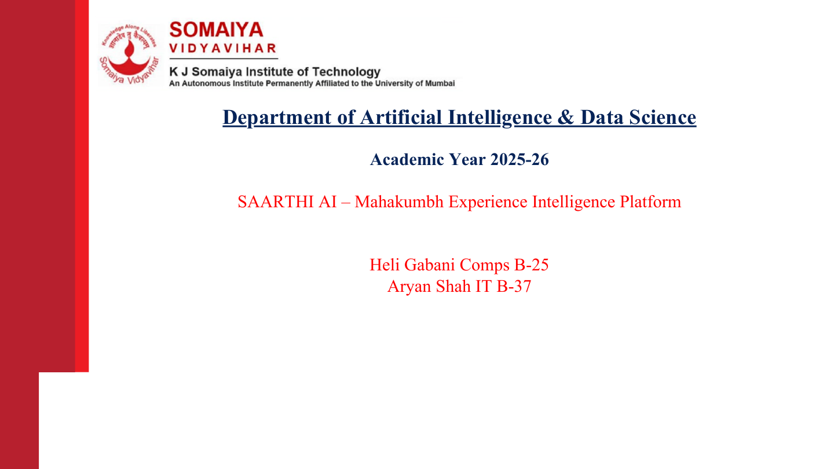
Department of Artificial Intelligence & Data Science
Academic Year 2025-26
KumbhRakshak
Safety and Decision Support for Nashik-Trimbakeshwar
Hardik Sedani T8-70 | Shubham Vishwakarma T5-13
Notes:
This is a project prototype presentation. It does not claim approval or operational use by the Maharashtra authorities.

Slide 2
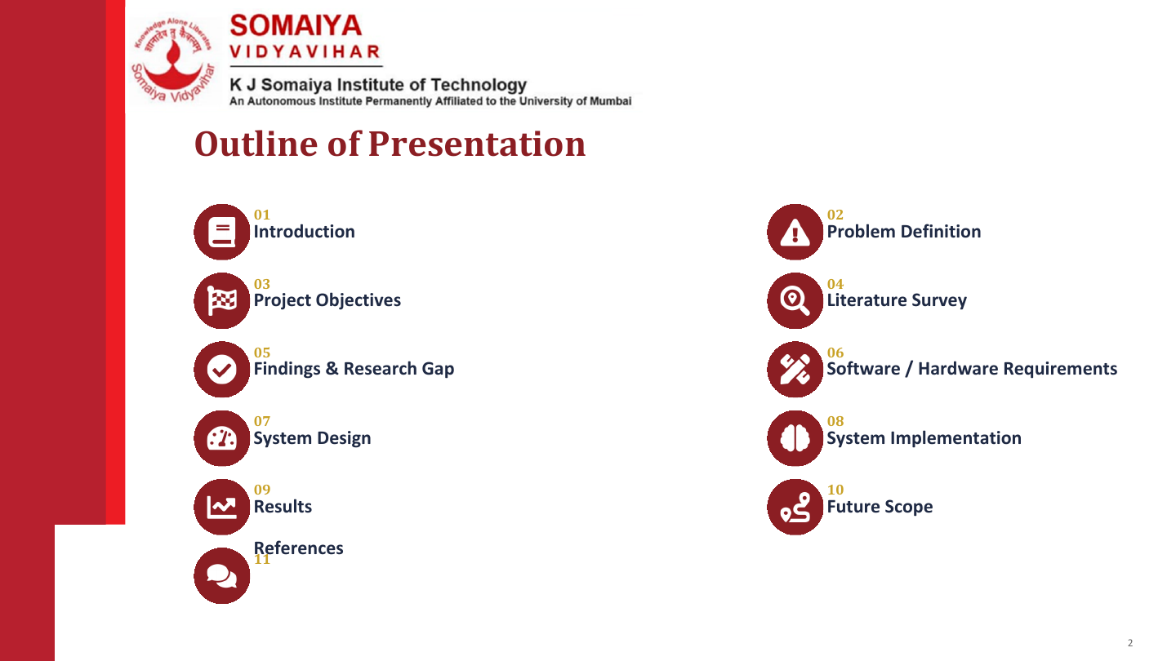
Notes:
The screenshots of the working website appear in the implementation, results and 3D place guide sections.

Slide 3
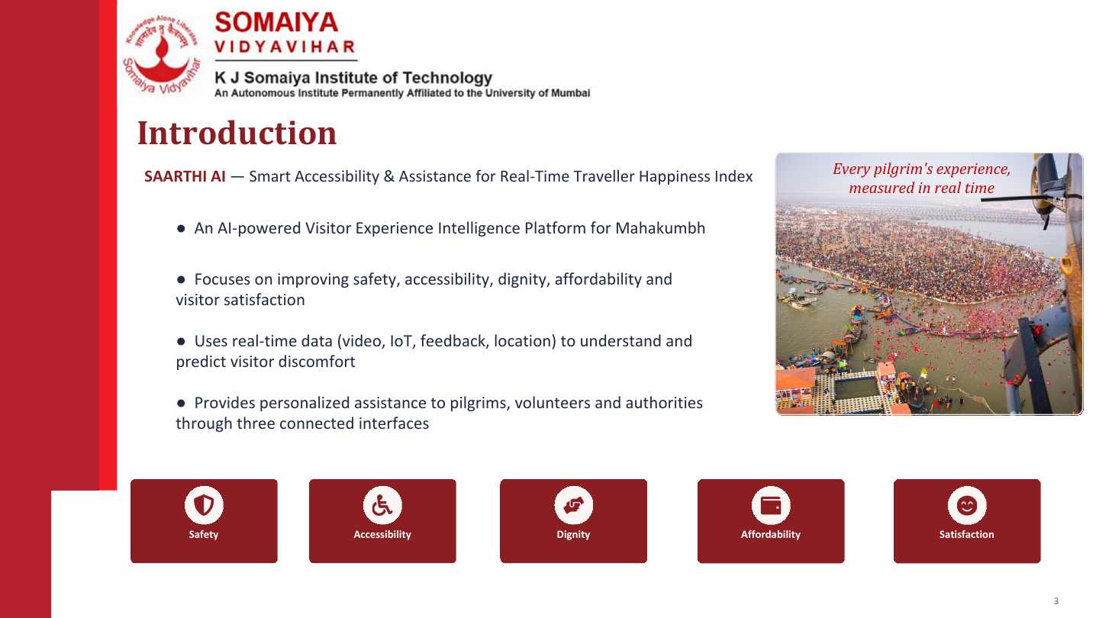
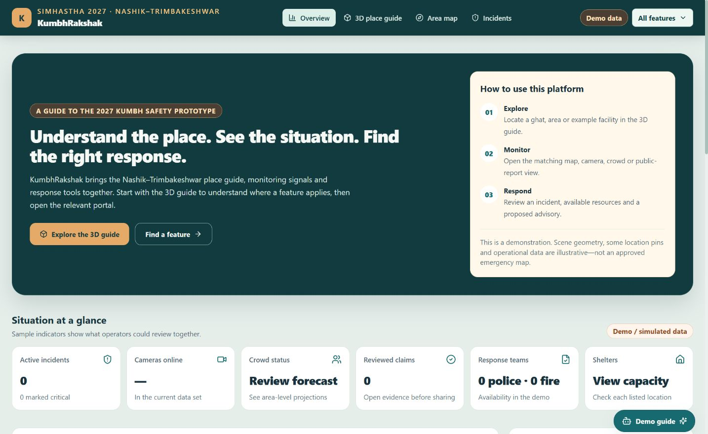
KumbhRakshak
A place-linked command-centre prototype for the upcoming Nashik-Trimbakeshwar Simhastha.
• Shows locations, crowd indicators and incident information together
• Uses a 3D guide to explain where ghats and facilities belong
• Links each place to its relevant monitoring or response portal
• Requires official GIS, live feeds and validation before field use
Notes:
Website screenshot captured from the local project demo on 3 October 2026. Indicators are simulated.

Slide 4
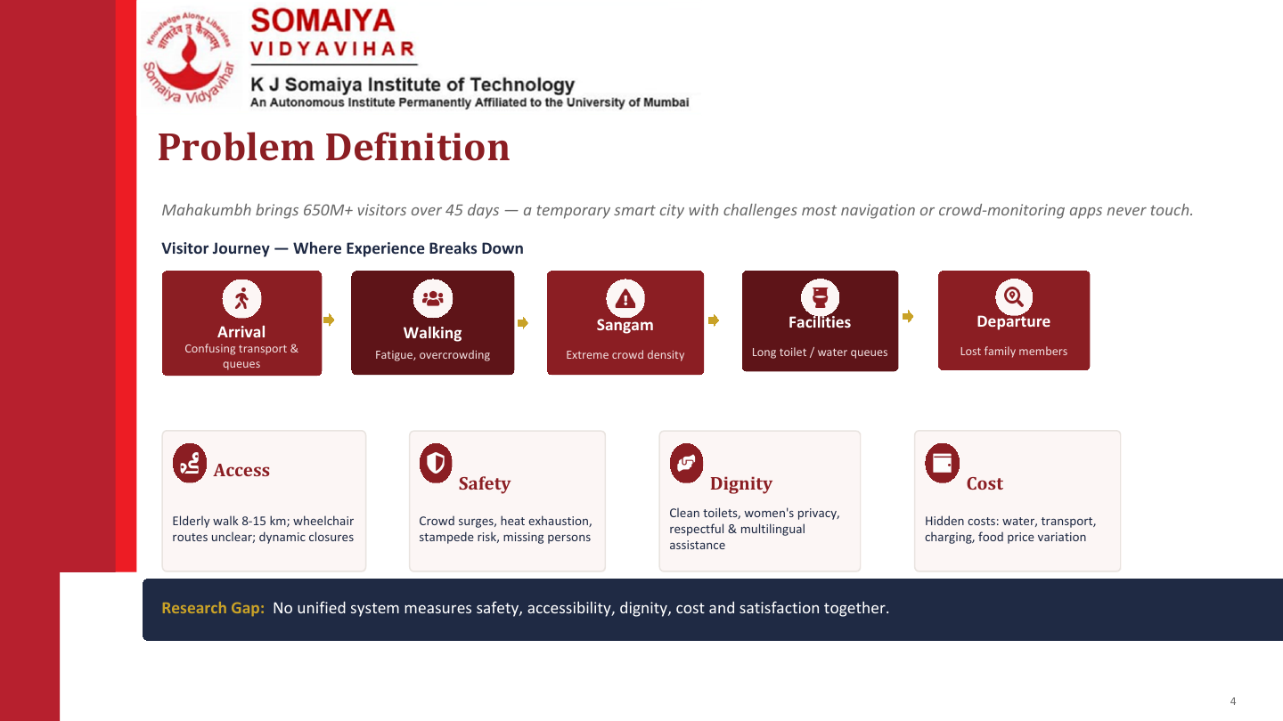
A large event needs clear place context when crowd, camera and public reports arrive separately.
Ghat
Crowd bottlenecks
Unclear links between ghats, routes and relevant portals
Crowd and incident inputs arrive in separate views
Unverified posts can spread during an event
Human approval and clear context remain essential
Research Gap:
A place-linked view that connects signals, facilities and human response is missing from many tools.
Notes:
Original visitor journey cards are retained as contextual problem framing. The project solution is a prototype.

Slide 5
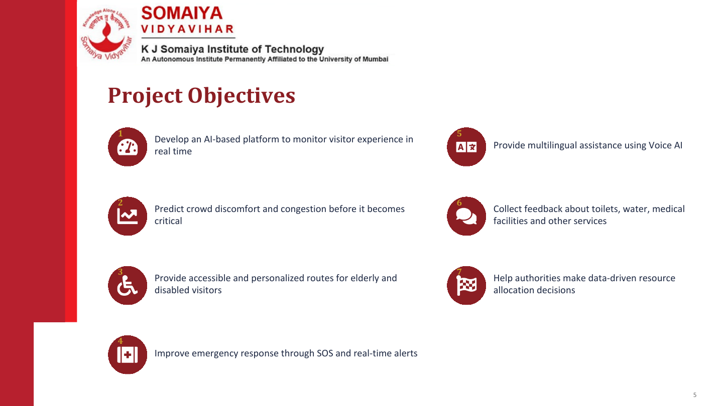
Show Nashik and Trimbakeshwar landmarks in an interactive 3D guide
Bring many project features into one understandable website
Connect each landmark to the related crowd, map or response portal
Support claim review before public communication
Surface crowd pressure and incident signals for human review
Prepare for GIS and live-feed integration after validation
Explain demo data and unverified information clearly

Slide 6
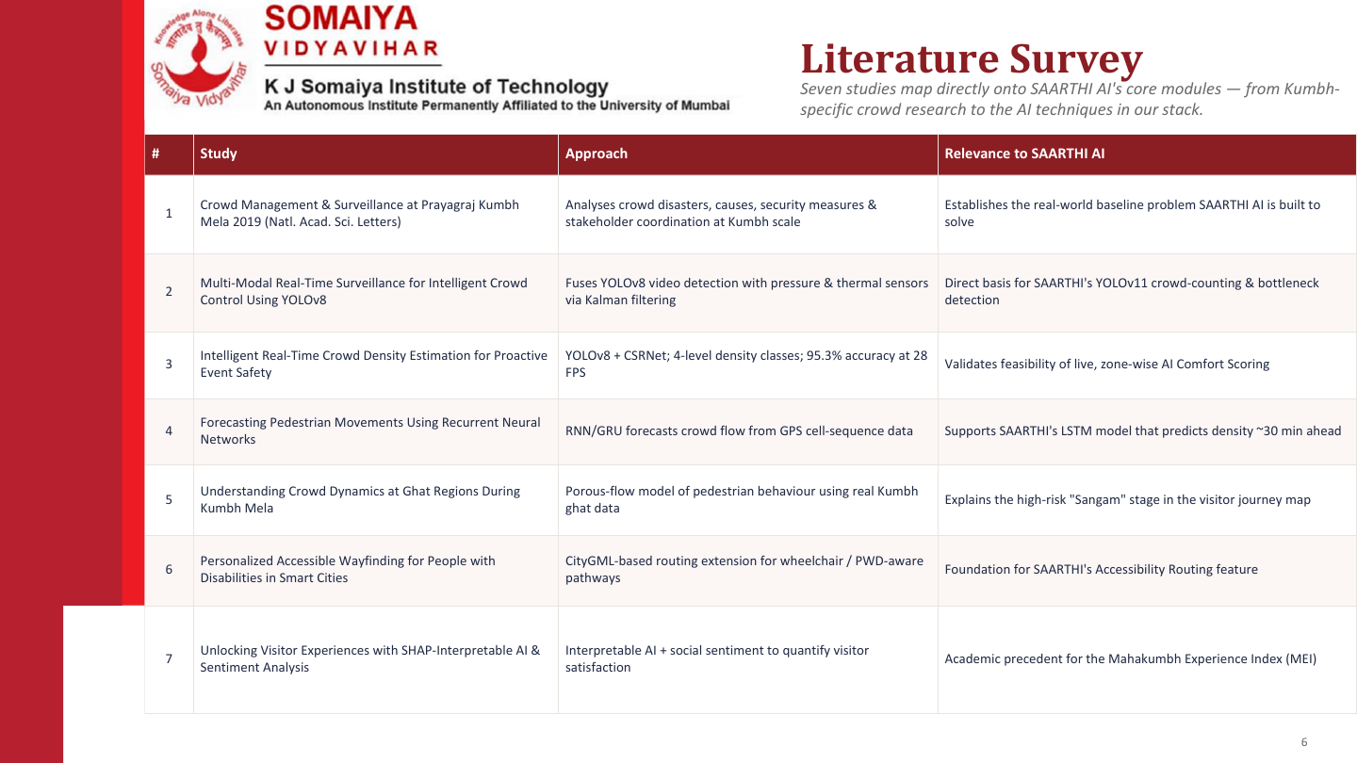
Literature Survey
Research on Kumbh safety, crowd analysis and digital reporting informs this prototype.
Relevance to KumbhRakshak
Sets the real-world safety and coordination context
Supports camera-based crowd observation as a future input
Shows density estimation can help zone-level review
Motivates forecasts, but field accuracy must be tested
Explains risk around ghat pedestrian bottlenecks
Supports accessibility-aware place guidance
Motivates human review of public reports and claims

Slide 7
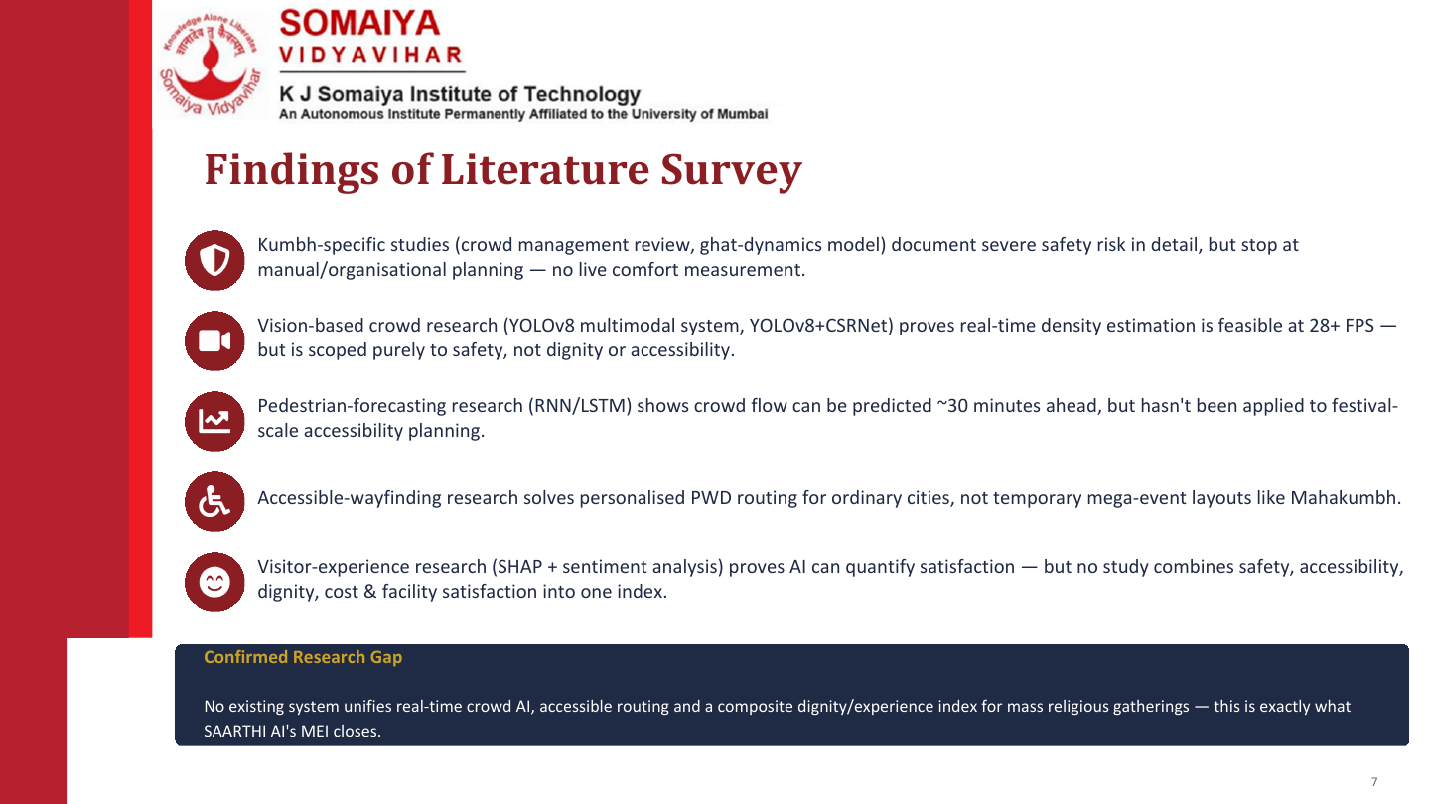
Kumbh studies show the scale of crowd coordination and safety planning.
Vision research supports crowd counting, but site-specific validation is essential.
Forecasting can aid early review when reliable local data is available.
Accessible navigation research informs a future verified route layer.
Fast-moving online claims require evidence and human approval before response.
Confirmed Research Gap
KumbhRakshak brings place context, monitoring views and response workflows together. Field validation remains necessary.

Slide 8
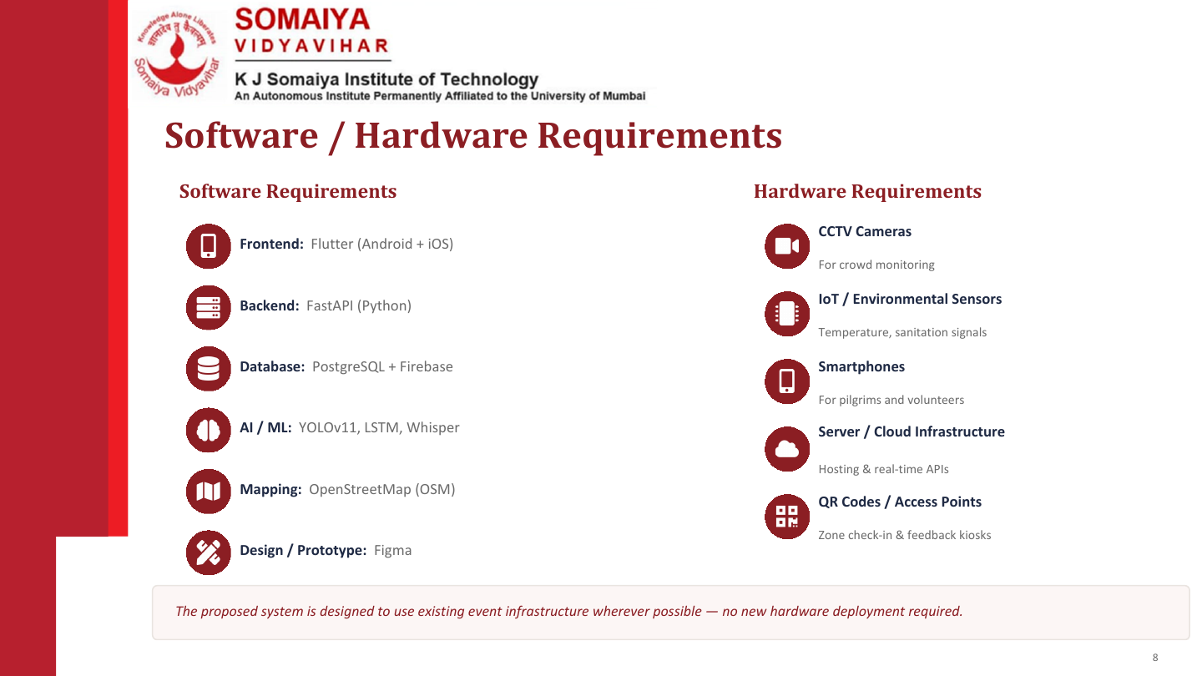
Frontend: Next.js, React, Three.js
Camera feeds: permissioned sources only
Backend: FastAPI and WebSockets
Operator laptop or server: 8-16 GB RAM
Data: Firestore adapter, demo memory mode
Phones: browsers for field access
AI: vision, claim and crowd modules
Network: reliable and secured APIs
Maps: Mapbox GL and OpenStreetMap
GIS: official ghat and facility coordinates
Tools: Docker, Git, VS Code
A live deployment needs official data access, security review and field testing.

Slide 9
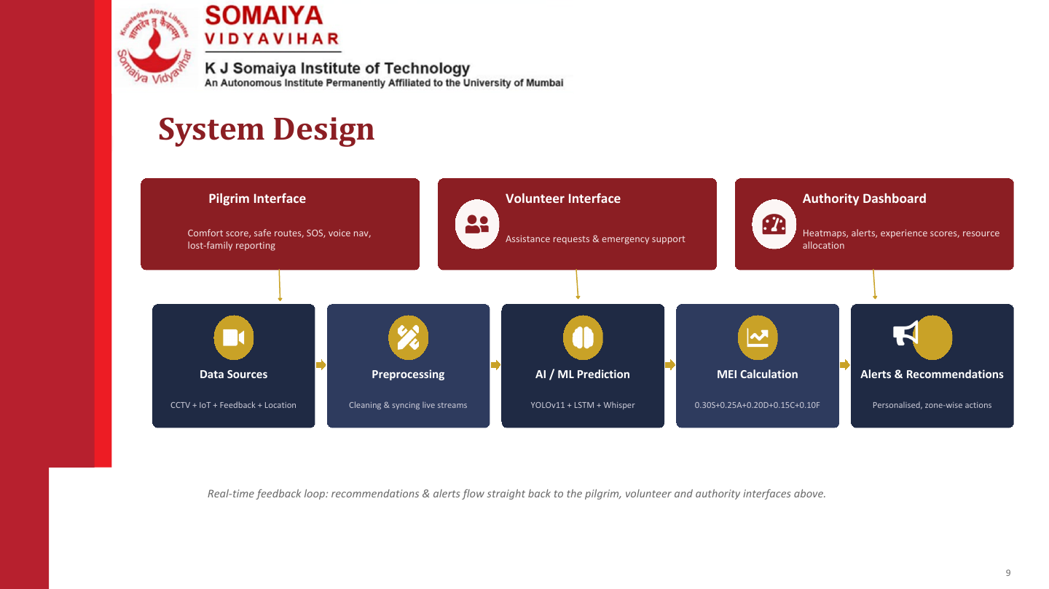
Public Interface
Field Interface
Operator Dashboard
Place guide, advisories and reports
Observations and incident support
Crowd, cameras and human decisions
Place & Signal Inputs
Event Review
Risk Indicators
Human Decision
Alerts & Guidance
Maps, feeds and reports
Evidence and context
Illustrative demo values
Operator approval
Approved actions
The dashboard connects each signal to a named location before an operator decides what to do.

Slide 10
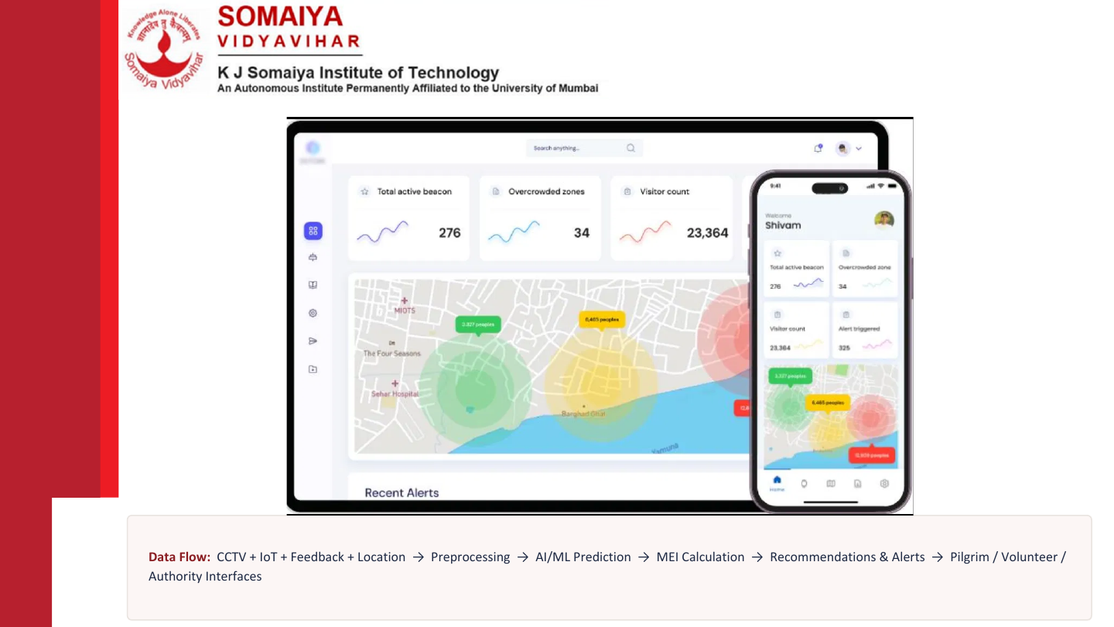
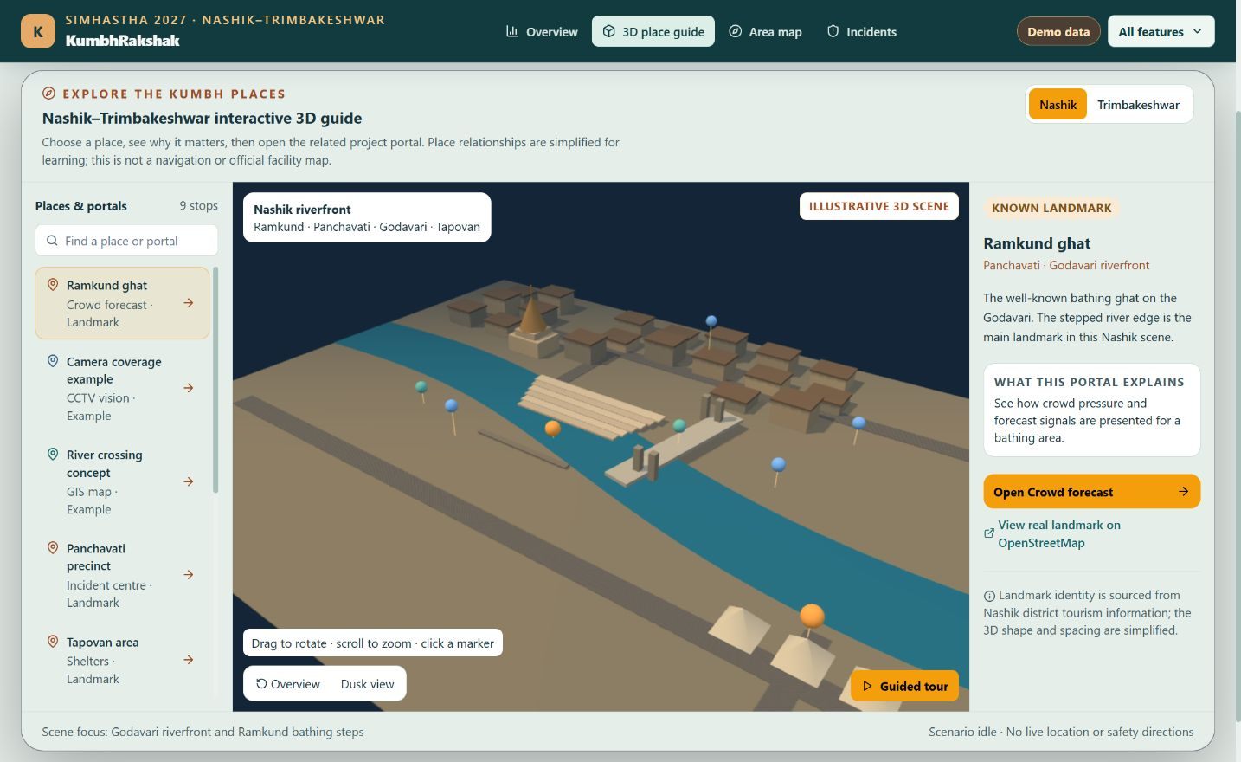
KumbhRakshak 3D Place Guide
Schematic Nashik scene: choose Ramkund or another visible landmark, then open its linked feature portal.
Notes:
Real screenshot from the local project demo on 3 October 2026. The 3D scene is illustrative, not an official site plan.

Slide 11
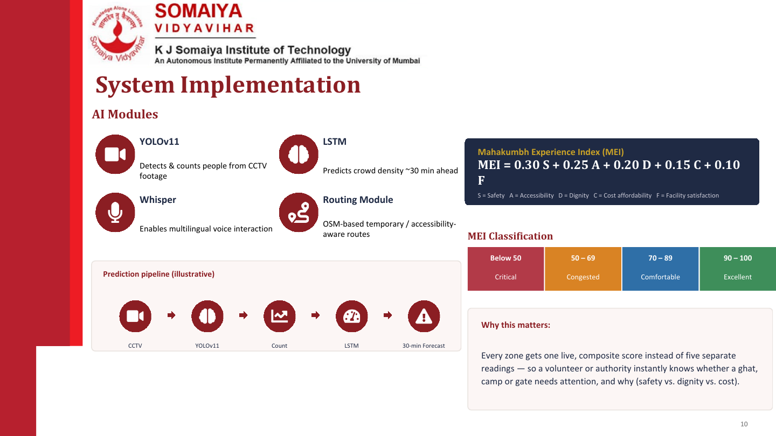
Prototype Modules
3D Place Guide
Crowd Portal
Illustrative Nashik and Trimbakeshwar scenes
Example 15, 30 and 60-minute forecasts
Prototype Status
Next.js front end + FastAPI back end
In-memory demo data and WebSocket events
Incident Portal
Claim Review
Timeline and operator review
Evidence before public response
Current boundaries
Demo workflow
• Real CCTV, crowd counts and GIS are not connected.
Select a place, open its portal, review the signal and record an operator decision.
• Scenario events and forecast values are simulated.
• Emergency actions need an authorized human operator.

Slide 12
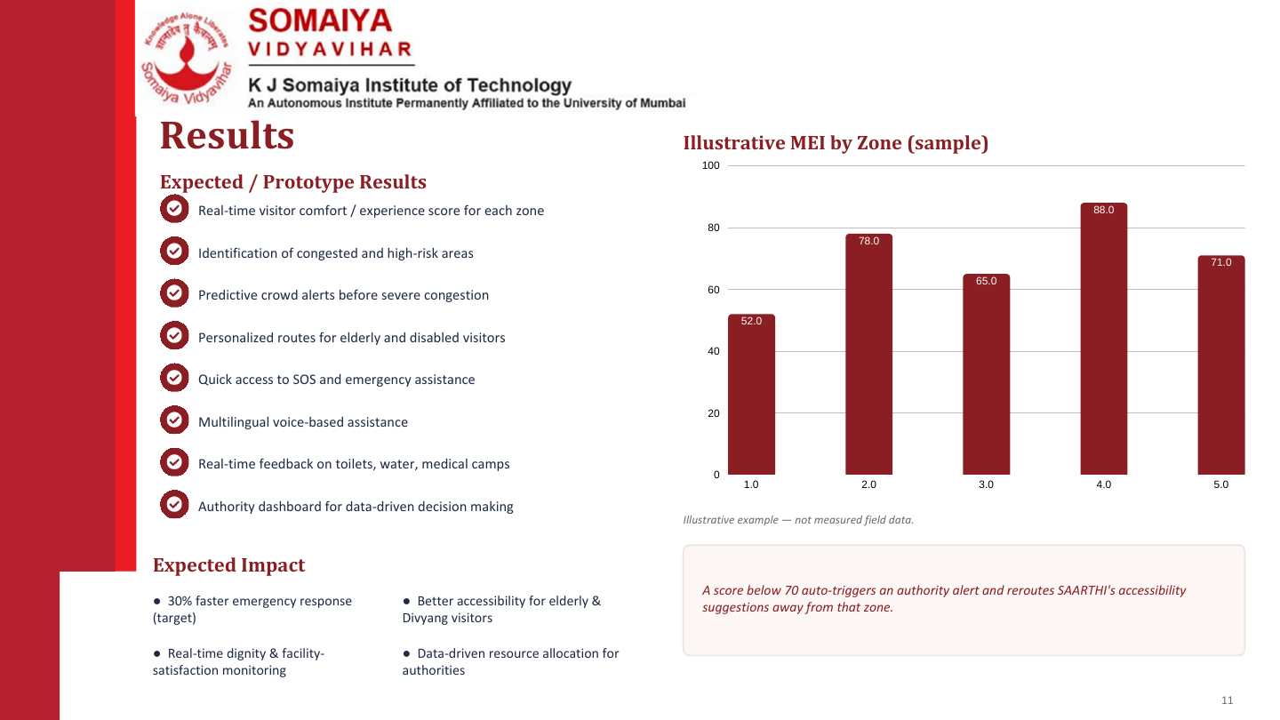
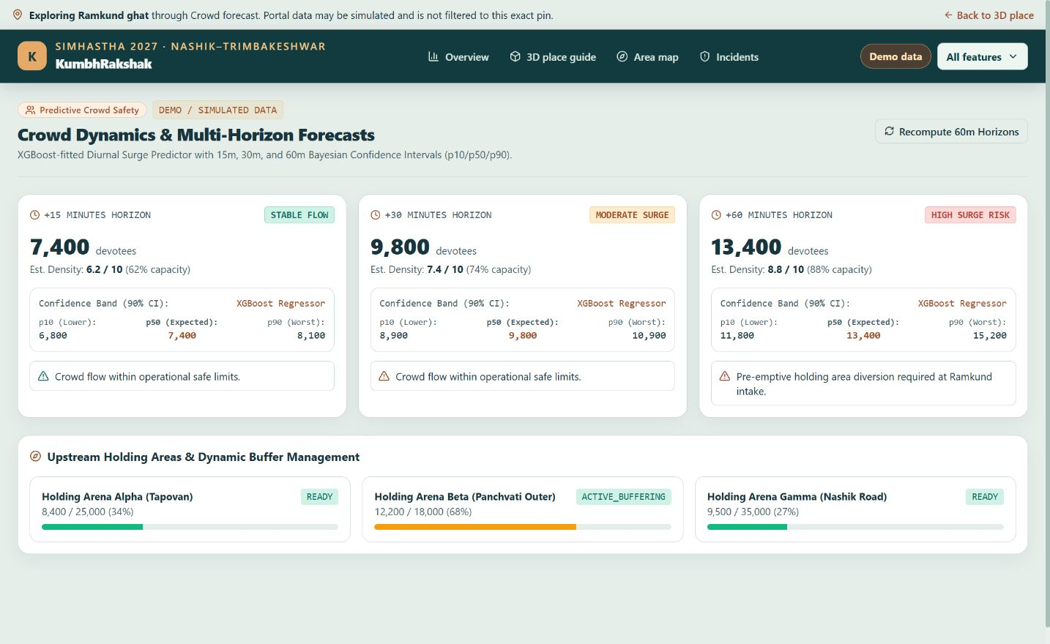
Demonstrated Prototype Results
3D place guide opens Nashik and Trimbakeshwar scenes
Ramkund hotspot links to a crowd-related portal
Simulation starts, pauses and logs injected demo events
Crowd portal displays example forecast cards
Overview groups available features by workflow
Local back-end tests passed in demo mode
All operational figures are labeled as illustrative
Field accuracy and response impact remain untested
Crowd portal: simulated values
Validation before field use
The screenshots demonstrate software behavior; they do not establish safety performance at a real event.
Connect verified GIS and live feeds, then test alerts, accuracy and response workflows with local authorities.
Notes:
Screenshot from local project demo, 3 October 2026. Forecast values are simulated, not measured field data.

Slide 13
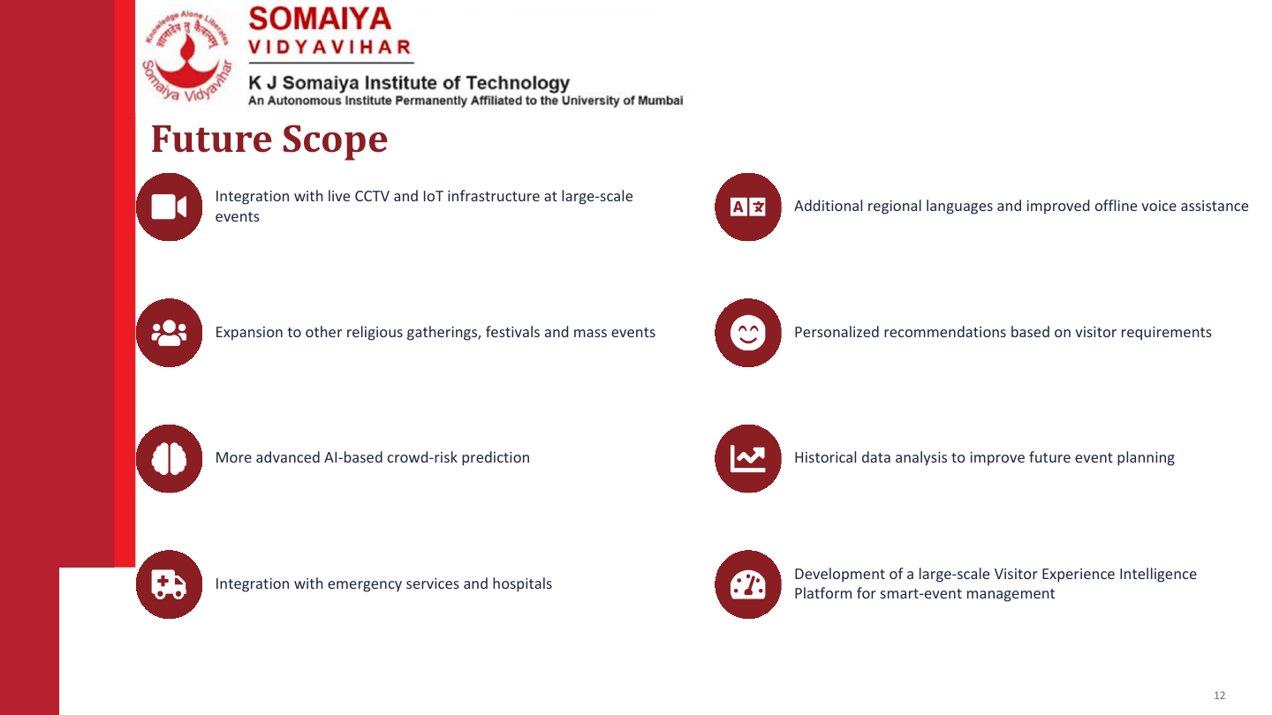
Use approved 2027 GIS and ghat facility coordinates
Add audited, multilingual public guidance
Integrate permissioned camera and incident feeds
Test low-connectivity use with volunteers
Measure risk-model accuracy and false alerts locally
Run staged pilots before operational use
Study historical data for future planning
Connect emergency services through approved protocols

Slide 14
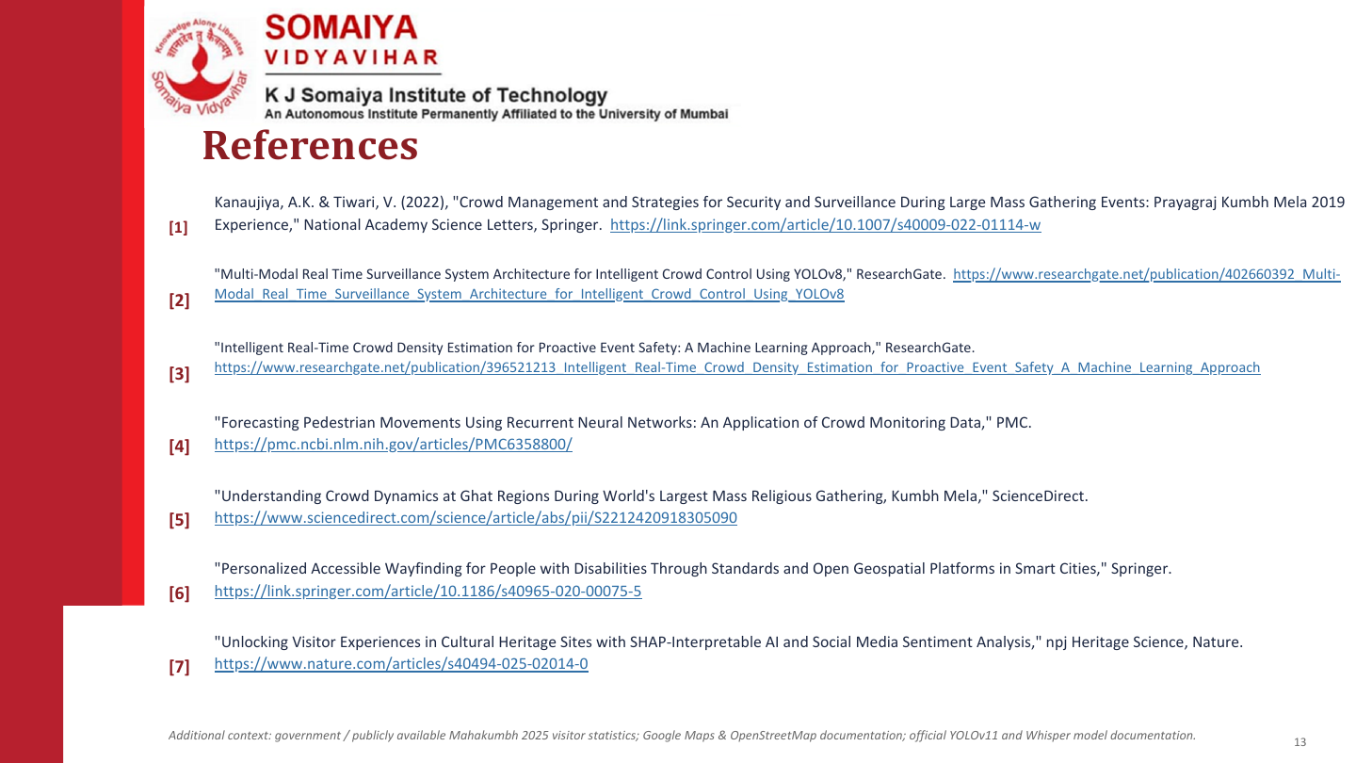
[1]
Kanaujiya, A.K. & Tiwari, V. (2022), Crowd Management and Strategies for Security and Surveillance During Large Mass Gathering Events: Prayagraj Kumbh Mela 2019 Experience. National Academy Science Letters.
[2]
Nashik District Administration, Ramkund Nashik, official landmark information.
[3]
Nashik District Administration, Kushavart Tirtha, Trimbakeshwar, official landmark information.
[4]
Tiwari, S. & Chowdhary, R. (2022), Technology and crowd management: Kumbh case study.
[5]
KumbhRakshak project repository: github.com/hardiksedani/mahakumbh_projects
[6]
KumbhRakshak local website prototype, screenshots captured 3 October 2026.
Notes:
Project repository: https://github.com/hardiksedani/mahakumbh_projects
Official landmark sources: https://nashik.gov.in/en/tourist-place/ramkund-nashik/ and https://nashik.gov.in/en/tourist-place/kushavart-tirtha-trimbakeshwar/

Slide 15
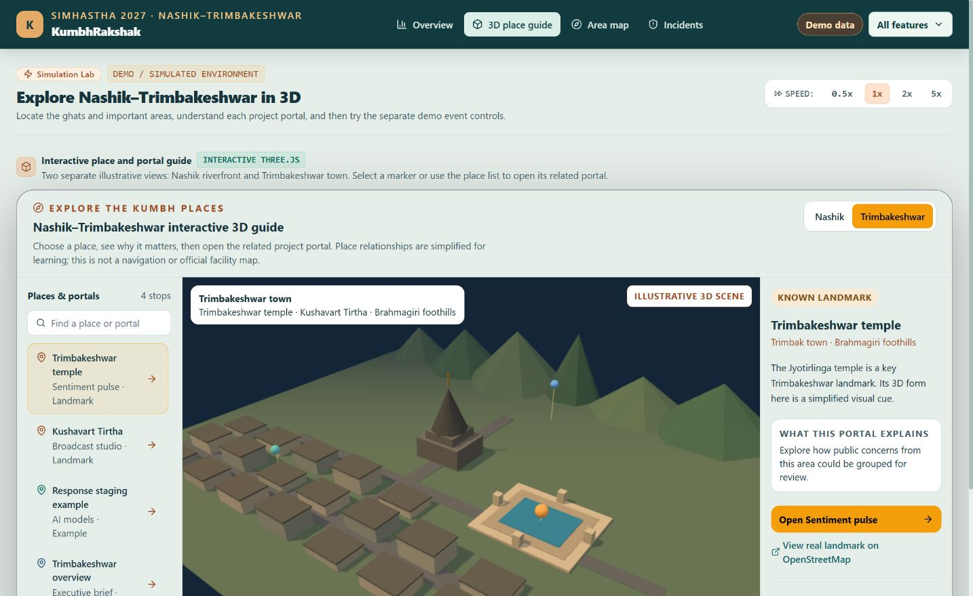
Two Linked 3D Scenes
Nashik and Trimbakeshwar each have schematic landmarks and direct links to the relevant feature portals.
Notes:
Two screenshots from the local project demo. Scenes and pin locations are illustrative and require official GIS approval.

Slide 16

Notes:
Thank you.

