Slide 1
CS-305 Project
Team Zero Dawn

Slide 2
Introduction to IPCP
IPCP classifies program counters into known prefetching ideas
Namely - Global Stream, IP Stride, Complex Stride and Next Line
Reference: https://www.cse.iitb.ac.in/~biswa/IPCP_ISCA20.pdf

Slide 3
The Goal
To improve performance of IPCP where it is low ☺

Slide 4
Where is it low?
In perlbench, mcf, omnetpp, leela, xz

Slide 5
Why is it low?

Slide 6
600.perlbench_s-570B

Slide 7


About the benchmark
The workload of this benchmark consists of:
SpamAssassin MHonArc Specdiff from SPEC 2017
(A mail spam filter) (An email to html converter)
A utility tool that checks the Benchmark output

Slide 8


All of the loads have a thing in common which is ...

Slide 9


String Processing
So we can expect large chunks of contiguous access patterns from the memory.

Slide 10
Why improvement is low?
Perlbench is mostly insensitive to prefetching and the L1D hit-rate is already ~99.95% which is very high and there is little improvement in implementing a prefetcher.
The working set size of this string processing application is small and the addition of the prefetching unit itself adds overhead to the runtime of the benchmark.
Perlbench has a limited need for cache capacity and can be well executed without the need to regularly lookup the main memory.

Slide 11
Improvement Efforts
Since the coverage by the global streaming class was the least for the perl benchmark, decreasing the size of the global history buffer slightly increased the IPC.
Next line class has good coverage, so the priority of prefetching was changed by making the next line prefecture first, followed by GS, CS and CPLX classes, which gave some improvements.
Decreasing the threshold value of confidence for CS prefetching also helped in slight improvement.
Prefetch Degree updation based on prefetch hits/misses and confidence.

Slide 12
Some metrics
 | Baseline | IPCP | IPCP-modified
IPC | 1.38966 | 1.39974 | 1.40294
L1D miss rate | 0.049% | 0.033% | 0.036%
L2C miss rate | 72.35% | 47.85% | 29.95%
IPC Improvement | 1.0000000000 | 1.00725357282 | 1.00955629435
We can observe a substantial improvement in the hit rate of the L2 cache which slightly increases the IPC despite the slight decrease in L1D hit-rate. Due to the very high rate of the baseline, the observed improvement is very less.

Slide 13
641.leela_s-1083B

Slide 14

About the benchmark
This benchmark is a Go playing engine featuring Monte Carlo based position estimation

Slide 15
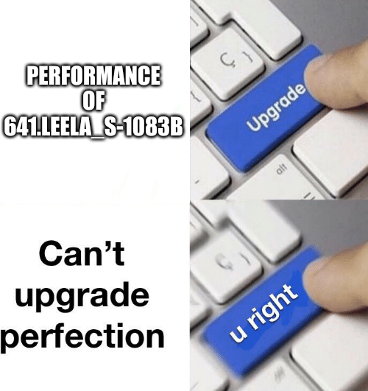
Why Less Improvement with IPCP?
Leela have 98.8% hit rate in L1D and 96% hit rate in L2C with no prefetcher
This testbench is not too much memory intense and have greater temporal locality
Using IPCP reduced number of misses by nearly 42% but the number of misses are already low with no prefetcher, hence we were unable to find any substantial improvement

Slide 16
Some Improvements
Since most of the IP’s are being classified as CPLX, hence increasing the prefetch degree for CPLX class slightly improved the IPC
Checking MSHR occupancy to decide the fill level of prefetching data and using a two bit ip_valid field which will increase for every memory access by that ip and decrease in case of conflict with another ip also slightly improved the IPC (to 0.763654)

Slide 17
Some Results
Prefetcher | No Prefetcher | IPCP | Modified with MSHR occupancy
IPC | 0.753105 | 0.763613 | 0.763654
CPLX class Prefetch Degree | 3 | 5 | 9 | 13
IPC | 0.753105 | 0.763714 | 0.763855 | 0.763985

Slide 18
620.omnetpp_s-141B

Slide 19
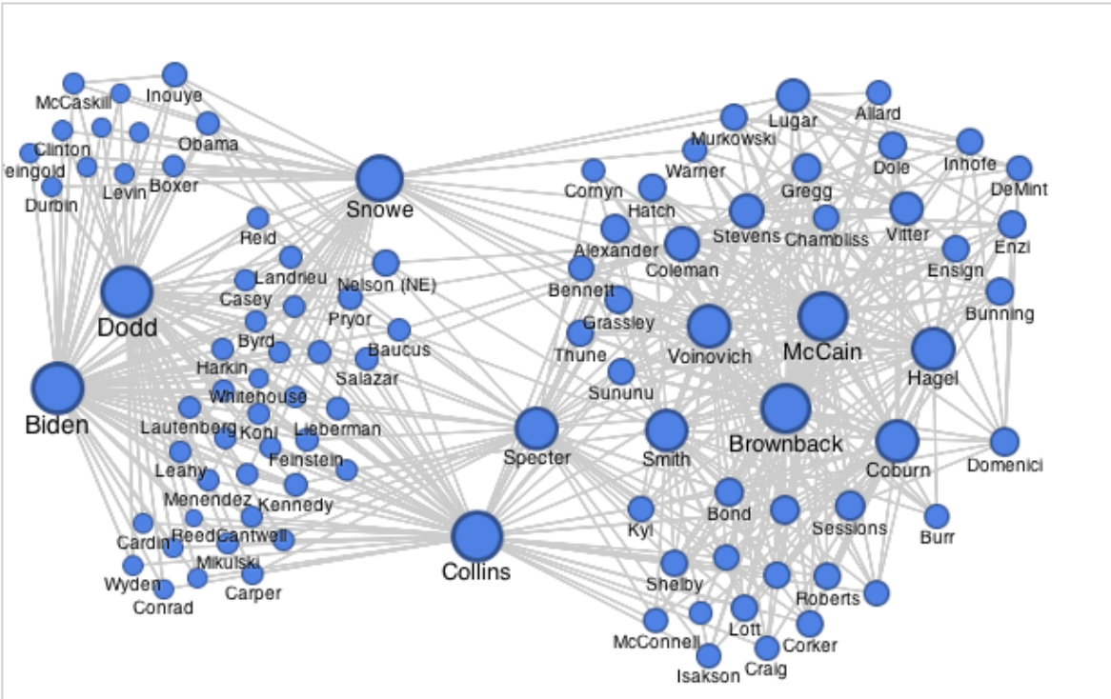
About benchmark
Ethernet Simulation:
Physical layers
Traffic generation
Discrete event simulator

Slide 20
What to expect?
Random memory access are inherent. For eg : send a packet to randomly selected node in the network
Graphs traversals are involved. Eg : Packet traversal, shortest path algorithms.
Should we expect good locality access?
Can we expect 100% coverage? No.
Cannot predict random selection of nodes with any learning scheme.

Slide 21

Some metrics
 | Baseline | IPCP
IPC | 0.309583 | 0.32368
L1 cache hit rate | 93.34% | 93.56%
L2 cache hit rate | 29.21% | 40.49%
LLC cache hit rate | 19.72% | 24.91%
High L1D hit rate, locality is expected
Improvement mainly coming from L2, LLC
Performance improvement : 4.5%
*Above metrics are based on only loads

Slide 22


Why Low improvement
Low prefetching accuracy. Leading to cache pollution too
Eg: L2 prefetches more lines than the no of request!!! (about 50%)
Probably CPLX class unable to capture random access and graph traversal algorithm’s memory access
Maybe the program is already close to max theoretical speed. (Assuming random access cannot be predicted)
What’s next line?

Slide 23
Our efforts : Further improvement
Disabling CPLX prefetching : Improved a further 1%
Adjust degree based on confidence in cplx : Improved further by 0.4%
Advantage : Less cache pollution
Tweaking existing parameters also didn’t bring any further improvements beyond 1%
Default NL prefetching at L2 : Very little further improvement (0.27%)

Slide 24
605.mcf_s-994B

Slide 25
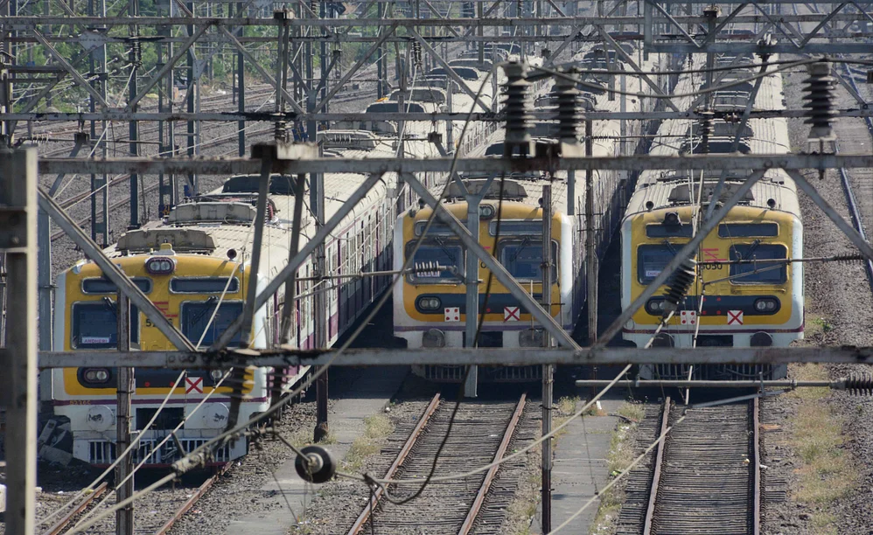
605.mcf_s-994B
Benchmark derived from single-depot vehicle scheduling in public mass transportation.
High miss rate in L2C and LLC already and IPCP degraded the performance.

Slide 26
Some metrics
 | Baseline | IPCP
L1D hit rate | 88.6% | 89%
L2C hit rate | 43.8% | 41%
LLC hit rate | 46.7% | 37%
The coverage of NL is very high and a lot of data is uncovered
We can expect good locality here because of the L1D hit rate

Slide 27
Some experiments
The baseline IPC for 10 + 10 instructions is 0.406337 and IPCP produced a value of 0.382881
When the NL part of the prefetcher was removed, an improvement of 0.6% was observed over baseline
When the NL threshold was decreased, an improvement of 0.4% was observed over baseline
When prefetch control based on page numbers was added, an improvement of 5.5% was observed over IPCP but still 0.6% degradation over baseline

Slide 28
Observations
Next line prefetching giving degradation may imply that there is some back-and-forth accesses in program
As with the other benchmarks, the L1D hit rate here is already high (~89%), which makes the prefetching effort have little value

Slide 29
657.xz_s-2302B

Slide 30
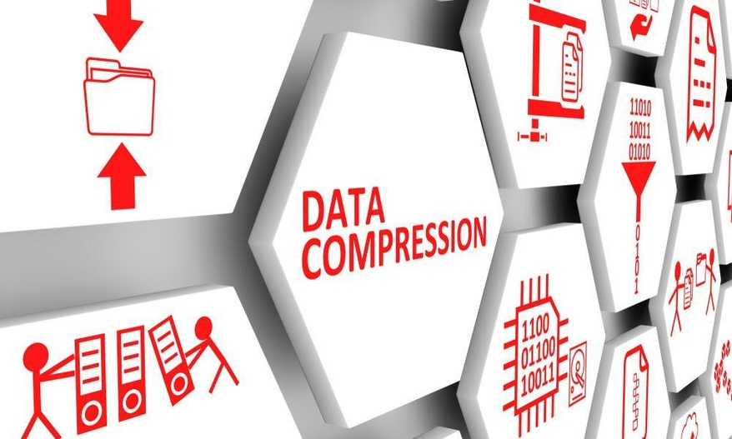
About the benchmark
xz Data Compression - entirely in memory
No IO - focusing on performance of CPU, memory

Slide 31
Some metrics
 | Baseline | IPCP
IPC | 0.819729 | 0.811273
L1D cache hit rate | 96.43% | 96.54%
L2C hit rate | 50.16% | 47.26%
This benchmark is similar to omnetpp and mcf - expect high locality as L1D hit rate is high

Slide 32

Attempts at Improving
Similar to what was done for the previous benchmarks.
When NL prefetching is removed an improvement of 0.4% over IPCP is observed
When NL threshold is decreased, an improvement of 0.1% over IPCP
What could we do?

Slide 33
Ideas

Slide 34
Modification Idea to IPCP
Used MSHR occupancy in L1D cache to decide fill_level for the prefetch. Used a 2-bit ip_valid field which increases upon accessing the IP table by the same IP and decreases on being accessed by a different IP

Slide 35
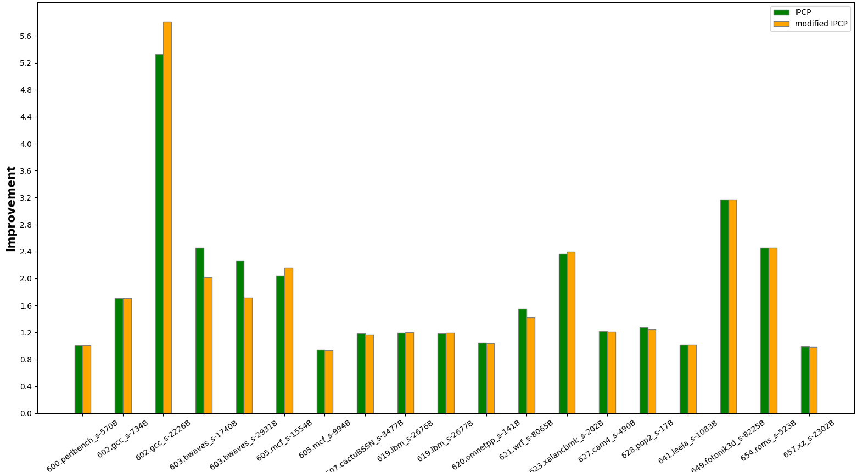
The results obtained are

Slide 36
Some Observations
IPCP gave an average improvement(in IPC) of 80.98% where as the modified code gave an average improvement(in IPC) of 78.21% over these 19 benchmarks
The decrease in improvement after modifying the IPCP is maybe because some testbenches may find most of the prefetching data in it’s own cache, hence no need to check for MSHR occupancy

Slide 37
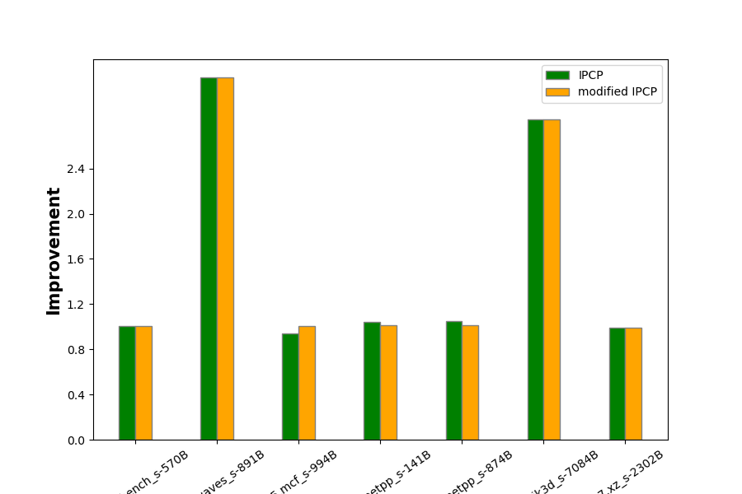
Some results for NL removal

Slide 38
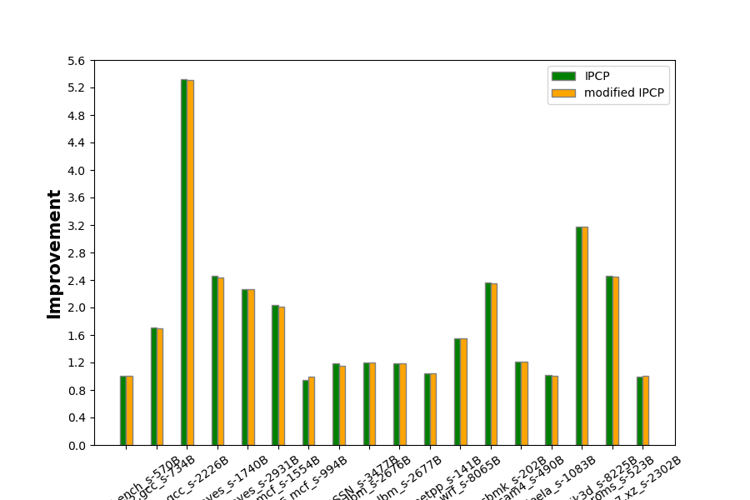
Some results for thrash protection

Slide 39
Conclusions

Slide 40
Conclusion
We have implemented some new ideas like thrashing protection and using MSHR occupancy to decide the fill level
We weren’t able to improve the low performing benchmarks by that much because they are irregular traces, but we got some insights and were able to get small improvements individually

Slide 41
Thank You

