Slide 1
Sobel Edge Detection using HLS on the Zybo Z7000
FINAL PROJECT PRESENTATION
Presented by :- FNU Hardik

Slide 2
Presentation Outline
2
General Overview
Sobel Edge Detection Algorithm
HLS Implementation (C++ source code)
Vivado RTL Integration
Simulation Results (HLS)
Conclusions
Demonstration
References

Slide 3


General Overview
3
This project implements a video processing pipeline that captures video data from an incoming HDMI stream and applies a Sobel Edge Detection filter to create a black and white, edge detected output video stream.
The figures below show an image before and after a Sobel filter was applied to it. The images have been referenced from [1].
Figure 1: Before Sobel (left) and After Sobel (right) [1].
These images shown above have been processed in a 640x480p resolution and hence might seem more prominent than my demonstration later-on in this presentation because I’ve implemented the processing algorithm in a 1280x720p resolution.

Slide 4
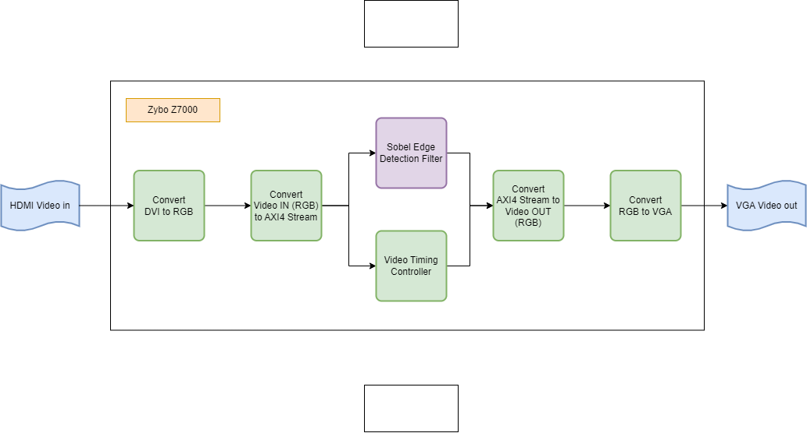
General Overview
4
The figure below shows a high-level block diagram of the algorithm used to implement this project.
Figure 2: Block Diagram of Sobel Edge Detector Implementation.

Slide 5
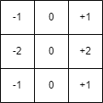
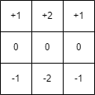

Sobel Edge Detection
5
Sobel Edge Detection works using two 3x3 Kernels, which iterate over the entire 1280x720 pixel array and creates a filtered output which consists of only black and white pixels.
The black pixels denote no change in intensity values while the white pixels signify a change in intensity values or an edge.
Figure 3: 3x3 Sobel Kernel in X-axis (left) and Y-axis (right).
The 3x3 Kernels are convoluted with the original image to calculate approximations of the derivatives in the X and Y directions.
The resulting gradient approximation can be combined to give the actual gradient magnitude using:
G = $\sqrt{G_{x}^{2}+G_{y}^{2}}$

Slide 6
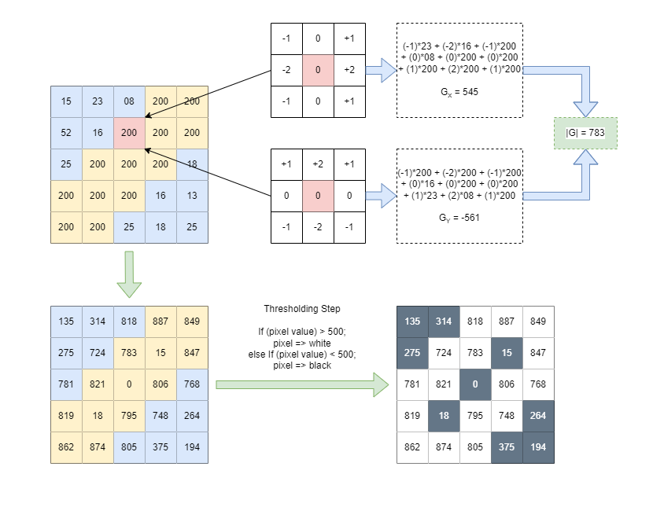
Sobel Edge Detection
6
Figure 4: Sobel Kernel Convolution Visualization.

Slide 7
HLS Implementation
7
HLS stands for “High Level Synthesis”.
It is a workflow which allows software programmers (more experienced with C/C++) to design RTL components using High Level Programming languages instead of the normal workflow which involves using VHDL and Verilog.
In this workflow the RTL modules are written as functions in C/C++, these functions will prompt the compiler/synthesis tool to create hardware components which mimic the behavior of the described C++ code.
Few major disadvantages of this workflow include:
Functions involving repeated iterations over the same input data might need to be optimized or pipelined in order to adhere to any timing restrictions. This problem becomes more emphasized in streaming designs like this presentation.
Most of the C/C++ functions (modules) made in this manner will not be synthesizable into actual hardware components and so provisions will need to be made.
Support for any errors encountered during design process will be limited and the designer will be lucky if he is able to find any help online.

Slide 8
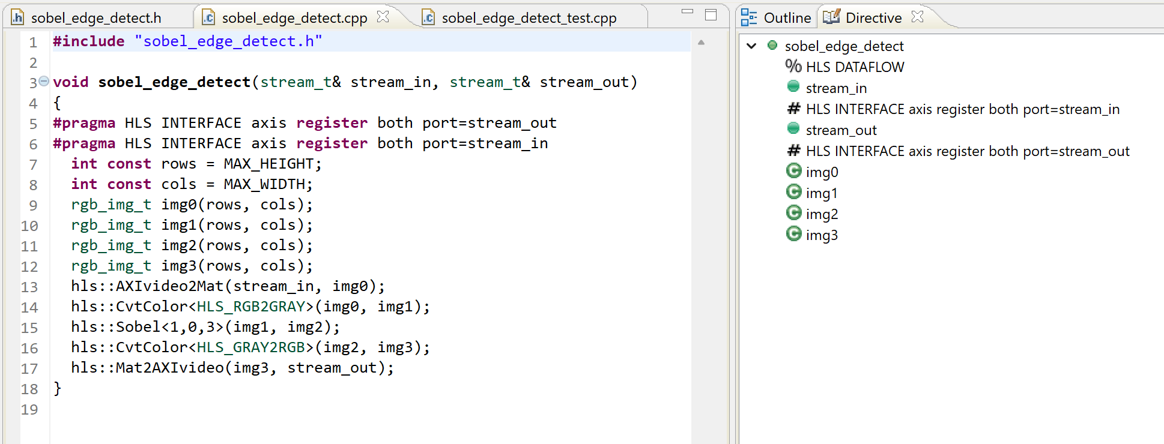
HLS Implementation
8
The figure below shows the source code (C++) of the main Sobel module.
Figure 5: Sobel Edge Detection main module source code (C++).

Slide 9
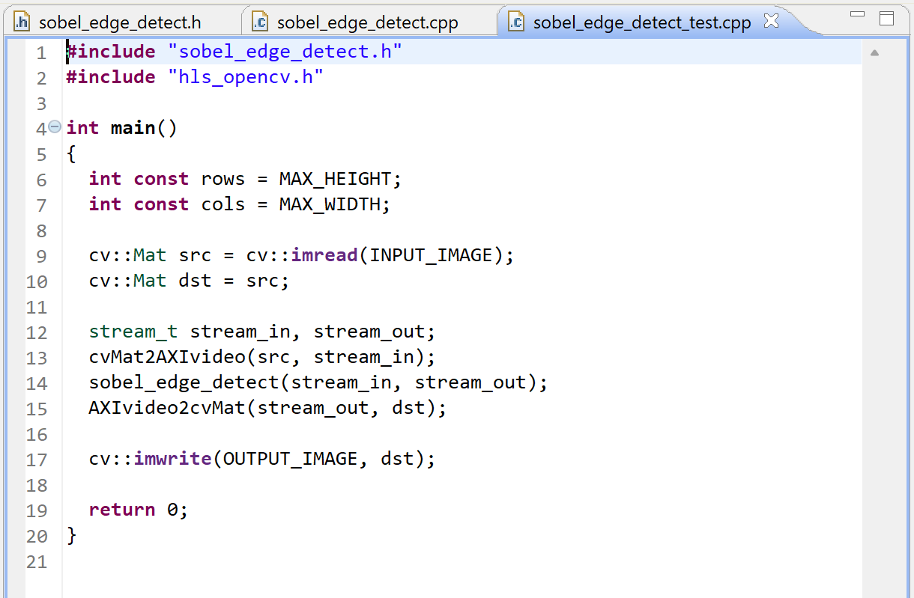
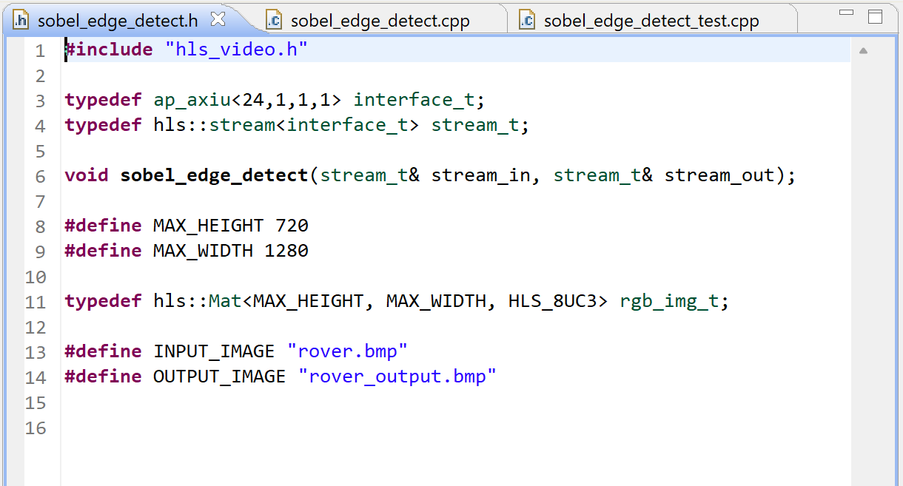
HLS Implementation
9
The figure below shows the source code (C++) of the header file and the testbench modules.
Figure 6: Sobel Edge Detection header file (left) and Testbench module (right) source code (C++).

Slide 10
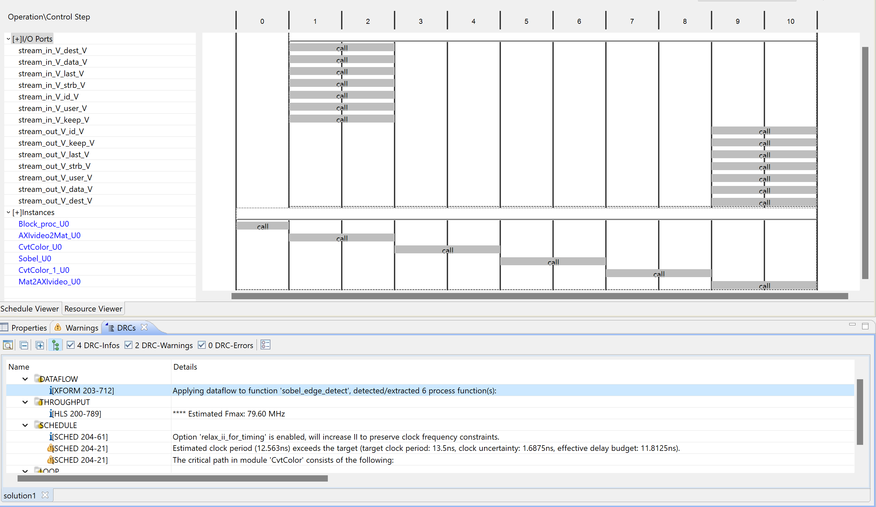
HLS Implementation
10
The figure below shows the different pipeline stages that the compiler (Vivado HLS) has determined based on the HLS dataflow directive.
Few things to note from the figure presented here:-
The design has been segmented into 6 stages of pipeline automatically by the compiler.
The design can perform at a maximum of 79.60 Mhz, we wish to utilize it at 74 Mhz which is within limits.
The bottleneck for this design is the stage called ‘CvtColor_U0’.
Figure 7: Pipeline Stages for Sobel Edge Detection RTL module.

Slide 11
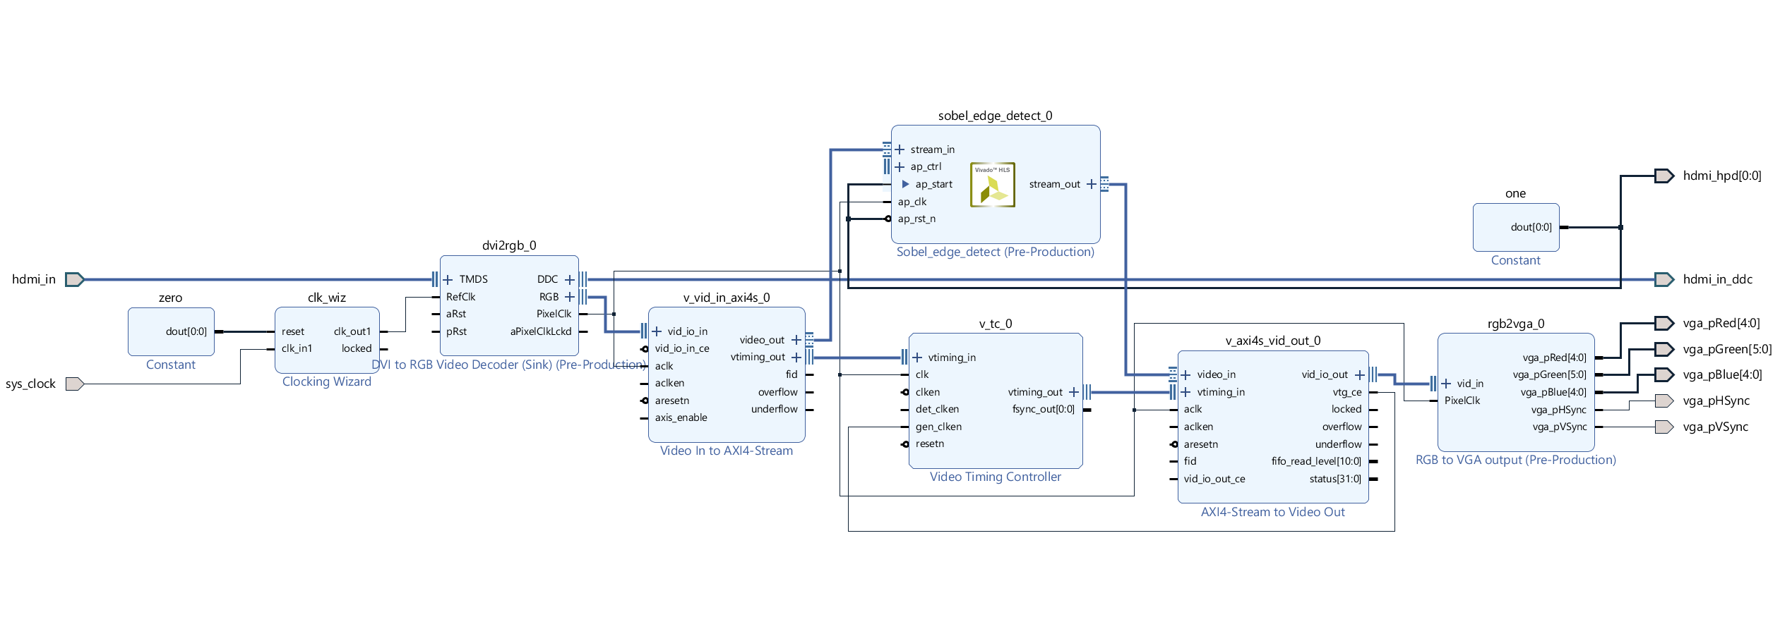
Vivado RTL Integration
11
The figure below shows the Sobel IP package created using the HLS workflow integrated into a block design in Vivado.
Figure 8: RTL Schematic including the Sobel IP block imported from HLS.

Slide 12

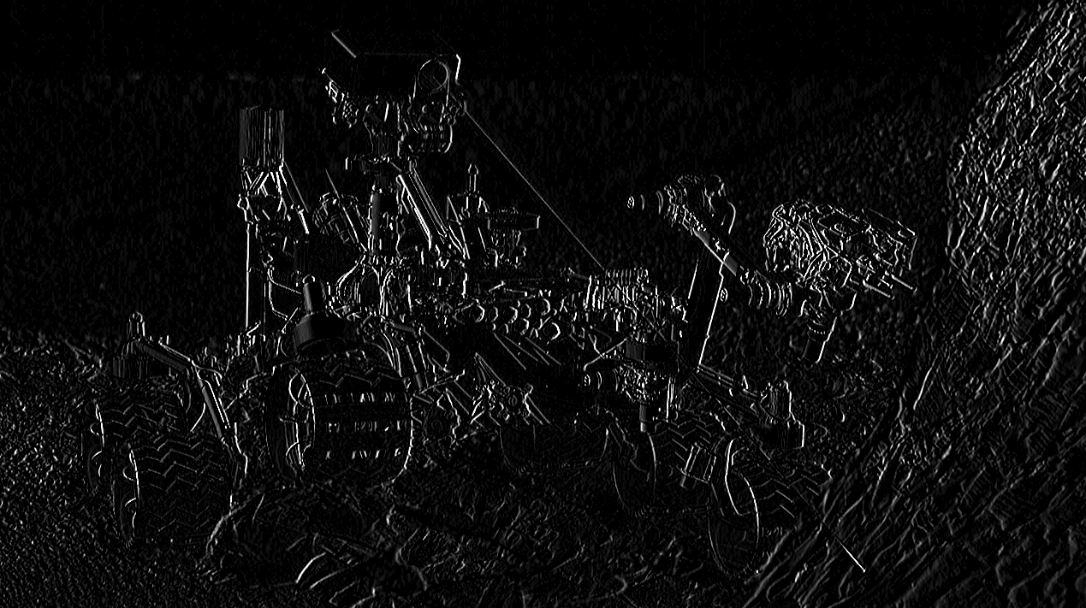
Simulation Results (HLS)
12
The figures below show the C++ (HLS) Testbench results.
Figure 9: Image before Sobel processing (left) and after Sobel processing (right).

Slide 13
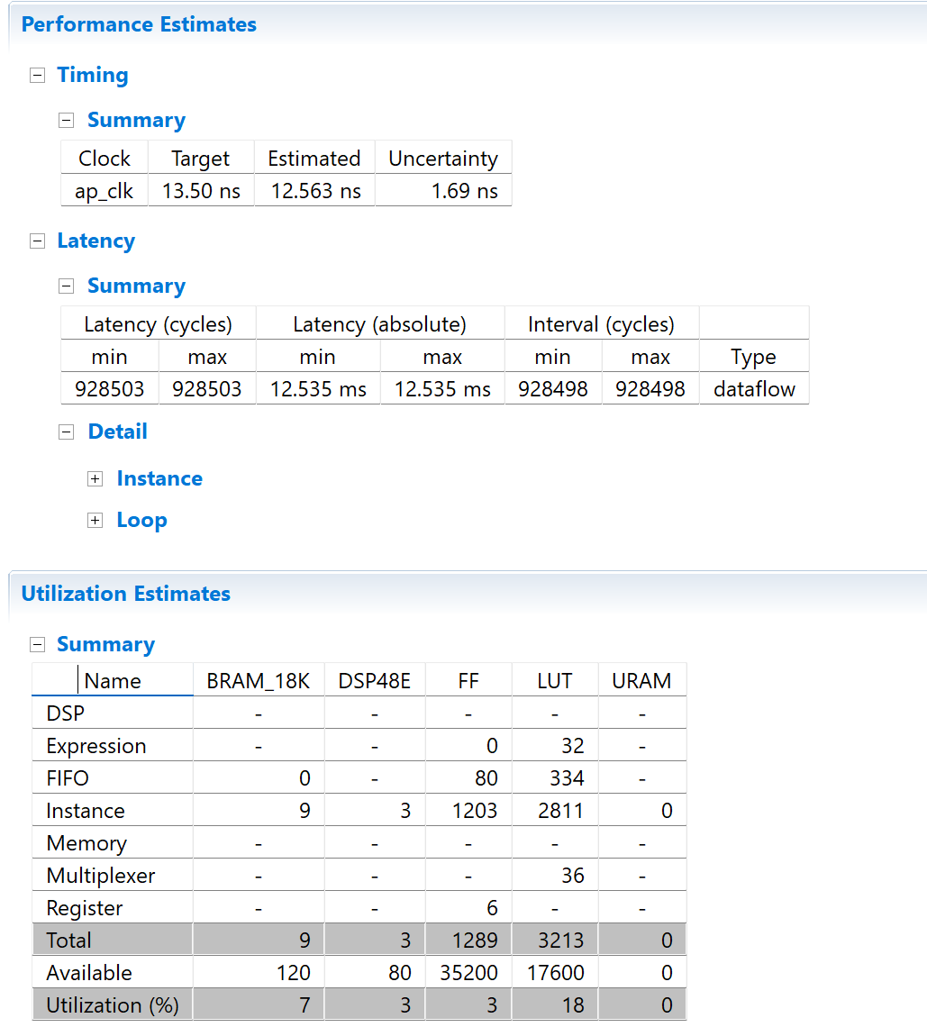
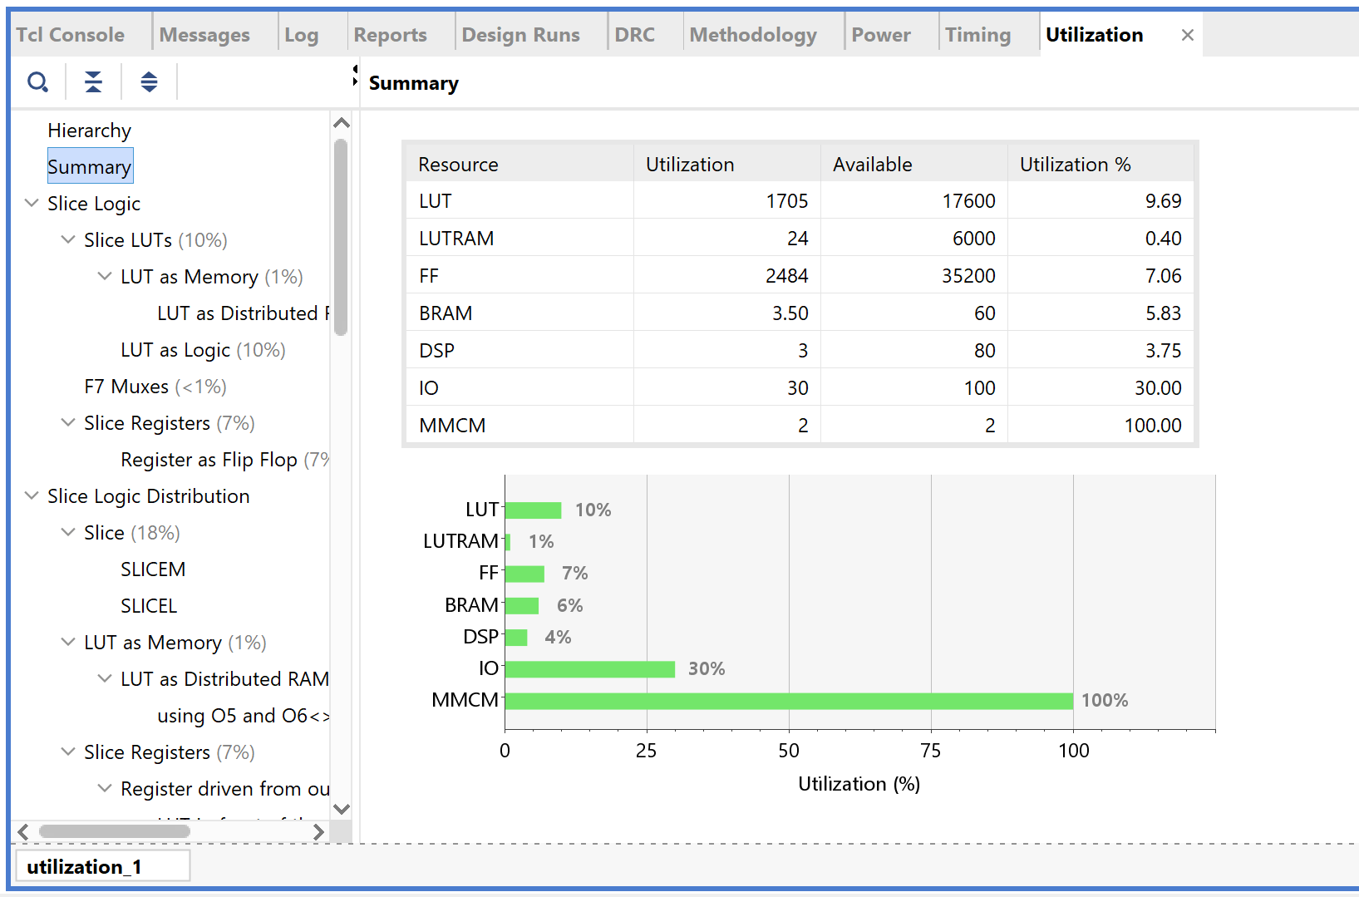
Conclusions
13
The figures below show the resource utilization specifically for the Sobel Edge Detect Module (HLS utilization reports) and the overall utilization summary (Vivado reports).
Figure 11: Resource Utilization Summary (Vivado)
Figure 10: Performance Estimates (HLS)

Slide 14
Demonstration
14

Slide 15
References
15
[1] Research Paper - Sobel Implementation: https://iopscience.iop.org/article/10.1088/1742-6596/1678/1/012105/pdf
[2] Vivado HLS User Guide: https://docs.xilinx.com/v/u/2017.4-English/ug902-vivado-high-level-synthesis
[3] HLS User Guide: https://docs.xilinx.com/r/en-US/ug1399-vitis-hls
[4] Xilinx Application Note - SoC Sobel Filter Implementation: https://docs.xilinx.com/v/u/en-US/xapp890-zynq-sobel-vivado-hls
[5] FPGA HLS Design and Verification Techniques: https://indico.cern.ch/event/442428/attachments/1200645/1748090/mhusejko_PH_ESE_HLS_v3.pdf

Slide 16
QnA ?

