Slide 2
Spring Data JPA

Slide 3
JPA
What is JPA?
Java Persistent API
ORM (Java object, DB tables)
Hibernate V/s JPA
JPA is a specification whereas Hibernate is one of the implementation
What is Spring data JPA?
Implementing a data access layer of an application has been cumbersome for quite a while. Too much boilerplate code has to be written to execute simple queries as well as perform pagination, and auditing. Spring Data JPA aims to significantly improve the implementation of data access layers by reducing the effort to the amount that’s actually needed.
As a developer you write your repository interfaces, including custom finder methods, and Spring will provide the implementation automatically.
http://projects.spring.io/spring-data-jpa/
Spring Data JPA is not a JPA provider.
library / framework that adds an extra layer of abstraction on the top of JPA provider
lot of abstraction from writing SQL and even some HQL using query method declaration
Hibernate V/s Spring-JPA

Slide 4
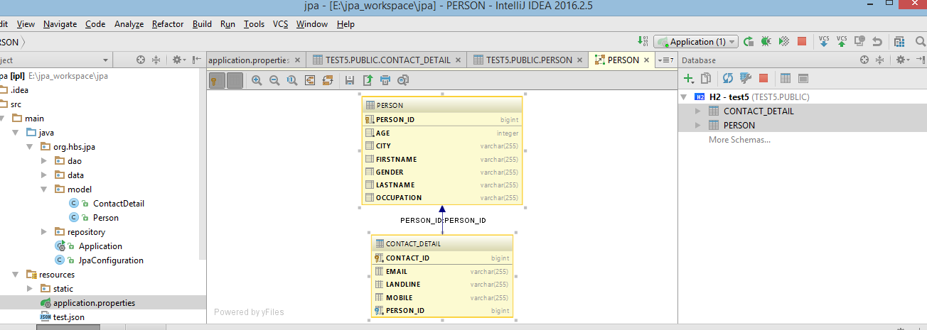

Slide 5
https://docs.spring.io/spring-data/jpa/docs/current/reference/html/
Table 4. Supported keywords inside method names
Keyword | Sample | JPQL snippet
And | findByLastnameAndFirstname | … where x.lastname = ?1 and x.firstname = ?2
Or | findByLastnameOrFirstname | … where x.lastname = ?1 or x.firstname = ?2
Is,Equals | findByFirstname,findByFirstnameIs,findByFirstnameEquals | … where x.firstname = ?1
Between | findByStartDateBetween | … where x.startDate between ?1 and ?2
LessThan | findByAgeLessThan | … where x.age < ?1
LessThanEqual | findByAgeLessThanEqual | … where x.age <= ?1
GreaterThan | findByAgeGreaterThan | … where x.age > ?1
GreaterThanEqual | findByAgeGreaterThanEqual | … where x.age >= ?1
After | findByStartDateAfter | … where x.startDate > ?1
Before | findByStartDateBefore | … where x.startDate < ?1
IsNull | findByAgeIsNull | … where x.age is null
IsNotNull,NotNull | findByAge(Is)NotNull | … where x.age not null
Like | findByFirstnameLike | … where x.firstname like ?1
NotLike | findByFirstnameNotLike | … where x.firstname not like ?1
StartingWith | findByFirstnameStartingWith | … where x.firstname like ?1(parameter bound with appended %)
EndingWith | findByFirstnameEndingWith | … where x.firstname like ?1(parameter bound with prepended %)
Containing | findByFirstnameContaining | … where x.firstname like ?1(parameter bound wrapped in %)
OrderBy | findByAgeOrderByLastnameDesc | … where x.age = ?1 order by x.lastname desc
Not | findByLastnameNot | … where x.lastname <> ?1
In | findByAgeIn(Collection<Age> ages) | … where x.age in ?1
NotIn | findByAgeNotIn(Collection<Age> age) | … where x.age not in ?1
True | findByActiveTrue() | … where x.active = true
False | findByActiveFalse() | … where x.active = false
IgnoreCase | findByFirstnameIgnoreCase | … where UPPER(x.firstame) = UPPER(?1)

Slide 6
Can call procedure as well through JPA
Predicate can be used to form query
Transaction Management
Locking
Auditing
http://docs.spring.io/spring-data/jpa/docs/1.4.1.RELEASE/reference/html/jpa.repositories.html

Slide 7
Github URL
https://github.com/hardiksodha/jpa

Slide 8
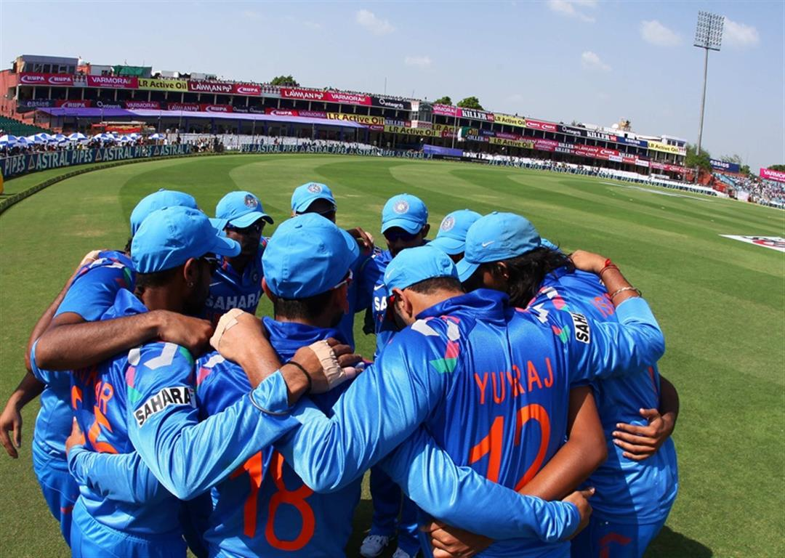
Thanks!!
Q & A.

