Slide 1
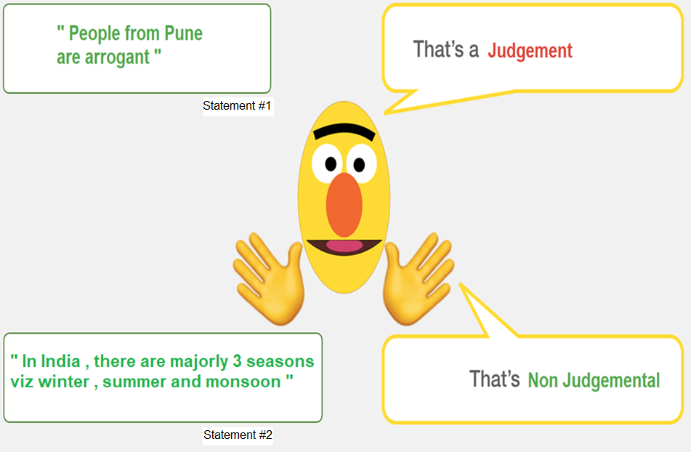

Slide 2
Capstone Project : Classification of Statements as Judgmental Or Non-Judgmental 27th March 2021
Anjali Chand
Hardik Raja
Jayant Rajurkar
Mentor & Guide : Prof Ashish Tendulkar

Slide 3
Motivation
Use our knowledge and skill in building something which will help society
This model will tell us if we are ‘Mostly Judgmental’ about people or Mostly Non Judgmental
Being Judgmental may hurt the other person and also demoralize
Use Cases :
We identify some use cases of this predictor
Social discussion
Corporate Reviews
WhatsApp Discussion
Speech Analysis of Popular Politicians , Celebrities
…and many more

Slide 4
Table of Content
Project Charter
Dataset
Model Flow :
Tokenization
Padding
Masking
Model Training
Evaluation
Deployment
Future Plans

Slide 5
Project Charter
Problem Statement | Prediction of Arguments in Social Behavior for Detecting Judgmental & Non-Judgmental Statements
Members | Anjali Chand , Hardik Raja , Jayant Rajurkar
Tools | Python , NLP , Google Colab , Streamlit with Heroku
Model Selection | Supervised Learning > Binary Class Classification > DistilBERT > Logistic Regression

Slide 6
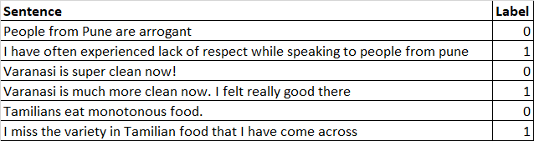
Dataset
Data Used | This is something unique we have done which mostly data scientists don’t do. We ourselves have created the database as there was no work done on this concept in past. We also labelled it by taking inputs from the domain experts and then finalized the labels.
Dataset Information | The data contains the list of statements. Each statement is labelled as Judgmental or Non Judgmental
Data file format | .csv
No of files | 01
Train dataset | 1 Feature , 1 Label and 320 Observations. 159 Judgmental & 161 Non Judgmental

Slide 7
The Flow
We have solved this problem using a pre trained model called DistilBERT. The output of DistilBERT model is used in Logistic Regression Model to predict the class
DistilBERT is a transformer based model which is used for classification of text.
Understanding Problem Statement
Use Case
Model Evaluation Metrics – Accuracy and ROC AUC Score
Trained Pre Trained Model : This involves various steps which we did manually
Data Splitting (Train : Test)
Feeding into Logistic Regression Model
Model Evaluation
Deployment
We built 4 different models and finally selected DistilBERT

Slide 8
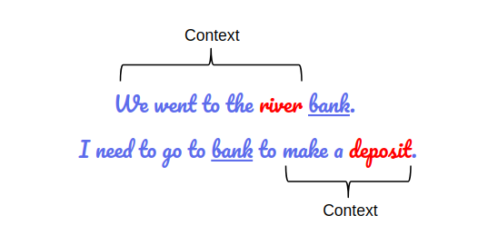
Understanding DistilBERT
DistilBERT is a transformer based model which is used for classification of text.
DistilBERT, a distilled version of BERT: Smaller (40% less parameters than BERT -base-uncased) Faster (runs 60% faster than BERT) , Cheaper and Lighter.
BERT is a “deeply bidirectional” model. Bidirectional means that BERT learns information from both the left and the right side of a token’s context during the training phase

Slide 9
What DistilBERT Has Done For Us ?
Text Pre-processing
Position Embedding
Segment Embedding
Token embedding
Notes:
The developers behind BERT have added a specific set of rules to represent the input text for the model. Many of these are creative design choices that make the model even better.
Every input embedding is a combination of 3 embeddings:
Position Embeddings: BERT learns and uses positional embeddings to express the position of words in a sentence. These are added to overcome the limitation of Transformer which, unlike an RNN, is not able to capture “sequence” or “order” information
Segment Embeddings: BERT can also take sentence pairs as inputs for tasks (Question-Answering). That’s why it learns a unique embedding for the first and the second sentences to help the model distinguish between them. In the above example, all the tokens marked as EA belong to sentence A (and similarly for EB)
Token Embeddings: These are the embeddings learned for the specific token from the WordPiece token vocabulary
For a given token, its input representation is constructed by summing the corresponding token, segment, and position embeddings.
Such a comprehensive embedding scheme contains a lot of useful information for the model.
These combinations of preprocessing steps make BERT so versatile. This implies that without making any major change in the model’s architecture, we can easily train it on multiple kinds of NLP tasks.

Slide 10
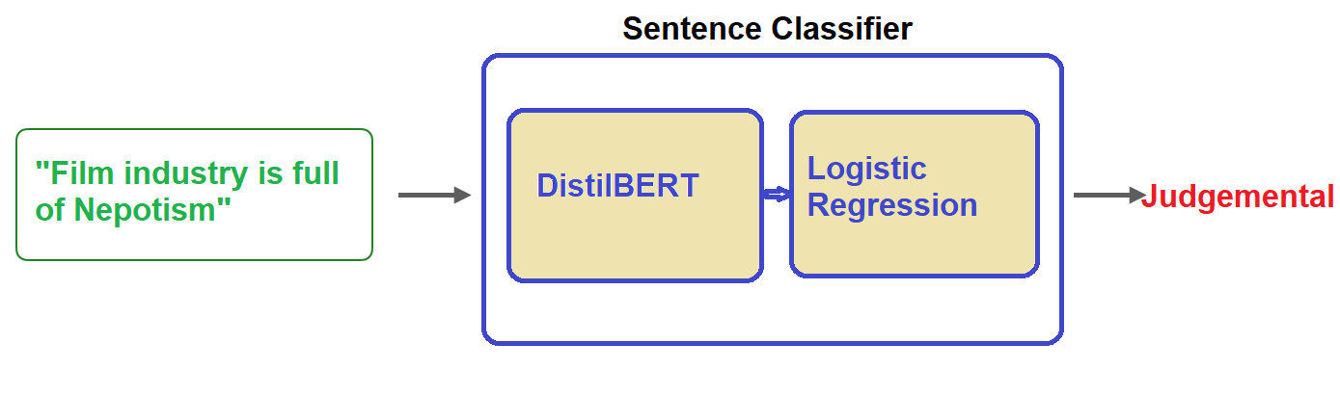
Models: Sentence Judgmental Classification
We have used two models here :
DistilBERT processes the sentence and passes along some information it extracted from it on to the next model.
DistilBERT is a smaller version of BERT developed and open sourced by the team at HuggingFace. It’s a lighter and faster version of BERT that roughly matches its performance.
The next model, a basic Logistic Regression model from scikit learn will take in the result of DistilBERT’s processing, and classify the sentence as either Judgemental or Non Judgemental (0 or 1, respectively).
The data we pass between the two models is a vector of size 768. We can think of this of vector as an embedding for the sentence that we can use for classification.

Slide 11
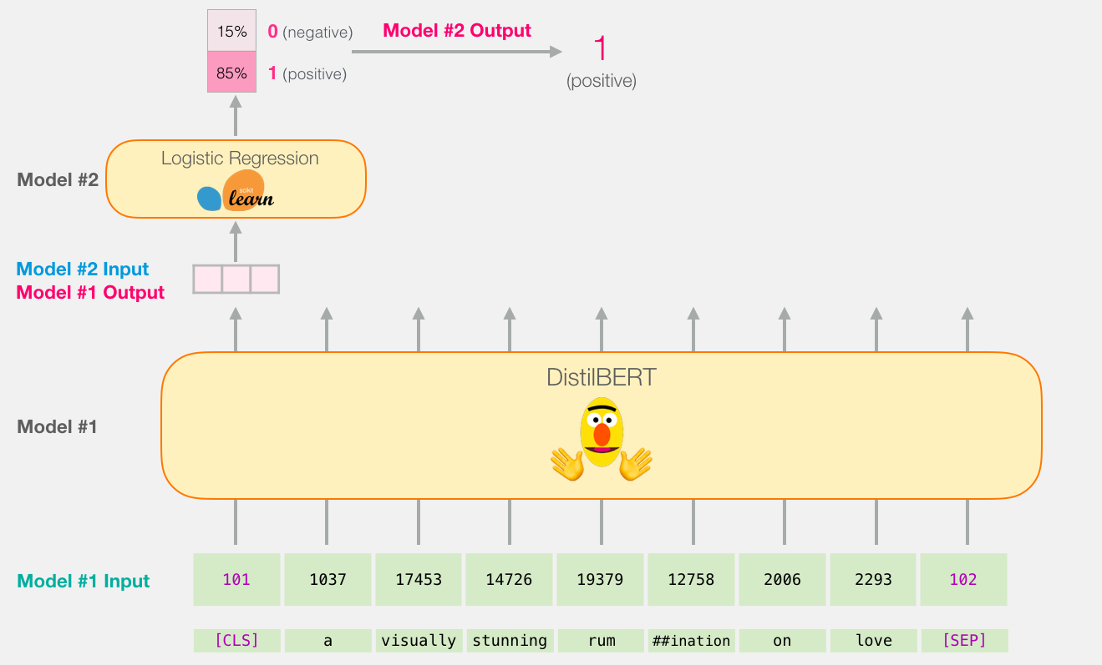
Model’s Bird View

Slide 12
Step 1 : Loading The Pre Trained Model

Slide 13
Step 2 : Preparing The Dataset - Tokenization

Slide 14
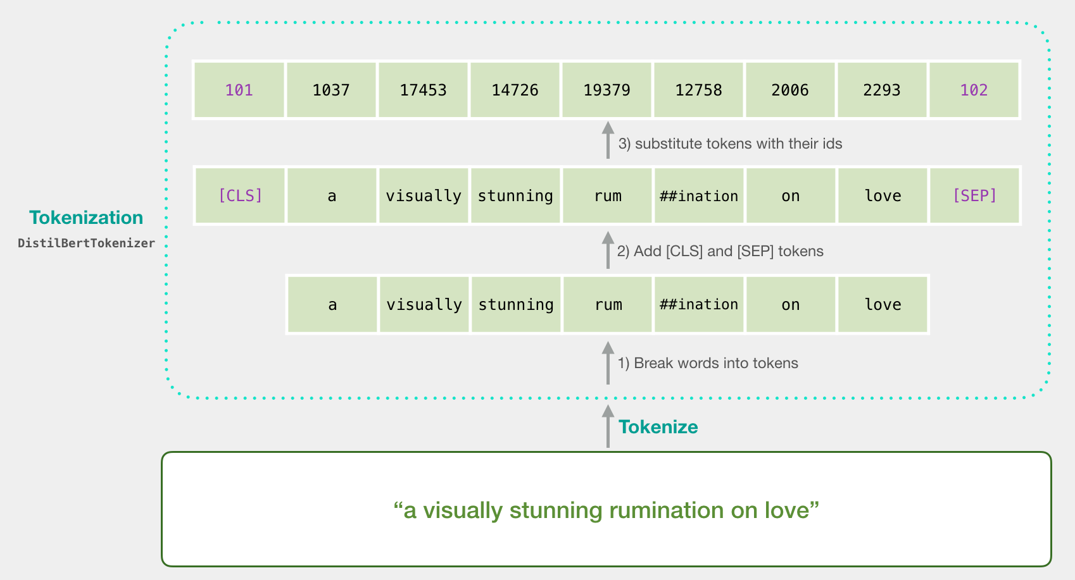
Tokenization
Our first step is to tokenize the sentences -- break them up into word and subwords in the format BERT is comfortable with.

Slide 15
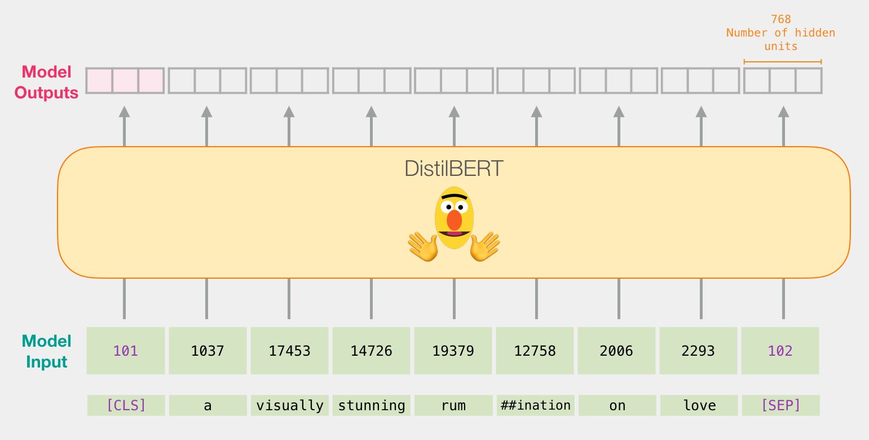
Tokenization
Passing the input vector through DistilBERT . The output would be a vector for each input token. each vector is made up of 768 numbers (floats).
Because this is a sentence classification task, we ignore all except the first vector (the one associated with the [CLS] token). The one vector we pass as the input to the logistic regression model.

Slide 16
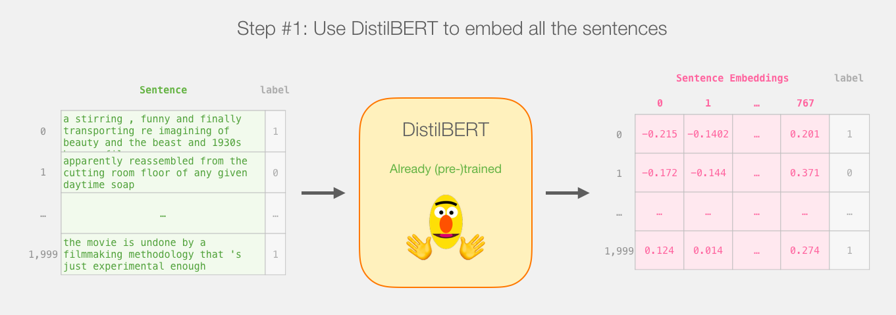
Tokenization
Finally we get the vector of size 768 for each word

Slide 17
Step 3 : Padding & Masking

Slide 18
Padding & Masking
After tokenization, we got the list of sentences -- each sentences is represented as a list of tokens. We wanted BERT to process our examples all at once (as one batch).
The dataset is currently a list of lists.
Padding :
Before DistilBERT can process this as input, we’ll need to make all the vectors the same size by padding shorter sentences with the token id 0.
Masking : If we directly send `padded` to BERT, that would slightly confuse it. We then had to create another variable to tell it to ignore (mask) the padding we've added when it's processing its input. That's what attention_mask is:
After the padding and masking , we have a matrix/tensor that is ready to be passed to BERT:

Slide 19
Step 4 : Running a Pre Trained Model

Slide 20
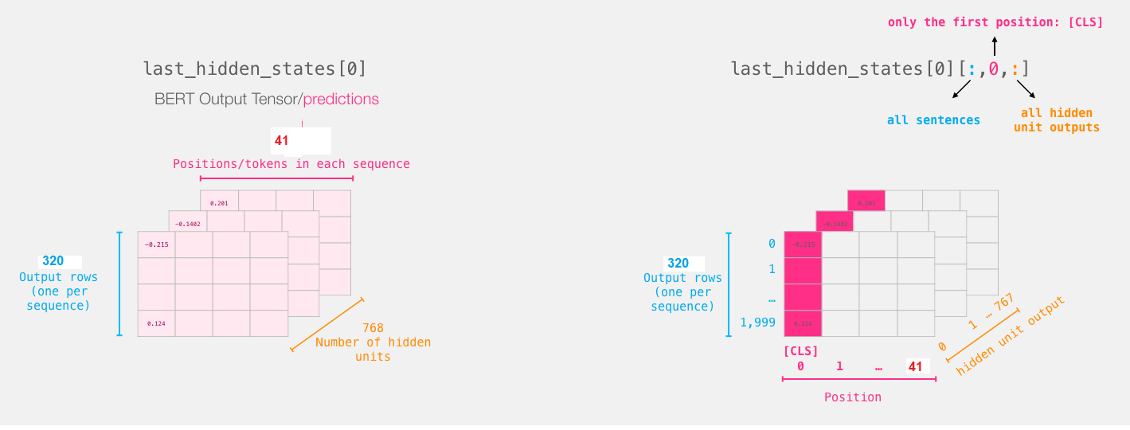
Running The Pre Trained Model
After running this step, last_hidden_states holds the outputs of DistilBERT.
It is a tuple with the shape (number of examples, max number of tokens in the sequence,
number of hidden units in the DistilBERT model).
In our case, this will be 320 , 41 (which is the number of tokens in the longest sequence from the 320 examples),
768 (the number of hidden units in the DistilBERT model).

Slide 21
Step 5 : Train Test Split &
Building Logistic Regression

Slide 22
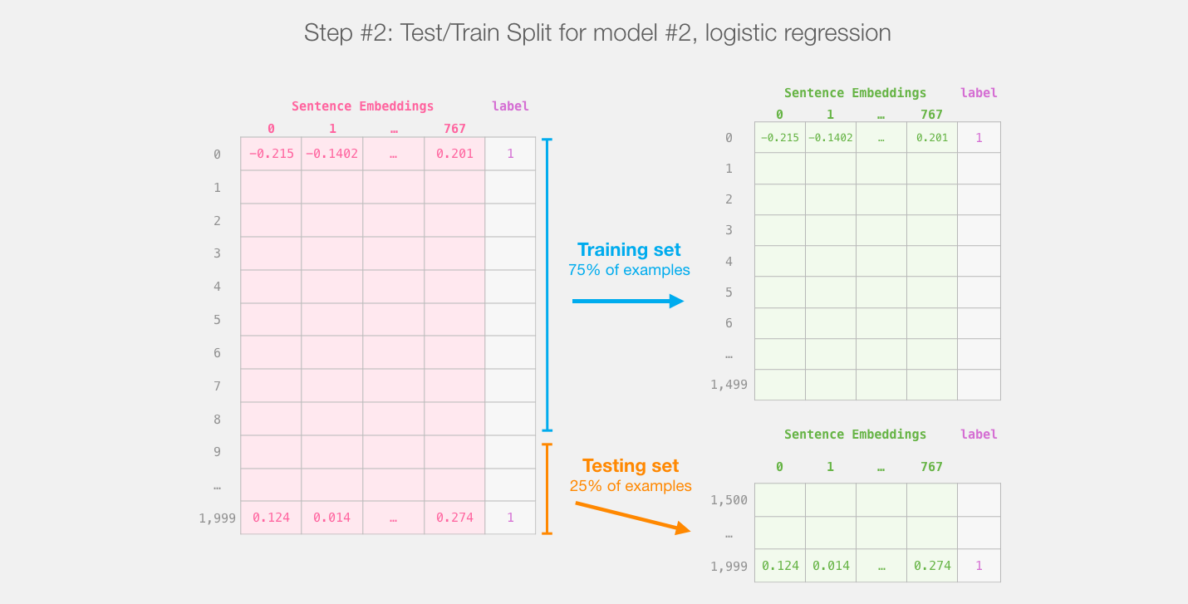
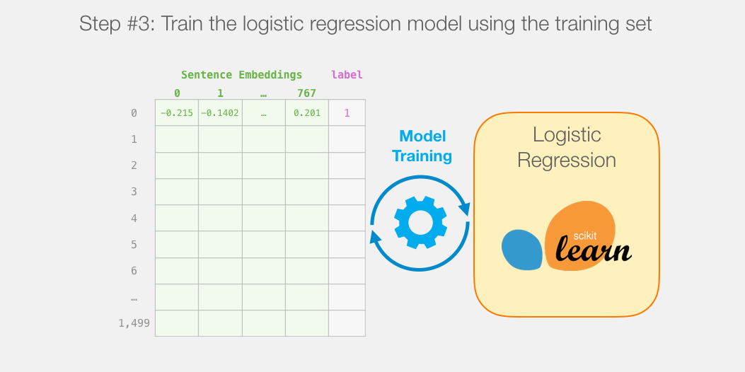
Train/Test Split & Model Training

Slide 23
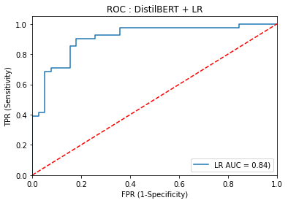
Optimization & Results
Model | TF-IDF |  | DistilBERT |  | Spacy+Wikipedia | Bi-Directional RNN +GloVe
Metrics | Random Forest | Logistic Regression | Logistic Regression | Gaussian Naïve Bayes | Logistic Regression | Logistic Regression
Accuracy | 54.68% | 51.56% | 86.25% | 77.50% | 74.00% | 55.00%
F1 Score | 61.00% | 56.00% | 87.00% | 78.00% | N/A | 61.00%
Precision | 55.00% | 53.00% | 86.00% | 78.00% | N/A | 62.00%
Recall | 70.00% | 61.00% | 88.00% | 77.00% | N/A | 61.00%
We also used Grid Search Cross Validation to get the best parameters. However this has not improved model’s accuracy much

Slide 24
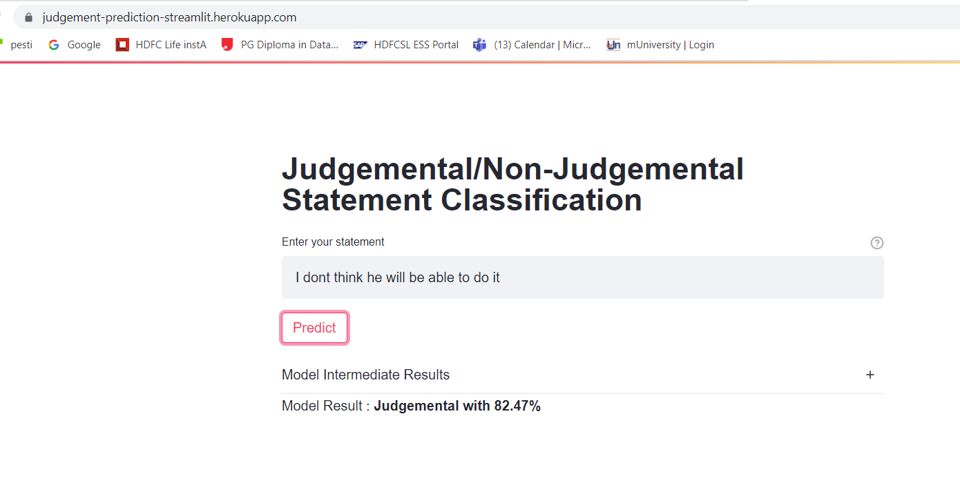
Deployment
Technologies
Streamlit
Heroku
https://judgement-prediction-streamlit.herokuapp.com/

Slide 25
Future Plans
We have below plans to fine tune it and utilize it for social good.
Use Active learning
Knowledge Based Rule Incorporation (adding one more column)
Breaking Speech Into Sentences
Developing an app

Slide 26
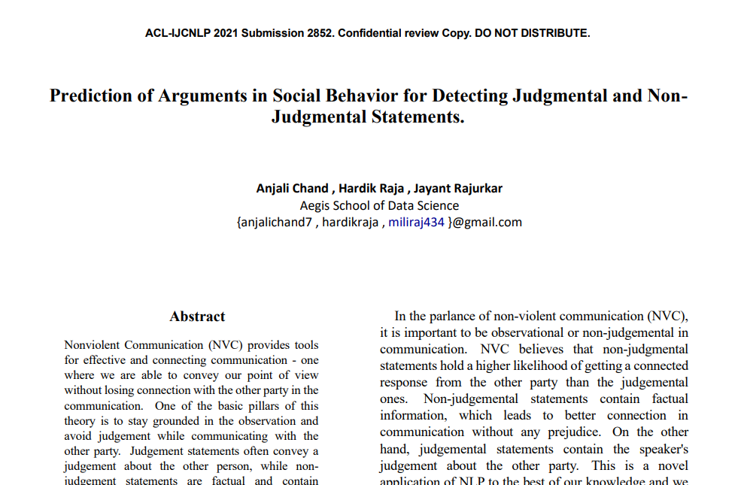
Paper Submitted

Slide 27
Thank You !!!

