Slide 1
Hotel Booking Analytics Dashboard
Power BI | SQL | Data Analytics Project

Slide 2
Project Overview
Objectives:
• Analyze booking performance
• Monitor revenue
• Understand customer behavior
• Evaluate transactions & ratings

Slide 3
Dataset Overview
Hotels,
Bookings, Users, Transactions, Ratings

Slide 4
Project Workflow
Raw Data → Cleaning → SQL → Data Model → DAX → Dashboards → Insights

Slide 5
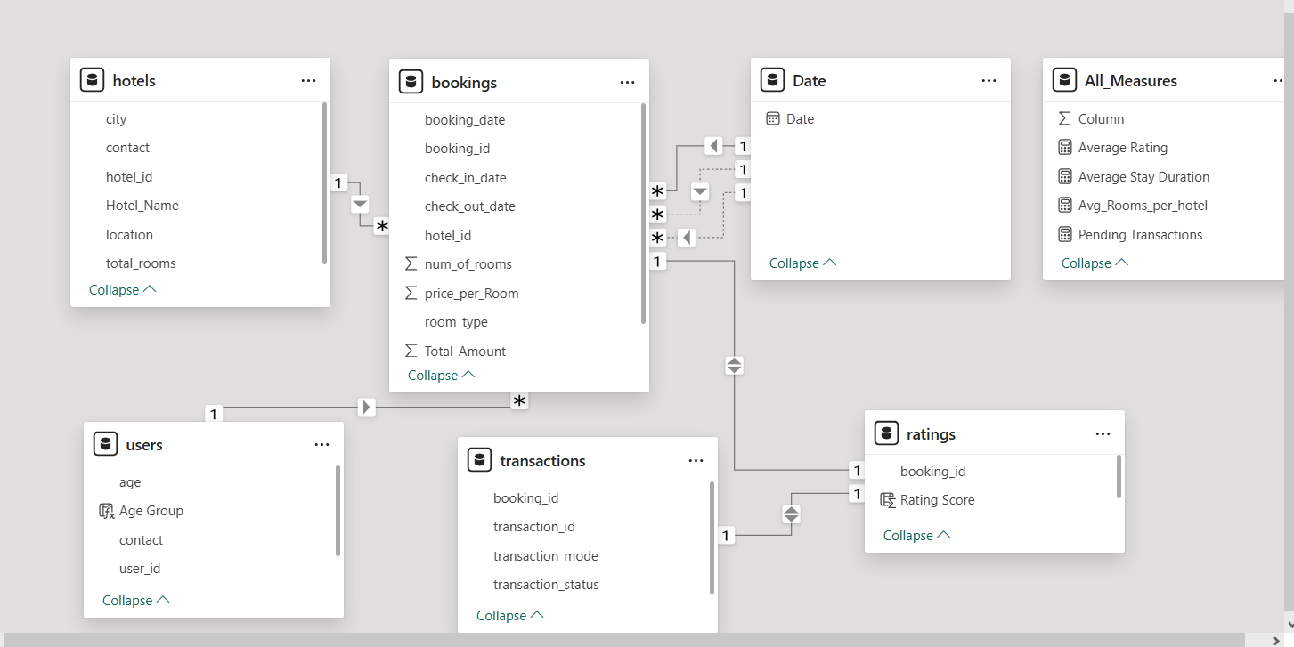
Relationship Data Model

Slide 6
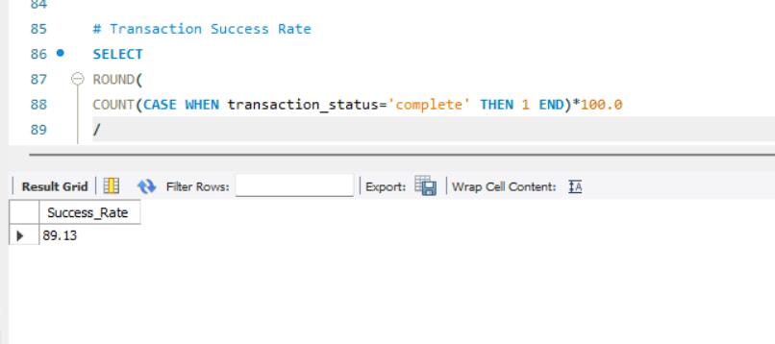
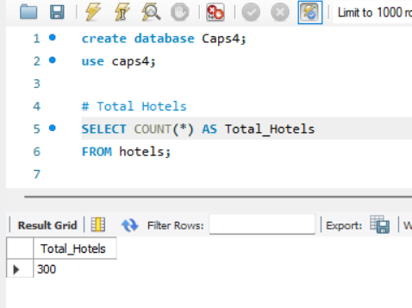
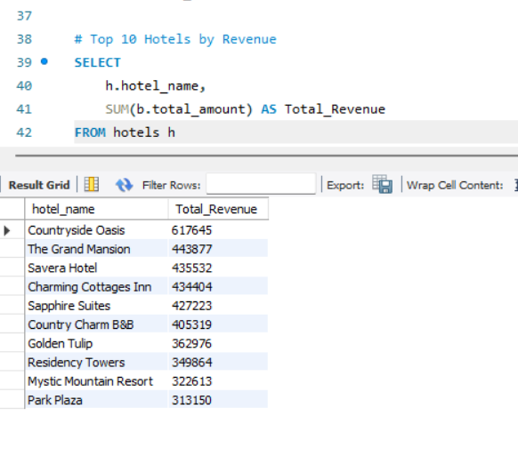
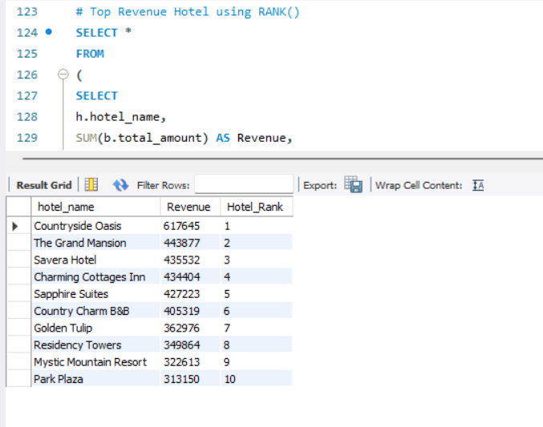
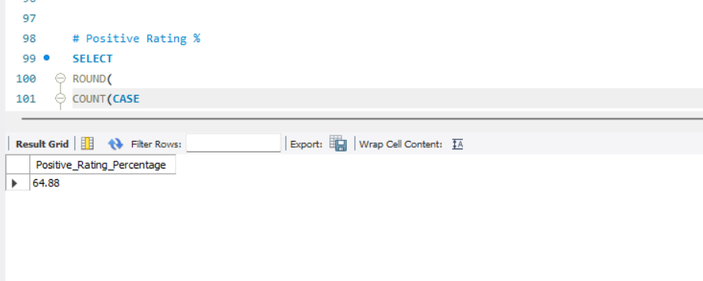
SQL Analysis

Slide 7
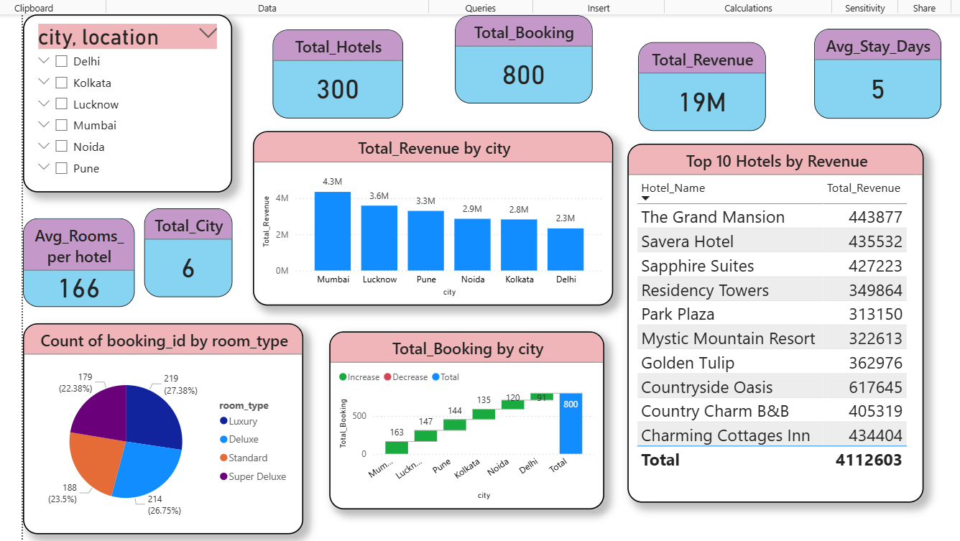
Hotel Booking Overview

Slide 8
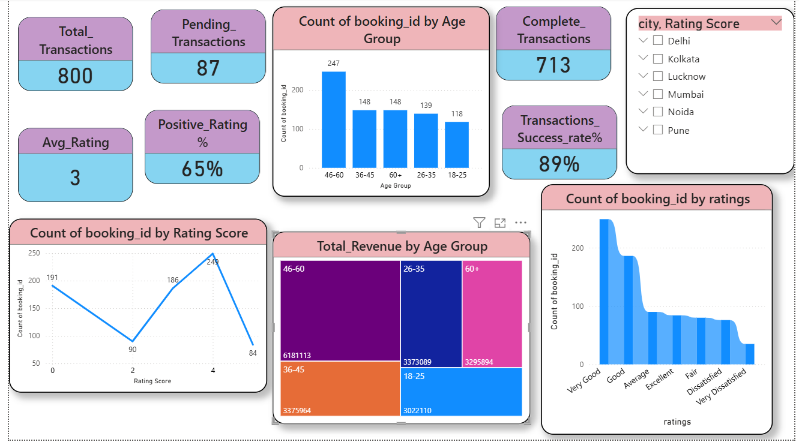
Customer & Transaction Insights

Slide 9
Key Business Insights
• Highest revenue city
• Top hotels
• Revenue by Group_Age
• Success rate
• Rating insights

Slide 10
Tools & Technologies
Power BI,
SQL,
DAX,
Power Query

Slide 11
Challenges & Solutions
Relationships,
DAX,
KPIs,
Interactive visuals

Slide 12
Future Enhancements
Forecasting,
Segmentation,
Occupancy

Slide 13
Conclusion
Business-ready interactive analytics dashboard.

Slide 14
Thank You

