Slide 1

Cadence Financial Group
Case Study 2 - Text Analysis & PII Detection
Mahi Bagla (24BCI0291), Sahib Singh (24BCI0292), Aarav Gupta (24BCI0293), Hardik Vikas Jain (24BCI0294), Rupanshu (24BCI0308)

Slide 2

Problem Statement & Objectives
Cadence Financial Group uses an AI document analysis agent to review business documents. These documents may contain Personally Identifiable Information (PII), such as employee names, email addresses, phone numbers and identification details.
Cadence's policy restricts PII from being processed by AI models. Therefore, documents must be processed to detect, classify and redact PII before their content is passed to a Large Language Model (LLM).
OUR OBJECTIVES:
  Extract text: Process PDF, DOCX and PPTX files, including scanned PDF pages where OCR is required.
  Detect and classify PII: Identify supported PII categories and preserve the source location of each finding.
  Redact and report: Mask detected PII and generate traceable findings so sensitive text is not passed to the LLM.

Slide 3
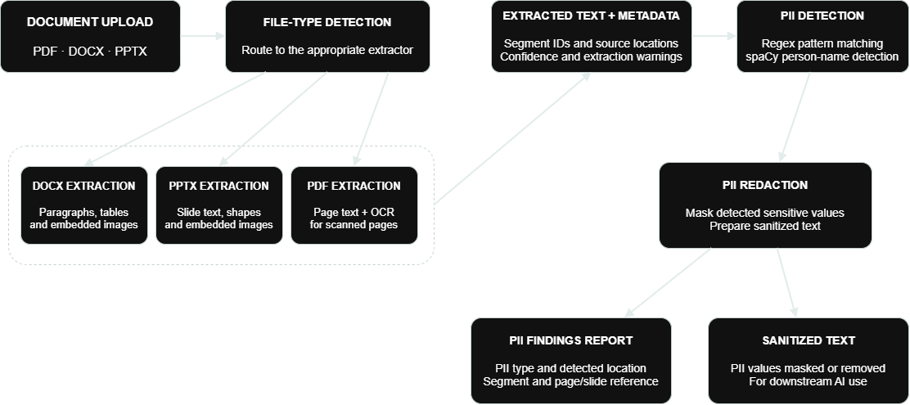
Functional Solution Blueprint

Slide 4
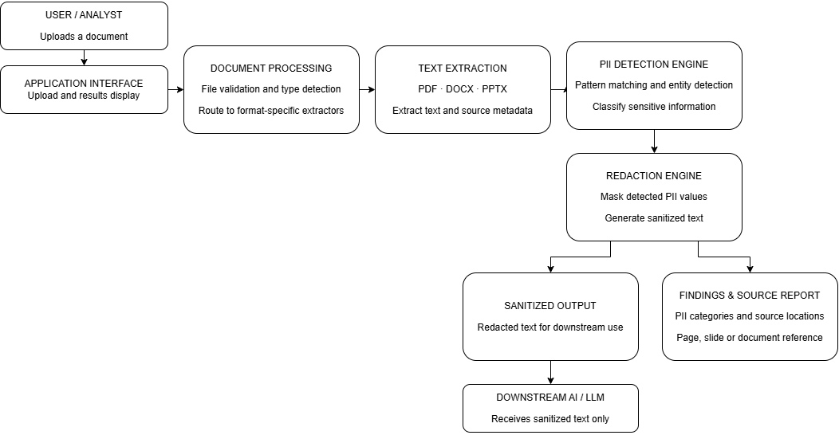
Technical System Architecture

Slide 5
Multi-Format Text Extraction
PDF Extraction
Word Extraction
PowerPoint Extraction
  Extract text from PDF pages.
  Preserve page-level source references.
  Use OCR for scanned PDFs and embedded images.
  Record OCR confidence and extraction warnings.
  Extract paragraphs and tables.
  Process embedded images using OCR where applicable.
  Preserve source document and segment IDs.
  Record extraction method and warnings.
  Extract slide text and text elements.
  Preserve slide-level source references.
  Process embedded images using OCR where applicable.
  Record extraction method and warnings.
Common output: Extracted text with source metadata, including file name, segment ID, location, extraction method, confidence and warnings, ready for PII detection and classification.

Slide 6
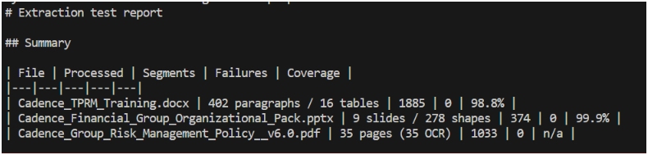
Multi-Format Text Extraction

Slide 7

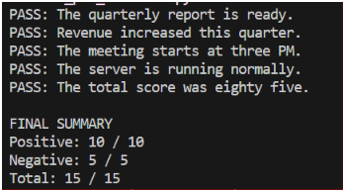
PII Detection & Classification
Personal Identifiers
  Detect potential person names.
  Use spaCy Named Entity Recognition (NER).
Contact Information
  Detect email addresses using regex.
  Detect Indian mobile phone numbers.
Technical Identifiers
  Detect and validate IPv4 addresses.
  Identify supported employee and account ID patterns.
Detection Output
  Classify each detected PII type.
  Record source location and segment ID.
  Store character positions and detection method.

Slide 8

PII Redaction
Source Traceability
Redaction & Source Traceability
  Replace detected sensitive values with placeholders.
  Preserve surrounding text wherever possible.
  Generate sanitized text for downstream processing.
  Prevent unredacted PII from reaching the LLM.
  Record the source document.
  Preserve page, slide, and segment references.
  Store the detected entity type and character positions.
  Link each finding to its original extracted text.
Example
BEFORE REDACTION
  Contact the customer at alex@example.com for verification.
AFTER REDACTION
  Contact the customer at [EMAIL_REDACTED] for verification.

Slide 9
Mathematical Redaction Mechanics & Right-to-Left Offset Integrity
Left-to-Right Replacement
Right-to-Left Replacement
Replacing an earlier value changes string length and can invalidate the character offsets of later findings.
Sort findings within each segment by descending start_char and replace the rightmost match first.
Replacement formula
T(i) = T(i-1) [0:si] + tagi + T(i-1)[ei:L]

Slide 10
Audit Trails, Compliance Sign-Off & QA Validation Metrics
Findings CSV
Compliance Certificate
QA Log
  Records source files, locations, entity types, detected values and character offsets.
  findings.csv
  Can record execution status, segment counts, redaction totals and timestamps for sign-off.
  compliance_certificate.json
  Tracks verification results and errors, including false positives and false negatives where measured.
  qa_log.csv
Precision
Recall
TP / (TP + FP) * 100
Of all detected PII findings, how many were correct?
TP / (TP + FN) * 100
Of all actual PII instances, how many were detected?

Slide 11
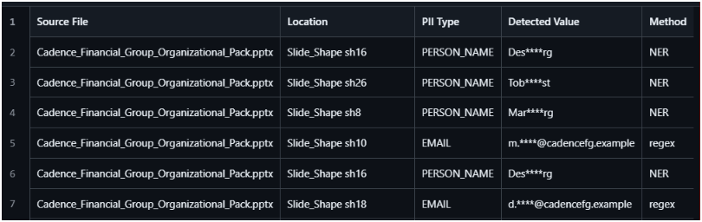
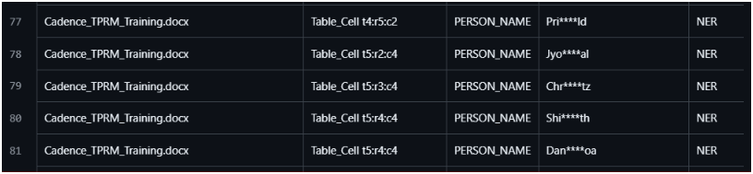
Working Demonstration

Slide 12
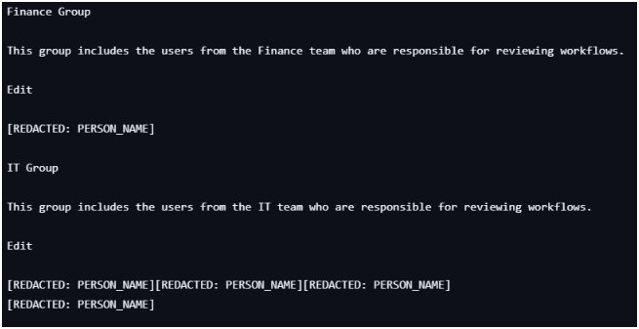
Working Demonstration

Slide 13
Validation, Results & Limitations
Validation Approach
Evaluation Metrics
Limitations
  DOCX, PPTX and scanned PDF extraction tested.
  PII detector tested using 10 positive and 5 negative cases.
  Integrated outputs include findings, sanitized text and QA logs.
  DOCX: 1,885 segments extracted.
  PPTX: 374 segments extracted.
  PDF: 1,033 OCR segments across 35 pages.
  Detector tests: 15/15 passed.
  Extraction: zero reported failures across all three files in the successful run.
  OCR may misread text in scanned documents.
  Some embedded vector images were not OCR-processed.
  Name detection can produce false positives.
  The small test suite does not establish real-world precision or recall.
  Complete redaction coverage still needs verification.
Case study targets: Retain at least 80% of document structure with context; aim for PII detection coverage approaching 100%.

Slide 14
Conclusion & Next Steps
Conclusion
Future Scope
  Developed document extraction for DOCX, PPTX and scanned PDF files.
  Implemented PII detection using regular expressions and spaCy NER.
  Generated structured findings with source-location information.
  Produced sanitized text outputs with redaction placeholders.
  Improve OCR handling and reduce false positives.
  Expand PII categories and test coverage.
  Evaluate precision and recall using labelled data.
  Verify end-to-end redaction and ensure only sanitized content reaches the LLM.
Our goal: Make document content safer for AI processing without losing the context needed to use it.

