Slide 1
Container Isolation: How Docker Tricks the OS
Case Study: Docker Containers & Cloud Computing
Operating Systems Class Presentation
Notes:
Good morning/afternoon. Today I will explain container isolation using Docker as a case study. The main idea is that containers are not full virtual machines. They are ordinary Linux processes wrapped with kernel isolation features.

Slide 2
Agenda
Introduction to containers
Virtual machines vs containers
Linux namespaces
Control groups (cgroups)
Overlay filesystems
Security layers
Docker execution model
Containers in cloud computing
Limitations and security concerns
Conclusion
Notes:
We will first compare containers with virtual machines, then discuss the four main isolation mechanisms: namespaces, cgroups, overlay filesystems, and security layers. Finally, we will look at cloud computing use and limitations.

Slide 3
What Is a Container?
A lightweight, isolated user-space environment
Shares the host operating system kernel
Packages application code, libraries, and dependencies
Faster and lighter than a full virtual machine
Uses Linux kernel features such as namespaces and cgroups
Notes:
A container looks like a separate machine to the application inside it, but from the kernel's point of view it is just a process with restricted visibility and limited resources.

Slide 4
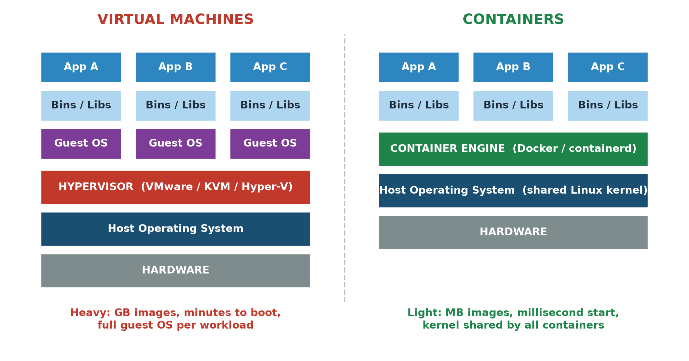
Virtual Machines vs Containers
Notes:
VMs duplicate the whole OS per workload; containers share one kernel.

Slide 5
Virtual Machines vs Containers
Virtual machines emulate complete hardware
  Require a hypervisor such as VMware, KVM, or VirtualBox
  Each VM runs a full guest operating system
Containers use OS-level isolation
  Containers share the host kernel
  Containers start in milliseconds to seconds
VMs provide stronger isolation but higher overhead
Containers provide faster deployment and higher density
Notes:
Virtual machines emulate complete hardware and run separate operating systems. Containers share the host kernel, so they are faster and lighter, but their isolation boundary is not as strong as a full VM.

Slide 6
Pillar 1: Linux Namespaces
Namespaces control what a process can see
PID namespace: isolates process IDs
NET namespace: isolates network interfaces and ports
MNT namespace: isolates mount points
UTS namespace: isolates hostname
IPC namespace: isolates inter-process communication
USER namespace: isolates user and group IDs
Each container gets a private view of the system
Notes:
Namespaces provide visibility isolation. For example, a process inside a container can believe it is PID 1, even though on the host it has a completely different PID.

Slide 7
Pillar 2: Control Groups (cgroups)
Cgroups control how much resource a container can use
CPU: limit percentage of processor time
Memory: set hard memory limits
Block I/O: limit disk read/write bandwidth
PIDs: limit number of processes
Devices: allow or deny device access
Prevents one container from starving others
Notes:
If namespaces control visibility, cgroups control quantity. They are important in cloud environments because many containers share the same physical machine.

Slide 8
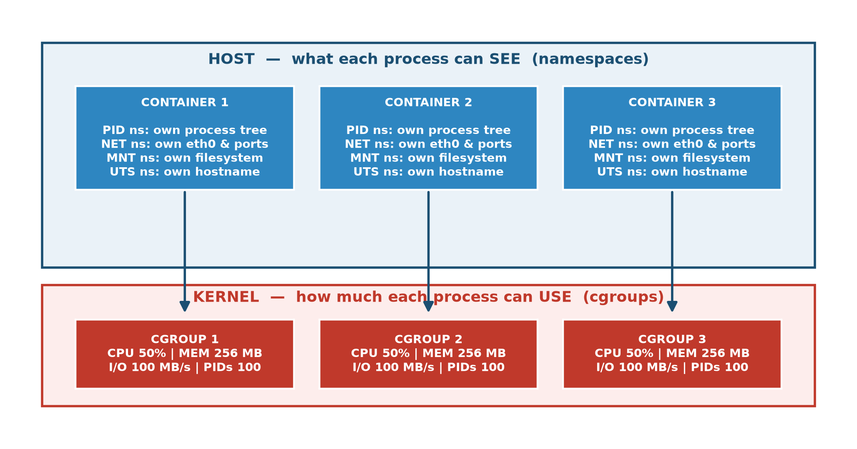
Namespaces vs Cgroups: See vs Use
Notes:
Namespaces control visibility; cgroups control quantity.

Slide 9
Pillar 3: Overlay Filesystems
Container Writable Layer
-----------------------------------
Read-only Layer 3: Application code
Read-only Layer 2: Libraries/runtime
Read-only Layer 1: Base OS image
Notes:
Overlay filesystems give each container a private filesystem view. The container can modify files, but changes are stored in its own writable layer and do not affect other containers.

Slide 10
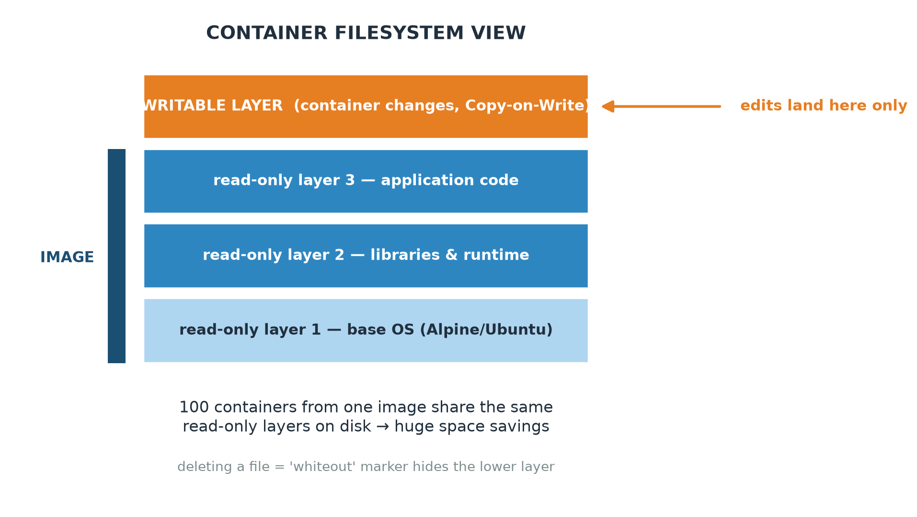
Overlay Filesystem Layers
Notes:
Only the writable layer differs per container; base layers are shared.

Slide 11
Pillar 4: Security Layers
Cgroups limit resource usage
Namespaces isolate visibility
Linux capabilities remove unnecessary root privileges
Seccomp-BPF restricts allowed system calls
AppArmor or SELinux enforces mandatory access control
Docker uses defense-in-depth
Notes:
Container isolation is not based on one magic feature. It combines several kernel mechanisms to reduce the attack surface.

Slide 12
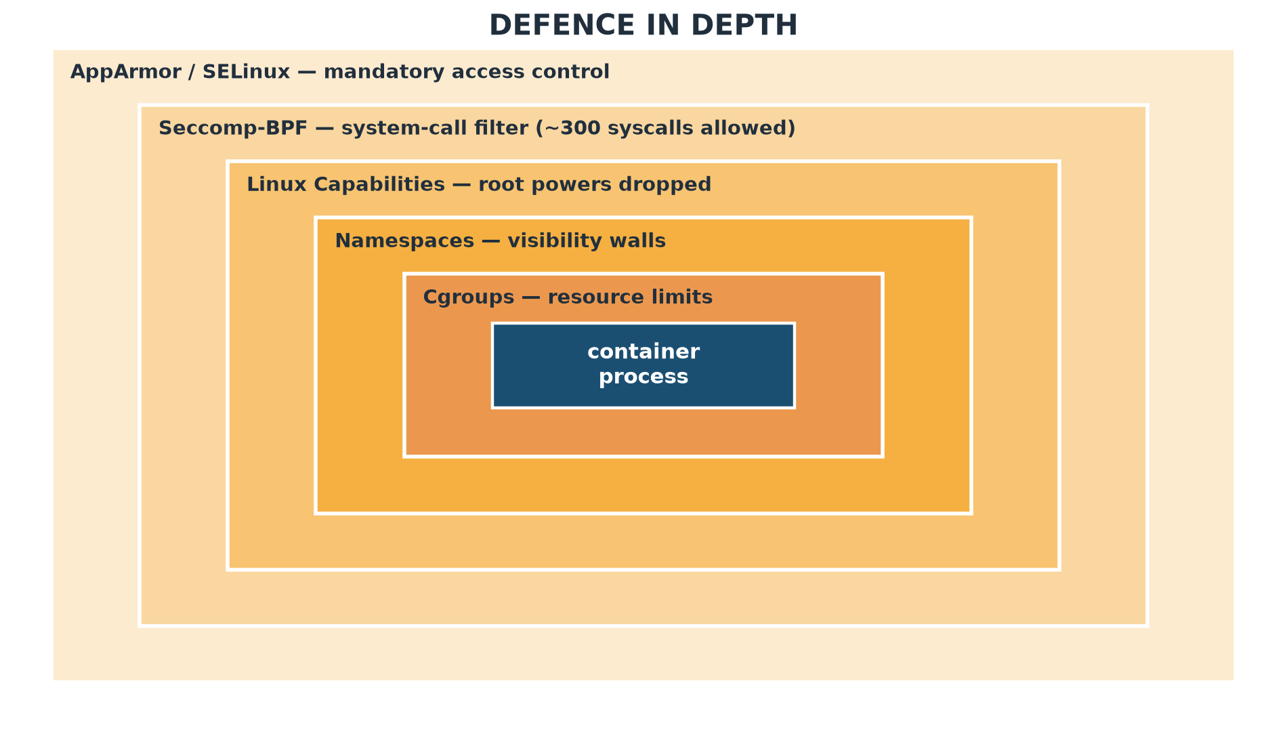
Defence in Depth
Notes:
An attacker must bypass every ring, not just one mechanism.

Slide 13
How Docker Launches a Container
docker CLI -> dockerd -> containerd -> runc
runc performs:
1. clone() with namespace flags
2. cgroup resource setup
3. filesystem setup with pivot_root()
4. capability dropping and seccomp filtering
5. exec() of container entrypoint
Notes:
When a user runs docker run, the Docker daemon eventually asks runc to create the container. runc is the low-level component that interacts directly with Linux kernel isolation features.

Slide 14
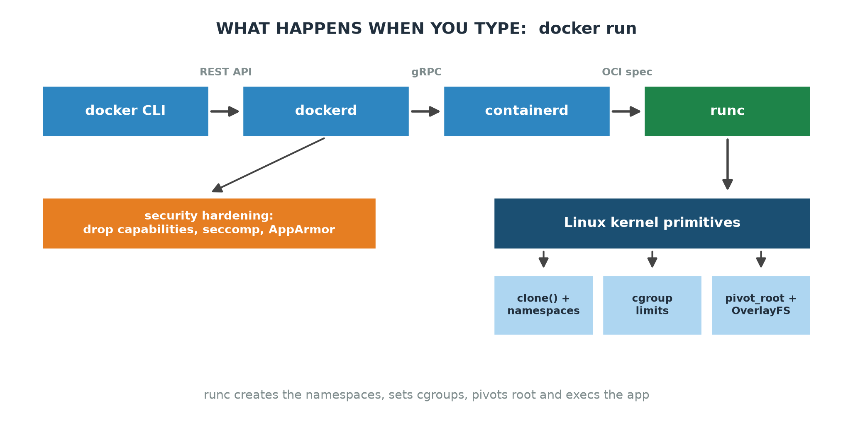
Inside docker run
Notes:
CLI -> dockerd -> containerd -> runc -> kernel primitives.

Slide 15
Example Docker Command
docker run -d --name web \
--memory=256m \
--cpus=0.5 \
--read-only \
--tmpfs /tmp \
--security-opt=no-new-privileges \
nginx:alpine
Notes:
This single command creates namespaces, cgroups, filesystem isolation, and security restrictions for the container.

Slide 16
Class Demo: Observing Isolation
docker run -d --name demo --memory=128m --cpus=0.5 nginx:alpine
docker top demo
ps aux | grep nginx
docker inspect demo --format '{{.HostConfig.Memory}}'
PID=$(docker inspect -f '{{.State.Pid}}' demo)
ls -l /proc/$PID/ns/
Notes:
This demo shows that the container process has one PID inside the container but another PID on the host. The /proc namespace listing shows the separate namespaces assigned to the container.

Slide 17
Containers in Cloud Computing
Cloud providers use containers for fast scaling
Many workloads can share the same physical server
Kubernetes manages containers across many machines
Managed services include AWS EKS, Google GKE, Azure AKS
Serverless platforms often use containers or microVMs
Isolation enables multi-tenant cloud environments
Notes:
Cloud computing depends heavily on isolation. Containers allow providers to run many workloads on the same physical servers while maintaining separation between applications.

Slide 18
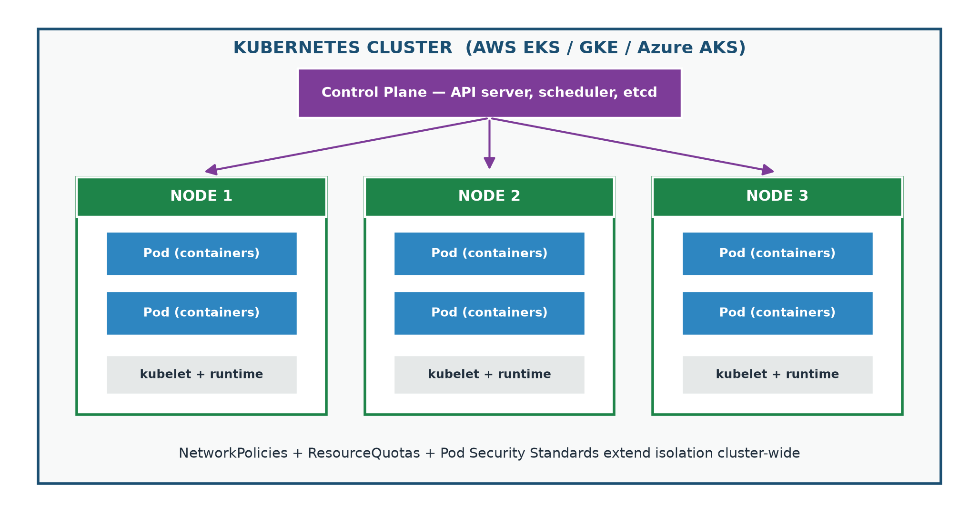
Kubernetes: Isolation at Cloud Scale
Notes:
Control plane schedules pods; policies extend isolation cluster-wide.

Slide 19
Isolation Strength Spectrum
Weaker Isolation <---------------------------------------> Stronger Isolation
chroot Docker gVisor/user-space kernel Kata/Firecracker Full VM
Notes:
Containers are not the strongest possible isolation mechanism. For untrusted code, cloud providers may add gVisor, Kata Containers, Firecracker microVMs, or full virtual machines.

Slide 20
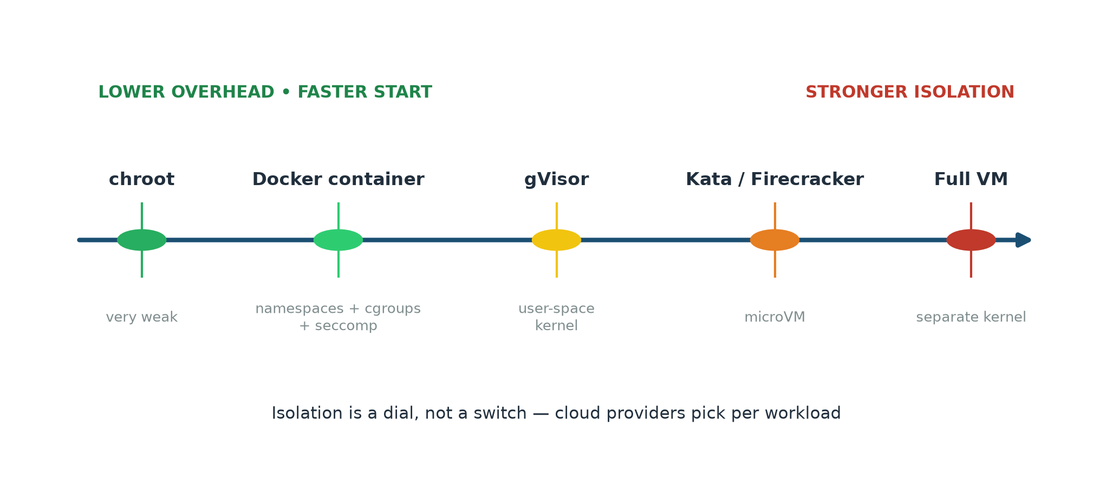
Isolation Strength Spectrum
Notes:
Isolation is a dial: containers are mid-spectrum; microVMs and VMs are stronger.

Slide 21
Limitations and Security Concerns
Containers share the host kernel
A kernel vulnerability may affect all containers
Privileged containers weaken isolation
Side-channel attacks may cross container boundaries
Malicious images can introduce vulnerabilities
Network traffic may need encryption
Notes:
Containers provide strong practical isolation, but they are not as hard a boundary as full virtual machines. For untrusted code, stronger isolation technologies should be used.

Slide 22
Key Takeaways
Containers are isolated processes, not full virtual machines
Namespaces control what a container can see
Cgroups control how much resource a container can use
Overlay filesystems provide private filesystem views
Security layers reduce privileges and system-call access
Containers are central to modern cloud computing
Notes:
To summarize, container isolation is built from several operating system mechanisms working together. This is why containers are lightweight, fast, and useful for cloud deployment, but still require careful security.

Slide 23
Questions?
Thank you for listening
Any questions?
Notes:
Thank the audience and invite questions.

