Slide 1
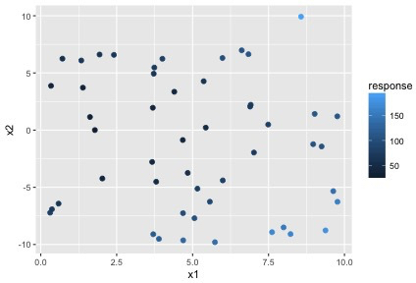
(quantitative) response variable is color

Slide 2
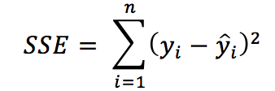
(quantitative) response variable is color
Total RSS = 85,285
RSS

Slide 3
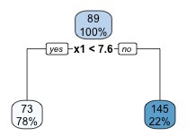
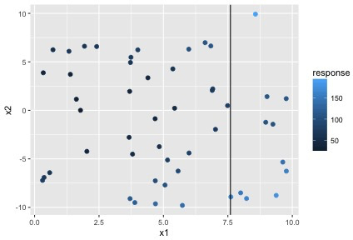
First split (min sum of RSS)
Tree
Scatterplot

Slide 4
First split (min sum of RSS)
Total RSS = 41,134
Tree
Scatterplot
RSS = 31457
RSS = 9677

Slide 5
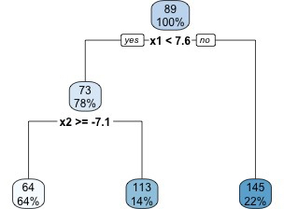
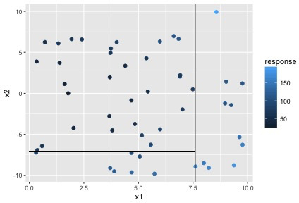
Next split (min RSS)
Tree
Scatterplot

Slide 6
Next split (min RSS)
Total RSS = 27,299
Tree
Scatterplot
RSS = 15068
RSS = 9677
RSS = 2554

Slide 7
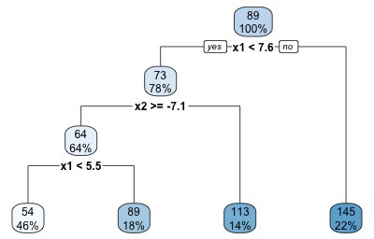
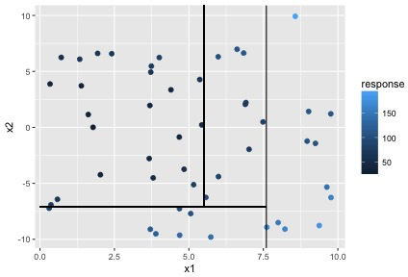
Next split (min RSS)
Tree
Scatterplot

Slide 8
Next split (min RSS)
Total RSS = 19,488
Tree
Scatterplot
RSS = 1795
RSS = 5462
RSS = 9677
RSS = 2554

Slide 9
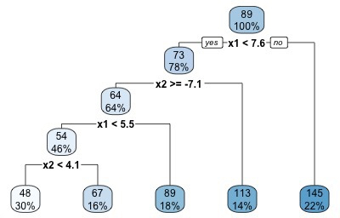
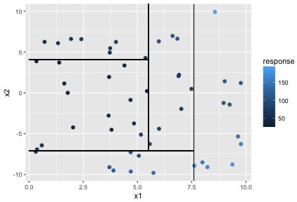
Next split (min RSS)
Tree
Scatterplot

Slide 10
Next split (min RSS)
Total RSS = 17,480
Tree
Scatterplot
RSS = 1795
RSS = 442
RSS = 9677
RSS = 3012
RSS = 2554
Notes:
There are lots of methods for determining how much to grow a tree. We won’t discuss here.
Where value would I predict for an observation at x1=6, x2= 1 ? → 89

