Slide 1
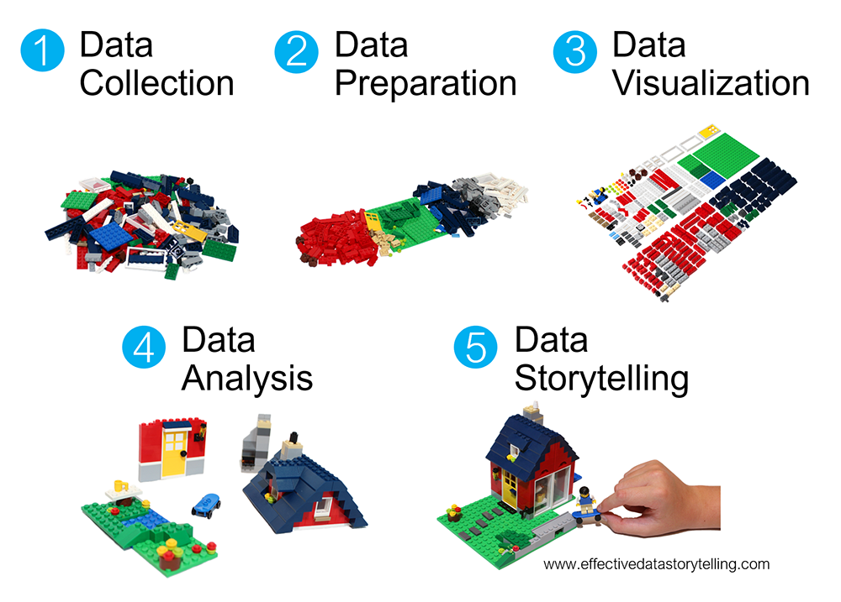
Data
Acquisition
Data
Exploration
Data
Visualization
Data
Conclusions
Data
Communication

