Slide 1
Checklist
Create GitHub account
Register on ClassPortal [skaha.cs.ubc.ca:11310] (Must be done by 10:15)
Read project README [github.com/ubccpsc/310/tree/2017jan/project]
Read Deliverable 0 https://github.com/ubccpsc/310/blob/2017jan/project/Deliverable0.md
Install Git, Node, Yarn
Install IDE of your choice (WebStorm, Visual Studio, Atom, etc)
Notes:
How many people are comfortable with git (either command line or in your IDE)?

Slide 2
Deliverable 0 Overview
https://github.com/ubccpsc/310/blob/2017jan/project/Deliverable0.md

Slide 3
Useful Resources
Validate your JSON
JSON lint (http://jsonlint.com)
JavaScript documentation (also HTML & CSS)
Mozilla Developer Network (http://developer.mozilla.org)
TypeScript documentation
Quick start (http://www.typescriptlang.org/docs/tutorial.html)
Handbook (http://www.typescriptlang.org/docs/handbook/basic-types.html)
Git tutorial
git – the simple guide (http://rogerdudler.github.io/git-guide/)

Slide 4
JSON Tutorial – Syntax
https://www.tutorialspoint.com/json/json_quick_guide.htm
Syntax:
Essentially subset of JavaScript syntax
Data is represented as name/value pairs
Curly braces hold objects, names are followed by a colon, name/values pairs are separated by commas
Collection of name/value pairs
{ "book" : { "id": 0, "title": "Design Patterns" } }
Square brackets hold arrays – values are separated by commas
Ordered list of values
[1,2,3] or ["a", 1, "7", null, {}, true, 0.3, 3e-1]
Notes:
Jsonlint.com

Slide 5
JSON Tutorial – Data Types
Data Types
Type | Description
Number | double- precision floating-point format in JavaScript - Ex: 0, 15, -3, 0.4, 5e-10, 8E+2
String | double-quoted Unicode with backslash escaping - Does not support multiline string
Boolean | true or false
Array | an ordered sequence of values
Value | it can be a string, a number, true or false, null, etc.
Object | an unordered collection of key:value pairs
Whitespace | can be used between any pair of tokens
null | empty

Slide 6
JSON Tutorial – Example
{
"d0": {
"description": "",
"releaseDate": "2017-01-06T09:00:00",
"dueDate": "2017-01-16T12:00:00",
"repos": [
{
"name": "d0-testsuite",
"url": "https://github.com/CS310-2017Jan/d0-testsuite",
"visibility": 0
}
],
"rate": 43200000,
"gradeFormula": "0.8*<TEST_PERCENTAGE>+0.2*Math.min(<COVERAGE_PERCENTAGE>+5, 100)",
"externalUrls": ["http://skaha.cs.ubc.ca:11313"]
}
}
Notes:
Double quoted
Watch for trailing commas

Slide 7
JSON Tutorial – Accessing Values
We can access values in a JSON object two different ways:
Dot notation: value = object.key
We know the key at compile time
Indexing: value = object[key]
We don’t know the key at compile time
Example:
var myObj = {"a": 100, "b": 15};
myObj.a; //100
myObj["b"]; //15

Slide 8
JSON Tutorial – Construct JSON Dynamically

Slide 9
JSON Tutorial – Iterating
Object.keys(obj)
obj – the object to iterate over
Returns array of strings that represent all the enumerable properties of the given object
Example:
var myObj = {"a": 100, "b": 15};
var keys = Object.keys(myObj); //["a","b"]
myObj[keys[0]]; //100

Slide 10
Useful Functions
isNumeric

Slide 11
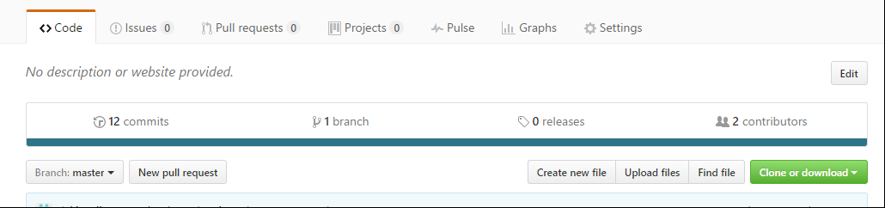
Using AutoTest

Slide 12
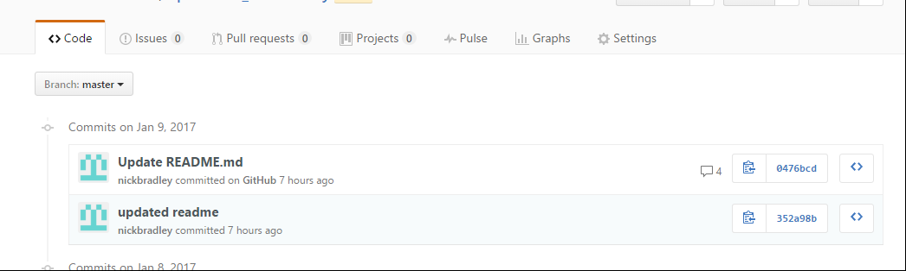
Using AutoTest

Slide 13
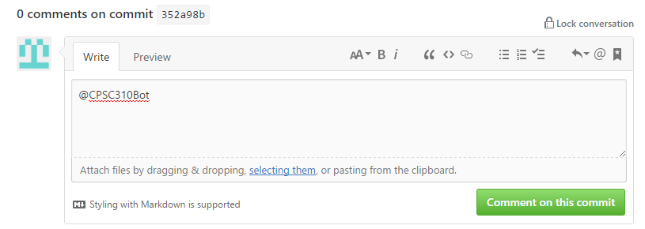
Using AutoTest

Slide 14
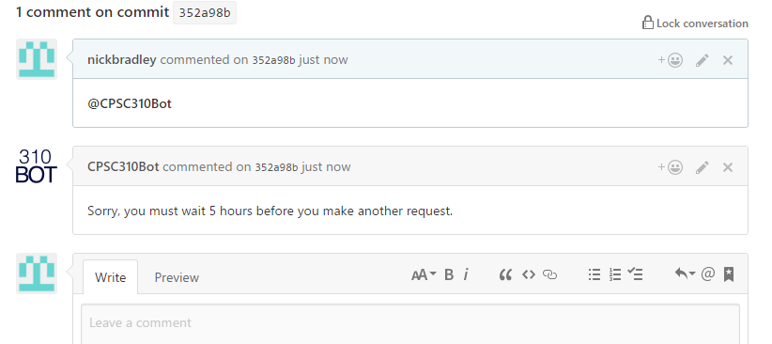
Using AutoTest

