Slide 1
Unit 2
CPU Pipeline

Slide 2
Pipelined Y86 Implementation
Unit outline
  Motivation and basic concepts
  Initial Implementation
  Hazards
    Types of hazards
    Dealing with hazards by stalling
    Data hazards: forwarding to avoid stalling
    Control hazards: branch prediction
    Indirect jumps
  Performance analysis

Slide 3
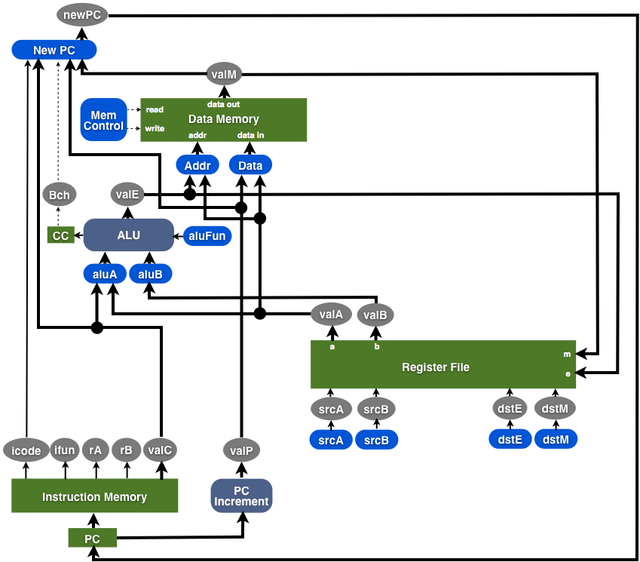
Design so Far
f.prPC
register file
F
D
E
M
W
CC
main memory

Slide 4
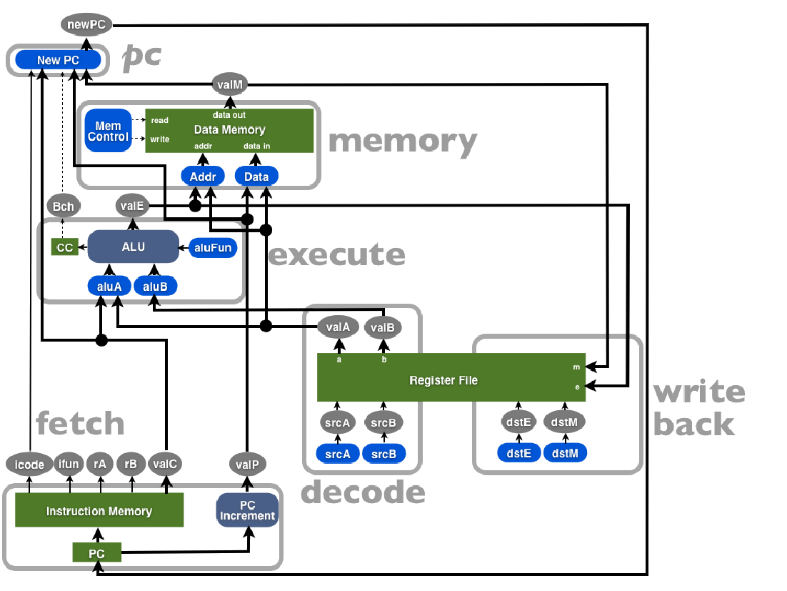

Slide 5
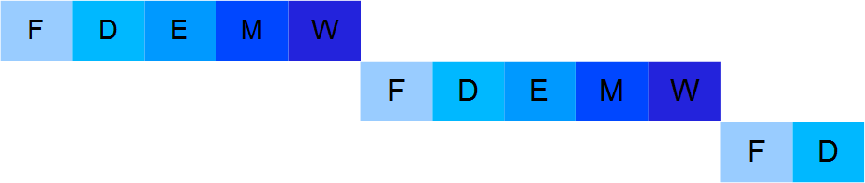
Motivation and basic concepts
How instruction execution proceeds:
Sequential Y86 implementation
Instr 1:
Instr 2:
Instr 3:

Slide 6
Motivation and basic concepts
Pipeline computation
  Divide the execution into modules (fetch, decode, ...)
    Modules are ordered along the flow of computation.
    One module's output is the input of the next module.
Turn each module into a pipeline stage.
  Add pipeline registers before every stage except the 1st.
  These store the inputs for that stage.
  Stages execute in parallel working on different instructions.
As we will see later this introduces new problems.

Slide 7
Human Pipeline

Slide 8
Sequencing a 3-Stage Pipeline
Clock
OP1
B
C
OP2
A
B
OP3
A
120
240
360
Time
●


❍

Time = 239
●
Time = 300
100 ps
20 ps
100 ps
20 ps
100 ps
20 ps
100 ps
20 ps
100 ps
20 ps
100 ps
20 ps
Comb.
logic
A
R
e
g
Comb.
logic
B
R
e
g
Comb.
logic
C
R
e
g
Comb.
logic
A
R
e
g
Comb.
logic
B
R
e
g
Comb.
logic
C
R
e
g

Time = 241
Clock
❍
Time = 359
Clock
100 ps
20 ps
100 ps
20 ps
100 ps
20 ps
100 ps
20 ps
100 ps
20 ps
100 ps
20 ps
Comb.
logic
A
R
e
g
Comb.
logic
B
R
e
g
Comb.
logic
C
R
e
g
Comb.
logic
A
R
e
g
Comb.
logic
B
R
e
g
Comb.
logic
C
R
e
g
Clock
Clock
8

Slide 9
Sequencing a 3-Stage Pipeline

Time = 239
100 ps
20 ps
100 ps
20 ps
100 ps
20 ps
Comb.
logic
A
R
e
g
Comb.
logic
B
R
e
g
Comb.
logic
C
R
e
g

Time = 241
Clock
100 ps
20 ps
100 ps
20 ps
100 ps
20 ps
Comb.
logic
A
R
e
g
Comb.
logic
B
R
e
g
Comb.
logic
C
R
e
g
Clock
9

Slide 10
Sequencing a 3-Stage Pipeline
●
Time = 300
100 ps
20 ps
100 ps
20 ps
100 ps
20 ps
Comb.
logic
A
R
e
g
Comb.
logic
B
R
e
g
Comb.
logic
C
R
e
g
❍
Time = 359
Clock
100 ps
20 ps
100 ps
20 ps
100 ps
20 ps
Comb.
logic
A
R
e
g
Comb.
logic
B
R
e
g
Comb.
logic
C
R
e
g
Clock
10

Slide 11
Pipeline Stages
How many stages should a pipeline have?
If it has too few stages...
  We are not exploiting the parallelism present in the program.
If it has too many...
  There is high overhead and complexity.
  The program may not have enough parallelism to use them well.

Slide 12
Examples
MIPS processor (1985): first RISC processor, 5 stages.
Sparc, PowerPC processors: 9 pipeline stages.
Intel Pentium IV (late models): ____________
Intel Core i7 processor: _______________

Slide 13
RISC vs CISC
Data Access
  RISC – only load and store operations access memory
  CISC – many different operations can access memory
Registers
  RISC – many general purpose registers
  CISC – few general purpose registers – some with special purpose
Addressing modes
  RISC – few & simple, so operation performance is easy to predict
  CISC – many so operation performance is unpredictable

Slide 14
How do we measure processor efficiency?
Latency:
  How long it takes to execute one instruction from start to finish.
Throughput:
  The number of instructions we can execute per unit of time.
  This is the only meaningful measure for pipelined CPUs.

Slide 15
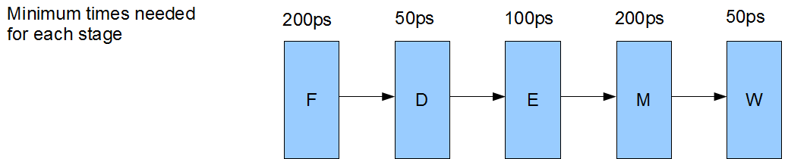
Latency & Throughput
Sequential Implementation
Latency
Throughput

Slide 16




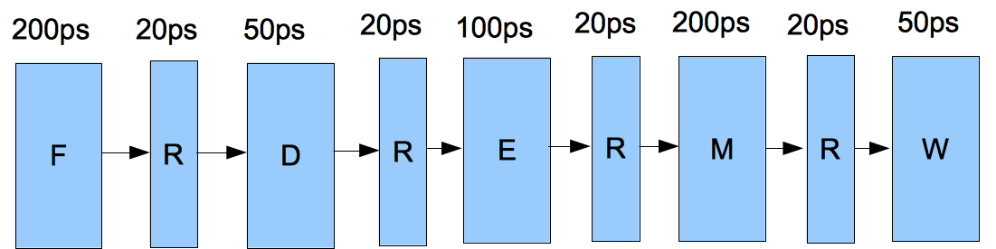




Measuring Performance
Pipeline Stages
Pipeline Overhead
Throughput
  the rate at which instructions leave the pipeline
  what is it here?______________
  in general? _________________
Latency
  total time it takes an instruction to be processed by entire pipeline
  what is it here? ______________
  in general? __________________

Slide 17
Pipelined Y86 Implementation
Unit outline
  Motivation and basic concepts
  Initial Implementation
  Hazards
    Types of hazards
    Dealing with hazards by stalling
    Data hazards: forwarding to avoid stalling
    Control hazards: branch prediction
    Indirect jumps
  Performance analysis

Slide 18
Pipelined Computation
divide execution into modules along flow of computation
  classic RISC pipeline has five modules
  modules arranged in order along computation flow
  all inputs to a module must be computed by an earlier module in flow
turn modules into pipeline stages
  add pipeline registers between each stage
  registers store inputs for that stage
  each stage executes in parallel working on a different instruction
observe that
  a stage has less gate-propagation delay than overall circuit
  what determines clock rate? __________________________
  new instruction retrieved by FETCH on each cycle

Slide 19
The RISC Pipeline
How many stages?
  enough to achieve sufficient parallelism
    must have enough parallelism in the program
  not too much to add undo overhead or complexity
What are they?
  divide instructions into stages that instruction completes in order
    e.g.: do A, then B, then C, then D, then D and then instruction is done
    then we can execute the stages in parallel on different instructions
lets look at rmmovq rA, D(rB), for example
  what are the parts?
  what order do they need to execute?

Slide 20
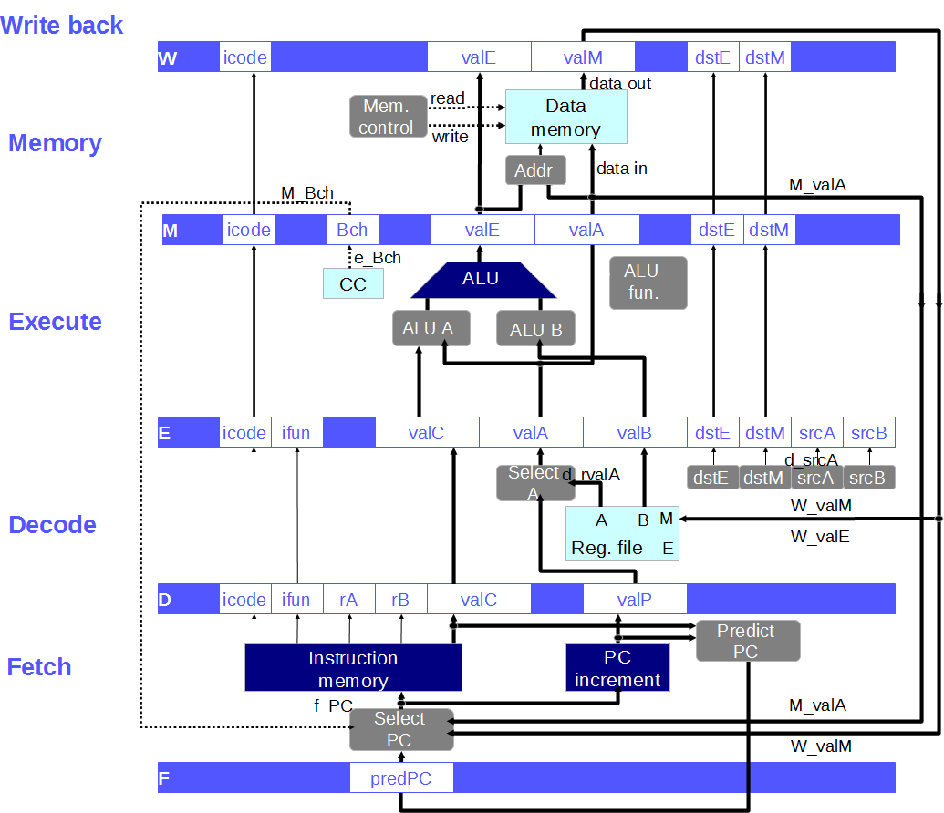
rmmovq rA, D(rB) 40ABDDDDDDDDFFFFFFFF

Slide 21
An Example Problem
What will each pipeline register contain when the last instruction in this sequence is entering the Fetch stage?
.pos 0x100
irmovq $1, %rax
irmovq $2, %rcx
irmovq $3, %rdx
irmovq $4, %rbx
irmovq $5, %rsi

Slide 22
Data Flow Through Processor Stages
F
D
➤
E
M
W
f.prPC
d.iCd | ➤
d.iFn | ➤
d.rA
d.rB
d.valC | ➤
d.valP
e.iCd
e.iFn
e.valC
e.srcA
e.srcB
e.dstE
e.dstM
e.valA
e.valB
m.iCd
m.dstE
m.dstM
m.valA
m.valE
m.bch
w.iCd
w.dstE
w.dstM
m.valE
w.valM
irmovq $1, %rax
irmovq $2, %rcx
irmovq $3, %rdx
irmovq $4, %rbx
irmovq $5, %rsi
main memory
register file

Slide 23
Data Flow Through Processor Stages
F
D
➤
E
M
W
f.prPC
irmovq $1, %rax
main memory
register file

Slide 24
Data Flow Through Processor Stages
F
D
➤
E
M
W
f.prPC
d.iCd
d.iFn
d.rA
d.rB
d.valC
d.valP
irmovq $2, %rcx
irmovq $1, %rax
main memory
register file

Slide 25
Data Flow Through Processor Stages
F
D
➤
E
M
W
f.prPC
d.iCd
d.iFn
d.rA
d.rB
d.valC
d.valP
e.iCd
e.iFn
e.valC
e.srcA
e.srcB
e.dstE
e.dstM
e.valA
e.valB
irmovq $3, %rdx
irmovq $2, %rcx
irmovq $1, %rax
main memory
register file

Slide 26
Data Flow Through Processor Stages
F
D
➤
E
M
W
f.prPC
d.iCd
d.iFn
d.rA
d.rB
d.valC
d.valP
e.iCd
e.iFn
e.valC
e.srcA
e.srcB
e.dstE
e.dstM
e.valA
e.valB
m.iCd
m.dstE
m.dstM
m.valA
m.valE
m.bch
irmovq $4, %rbx
irmovq $3, %rdx
irmovq $2, %rcx
irmovq $1, %rax
main memory
register file

Slide 27
Data Flow Through Processor Stages
F
D
➤
E
M
W
f.prPC
d.iCd
d.iFn
d.rA
d.rB
d.valC
d.valP
e.iCd
e.iFn
e.valC
e.srcA
e.srcB
e.dstE
e.dstM
e.valA
e.valB
m.iCd
m.dstE
m.dstM
m.valA
m.valE
m.bch
w.iCd
w.dstE
w.dstM
m.valE
w.valM
irmovq $5, %rsi
irmovq $4, %rbx
irmovq $3, %rdx
irmovq $2, %rcx
irmovq $1, %rax
main memory
register file

Slide 28
Terminology
an instruction is in flight when
  it is executing in the pipeline
an instruction is retired when
  it exits the pipeline; i.e., it completes
on upcoming slides ...
  exploiting and expressing parallelism
  instruction-level parallelism
  instruction dependencies
  thread-level parallelism
  sequential consistency
  pipeline hazard, stall and bubble

Slide 29
Ordering Instruction Execution
What we think now
  program we write specifies/determines order of instruction execution
What about the pipeline presents a problem?
  are pipelined instructions still executed in order?
  think about the register file ...
  what about conditional jumps ...
What really determines instruction execution order?

Slide 30
Pipeline Considerations
At what stage will %rax be updated?
Consider this code:
irmovq $5, %rax
addq %rax, %rdx
At what stage is irmovq in when addq needs %rax?
At what stage is %rax extracted from the register file?

Slide 31
Instruction-Level Parallelism
Pipeline requires some parallelism
  multiple in-flight instructions
  run partly at the same time
  may even run out-of-order
The program must have the same output as if instructions were executed sequentially.
31

Slide 32
Dependencies Constrain Parallelism
A dependency means that the execution of 2 or more instructions has to proceed in strict time order to be able to produce the same output as if one instruction were completely executed before the next instruction is started.
If no dependency, execution order doesn’t matter
Compilers try to expose as much instruction-level parallelism as they can by separating dependent instructions and grouping them with others on which they don’t depend

Slide 33
Dependencies
Example: how can we rewrite the following code to expose more parallelism?
addq %rax, %rbx
iaddq $5, %rbx
addq %rdx, %rcx
iaddq $9, %rcx
addq %rsi, %rdi
iaddq $3, %rdi

Slide 34
Compilers & Instruction Parallelism
Compilers can reorder instructions to expose as much instruction-level parallelism as possible.
However they cannot know every detail of the processor's pipeline (e.g. later Pentium IV's had more stages than earlier ones).
So the pipeline must handle all dependencies correctly

Slide 35
Dependency Types
Data dependencies
  This is involves dependencies between registers
Control dependencies
  This involves the flow of control (i.e. how the PC needs to be adjusted)

Slide 36
Classifying Data Dependencies
if A and B are instructions, then A ≺ B means instruction B depends on instruction A.
  Causal: A ≺ B if B reads a value written by A.
  Output: A ≺ B if B writes to a location written by A.
  Alias (anti): A ≺ B if B writes to a location read by A.
Read “<“ as must happen before

Slide 37
Control Dependencies
Whether a branch is taken or not taken (jmp, jxx, call, ret).
When an instruction writes to instruction memory (self-modifying code).

Slide 38
Types of Data Dependency
(a) Causal dependency (c) anti (alias) dependency
(b) output dependency (d) no dependency
1.
a = 1;
b = 2;
a = 1;
a = 2;
a = 1;
b = a;
b = a;
a = 1;
2.
3.
4.

Slide 39
Exercise Classify Examples
No dependency 3) anti-dependency
2) Casual dependency 4) output dependency
(a) irmovq $1, %rax rrmovq %rcx, %rax | (c) rrmovq %rax, %rcx irmovq $1, %rax
(b) irmovq $1, %rax rrmovq %rax, %rcx | (d) irmovq $1, %rax irmovq $2, %rcx

Slide 40
Expressing vs Exploiting Parallelism
What does this mean?
expressing: its how the programmer tells the system that two pieces of code can execute in parallel
exploiting: is the system actually executing two pieces of code in parallel
How do you express parallelism in Java?
Is this mechanism useful for expressing ILP?

Slide 41
Exploiting Instruction-Level Parallelism
The problem with instruction-level parallelism is:
Programming languages like C, C++ and Java are based on the sequential consistency model:
  The effect of executing the program must be the same as if instructions were executed one by one in the order they are written.
Programmers write code without thinking about parallelism
Example:
Can be rewritten as:
But compilers must find this on their own.

Slide 42
Pipelined Y86 Implementation
Unit outline
Motivation and basic concepts
Initial implementation
Hazards
  Types of hazards
  Dealing with hazards by stalling
  Data hazards: using data forwarding to avoid stalling
  Control hazards: branch prediction
  Indirect jumps
Performance analysis.

Slide 43
What is the problem here?
irmovq $1, %rax
F
D
E
M
W
addq %rax, %rbx
F
D
E
M
W
F
D
E
M
W
addq %rax, %rcx
F
D
E
M
W
addq %rax, %rdx
addq %rax, %rsi
F
D
E
M
W
time

Slide 44
Hazard Definition
A pipeline hazard exists when the “normal” progression of instructions through the pipeline would violate a data or control dependency.
What can we do?
  Nothing?
Therefore:
One possible solution is:

Slide 45
Pipeline Hazard
definition
  a pipeline hazard exists when the processor’s execution would violate a data or control dependency
what might we do
  can’t do nothing
    execution might produce erroneous results
  must detect
  we could stall
defns
  pipeline stall: holding an instruction in a pipeline stage for an extra cycle, always produces a bubble in the subsequent stage in the next cycle
  pipeline bubble: when a pipeline stage is forced to do nothing in order to avoid a hazard.
irmovq $1, %rax
F
D
E
M
W
addq %rax, %rbx
F
D
E
M
W
addq %rax, %rcx
F
D
E
M
W
addq %rax, %rdx
F
D
E
M
W
time
F
D
E
M
W

Slide 46
Stalling
defns
  pipeline stall: hold an instruction in a pipeline stage for an extra cycle
    always produces a bubble in the subsequent stage in the next cycle
  pipeline bubble: when a pipeline stage is forced to do nothing in order to avoid a hazard. (result of a previous stall)
irmovq $1, %rax
F
D
E
M
W
addq %rax, %rbx
F
D
D
D
D
E
M
W
subq %rax, %rcx
F
F
F
F
D
E
M
xorq %rax, %rdx
F
D
E
time

Slide 47
Stalling
defns
  pipeline stall: hold an instruction in a pipeline stage for an extra cycle
    always produces a bubble in the subsequent stage in the next cycle
  pipeline bubble: when a pipeline stage is forced to do nothing in order to avoid a hazard. (result of a previous stall)
irmovq $1, %rax
F
D
E
M
W
addq %rax, %rbx
F
D
D
D
D
E
M
W
subq %rax, %rcx
F
F
F
F
D
E
M
xorq %rax, %rdx
F
D
E
time

Slide 48
Stalling
defns
  pipeline stall: hold an instruction in a pipeline stage for an extra cycle
    always produces a bubble in the subsequent stage in the next cycle
  pipeline bubble: when a pipeline stage is forced to do nothing in order to avoid a hazard. (result of a previous stall)
irmovq $1, %rax
F
D
E
M
W
addq %rax, %rbx
F
D
D
D
D
E
M
W
subq %rax, %rcx
F
F
F
F
D
E
M
xorq %rax, %rdx
F
D
E
time

Slide 49
Stalling
defns
  pipeline stall: hold an instruction in a pipeline stage for an extra cycle
    always produces a bubble in the subsequent stage in the next cycle
  pipeline bubble: when a pipeline stage is forced to do nothing in order to avoid a hazard. (result of a previous stall)
irmovq $1, %rax
F
D
E
M
W
addq %rax, %rbx
F
D
D
D
D
E
M
W
subq %rax, %rcx
F
F
F
F
D
E
M
xorq %rax, %rdx
F
D
E
time

Slide 50
Stalling
defns
  pipeline stall: hold an instruction in a pipeline stage for an extra cycle
    always produces a bubble in the subsequent stage in the next cycle
  pipeline bubble: when a pipeline stage is forced to do nothing in order to avoid a hazard. (result of a previous stall)
irmovq $1, %rax
F
D
E
M
W
addq %rax, %rbx
F
D
D
D
D
E
M
W
subq %rax, %rcx
F
F
F
F
D
E
M
xorq %rax, %rdx
F
D
E
time

Slide 51
Stalling
defns
  pipeline stall: hold an instruction in a pipeline stage for an extra cycle
    always produces a bubble in the subsequent stage in the next cycle
  pipeline bubble: when a pipeline stage is forced to do nothing in order to avoid a hazard. (result of a previous stall)
irmovq $1, %rax
F
D
E
M
W
addq %rax, %rbx
F
D
D
D
D
E
M
W
subq %rax, %rcx
F
F
F
F
D
E
M
xorq %rax, %rdx
F
D
E
time

Slide 52
Stalling
defns
  pipeline stall: hold an instruction in a pipeline stage for an extra cycle
    always produces a bubble in the subsequent stage in the next cycle
  pipeline bubble: when a pipeline stage is forced to do nothing in order to avoid a hazard. (result of a previous stall)
irmovq $1, %rax
F
D
E
M
W
addq %rax, %rbx
F
D
D
D
D
E
M
W
subq %rax, %rcx
F
F
F
F
D
E
M
xorq %rax, %rdx
F
D
E
time

Slide 53
Stalling
defns
  pipeline stall: hold an instruction in a pipeline stage for an extra cycle
    always produces a bubble in the subsequent stage in the next cycle
  pipeline bubble: when a pipeline stage is forced to do nothing in order to avoid a hazard. (result of a previous stall)
irmovq $1, %rax
F
D
E
M
W
addq %rax, %rbx
F
D
D
D
D
E
M
W
subq %rax, %rcx
F
F
F
F
D
E
M
xorq %rax, %rdx
F
D
E
time

Slide 54
Stalling
defns
  pipeline stall: hold an instruction in a pipeline stage for an extra cycle
    always produces a bubble in the subsequent stage in the next cycle
  pipeline bubble: when a pipeline stage is forced to do nothing in order to avoid a hazard. (result of a previous stall)
irmovq $1, %rax
F
D
E
M
W
addq %rax, %rbx
F
D
D
D
D
E
M
W
subq %rax, %rcx
F
F
F
F
D
E
M
xorq %rax, %rdx
F
D
E
time

Slide 55
Stalling
defns
  pipeline stall: hold an instruction in a pipeline stage for an extra cycle
    always produces a bubble in the subsequent stage in the next cycle
  pipeline bubble: when a pipeline stage is forced to do nothing in order to avoid a hazard. (result of a previous stall)
irmovq $1, %rax
F
D
E
M
W
addq %rax, %rbx
F
D
D
D
D
E
M
W
subq %rax, %rcx
F
F
F
F
D
E
M
xorq %rax, %rdx
F
D
E
time

Slide 56
Bubble
The term pipeline bubble denotes a pipeline stage that is forced to do nothing to avoid a hazard, because of a stall in a previous stage.
The bubble is an instruction that has been converted into a NOP

Slide 57
Example
F
D
E
M
W
irmovq
?
?
?
?
addq
irmovq
?
?
?
subq
addq
irmovq
?
?
subq
addq
bubble
irmovq
?
subq
addq
bubble
bubble
irmovq
subq
addq
bubble
bubble
bubble
xorq
subq
addq
bubble
bubble
xorq
subq
addq
bubble
xorq
subq
addq

Slide 58
Example
F
D
E
M
W
irmovq
?
?
?
?
addq
irmovq
?
?
?
subq
addq
irmovq
?
?
subq
addq
bubble
irmovq
?
subq
addq
bubble
bubble
irmovq
subq
addq
bubble
bubble
bubble
xorq
subq
addq
bubble
bubble
xorq
subq
addq
bubble
xorq
subq
addq

Slide 59
Example
F
D
E
M
W
irmovq
?
?
?
?
addq
irmovq
?
?
?
subq
addq
irmovq
?
?
subq
addq
bubble
irmovq
?
subq
addq
bubble
bubble
irmovq
subq
addq
bubble
bubble
bubble
xorq
subq
addq
bubble
bubble
xorq
subq
addq
bubble
xorq
subq
addq

Slide 60
Example
F
D
E
M
W
irmovq
?
?
?
?
addq
irmovq
?
?
?
subq
addq
irmovq
?
?
subq
addq
bubble
irmovq
?
subq
addq
bubble
bubble
irmovq
subq
addq
bubble
bubble
bubble
xorq
subq
addq
bubble
bubble
xorq
subq
addq
bubble
xorq
subq
addq

Slide 61
Example
F
D
E
M
W
irmovq
?
?
?
?
addq
irmovq
?
?
?
subq
addq
irmovq
?
?
subq
addq
bubble
irmovq
?
subq
addq
bubble
bubble
irmovq
subq
addq
bubble
bubble
bubble
xorq
subq
addq
bubble
bubble
xorq
subq
addq
bubble
xorq
subq
addq

Slide 62
Example
F
D
E
M
W
irmovq
?
?
?
?
addq
irmovq
?
?
?
subq
addq
irmovq
?
?
subq
addq
bubble
irmovq
?
subq
addq
bubble
bubble
irmovq
subq
addq
bubble
bubble
bubble
xorq
subq
addq
bubble
bubble
xorq
subq
addq
bubble
xorq
subq
addq

Slide 63
Example
F
D
E
M
W
irmovq
?
?
?
?
addq
irmovq
?
?
?
subq
addq
irmovq
?
?
subq
addq
bubble
irmovq
?
subq
addq
bubble
bubble
irmovq
subq
addq
bubble
bubble
bubble
xorq
subq
addq
bubble
bubble
xorq
subq
addq
bubble
xorq
subq
addq

Slide 64
Example
F
D
E
M
W
irmovq
?
?
?
?
addq
irmovq
?
?
?
subq
addq
irmovq
?
?
subq
addq
bubble
irmovq
?
subq
addq
bubble
bubble
irmovq
subq
addq
bubble
bubble
bubble
xorq
subq
addq
bubble
bubble
xorq
subq
addq
bubble
xorq
subq
addq

Slide 65
Example
F
D
E
M
W
irmovq
?
?
?
?
addq
irmovq
?
?
?
subq
addq
irmovq
?
?
subq
addq
bubble
irmovq
?
subq
addq
bubble
bubble
irmovq
subq
addq
bubble
bubble
bubble
xorq
subq
addq
bubble
bubble
xorq
subq
addq
bubble
xorq
subq
addq

Slide 66
Example
F
D
E
M
W
irmovq
?
?
?
?
addq
irmovq
?
?
?
subq
addq
irmovq
?
?
subq
addq
bubble
irmovq
?
subq
addq
bubble
bubble
irmovq
subq
addq
bubble
bubble
bubble
xorq
subq
addq
bubble
bubble
xorq
subq
addq
bubble
xorq
subq
addq

Slide 67
Example
F | D | E | M | W
jne done
Addq %r9, %r10 rrmovq %r10, %rax

Slide 68
What About Anti and Output Dependencies
They aren’t real dependencies provided instructions are executed in-order, which at this point we are assuming
Output is special case where first instruction’s output can be ignored
irmovq $1, %rax
irmovq $2, %rax
addq %rax, %rdx
irmovq $1, %rax
Output
Causal
Anti

Slide 69
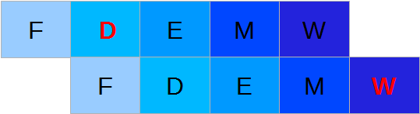
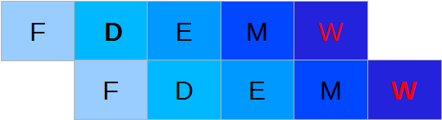
Types of Hazards
Only issue if out
of order execution
For our pipelined Y86 implementation:
Anti-dependency:
addq %rax, %rdx
irmovq $1, %rax
Output dependency:
addq %rax, %rdx
irmovq $1, %rdx
So the solution is:

Slide 70
Doing Something Better than Stalling
Is important
  every stall creates a pipeline bubble
  every bubble results in a cycle when processor can’t retire an instruction
  retiring a bubble is of no value to program execution
What are the consequences of bubbles on throughput?
Ideas needed to deal with
  data dependencies
  control dependencies

Slide 71
Y86 Pipeline Hazards
data hazards: only issue is
  causal hazards on register file, why?
  what not
    memory or condition codes?
control hazards
  conditional jump
  Return
  why not unconditional jump or call?

Slide 72
Pipe–: Resolving Hazards by Stalling
Summary
data hazards
  reading registers in decode that are written by instructions currently in execute, memory or write-back stages
  stall instruction in decode until writer is retired
  how many stall cycles? ______

Slide 73
Control Hazards
  Conditional jump
  At what stage do we know which PC?
  At what stage is the PC needed?
  how many stall cycles? ______
Return
  The next PC is available at the end of?
  how many stall cycles? ______

Slide 74
Example JNE
F | D | E | M | W
jne done | ? | ? | ? | ?
bubble | jne done | ? | ? | ?
bubble | bubble | jne done | ? | ?
rrmovq %r9,%rax | bubble | bubble | jne done | ?
addq %r8,%r9 | rrmovq %r9,%rax | bubble | bubble | jne done

Slide 75
Example JNE
F | D | E | M | W
jne done | ? | ? | ? | ?
Bubble?? | jne done | ? | ? | ?
bubble | bubble | jne done | ? | ?
rrmovq %r9,%rax | bubble | bubble | jne done | ?
addq %r8,%r9 | rrmovq %r9,%rax | bubble | bubble | jne done

Slide 76
Example JNE
F | D | E | M | W
jne done | ? | ? | ? | ?
Bubble?? | jne done | ? | ? | ?
Bubble?? | bubble | jne done | ? | ?
rrmovq %r9,%rax | bubble | bubble | jne done | ?
addq %r8,%r9 | rrmovq %r9,%rax | bubble | bubble | jne done

Slide 77
Example JNE
F | D | E | M | W
jne done | ? | ? | ? | ?
Bubble??? | jne done | ? | ? | ?
Bubble??? | bubble | jne done | ? | ?
rrmovq %r9,%rax | bubble | bubble | jne done | ?
addq %r8,%r9 | rrmovq %r9,%rax | bubble | bubble | jne done

Slide 78
Example JNE
F | D | E | M | W
jne done | ? | ? | ? | ?
Bubble??? | jne done | ? | ? | ?
Bubble??? | bubble | jne done | ? | ?
rrmovq %r9,%rax | bubble | bubble | jne done | ?
addq %r8,%r9 | rrmovq %r9,%rax | bubble | bubble | jne done

Slide 79
Example ret
F | D | E | M | W
ret | ? | ? | ? | ?
Bubble??? | ret | ? | ? | ?
Bubble??? | bubble | ret | ? | ?
Bubble??? | bubble | bubble | ret | ?
popq %r9 | bubble | bubble | bubble | ret
popq %r10 | Poprq %9 | bubble | bubble | bubble

Slide 80
Example ret
F | D | E | M | W
ret | ? | ? | ? | ?
Bubble??? | ret | ? | ? | ?
Bubble??? | bubble | ret | ? | ?
Bubble??? | bubble | bubble | ret | ?
popq %r9 | bubble | bubble | bubble | ret
popq %r10 | Poprq %9 | bubble | bubble | bubble

Slide 81
Example ret
F | D | E | M | W
ret | ? | ? | ? | ?
Bubble??? | ret | ? | ? | ?
Bubble??? | bubble | ret | ? | ?
Bubble??? | bubble | bubble | ret | ?
popq %r9 | bubble | bubble | bubble | ret
popq %r10 | Poprq %9 | bubble | bubble | bubble

Slide 82
Example ret
F | D | E | M | W
ret | ? | ? | ? | ?
Bubble??? | ret | ? | ? | ?
Bubble??? | bubble | ret | ? | ?
Bubble??? | bubble | bubble | ret | ?
popq %r9 | bubble | bubble | bubble | ret
popq %r10 | Poprq %9 | bubble | bubble | bubble

Slide 83
Example ret
F | D | E | M | W
ret | ? | ? | ? | ?
Bubble??? | ret | ? | ? | ?
Bubble??? | bubble | ret | ? | ?
Bubble??? | bubble | bubble | ret | ?
popq %r9 | bubble | bubble | bubble | ret
popq %r10 | Poprq %9 | bubble | bubble | bubble

Slide 84
Example ret
F | D | E | M | W
ret | ? | ? | ? | ?
Bubble??? | ret | ? | ? | ?
Bubble??? | bubble | ret | ? | ?
Bubble??? | bubble | bubble | ret | ?
popq %r9 | bubble | bubble | bubble | ret
popq %r10 | Poprq %9 | bubble | bubble | bubble

Slide 85
Pipeline Control Unit
The pipeline-control module
  is a hardware component (circuit) separate from the 5 stages
  examines values across every stage
  decides whether stage should stall or bubble
85

Slide 86
Dealing with hazards
Each stage register has a control input that determines what happens when the clock ticks:
  Normal: register's new value is the input value.
  Stall: register's new value is the same as its current value.
  Bubble: register's new value is the same as for NOP.

Slide 87
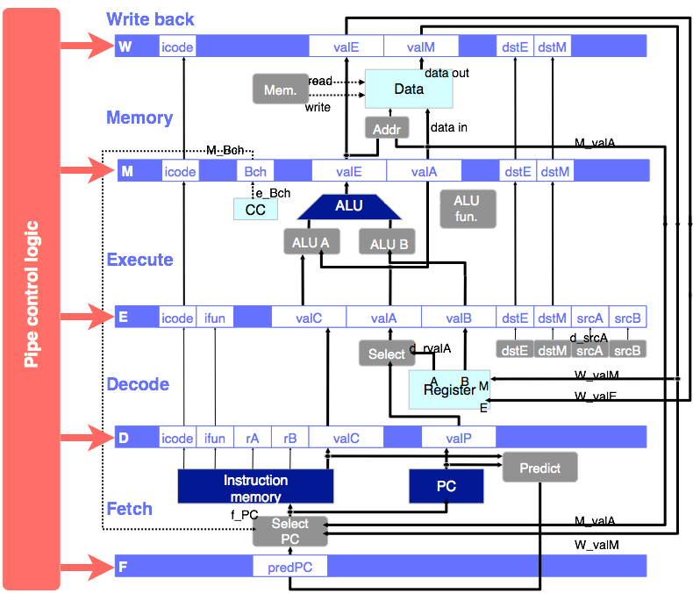
Pipeline Control Unit
87

Slide 88
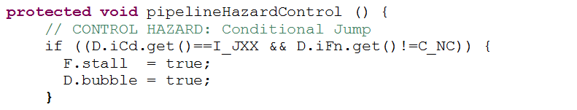
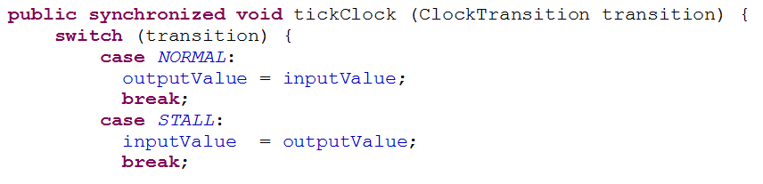
In the Simulator
stage.stall/stage.bubble determine the control input for the stage registers:
In file Register.java:

Slide 89
Pipelined Y86 Implementation
Unit outline
Motivation and basic concepts
Initial implementation
Hazards
  Types of hazards
  Dealing with hazards by stalling
  Data hazards: using data forwarding to avoid stalling
  Control hazards: branch prediction
  Indirect jumps
Performance analysis.

Slide 90
Dealing with Causal Dependencies
may have to stall
  an instruction can’t read a value that the processor doesn’t know yet
but in most cases processor has computed value, it just hasn’t written it to the register file yet
so data forwarding will resolve hazard (in these cases)
  is mechanism that forwards values from later pipeline stages to earlier ones so that an instruction can read value before it is written back to register file

Slide 91
Data Forwarding
In y86, at the end of what stage is output known by CPU?
  irmovq, addq, subq, andq, xorq, pushq, popq (rsp), call (rsp), ret (rsp)
  mrmovq, popl (target reg)
in y86, at the end of what stage is register value needed?

Slide 92
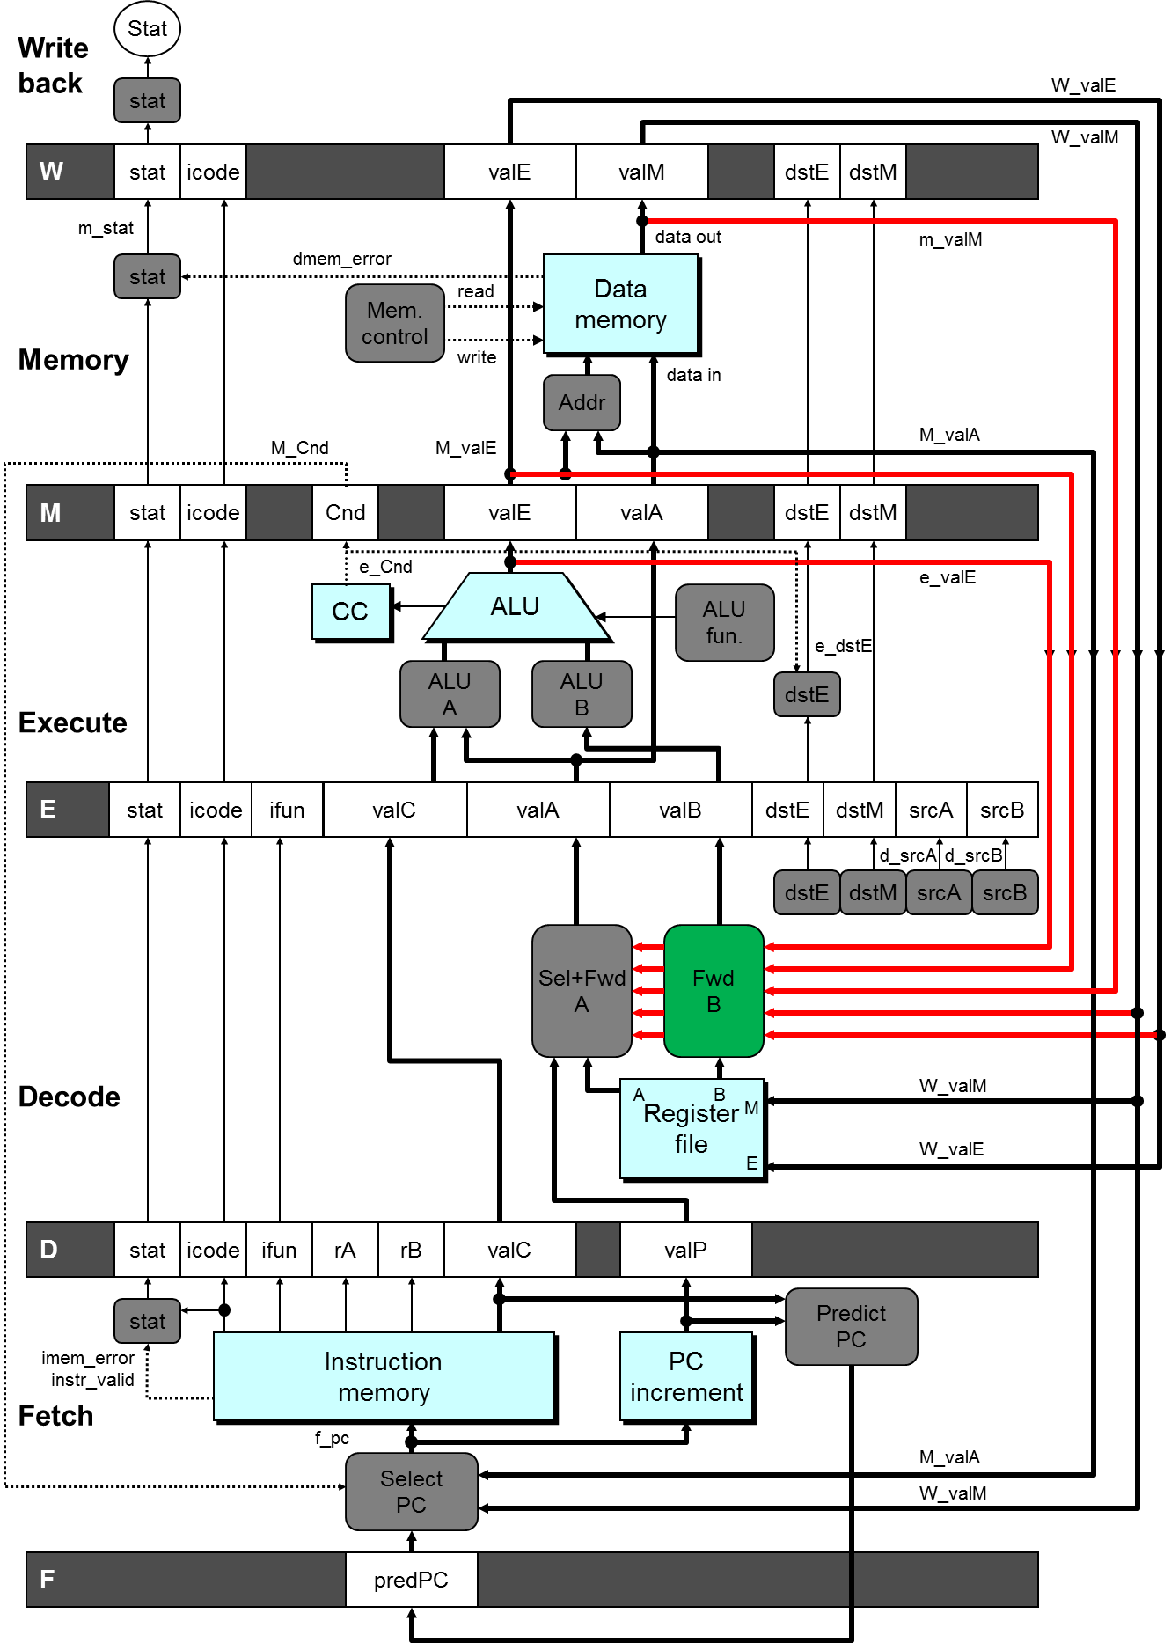
Pipe (with forwarding)
to
  D
from
  W new value to register file
  M new value read from memory
  E new value from ALU
by
  sending value and name
  from all three stages
  back to forwarding logic
  in decode stage
92

Slide 93
93

Slide 94
Types of Y86 Data Hazards
register-register hazards
  rmmovq, irmovq, addq, subl, andl, xorl, pushq, popq (rsp), call (rsp), ret (rsp)
  forward to decode from execute, memory or write back
load-use hazards
  mrmovq, popq (target reg)
  stall use one cycle
  forward to decode from memory or write back
irmovq $1, %rax
F
D
E
M
W
addq %rax, %rbx
F
D
E
M
W
addq %rax, %rcx
F
D
E
M
W
addq %rax, %rdx
F
D
E
M
W
F
D
E
M
W
time
mrmovq (%esi), %rax
F
D
E
M
W
addq %rax, %rbx
F
D
E
M
W
addq %rax, %rcx
F
D
E
M
W
addq %rax, %rdx
F
D
E
M
W
time
F
D
E
M
W

Slide 95
Register to Register Hazard with
Data Forwarding
Instructions: irmovq, addq, subq, andq, xorq
    AND
pushq, popq, call, ret - all depend upon %rsp
Forward from _____ to _______
irmovq $10, %rax
F
D
E
M
W
addq %rax, %rbx
F
D
E
M
W
addq %rax, %rcx
F
D
E
M
W
addq %rax, %rdx
F
D
E
M
W
Time

Slide 96
Load Use Hazard with
Data Forwarding
Instructions: mrmovq, popq
Stall 1 cycle
Forward from _____ to _______
mrmovq (%esi), %rax
F
D
E
M
W
addq %rax, %rbx
F
D
D
E
M
W
addq %rax, %rcx
F
F
D
E
M
W
addq %rax, %rdx
F
D
E
M
W
Time

Slide 97
Pipe (with forwarding)
97

Slide 98
Forwarding implementation
E_dstE
e_valE
M_dstE
M_valE
M_dstM
m_valM
E
icode
ifun
valC
valA
valB
dstE
dstM
srcA
srcB
W_dstM
W_valM
W_dstE
Sel+Fwd
A
Fwd
B
W_valE
In Decode – need to fix this part of the circuit:
// read valA from register file
if (d.srcA.getValueProduced() != R_NONE)
d.valA.set (reg.get (d.srcA.getValueProduced()));
else
d.valA.set (0);
d_rvalA
d_rvalB
A
B
dstM
Register
file
M
dstE
srcA
srcB
E
d_srcB
d_srcA
dstE
dstM
srcA
srcB
D
icode
ifun
rA
rB
valC
valP

Slide 99
Pipelined Y86 Implementation
Unit outline
Motivation and basic concepts
Initial implementation
Hazards
  Types of hazards
  Dealing with hazards by stalling
  Data hazards: using data forwarding to avoid stalling
  Control hazards: branch prediction
  Indirect jumps
Performance analysis.

Slide 100
Control Dependencies
Unconditional jumps and procedure calls
  Hazard? (e.g. jmp foo, call bar)
Conditional jumps
  Hazard? (e.g. jle foo)
  What is the problem?
  At what stage does the CPU know the answer?
Return
  Hazard? (e.g. ret)
  What is the problem?
  At what stage does the CPU know the answer?
Do we have to stall?

Slide 101
Jump Prediction
to resolve conditional-jump hazard
  jump is either taken or not, don’t know until jump is finished E
  don’t whether to use valP or valC for instruction following jump
guess at whether branch is taken or not
  guess that its either valP (not taken) or valC (taken)
  start these speculative instructions through pipeline
when jump reaches E we know if we guessed right
  speculative instructions have only gotten to D
  if guessed wrong, shoot down the instructions that should have executed
    turn them into bubbles, no-ops
result
  no bubble if guess right
  two bubbles if guess wrong
we will guess taken
  what is the right guess? more shortly ...
jle foo
F
D
E
M
W
jgt foo
F
D
E
M
W
F
D
E
M
W
F
D
E
M
W
F
D
E
M
W
F
D
E
M
W
F
D
E
M
W
F
D
E
M
W
time
F
D
E
M
W
time
F
D
E
M
W

Slide 102
Branch Prediction
Problem:
  We won’t know whether or not to jump until end of Execute stage
  In the fetch stage (i.e. when setting the next PC) we don’t know if we should use valP (branch not taken) or valC (branch taken)
Idea:
  Guess whether or not branch taken
  Start speculative execution of instructions
  None will reach M or W stage before we know if the guess was wrong
Guess wrong:
  Shoot down all speculative instructions by turning into bubbles

Slide 103
Branch Prediction
For conditional jumps:
  No bubble if guess right
  Two bubbles if guess wrong
0x100 jle $oxbadbeef
F
D
E
M
W
0xbadbeef addq %rax, %rbx
F
D
E
M
W
0xbadbeef + 2 addq %rax, %rcx
F
D
E
M
W
0x105 irmovq $0, %rax
F
D
E
M
W
Time

Slide 104
Predicting the Next PC in Fetch Stage
unconditional jumps
  call and jmp
  predPC = valC, available in ?
conditional jumps
  know if branch taken in ?? (e_bch / M.bch)
  jump prediction in ??
    predict whether jump is taken
    predPC = valC (i.e., taken)
  misprediction control hazard
    handled by “Select PC” in F
    feedback from M
  no stall if prediction is correct
return from procedure call
  know target in M
    feedback from W to “Select PC” in F
  y86 stalls 3 cycles
    but, could use on-chip return-address stack
Write back
W
icode
valE
valM
dstE
dstM
Mem.
control
read
data out
Data
memory
Memory
write
data in
Addr
M_Bch
M_valA
M
icode
Bch
valE
valA
dstE
dstM
e_Bch
ALU
ALU
fun.
CC
ALU
A
ALU
B
Execute
E
icode
ifun
valC
valA
valB
dstE
dstM
srcA
srcB
Select
A
dstE
dstM
d_srcA
d_rvalA
srcA
srcB
A
B
W_valM
Decode
Register
file
M
W_valE
E
D
icode
ifun
rA
rB
valC
valP
Predict
PC
Instruction
memory
PC
increment
Fetch
f_PC
Select
PC
M_valA
W_valM
F
predPC
104

Slide 105
Jump Prediction
fetch has two sub-modules
M_icode
M_Bch
M_valA
W_icode
Predict
  when conditional jump is in F
  F predicts taken, setting f.prPC to valC
If mis-predict, fetch from correct path
  when miss-predicted jump is in M
    i.e., M.bch == 0
  F ignores prPC; selects instruction at m.valP
If miss-predict, shootdown
  when mis-predicted jump is in E
  pipeline control sets D and E to bubble
D
icode
ifun
rA
rB
valC
valP
W_valM
Predict
PC
Instr
valid
Need
valC
Need
regids
PC
increment
Split
Align
Byte 0
Bytes 1-5
private void fetch_PredictPC () {
f.prPC.set (valC or valP);
Instruction
memory
Select
PC
F
predPC
protected void fetch () {
fetch_SelectPC ();
int pc = f.pc.getValueP...d()
...
fetch_PredictPC ();
protected void fetch_SelectPC () {
// get correct PC for mispredicted jumps in M or ret in W
f.pc.set (?);
protected void pipelineHazardControl () {
// bubble D and E for mis-predicted jump and stall for ret

Slide 106
Exercise
fetch has two sub-modules
M_icode
M_Bch
M_valA
W_icode
Implement selectPC
D
icode
ifun
rA
rB
valC
valP
W_valM
Predict
PC
Instr
valid
Need
valC
protected void fetch_SelectPC () {
// get correct PC for mispredicted jumps in M or ret in W
f.pc.set (?);
Need
regids
PC
increment
Split
Align
Byte 0
Bytes 1-5
Instruction
memory
Select
PC
F
predPC
protected void fetch () {
fetch_SelectPC ();
int pc = f.pc.getValueP...d()
...
fetch_PredictPC ();

Slide 107
Is it jump prediction or guessing?
Are jumps usually 50% likely to be taken, and 50% not?
  If so might as well just guess at random.
Consider how jumps are used in a program:
  loops:
    continue condition at bottom of loop is normally taken.
    exit condition at top of loop is normally not taken.
ifs:
  if testing for error condition, error handling code normally skipped.
  if testing for recursion base case, base case normally skipped.

Slide 108
Observations
Most jumps tend to one way (taken or not taken for that line of code predominates)
Supported by empirical evidence
If we can figure this out we can improve a program’s performance

Slide 109
What the compiler knows
In many cases the compiler can make a good prediction because:
  It creates the code
  For loops it knows if the jump means exit or continue
  Might be able to spot error test for ifs
  Only has the program text to make decisions on
  Cannot (usually) use dynamic information from execution

Slide 110
What compiler wants from ISA
Conditional jumps to be predicted one way or the other.
ISA needs to state this explicitly so the compiler knows which way to adjust code
Complicated prediction rules are OK as long as it is specified

Slide 111
Example of complex prediction
predict backward jumps are taken and forward jumps are not taken
  backward jumps (that just go a short distance) are almost always loop-continue jumps
  so they will be mostly taken
  forward jumps could be anything, so ISA might make this predict not taken to add flexibility
but, what’s most important is that the compiler know what the processor will do
Static
Jump
prediction

Slide 112
Dynamic Jump Prediction
Sometimes the compiler can’t tell, but jump still has a strong tendency one way or another
  e.g., its hard for compilers to tell which if branch tends to be executed
Dynamic Jump Prediction is done by CPU Hardware
  this is a type of jump where the compiler does not know what will happen
  the hardware bases its prediction on the behaviour it observes of the jump

Slide 113
Implementing
  CPU hardware maintains an on-chip cache of recent jump results
  when jump is in Execute stage (bch is computed) it updates this cache
  when jump is in Fetch state, use history as basis for prediction
(jump-address) => (was jump taken the last time it was executed?)
jumpCache.get (valP-9). set (bch)
f.prPC = jumpCache.get (valP-9)? valC : valP

Slide 114
Even Better
Remember not just the last execution, but the last few by storing branch history as a sequence of bits with 1 indicating taken
  e.g., 1010 means the jump’s recent taken history was: no, yes, no yes
Use the count of the majority of bits as prediction
jumpCache.get (valP-9). set ((jumpCache.get (valP-9) << 1) | bch)
N = total # of bits used to store history (usually 4)
x = 0;
for (bits = jumpCache.get (valP-9).get(); bits!=0; bits >>> 1)
x += bits & 1;
f.prPC = (x > N/2)? valC : valP

Slide 115
Even Better
Remember not just the last execution, but the last few by storing branch history as a sequence of bits with 1 indicating taken
  e.g., 1010 means the jump’s recent taken history was: no, yes, no yes
Use the count of the majority of bits as prediction
Try to observe a pattern

Slide 116
Dynamic Prediction & Compiler
Compiler needs to know if jump prediction is used and how the decision is made
One option
  Have a set of branch instructions that use static prediction
  Second set that uses dynamic prediction
Why?

Slide 117
The return Hazard
Problem
  Can’t predict what to put in F when ret moves to E
  Must read return address from memory but that doesn’t happen until M
Result
  leads to seeming inevitable 3 bubbles for each return
  returns are common, because procedures are small - a good idea for program readability, but with bad performance consequences

Slide 118
Solution
Maintain a small stack of return addresses on the CPU Chip
  when call instruction in F
  when ret instruction in F
note that this stack is finite size and small, so return address may not be there
  in this case, we follow the old procedure and stall three times (i.e., iFn == 0)
returnCache.push (valP)
if (! returnCache.isEmpty ()) {
f.prPC = returnCache.pop ();
f.iFn = 1; // hack to tell pipelineHazardControl not to bubble

Slide 119
Pipelined Y86 Implementation
Unit outline
Motivation and basic concepts
Initial implementation
Hazards
  Types of hazards
  Dealing with hazards by stalling
  Data hazards: using data forwarding to avoid stalling
  Control hazards: branch prediction
  Indirect jumps
Performance analysis.

Slide 120
Indirect Jumps
Y86 doesn’t have these, but they are necessary and common
  Indirect jump: jmp D(%rax)
    PC ← D + R[%rax]
  Double indirect jump: jmp *D(%rax)
    PC ← M[D + R[%rax]]

Slide 121
Problem
Unlike direct jumps, we do not know the target address in F
  for indirect we know it at the end of ??
  for double-indirect we know it at the end of ??
  Consequently, we cannot predict it in F, too many targets
This is really bad, why?
  virtually every procedure call in object-oriented language is double-indirect

Slide 122
Polymorphic Dispatch
class Base {
void foo () { ... }
void bar () { ... }
}
class Sub extends Base {
void foo () { ... }
}
void zot (Base b) {
b.foo ();
}
To generate code for the call object.method() (e.g. b.foo())
  object contains pointer to table with method addresses.
  Index into the table is determined by the method name.
  Assuming %rax is object address, D is method index:
  mrmovq (%rax), %rbx
  // %rbx is now table address
  call *D(%rbx)
  // jump to method address stored in table

Slide 123
B = new Base()
B
Method Table for Base
methodPtr
Method1() {}
varA
Method1()
Method2() {}
varB
Method2()
varC
methodPtr
varA
varB
C
varC

Slide 124
B = new subBase()
Method Table for Base
subB
methodPtr
Method1()
Method1() {}
varA
Method2()
Method2() {}
varB
varC
Method1()
subMethod2() {}
Method2()

Slide 125
void a1(void) {
printf("a1\n");
}
void a2(void) {
printf("a2\n");
}
int main(int argc, char **argv) {
void (*foo[2])(void);
foo[0] = a1; foo[1] = a2;
foo[0](); foo[1]();
}

Slide 126
Prediction for Indirect Jumps
This is bonus material. You will not be examined on this. You many ignore it.
Key observation
  while compiler does not actually know the class of object, it knows only that the object implements the static type of the variable
  many variables tend to store objects of the same type over time
Key idea
  the hardware (or Java Virtual Machine) remembers object type and target address used the last time call was executed. If next call is to same type, it uses cached target address instead of reading it from memory.
Implementation
  maintain a cache of call instructions with address of procedure last called (ID a call instruction by its address)
    predict that call will call this same procedure again when the same call instruction is executed

Slide 127
Summary of y86 pipeline hazards
in-order execution in pipeline
  focus only on dependency problems within one, in-order, pipeline
    but, modern processors = pipeline + add superscalar + out-of-order execution
data hazards (causal: read-after-write)
problems ⇒ erroneous computation
    register read in stage D
    but write in W
    non-problems
    memory, cc, and register output and anti
  solutions
    forward values across stages, stall if necessary (load/use)
    have new value in E or in M (for mrmovq and popl)
control hazards
  problem ⇒ pipeline bubble
    jxx target computed in E, ret in M
  solutions
    stall or delay slot plus forwarding
    or predict branch target in F
OP1
F
D
E
M
W
OP2
F
D
E
M
W
OP3
F
D
E
M
W
OP4
F
D
E
M
W
OP5
F
D
E
M
W
time
OP1
F
D
E
M
W
bubble
F
D
E
M
W
bubble
F
D
E
M
W
OP2
F
D
E
M
W
OP3
F
D
E
M
W
time
127

Slide 128
Pipelined Y86 Implementation
Unit outline
Motivation and basic concepts
Initial implementation
Hazards
  Types of hazards
  Dealing with hazards by stalling
  Data hazards: using data forwarding to avoid stalling
  Control hazards: branch prediction
  Indirect jumps
Performance analysis.

Slide 129
Performance Analysis
cycles per instruction (CPI)
  measures pipeline efficiency = 1/throughput
CPI = totalCycles / instructionRetiredCycles
= 1 + lp + mp + rp
bubble penalties
  load/use lp = 1 bubble * probability of occurrence
  branch misprediction mp = 2 bubbles * probability of occurrence
  return rp = 3 bubbles * probability of occurrence
129

Slide 130
Performance Analysis Example
Cause | Name | Instruction frequency | Condition frequency | Bubbles | Penalty
load/use | lp | 25% | 20% | 1 | ?
mispredict | mp | 20% | 40% | 2 | ?
return | rp | 2% | 100% | 3 | ?
total |  |  |  |  | ?
CPI = ?
130

Slide 131
Limits to Pipeline Depth
Goal is improved throughput
  retired instructions / second
  (CPI * clock-period) ⁻¹
Are deeper pipelines better?
  Pros
  Cons

Slide 132
Other Techniques
super-scalar
  Multiple pipelines that run in parallel
  Issue multiple instructions on each cycle
  Instructions execute in parallel and can even bypass each other
hyper-threading
  OS loads multiple runnable treads into CPU usually from same process
  CPU does fast switching among threads to use resources when one thread stalls
multi-core
  Multiple CPUs per chip, each pipelined, super-scalar etc.
  CPU’s execute independent threads from possibly different processes
  Typically have private L1 caches and a shared L2 cache
  Cores may be symmetric or not (i.e., with same capabilities or not)
    e.g., Intel Core Duo is symmetric and the IBM/Sony Cell processor is asymmetric

Slide 133
Summary
ISA: y86 vs x86 (IA32)
  y86 is RISC-like
  x86 is CISC, converted to RISC micro ops in hardware
  e.g., addq %rax, (%rbx) is really 3 micro operations
y86 implementation: pipelined architecture
  divide execution into stages to improve throughput
  reduce cycle time; make more efficient use of transistors
  instruction-level parallelism
  dependencies and hazards
  data forwarding
  branch prediction
x86 implementation: y86 vs x86
  super-pipelined and superscalar
  redundant functional units
  out-of-order execution
  predict multiple branch paths at once
performance very workload sensitive

