Slide 1
Unit 5
Virtual Memory

Slide 2
Virtual Memory Learning Goals
By the end of this unit, you should be able to:
Explain why, despite the fact that Virtual Memory (VM) uses main memory as a cache for disk, VM tends to have significantly different organization and mechanisms from caches.
Trace the translation of a virtual address to a physical address through a given translation lookaside buffer, page table, and cache to retrieve the physical address.

Slide 3
An Overview
CPUs execute instructions
Instructions and data are in main memory
Caches bring highly used data and instructions “closer” to the CPU to speedup access
Processes are collections of instructions and data
Each process has: instructions, stack, heap, and data areas
Multiple processes reside in memory at once
How do we keep track of the memory all the processes are using?
415 will cover this and more!!
Shameless 415 plug

Slide 4
Virtual Memory
00∙∙∙∙∙∙0
Programs refer to memory addresses
movl (%ecx),%eax
Conceptually very large array of bytes
Each byte has its own address
Actually implemented with hierarchy of different memory types
System provides address space private to particular “process”
Allocation: Compiler and run-time system
Specify where different program objects should be stored
Easier if all allocation for a program/process is within its own address space and the space has the same view/layout across all processes.
But why virtual memory?
Why not physical memory?
FF∙∙∙∙∙∙F

Slide 5
Problem 1: How Does Everything Fit?
64-bit addresses:
16 Exabyte
Physical main memory:
Few Gigabytes
Actual amount of RAM
Program’s
address space
?
Not to scale
And there are many processes ….
Notes:
5

Slide 6
Problem 2: Memory Management
Each process has
Physical main memory
Process 1
Process 2
Process 3
…
Process n
stack
heap
.text
.data
…
x
What goes where?
Processes require differing amounts of code, stack, heap and data areas.
Notes:
6

Slide 7
Problem 3: How To Protect
Physical main memory
Process i
Process j
Problem 4: How To Share?
Physical main memory
Process i
Process j
Notes:
7

Slide 8
Solution: Level Of Indirection
Virtual memory
mapping
Process 1
Physical memory
Virtual memory
Process n
Each process gets its own private memory space
Solves the previous problems

Slide 9
Address Spaces
Linear address space: Ordered set of contiguous non-negative integer addresses: {0, 1, 2, 3 … }
Virtual address space: Set of N = 2^{n} virtual addresses {0, 1, 2, 3, …, N-1}
Physical address space: Set of M = 2^{m} physical addresses {0, 1, 2, 3, …, M-1}
Clean distinction between data (bytes) and their attributes (addresses)
Every byte in main memory: one physical address, and one (or more) virtual address(es)
Each object (i.e. collection of bytes) can now have multiple addresses (This is a statement of fact, we will see how later.)
Notes:
9

Slide 10
A System Using Physical Addressing
Main memory
0:
1:
Physical address
(PA)
2:
CPU
3:
4:
5:
6:
7:
8:
...
M-1:
Data word
Used in “simple” systems like embedded microcontrollers in devices like cars, elevators, and digital picture frames

Slide 11
Virtual Memory
Unit 5
March 31

Slide 12
A System Using Virtual Addressing
Main memory
0:
CPU Chip
1:
Cache
2:
Virtual address
(VA)
Physical address
(PA)
CPU
MMU
3:
4:
5:
6:
7:
8:
...
M-1:
Data word
Used in all modern desktops, laptops, workstations
One of the great ideas in computer science
Cache is between MMU and main memory. Why?

Slide 13
Logical to Physical Address Translation
Code
Data
Heap ➔
Stack ⬅
MMU
Physical Memory
Notes:
13

Slide 14
1- Why Virtual Memory (VM)?
Efficient use of limited main memory (RAM)
Use RAM as a cache for the parts of a virtual address space
some non-cached parts stored on disk
some (unallocated) non-cached parts stored nowhere
Keep only active areas of virtual address space (i.e. working set) in memory
transfer data back and forth to disk as needed (Transfer is expensive)

Slide 15
2- Why Virtual Memory (VM)?
Simplifies memory management for programmers
Each process gets the same full, private linear address space
Isolates address spaces
One process can’t interfere with another’s memory since they operate in different address spaces
User process cannot access privileged information since different sections of address spaces can have different permissions

Slide 16
Memory Hierarchy: Core 2 Duo
Not drawn to scale
L1/L2 cache: 64 B blocks
~4 MB
~4 GB
~500 GB
L1
I-cache
L2 unified cache
Main Memory
Disk
32 KB
CPU
Reg
L1
D-cache
Throughput:
16 B/cycle
8 B/cycle
2 B/cycle
millions
Latency:
3 cycles
14 cycles
100 cycles
1 B/30 cycles
Miss penalty (latency): 30x
Miss penalty (latency): 10,000x
Notes:
16

Slide 17
VM as a Tool for Caching
Virtual memory: array of N = 2^{n} contiguous bytes
think of the array (allocated part) as being stored on disk
Physical main memory (DRAM) = cache for allocated virtual memory
Blocks are called pages; size = 2^{p}
Disk
Virtual memory
Physical memory
VP 0
Unallocated
0
VP 1
Cached
0
Empty
PP 0
Uncached
PP 1
Unallocated
Empty
Cached
Uncached
Empty
Cached
2^{m}-1
PP 2^{m-p}-1
VP 2^{n-p}-1
Uncached
2^{n}-1
Virtual pages (VP's)
(stored on disk, sort of)
Physical pages (PP's)
cached in DRAM

Slide 18
DRAM Cache Organization
DRAM cache organization driven by the enormous miss penalty
DRAM is about 10x slower than SRAM
Disk is about 10,000x slower than DRAM
For first byte, faster for next byte
Consequences
Large page (block) size: typically 4-8 KB, sometimes 4 MB
Fully associative
Any VP can be placed in any PP
Requires a “large” mapping function – different from CPU caches
Highly sophisticated, computationally expensive replacement algorithms
Too complicated and open-ended to be implemented in hardware
Write-back rather than write-through

Slide 19
Virtual Address -> Physical Address via Pages
Breakup the logical address ranges into pages (Same idea as a cache block)
Map each logical page of memory to a page frame of physical memory
Use a page table to maintain the mapping of virtual to physical addresses (page table is used by the MMU)
Each process has its own page table
Each time a process switch occurs there is a corresponding switch in the page table used by the MMU
Logical memory page is the same size as the physical memory page size
Notes:
19

Slide 20
Virtual Memory
Unit 5
April 3

Slide 21
Paging
An address reference is now composed of a page number and the offset into that page
MMU takes a virtual address and determines the page number to map to a page frame (physical page)
The offset is then appended to that page frame to produce the address of interest
Notes:
21

Slide 22
Plan
Translate a virtual address to physical address
Page table structure
What happens on hits and misses
Multi-level page tables
TLB
Notes:
22

Slide 23
Address Translation: Page Tables
A page table is an array of page table entries (PTEs) that maps virtual pages to physical pages. Here: 8 VPs
Per-process kernel data structure in DRAM
Physical memory
(DRAM)
Physical page
number or
disk address
Valid
VP 1
PP 0
PTE 0
0
null
VP 2
1
VP 7
VP 4
PP 3
1
0
1
0
null
Virtual memory
(disk)
0
PTE 7
1
VP 1
Memory resident
page table
(DRAM)
VP 2
VP 3
VP 4
VP 6
VP 7

Slide 24
Paging - High level view – so far
Each page is a fixed size (power of 2), typically 4K (Solaris 8K) but may be much a larger (4MB)
Location of frames does not correspond to order of pages (i.e. first logical page is not the first physical page)
Not all pages have corresponding frames (pages may be invalid)
Multiple pages may map to the same frame (shared memory)
The unit of swapping in or out is the page
Notes:
24

Slide 25
MMU Role
Hardware
Break a logical address into:
Page number
Offset into a page
Take the page number and look it up in a page table to get the frame's starting physical address
Append offset to the address to get the physical address to access
Maintained by the kernel
Kept in regular main memory
Notes:
25

Slide 26
Paging - Operation
MMU splits logical address into page number and offset
Offset is 0 to 2¹² – 1 (4095)
Page number range 0 to 2²⁰ – 1 (1,048,575)
31
30
12
11
1
0
20 bit page number
12 bit page offset
Notes:
26

Slide 27
Examples
Suppose that 12 bit offset (virtual page offset VPO) and 20 bit virtual page index(VPI)
0x 12345678
Lookup 12345 in page table. Suppose it is 321, the physical address will be 0x321678
This implies that the page size is 2¹² or 4096 bytes
The page frame number

Slide 28
Paging Problems
Have to keep track of many pages
Is there an efficient way to map from a page to a frame?
Is there an efficient way to provide memory protection?
Notes:
28
Ask how much information needs to be kept track of for a swapping system

Slide 29
Single level page tables
Simplest solution is to use one page table per process
Table maps page of process's virtual (logical) memory space to physical frame
MMU uses the table to perform each look up
Page number corresponds to (indexes) page entry
Notes:
29

Slide 30
Page table entry
Frame number
Valid/invalid bit
Reference bit
Dirty bit
Access bits
read/write, code/data
Notes:
30

Slide 31
Single level page tables
Current address-space
register
V
D
R
ACC
V
D
R
ACC
V
D
R
ACC
V
D
R
ACC
V
D
R
ACC
Notes:
31
The various colours above mean something
V -> valid page green yes, pink no
D -> dirty green yes, pink no
R - > referenced brown yes, clear no
Remark that there has to be one of these entries for every process

Slide 32
Page Hit
Page hit: reference to VM word that is in physical memory
Physical memory
(DRAM)
Physical page
number or
disk address
Virtual address
Valid
VP 1
PP 0
PTE 0
0
null
VP 2
1
VP 7
VP 4
PP 3
1
0
1
0
null
Virtual memory
(disk)
0
PTE 7
1
VP 1
Memory resident
page table
(DRAM)
VP 2
VP 3
VP 4
VP 6
VP 7

Slide 33
Page Miss
Page miss: reference to VM word that is not in physical memory
Physical memory
(DRAM)
Physical page
number or
disk address
Virtual address
Valid
VP 1
PP 0
PTE 0
0
null
VP 2
1
VP 7
VP 4
PP 3
1
0
1
0
null
Virtual memory
(disk)
0
PTE 7
1
VP 1
Memory resident
page table
(DRAM)
VP 2
VP 3
VP 4
VP 6
VP 7

Slide 34
Handling Page Fault
Page miss causes page fault (an exception)
Physical memory
(DRAM)
Physical page
number or
disk address
Virtual address
Valid
VP 1
PP 0
PTE 0
0
null
VP 2
1
VP 7
VP 4
PP 3
1
0
1
0
null
Virtual memory
(disk)
0
PTE 7
1
VP 1
Memory resident
page table
(DRAM)
VP 2
VP 3
VP 4
VP 6
VP 7

Slide 35
Handling Page Fault
Page miss causes page fault (an exception)
Page fault handler selects a victim to be evicted (here VP 4)
Physical memory
(DRAM)
Physical page
number or
disk address
Virtual address
Valid
VP 1
PP 0
PTE 0
0
null
VP 2
1
VP 7
VP 4
PP 3
1
0
1
0
null
Virtual memory
(disk)
0
PTE 7
1
VP 1
Memory resident
page table
(DRAM)
VP 2
VP 3
VP 4
VP 6
VP 7

Slide 36
Handling Page Fault
Page miss causes page fault (an exception)
Page fault handler selects a victim to be evicted (here VP 4)
Physical memory
(DRAM)
Physical page
number or
disk address
Virtual address
Valid
VP 1
PP 0
PTE 0
0
null
VP 2
1
VP 7
VP 3
PP 3
1
1
0
0
null
Virtual memory
(disk)
0
PTE 7
1
VP 1
Memory resident
page table
(DRAM)
VP 2
VP 3
VP 4
VP 6
VP 7

Slide 37
Handling Page Fault
Page miss causes page fault (an exception)
Page fault handler selects a victim to be evicted (here VP 4)
Offending instruction is restarted: page hit!
Physical memory
(DRAM)
Physical page
number or
disk address
Virtual address
Valid
VP 1
PP 0
PTE 0
0
null
VP 2
1
VP 7
VP 3
PP 3
1
1
0
0
null
Virtual memory
(disk)
0
PTE 7
1
VP 1
Memory resident
page table
(DRAM)
VP 2
VP 3
VP 4
VP 6
VP 7

Slide 38
Address Translation With a Page Table
Virtual address
Page table base register
(PTBR)
Virtual page number (VPN)
Virtual page offset (VPO)
Page table address
for process
Page table
Valid
Physical page number (PPN)
Valid bit = 0:
page not in memory
(page fault)
Physical page number (PPN)
Physical page offset (PPO)
Physical address
Notes:
38

Slide 39
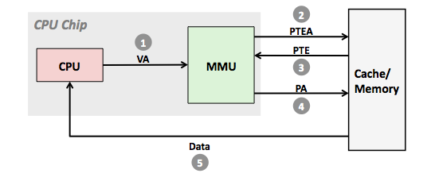
Address Translation: Page Hit
1) Processor sends virtual address to MMU
2-3) MMU fetches PTE from page table in memory
4) MMU sends physical address to cache/memory
5) Cache/memory sends data word to processor

Slide 40
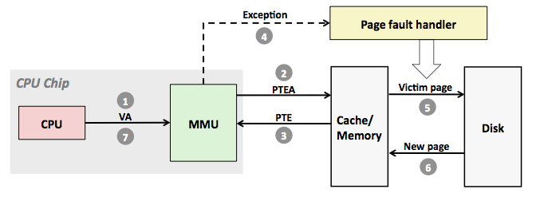
Address Translation: Page Fault
1) Processor sends virtual address to MMU
2-3) MMU fetches PTE from page table in memory
4) Valid bit is zero, so MMU triggers page fault exception
5) Handler identifies victim (and, if dirty, pages it out to disk)
6) Handler pages in new page and updates PTE in memory
7) Handler returns to original process, restarting faulting instruction

Slide 41
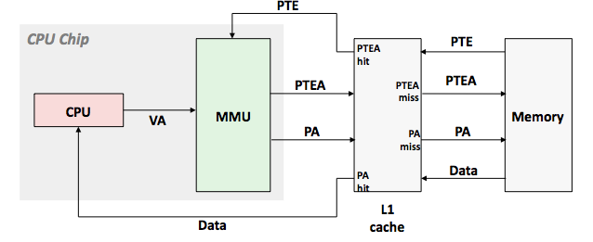
Integrating VM and Cache
VA: virtual address, PA: physical address, PTE: page table entry, PTEA = PTE address

Slide 42
Paging - Benefits
Memory spaces no longer have to be contiguous in physical memory
Memory spaces can be large, millions of pages
Pages are all the same size so external memory fragmentation no longer occurs. Fragmentation in the swap space eliminated at the cost of keeping track of the pages
Need to swap out just as many pages as you need to make space, as opposed to the entire process or segment
Memory protection can be done on the level of pages
Memory can easily be shared by putting entries to the same physical pages into the page tables of different processes
Notes:
42
(still have internal fragmentation)

Slide 43
Single Level PT Benefits
Simple data structure
Requires only one lookup to perform translation
Problem
Table is proportional to size of memory space
4 gigs / 4096 = 1 million entries * 8 bytes = 5-8 megabytes per process
We have a problem
Notes:
43
4 gigs / 4096 = 1 million entries * 8 bytes = 5-8 megabytes/process depending upon the size of the entry multiply that
by the number of processes and you have a problem if you have several hundred processes
But if we had only 24 bits like the IBM 370 machines then
16MB/4096 = 4096 * (5 or 8) = 20 – 32K much more manageable

Slide 44
Multi-level tables
Instead of having a reference consist of a page number and offset
A reference consists of 2 or 3 indices and an offset
First index indexes first level table, which points to a second
Second index is then used to index second table
Eventually we find the frame number and perform the mapping
Don't have to store swaths of page mappings that are not used!
However, a translation now takes 2 or 3 main memory lookups!
That's expensive, 3 physical lookups for each logical memory address if we have 3 indexes!
Notes:
44
Point out that all these table are stored in main memory and accessing them has the same cost – how can this be sped up

Slide 45
Virtual Memory
Unit 5
April 5

Slide 46
Multi-level Tables - picture
V
V
D
R
ACC
V
V
D
R
ACC
V
V
D
R
ACC
V
D
R
ACC
V
V
D
R
ACC
V
V
D
R
ACC
V
D
R
ACC
V
D
R
ACC
Current address-space
register
V
D
R
ACC
V
D
R
ACC
31
30
22
21
12
11
1
0
10 bit table 1
10 bit table 2
12 bit page offset
Notes:
46
2^10 = 1024

Slide 47
Speeding up address translation
Observation: Most address references are localized
Cache the translations
The Translation Lookaside Buffer (TLB) does this
It's associative memory that caches the page translations
Some TLB's can be loaded and saved as part of a process context switch
Notes:
47

Slide 48
Updated MMU Operation
Logical Address
MMU
PT 1
Check Page
Tables
TLB
Check TLB
Cache
PT2
Update TLB
Cache
Physical Address
Notes:
48

Slide 49
Updated MMU operation
Logical address is presented to the MMU
TLB is checked to see if there is a logical to physical address mapping present
In parallel, start address lookup in page tables
If a mapping is found use mapping, stop PT lookup
If a miss wait for PT lookup to complete
Store new logical to physical mapping in TLB
Have physical address at this point
For the TLB to be really useful, try to get a hit rate of greater than 95%.
Notes:
49

Slide 50
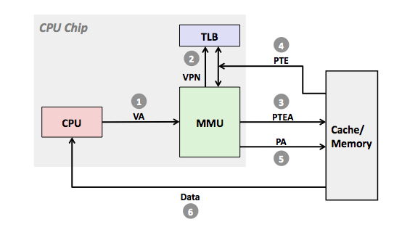
TLB Miss
In parallel
A TLB miss incurs an additional memory access (the PTE) Fortunately, TLB misses are rare. Why?

Slide 51
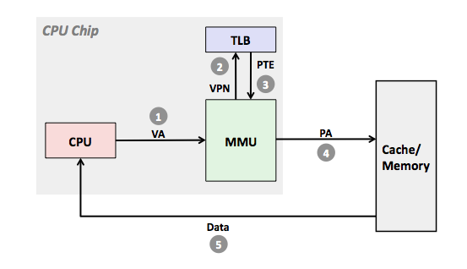
TLB Hit
In parallel
Cancelled on hit
PTEA
A TLB hit eliminates a memory access

Slide 52
TLB Observations
The more TLB entries then:
More translations can be held
Higher the hit rates (i.e. fewer full lookups required)
Result - faster overall operation
However
Hardware for the TLBs is expensive (chip real estate, delays)
Loading and unloading the TLB is expensive (time wise)
Can a larger TLB improve the hit rate enough to matter?
Notes:
52
Talk about cost hit rate tradeoffs

Slide 53
Why does it work? Locality
Virtual memory works because of locality
At any point in time, programs tend to access a set of active virtual pages called the working set
Programs with better temporal locality will have smaller working sets
If (working set size < allocated main memory size)
Good performance for one process after compulsory misses
If ( SUM(working set sizes) > main memory size )
Thrashing: Performance meltdown where pages are swapped (copied) in and out continuously

Slide 54
Page Replacement
The policy that selects the page frame to remove when space is needed
Poor page replacement algorithm can have a huge impact on the system performance
How do you decide what page to page out?
Notes:
54

Slide 55
Replacement Policy
Optimal: This is the theoretical best possible choice
The page to remove is the one that will not be used for the longest time (To implement this we would need to be able to predict the future)
Idea: Based on the idea of temporal locality, if a page hasn’t been used recently it is unlikely to be used and therefore a good candidate for eviction.
Notes:
55

Slide 56
LRU approx:
Use page table reference bit
At a fixed interval shift reference bit into high bit of a counter for that page (counter is a history of the intervals each page was referenced in)
Page with smallest number is LRU (approximately)
If all 1s then used in every scan interval, if all 0s then never used
Notes:
56
Bit shifted in is 0

Slide 57
What problems can we solve with virtual memory?

Slide 58
VM as a Tool for Memory Management
Key idea: each process has its own virtual address space
It can view memory as a simple linear array
Mapping function scatters addresses through physical memory
Well chosen mappings simplify memory allocation and management
NOT earlier shown in class – part of assigned reading & testable
0
Address
translation
0
Virtual Address Space for Process 1:
Physical
Address
Space (DRAM)
VP 1
VP 2
PP 2
...
N-1
PP 4
PP 6
(e.g., read-only
library code)
Virtual Address Space for Process 2:
0
PP 8
VP 1
VP 2
...
...
N-1
M-1

Slide 59
VM as a Tool for Memory Management - Sharing
shown earlier in class – part of assigned reading & testable
Memory allocation
Each virtual page can be mapped to any physical page
A virtual page can be stored in different physical pages at different times
Sharing code and data among processes
Map virtual pages to the same physical page (here: PP 6)
Shown earlier in class – part of assigned reading & testable
0
Address
translation
0
Virtual Address Space for Process 1:
Physical
Address
Space (DRAM)
VP 1
VP 2
PP 2
...
N-1
PP 6
(e.g., read-only
library code)
Virtual Address Space for Process 2:
0
PP 8
VP 1
VP 2
...
...
N-1
M-1

Slide 60
VM as a Tool for Memory Protection
Extend PTEs with permission bits
Page fault handler checks these before remapping
If violated, send process SIGSEGV (segmentation fault)
Review of earlier material – part of assigned reading & testable
Physical
Address Space
Process i:
SUP
READ
WRITE
Address
VP 0:
No
Yes
No
PP 6
VP 1:
No
Yes
Yes
PP 4
VP 2:
Yes
Yes
Yes
PP 2
PP 2
•
•
•
PP 4
PP 6
Process j:
SUP
READ
WRITE
Address
PP 8
VP 0:
No
Yes
No
PP 9
PP 9
VP 1:
Yes
Yes
Yes
PP 6
VP 2:
No
Yes
Yes
PP 11
PP 11

Slide 61
Simplifying Linking and Loading
NOT shown in class – NOT TESTABLE
Memory
invisible to
user code
Kernel virtual memory
Linking
Each program has similar virtual address space
Code, stack, and shared libraries always start at the same address
Loading
execve() allocates virtual pages for .text and .data sections = creates PTEs marked as invalid
The .text and .data sections are copied, page by page, on demand by the virtual memory system
0xc0000000
User stack
(created at runtime)
%esp
(stack
pointer)
Memory-mapped region for
shared libraries
0x40000000
brk
Run-time heap
(created by malloc)
Read/write segment
(.data, .bss)
Loaded
from
the
executable
file
Read-only segment
(.init, .text, .rodata)
0x08048000
Unused
0

Slide 62
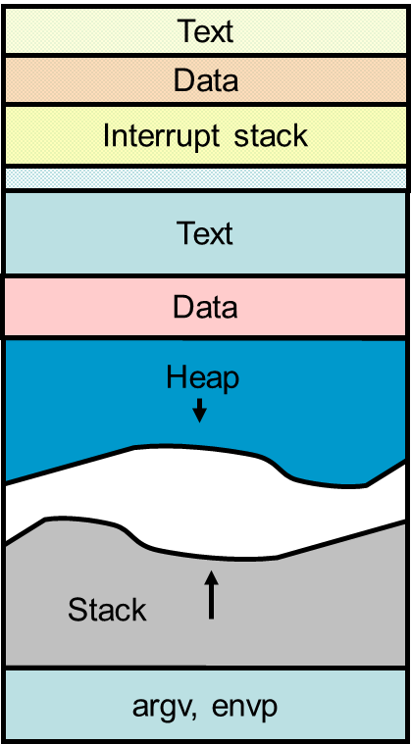
What does the VM layout look like?
NOT shown in class – NOT TESTABLE
4 GB address space
Text
PT 1
Data
Interrupt stack
Text
Data
Heap
PT2
Stack
argv, envp

Slide 63
What does the VM layout look like in physical memory?
NOT shown in class – NOT TESTABLE
4 GB address space
Heap
Heap
Text
Text
Kernel Stack(s)
argv, envp
argv, envp
Text
Data
Data
Data
Stack
Stack
PT 2
PT 1

Slide 64
OS Support: VIRTUAL MEMORY Summary
Each process has its own virtual address space
machine instructions name memory with virtual addresses
CPU hardware translates these to physical addresses using a page table
called the memory management unit (MMU)
page == disk block
translation: VA = [ VPN ][ PAGE OFFSET] => PA = [ PFN ] [ PAGE OFFSET ]
the base of the current process’s page table is stored in a reserved register for the MMU to use
Virtual Memory Mapping
virtual address space is divided into a few large variable-size regions
each VM region is a mapping of a file on the disk (or part of a file)
mapping occurs
the program text, global variables, libraries, stack and heap are mapped (to disk) when program starts
physical memory is cache of this VM-mapped, disk-resident data
implications for addressed-based naming

Slide 65
Summary
Programmer’s view of virtual memory
Each process has its own private linear address space
Cannot be corrupted by other processes
System view of virtual memory
Uses memory efficiently by caching virtual memory pages
Efficient only because of locality
Simplifies memory management and programming
Simplifies protection by providing a convenient interpositioning point to check permissions

Slide 66
Final Exam Format
2.5 hours (150 minutes) with format similar to quizzes but no group component
Expect 1 quiz+ worth of material since the last quiz (~40 minutes)
Remaining time for problems from the rest of the course material cover
Warning: unlike some courses material at the end of course doesn’t build directly on material from beginning of the course

Slide 67
Broad Topic Reminder
Instruction sets – Assembly language
Pipelining
Caches
Locality
File systems
Virtual Memory
Use the learning goals to direct your studying!

Slide 68
Some Extra slides
The slides which follow were not shown in class, however we did talk about the material and did touch on it in earlier slides. As a result this is material you are responsible for. It is also covered in the assigned readings.
Some of the slides are repeats of earlier slides

Slide 69
Virtual Memory
NOT shown in class – part of assigned reading & testable
Initially assumed that processes had to be completely in memory to run
For the execution of any one instruction there are at most 3 distinct pages needed
A code page (the next instruction, ignore deep pipelines)
Data source (load)
Data destination (store)
Programs exhibit a high degree of spatial locality
Notes:
69
As a result only those pages actually need to be in physical memory
This works because most address references, be they to code, stack, or data areas, tend to exhibit a high degree of spatial locality
Also comment that that is why caches work
The most likely place to get data from is the same page you are currently on

Slide 70
Virtual Memory - observations
NOT shown in class – part of assigned reading & testable
Virtual memory allows multiple processes to run
Provides the illusion to the process that there is enough physical memory, even when there isn't
Allows better use of physical memory
Only the memory that a process actually needs, needs be allocated; as opposed to what the process thinks it needs
Process "notifies" the OS that it needs a page by generating a fault – and the OS brings the page in, this is paging
Notes:
70

Slide 71
Demand Paging – big picture
NOT shown in class review of earlier material – part of assigned reading & testable
Pages not in memory are marked as invalid
On fault check to see if the address is in the valid range for the process
If not kill process
If page was allocated but not mapped in memory
Find a free frame (may need to page something out)
Add frame to page table
Load frame from paging area or file system
Notes:
71
The only time that a page needs to be in memory is when it is asked for
How does a page get asked for?
Previous models have the process killed if it accesses an invalid page
Key concept is that the fault is used to notify the OS that memory needs to be managed

Slide 72
Paging Requirements
NOT shown in class review of earlier material – part of assigned reading & testable
To support demand paging we need to:
Know which process pages are valid
Track page location
Disk
Memory
Know which frames are free
Big question is what do we do when we run out of free frames?
Notes:
72

Slide 73
Page Replacement
The policy that selects the page frame to remove when space is needed
Poor page replacement algorithm can have a huge impact on the system performance
How do you decide what page to page out?
Notes:
73

Slide 74
Replacement Policy
Optimal: This is the theoretical best possible choice
The page to remove is the one that will not be used for the longest time (To implement this we would need to be able to predict the future)
FIFO:
Keep a queue of pages, page that was brought in first gets selected
Doesn't take advantage of spatial locality
Notes:
74

Slide 75
Page Replacement - cont
NOT shown in class review of earlier material – part of assigned reading &
testable for definitions
LRU:
Keep last used time for each page
Select page with the oldest time stamp
Impractical to implement
Notes:
75
When pushing a page remove it from its other location in the queue is there is one

Slide 76
LRU approx:
Taled about in class
Use page table reference bit
At a fixed interval shift reference bit into high bit of a counter for that page (counter is a history of the intervals each page was referenced in)
Page with smallest number is LRU (approximately)
If all 1s then used in every scan interval, if all 0s then never used
Notes:
76
Bit shifted in is 0

Slide 77
Least Actively Used
NOT shown in class just need to know that it exists
Do not have to know how it is implemented
Start page with activity of 3
During scan if reference bit set, increase activity count (max is 64), clear reference bit
If during scan reference bit clear, decrement activity count
When activity goes to 0 classify page as inactive.
Notes:
77

Slide 78
Page Replacement Considerations
NOT shown in class alluded to in other materials earlier in section
just need to know that it exists along with the types of information
That might be considered but not the details as to why or how that
Information would be used.
78
Dirty pages are expensive to choose as one must copy them to disk and bring another page in (2 disk transfers)
Clean pages have only the page-in cost
Some pages can’t be paged out
Pages from low priority process should be freed before pages from higher priority processes
These points need to be considered in combination with the overall strategy such as LRU
Notes:
78

