Slide 1

Identifying loci under selection
(from a genomic perspective)
Nick Harding. Kwaitkowski group.
MalariaGEN Resource Centre – BDI
November 2017

Slide 2
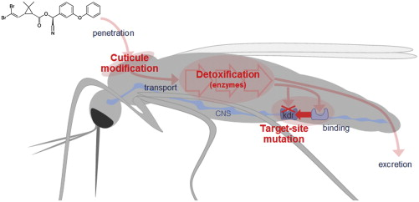
Genome-wide search for signals of selection
From Nkya et al 2012
Notes:
Footprints are a useful analogy here.
We take the role of detectives looking for clues, but also describes the fact that selection pressure on populations can leave an imprint in genomes that we can discover generations later.

Slide 3
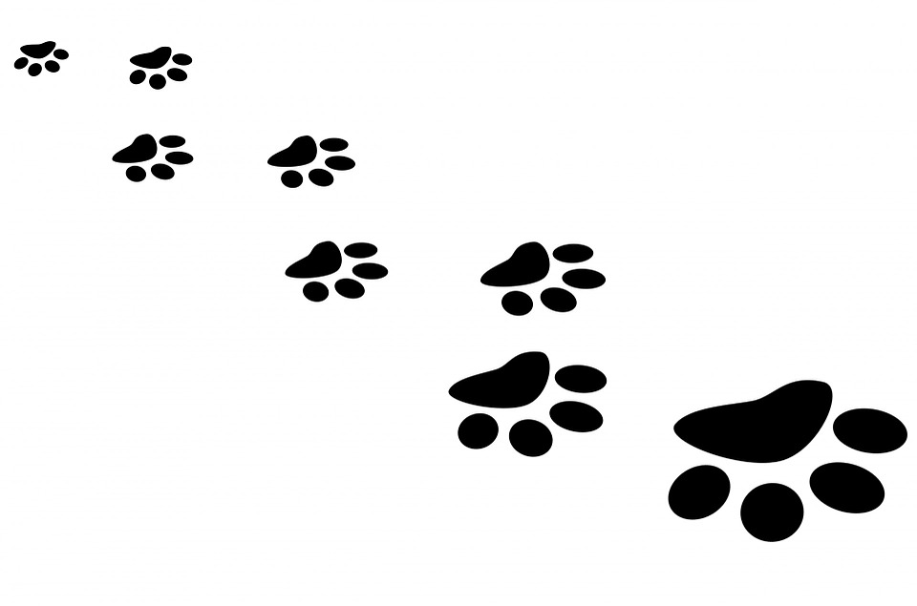
Genome-wide search for signals of selection
Notes:
Footprints are a useful analogy here.
We take the role of detectives looking for clues, but also describes the fact that selection pressure on populations can leave an imprint in genomes that we can discover generations later.

Slide 4
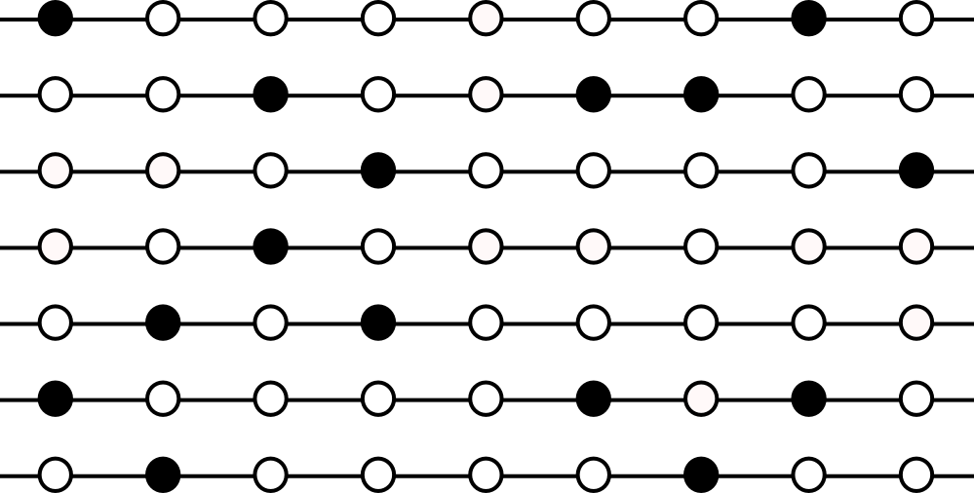
Beneficial haplotypes rise in frequency
Normal levels of variation
Notes:
This is a major simplification, so bear with me.
This is a population of chromosomes, with genetic markers that have 2 alleles.
We won’t worry about diploid individuals or recombination just yet.

Slide 5
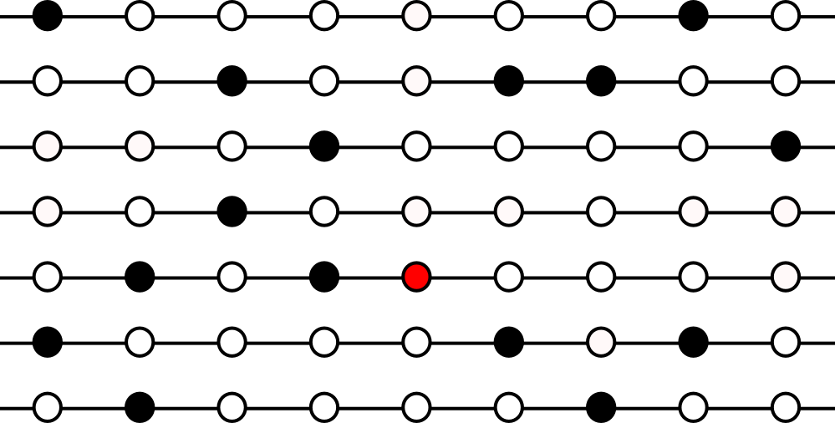
Beneficial haplotypes rise in frequency
A new beneficial mutation arises
Notes:
What happens here is that a benefical mutation arises, that gives one chromosome a much better chance of being represented in the next generation.
This might be found in an Anopheles mosquito, and the allele might dramatically increase it’s ability to survive contact with a Pyrethoid impregnated bednet, or something else.

Slide 6
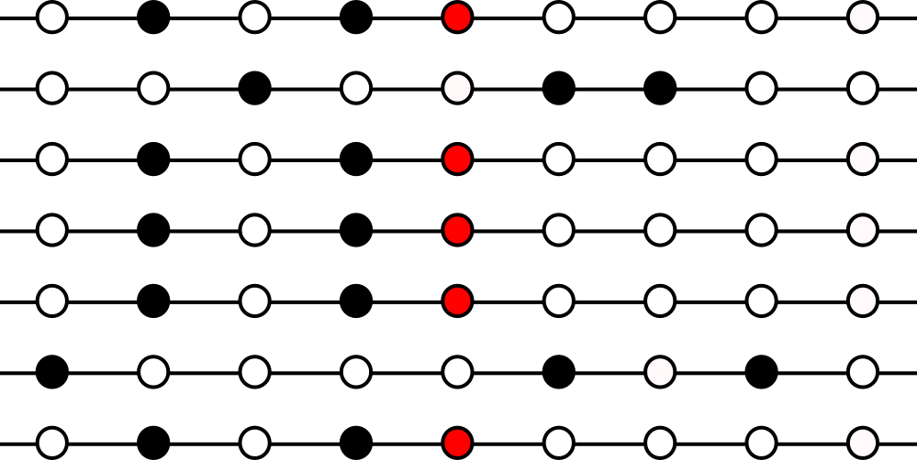
Beneficial haplotypes rise in frequency
Haplotypes with the new mutation become frequent: Selective Sweep
Longer shared haplotypes
Loss of diversity
Increased differentiation
Higher frequency of derived alleles
Notes:
So, I’m using the term haplotype here- and what that means is just the genetic sequence pertaining to a chromosome, rather than an individual. Individuals have genotypes (2 chromosomes), chromosomes have haplotypes
So in the next generation, the haplotype carrying the new mutation is common. We call this a selective sweep, as the causal allele rises in frequency, along with linked variation.
Importantly this event results in measurable differences in the variation present at this locus-
These are exactly the data that lets us infer where selection events have occurred.

Slide 7
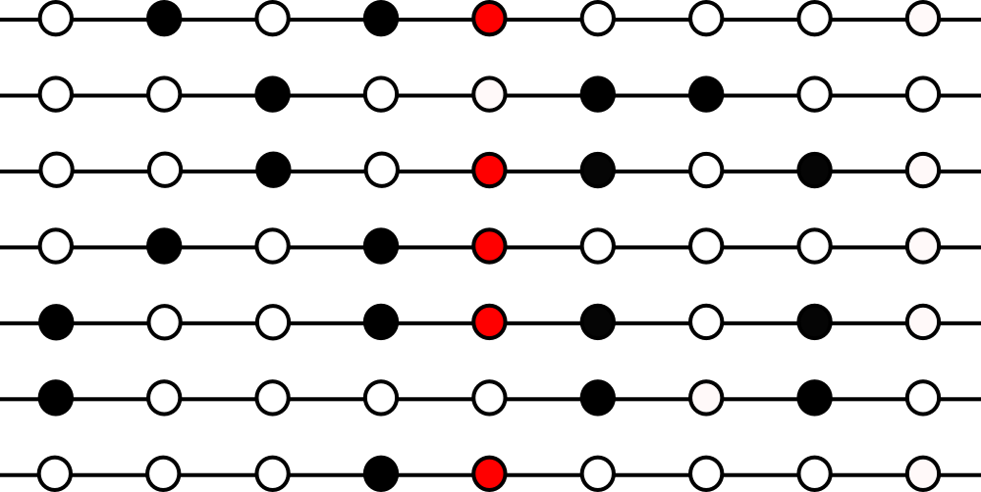
Beneficial haplotypes rise in frequency
Over time, recombination breaks up these haplotypes
Notes:
Now- lets talk a little bit about recombination. Periodically in meiosis, recombination events will break the linkage between the allele and nearby variation.

Slide 8
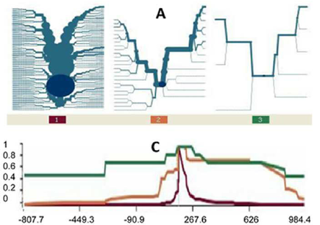
EHH- Extended haplotype homozygosity
A metric to measure haplotype decay
EHH is a measure of how many haplotypes remain the same as you move away from a core locus.
Many scans for natural selection leverage this metric.
EHH
Ghansah et al, 2012 PloS One
Notes:
At a core locus define haploypes based on some genetic markers. Under a null hypothesis expect them to decay at a similar rate.
If a selection event has taken place, the members of the haplotype will have a more recent MRCA, and the haplotype will decay more slowly.

Slide 9
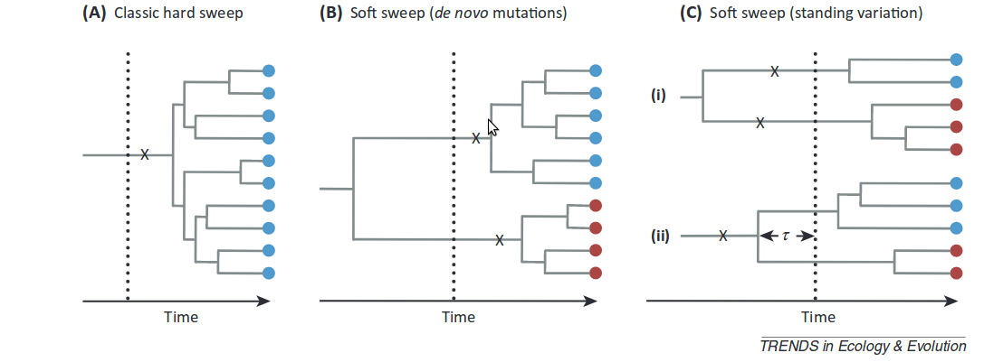
A note on hard vs soft sweeps
Essentially- soft sweeps occur on standing variation, so multiple haploypes can carry a beneficial allele
Messer and Petrov, TEE 2013
Notes:
Now- lets talk a little bit about recombination. Periodically in meiosis, recombination events will break the linkage between the allele and nearby variation.

Slide 10
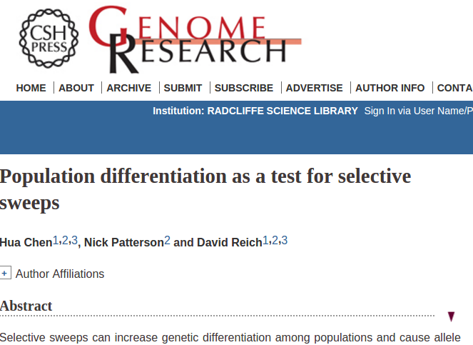
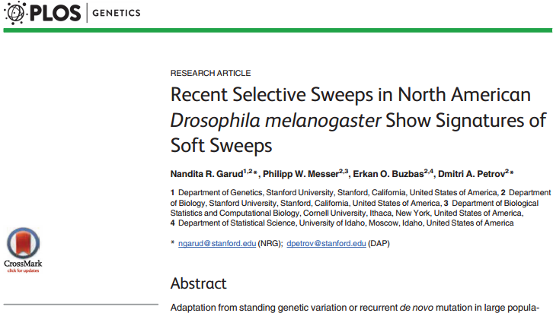
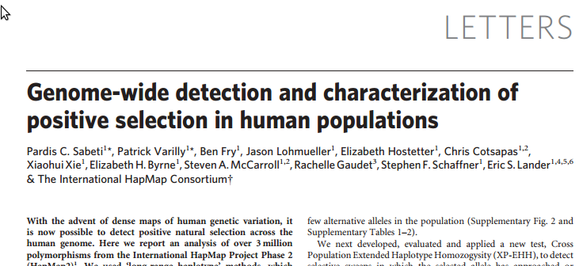
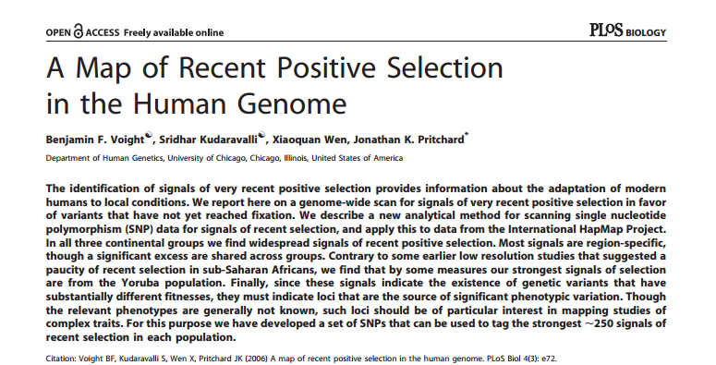
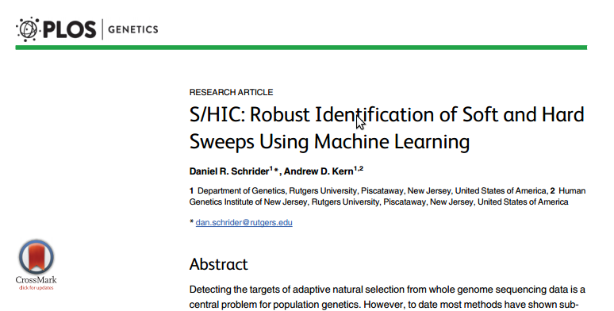
Genome-wide search for signals of selection
Notes:
Agnostic searches for interesting loci- have to cope with multiple testing issues, and genomic features that may cause false positives.

Slide 11
Haplotypes are very informative
What is a haplotype?
A / T
A / A
G / T
T / A
C / G
G / G
A / T
A
A
T
A
G
G
A
T
A
G
T
C
G
T
Phasing
Genotype data.
2 alleles for each SNP.
Haplotype data. Alleles are associated with a chromosome. Alleles are unchanged, but we have added information.

Slide 12
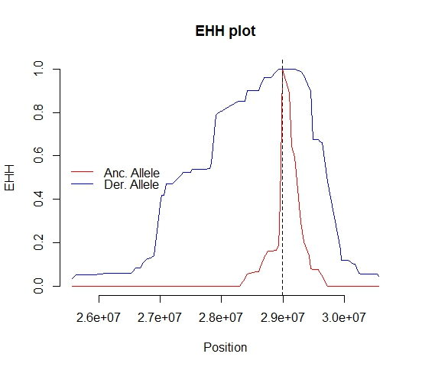
iHS- integrated haplotype score
iHS is a haplotype based method
It compares relative haplotype sharing between alleles
1. Compute area under curve for 2 alleles
2. Take ratio
3. Do this for every SNP in the genome
4. Normalise in frequency tranches

Slide 13
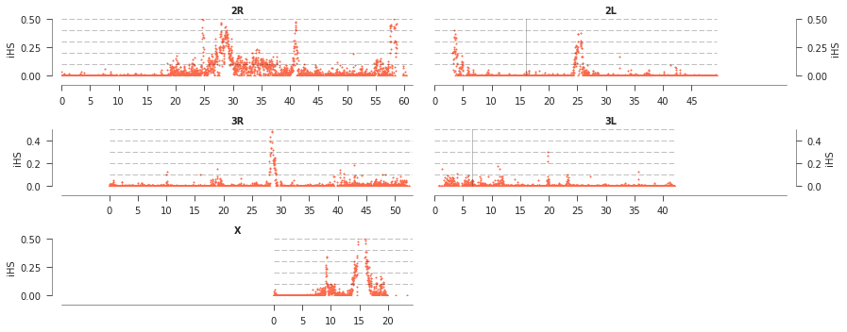
iHS- integrated haplotype score
iHS is a haplotype based method
It compares relative haplotype sharing between alleles
Below data from Ag1k, A. coluzzii from Burkina Faso

Slide 14
XP-EHH
similar, but compares EHH between populations.
- EHH based, similar to iHS
- Compute over all segregating SNPs
- No adjustment step
Population A
Population B

Slide 15
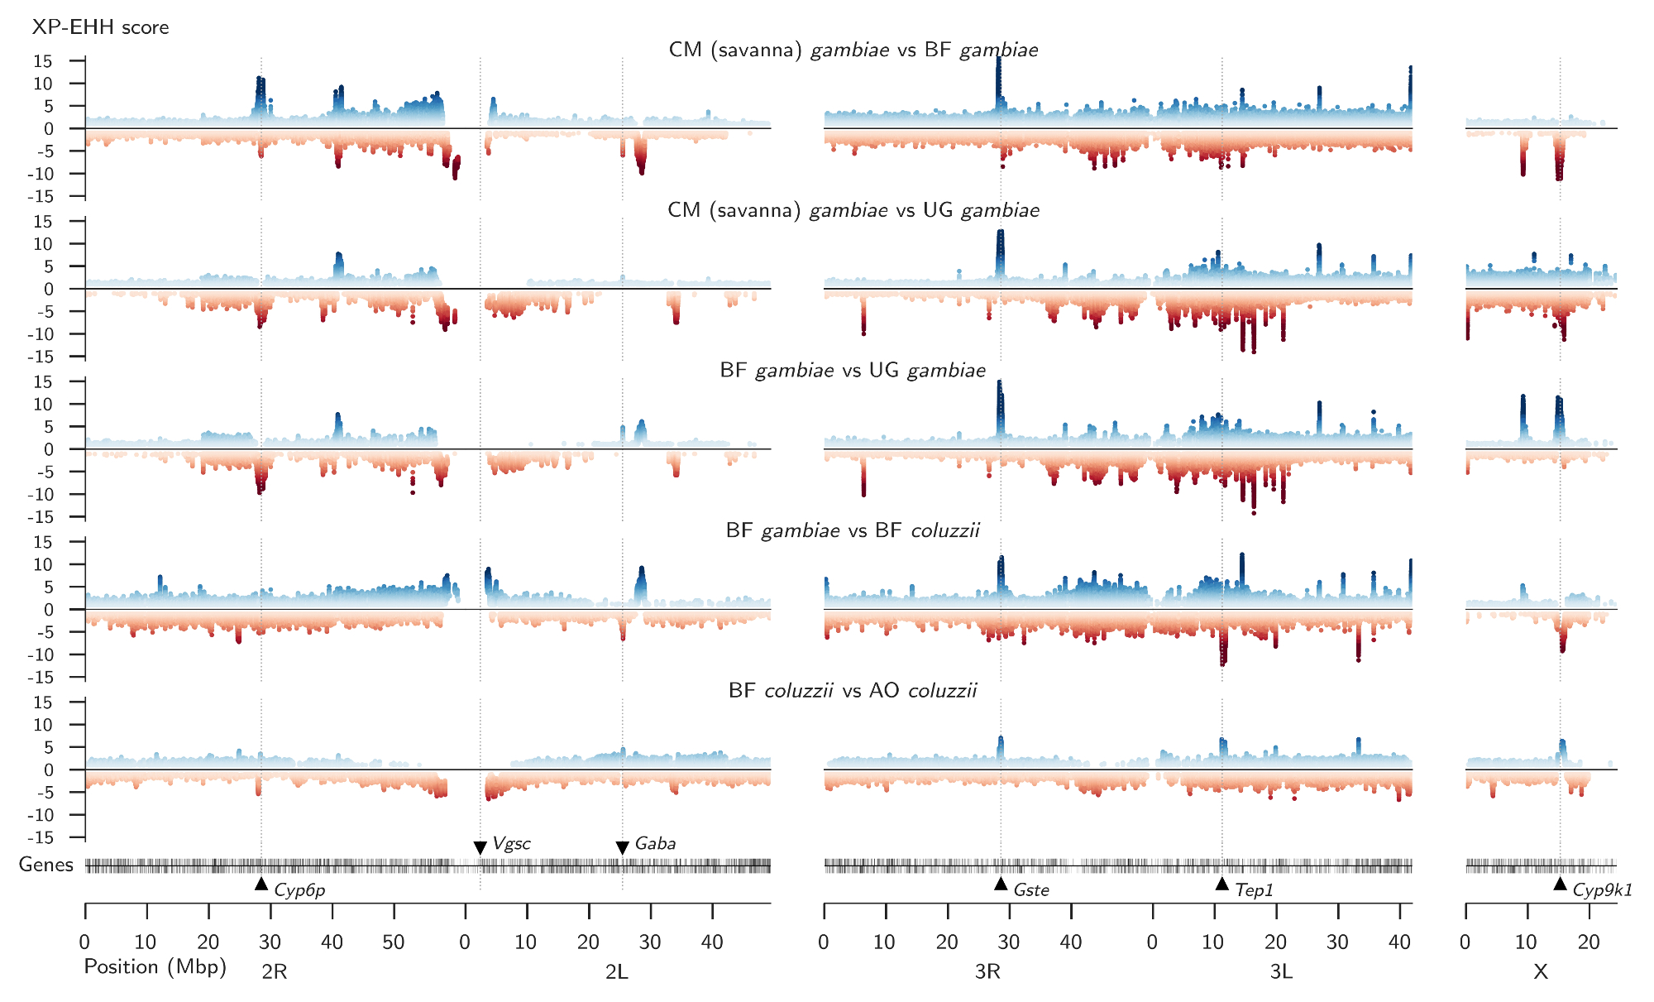
XP-EHH

Slide 16
H12
A measure of haplotype diversity.
- Choose a region in the genome
- Count the number of each distinct haplotype
- H1 is the frequency of the most common haplotype
- H12 is the frequency of the most common and the second most common.
0.0
0.6
0.9
By dividing our genome into windows, we can look across the genome for unusually high values of H12.

Slide 17
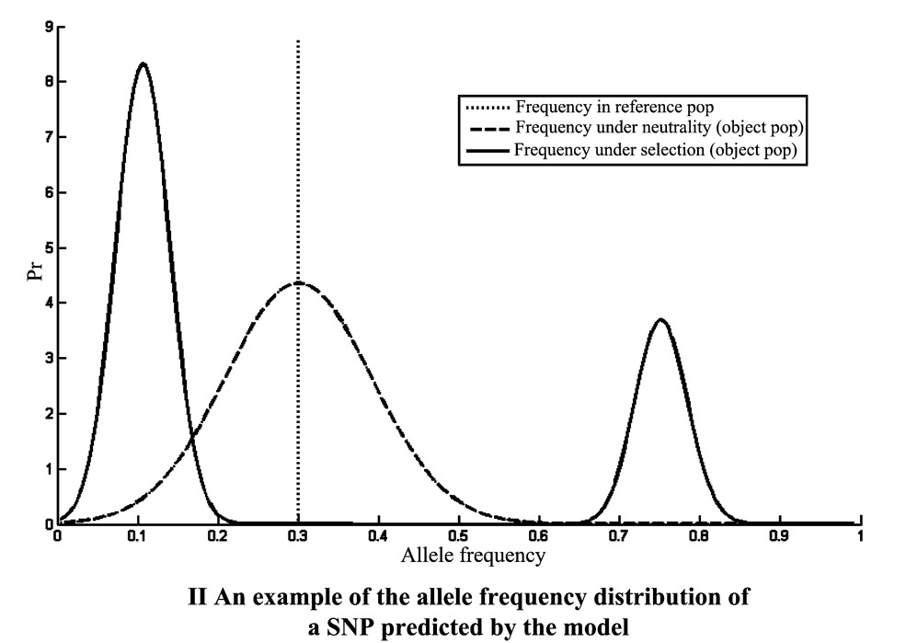
XP-CLR
1. Uses a reference population to estimate likely allele frequency distribution
2. Each SNP is given a likelihood ratio of neutral vs various selection coefficients
3. Idea is that extreme drift more likely to be observed in presence of selection
A differentiation based method
Haplotype free method!
From Chen et al, Genome Research 2010

Slide 18
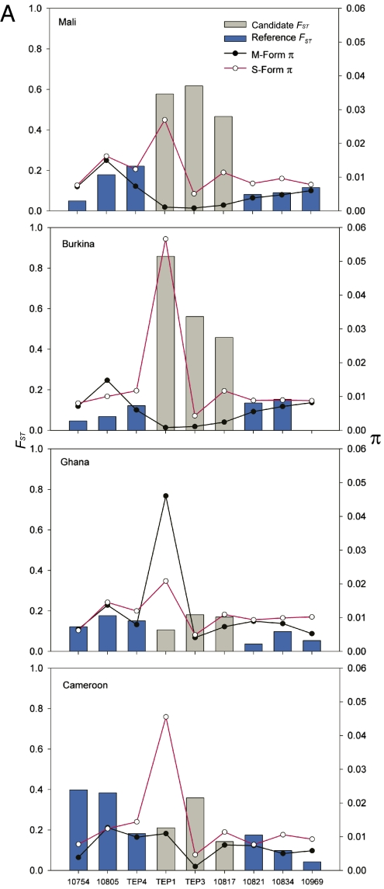
Fst – fixation index
Fst is a simple measure of allele frequency differences.
Over the whole genome it’s informative about population relatedness, but on a smaller scale local differentiation may be a result of selection.
1. Fst between two populations is calculated in windows.
2. Unusually high values may suggest selection.
Haplotype free method!

Slide 19
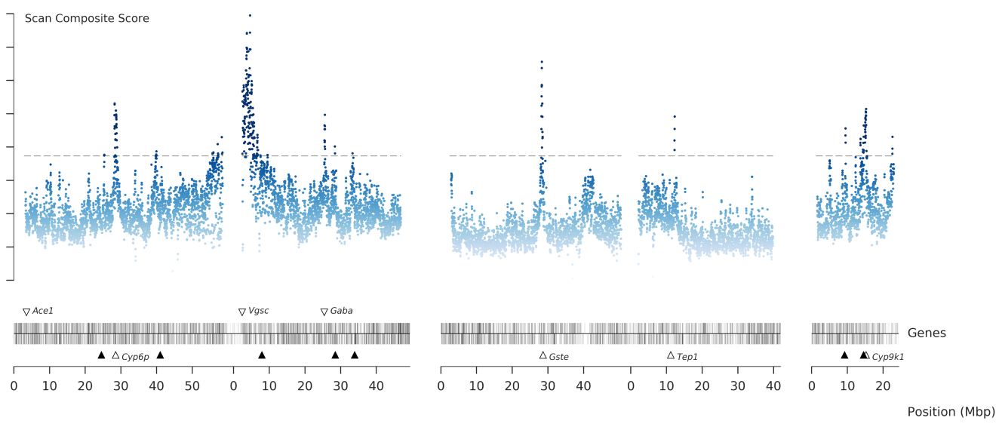
Other methods...
Many other methods exist:
S/HIC – a machine learning based approach that classifies regions as neutral/under selection etc.
SweeD – method based on distortions in allele frequency spectrum
Delta Tajima’s D- highlights differences in rates of rare and common variants
Scikit-allel has functions to compute xpehh, ihs and H12.

Slide 20
Finally… symlinks (for the practical)
DIRECTORY
/home/njh/analysis
FILE
/home/njh/data/Anopheles/vcf/ag1000g.vcf.gz
../data/Anopheles/vcf/ag1000g.vcf.gz
# or
/home/njh/data/Anopheles/vcf/ag1000g.vcf.gz
ln -s ../data/Anopheles/vcf/ag1000g.vcf.gz
ag1000g.vcf.gz

Slide 21
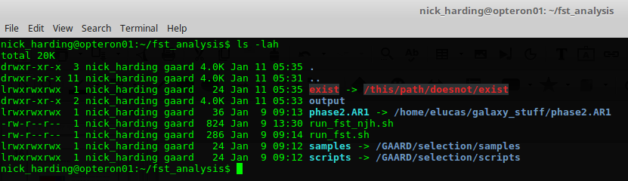
Finally… symlinks (for the practical)

