Slide 1
snakemake
Human readable workflow system
- Nick Harding / [KWIAT / malariaGEN]
http://snakemake.readthedocs.io/en/stable/#
Copyright (c) 2012-2017 Johannes Köster johannes.koester@protonmail.com (see LICENSE)

Slide 2
Snakemake
Text format- that defines a workflow.
Essentially python,but with a few extra commands
It performs execution of rules, where rules generate files
Key benefit is snakemake determines which rules need to be run, and in which order.

Slide 3
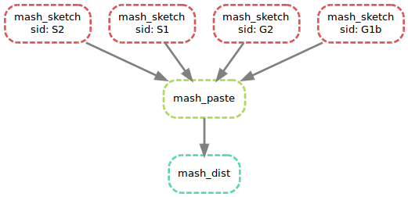
A simple example
Running mash
# best command ever
snakemake --dag | dot -Tsvg > dag.svg

Slide 4
A simple example
Invoke via a rule or a file
Structure of a rule
Works backwards and executes rules as required
Wildcards!
expand()

Slide 5
A more complex example
More features:
config files
run / script
Multiple wildcards
Wildcard constraints

Slide 6
Using the cluster
Build in support for several cluster environment managers- but here SGE.
Set up a qsub command
Define environment- use conda
Use script, not run
Each job has a memory requirement
Scales easily!

Slide 7
Best practices
Snakemake instructions are code- but live in data generation directories
Although a well defined snakemake file can be reused, experience suggests these are in the minority.
Snakemake files, definitely belong in a repo, but easy to get out of sync during dev.
Current preferred solution is a symlink to a repo on disk

Slide 8
Issues- why shouldn’t you use this?
Logging not the best- if a job errors, it can be tricky to find relevant log, and this is system dependent.
Other systems have a GUI, helps debugging
Cryptic errors: especially with wildcard clashes

