Slide 1
Project 2
Samantha Harding

Slide 2

Data and Definitions
This project used Medicare utilization data for inpatient cases in 2016, 2017, and 2018, as well as a crosswalk going from DRG to procedure group (service line)

Slide 3
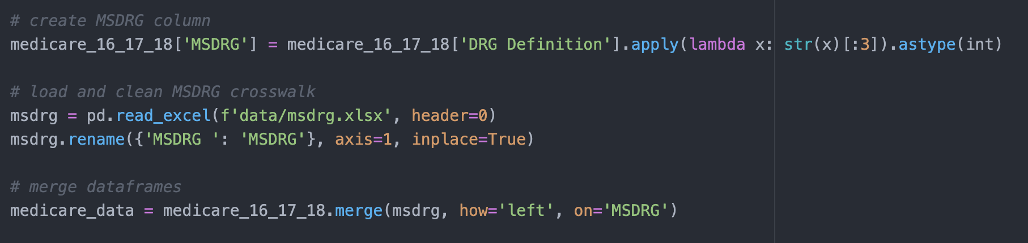
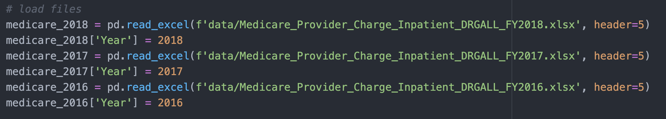
Loading and Cleaning
A column of DRG numbers was added to the Medicare database so that the two data sources could be merged

Slide 4
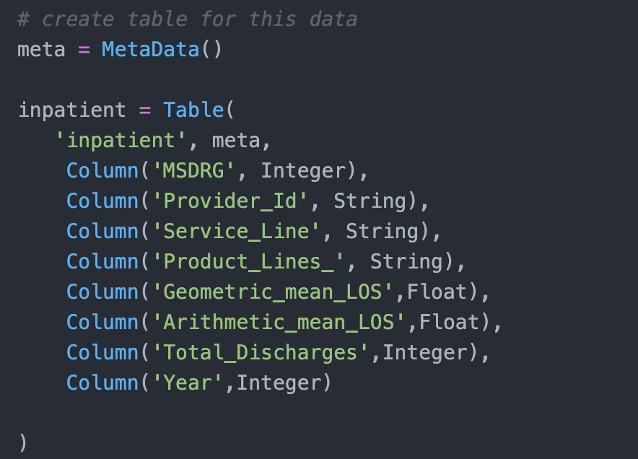
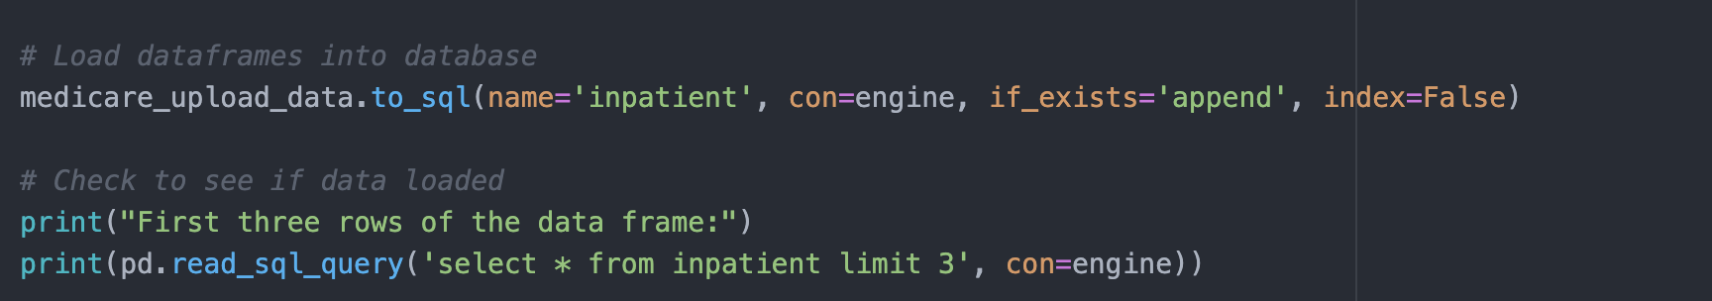
Loading and Cleaning
For this project, only a few columns were loaded into the SQLAlchemy database, and even fewer were used. Useful columns were selected, and a table for the data was made to house each of them. This data was loaded into a database and printed as a check.

Slide 5
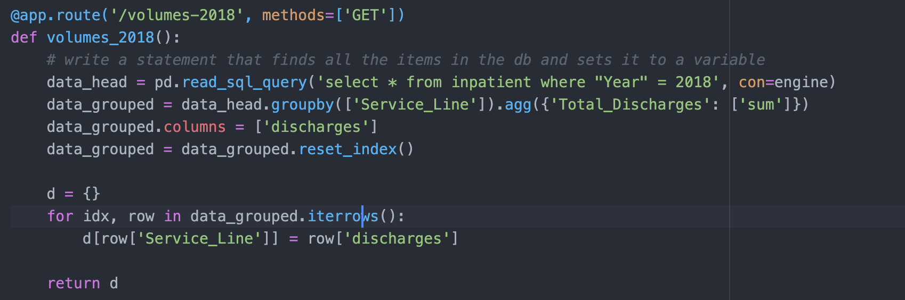
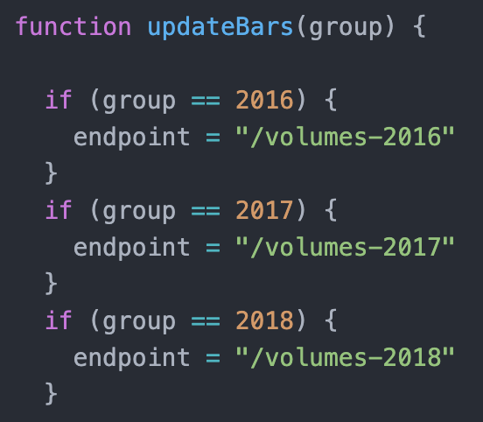
Post-Database Transformations
The database was connected to via flask, and further manipulations (grouping, aggregating, transforming) were done for ease of visualization. Drop down menus connect to different paths in flask.

Slide 6
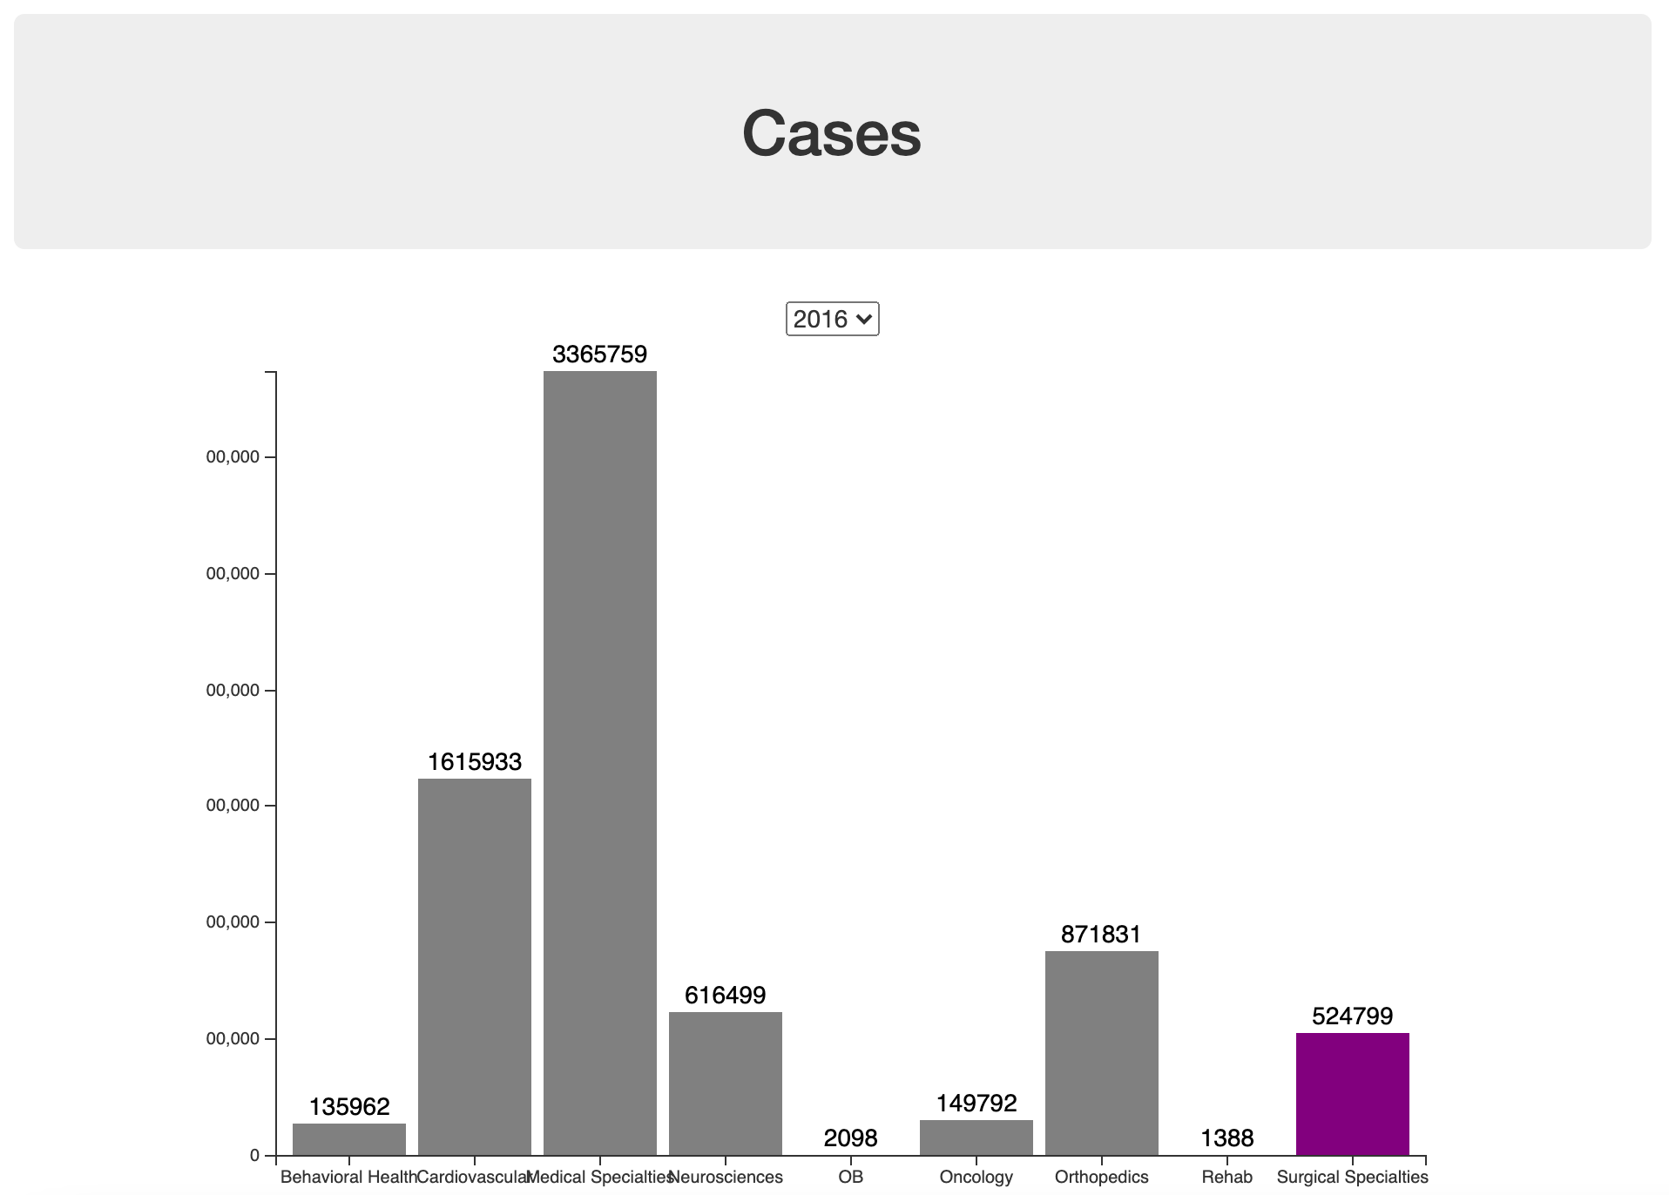
Visualization
First visualization gives actual utilization (cases) by service line, with stylistic elements provided by bootstrap and CSS.
Drop Down Menu
Highlight

Slide 7
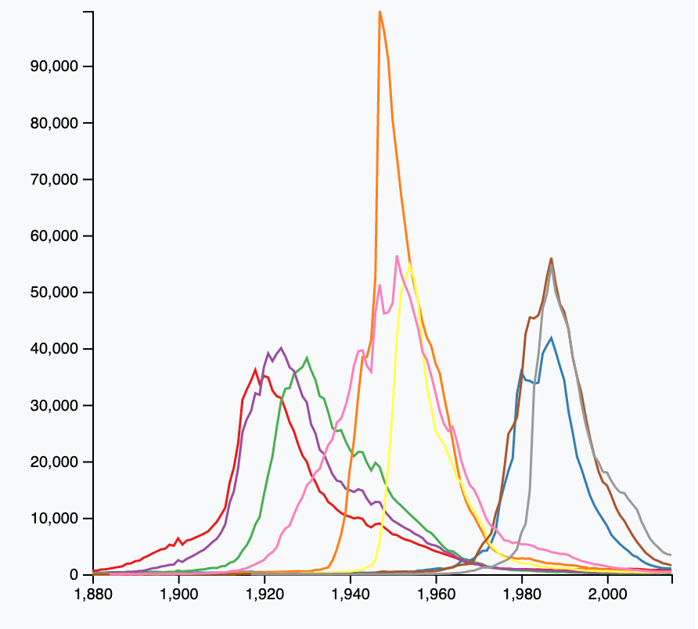

Visualization
Second visualization is static and gives changes in utilization per capita across the three-year period by service line.
This visualization is BROKEN due to a last-minute library change, and will hopefully be up for display or demo by 12:01 CMT on 7.30

Slide 8
Conclusion / Further Work
Would be interesting to add in a predictive utilization bar chart
User could input year, and backend function would project out approximate cases per capita by service line for that year
Would best show trends in utilization
Similarly, a static line chart projecting out ten utilization by service line would be a good summary of the above information
Fixing the broken chart in a timely manner would probably be a good idea

