Slide 1
Lunch & Learn – Docker (Containerisation)
Hardish Wilkhu

Slide 2
Agenda
Objectives
What is containerisation?
Why use Docker?
Using Docker – Lets get hands on

Slide 3
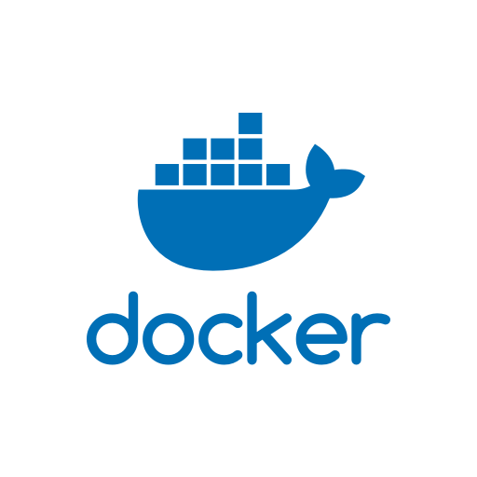
What is containerisation? It isn‘t a Virtual Machine
Virtulisation
App
App
App
App
Containerisation
Bin/Libs
Bin/Libs
Bin/Libs
Bin/Libs
Guest OS
Guest OS
Guest OS
Guest OS
App
App
App
App
Bin/Libs
Bin/Libs
Bin/Libs
Bin/Libs
Hypervisor
Docker Daemon
Host OS
Host OS
Containerisation is not virtualisation
Notes:
Fixar a posicao do titulo – sempre do lado esquerdo.
Sempre que tiver muito texto o coluna deve sempre ser “ narrowed” , se nao fica dificil de ler. Colocar paragrafos no texto.
Linha vertical deve ser mais fina e as pontas NUNCA devem ser arredondadas.

Slide 4
Why use containerisation? Portability,Speed,Serverless...
Portability – Containers can run anywhere and will run exactly the same.
Serverless – You don’t have to worry about underlying hardware.
Faster & easier deployments – Build the Image, ship it out.
Version control – Images can be versioned and have the correct dependencies.
Scalability – Easy to scale, just run it more.
Separation of processes – Leave me alone.
Administration – much easier to manage your services.
Containerisation is your friend

