Slide 1
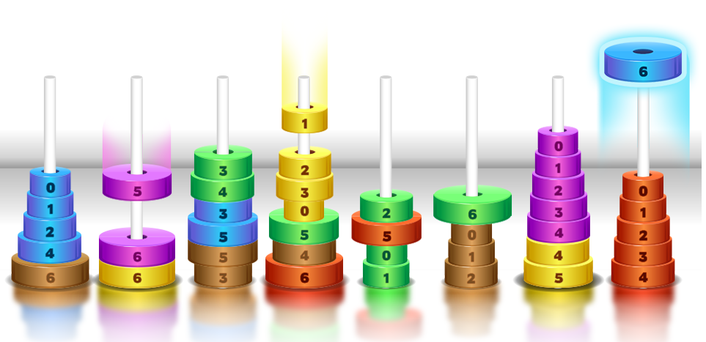
Course Game - DAIICT
First review – Group 2

Slide 2
Objective
The basic objective of this course game is to make learning easy.
Connecting the traditional teaching with real life scenarios so that the basic concept about the course gets clear.
Providing a medium to the faculties to interact with the students.
Game
Tutorials
Notifications

Slide 3
Project Manager – Jaspreet Chhabra
Role Assigned | Project Manager, Game Developer and Web interface developer
Feasibility Report | Requirement Analysis, Scope, Purpose, documentation
SRS | User Stories, Constraints, Scope, Purpose, Concept Map, documentation, Software and Hardware interface, documentation
Project Planning report | Introduction, scope management, Work breakdown structure, Deployment Plan, Change control management, Milestone/activities, Project Schedule, Dependencies, Gantt Chart, Cost/Budget Management, Quality Management, Risk Management, Activity Network, CPA for each module, Tracking of the project activities, Pert chart
Test plan Report | Whole Test plan Document including documentation
Web App (Implementation) | Have worked on all the modules implemented
Game development | 2 Games
Testing | GUI Testing of Web interface using Selenium IDE
Other | Interviewer, Reviewing and editing of document

Slide 4
Tasks assigned – Chintan Sanghavi
Role Assigned | Web Application Developer and Tester
Feasibility Report | Risk Analysis
SRS | Requirement Analysis(Functional) , Product Functions
Project Planning report | Risk Management
Test plan Report | Test Cases
Web App (Implementation) | Add, update and delete game
Testing | Load using JMETER
Other | Interviewing, Video

Slide 5
Tasks assigned – Fatema Kapadvanjwala
Role Assigned | Web Application Developer and Tester
Feasibility Report | Problem Statement, Purpose, Scope, Benefits
SRS | Software and Hardware interface
Web App (Implementation) | Login
Testing | Random Testing, GUI testing of mobile and web application using expresso and Selenium tool.
Other | Documentation, 2 MOM

Slide 6
Tasks assigned – Mansi Shah
Role Assigned | Scrum Master and Web Application Developer
Feasibility Report | Problem Statement, Deliverables, Requirement Analysis (functional), documentation
SRS | User Stories, Constraints, Concept Map, documentation
Project Planning report | Introduction, scope management, Work breakdown structure, Change control management, Milestone/activities, Dependencies, Gantt Chart, Cost/Budget Management, Quality Management, Risk Management, Activity Network, CPA for each module, Tracking of the project activities, Pert chart, documentation
Test plan Report | Test Cases
Web App (Implementation) | User Interface of Web Interface
Testing | GUI testing – Selenium tool
Other | Interviewer, Reviewing and editing of documents

Slide 7
Tasks assigned – Kush Shah
Role Assigned | Game developer and Tester
Feasibility Report | Visibility Plan, Business Considerations
SRS | Architectural Design
Project Planning report | Dependencies
Game Development | Graphics

Slide 8
Project Manager – Hardik Bohra
Role Assigned | Game Developer and API Developer
Feasibility Report | Requirement Analysis (CMS), technical Req.
SRS | Functional Req., Product Functions, Concept Map
Project Planning report | Risk Management
Test plan Report | Test cases
API Development | Whole Application programming Interface
Game development | 2 Games
Other | Interviewer, Video

Slide 9
Tasks assigned – Palash Khandelwal
Role Assigned | Web Application Developer
Feasibility Report | SDLC, outline plan-milestone
SRS | User Characteristics, Concept Map
Project Planning report | Quality Management
Web Interface (Implementation) | User Interface of Web Interface
Other | Documentation, MOM

Slide 10
Tasks assigned – Hardik Thakkar
Role Assigned | Web Application developer
Feasibility Report | Process Model
SRS | User Characteristics, Concept Map
Project Planning report | Quality Management
Web Interface (Implementation) | Have worked on all the modules implemented
Other | Wikipedia Page

Slide 11
Tasks assigned – Dishant Patel
Role Assigned | Game Developer and Mobile Application Developer
Feasibility Report | Requirement analysis (CMS), Technical Req.
SRS | Non-Functional req., Concept Map, Architectural Design
Project Planning report | Deployment plan
Android Application | Developing the entire Android Application
Game Development | 2 Games
Testing | Tested the API using Mocha and Chai
Other | Wikipedia Page

Slide 12
Milestones…
Sprints | Course Game Application | Content Management System
1 | User Management | User Management
2 | Game Development | Course Management
3 | Course Selection | Game Management
4 | View tutorials and announcements | Manage Material, Manage Announcements

Slide 13
Lessons Learnt
Project Estimation is the main part of the Project Life cycle.
Clear understanding of the requirements is a key to the successfulness of the project.
Technically sound with atleast some of the technologies used in the project.

Slide 14
Achivements…
Technologies Learnt
Angular JS
Node JS
Android
Mongo Db
Basic testing tools
GITHUB was one of the most useful tool used by the team in order to maintain the versioning of the project

Slide 15
Mistakes…
There was a mistake in resource management which lead to delay of project implementation.
All the technologies used were new to most of the members in the group so it took a look time to learn the technologies.

Slide 16
Rating of your software artifacts (0-5)
4/5

Slide 17

Overall rating of your project (out of 10)
8/10

Slide 18

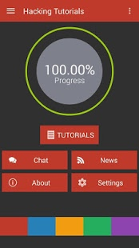





All about the project …
Consists of Games, Materials, Quizzes and Quick notifications.
DATA STRUCTURES
Games

Slide 19


