Slide 1
Chapter Sixteen
Equilibrium

Slide 2
Market Equilibrium
A market is in equilibrium when total quantity demanded by buyers equals total quantity supplied by sellers.

Slide 3
Market Equilibrium
Market
demand
p
q=D(p)
D(p)

Slide 4
Market Equilibrium
Market
supply
p
q=S(p)
S(p)

Slide 5
Market Equilibrium
Market
demand
Market
supply
p
q=S(p)
q=D(p)
D(p), S(p)

Slide 6
Market Equilibrium
Market
demand
Market
supply
p
q=S(p)
p*
q=D(p)
q*
D(p), S(p)

Slide 7
Market Equilibrium
Market
demand
Market
supply
p
q=S(p)
D(p*) = S(p*); the market
is in equilibrium.
p*
q=D(p)
q*
D(p), S(p)

Slide 8
Market Equilibrium
Market
demand
Market
supply
p
q=S(p)
D(p’) < S(p’); an excess
of quantity supplied over
quantity demanded.
p’
p*
q=D(p)
D(p’)
S(p’)
D(p), S(p)

Slide 9
Market Equilibrium
Market
demand
Market
supply
p
q=S(p)
D(p’) < S(p’); an excess
of quantity supplied over
quantity demanded.
p’
p*
q=D(p)
D(p’)
S(p’)
D(p), S(p)
Market price must fall towards p*.

Slide 10
Market Equilibrium
Market
demand
Market
supply
p
q=S(p)
D(p”) > S(p”); an excess
of quantity demanded
over quantity supplied.
p*
p”
q=D(p)
S(p”)
D(p”)
D(p), S(p)

Slide 11
Market Equilibrium
Market
demand
Market
supply
p
q=S(p)
D(p”) > S(p”); an excess
of quantity demanded
over quantity supplied.
p*
p”
q=D(p)
S(p”)
D(p”)
D(p), S(p)
Market price must rise towards p*.

Slide 12


Market Equilibrium
An example of calculating a market equilibrium when the market demand and supply curves are linear.

Slide 13
Market Equilibrium
Market
demand
Market
supply
p
S(p) = c+dp
p*
D(p) = a-bp
q*
D(p), S(p)

Slide 14
Market Equilibrium
Market
demand
Market
supply
p
S(p) = c+dp
What are the values
of p* and q*?
p*
D(p) = a-bp
q*
D(p), S(p)

Slide 15
Market Equilibrium
At the equilibrium price p*, D(p*) = S(p*).

Slide 16
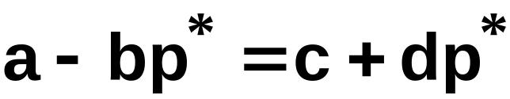
Market Equilibrium
At the equilibrium price p*, D(p*) = S(p*).
That is,

Slide 17
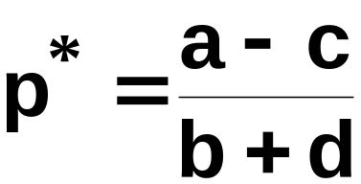
Market Equilibrium
At the equilibrium price p*, D(p*) = S(p*).
That is,
which gives

Slide 18
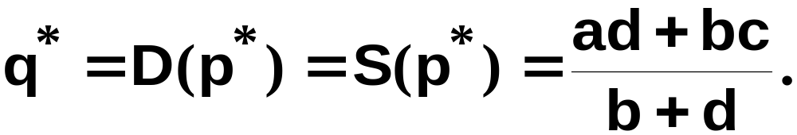
Market Equilibrium
At the equilibrium price p*, D(p*) = S(p*).
That is,
which gives
and

Slide 19
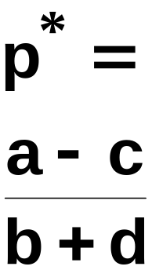
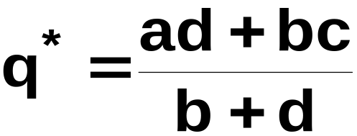
Market Equilibrium
Market
demand
Market
supply
p
S(p) = c+dp
D(p) = a-bp
D(p), S(p)

Slide 20
Market Equilibrium
Can we calculate the market equilibrium using the inverse market demand and supply curves?

Slide 21
Market Equilibrium
Can we calculate the market equilibrium using the inverse market demand and supply curves?
Yes, it is the same calculation.

Slide 22
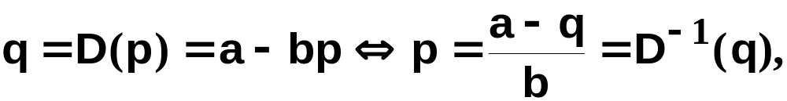
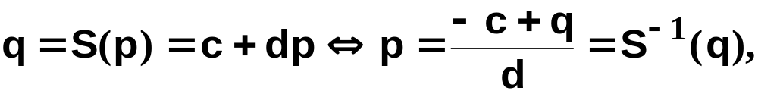
Market Equilibrium
the equation of the inverse market
demand curve. And
the equation of the inverse market
supply curve.

Slide 23
Market Equilibrium
Market
inverse
demand
D⁻¹(q),
S⁻¹(q)
Market inverse supply
S⁻¹(q) = (-c+q)/d
p*
D⁻¹(q) = (a-q)/b
q*
q

Slide 24
Market Equilibrium
D⁻¹(q),
S⁻¹(q)
Market
demand
Market inverse supply
S⁻¹(q) = (-c+q)/d
At equilibrium,
D⁻¹(q*) = S⁻¹(q*).
p*
D⁻¹(q) = (a-q)/b
q*
q

Slide 25
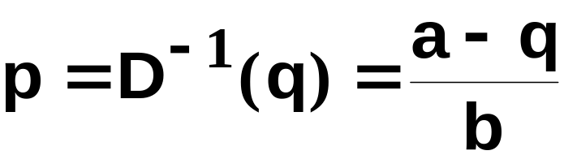
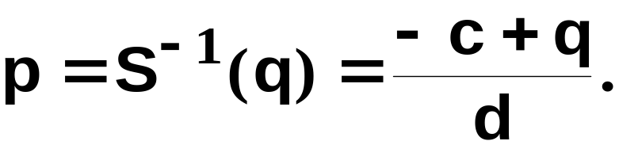
Market Equilibrium
and
At the equilibrium quantity q*, D⁻¹(p*) = S⁻¹(p*).

Slide 26
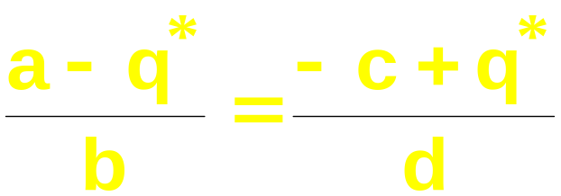
Market Equilibrium
and
At the equilibrium quantity q*, D⁻¹(p*) = S⁻¹(p*).
That is,

Slide 27
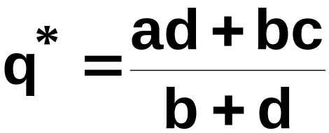
Market Equilibrium
and
At the equilibrium quantity q*, D⁻¹(p*) = S⁻¹(p*).
That is,
which gives

Slide 28
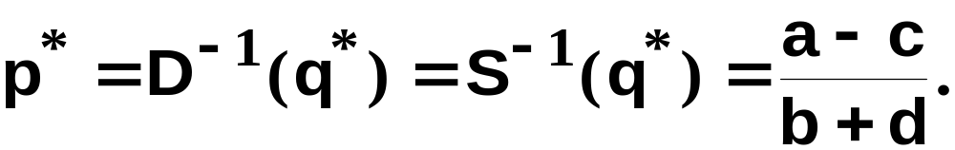
Market Equilibrium
and
At the equilibrium quantity q*, D⁻¹(p*) = S⁻¹(p*).
That is,
which gives
and

Slide 29
Market Equilibrium
D⁻¹(q),
S⁻¹(q)
Market
demand
Market
supply
S⁻¹(q) = (-c+q)/d
D⁻¹(q) = (a-q)/b
q

Slide 30
Market Equilibrium
Two special cases:
  quantity supplied is fixed, independent of the market price, and
  quantity supplied is extremely sensitive to the market price.

Slide 31
Market Equilibrium
Market quantity supplied is
fixed, independent of price.
p
q*
q

Slide 32
Market Equilibrium
Market quantity supplied is
fixed, independent of price.
p
S(p) = c+dp, so d=0
and S(p) ≡ c.
q* = c
q

Slide 33
Market Equilibrium
Market
demand
Market quantity supplied is
fixed, independent of price.
p
S(p) = c+dp, so d=0
and S(p) ≡ c.
D⁻¹(q) = (a-q)/b
q* = c
q

Slide 34
Market Equilibrium
Market
demand
Market quantity supplied is
fixed, independent of price.
p
S(p) = c+dp, so d=0
and S(p) ≡ c.
p*
D⁻¹(q) = (a-q)/b
q* = c
q

Slide 35
Market Equilibrium
Market
demand
Market quantity supplied is
fixed, independent of price.
p
S(p) = c+dp, so d=0
and S(p) ≡ c.
p* =
(a-c)/b
p* = D⁻¹(q*); that is,
p* = (a-c)/b.
D⁻¹(q) = (a-q)/b
q* = c
q

Slide 36
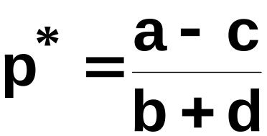

Market Equilibrium
Market
demand
Market quantity supplied is
fixed, independent of price.
p
S(p) = c+dp, so d=0
and S(p) ≡ c.
p* =
(a-c)/b
p* = D⁻¹(q*); that is,
p* = (a-c)/b.
D⁻¹(q) = (a-q)/b
q* = c
q

Slide 37
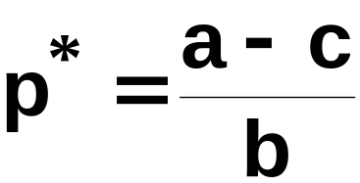
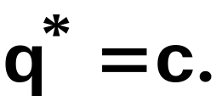
Market Equilibrium
Market
demand
Market quantity supplied is
fixed, independent of price.
p
S(p) = c+dp, so d=0
and S(p) ≡ c.
p* =
(a-c)/b
p* = D⁻¹(q*); that is,
p* = (a-c)/b.
D⁻¹(q) = (a-q)/b
q* = c
q
with d = 0 give

Slide 38
Market Equilibrium
Two special cases are
  when quantity supplied is fixed, independent of the market price, and
  when quantity supplied is extremely sensitive to the market price.
✓

Slide 39
Market Equilibrium
Market quantity supplied is
extremely sensitive to price.
p
q

Slide 40
Market Equilibrium
Market quantity supplied is
extremely sensitive to price.
p
S⁻¹(q) = p*.
p*
q

Slide 41
Market Equilibrium
Market
demand
Market quantity supplied is
extremely sensitive to price.
p
S⁻¹(q) = p*.
p*
D⁻¹(q) = (a-q)/b
q

Slide 42
Market Equilibrium
Market
demand
Market quantity supplied is
extremely sensitive to price.
p
S⁻¹(q) = p*.
p*
D⁻¹(q) = (a-q)/b
q*
q

Slide 43
Market Equilibrium
Market
demand
Market quantity supplied is
extremely sensitive to price.
p
S⁻¹(q) = p*.
p* = D⁻¹(q*) = (a-q*)/b so
q* = a-bp*
p*
D⁻¹(q) = (a-q)/b
q* =
a-bp*
q

Slide 44
Quantity Taxes
A quantity tax levied at a rate of $t is a tax of $t paid on each unit traded.
If the tax is levied on sellers then it is an excise tax.
If the tax is levied on buyers then it is a sales tax.

Slide 45
Quantity Taxes
What is the effect of a quantity tax on a market’s equilibrium?
How are prices affected?
How is the quantity traded affected?
Who pays the tax?
How are gains-to-trade altered?

Slide 46
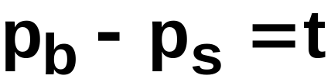
Quantity Taxes
A tax rate t makes the price paid by buyers, p_{b}, higher by t from the price received by sellers, p_{s}.

Slide 47
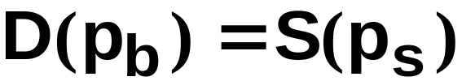
Quantity Taxes
Even with a tax the market must clear.
I.e. quantity demanded by buyers at price p_{b} must equal quantity supplied by sellers at price p_{s}.

Slide 48
Quantity Taxes
and
describe the market’s equilibrium.
Notice these conditions apply no
matter if the tax is levied on sellers or on
buyers.

Slide 49
Quantity Taxes
and
describe the market’s equilibrium.
Notice that these two conditions apply no
matter if the tax is levied on sellers or on
buyers.
Hence, a sales tax rate $t has the
same effect as an excise tax rate $t.

Slide 50
Quantity Taxes & Market Equilibrium
Market
demand
Market
supply
p
No tax
p*
q*
D(p), S(p)

Slide 51
Quantity Taxes & Market Equilibrium
Market
demand
Market
supply
p
An excise tax
raises the market
supply curve by $t
$t
p*
q*
D(p), S(p)

Slide 52
Quantity Taxes & Market Equilibrium
Market
demand
Market
supply
p
An excise tax
raises the market
supply curve by $t,
raises the buyers’
price and lowers the
quantity traded.
p_{b}
$t
p*
q^{t}
q*
D(p), S(p)

Slide 53
Quantity Taxes & Market Equilibrium
Market
demand
Market
supply
p
An excise tax
raises the market
supply curve by $t,
raises the buyers’
price and lowers the
quantity traded.
p_{b}
$t
p*
p_{s}
q^{t}
q*
D(p), S(p)
And sellers receive only p_{s} = p_{b} - t.

Slide 54
Quantity Taxes & Market Equilibrium
Market
demand
Market
supply
p
No tax
p*
q*
D(p), S(p)

Slide 55
Quantity Taxes & Market Equilibrium
Market
demand
Market
supply
p
An sales tax lowers
the market demand
curve by $t
p*
$t
q*
D(p), S(p)

Slide 56
Quantity Taxes & Market Equilibrium
Market
demand
Market
supply
p
An sales tax lowers
the market demand
curve by $t, lowers
the sellers’ price and
reduces the quantity
traded.
p*
p_{s}
$t
q^{t}
q*
D(p), S(p)

Slide 57
Quantity Taxes & Market Equilibrium
Market
demand
Market
supply
p
An sales tax lowers
the market demand
curve by $t, lowers
the sellers’ price and
reduces the quantity
traded.
p_{b}
p_{b}
p_{b}
p*
p_{s}
$t
q^{t}
q*
D(p), S(p)
And buyers pay p_{b} = p_{s} + t.

Slide 58
Quantity Taxes & Market Equilibrium
Market
demand
Market
supply
p
A sales tax levied at
rate $t has the same
effects on the
market’s equilibrium
as does an excise tax
levied at rate $t.
p_{b}
$t
p_{b}
p_{b}
p*
p_{s}
$t
q^{t}
q*
D(p), S(p)

Slide 59
Quantity Taxes & Market Equilibrium
Who pays the tax of $t per unit traded?
The division of the $t between buyers and sellers is the incidence of the tax.

Slide 60
Quantity Taxes & Market Equilibrium
Market
demand
Market
supply
p
p_{b}
p_{b}
p_{b}
p*
p_{s}
q^{t}
q*
D(p), S(p)

Slide 61
Quantity Taxes & Market Equilibrium
Market
demand
Market
supply
p
Tax paid by
buyers
p_{b}
p_{b}
p_{b}
p*
p_{s}
q^{t}
q*
D(p), S(p)

Slide 62
Quantity Taxes & Market Equilibrium
Market
demand
Market
supply
p
p_{b}
p_{b}
p_{b}
p*
p_{s}
Tax paid by
sellers
q^{t}
q*
D(p), S(p)

Slide 63
Quantity Taxes & Market Equilibrium
Market
demand
Market
supply
p
Tax paid by
buyers
p_{b}
p_{b}
p_{b}
p*
p_{s}
Tax paid by
sellers
q^{t}
q*
D(p), S(p)

Slide 64


Quantity Taxes & Market Equilibrium
E.g. suppose the market demand and supply curves are linear.

Slide 65

Quantity Taxes & Market Equilibrium
and

Slide 66



Quantity Taxes & Market Equilibrium
and
With the tax, the market equilibrium satisfies
and
so
and

Slide 67
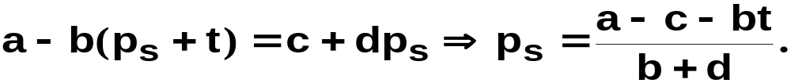
Quantity Taxes & Market Equilibrium
and
With the tax, the market equilibrium satisfies
and
so
and
Substituting for p_{b} gives

Slide 68
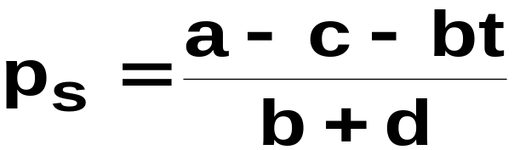

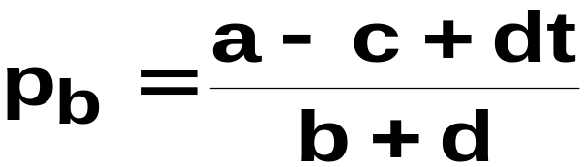
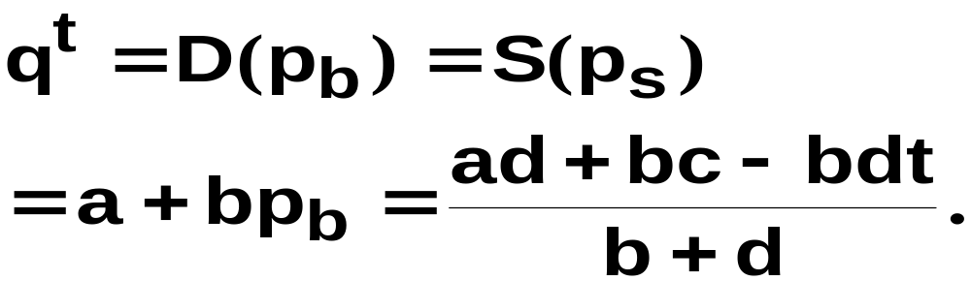
Quantity Taxes & Market Equilibrium
and
give
The quantity traded at equilibrium is

Slide 69
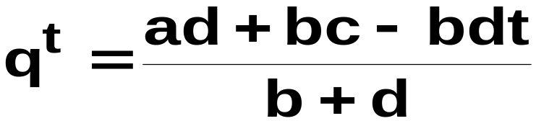
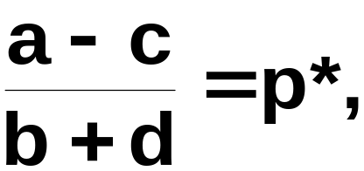
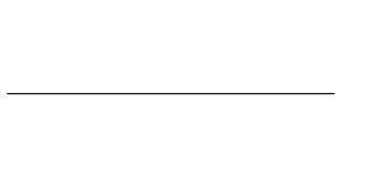
Quantity Taxes & Market Equilibrium
the
equilibrium price if
there is no tax (t = 0) and q^{t}
the quantity traded at equilibrium
when there is no tax.
As t → 0, p_{s} and p_{b} →
→

Slide 70
Quantity Taxes & Market Equilibrium
As t increases, p_{s} falls,
p_{b} rises,
and q^{t} falls.

Slide 71
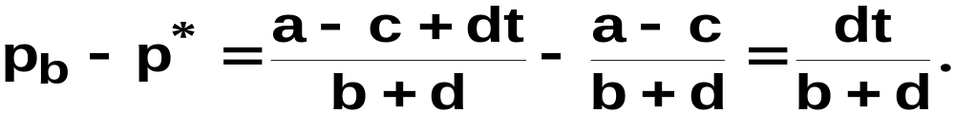
Quantity Taxes & Market Equilibrium
The tax paid per unit by the buyer is

Slide 72
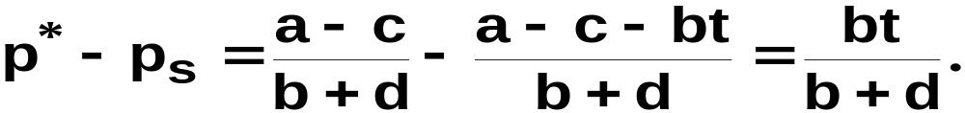
Quantity Taxes & Market Equilibrium
The tax paid per unit by the buyer is
The tax paid per unit by the seller is

Slide 73
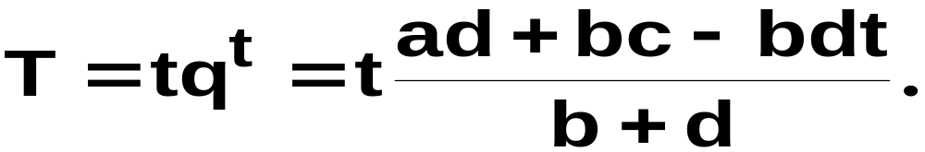
Quantity Taxes & Market Equilibrium
The total tax paid (by buyers and sellers
combined) is

Slide 74
Tax Incidence and Own-Price Elasticities
The incidence of a quantity tax depends upon the own-price elasticities of demand and supply.

Slide 75
Tax Incidence and Own-Price Elasticities
Market
demand
Market
supply
p
p_{b}
$t
p*
p_{s}
q^{t}
q*
D(p), S(p)

Slide 76
Tax Incidence and Own-Price Elasticities
Market
demand
Market
supply
p
Change to buyers’
price is p_{b} - p*.
Change to quantity
demanded is Δq.
p_{b}
$t
p*
p_{s}
q^{t}
q*
D(p), S(p)
Δq

Slide 77
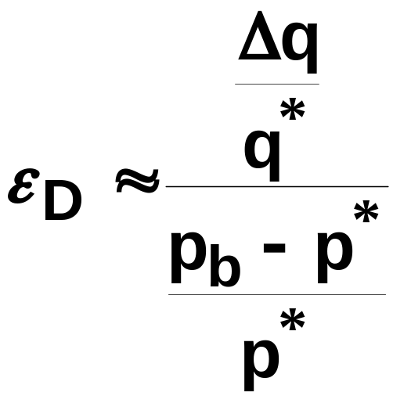
Tax Incidence and Own-Price Elasticities
Around p = p* the own-price elasticity
of demand is approximately

Slide 78
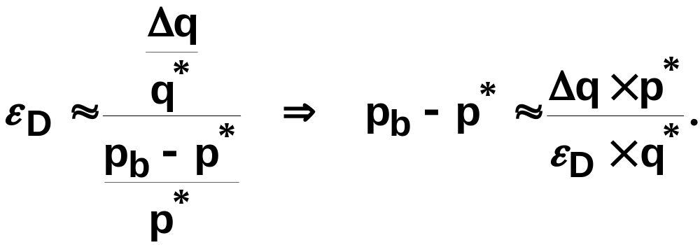
Tax Incidence and Own-Price Elasticities
Around p = p* the own-price elasticity
of demand is approximately

Slide 79
Tax Incidence and Own-Price Elasticities
Market
demand
Market
supply
p
p_{b}
$t
p*
p_{s}
q^{t}
q*
D(p), S(p)

Slide 80
Tax Incidence and Own-Price Elasticities
Market
demand
Market
supply
p
Change to sellers’
price is p_{s} - p*.
Change to quantity
demanded is Δq.
p_{b}
$t
p*
p_{s}
q^{t}
q*
D(p), S(p)
Δq

Slide 81
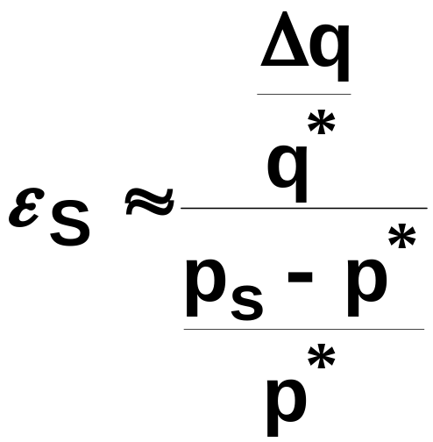
Tax Incidence and Own-Price Elasticities
Around p = p* the own-price elasticity
of supply is approximately

Slide 82
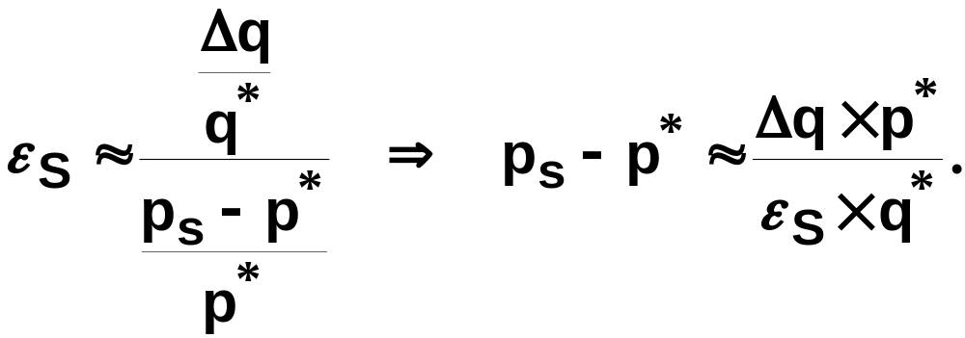
Tax Incidence and Own-Price Elasticities
Around p = p* the own-price elasticity
of supply is approximately

Slide 83
Tax Incidence and Own-Price Elasticities
Market
demand
Market
supply
p
Tax paid by
buyers
p_{b}
p_{b}
p_{b}
p*
p_{s}
Tax paid by
sellers
q^{t}
q*
D(p), S(p)

Slide 84
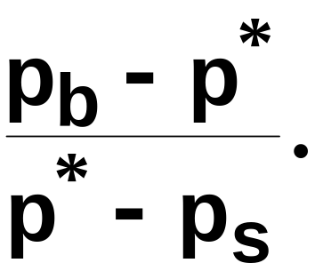
Tax Incidence and Own-Price Elasticities
Market
demand
Market
supply
p
Tax paid by
buyers
p_{b}
p_{b}
p_{b}
p*
p_{s}
Tax paid by
sellers
q^{t}
q*
D(p), S(p)
Tax incidence =

Slide 85
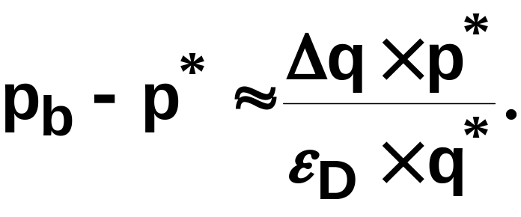
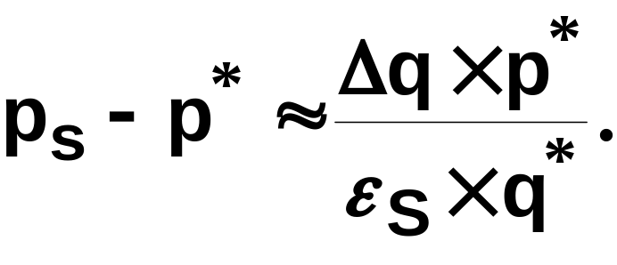
Tax Incidence and Own-Price Elasticities
Tax incidence =

Slide 86
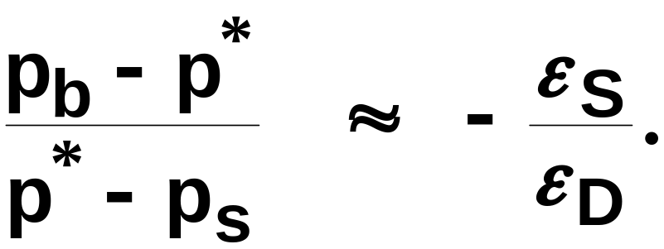
Tax Incidence and Own-Price Elasticities
Tax incidence =
So

Slide 87
Tax Incidence and Own-Price Elasticities
Tax incidence is
The fraction of a $t quantity tax paid
by buyers rises as supply becomes more
own-price elastic or as demand becomes
less own-price elastic.

Slide 88
Tax Incidence and Own-Price Elasticities
Market
demand
Market
supply
p
As market demand
becomes less own-
price elastic, tax
incidence shifts more
to the buyers.
p_{b}
$t
p*
p_{s}
q^{t}
q*
D(p), S(p)

Slide 89
Tax Incidence and Own-Price Elasticities
Market
demand
Market
supply
p
As market demand
becomes less own-
price elastic, tax
incidence shifts more
to the buyers.
p_{b}
$t
p*
p_{s}
q^{t}
q*
D(p), S(p)

Slide 90
Tax Incidence and Own-Price Elasticities
Market
demand
Market
supply
p
As market demand
becomes less own-
price elastic, tax
incidence shifts more
to the buyers.
p_{b}
$t
p_{s}= p*
q^{t} = q*
D(p), S(p)

Slide 91
Tax Incidence and Own-Price Elasticities
Market
demand
Market
supply
p
As market demand
becomes less own-
price elastic, tax
incidence shifts more
to the buyers.
p_{b}
$t
p_{s}= p*
q^{t} = q*
D(p), S(p)
When ε_{D} = 0, buyers pay the entire tax, even though it is levied on the sellers.

Slide 92
Tax Incidence and Own-Price Elasticities
Tax incidence is
Similarly, the fraction of a $t quantity
tax paid by sellers rises as supply
becomes less own-price elastic or as
demand becomes more own-price elastic.

Slide 93
Deadweight Loss and Own-Price Elasticities
A quantity tax imposed on a competitive market reduces the quantity traded and so reduces gains-to-trade (i.e. the sum of Consumers’ and Producers’ Surpluses).
The lost total surplus is the tax’s deadweight loss, or excess burden.

Slide 94
Deadweight Loss and Own-Price Elasticities
Market
demand
Market
supply
p
No tax
p*
q*
D(p), S(p)

Slide 95
Deadweight Loss and Own-Price Elasticities
Market
demand
Market
supply
p
No tax
CS
p*
q*
D(p), S(p)

Slide 96
Deadweight Loss and Own-Price Elasticities
Market
demand
Market
supply
p
No tax
p*
PS
q*
D(p), S(p)

Slide 97
Deadweight Loss and Own-Price Elasticities
Market
demand
Market
supply
p
No tax
CS
p*
PS
q*
D(p), S(p)

Slide 98
Deadweight Loss and Own-Price Elasticities
Market
demand
Market
supply
p
No tax
CS
p*
PS
q*
D(p), S(p)

Slide 99
Deadweight Loss and Own-Price Elasticities
Market
demand
Market
supply
p
The tax reduces
both CS and PS
p_{b}
CS
$t
p*
p_{s}
PS
q^{t}
q*
D(p), S(p)

Slide 100
Deadweight Loss and Own-Price Elasticities
Market
demand
Market
supply
p
The tax reduces
both CS and PS,
transfers surplus
to government
p_{b}
CS
$t
p*
Tax
p_{s}
PS
q^{t}
q*
D(p), S(p)

Slide 101
Deadweight Loss and Own-Price Elasticities
Market
demand
Market
supply
p
The tax reduces
both CS and PS,
transfers surplus
to government
p_{b}
CS
$t
p*
Tax
p_{s}
PS
q^{t}
q*
D(p), S(p)

Slide 102
Deadweight Loss and Own-Price Elasticities
Market
demand
Market
supply
p
The tax reduces
both CS and PS,
transfers surplus
to government
p_{b}
CS
$t
p*
Tax
p_{s}
PS
q^{t}
q*
D(p), S(p)

Slide 103
Deadweight Loss and Own-Price Elasticities
Market
demand
Market
supply
p
The tax reduces
both CS and PS,
transfers surplus
to government,
and lowers total
surplus.
p_{b}
CS
$t
p*
Tax
p_{s}
PS
q^{t}
q*
D(p), S(p)

Slide 104
Deadweight Loss and Own-Price Elasticities
Market
demand
Market
supply
p
p_{b}
CS
$t
p*
Tax
p_{s}
PS
Deadweight loss
q^{t}
q*
D(p), S(p)

Slide 105
Deadweight Loss and Own-Price Elasticities
Market
demand
Market
supply
p
p_{b}
$t
p*
p_{s}
Deadweight loss
q^{t}
q*
D(p), S(p)

Slide 106
Deadweight Loss and Own-Price Elasticities
Market
demand
Market
supply
p
Deadweight loss falls
as market demand
becomes less own-
price elastic.
p_{b}
$t
p*
p_{s}
q^{t}
q*
D(p), S(p)

Slide 107
Deadweight Loss and Own-Price Elasticities
Market
demand
Market
supply
p
Deadweight loss falls
as market demand
becomes less own-
price elastic.
p_{b}
$t
p*
p_{s}
q^{t}
q*
D(p), S(p)

Slide 108
Deadweight Loss and Own-Price Elasticities
Market
demand
Market
supply
p
Deadweight loss falls
as market demand
becomes less own-
price elastic.
p_{b}
$t
p_{s}= p*
q^{t} = q*
D(p), S(p)
When ε_{D} = 0, the tax causes no deadweight loss.

Slide 109
Deadweight Loss and Own-Price Elasticities
Deadweight loss due to a quantity tax rises as either market demand or market supply becomes more own-price elastic.
If either ε_{D} = 0 or ε_{S} = 0 then the deadweight loss is zero.

