Slide 1
Chapter Fourteen
Consumer’s Surplus

Slide 2
Monetary Measures of Gains-to-Trade
You can buy as much gasoline as you wish at $1 per gallon once you enter the gasoline market.
Q: What is the most you would pay to enter the market?

Slide 3
Monetary Measures of Gains-to-Trade
A: You would pay up to the dollar value of the gains-to-trade you would enjoy once in the market.
How can such gains-to-trade be measured?

Slide 4
Monetary Measures of Gains-to-Trade
Three such measures are:
  Consumer’s Surplus
  Equivalent Variation, and
  Compensating Variation.
Only in one special circumstance do these three measures coincide.

Slide 5
$ Equivalent Utility Gains
Suppose gasoline can be bought only in lumps of one gallon.
Use r₁ to denote the most a single consumer would pay for a 1st gallon -- call this her reservation price for the 1st gallon.
r₁ is the dollar equivalent of the marginal utility of the 1st gallon.

Slide 6
$ Equivalent Utility Gains
Now that she has one gallon, use r₂ to denote the most she would pay for a 2nd gallon -- this is her reservation price for the 2nd gallon.
r₂ is the dollar equivalent of the marginal utility of the 2nd gallon.

Slide 7
$ Equivalent Utility Gains
Generally, if she already has n-1 gallons of gasoline then r_{n} denotes the most she will pay for an nth gallon.
r_{n} is the dollar equivalent of the marginal utility of the nth gallon.

Slide 8
$ Equivalent Utility Gains
r₁ + … + r_{n} will therefore be the dollar equivalent of the total change to utility from acquiring n gallons of gasoline at a price of $0.
So r₁ + … + r_{n} - p_{G}n will be the dollar equivalent of the total change to utility from acquiring n gallons of gasoline at a price of $p_{G} each.

Slide 9
$ Equivalent Utility Gains
A plot of r₁, r₂, … , r_{n}, … against n is a reservation-price curve. This is not quite the same as the consumer’s demand curve for gasoline.

Slide 10
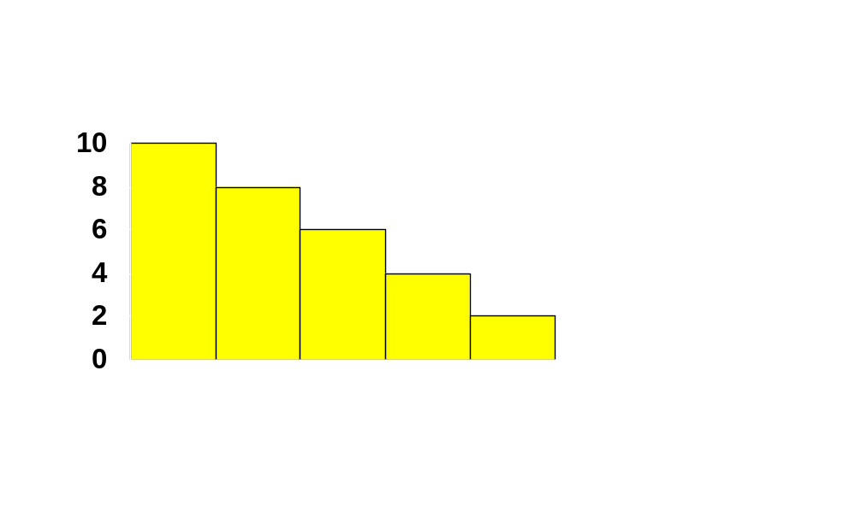
$ Equivalent Utility Gains
r₁
r₂
r₃
r₄
r₅
r₆
1
2
3
4
5
6

Slide 11
$ Equivalent Utility Gains
What is the monetary value of our consumer’s gain-to-trading in the gasoline market at a price of $p_{G}?

Slide 12
$ Equivalent Utility Gains
The dollar equivalent net utility gain for the 1st gallon is $(r₁ - p_{G})
and is $(r₂ - p_{G}) for the 2nd gallon,
and so on, so the dollar value of the gain-to-trade is
$(r₁ - p_{G}) + $(r₂ - p_{G}) + …
for as long as r_{n} - p_{G} > 0.

Slide 13
$ Equivalent Utility Gains
r₁
r₂
r₃
r₄
p_{G}
r₅
r₆
1
2
3
4
5
6

Slide 14
$ Equivalent Utility Gains
r₁
r₂
r₃
r₄
p_{G}
r₅
r₆
1
2
3
4
5
6

Slide 15
$ Equivalent Utility Gains
$ value of net utility gains-to-trade
r₁
r₂
r₃
r₄
p_{G}
r₅
r₆
1
2
3
4
5
6

Slide 16
$ Equivalent Utility Gains
Now suppose that gasoline is sold in half-gallon units.
r₁, r₂, … , r_{n}, … denote the consumer’s reservation prices for successive half-gallons of gasoline.
Our consumer’s new reservation price curve is

Slide 17
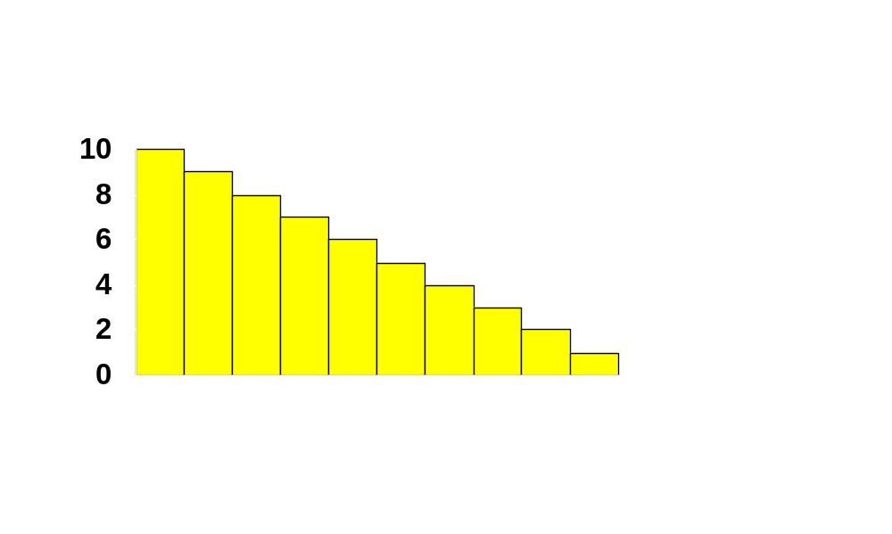
$ Equivalent Utility Gains
r₁
r₃
r₅
r₇
r₉
r₁₁
1
2
3
4
5
6
7
8
9
10
11

Slide 18
$ Equivalent Utility Gains
r₁
r₃
r₅
r₇
p_{G}
r₉
r₁₁
1
2
3
4
5
6
7
8
9
10
11

Slide 19
$ Equivalent Utility Gains
$ value of net utility gains-to-trade
r₁
r₃
r₅
r₇
p_{G}
r₉
r₁₁
1
2
3
4
5
6
7
8
9
10
11

Slide 20
$ Equivalent Utility Gains
And if gasoline is available in one-quarter gallon units ...

Slide 21

$ Equivalent Utility Gains
1
2
3
4
5
6
7
8
9
10
11

Slide 22
$ Equivalent Utility Gains
p_{G}
1
2
3
4
5
6
7
8
9
10
11

Slide 23
$ Equivalent Utility Gains
$ value of net utility gains-to-trade
p_{G}

Slide 24
$ Equivalent Utility Gains
Finally, if gasoline can be purchased in any quantity then ...

Slide 25
$ Equivalent Utility Gains
($) Res.
Prices
Reservation Price Curve for Gasoline
Gasoline

Slide 26
$ Equivalent Utility Gains
($) Res.
Prices
Reservation Price Curve for Gasoline
p_{G}
Gasoline

Slide 27
$ Equivalent Utility Gains
($) Res.
Prices
Reservation Price Curve for Gasoline
$ value of net utility gains-to-trade
p_{G}
Gasoline

Slide 28
$ Equivalent Utility Gains
Unfortunately, estimating a consumer’s reservation-price curve is difficult,
so, as an approximation, the reservation-price curve is replaced with the consumer’s ordinary demand curve.

Slide 29
Consumer’s Surplus
A consumer’s reservation-price curve is not quite the same as her ordinary demand curve. Why not?
A reservation-price curve describes sequentially the values of successive single units of a commodity.
An ordinary demand curve describes the most that would be paid for q units of a commodity purchased simultaneously.

Slide 30
Consumer’s Surplus
Approximating the net utility gain area under the reservation-price curve by the corresponding area under the ordinary demand curve gives the Consumer’s Surplus measure of net utility gain.

Slide 31
Consumer’s Surplus
($)
Reservation price curve for gasoline
Ordinary demand curve for gasoline
Gasoline

Slide 32
Consumer’s Surplus
($)
Reservation price curve for gasoline
Ordinary demand curve for gasoline
p_{G}
Gasoline

Slide 33
Consumer’s Surplus
($)
Reservation price curve for gasoline
Ordinary demand curve for gasoline
$ value of net utility gains-to-trade
p_{G}
Gasoline

Slide 34
Consumer’s Surplus
($)
Reservation price curve for gasoline
Ordinary demand curve for gasoline
$ value of net utility gains-to-trade
Consumer’s Surplus
p_{G}
Gasoline

Slide 35
Consumer’s Surplus
($)
Reservation price curve for gasoline
Ordinary demand curve for gasoline
$ value of net utility gains-to-trade
Consumer’s Surplus
p_{G}
Gasoline

Slide 36
Consumer’s Surplus
The difference between the consumer’s reservation-price and ordinary demand curves is due to income effects.
But, if the consumer’s utility function is quasilinear in income then there are no income effects and Consumer’s Surplus is an exact $ measure of gains-to-trade.

Slide 37

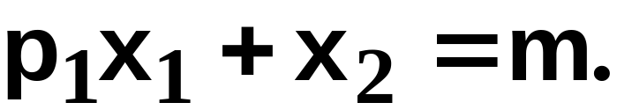
Consumer’s Surplus
The consumer’s utility function is
quasilinear in x_{2.}
Take p₂ = 1. Then the consumer’s
choice problem is to maximize
subject to

Slide 38
Consumer’s Surplus
The consumer’s utility function is
quasilinear in x_{2.}
Take p₂ = 1. Then the consumer’s
choice problem is to maximize
subject to

Slide 39
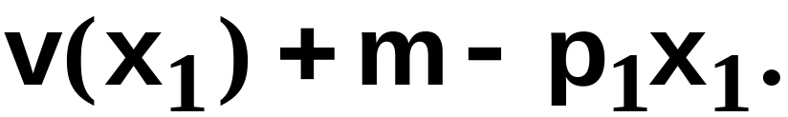
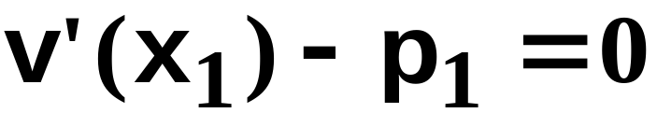
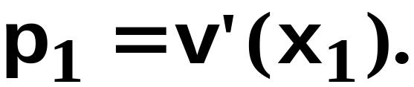
Consumer’s Surplus
That is, choose x₁ to maximize
The first-order condition is
That is,
This is the equation of the consumer’s
ordinary demand for commodity 1.

Slide 40
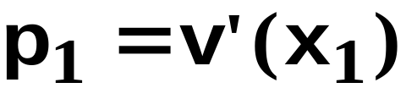



Consumer’s Surplus
p₁
Ordinary demand curve,
CS

Slide 41
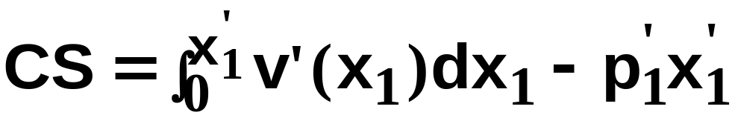
Consumer’s Surplus
p₁
Ordinary demand curve,
CS

Slide 42
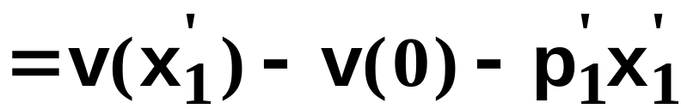
Consumer’s Surplus
p₁
Ordinary demand curve,
CS

Slide 43
Consumer’s Surplus
p₁
Ordinary demand curve,
is exactly the consumer’s utility
gain from consuming x₁’
units of commodity 1.
CS

Slide 44
Consumer’s Surplus
Consumer’s Surplus is an exact dollar measure of utility gained from consuming commodity 1 when the consumer’s utility function is quasilinear in commodity 2.
Otherwise Consumer’s Surplus is an approximation.

Slide 45
Consumer’s Surplus
The change to a consumer’s total utility due to a change to p₁ is approximately the change in her Consumer’s Surplus.

Slide 46
Consumer’s Surplus
p₁
p₁(x₁), the inverse ordinary demand
curve for commodity 1

Slide 47
Consumer’s Surplus
p₁
p₁(x₁)
CS before

Slide 48


Consumer’s Surplus
p₁
p₁(x₁)
CS after

Slide 49
Consumer’s Surplus
p₁
p₁(x₁), inverse ordinary demand
curve for commodity 1.
Lost CS

Slide 50
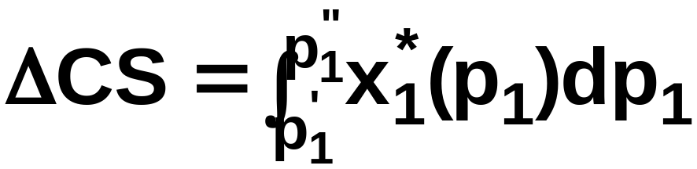
Consumer’s Surplus
x₁*(p₁), the consumer’s ordinary
demand curve for commodity 1.
measures the loss in
Consumer’s Surplus.
Lost
CS
p₁

Slide 51
Compensating Variation and Equivalent Variation
Two additional dollar measures of the total utility change caused by a price change are Compensating Variation and Equivalent Variation.

Slide 52
Compensating Variation
p₁ rises.
Q: What is the least extra income that, at the new prices, just restores the consumer’s original utility level?

Slide 53
Compensating Variation
p₁ rises.
Q: What is the least extra income that, at the new prices, just restores the consumer’s original utility level?
A: The Compensating Variation.

Slide 54
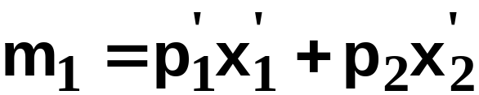

Compensating Variation
p₁=p₁’
p₂ is fixed.
x₂
u₁
x₁

Slide 55
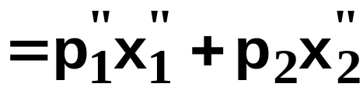

Compensating Variation
p₁=p₁’
p₁=p₁”
p₂ is fixed.
x₂
u₁
u₂
x₁

Slide 56
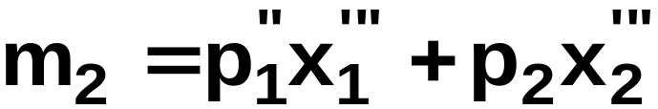

Compensating Variation
p₁=p₁’
p₁=p₁”
p₂ is fixed.
x₂
u₁
u₂
x₁

Slide 57
Compensating Variation
p₁=p₁’
p₁=p₁”
p₂ is fixed.
x₂
u₁
u₂
CV = m₂ - m₁.
x₁

Slide 58
Equivalent Variation
p₁ rises.
Q: What is the least extra income that, at the original prices, just restores the consumer’s original utility level?
A: The Equivalent Variation.

Slide 59
Equivalent Variation
p₁=p₁’
p₂ is fixed.
x₂
u₁
x₁

Slide 60
Equivalent Variation
p₁=p₁’
p₁=p₁”
p₂ is fixed.
x₂
u₁
u₂
x₁

Slide 61
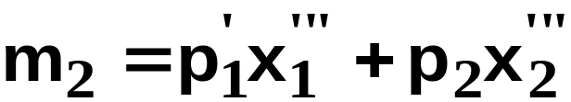
Equivalent Variation
p₁=p₁’
p₁=p₁”
p₂ is fixed.
x₂
u₁
u₂
x₁

Slide 62
Equivalent Variation
p₁=p₁’
p₁=p₁”
p₂ is fixed.
x₂
u₁
u₂
EV = m₁ - m₂.
x₁

Slide 63
Consumer’s Surplus, Compensating Variation and Equivalent Variation
Relationship 1: When the consumer’s preferences are quasilinear, all three measures are the same.

Slide 64
Consumer’s Surplus, Compensating Variation and Equivalent Variation
Consider first the change in Consumer’s Surplus when p₁ rises from p₁’ to p₁”.

Slide 65
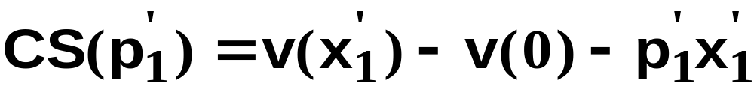
Consumer’s Surplus, Compensating Variation and Equivalent Variation
If
then

Slide 66
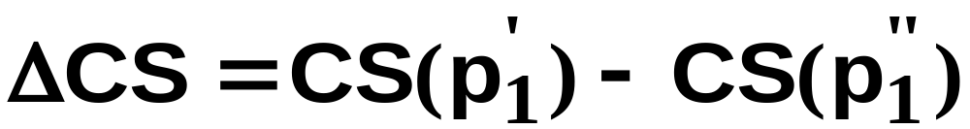
Consumer’s Surplus, Compensating Variation and Equivalent Variation
If
then
and so the change in CS when p₁ rises
from p₁’ to p₁” is

Slide 67
Consumer’s Surplus, Compensating Variation and Equivalent Variation
If
then
and so the change in CS when p₁ rises
from p₁’ to p₁” is

Slide 68
Consumer’s Surplus, Compensating Variation and Equivalent Variation
If
then
and so the change in CS when p₁ rises
from p₁’ to p₁” is

Slide 69
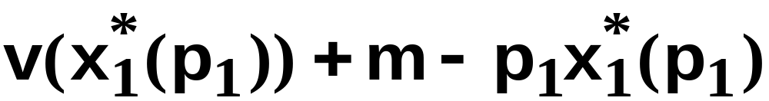
Consumer’s Surplus, Compensating Variation and Equivalent Variation
Now consider the change in CV when p₁ rises from p₁’ to p₁”.
The consumer’s utility for given p₁ is
and CV is the extra income which, at the new prices, makes the consumer’s utility the same as at the old prices. That is, ...

Slide 70
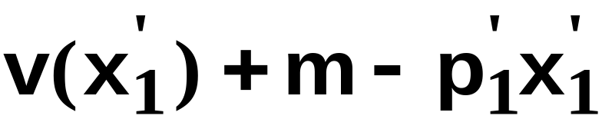
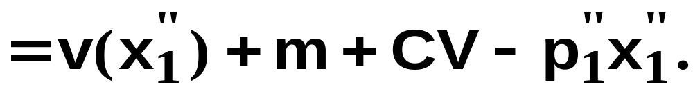
Consumer’s Surplus, Compensating Variation and Equivalent Variation

Slide 71

Consumer’s Surplus, Compensating Variation and Equivalent Variation
So

Slide 72
Consumer’s Surplus, Compensating Variation and Equivalent Variation
Now consider the change in EV when p₁ rises from p₁’ to p₁”.
The consumer’s utility for given p₁ is
and EV is the extra income which, at the old prices, makes the consumer’s utility the same as at the new prices. That is, ...

Slide 73

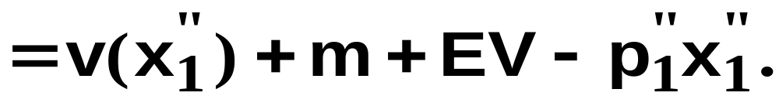
Consumer’s Surplus, Compensating Variation and Equivalent Variation

Slide 74
Consumer’s Surplus, Compensating Variation and Equivalent Variation
That is,

Slide 75
Consumer’s Surplus, Compensating Variation and Equivalent Variation
So when the consumer has quasilinear
utility,
CV = EV = ΔCS.
But, otherwise, we have:
Relationship 2: In size, EV < ΔCS < CV.

Slide 76
Producer’s Surplus
Changes in a firm’s welfare can be measured in dollars much as for a consumer.

Slide 77
Producer’s Surplus
Output price (p)
Marginal Cost
y
(output units)

Slide 78


Producer’s Surplus
Output price (p)
Marginal Cost
y
(output units)

Slide 79

Producer’s Surplus
Output price (p)
Marginal Cost
Revenue
=
y
(output units)

Slide 80
Producer’s Surplus
Output price (p)
Marginal Cost
Variable Cost of producing
y’ units is the sum of the
marginal costs
y
(output units)

Slide 81
Producer’s Surplus
Output price (p)
Revenue less VC
is the Producer’s
Surplus.
Marginal Cost
Variable Cost of producing
y’ units is the sum of the
marginal costs
y
(output units)

