Slide 1
Chapter Seventeen
Auctions

Slide 2
Who Uses Auctions?
Owners of art, cars, stamps, machines, mineral rights etc.
Q: Why auction?

Slide 3
Who Uses Auctions?
Owners of art, cars, stamps, machines, mineral rights etc.
Q: Why auction?
A: Because many markets are imperfect and it is hard to discover potential buyers’ true valuations of your asset. Auctions help to discover this information.

Slide 4
Types of Auctions
English auction:
  bids are public announcements
  bid price rises until there are no further bids
  highest bid wins
  winner pays his bid.

Slide 5
Types of Auctions
Sealed-bid first-price auction:
  bids are private information
  bids are made simultaneously
  highest bid wins
  winner pays his bid.

Slide 6
Types of Auctions
Sealed-bid second-price auction:
  bids are private information
  bids are made simultaneously
  highest bidder wins
  winner pays second-highest bid
  also known as a Vickrey auction.

Slide 7
Types of Auctions
Dutch auction:
  auctioneer announces a high bid and then gradually lowers the bid
  first buyer to accept wins and pays that price.

Slide 8
Reserve Price
A seller specified bid level below which no sale is made.

Slide 9
Economists’ Classification of Auctions
Private-value auctions:
  every potential buyer knows for sure her own valuation of the item for sale
  all these individual valuations are independent of each other.

Slide 10
Economists’ Classification of Auctions
Common-value auctions:
  item for sale has the same value to every potential buyer
  potential buyers differ in their own estimates of this common value.

Slide 11
Auction Design
Goals:
  Pareto efficiency
  maximization of the seller’s profit.

Slide 12
Auction Design
Pareto efficiency:
  the item must sell to the buyer with the highest valuation of the item.
Which auctions are Pareto efficient?

Slide 13
Auctions and Efficiency
English auction with no reserve price must be efficient since, if a buyer with a low valuation was about to buy, the highest valuation buyer would bid higher.

Slide 14
Auctions and Efficiency
English auction with a reserve price need not be efficient since if the reserve price is set above the (unknown to the seller) highest buyer valuation, then there will be no sale and so no gains-to-trade.

Slide 15
Auctions and Efficiency
Dutch auction need not be efficient. No buyer knows other buyers’ valuations, so the highest valuation buyer may delay too long and lose to another bidder.

Slide 16
Auctions and Efficiency
Sealed-bid first-price auction need not be efficient. No buyer knows other buyers’ valuations, so the highest valuation buyer may bid too low and lose to another bidder.

Slide 17
Auctions and Efficiency
Sealed-bid second-price auction is Pareto efficient even though no buyer knows the other buyers’ valuations (more on this later).

Slide 18
Why Use a Reserve Price?
Suppose there are 2 buyers.
The seller believes each buyer’s valuation is $20 with chance 1/2 and $50 with chance 1/2.
I.e. with chance 1/4 each, the seller believes she faces buyer valuations ($20,$20), ($20,$50), ($50,$20) and ($50,$50).

Slide 19
Why Use a Reserve Price?
I.e. with chance 1/4 each, the seller believes she faces buyer valuations ($20,$20), ($20,$50), ($50,$20) and ($50,$50).
Use an English auction.
Bids must be raised by at least $1.
With chance 1/4 each, winning bids will be $20, $21, $21 and $50 if there is no reserve price.

Slide 20
Why Use a Reserve Price?
With chance 1/4 each, winning bids will be $20, $21, $21 and $50 if there is no reserve price.
Seller’s expected revenue is
($20 + $21 + $21 + $50)/4 = $28
with no reserve price.

Slide 21
Why Use a Reserve Price?
With chance 1/4 each, the seller believes she faces buyer valuations ($20,$20), ($20,$50), ($50,$20) and ($50,$50).
Set a reserve price of $50.
With chance 1/4 there will be no sale.
With chance 3/4 the winning bid will be $50.

Slide 22
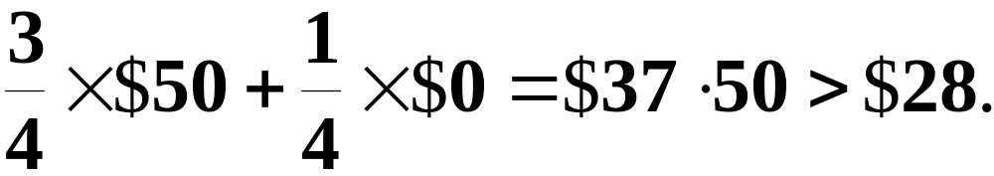
Why Use a Reserve Price?
Set a reserve price of $50.
With chance 1/4 there will be no sale.
With chance 3/4 the winning bid will be $50.
Seller’s expected revenue is

Slide 23
Reserve Price and Efficiency
The reserve price causes an efficiency loss since, with chance 1/4, there is no trade.

Slide 24
Second-Price, Sealed-Bid Auction
  bids are private information
  bids are made simultaneously
  highest bidder wins
  winner pays second-highest bid
  also known as a Vickrey auction.

Slide 25
Second-Price, Sealed-Bid Auction
No bidder knows any other bidder’s true valuation of the item for sale.
Yet, it is individually rational for each bidder to state truthfully his own valuation. Why?
E.g. two bidders with true valuations v₁ and v₂.

Slide 26
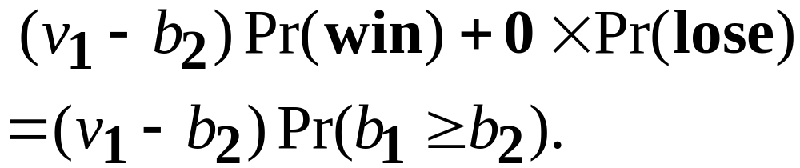
Second-Price, Sealed-Bid Auction
E.g. two bidders with true valuations v₁ and v₂.
Bids are b₁ and b₂.
Expected gain to bidder 1 is

Slide 27

Second-Price, Sealed-Bid Auction
Expected gain to bidder 1 is
How is this maximized?
If v₁ > b₂, then maximize the prob. of winning; i.e. set b₁ = v₁.
If v₁ < b₂, then minimize the prob. of winning; i.e. set b₁ = v₁.
Either way, telling the truth is best!

Slide 28
Second-Price, Sealed-Bid Auction
Since truth-telling is best for every bidder, the highest valuation bidder will win.
Hence the second-price, sealed-bid auction is Pareto-efficient.

Slide 29
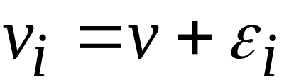


Common-Value Auctions
The item for sale has the same value to every potential buyer.
Potential buyers differ in their own estimates of this common value.
Bidder i’s estimate is
where is the common value and is bidder i’s estimation error.

Slide 30
Common-Value Auctions
Bidder i’s estimate is
where is the common value and is bidder i’s estimation error.
If every bid is truthful, the winner is the bidder with the largest estimation error
so a truthful winner on average pays more than the true value -- the winner’s curse.

Slide 31
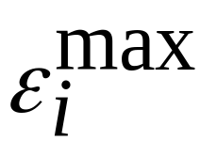
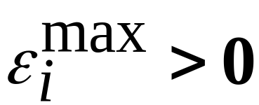
Common-Value Auctions
If every bid is truthful, the winner is the bidder with the largest estimation error -- call it
If then a truthful winner on average pays more than the true value -- the winner’s curse.
So bids should on average be less than in a common-value auction.

