Slide 1
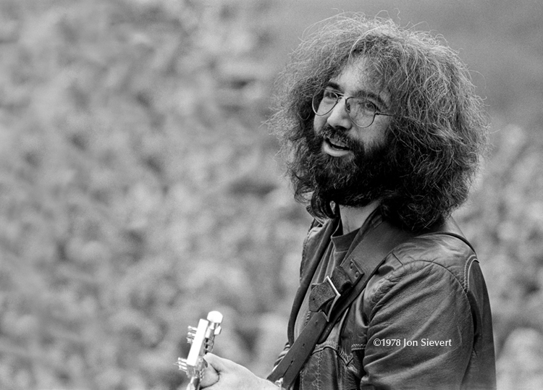
Hardly Strictly Jerry
Sat, Sept 29, 2018
548 Kaimake Loop
Kailua, Hi
5pm: Potluck and BYOB 6pm: Music starts
RSVP: Joanne
808-255-9683
Joanne.amberg@gmail.com

