Slide 1
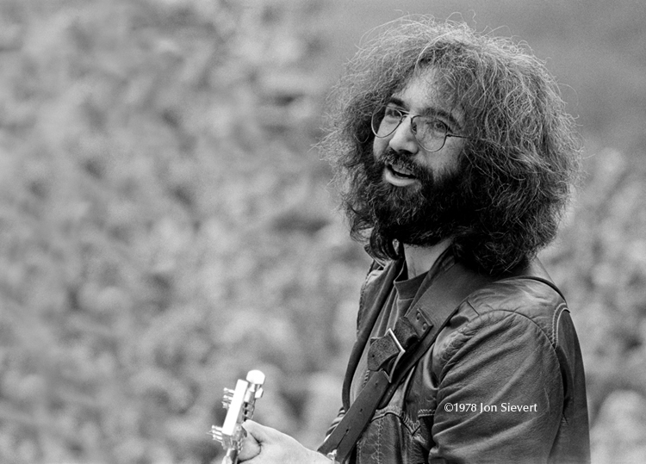
Hardly Strictly Jerry
Sat, Sept 29, 2018
548 Kaimake Loop
Kailua, Hi
6pm: Potluck, BYOB, Music, Dance Party
RSVP: text/call Joanne
808-255-9683
Joanne.amberg@gmail.com

