Slide 1
Computer Networks
(5th Edition)
Andrew S. Tanenbaum
主讲教师: 陆魁军
Email: lukj@zju.edu.cn
浙江大学计算机学院
310027 浙江 杭州 玉泉校区
© Copyright 2014 by lu kui jun in computer department of Zhejiang university, All right reserved.

Slide 2
Chapter 1 INTRODUCTION
Distributed system vs Computer network
  Distributed system
    A collection of independent computers appear to its user as a single coherent system.
    A single model is presented to users.
    Middleware is responsible for implementing this model. Middleware: a layer of software on top of the operating system.
    Hardware and software differences of computers in system are not visible to user.
    Example: World Wide Web.
  Computer network
    Actual machines are exposed to users.
    Differences of computers in system are visible to user.

Slide 3
1.1 USES OF COMPUTER NETWORKS
  1.1.1 Business Applications
  1.1.2 Home Applications
  1.1.3 Mobile Users
  1.1.4 Social Issues

Slide 4
快速讲解
1.1.1 Business Applications
  goal 1: Resource sharing. Resource: programs, equipment, data.
    Information sharing
    International access to database, end the “tyranny of geography”(苛刻的地理条件）.
    Client-server model. e.g, web access: PC(client) and web server.
  goal 2: to provide a powerful communication medium among employees. e.g. Email，videoconference(视频会议）
  goal 3: doing business electronically with other companies, e-commerce(电子商务)

Slide 5
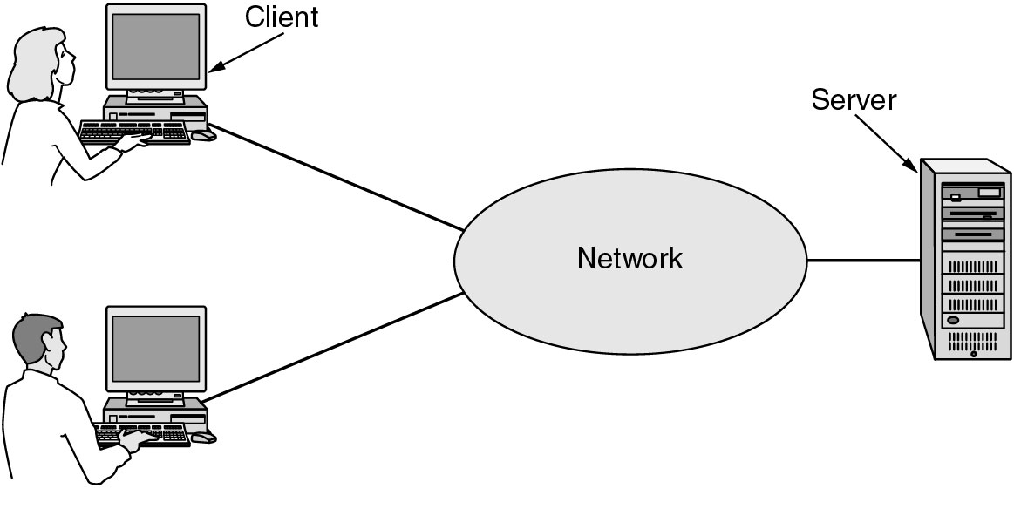
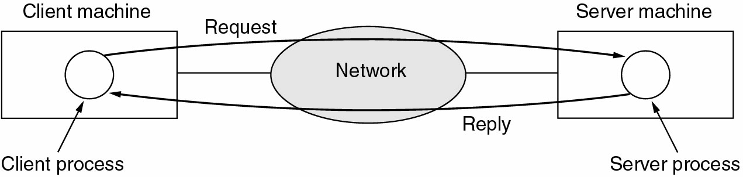
Fig1.1 A network with two clients and one server.
Fig 1-2. The client-server model involves requests and replies.

Slide 6
快速讲解
1.1.2 Home Applications
  Access to remote information
    surfing the World Wide Web
    reading online newspapers
    email
  Person-to-person communication
  Interactive entertainment
    Video on demand(视频点播）
    playing game
  Electronic commerce

Slide 7
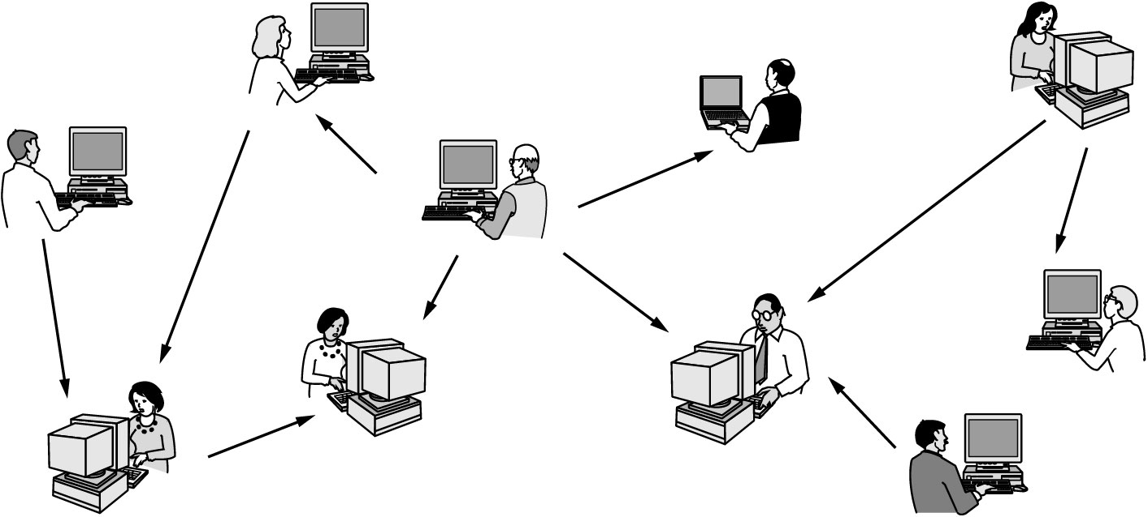
  Person-to-person communication
    instant messaging(person to person), chat room (multiperson)
    newsgroup(using NNTP)
    peer-to-peer communication, a model distinguished from client-server model.
      Music fans swapping music indexed by Napster server.
      electronic crime: electronic gambling.
    Telephone calls,video phones, Internet radio…
快速讲解
Fig 1-3. In peer-to-peer system there are no fixed clients and servers.

Slide 8
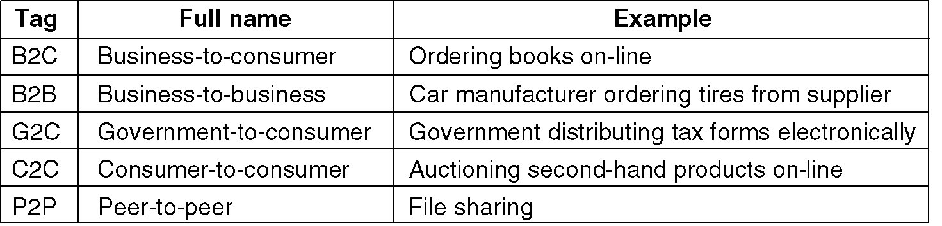
  Electronic commerce
    home shopping, instant video
    access to financial institution: pay bill electronically, network bank…
    electronic flea market, online auction(拍卖） of second-hand goods
    telelearning, telemedicine,...
快速讲解
Fig 1-4. Some forms of e-commerce.

Slide 9
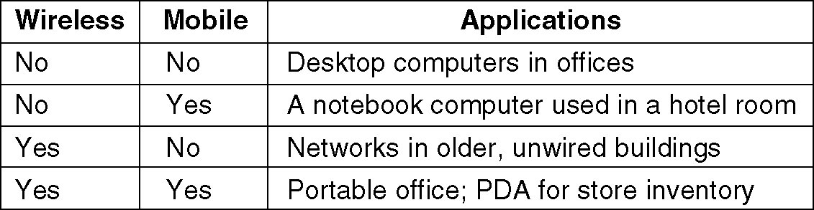
快速讲解
1.1.3 Mobile Users
Fig 1-5. Combinations of wireless networks and mobile computing.

Slide 10
1.2 NETWORK HARDWARE
Two Types of Transmission Technology
  Broadcast links,broadcast networks
    broadcasting, multicasting
  Point-to-point links, point-to-point networks
    unicasting
Classifying Network(about Scale)- [see fig 1-6]
  Local Area Network(LAN )
  Metropolitan Area Networks(MAN)
  Wide Area Networks(WAN)
  …

Slide 11
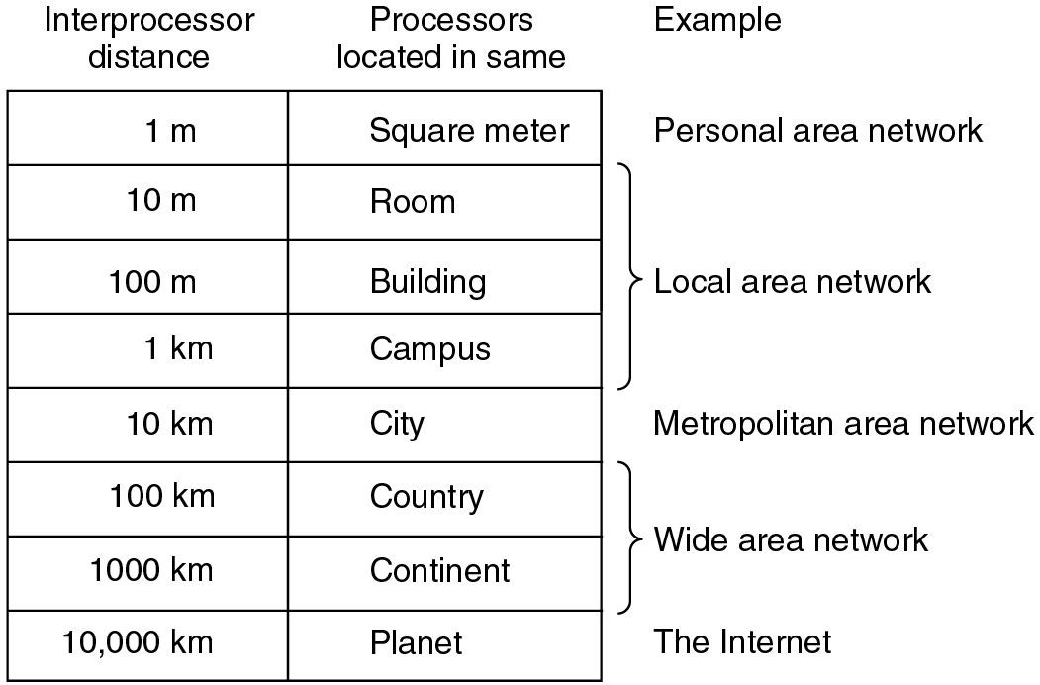
1.2 NETWORK HARDWARE
Fig 1-6. Classification of interconnected processors by scale.

Slide 12
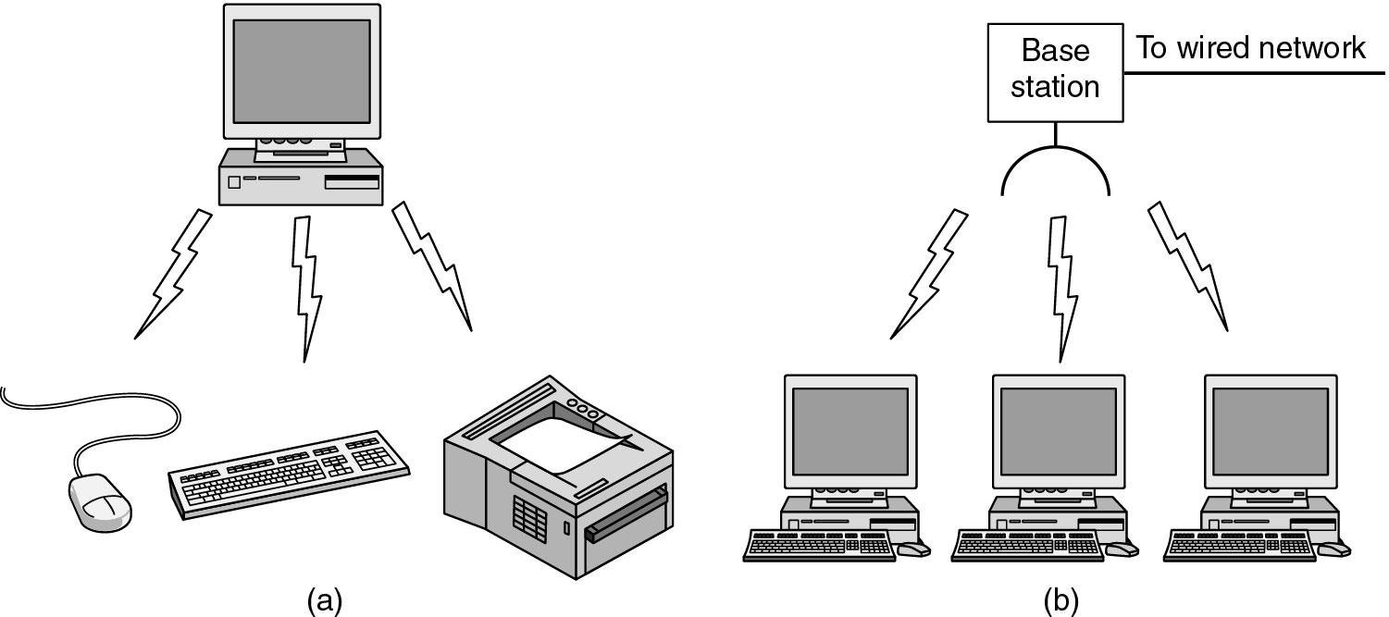
1.2.1 Personal Area Networks
PANs (Personal Area Networks)
Bluetooth

Slide 13
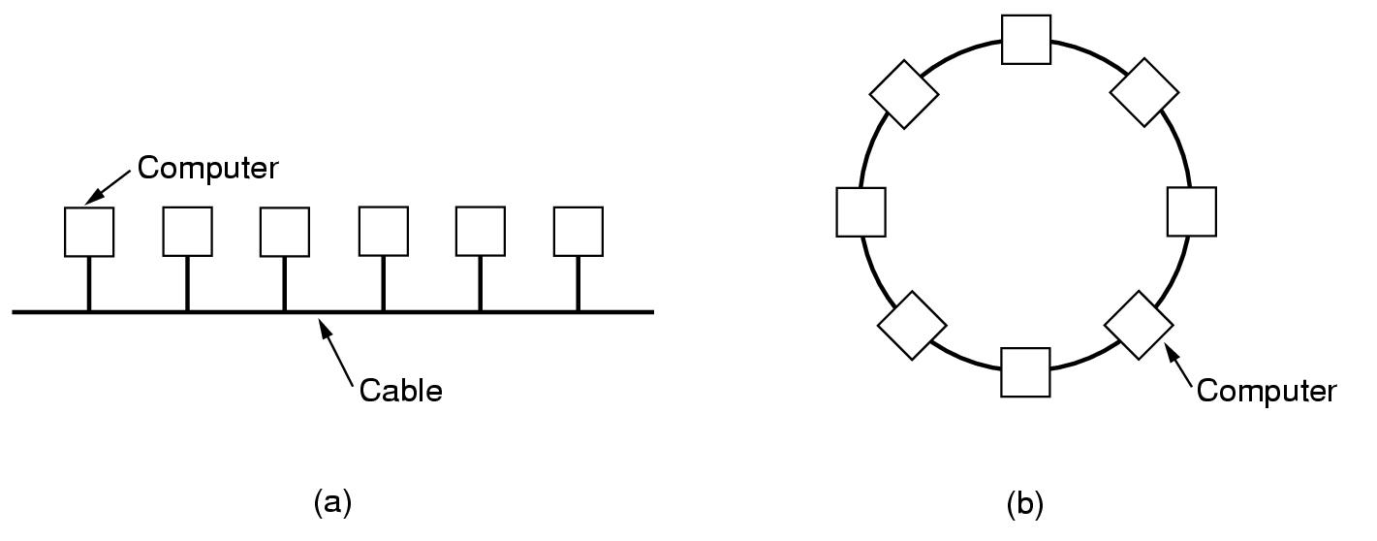
1.2.2 Local Area Network
Features
  Size、Transmission Technology、Topology-
    Bus(IEEE 802.3, Ethernet)
      10M,100M,1000M,10000Mb/s
    Ring(IEEE 802.5,IBM Token Ring, FDDI)
      IBM Token Ring:4 Mb/s, 16 Mb/s, FDDI:100 Mb/s

Slide 14
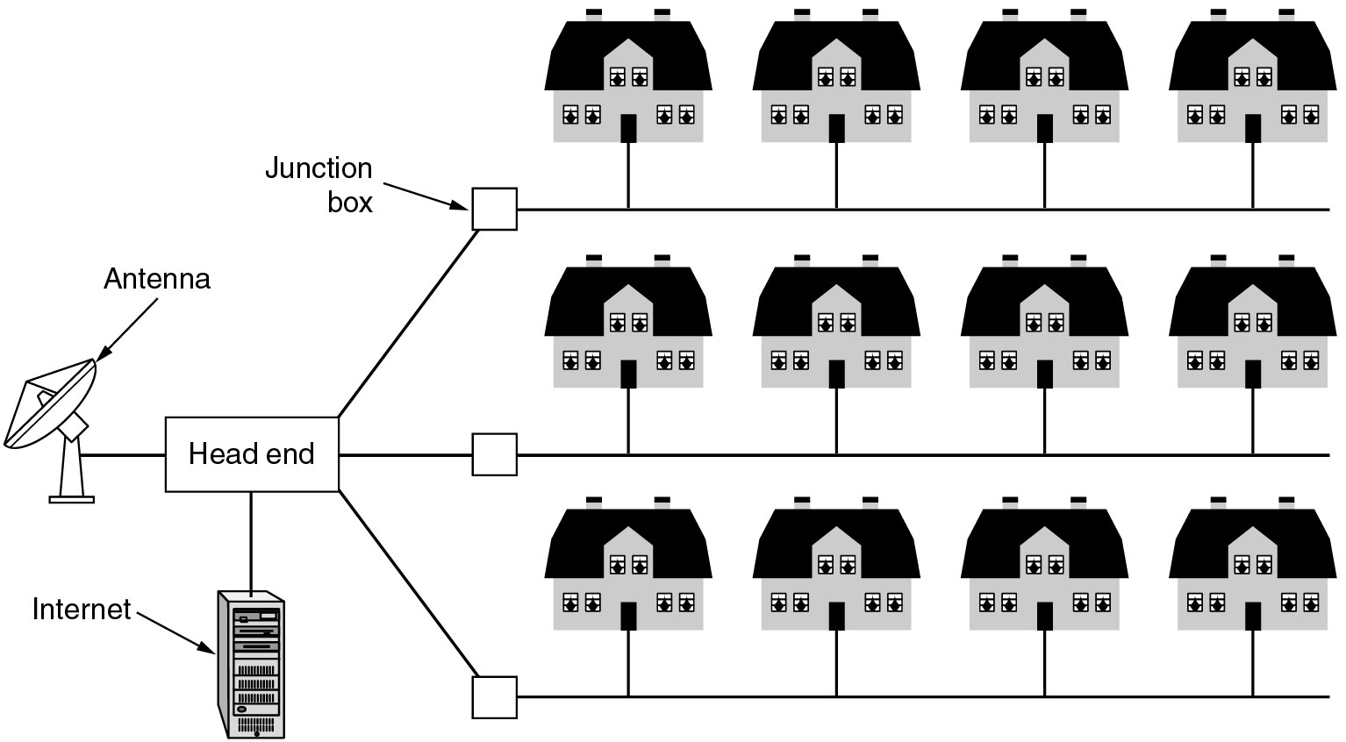
1.2.3 Metropolitan Area Network
Fig 1-9. A metropolitan area network based on cable TV.

Slide 15
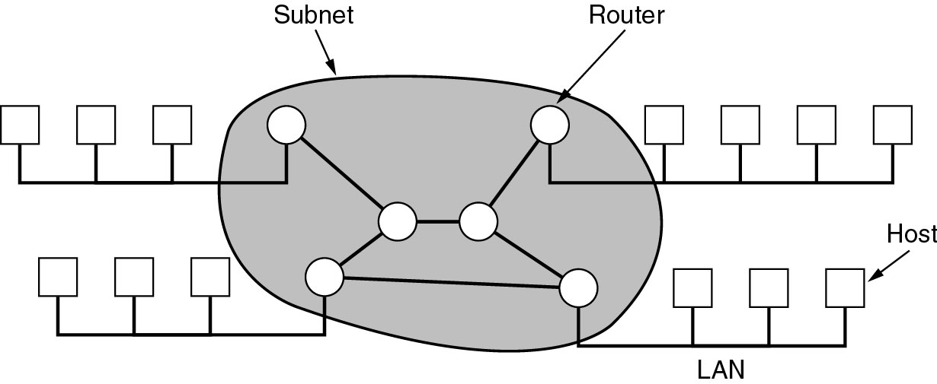
1.2.4 Wide Area Network
Features
  Transmission Technology
    host, subnet, router
      subnet’s main meaning: the collection of communication lines and routers.
      subnet’s secondary meaning: IP address’s subnet number.
    point to point ,Store and Forward,Packet Switched
Fig . Relation between hosts on LANs and the subnet.

Slide 16
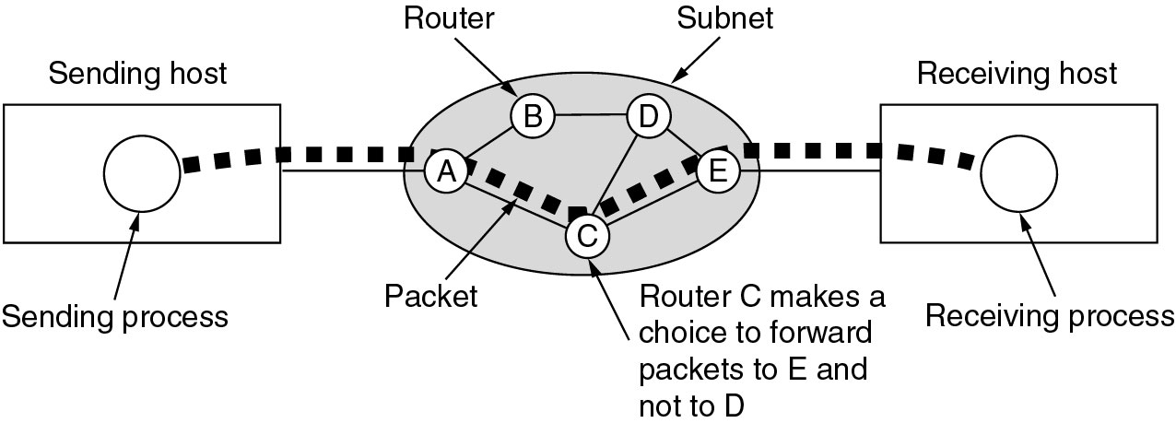
1.2.4 Wide Area Network (2)
In some network, all packets between a pair hosts must follow the same route.-----virtual circuit subnet
In others, each packet is routed separately.-----datagram subnet
Routing algorithm
Fig . A stream of packets from sender to receiver.

Slide 17
3 Categories of wireless networks
  System interconnection
    interconnecting the computer components ( monitor, keyboard,printers) to main computer unit, using short-range radio(e.g Bluetooth)
    Bluetooth can also connect digital cameras, headsets, scanners, … to a computer.
    the simplest form: master-slave mode--see fig 1-11(a)
  Wireless LANs
    802.11, see fig 1-11(b)
  Wireless WANs
    cellular telephone is a low bandwidth wireless system.
    802.16 is a standard for high bandwidth wireless WANs.

Slide 18
Wireless Networks
Fig . (a) Bluetooth configuration (b) Wireless LAN

Slide 19
Wireless Networks
快速讲解
Features of wireless networks
  Almost all wireless networks hook up to the wired network, in many ways
  Many people believe wireless is the trend of future.
  But, Bob Metcafe dissent this: “mobile wireless computers are like mobile pipeless bathrooms(卫生间）－－portapotties（便携式便壶）. They will be common on vehicles, and at construction sites, and rock concerts. My advice is to wire up your home and stay there.”
  History may record this remark in the same category as IBM‘s chairman T.J. Watson’s 1945 explanation of why IBM was not getting into the computer business:“Four or five computers should be enough for the entire world until the year 2000.”

Slide 20
1.2.5 Internetworks
Internetwork=internet, not equal to world wide Internet
Subnet: in WANs, it means the collection of routers and communication lines.
Network: the combination of subnet and its hosts.
Internetwork: a collection of interconnected networks by router, bridge, gateway.

Slide 21
1.3 Network Software
Protocol Hierarchies
Design Issues for the Layers
Connection-Oriented and Connectionless Services
Service Primitives
The Relationship of Services to Protocols

Slide 22
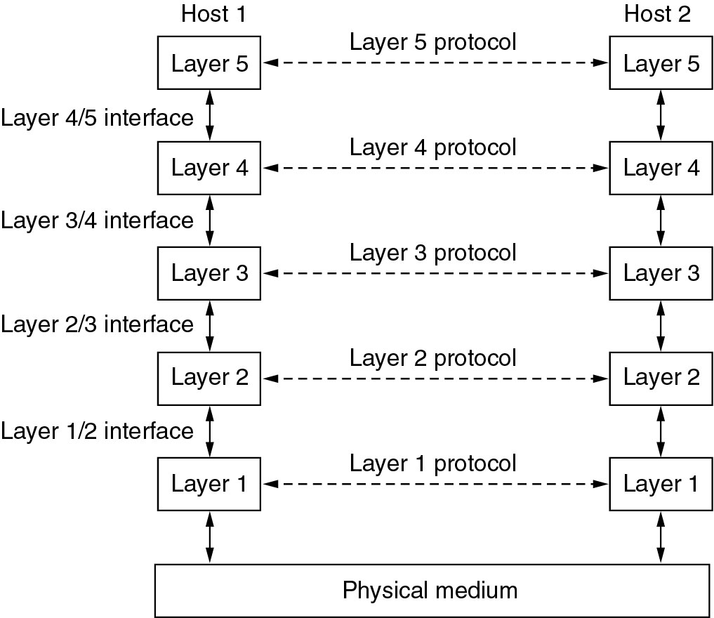
1.3.1 Protocol Hierarchies
Network architecture: a set of layers and protocols
Protocol stack: A list of protocols used by a certain system, one protocol per layer, is called protocol stack.
Fig 1-13. Layers, protocols, and interfaces.

Slide 23
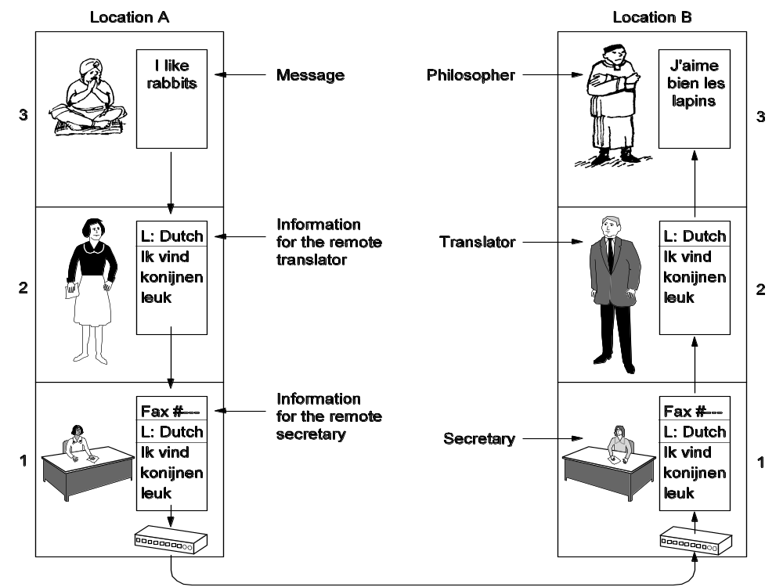
1.3.1 Protocol Hierarchies
Fig 1-14. The philosopher-translator-secretary architecture.

Slide 24
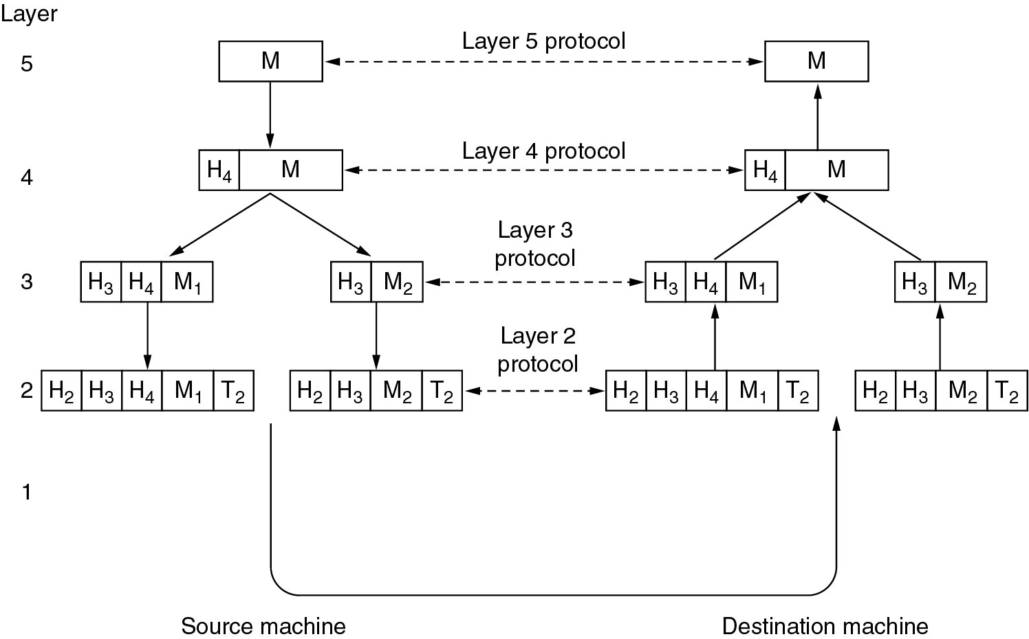
1.3.1 Protocol Hierarchies
Header, message
Fig 1-15. Example information flow supporting virtual communication in layer 5.

Slide 25
1.3.2 Design Issues for the Layers
Addressing
Error Control
Flow Control
Multiplexing
Routing

Slide 26
1.3.3 Connection-Oriented and Connectionless Services
Connection-Oriented Services
  is modeled after the telephone system.
  3 phases: establish, use, release connection.
  Reliable, sequential, with acknowledgement.
  is also called virtual circuit service.
Connectionless Services
  is modeled after the postal system.
  need not to establish and release connection.
  unreliable, not sequential, no acknowledgement.
  is also called datagram service.
Acknowledged datagram service
  Reliable, sequential, with acknowledgement.
  need not to establish and release connection.

Slide 27
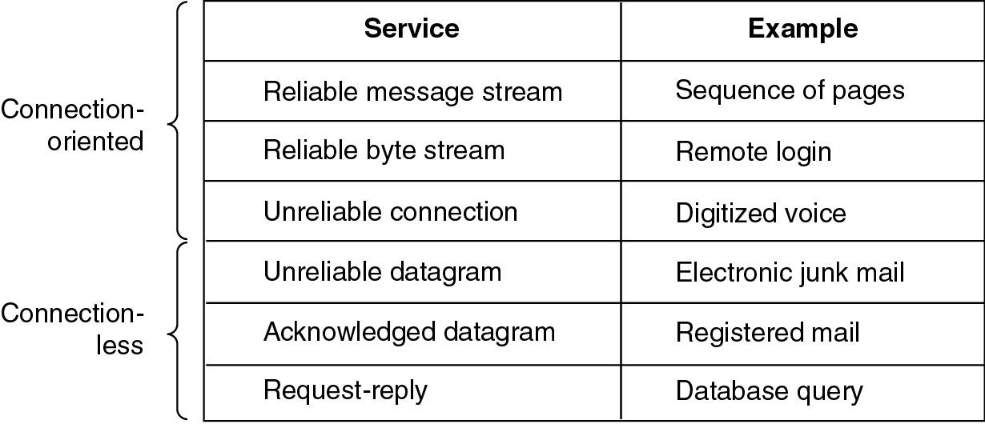
1.3.3 Connection-Oriented and Connectionless Services
Fig 1-16. Six different types of service.

Slide 28
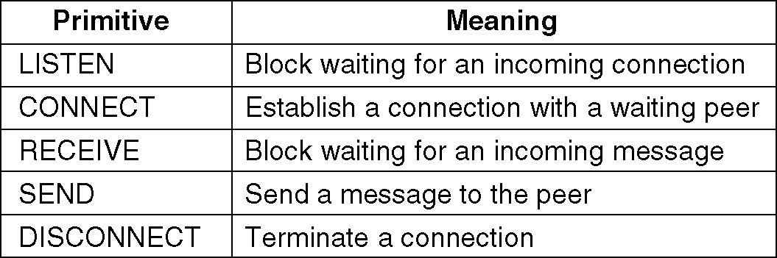
1.3.4 Service Primitives
The Primitives are normally system calls, when the protocols stack is located in operating system.
fig 1-17 is a minimal example to provide reliable transfer.
  Client-server model.
  Orders: listen, connect, send, receive, send, receive,… disconnect.
Fig 1-17. Five service primitives for implementing a simple connection-oriented service.

Slide 29
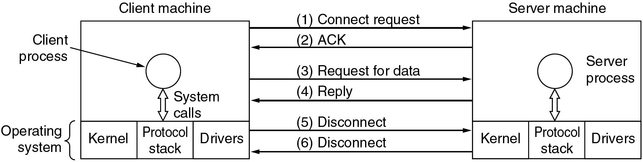
1.3.4 Service Primitives
Fig 1-18. Packets sent in a simple client-server interaction on a connection-oriented network.

Slide 30
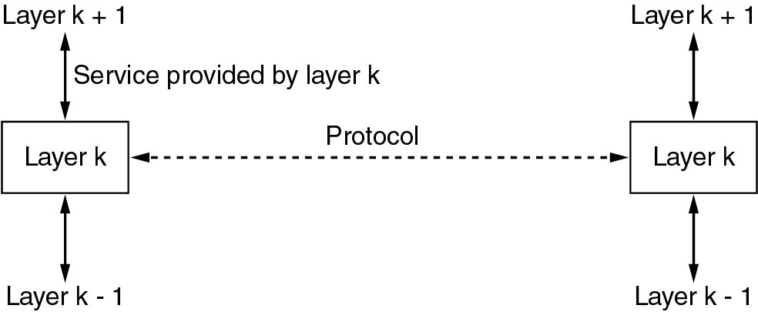
1.3.5 Services to Protocols Relationship
Service and protocol are distinct concepts.
Fig 1-19. The relationship between a service and a protocol.

Slide 31
1.4 Reference Models
The OSI Reference Model
The TCP/IP Reference Model
A Comparison of OSI and TCP/IP
A Critique of the OSI Model and Protocols
A Critique of the TCP/IP Reference Model

Slide 32
1.4.1 The OSI Reference Model
The OSI Reference Model (see next page)

Slide 33
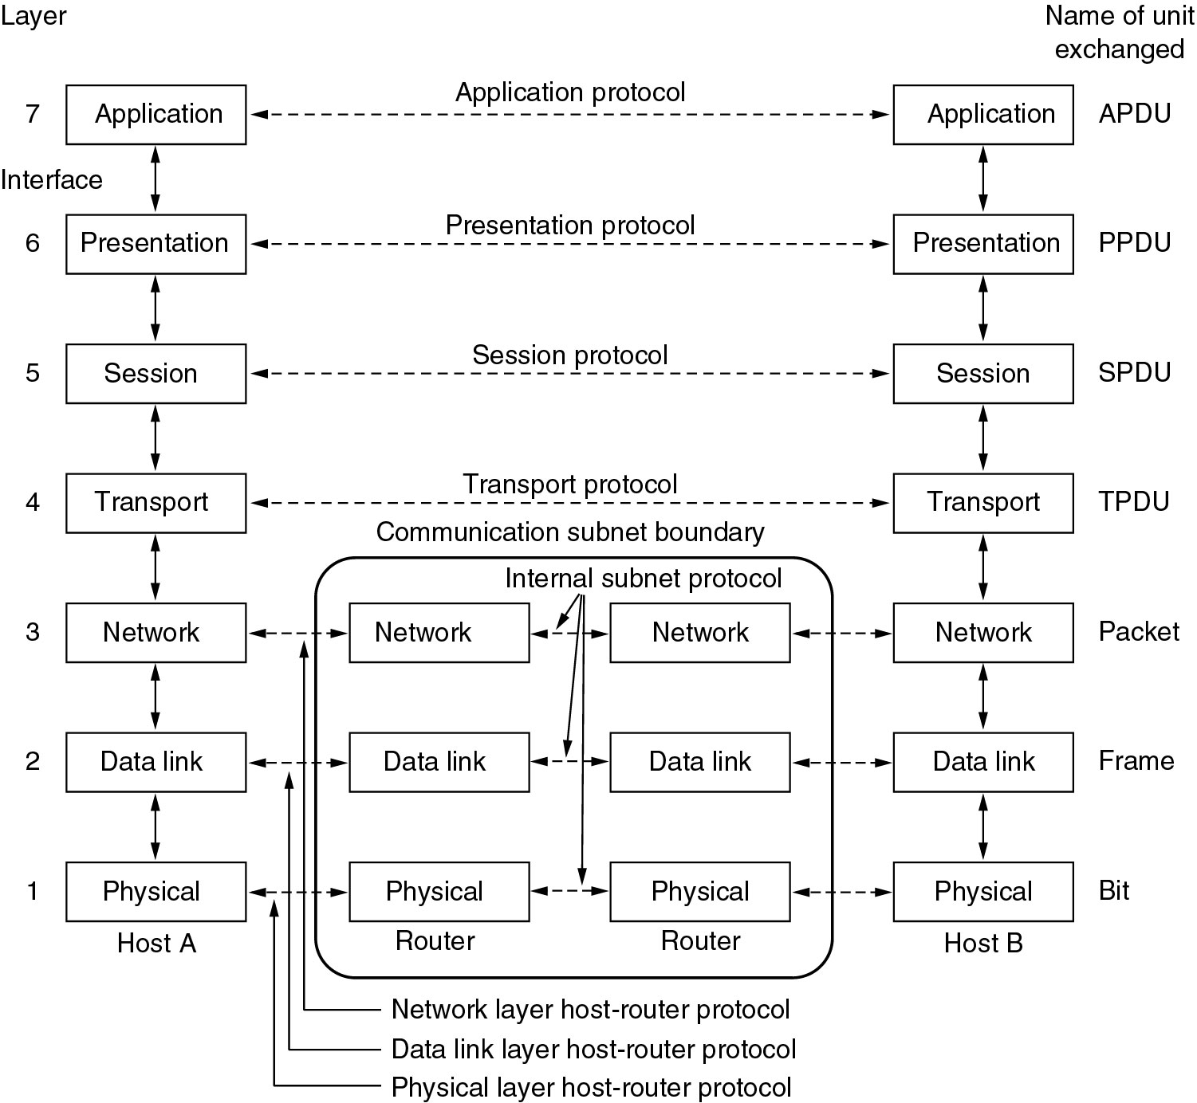
Fig 1-20. The OSI reference model.

Slide 34
Fig . Relation between hosts on LANs and the subnet.

Slide 35
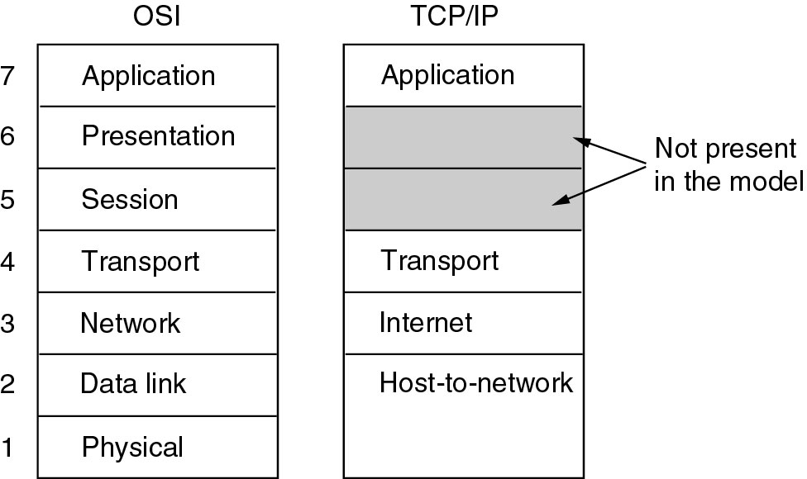
1.4.2 The TCP/IP reference model
DOD (Department of Defense), ARPANET-->Internet
To connect multiple different kinds of network
in war environment，surviving the loss of some subnet hardware
Host-to-network layer: TCP/IP model say little about this.
Fig 1-21. The TCP/IP reference model.

Slide 36
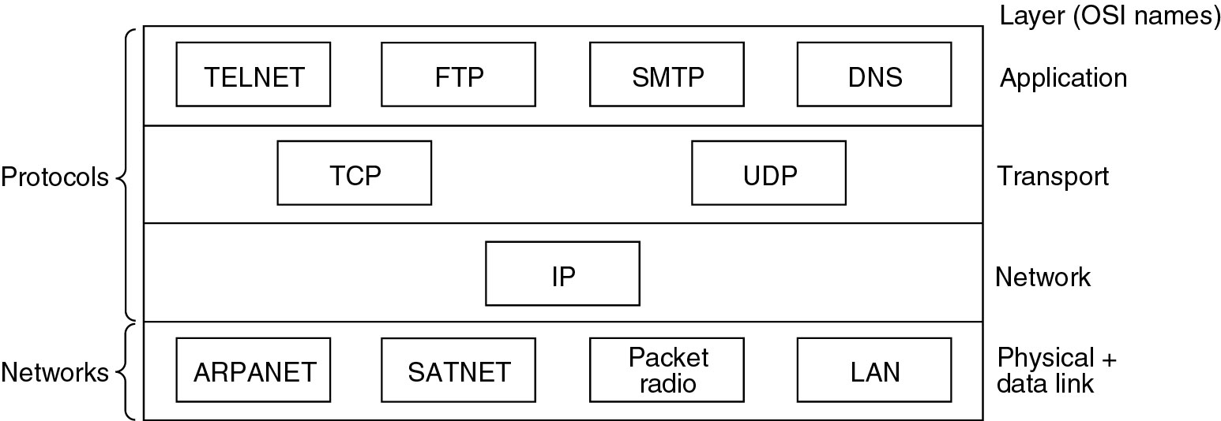
1.4.2 The TCP/IP reference model
The most important two protocols: IP (Internet Protocol), TCP (Transmission Control Protocol)
UDP (User Datagram Protocol)
FTP (File Transfer Protocol), DNS (Domain Name System),
TELNET(Virtual Terminal), SMTP (Simple Mail Transfer Protocol)
Fig 1-22. Protocols and networks in the TCP/IP model initially.

Slide 37
*1.4.4 Comparing OSI and TCP/IP Models
快速讲解
Concepts central to the OSI model
  Services
  Interfaces
  Protocols

Slide 38
*1.4.5 A Critique of the OSI Model and Protocols
快速讲解
Why OSI did not take over the world
  Bad timing
  Bad technology
  Bad implementations
  Bad politics

Slide 39
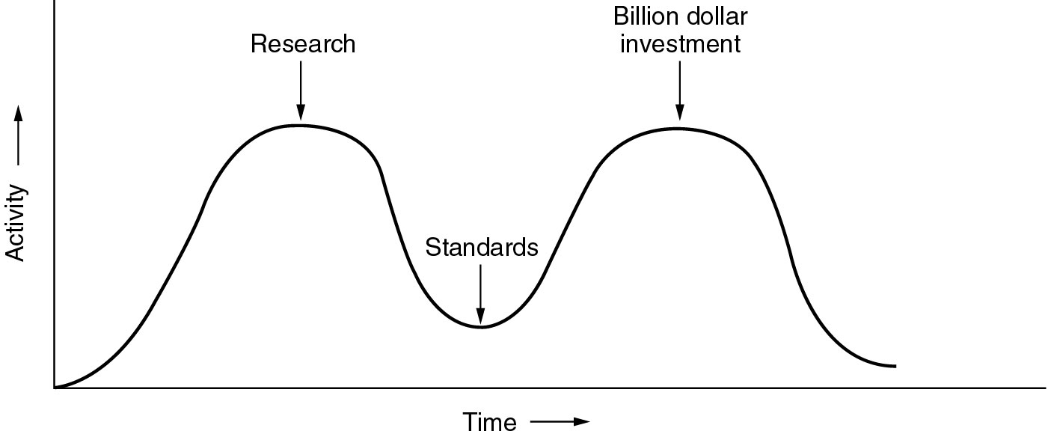
Bad Timing
快速讲解
Fig 1-24. The apocalypse of the two elephants.

Slide 40
*1.4.6 A Critique of the TCP/IP Reference Model
快速讲解
Problems:
Service, interface, and protocol not distinguished
Not a general model, it is poorly suited to describe any other protocol stack.
Host-to-network “layer” not really a layer
No mention of physical and data link layers
Minor protocols(次要协议) are produced by graduate student, deeply entrenched(扎根), hard to replace

Slide 41
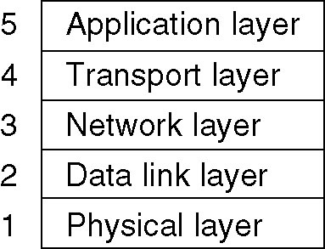
1.4.6 A Critique of the TCP/IP Reference Model
OSI model is useful for discussing computer network, but its protocols are not popular.
TCP/IP model is practically nonexistent, but its protocols are widely used.
Hybrid Model will be used in this book.
Fig 1-23. The hybrid reference model to be used in this book.

Slide 42
1.5 Example Networks
1.5.1 The Internet
1.5.3 Wireless LANs: 802:11

Slide 43
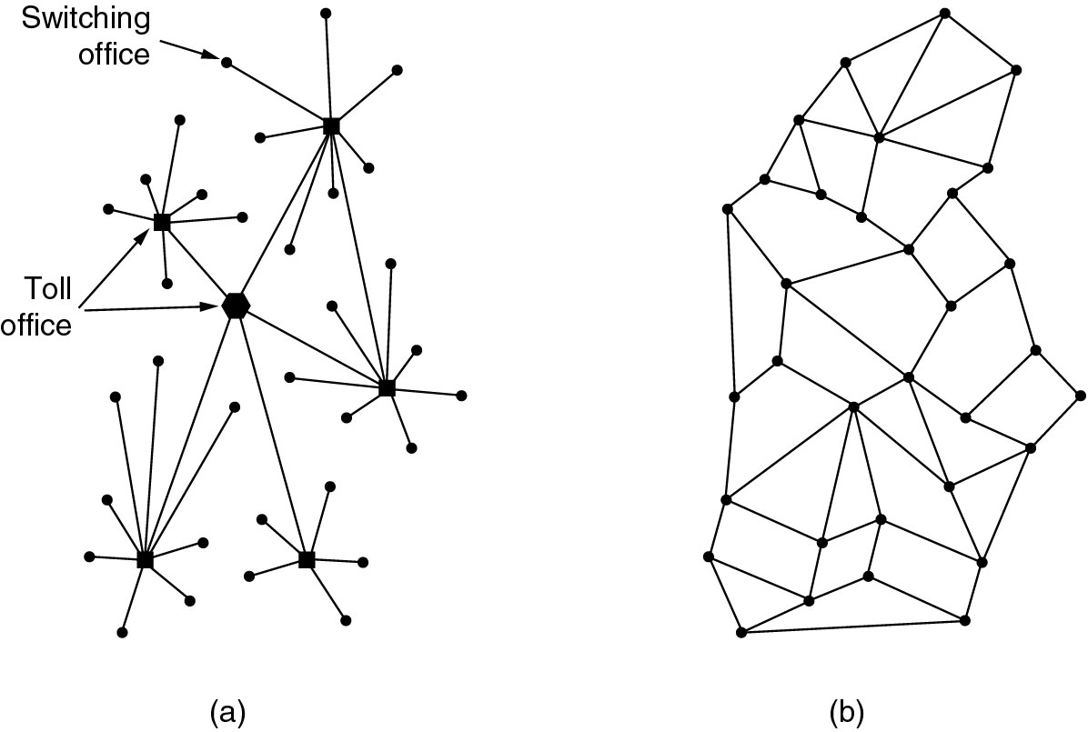
1.5.1 The Internet
The ARPANET
  1960,cold war, DOD contract to RAND corporation , Baran
  ARPA (the Advanced Research Projects Agency)
Fig 1-25. (a) Structure of the telephone system. (b) Baran’s proposed distributed switching system.

Slide 44
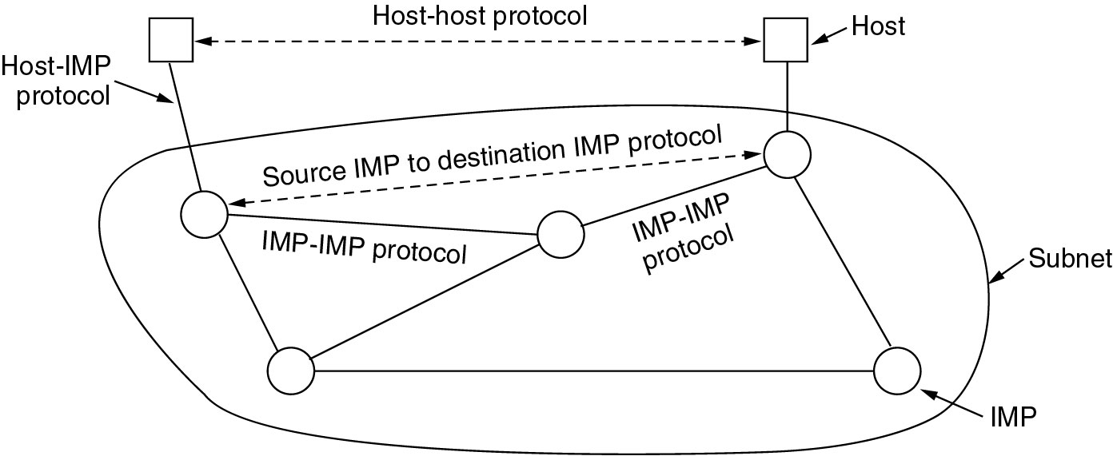
1.5.1 The Internet
The ARPANET(2)
Fig 1-26. The original ARPANET design.

Slide 45
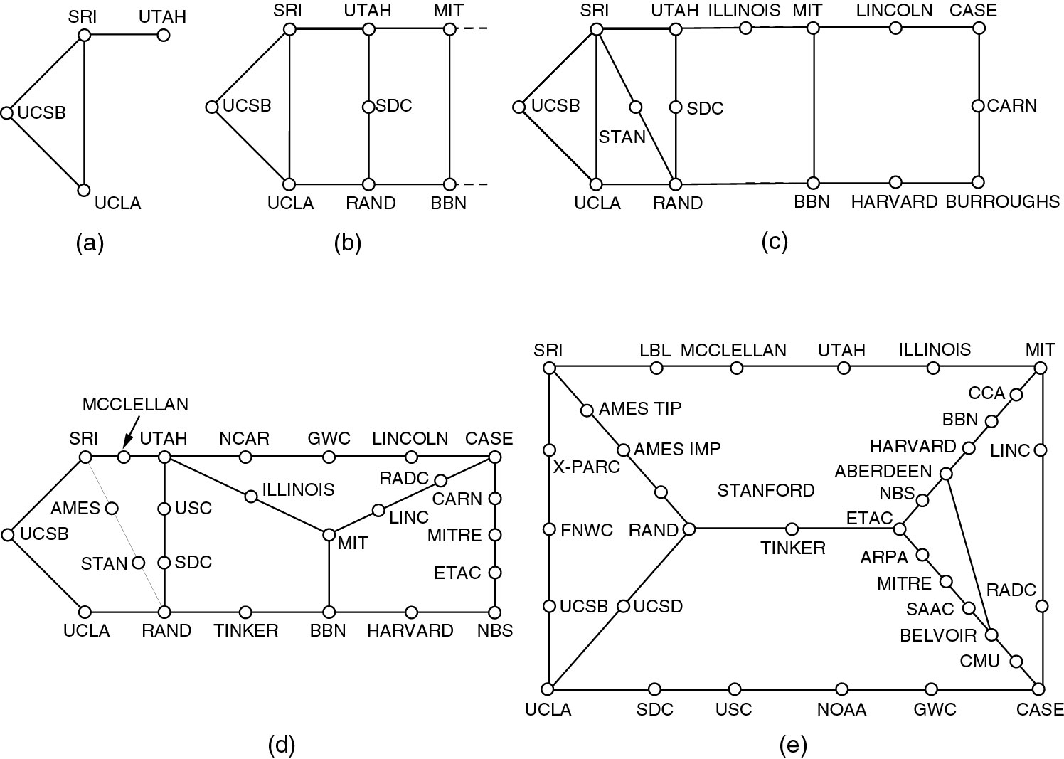
1.5.1 The Internet
The ARPANET(3)
Fig 1-27. Growth of the ARPANET (a) December 1969. (b) July 1970. (c) March 1971. (d) April 1972. (e) September 1972.

Slide 46
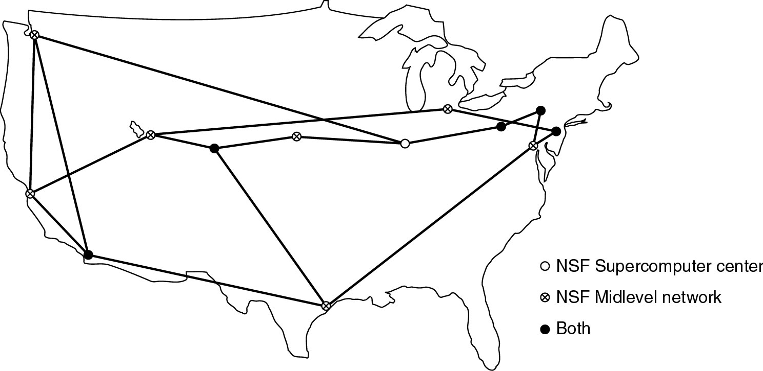
1.5.1 The Internet
NSFNET
Fig 1-28. The NSFNET backbone in 1988.

Slide 47
1.5.1 The Internet
Internet Usage
  Traditional applications (1970 – 1990)
    E-mail
    News
    Remote login
    File transfer
  WWW

Slide 48
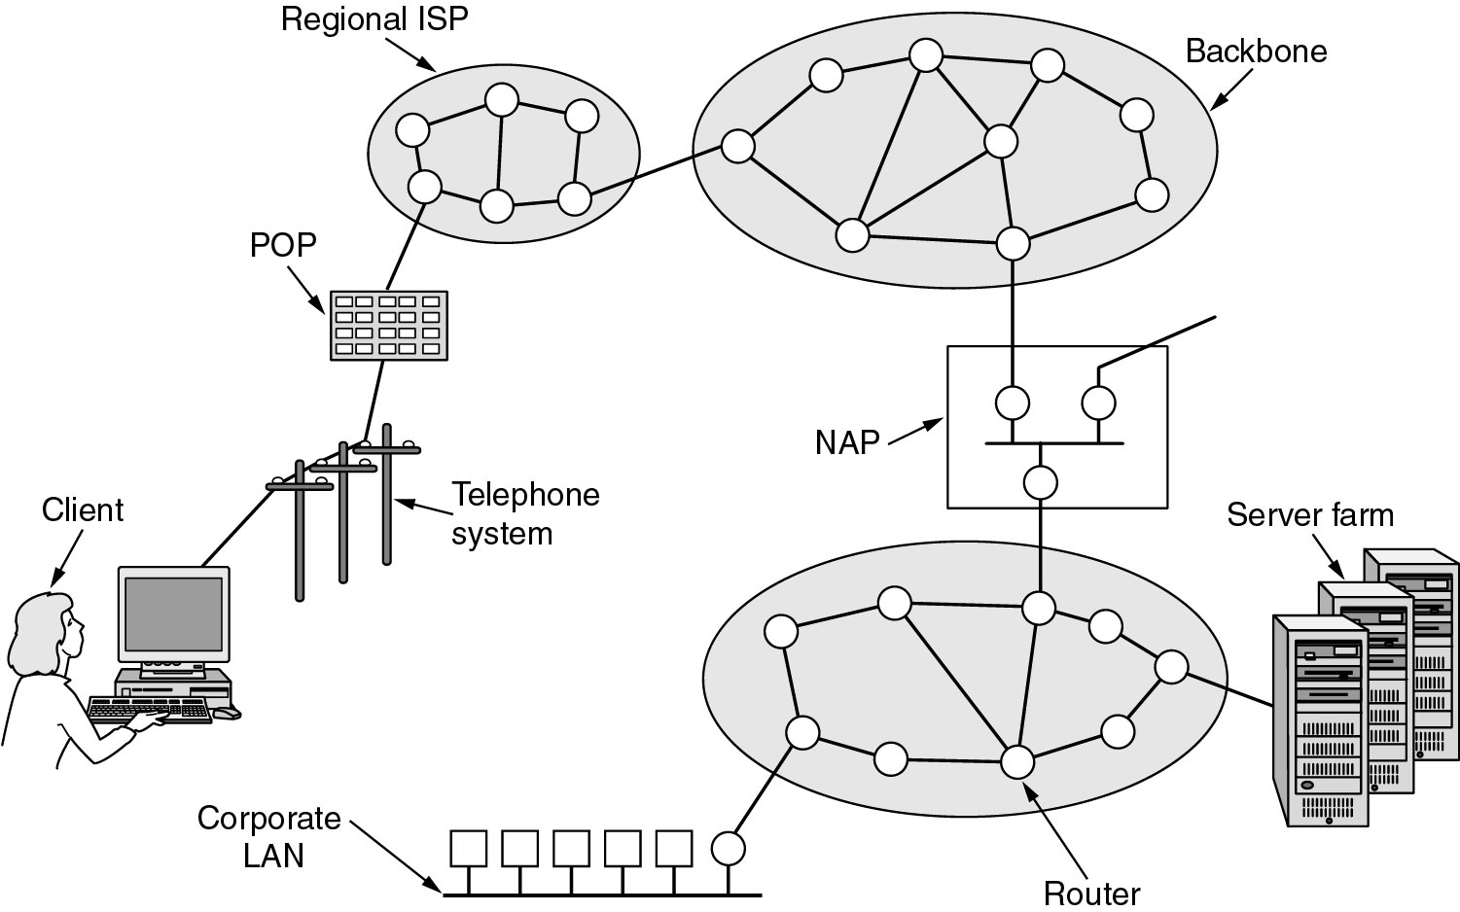
1.5.1 The Internet
Architecture of the Internet
  Client, dial line, ISP’s POP (Point of Presence, usually in switching office)
  NAP (Network Access Point): switching center of Internet backbones.
Fig 1-29. Overview of the Internet.

Slide 49
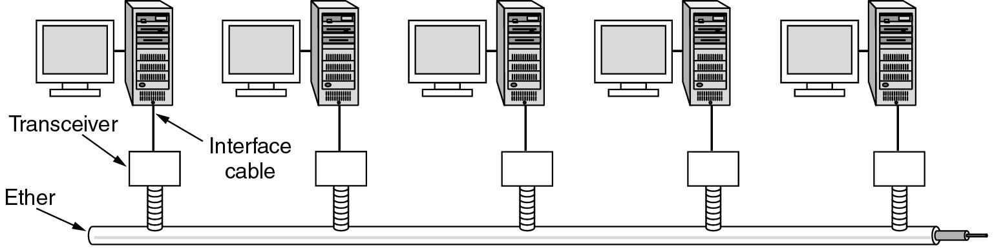
Ethernet
Bob Metacalfe, in Xerox PARC(Palo Alto Research Center),PC
Bob Metacalfe and David Boggs, first LAN, Coaxial cable, 2.5KM, 500M, up to 256 machines, 2.94 Mbps, CSMA/CD
1978, DIX (Digital, Intel, Xerox) Standard, 10 Mbps Ethernet
1983, IEEE 802.3. New version: 100 Mbps, 1000 Mbps
Fig 1-34. Architecture of the original Ethernet.

Slide 50
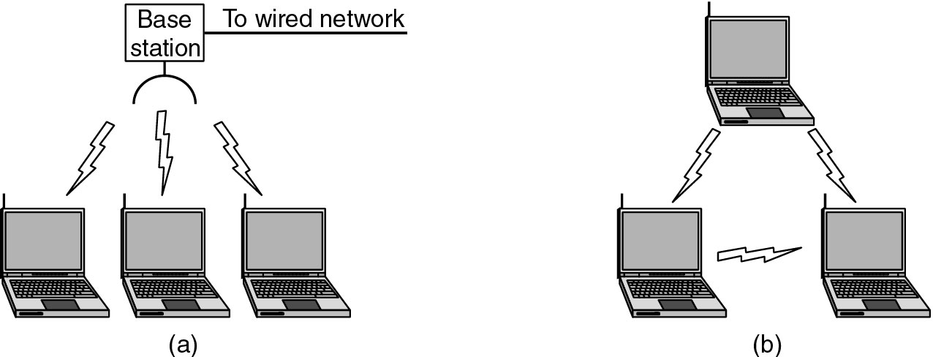
1.5.3 Wireless LANs: 802.11
Slang name(行话）of 802.11: WiFi
the standard works in two modes: -- see fig 1-35
  In the presence of a base station.
  In the absence of a base station.
Fig 1-35. (a) Wireless networking with a base station. (b) Ad hoc networking.

Slide 51
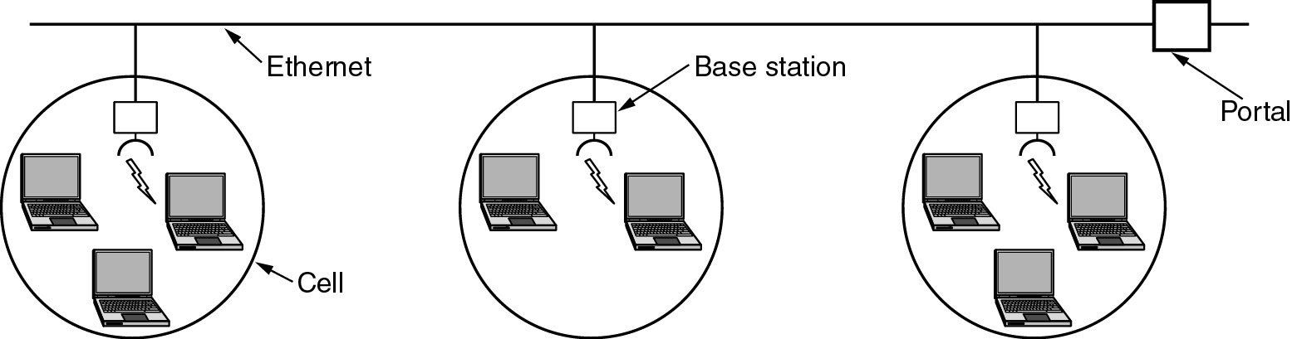
1.5.3 Wireless LANs: 802.11
Several inherent difference with Ethernet has to be dealt with by 802.11 standard:
  In Ethernet, a computer can transmit when the channel is idle, but in wireless LAN, this idea does not work well: when A is transmitting to B, C could not hear this because of long distance. So C will transmit to B too, a collision occurs. -- fig 1-36
  Interference of multipath fading.
  A lot of software is not aware of mobility.
  The network consists of multiple cells (fig 1-37), the entire system should like a single Ethernet.
Fig 1-37. A multicell 802.11 network.

Slide 52
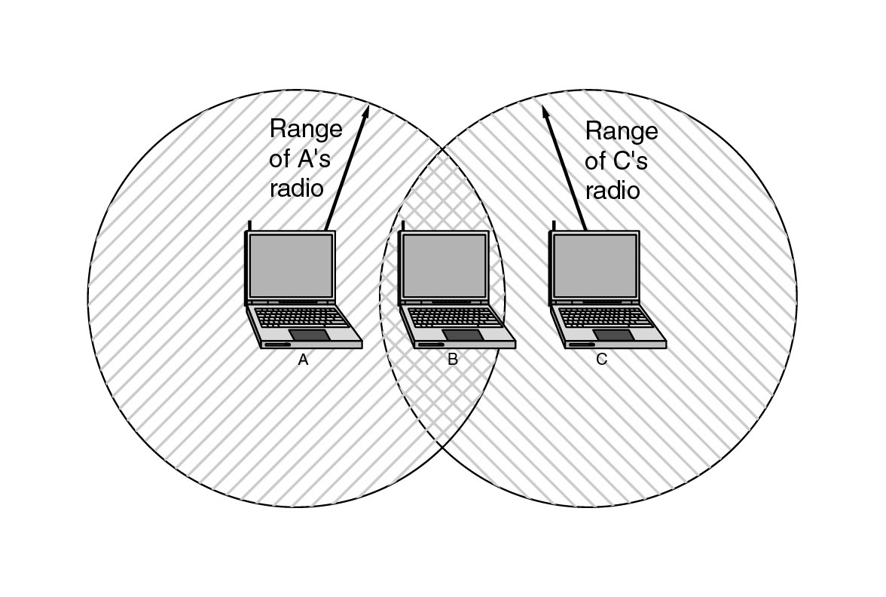
1.5.3 Wireless LANs: 802.11
Fig 1-36. The range of a single radio may not cover the entire system.

Slide 53
1.6 Network Standardization
Standards fall into two categories:
  De facto (Latin for “from the fact”) standard (事实上的标准）
  De jure (Latin for “by law”) standard (法定标准）：formal, legal standards adopted by some authorized standardization body.

Slide 54
1.6.1 Who’s Who in the Telecommunications World
ITU
  Main sectors
    Radiocommunications (ITU-R)
    Telecommunications Standardization (ITU-T)
    Development (ITU-D)
  Four Classes of Members
    National governments
    Sector members: telephone companies (AT&T, Vodafone, WorldCom), Telcom equipment manufacturers (Cisco, Nokia, Nortel), Computer venders (Compaq, Sun, Toshiba), chip manufacturers (Intel,Motorola, TI), ...
    Associate members
    Regulatory agencies

Slide 55
1.6.2 Who’s Who in the International Standards World
ISO (International Standards Organization): national standards organizations of the 89 member countries. Members: ANSI(U.S.), BSI ( Great Britain), AFNOR (France), DIN (Germany),...
ANSI (American National Standards Institute), the U.S. Representative in ISO, is a private, nongovernmental, nonprofit organization.
Standardization process:
  CD (Committee Draft),
  DIS (Draft International Standard)
  IS (International Standard)
NIST (National Institute of Standards and Technology): part of U.S. Department of Commerce.
IEEE (Institute of Electrical and Electronical Engineers), IEEE’s 802 committee, LAN’s standards

Slide 56
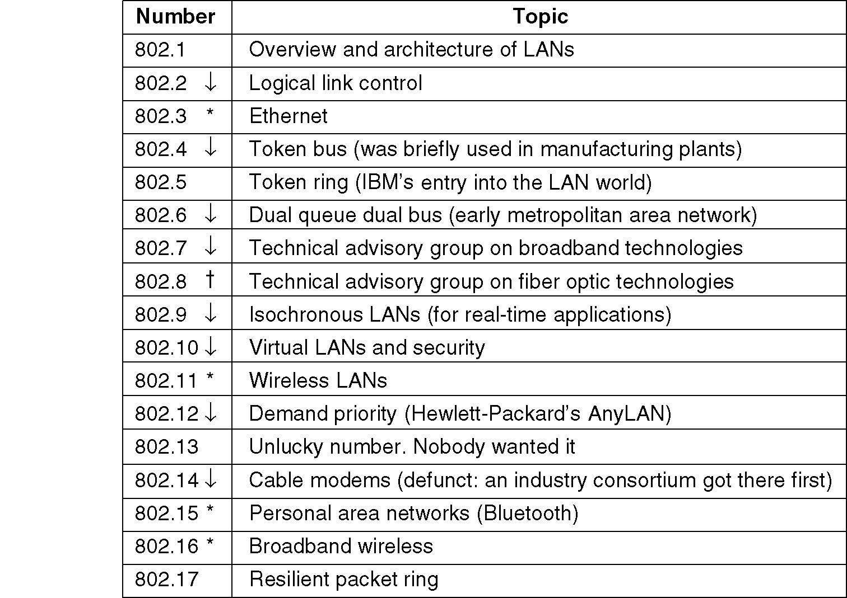
IEEE 802 Standards
Fig 1-38. The 802 working groups. The important ones are marked with *. The ones marked with ↓ are hibernating. The one marked with † gave up.

Slide 57
1.6.3 Who’s Who in the International Standards World
The Internet are very different from ITU-T and ISO.
  The people who come to ITU or ISO standardization meeting wear suits, while people who come to Internet standardization meeting wear jeans.
IAB (Internet Activities Board) --> Internet Architecture Board)
In 1989, IAB was reorganized.
  IRTF (Internet Research Task Force): is consist of researchers
  IETF (Internet Engineering Task Force): the others
RFCs (Request For Comments)
Standardization process in Internet
  Proposed Standard
  Draft Standard
    Internet Standard

Slide 58
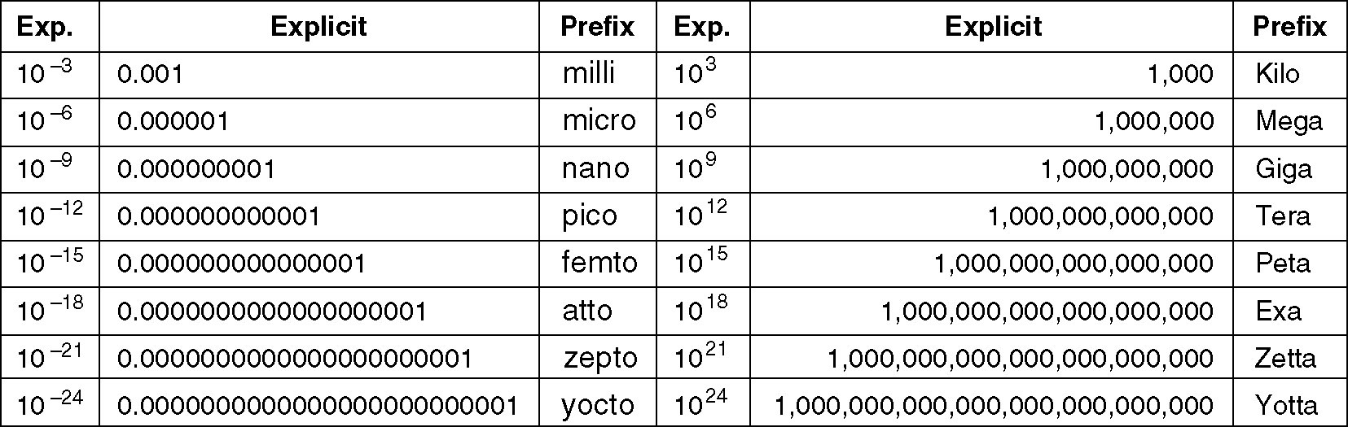
1.7 Metric Units
Fig 1-39. The principal metric prefixes.

