Slide 1
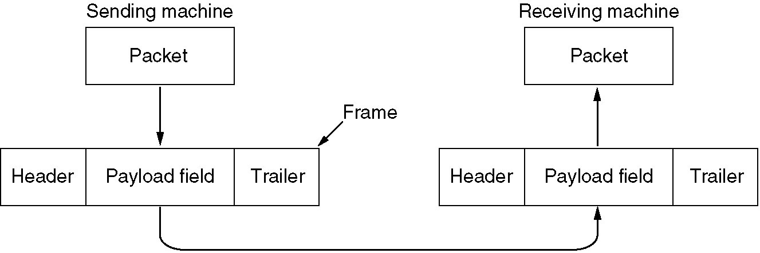
3 The DATA LINK LAYER
DATA LINK LAYER ISSUES
  Services provided to the network layer
  framing,frame--- DATA LINK LAYER PDU(Protocol Data Unit)
  Error control
  Flow control
Fig. Relationship between packets and frames.

Slide 2
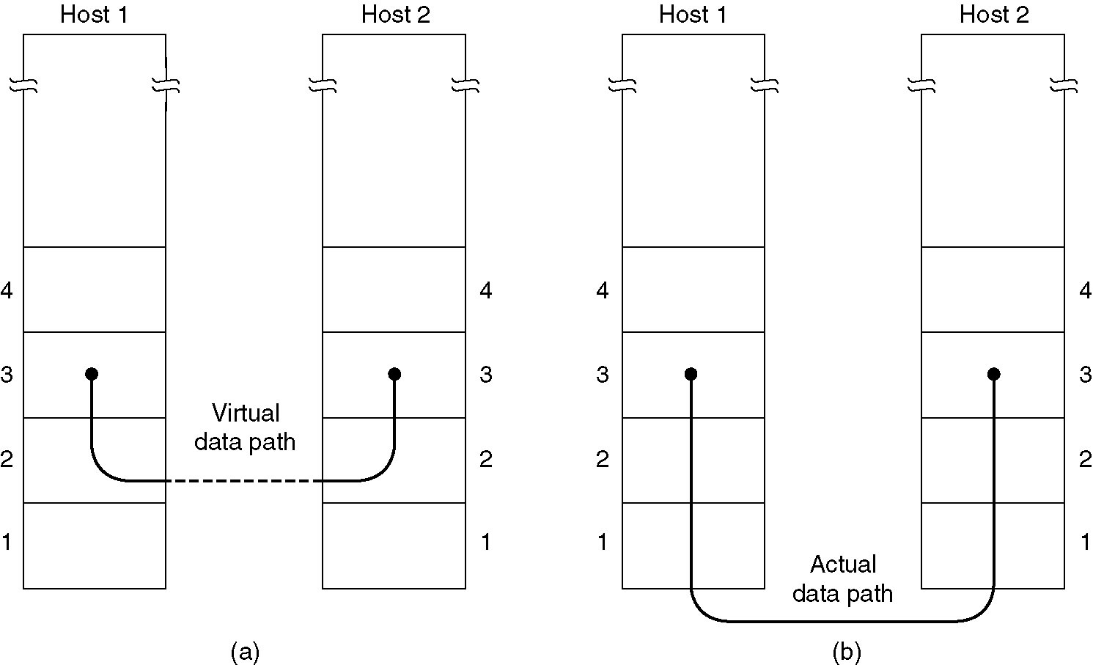
(a) Virtual communication. (b) Actual communication.

Slide 3
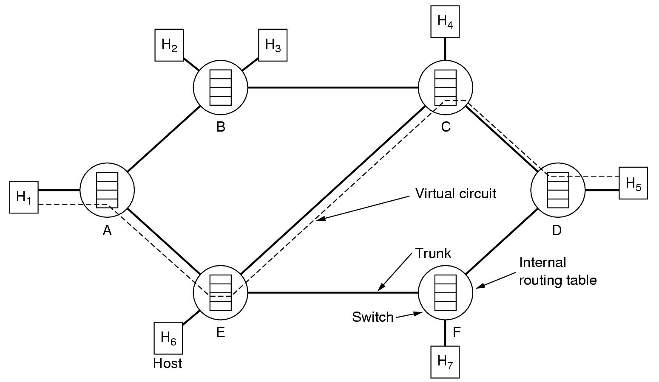
(补充)
物理链路和数据链路

Slide 4
DATA LINK LAYER DESIGN ISSUES
Services provided to the network layer
  Unacknowledged connectionless service
  Acknowledged connectionless service
  Acknowledged connection-oriented service
framing
  character count
  Byte stuffing or character stuffing(字符填充法）
  Bit stuffing (比特填充法）.
  Physical layer coding violation

Slide 5
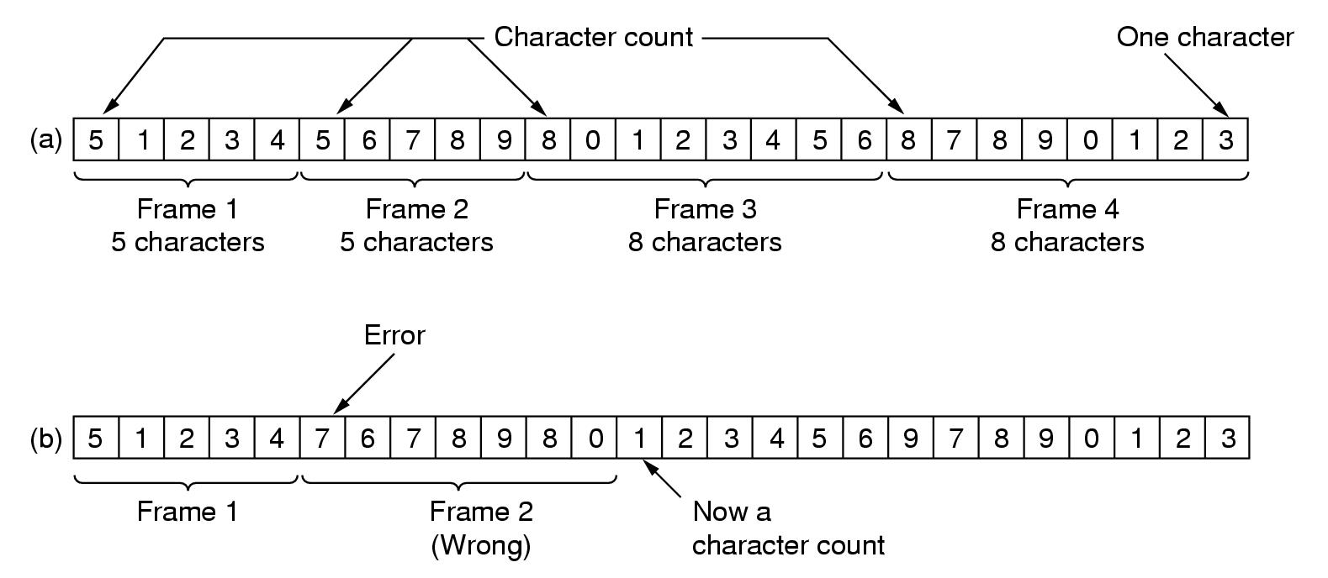
framing
  character count -[see fig 3-4]
A character stream. (a) Without errors (b) With one error

Slide 6
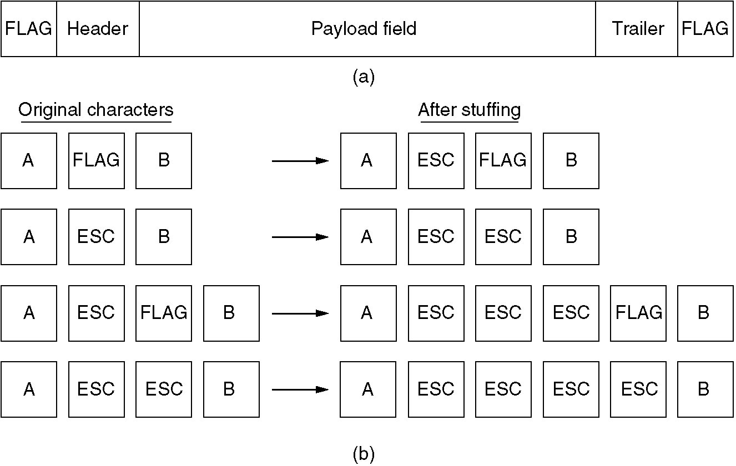
framing
  Byte stuffing or character stuffing:
    having each frame start and end with special character
(a) A frame delimited by flag bytes.
(b) Four examples of byte sequences before and after stuffing.

Slide 7
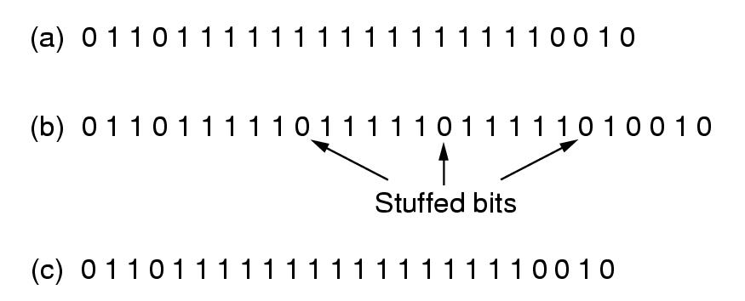
framing
  Starting and ending flags（01111110）,with bit stuffing. --see fig 3-5
Bit stuffing (a) The original Data (b). The data as they appearing on the line.
(c) The data as they are stored in the receiver’s memory after destuffing.

Slide 8
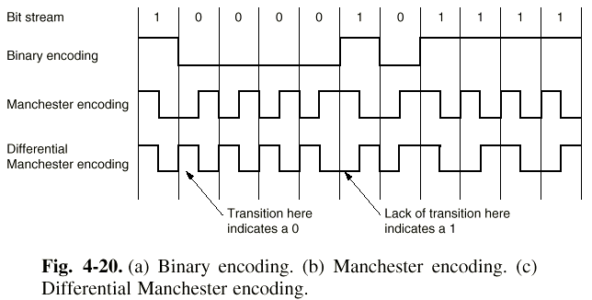
(补充)
framing
  Physical layer coding violation
    data 1:高-低电平对，0:低-高电平对
    Delimiter(coding violation): High-High pair, or Low-Low pair

Slide 9
Error Control
  Error detection
  Error correction
  Repeated data frame
  Lost frame
  Timer
Flow Control
  to solve the problem that a sender wants to transmit frames faster than the receiver can accept them.
  Two approaches
    feedback_based flow control: receiver gives sender permission
    rate_based flow control: limit the data rate at witch the sender may transmit data.

Slide 10
3.2 ERROR DETECTION AND CORRECTION
Error-correcting codes
  codeword: An n-bit unit containing data (m bit) and check bits (r bit). n=m+r
  Hamming distance of 2 codeword: The number of different bits in two codewords.
    10001001 xor 10110001=>00111000,Hamming distance=3
  Hamming distance of a codewords list: Given a codewords list, look for the two codewords whose Hamming distance is minimum in the list. This distance is Hamming distance.
    the list of four codewords : 0000000000, 0000011111, 1111100000, and 1111111111
    This list has a distance 5

Slide 11
3.2 ERROR DETECTION AND CORRECTION
  D(a,c) <= D(a,b) + D(b,c),here D(x,y)is the Hamming distance of codeword x and y
    e.g.
    a=0000000000, b=0000011111, c=1111111111
    D(a,c)=10, D(a,b)=5 , D(b,c)=5
    a=0000000000, b=1000011111, c=0111111111,
    D(a,c)=9, D(a,b)=6 , D(b,c)=5
  纠正d比特错
    需距离为2d+1比特的编码
      0000000000, 0000011111, 1111100000, and 1111111111
      0000000000 error →1100000000
      a=0000000000,b=1100000000,c是0000011111，1111100000, 1111111111中某一个
      1100000000 has the shortest distance with 0000000000.

Slide 12
3.2 ERROR DETECTION AND CORRECTION
Error-detecting codes
  polynomial code（cyclic redundancy code，CRC code）
  the algorithm for computing the checksum ： -[see page 140]
  CRC-12 = x¹²+x¹¹+x³+x²+x¹+1
  CRC-16 = x¹⁶+x¹⁵+x²+1
  CRC-CCITT = x¹⁶+x¹²+x⁵+1

Slide 13
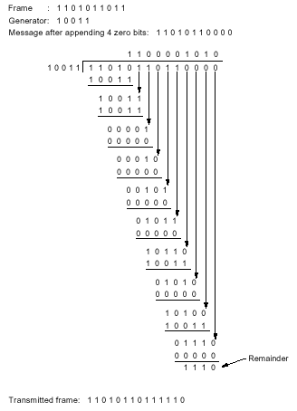
Cyclic Redundancy Check(CRC)
Modulo 2 Division
Check Remainder
Polynomial Representation
543210
||||||
110101 = x⁵+x⁴+x²+1
1101 1001 0011 = x¹¹+x¹⁰+x⁸+x⁷+x⁴+x+1
11 10 9 8 1 0

Slide 14
Popular Generator Polynomials
CRC-32 = x³²+x²⁶+x²³+x²²+x¹⁶+x¹²+x¹¹+x¹⁰
+x⁸+x⁷+x⁵+x⁴+x²+x¹+1
CRC-12 = x¹²+x¹¹+x³+x²+x¹+1
CRC-16 = x¹⁶+x¹⁵+x²+1
CRC-CCITT = x¹⁶+x¹²+x⁵+1
conclusion：
  r阶的多项式能够检测所有长度<=r的突发错误
  长度大于r+1的错误漏检的 概率为(1/2)^{r}.

Slide 15
停止等待协议(补充)
特征:
  发方每发送一帧就暂停,等待应答(ACK)到来。收方收到数据帧后发ACK帧给发方，发方再发送下—个数据帧。
要解决的问题-[fig lk3-3]
  DATA帧出错。
    对策：收方用NAK应答。
  DATA帧丢失。
    对策：使用定时器及重发。
  收方收到重复的DATA帧。
    对策：帧编号：0，1，0，1...

Slide 16
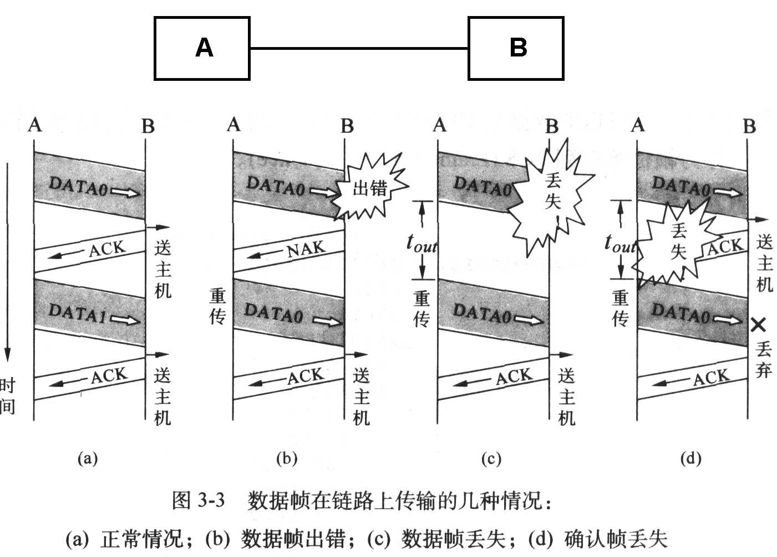
(补充)
Fig 1-3 两种广播式网络
(a) 总线型 (b) 环形

Slide 17
3.3 ELEMENTARY DATA LINK PROTOCOL
Multiple process(every layer entity corresponds to a process), packet, frame-[see fig 3-9]
wait_for_event(&event), 3 events:
  frame_arrival: Received correct frame,
  cksum_err: Received frame with checksum error
  timeout: timeout when sender waits acknowledgement
An unrestricted simplex protocol（Utopia)-[see fig 3-10]
  protocol 1,unidirectional data transmission, network layer of sender has unlimited data to transmit, network layer of receiver can receive unlimited data, channel never damages or loses frame .

Slide 18
#define MAX_PKT 1024 /* determines packet size in bytes */
typedef enum {false, true} boolean; /* boolean type */
typedef unsigned int seq_nr; /* sequence or ack numbers */
typedef struct {unsigned char data[MAX_PKT];} packet; /* packet definition */
typedef enum {data, ack, nak} frame_kind; /* frame_kind definition */
typedef struct { /* frames are transported in this layer */
frame_kind kind; /* what kind of a frame is it? */
seq_nr seq; /* sequence number */
seq_nr ack; /* acknowledgement number */
packet info; /* the network layer packet */
} frame;
/* Wait for an event to happen; return its type in event. */
void wait_for_event(event_type *event);
/* Fetch a packet from the network layer for transmission on the channel. */
void from_network_layer(packet *p);
/* Deliver information from an inbound frame to the network layer. */
void to_network_layer(packet *p);
Fig 3-9. Some definitions needed in the protocols to follow. These definitions are located in the file protocol.h.

Slide 19
/* Go get an inbound frame from the physical layer and copy it to r. */
void from_physical_layer(frame *r);
/* Pass the frame to the physical layer for transmission. */
void to_physical_layer(frame *s);
/* Start the clock running and enable the timeout event. */
void start_timer(seq_nr k);
/* Stop the clock and disable the timeout event. */
void stop_timer(seq_nr k);
/* Start an auxiliary timer and enable the ack_timeout event. */
void start_ack_timer(void);
/* Stop the auxiliary timer and disable the ack_timeout event. */
void stop_ack_timer(void);
/* Allow the network layer to cause a network_layer_ready event. */
void enable_network_layer(void);
/* Forbid the network layer from causing a network_layer_ready event. */
void disable_network_layer(void);
/* Macro inc is expanded in-line: Increment k circularly. */
#define inc(k) if (k < MAX_SEQ) k = k + 1; else k = 0
Fig 3-9. Some definitions needed in the protocols to follow. These definitions are located in the file protocol.h.

Slide 20
A simplex stop-and wait protocol-[see fig 3-11]
  protocol 2,stop-and-wait,simplex traffic, network layer of sender has unlimited data to transmit,channel never damages or loses frame.
  Discard restricted condition: network layer of receiver can receive unlimited data.
A simplex protocol for a noisy channel-[see fig 3-11]
  protocol 3 (上课讲解)
  a protocol of PAR
  timer, sequence
  PAR(Positive Acknowledgement Retransmission) / ARQ(Automatic Repeat reQuest)
  network layer of sender has unlimited data to transmit.
  Discard restricted condition: channel never damages or loses frame.

Slide 21
(补充)
A B
(next_frame_to_send) ( frame_expected)
(0) (0)
(DataA0 seq=0)----> ok
(0) (1)
ok <---- (ACK)
(1) stop timer A0 (1)
(DataA1 seq=1)----> ok
(1) (0)
ok <---- (ACK)
(0) (0)
(DataA2 seq=0)----> ok
(0) (1)
ok <---- (ACK)
(1) (1)
(DataA3 seq=1)----> ok
(1) (0)
Fig lk3-1 protocol 3: MAX_SEQ=1, Sender window size=1, receiver window size=1

Slide 22
(补充)
A B
(next_frame_to_send) ( frame_expected)
(0) (0)
(DataA0 seq=0)----> ok
(0) (1)
ok <---- (ACK)
(1) stop timer A0 (1)
(DataA1 seq=1)----> x damaged or lost
(1) (1)
(1) (1)
Timeout, 重发 (DataA1 seq=1)----> ok
(1) (0)
ok <---- (ACK)
(0) (0)
(DataA2 seq=0)----> ok
(0) (1)
Fig lk3-2 protocol 3 scenarios : frame gets damaged or lost

Slide 23
(补充)
A B
(next_frame_to_send) ( frame_expected)
(0) (0)
(DataA0 seq=0)----> ok
(0) (1)
ok <---- (ACK)
(1) stop timer A0 (1)
(DataA1 seq=1)----> ok
(1) (0)
damaged x <---- (ACK)
(1) (0)
no wait 重发 (DataA1 seq=1)----> ok
(1) (0)
ok <---- (ACK)
(0) (0)
(DataA2 seq=0)----> ok
(0) (1)
Fig lk3-3 protocol 3 scenarios : frame gets damaged or lost

Slide 24
(补充)
A B
(next_frame_to_send) ( frame_expected)
(0) (0)
(DataA0 seq=0)----> ok
(0) (1)
ok <---- (ACK)
(1) stop timer A0 (1)
(DataA1 seq=1)----> ok
(1) (0)
lost x <---- (ACK)
(1) (0)
Timeout, 重发 (DataA1 seq=1)----> ok
(1) (0)
ok <---- (ACK)
(0) (0)
(DataA2 seq=0)----> ok
(0) (1)
Fig lk3-4 protocol 3 scenarios : frame gets damaged or lost

Slide 25
/* Protocol 3 (par) allows unidirectional data flow over an unreliable channel. */
#define MAX_SEQ 1 /* must be 1 for protocol 3 */
typedef enum {frame_arrival, cksum_err, timeout} event_type;
#include "protocol.h"
void sender3(void)
{
seq_nr next_frame_to_send; /* seq number of next outgoing frame */
frame s; /* scratch variable */
packet buffer; /* buffer for an outbound packet */
event_type event;
next_frame_to_send = 0; /* initialize outbound sequence numbers */
from_network_layer(&buffer); /* fetch first packet */
while (true) {
s.info = buffer; /* construct a frame for transmission */
s.seq = next_frame_to_send; /* insert sequence number in frame */
to_physical_layer(&s); /* send it on its way */
start_timer(s.seq); /* if answer takes too long, time out */
wait_for_event(&event); /* frame_arrival, cksum_err, timeout */
if (event == frame_arrival) {
from_physical_layer(&s); /* get the acknowledgement */
if (s.ack == next_frame_to_send) {
from_network_layer(&buffer); /* get the next one to send */
inc(next_frame_to_send); /* invert next_frame_to_send */
}
}
} //while
}

Slide 26
void receiver3(void)
{
seq_nr frame_expected;
frame r, s;
event_type event;
frame_expected = 0;
while (true) {
wait_for_event(&event); /* possibilities: frame_arrival, cksum_err */
if (event == frame_arrival) {
/* A valid frame has arrived. */
from_physical_layer(&r); /* go get the newly arrived frame */
if (r.seq == frame_expected) {
/* This is what we have been waiting for. */
to_network_layer(&r.info); /* pass the data to the network layer */
inc(frame_expected); /* next time expect the other sequence nr */
}
s.ack = 1 - frame_expected; /* tell which frame is being acked */
to_physical_layer(&s); /* only the ack field is use */
}
}
}

Slide 27
Sliding Window Protocol
  Bidirectional transmission,piggybacking,better use of available bandwidth
  slide window
    sending window: The sequence numbers within the sender's window represent frames that have been sent or can be sent but are as yet not acknowledged.
    receiving window: corresponding to the set of frames which is permitted to accept for receiver
A 1-bit sliding window protocol-[see fig 3-12/13]
  protocol 4, Bidirectional transmission,noisy channel, network layer of sender has unlimited data to transmit
  Window size =1

Slide 28
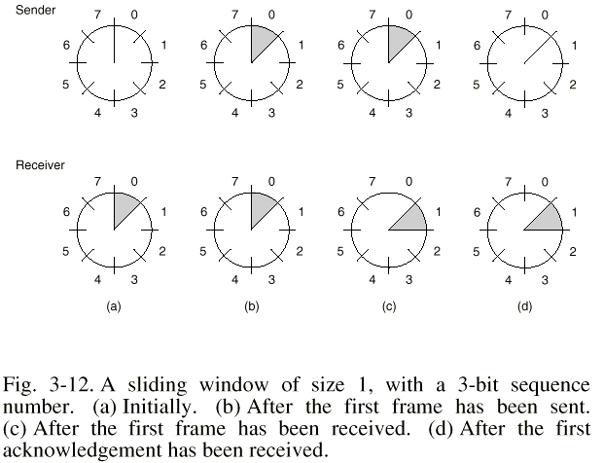

Slide 29
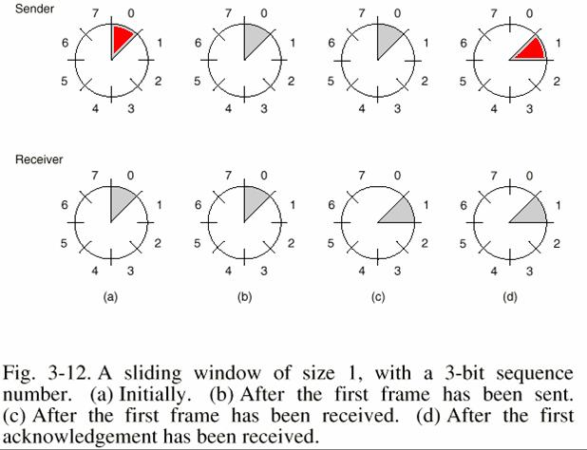
别的书上说：sending window is a set of sequence numbers corresponding to frame it is permitted to send for sender.下面是我根据别的书的作者的观点修改后的图片（红色是修改部分）。

Slide 30
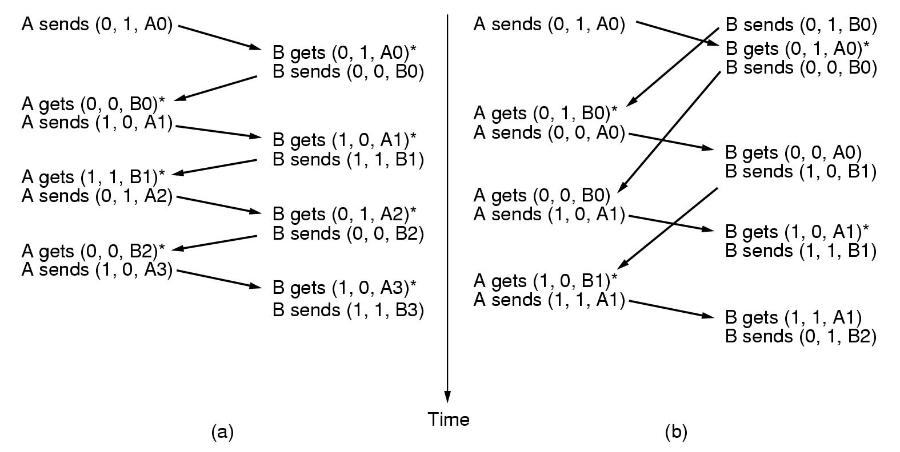
Two scenarios for protocol 4. The notation is (seq,ack,packet number).
An asterisk indicates where a network layer accept a packet.

Slide 31
Sliding Window Protocol
A Protocol Using Go Back n-[see fig 3-15(a)/16]
  protocol 5 (上课讲解)
  Stop-and-wait is not fitful for channel which has long round-trip delay, e.g. Satellite channel,270 ms
  Bidirectional transmission,noisy channel,
  Discard restricted condition: network layer of sender has unlimited data to transmit
  size of receiving window = 1, receiver discards all subsequent frames after a damaged or lost data frame.

Slide 32
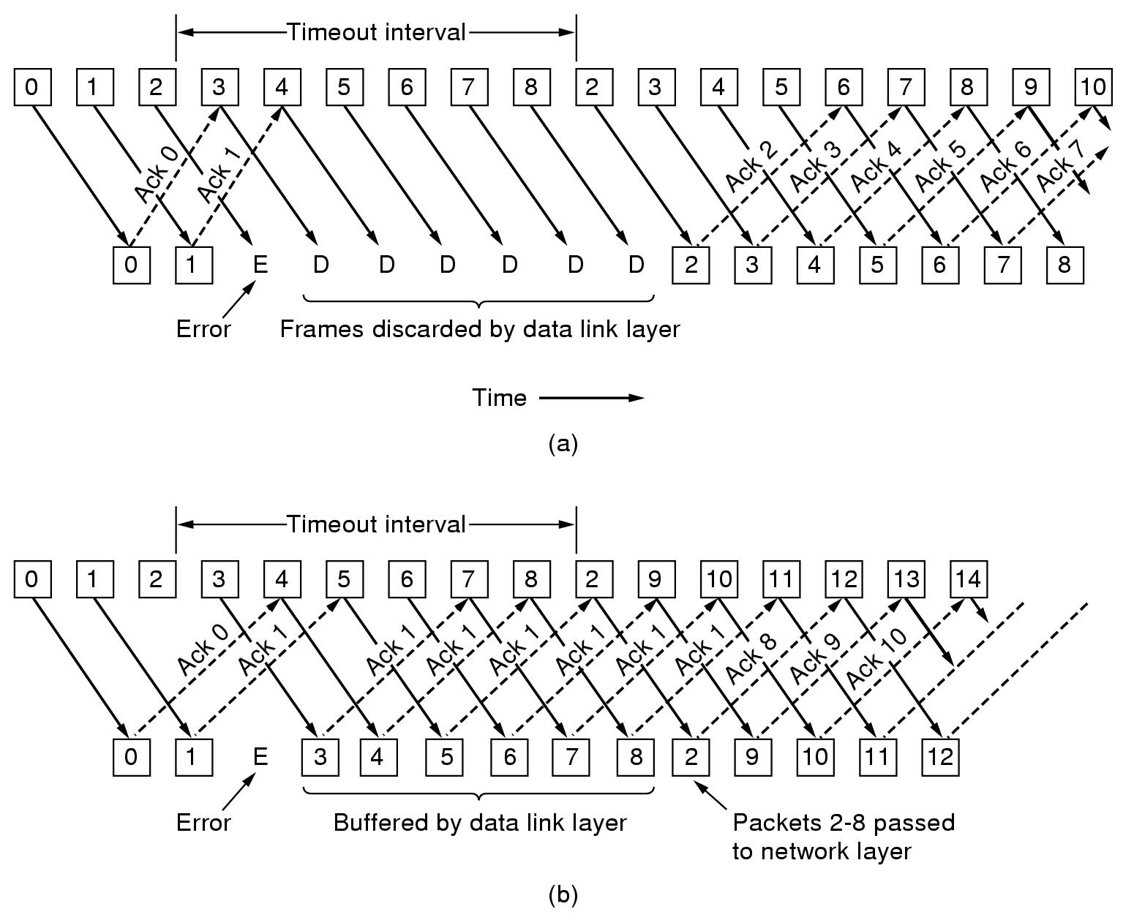
protocol using go back n.
protocol using selective repeat.
(a). Effect of an error when the receiver window size is 1.
(b) the receiver window size is larger than 1.

Slide 33
/* Protocol 5 (pipelining) allows multiple outstanding frames. The sender may transmit up
to MAX_SEQ frames without waiting for an ack. In addition, unlike the previous protocols,
the network layer is not assumed to have a new packet all the time. Instead, the
network layer causes a network_layer_ready event when there is a packet to send. */
#define MAX_SEQ 7 /* should be 2^n - 1 */
typedef enum {frame_arrival, cksum_err, timeout, network_layer_ready} event_type;
#include "protocol.h"
static boolean between(seq_nr a, seq_nr b, seq_nr c)
{
/* Return true if (a <=b < c circularly; false otherwise. */
if (((a <= b) && (b < c)) || ((c < a) && (a <= b)) || ((b < c) && (c < a)))
return(true); //(1,2,4), (6,7,2), (7,0,2)
else
return(false);
}

Slide 34
static void send_data(seq_nr frame_nr, seq_nr frame_expected, packet buffer[])
{
/* Construct and send a data frame. */
frame s; /* scratch variable */
s.info = buffer[frame_nr]; /* insert packet into frame */
s.seq = frame_nr; /* insert sequence number into frame */
s.ack = (frame_expected + MAX_SEQ) % (MAX_SEQ + 1); /* piggyback ack */
to_physical_layer(&s); /* transmit the frame */
start_timer(frame_nr); /* start the timer running */
}
void protocol5(void)
{
seq_nr next_frame_to_send; /* MAX_SEQ > 1; used for outbound stream */
seq_nr ack_expected; /* oldest frame as yet unacknowledged */
seq_nr frame_expected; /* next frame expected on inbound stream */
frame r; /* scratch variable */
packet buffer[MAX_SEQ+1]; /* buffers for the outbound stream */
seq_nr nbuffered; /* # output buffers currently in use */
seq_nr i; /* used to index into the buffer array */
event_type event;

Slide 35
enable_network_layer(); /* allow network_layer_ready events */
ack_expected = 0; /* next ack expected inbound */
next_frame_to_send = 0; /* next frame going out */
frame_expected = 0; /* number of frame expected inbound */
nbuffered = 0; /* initially no packets are buffered */
while (true) {
wait_for_event(&event); /* four possibilities: see event_type above */
switch(event) {
case network_layer_ready: /* the network layer has a packet to send */
/* Accept, save, and transmit a new frame. */
from_network_layer(&buffer[next_frame_to_send]); /* fetch new packet */
nbuffered = nbuffered + 1; /* expand the sender's window */
send_data(next_frame_to_send, frame_expected, buffer); /* transmit the frame */
inc(next_frame_to_send); /* advance sender's upper window edge */
break;
case frame_arrival: /* a data or control frame has arrived */
from_physical_layer(&r); /* get incoming frame from physical layer */
if (r.seq == frame_expected) {

Slide 36
/* Frames are accepted only in order. */
to_network_layer(&r.info); /* pass packet to network layer */
inc(frame_expected); /* advance lower edge of receiver's window */
}
/* Ack n implies n - 1, n - 2, etc. Check for this. */
while (between(ack_expected, r.ack, next_frame_to_send)) {
/* Handle piggybacked ack. */
nbuffered = nbuffered - 1; /* one frame fewer buffered */
stop_timer(ack_expected); /* frame arrived intact; stop timer */
inc(ack_expected); /* contract sender's window */
}
break;
case cksum_err: ; /* just ignore bad frames */
break;
case timeout: /* trouble; retransmit all outstanding frames */
next_frame_to_send = ack_expected; /* start retransmitting here */
for (i = 1; i <= nbuffered; i++) {
send_data(next_frame_to_send, frame_expected, buffer);
/* resend 1 frame */
inc(next_frame_to_send); /* prepare to send the next one */
}
}

Slide 37
if (nbuffered < MAX_SEQ)
enable_network_layer();
else
disable_network_layer();
}
}
The update rule for next_frame_to_send, frame_expected, ack_expected
  next_frame_to_send is increased every time a new or old frame is sent, or go back to ack_expected when timeout occurs.
  frame_expected is increased every time an expected frame is received.
  ack_expected is increased by n when an incoming frame acknowledged n outstanding frames which are waiting for acknowledgement.
  特别说明：程序的发送窗口大小为7，但为了方便地说明问题，图lk3-1，lk3-2，lk3-3中的发送窗口大小改为4。

Slide 38
(补充)
A B
(next_frame_to_send, frame_expected, ack_expected)
(0,0,0) (0,0,0)
(DataA0 seq=0, ack=7)----> ok
(1,0,0) (0,1,0)
(DataA1 seq=1, ack=7)----> ok
(2,0,0 ) (0,2,0)
(DataA2 seq=2, ack=7)----> ok
(3,0,0) (0,3,0)
(DataA3 seq=3, ack=7)----> ok
(4,0,0) (0,4,0)
ok <---- (DataB0 seq=0, ack=3)
(4,1,4) stop timer A0,A1,A2,A3 (1,4,0)
ok <---- (DataB1 seq=1, ack=3)
(4,2,4) (2,4,0)
(DataA4 seq=4, ack=1)----> ok
(5,2,4) (2,5,2)
ok <---- (DataB2 seq=2, ack=4)
(5,3,5) (3,5,2)
(DataA5 seq=5, ack=2)----> ok
Fig lk3-1 protocol 5:MAX_SEQ=7, Sender window size=4, receiver window size=1

Slide 39
(补充)
A B
(next_frame_to_send, frame_expected, ack_expected)
win(S)=colsed, win(R)=0
(DataA0 seq=0, ack=7)----> ok
win(S)=0, win(R)=0
(DataA1 seq=1, ack=7)----> ok
(DataA2 seq=2, ack=7)----> ok
(DataA3 seq=3, ack=7)----> ok
win(S)=0-3, win(R)=0
ok <---- (DataB0 seq=0, ack=3)
win(S)=closed, win(R)=1
ok <---- (DataB1 seq=1, ack=3)
win(S)=closed, win(R)=2
(DataA4 seq=4, ack=1)----> ok
win(S)=4, win(R)=2
ok <---- (DataB2 seq=2, ack=4)
win(S)=closed, win(R)=3
(DataA5 seq=5, ack=2)----> ok
Fig lk3-2 protocol 5:MAX_SEQ=7, Sender window size=4, receiver window size=1

Slide 40
(补充)
A B
(next_frame_to_send, frame_expected, ack_expected)
(0,0,0) (0,0,0)
(DataA0 seq=0, ack=7)----> ok
(1,0,0) (0,1,0)
(DataA1 seq=1, ack=7)----> x damaged or lost
(2,0,0 ) (0,1,0)
(DataA2 seq=2, ack=7)----> ok, discard
(3,0,0) (0,1,0)
(DataA3 seq=3, ack=7)----> ok, discard
(4,0,0) (0,1,0)
ok <---- (DataB0 seq=0, ack=0)
(4,1,1) stop timer A0 (1,1,0)
ok <---- (DataB1 seq=1, ack=0)
(4,2,1) (2,1,0)
Timeout, 重发 (DataA1 seq=1, ack=1)----> ok
(2,2,1) stop timer B0,B1 (2,2,2)
重发 (DataA2 seq=2, ack=1)----> ok
重发 (DataA3 seq=3, ack=1)----> ok
(4,2,1) (2,4,2)
ok <---- (DataB2 seq=2, ack=3)
(4,3,4) (3,4,2)
Fig lk3-3 protocol 5 scenarios: frame gets damaged or lost

Slide 41
Sliding Window Protocol
A Protocol Using Go Back n
  MAX_SEQ+1 distinct sequence numbers(0,1,2,... MAX_SEQ),no more than MAX_SEQ unacknowledged frames,the sender window<=MAX_SEQ.Why? Consider the following scenario with MAX_SEQ=7(a sender window of size eight):
    The sender sends frames 0 through 7.
    A piggybacked acknowledgement for frame 7 eventually comes back to the sender.
    The sender sends another eight frames,again with sequence numbers 0 through 7.
      All eight frames belonging to the second batch get lost
      All eight frames belonging to the second batch arrive successfully.
    Another piggybacked acknowledgement for frame 7 come in, ambiguity will arise to sender:
      All eight frames belonging to the second batch get lost,ack=7
      All eight frames belonging to the second batch arrive successfully,ack=7

Slide 42
Sliding Window Protocol
  A Protocol Using Go Back n( when the size of sender window=7,no ambiguity:
    The sender sends frames 0 through 6
    A piggybacked acknowledgement for frame 6 eventually comes back to the sender
    The sender sends another 7 frames:7,0,1,2,3,4,5,
      Frame 7,0,1,2,3,4,5 belonging to the second batch get lost
      Frame 7,0,1,2,3,4,5 belonging to the second batch arrive
    Another piggybacked acknowledgement comes in,no ambiguity
      Frame 7,0,1,2,3,4,5 belonging to the second batch get lost,ack=6
      Frame 7,0,1,2,3,4,5 belonging to the second batch arrive,ack=5
  Buffering: Since a sender may have to retransmit all the unacknowledged frames at a future time ,it must buffer all transmitted frames until acknowledgement arrives.
  Serious problem of Protocol 5: No acknowledgement could be sent, if there is no reverse traffic.
  Simulation of multiple timers in software-[see fig 3-17],

Slide 43
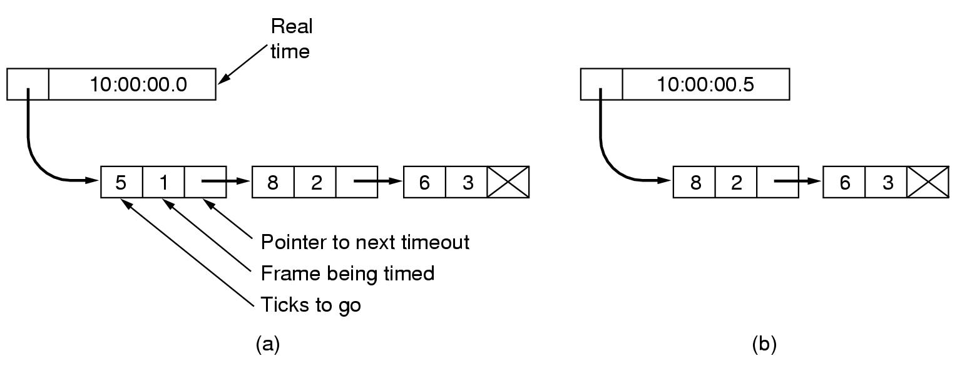
  Every outstanding frame need a timer, so multiple timer is required.
  Simulation of multiple timers in software-[see fig 3-17],
  Frame 1#,2#,3# will timeout at time 10:00:00.5, 10:00:01.3, and 10:00:01.9 respectively, the clock ticks once every 100ms (0.1s), every tick will decrement the counter at the header of list.
Fig 3-18. Simulation of multiple timers in software.

Slide 44
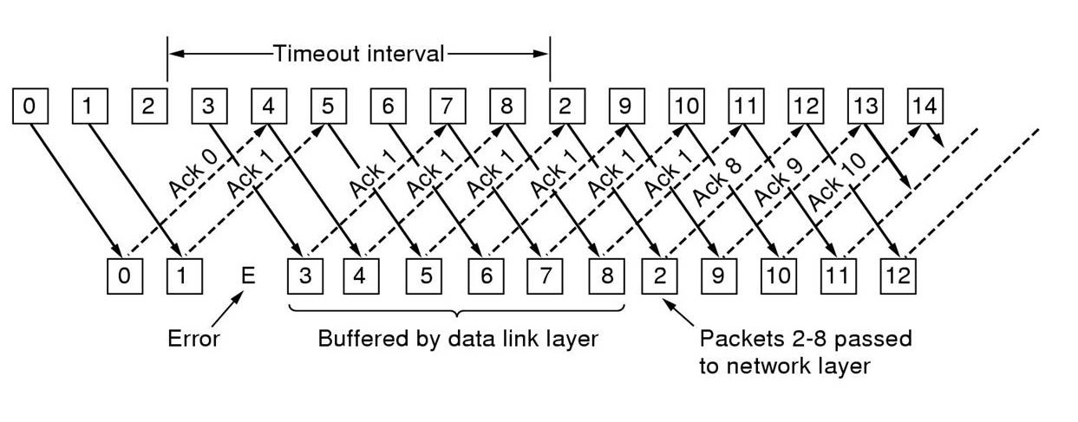
使用选择性重传的协议 （protocol 6）
  对于不按序到达的帧，不丢弃，而是保存起来，等所缺的帧到达后，把保存起来的那些顺序正确的多个帧一并上交。
  接收窗口的大小要等于发送窗口的大小；
  对于3 bit序号值，序号范围为 0－7，即MAX_SEQ=7,发送窗口的大小为(MAX_SEQ+1)/2=4，接受窗口的大小＝4

Slide 45
发送窗口的大小不能大于(MAX_SEQ+1)/2，这里是4（设MAX_SEQ＝7），原因如下：
  设发送窗口和接受窗口的大小都是5，序号空间为0－7；
  A的发送窗口＝[0,1,2,3,4], B的接收窗口＝[0,1,2,3,4]
  A向B发送 0、1、2、3、4＃帧，两种不同的情况发生了：
    情况1：B收到全部5个帧，应答也全部被A收到；A新的发送窗口＝[5，6，7，0，1], B新的接收窗口＝[5，6，7，0，1], A新发5，6，7，0，1＃帧；
    情况2：5个帧全部收到，但应答全部丢失，A新的发送窗口＝[0,1,2,3,4], B新的接收窗口＝[5，6，7，0，1]， A重发0＃帧；
  问题：新来的0＃帧会被接收并交给高层，如果是重发的（情况2 ）本该丢弃，却被B接收并交给高层。
    原因：在情况2下A的发送窗口 （[0,1,2,3,4]）与B的接收窗口（[5，6，7，0，1]）有重叠部分。

Slide 46
如果发送窗口的大小是4或更小，则问题解决：
  A的发送窗口＝[0,1,2,3], B的接收窗口＝[0,1,2,3]
  A向B发送 0、1、2、3＃帧，两种不同的情况发生了：
    情况1：B收到全部4个帧，应答也全部被A收到；A新的发送窗口＝[4，5，6，7], B新的接收窗口＝[4，5，6，7], A新发4，5，6，7＃帧；
    情况2：4个帧全部收到，但应答全部丢失，A的发送窗口＝[0,1,2,3], B的接收窗口＝[4，5，6，7]， A重发0＃帧；
  没问题：新来的0＃帧不在接收窗口内，是重发的，应丢弃。

Slide 47
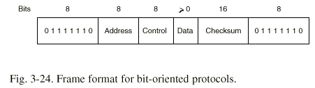
3.5 EXAMPLE DATA LINK PROTOCOLS
HDLC---High-level Data Link Control
  SDLC(IBM’SNA)→ADCCP(ANSI)
  →HDLC(ISO)→LAP(CCITT)→LAPB(X.25)
  bit-oriented protocol
  frame format-[see fig 3-24]
  flag sequence (01111110)、the minimum frame：three fields、32 bits
  three kinds of frames：Information、Supervisory、Unnumbered-[see fig 3-25]

Slide 48
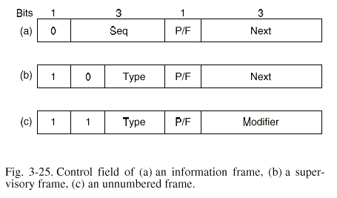
Seq --- sender seq(like former protocol 5 )
Next --- expected frame seq, different from former ack,it is (ack+1) mod 8

Slide 49
Information frame
Supervisory frame:
  RR(Receive Ready),接收准备就绪
  RNR(Receive Not Ready): to implement flow control
  REJ(Reject): like NAK frame,从Next起的所有帧都被否认,但确认序号为Next-1及其以前的各帧
  SREJ(Selective Reject),选择性拒绝
Unnumbered frame
  request to establish connection: SNRM(Set Normal Response Mode), SABM(set asynchronous balanced mode)
  request to disconnect: DISC(Disconnect)
  response frame: UA(unnumbered acknowledgement)
  report severe error: FRMR(FRaMe Reject)

Slide 50
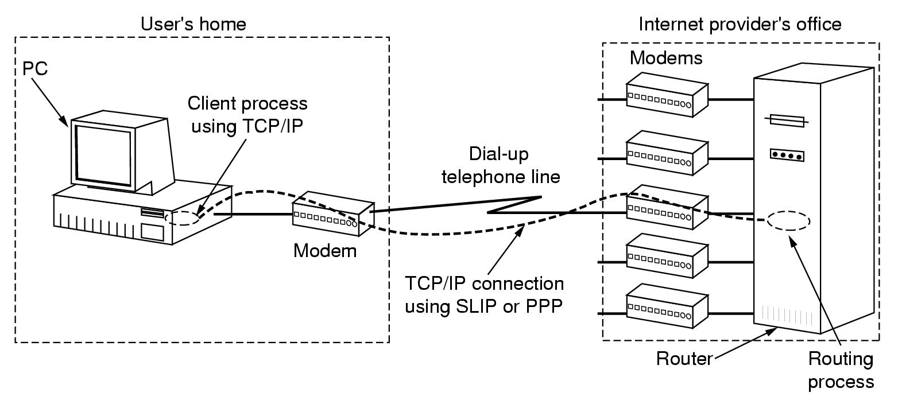
EXAMPLE DATA LINK PROTOCOLS
The Data Link Layer in the Internet-[see fig 3-26]

Slide 51
EXAMPLE DATA LINK PROTOCOLS
The Data Link Layer in the Internet-[see fig 3-26]
  PPP—Point to Point Protocol
    support：error detection、multiple protocols(IP,IPX,Apple Talk,XNS,...),allows IP address to be negotiated、permits authentication…
    LCP(Link Control Protocol).
    NCP(Network Control Protocol).
    Frame format(as HDLC):face character-[see fig 3-27]
    A simplified phase diagram for bringing a line up and down-[see fig 3-28]

Slide 52
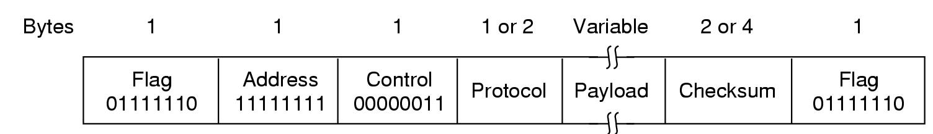

Slide 53
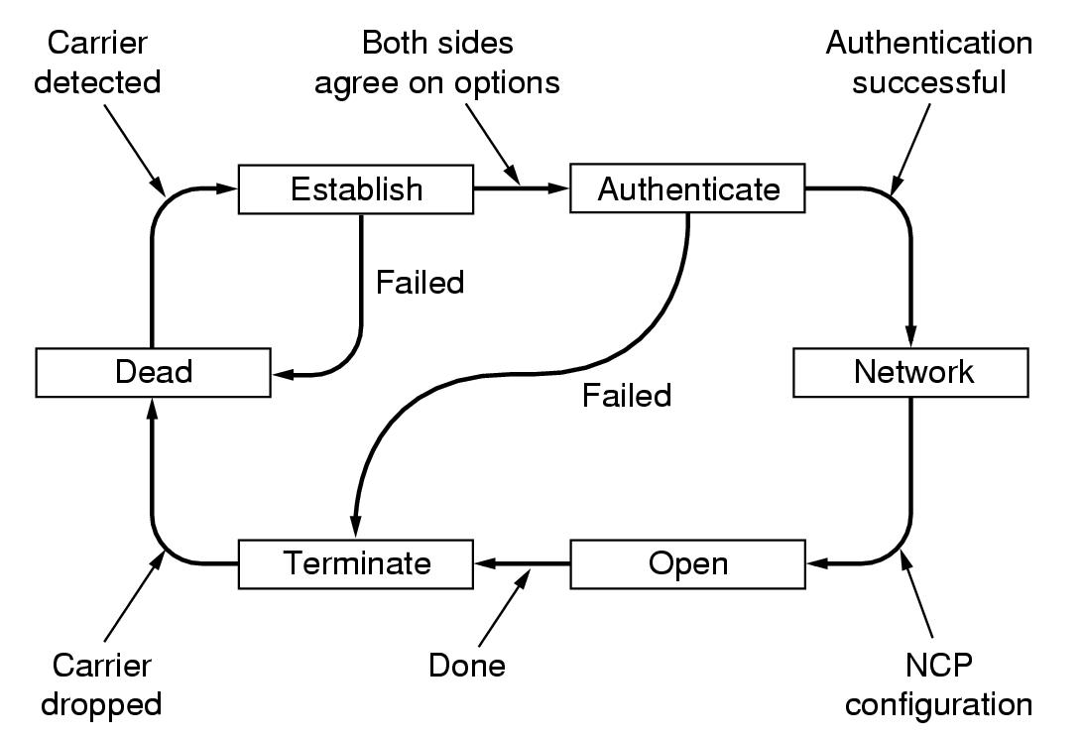

Slide 54
SUMMARY
The task of the data link layer
The size of window、the sliding window
stop-wait protocol、sliding window protocol
Models：finite state machine models and Petri net models
Example of the data link layer：
  bit-oriented：SDLC、HDLC、ADCCP or LAPB
  bit-oriented：SLIP and PPP（Internet）
  ATM systems：have their own protocol，a bare minimum of error checking、no flow control

