Slide 1
6 THE TRANSPORT LAYER
TASK OF THE TRANSPORT LAYER：
  To provide reliable,cost-effective data transport from the source machine to the destination machine

Slide 2
6.1 THE TRANSPORT SERVICE
6.1.1 Service Provided to the Upper Layers
  The ultimate goal
    To provide efficient,reliable,and cost-effective service to its users（application processes）
    The network,transport,and application layers-[see fig]show
  Types of transport service：
    Connection-oriented ,three phases：establishment,data transfer,and release
    connectionless
  OSI model is divided into two parts：
    Layers 1-4：transport service provider
    Layers 5-7：transport service user

Slide 3
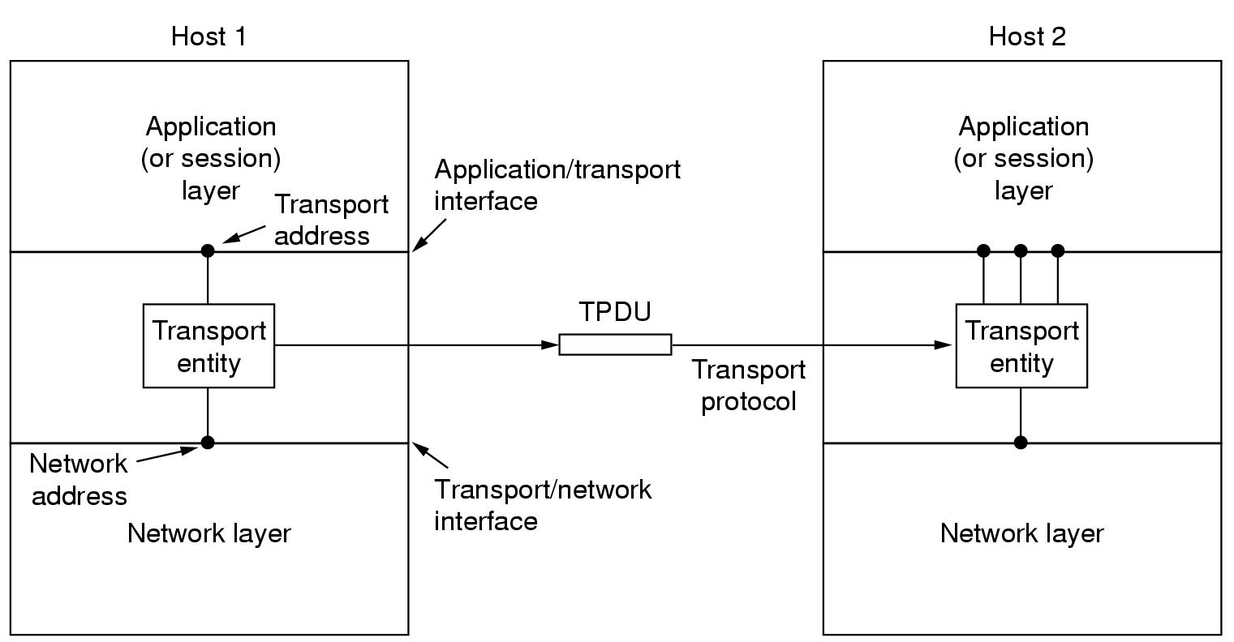
Fig..the network,transport,and application layers
back

Slide 4
6.1 THE TRANSPORT SERVICE
6.1.2 Transport Service Primitives
  Differences between transport service and network service
    The network service is generally unreliable, the connection-oriented transport service , in contrast, is reliable
    Different objects of the services:
      network service: transport entity
      transport service: application program and programmer
    Data transfer on network layer is much more difficult than on transport layer
  The primitives for a simple transport service-[see fig]
  Transport Protocol Data Unit(TPDU)
  Nesting of TPDUs, packets, and frames-[see fig]

Slide 5
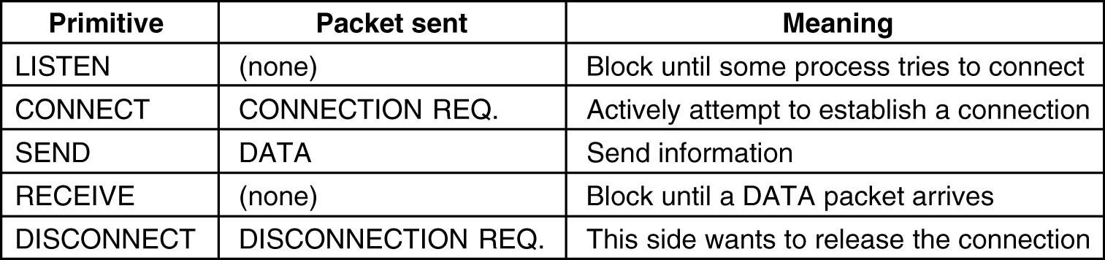
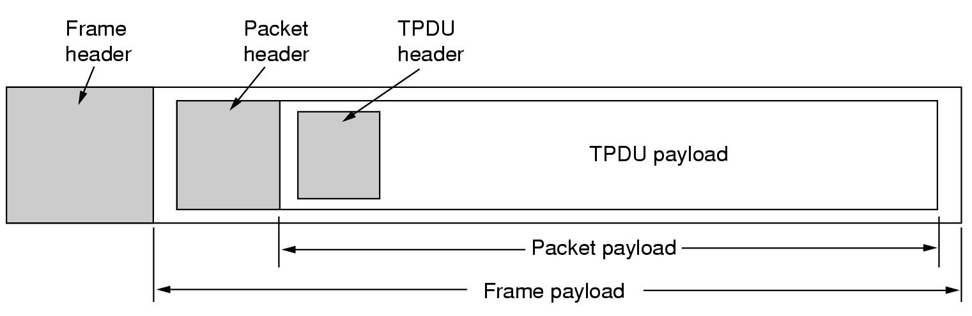
Fig.. The primitives for a simple transport service.
Fig. Nesting of TPDUs,packets,and frames.
back

Slide 6
6.1 THE TRANSPORT SERVICE
  Disconnection has two variants：
    Asymmetric: one side does a disconnection, and the entire connection is closed.
    Symmetric: each side does a disconnection, one direction of connection is closed.
  Connection establishment and release-[see fig] show

Slide 7
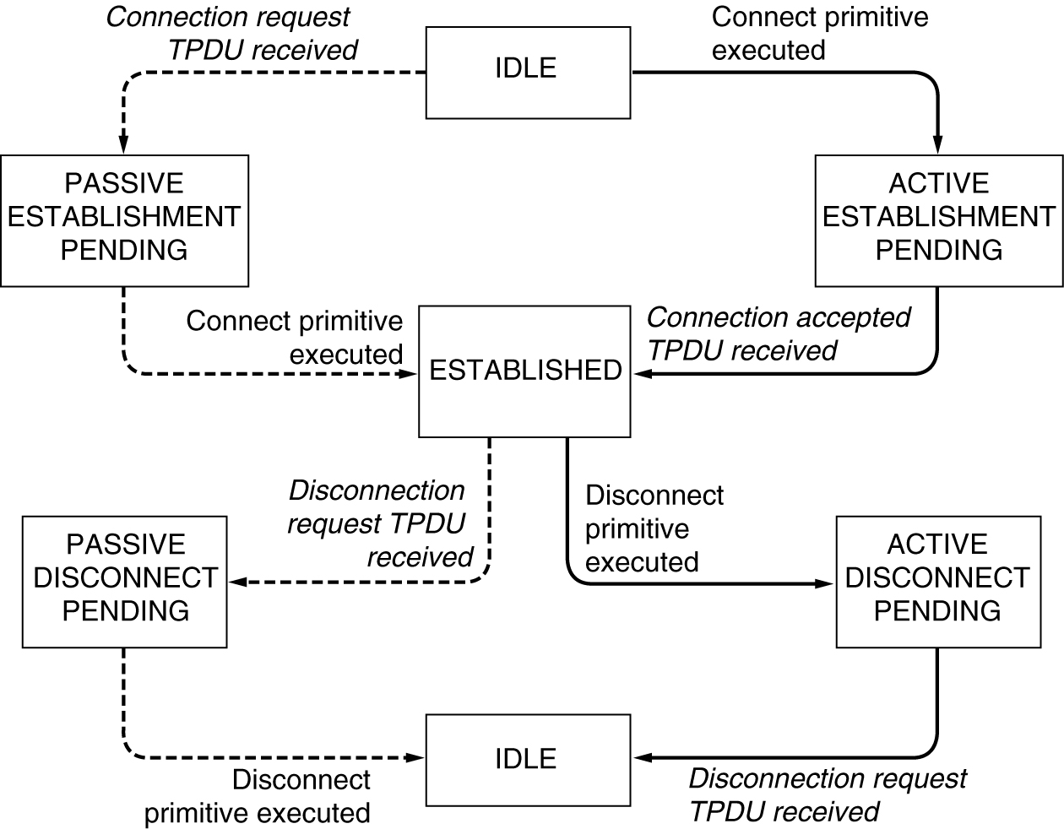
Fig. . A state diagram for a simple connection management scheme. Transition labeled in italics are caused by packet arrivals. The solid lines show the client’s state sequence. The dashed lines show the server’s state sequence.
back

Slide 8
6.1.3 Berkley Sockets(用于Unix的TCP中）-[see fig]
Primitive | Meaning
SOCKET | Create a new communication end point
BIND | Attach a local address to a socket
LISTEN | Announce willingness to accept connections; give queue size
ACCEPT | Block the caller until a connection attempt arrives
CONNECT | Actively attempt to establish a connection
SEND | Send some data over the connection
RECEIVE | Receive some data from the connection
CLOSE | Release the connection
Fig. The socket primitives for TCP.
back

Slide 9
6.1.3 Berkley Sockets(用于Unix的TCP中）-[see fig]
Primitive
Meaning
SOCKET
Not block
BIND
Not block
LISTEN
Not block
ACCEPT
Block until a connection attempt arrives
CONNECT
Not block
SEND
Not block
RECEIVE
Block if no data available
CLOSE
Not block
Fig. The socket primitives for TCP.
back

Slide 10
6.1 THE TRANSPORT SERVICE
6.1.4 An Example of Socket Programming:An Internet File Server -[see fig]
  Server code using sockets. show
    Create socket
    Bind socket
    Listen socket
    Accept: Block waiting for an incoming connection, and process it
  Client code using sockets. Show
    Useage:
      Client flits.cs.vu.nl /usr/tom/myfile > f
    Create socket
    Connect socket
    Send file name and get the file

Slide 11
gethostbyname(“flit.cs.vu.nl”)-->192.31.231.65
struct sockaddr_in {
    short sin_family; //2 byte e.g. AF_INET
    unsigned short sin_port; // 2 byte, e.g. 80
    struct in_addr sin_addr; // 4 byte, e.g. 8.32.4.51
    char sin_zero[8]
    }
struct sockaddr is similar to struct sockaddr_in.
INADDR_ANY: 0, its type is long (4 byte).
htonl(0x11223344) --> 0x44332211, in PC (little endian)
htons(0x7788) --> 0x8877, in PC (little endian)

Slide 12
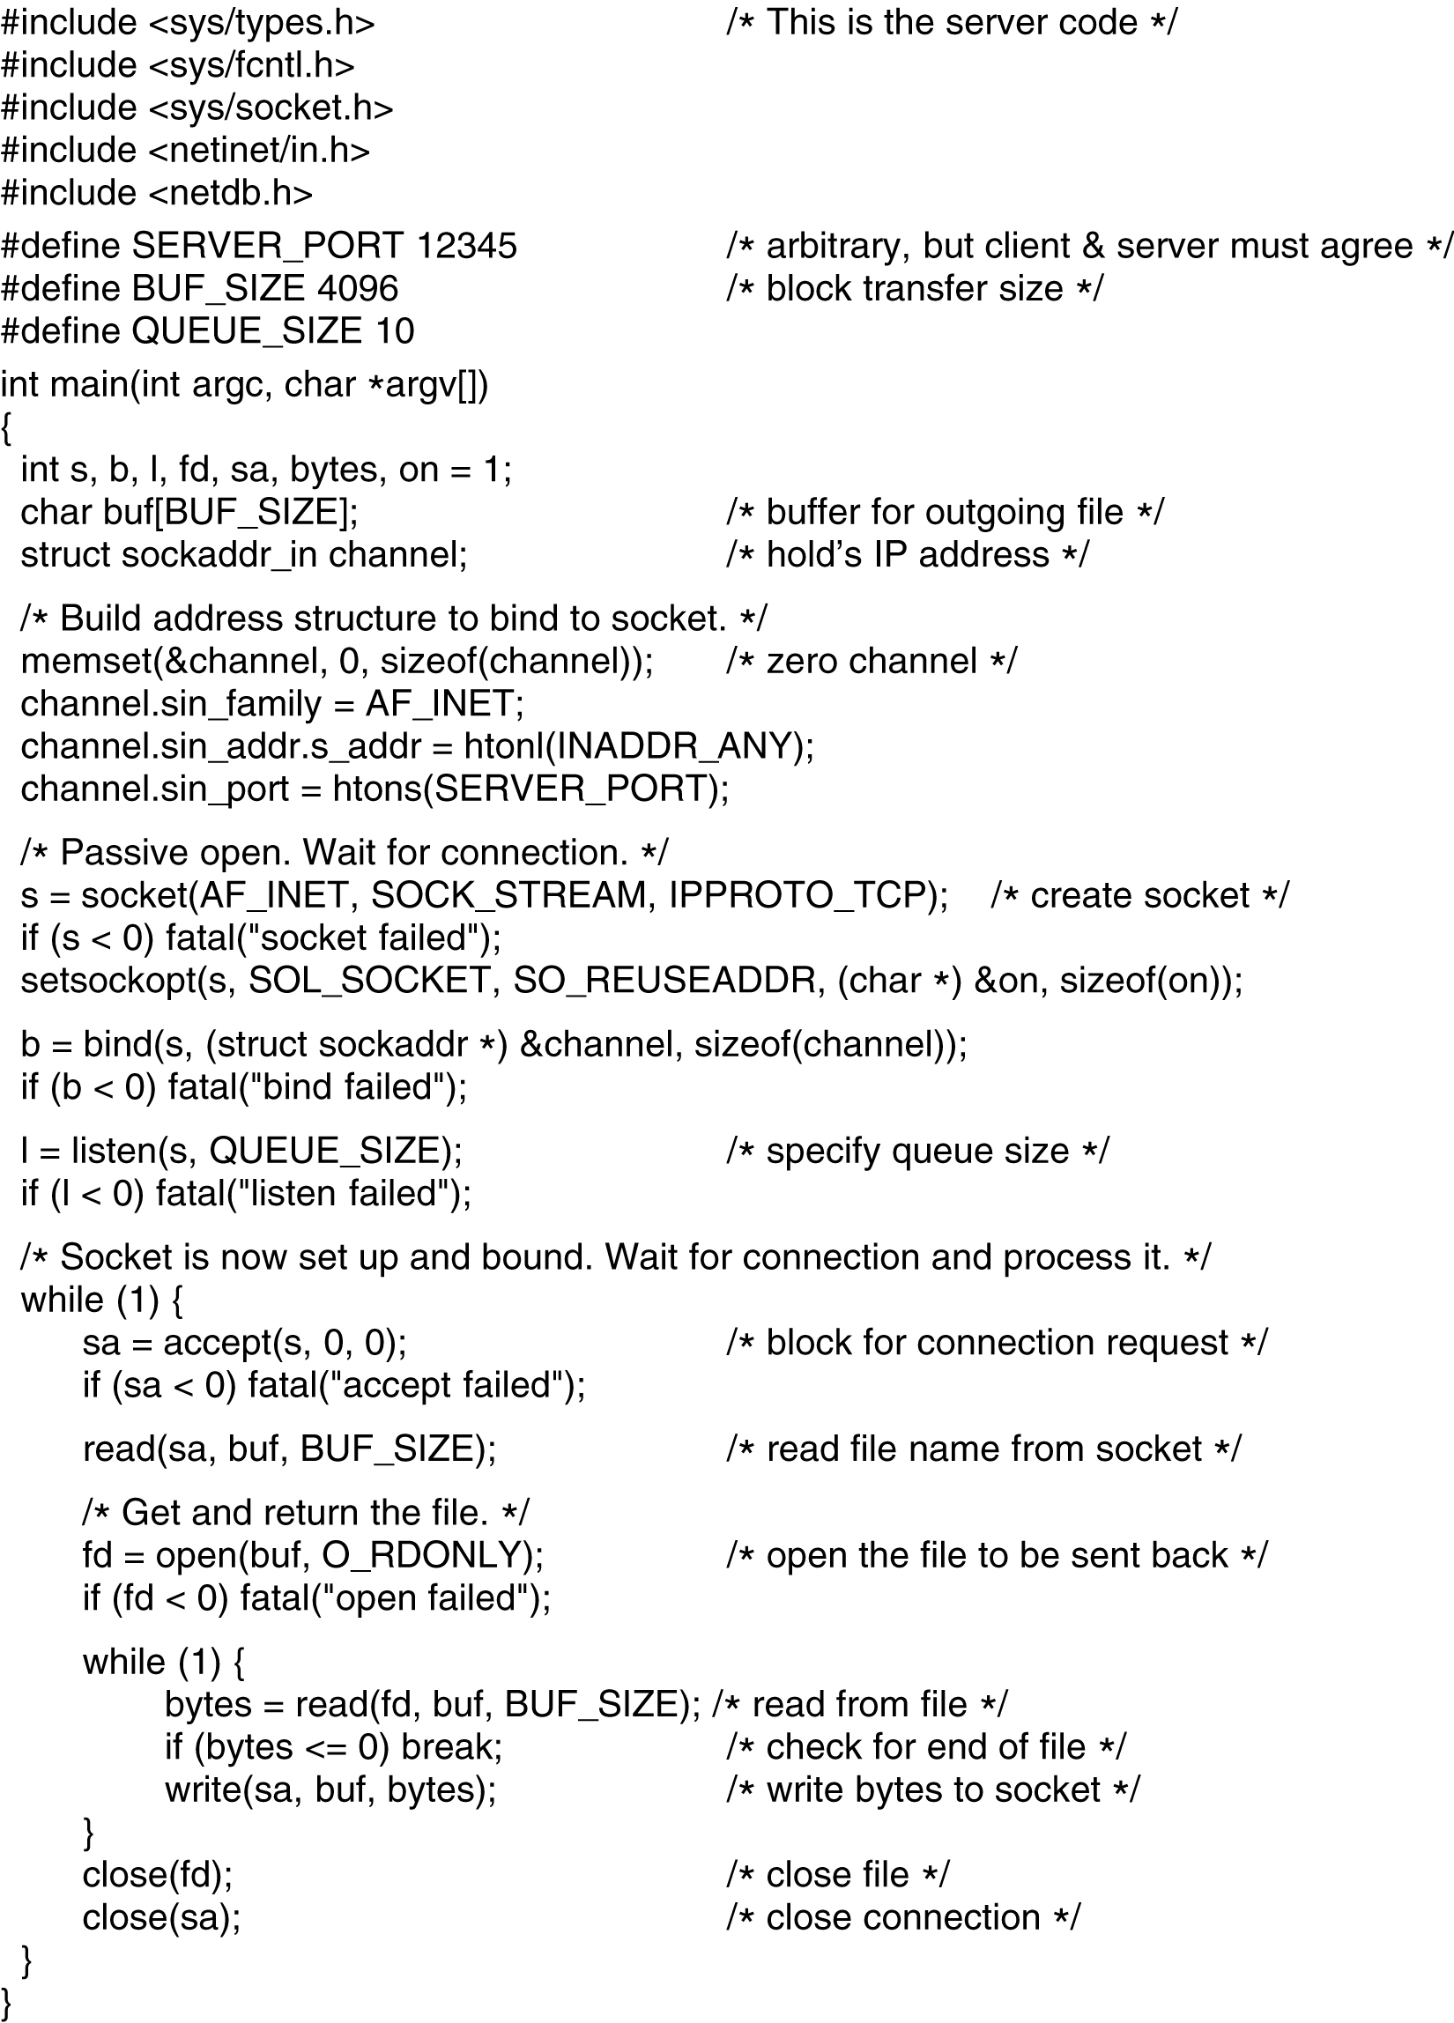
back
Fig. 6-6. Server code using sockets.

Slide 13
back
Fig.. Server code using sockets.

Slide 14
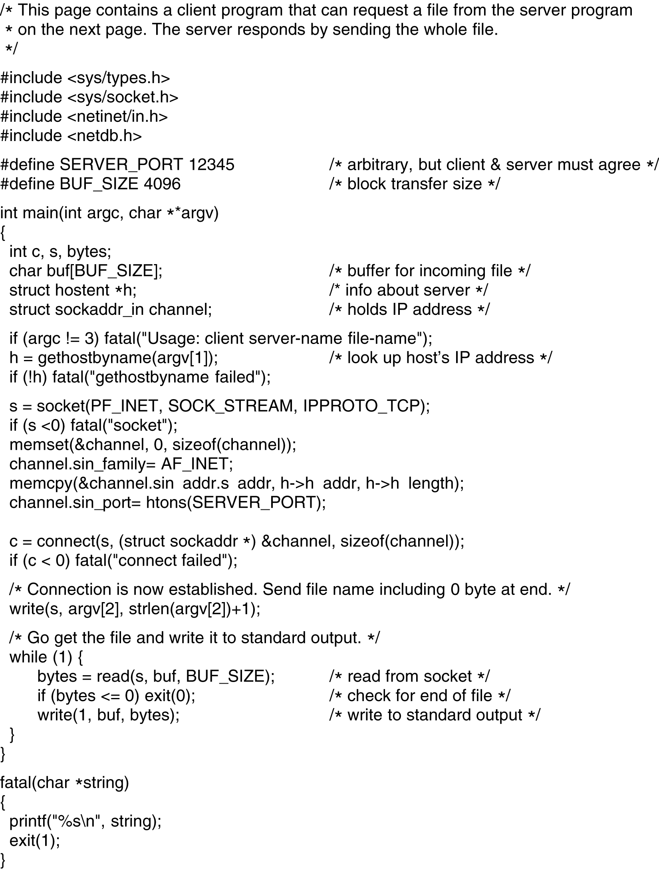
back

Slide 15
Fig. Client code using sockets.
back

Slide 16
6.2 ELEMENT OF TRANSPORT PROTOCOLS
6.2.2 Connection Establishment
  A complex process：the existence of delayed duplicates
  Solution ：three-way handshake-[see fig] show
    To solve the problems of delayed duplicate control TPDUs and its duplicate ACK
  Two-way handshake will result in half-connection.
    One side of a connection is open while the other side is close;
    This will waste resource.

Slide 17
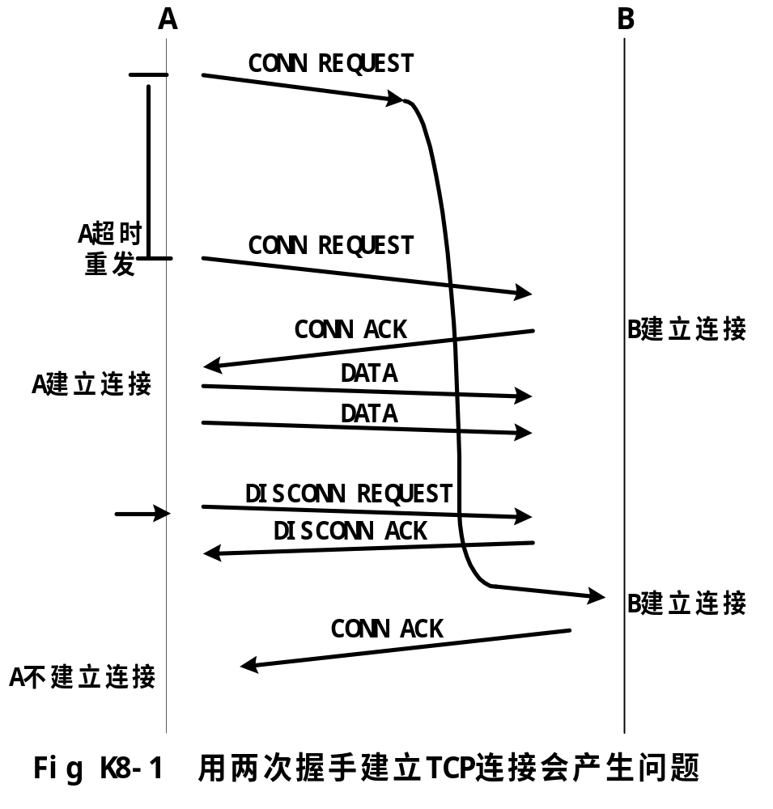
(补充)

Slide 18
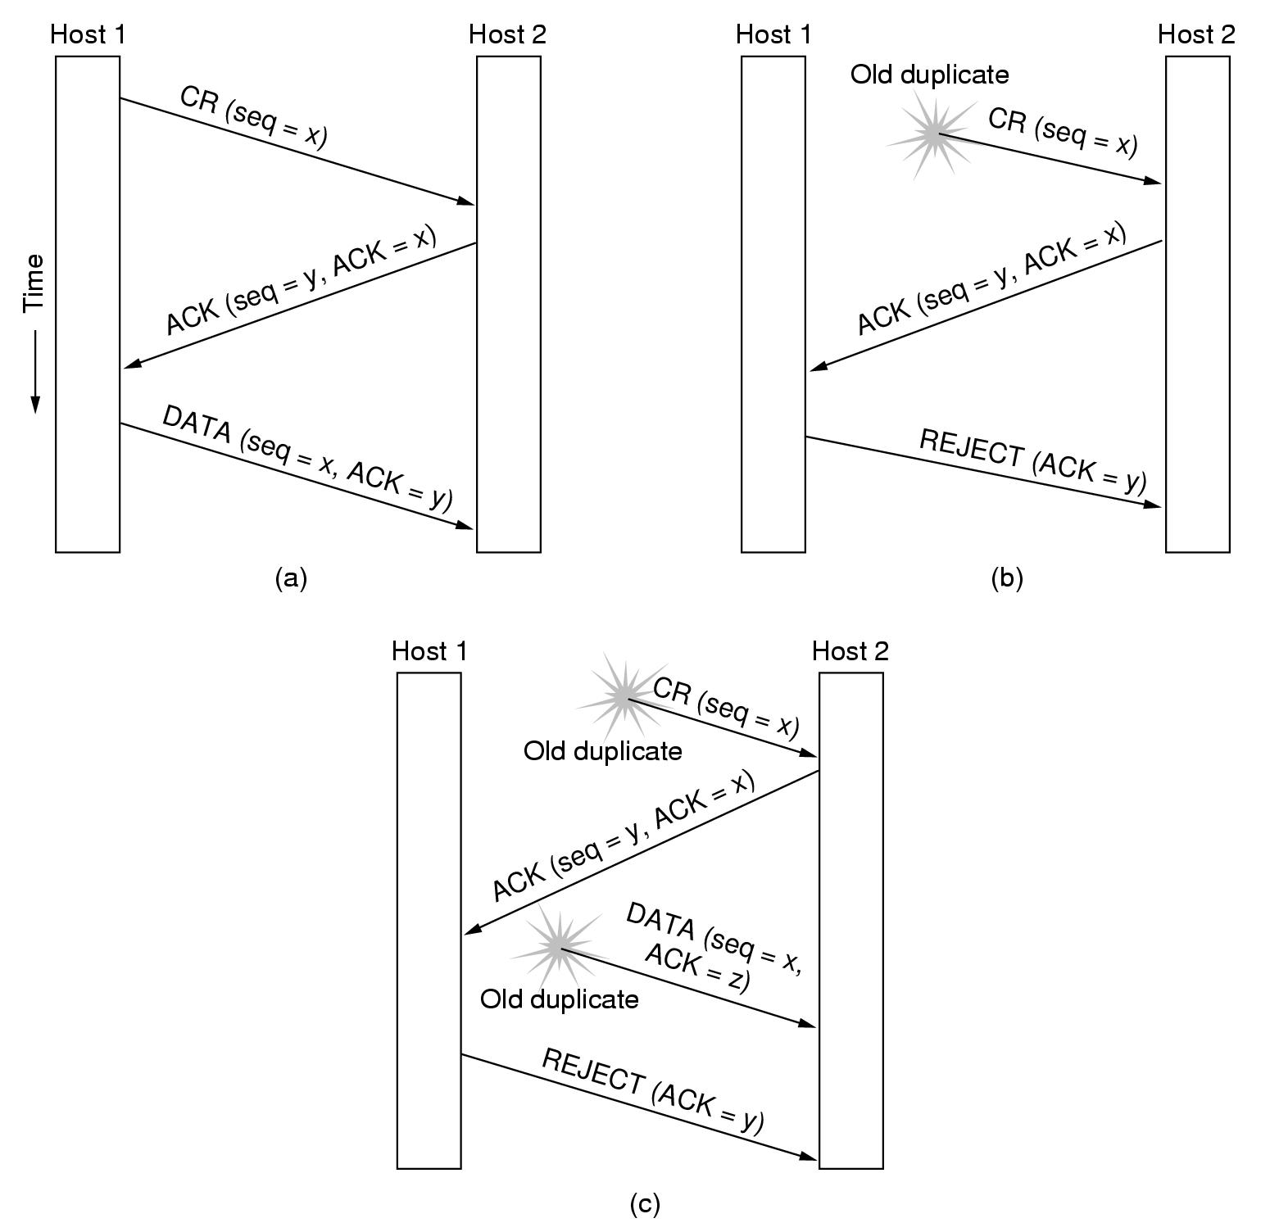
Fig. Three protocol scenarios for establishing a connection using a three-way handshake.CR denotes CONNECTION REQUEST.(a)Normal operation.(b)Old duplicate CONNECTION REQUESED appearing out of nowhere.©Duplicate CONNECTION REQUEST and duplicate ACK.
back

Slide 19
6.2 ELEMENT OF TRANSPORT PROOCOLS
6.2.3 Connection Release
  Two styles of terminating a connection：
    Asymmetric release –-may result in data loss-[see fig] show
    Symmetric release —Each direction of connection is released independently of the other one.
  Two-army problem-[see fig] show
    Handshake of two-way, three-way,four-way…does not help.
    No protocol exists to solve this problem.

Slide 20
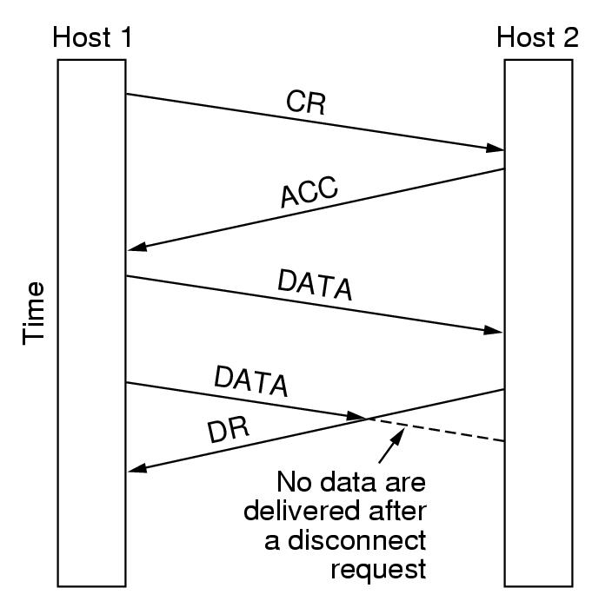
Fig.. Abrupt disconnection with loss of data.
back

Slide 21
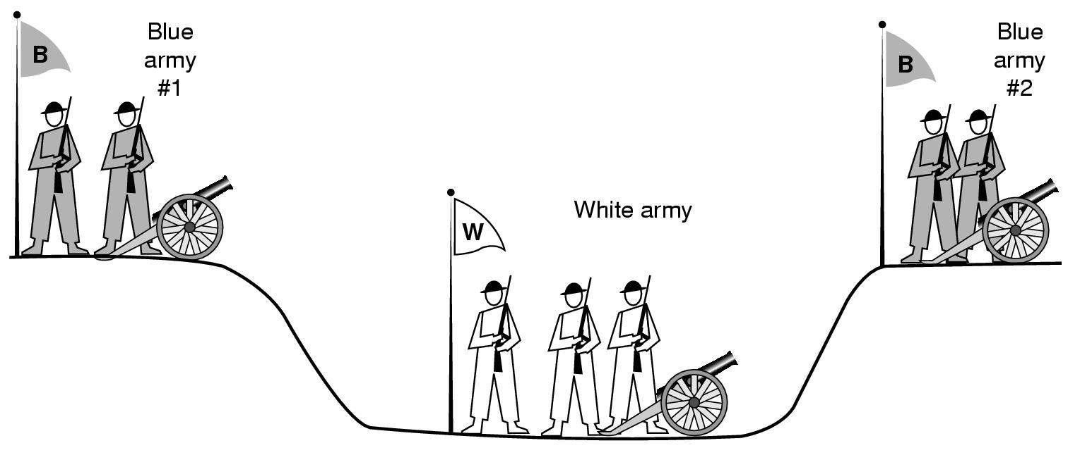
Fig.. The two-army problem.
back

Slide 22
6.2 ELEMENT OF TRANSPORT PROOCOLS
  In practice,three-way handshake is used-[see fig] show
    After timeout,Host1 will retransmit DR， Host2 will not retransmit DR，but close the connection。
    While this protocol is not infallible, it is usually adequate
    Problem of three-way handshake：the loss of initial DR and N retransmissions will finally result in a half-open connection
    One way to kill off half-open connections：if no TPDUs have arrived for a certain number of seconds,the connection is automatically disconnected.

Slide 23
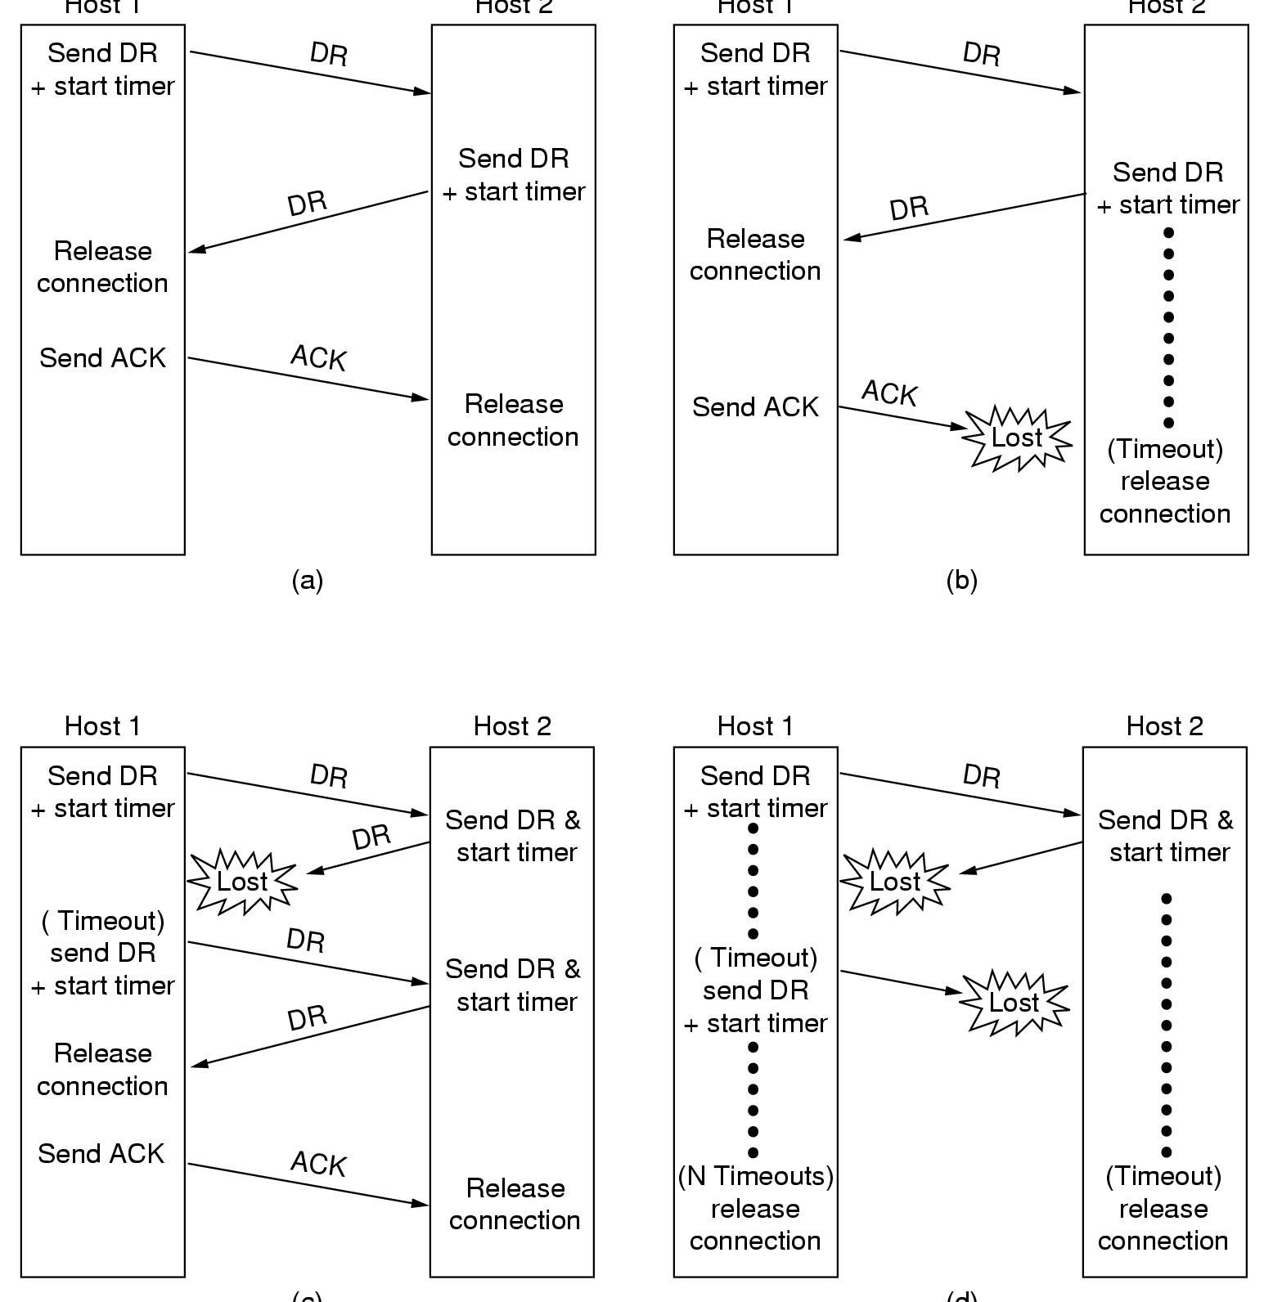
Fig. Four protocol scenarios for releasing a connection.(a)Normal case of three-way handshake.(b)Final ACK lost.©Response lost.(d)Response lost and subsequent DRs lost.
back

Slide 24
6.4 THE INTERNET TRANSPORT PROTOCOLS:UDP
The internet transport protocols：
  UDP(user data protocol) – a connectionless protocol
  TCP (transmission control protocol)– a connection-oriented protocol

Slide 25
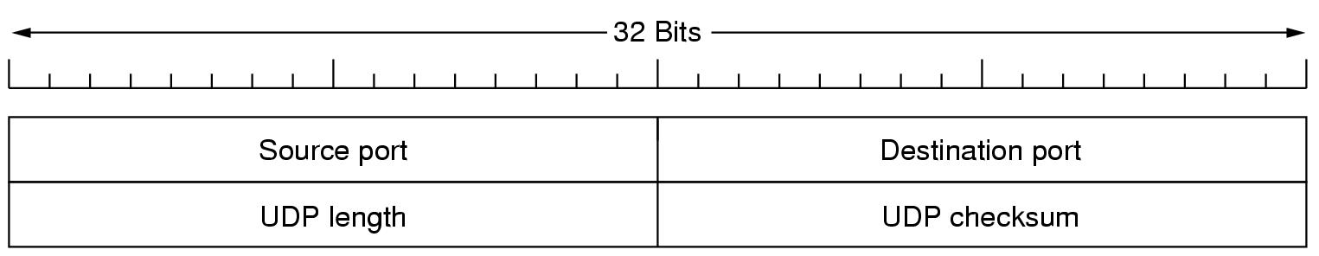
6.4 THE INTERNET TRANSPORT PROTOCOLS :UDP
6.4.1 Introduction to UDP
  A connectionless transport protocol without having to establish a connection --- UDP(User Data Protocol)
    Send encapsulated IP datagrams
    Send them without having to establish a connection
  UDP segment consists：8-byte header followed by the data.
    The UDP header -[see fig], UDP length：total length
Fig .The UDP header

Slide 26
6.4 THE INTERNET TRANSPORT PROTOCOLS :UDP
Some things UDP does not do: flow control, error control, or retransmission upon receipt of a bad segment.
Application of UDP:
  client-serer situation: the client sends a short request, and expects a short reply back. If either the request or reply is lost, the client just time out and try again.
  DNS (the Domain Name System): look up the IP address of some host name.

Slide 27
6.4 THE INTERNET TRANSPORT PROTOCOLS :UDP
6.4.2 Remote Procedure Call
  RPC(Remote Procedure Call) was done by Birrell and Nelson(1984), is the basis for many networking applications nowadays.
  Allowing programs to call procedures located on remote hosts.
  The steps in making an RPC -[see fig]
  Some problems with RPC:
    Passing pointers is almost impossible (solution is tricky, but it needs restrictions)
    Problem in weakly-typed languages,like C.
      E.g., to compute the inner production of two arrays. Each arrays could be terminated by a special value known only to the calling and called procedure. Client stub can not determine the length of the arrays.
    In some cases, it is difficult to deduce the types of the parameters.
    global variables in client are not shared by server procedure.

Slide 28
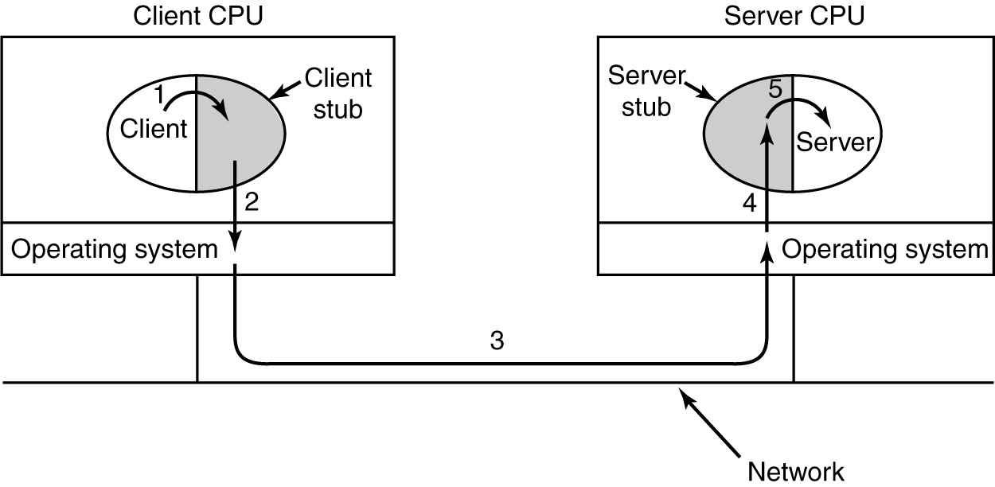
6.4 THE INTERNET TRANSPORT PROTOCOLS :UDP
Fig. Steps in making a remote procedure call. The stubs are shaded.

Slide 29
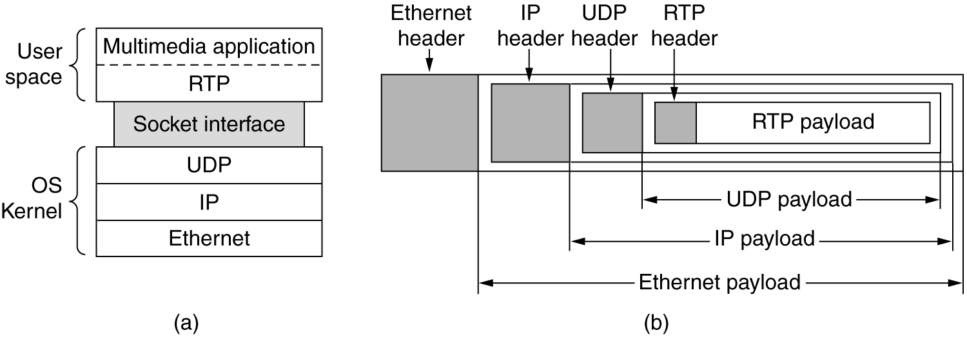
6.4 THE INTERNET TRANSPORT PROTOCOLS :UDP
6.4.3 The Real-Time Transport Protocol
  An application of UDP, described in RFC1889.
  The position of RTP in the protocol stack.-[see fig]
  The packet nesting. -[see fig]
Fig. (a) The position of RTP in the protocol stack. (b) Packet nesting.

Slide 30
6.4 THE INTERNET TRANSPORT PROTOCOLS :UDP
  Each RTP payload contain multiple samples. RTP defines several profiles (特征概述）, multiple encoding formats are allowed for each profile.
  RTP has no flow control, no error control, no acknowledgement, no retransmission.
  Timestamp: the timestamp is relative to the start of the stream, so only the difference between the timestamp is important.
  The RTP header:-[see fig]

Slide 31
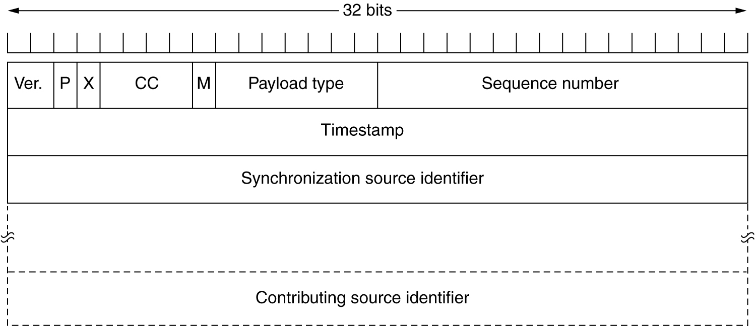
Fig. The RTP header.
Ver.: the Version field, already at 2.
P: Indicates the packet has been padded to a multiple of 4 bytes.
X: Indicates an extension header is present.
CC: The number of contributing sources,from 0 to 15.
M: An application-specific marker bit.
Payload type: The type of encoding algorithm used, e.g., MP3, PCM....
Sequence number: A counter, to detect lost packets.
Timestamp: Reduces the effect of jitter and allows multiple streams to be synchronized.

Slide 32
Fig. The RTP header.
Synchronization source identifier （SSI）: tells Which stream does the packet belong to? Video source? Left soundtrack? Right soundtrack?
Contributing source identifier: The list of each stream in a mixer. Total number is indicated by CC.
例如，一个接收者从某个视频服务器上收到两个混合流：
  第1个混合流是足球赛（SSI=1792)，它包含3个contributing source：视频、左声道、右声道 , 他们的CSI (contributing source identifier)分别是328，329，330。CC=3.
  第2个混合流是实时视频监控录像（SSI=1793)，它包含2个contributing source：视频，声音, 他们的CSI (contributing source identifier)分别是410，411。CC=2.
一个RTP包只能包含一个混合流。

Slide 33
  RTP sister protocol RTCP(Real-time Transport Control Protocol): handles feedback, synchronization, the user interface, but does not transport any data.

Slide 34
6.5 THE INTERNET TRANSPORT PROTOCOLS:TCP
6.5.1 Introduction to TCP
  A connection-oriented protocol ----TCP(Transimission Control Protocol) provides a reliable end-to-end byte stream over an unreliable internetwork.
  TCP transport entity: it manages TCP streams and interfaces to the IP layer.
  TCP furnish the reliability that most users want and that IP does not provide.

