Slide 1
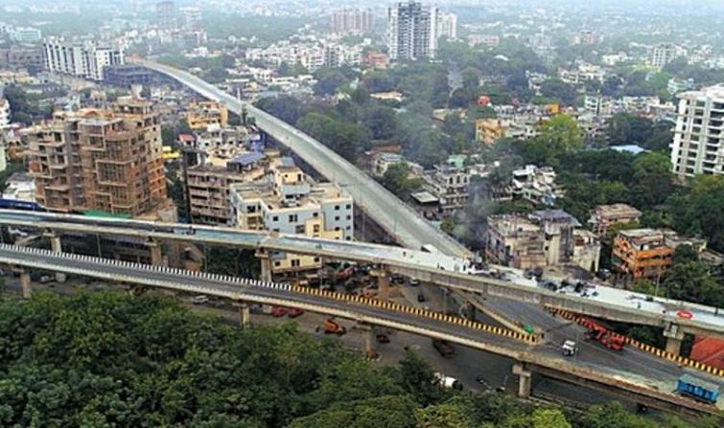
Clustering Localities of Nagpur

Slide 2
Introduction
Nagpur is the third largest city and the winter capital of the Indian state of Maharashtra and it is popularly known as the Orange City of India. It is the 13th largest city in India by population. There are around 42 localities in Nagpur. Each localities have their own popular venues and thus if we find similar localities based on their popular venues, it will help people who want to transfer to different localities in order to being close to their work offices.

Slide 3
Problem Statement
The main goal of this project is to cluster the localities of Nagpur based on their similarities. So if a person who want to shift to new locality as he/she wants to being as close as possible to their work offices but they also wants to shift in a locality where there are similar popular venues like cafes, restaurants etc. as their old localities.

Slide 4
Target Audience
So the target audience are the peoples who want to transfer to another localities in order to being as close as possible to their work offices with the similar popular venues like cafes, restaurants etc. as their old ones.
Outcome
The outcome of this project would be a good recommendation of a locality where a person can shift in order to get as close as possible to work office with the similar locality in terms of popular venues.

Slide 5
Data
Firstly we will fetch the localities of Nagpur. We can get this localities using the Wikipedia with the help of Web Scraping. We will scrape the webpage using the BeautifulSoup library of Python. Next we will need the coordinates of each localities that we can get using Geopy library of Python. Then at last we will pass this coordinates into the FourSquare API to fetch the nearby venues of each localities.

Slide 6
Required Libraries
Pandas (For data analysis & data wrangling)
Numpy (For handling data in a vectorized manner)
JSON (For handling JSON files)
Geopy (For converting an address into latitude and longitude values)
Plotly (Data Visualization)
Folium (Map Rendering)
Sklearn (For using Unsupervised Clustering method namely K-Means)
BeautifulSoup (For Web Scraping data from Wikipedia)

Slide 7
Methodology
The main aim of this project is to find the new locality for the peoples who want to shift to new locality in order to get close to their work office and they also want a similar surroundings in terms of popular venues as their old locality
Now in this project we are analyzing the localities of Nagpur city of Maharashtra and based on their similarities in terms of popular venues we are grouping them into clusters so the person who want to shift his/her residence to new locality can select the localities that are in the same cluster according to their convenience in terms of which is near to their work offices.

Slide 8
Exploratory Data Analysis - I
We have the data of localities in Nagpur in a Wikipedia web page. So at first, we are going to perform web scraping of Wikipedia page in order to get the localities of Nagpur. We can do the web scraping using the BeautifulSoup library of Python.
We are going to store the localities of Nagpur in Pandas Dataframe. During this process of storing in it we are also going to perform data cleaning where we are going to remove unwanted citations and information about the localities.
After that, we are going to fetch the Geolocation of the localities in terms of Latitude and Longitudes which we will be used later to fetch nearby popular venues.
We are going to perform this extraction of Geolocation using the Geopy Library of Python.

Slide 9
Exploratory Data Analysis - II
Then we are going to show the map with the indication of different localities of Nagpur which we can perform using the Folium Library of Python.
We are going to drop that localities which are far away from the Nagpur as people won’t shift there.
Then we are going to use the FourSquare API which will give the data of nearby venues in JSON format.
Finally we are going to use the K-Means Clustering algorithm to cluster the localities of Nagpur based on their similarities.

Slide 10
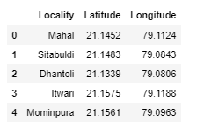
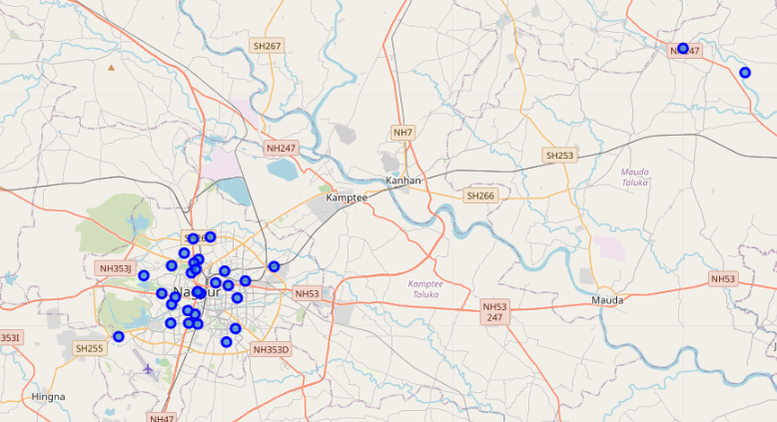
The Data frame with the localities as well as their Latitudes and Longitudes are as follows:
The map with the localities of Nagpur as labels is as shown below:

Slide 11
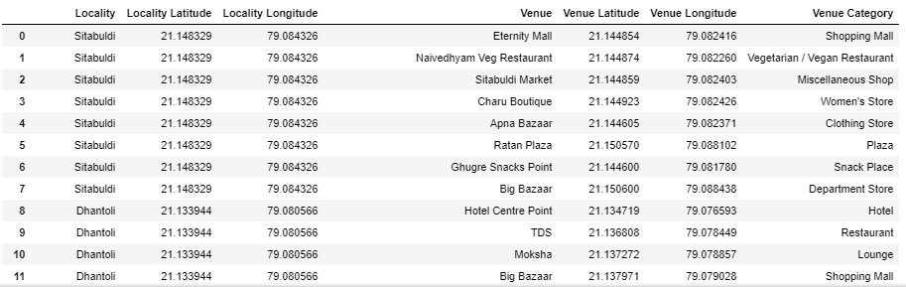
The data frame with the localities along with their venues and their respective categories is as follows:

Slide 12
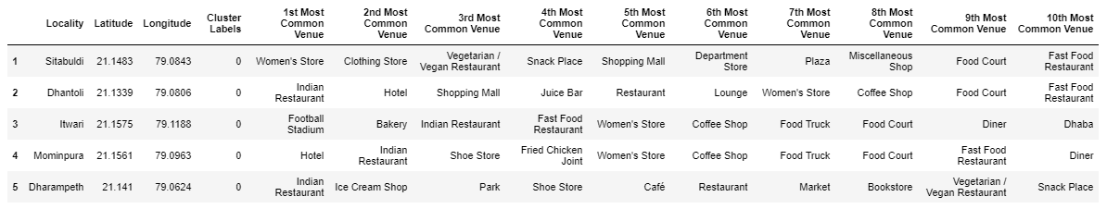
Results
There are 26 localities and 52 categories of nearby venues. As we can see that most of the localities falls into the Cluster 1 as they have similar category of popular venues across it. Also we have seen that other clusters i.e. Cluster 3 and Cluster 4 have only one locality in it and it’s obvious because they are locality situated near hills.
The Data frame with the cluster labels and their most common nearby venues is as follows:

Slide 13
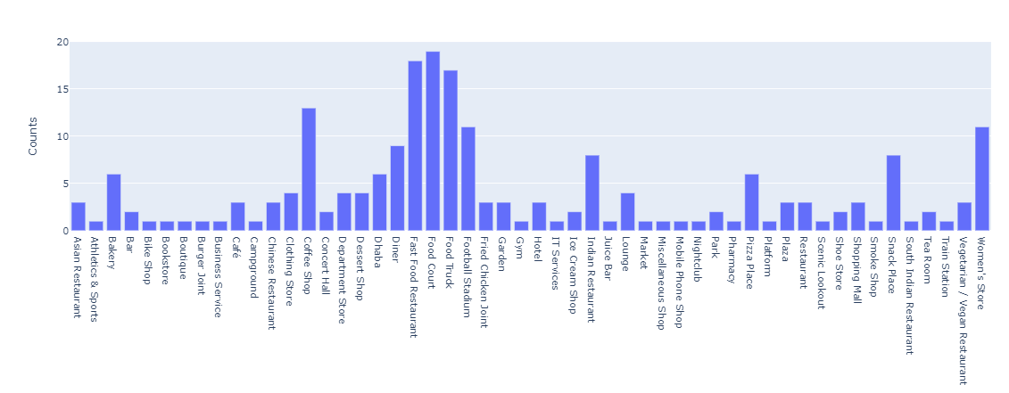
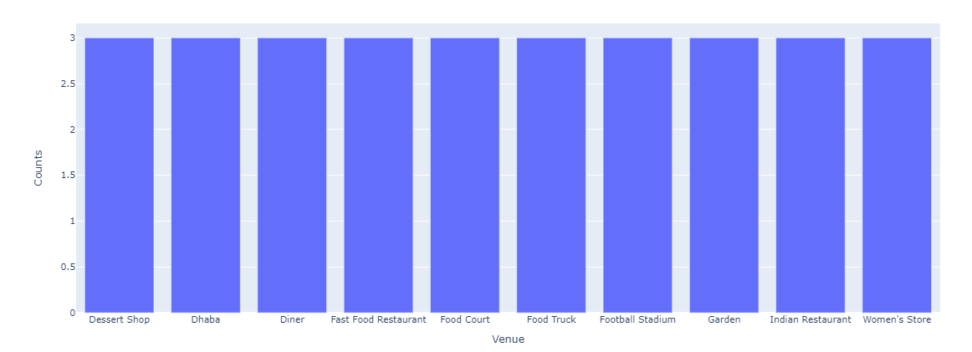
Cluster 1 Venues v/s Count
Cluster 2 Venues v/s Count

Slide 14
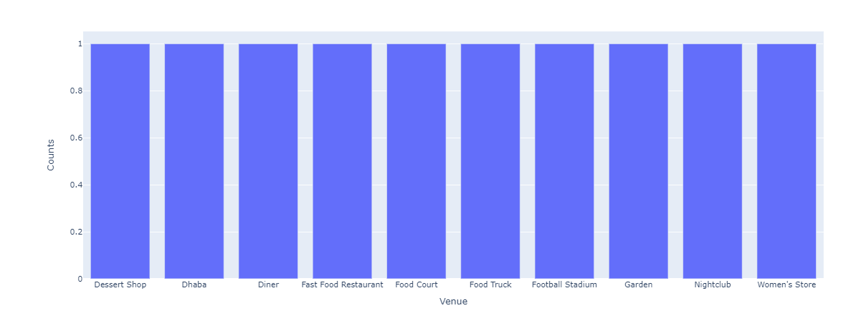
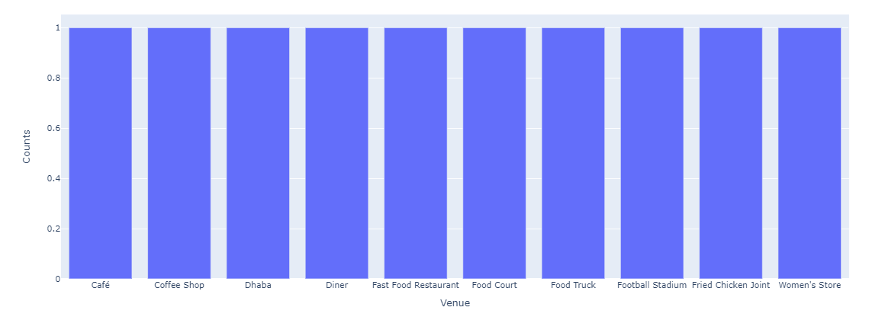
Cluster 3 Venues v/s Count
Cluster 4 Venues v/s Count

Slide 15
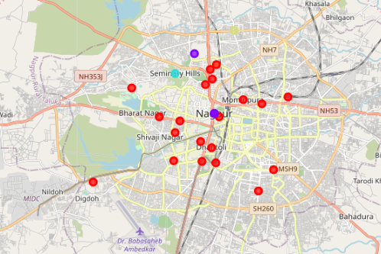
The map with the different clusters of the localities of Nagpur is as follows:

Slide 16
Discussion
As we can see most of the localities falls into the one cluster because most of them have common popular nearby venues.
We can notice that some cluster have only one locality because they are located on the outer portion of the city and nearby hilly areas.
Also we can see the clusters with the most localities in it almost contains all the categories because they are located in the inner part of the city where it is heavily populated compare to the outer regions.

Slide 17
Conclusion
This project is making clusters based on the limited data. So the accuracy of it can be increased by increasing the data. But by looking at the clusters, we can clearly see that the localities which are located in the inner part of Nagpur have been grouped into one cluster because they have most common nearby popular venues as mostly the inner part are densely populated compare to the outer regions. So to summarize it overly it is providing a good recommendation to a person in shifting to new locality which is similar to their old one.

Slide 18
Thank You!!!

