Slide 1

Reinforcement Learning
for Hide-and-Seek
Cathal Hardy | G00424572
Supervisor: Brian O'Shea | Atlantic Technological University | 2025/2026
Bachelor of Engineering (Honours) in Software & Electronic Engineering

Slide 2
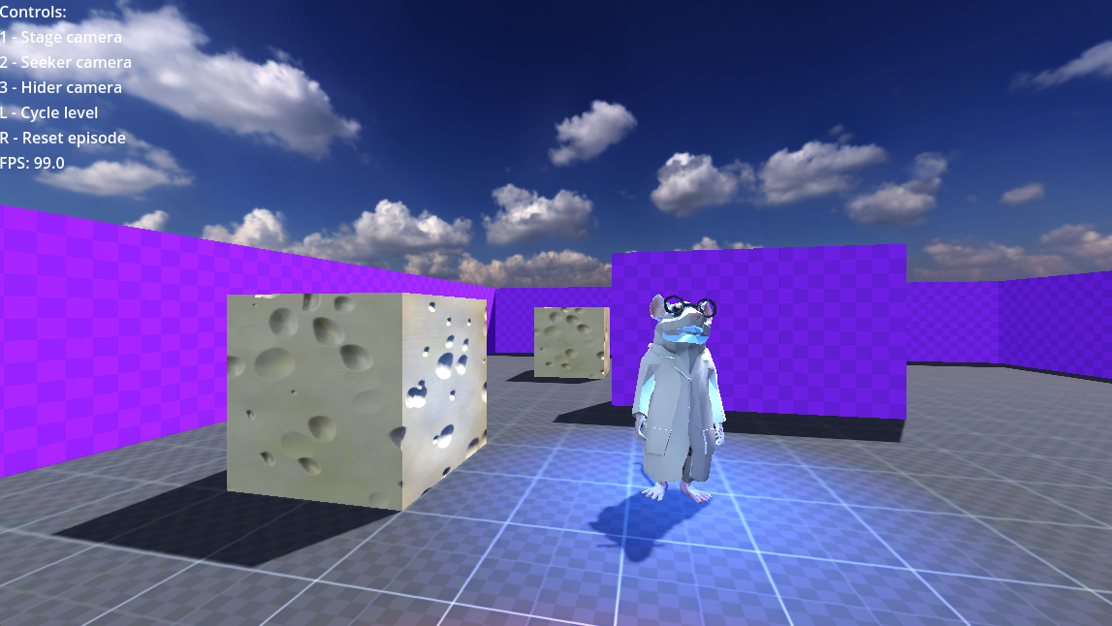
MOTIVATION
Why Hide-and-Seek?
Inspired by OpenAI's 2019 research
OpenAI's 2019 paper
"Emergent Tool Use from Multi-Agent Interaction" showed agents developing complex strategies through competition alone, no explicit programming.
What makes it interesting:
Seekers learned to chase
Hiders learned to build walls
Seekers learned to use ramps
Each side adapted to the other
This project
A scaled-down version using Godot + Python RL, running on a standard PC.

Slide 3
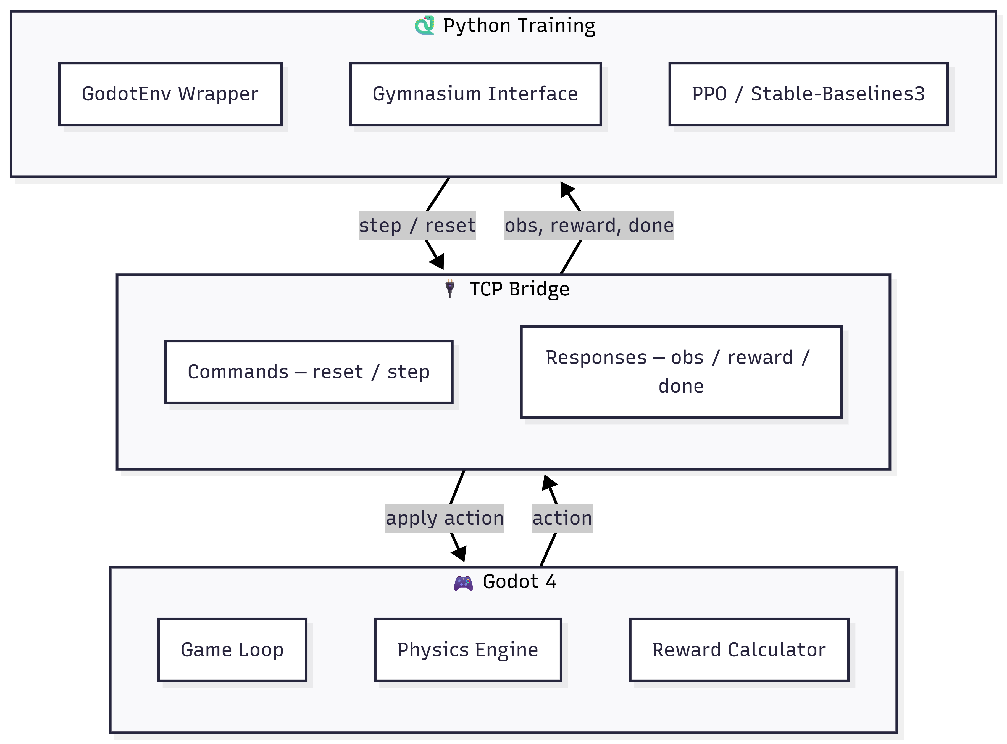
ARCHITECTURE
How It All Fits Together
Godot 4 ↔ TCP Bridge ↔ Python / SB3
Godot 4
TCP Bridge
Python / SB3
Game engine - physics, agents, reward calc
JSON messages: reset / step commands
PPO training, GodotEnv wrapper, Gymnasium

Slide 4
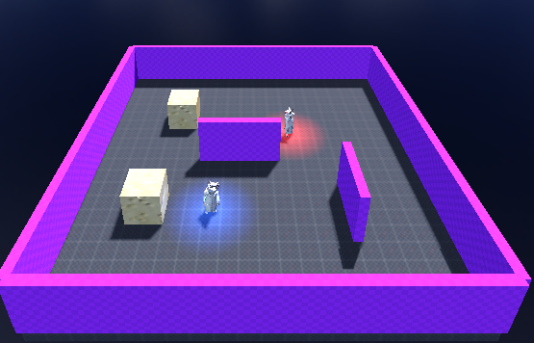
ENVIRONMENT
The Game Environment
Built in Godot 4 - headless during training
Arena
20×20m flat arena with boundary walls and internal obstacles
Agents
Seeker (red) chases Hider (blue) - 3D models via Rodin AI + Mixamo
Obs
velocity, facing direction, self position, 16 LIDAR rays, 23 vision cone rays, opponent features when visible
Actions
4 discrete actions: forward, backward, turn left, turn right
Reward
Distance-delta shaping + catch bonus (+10) or timeout penalty (−5)

Slide 5
TRAINING
Training Pipeline
Curriculum learning - 5 stages from simple to adversarial
Stage 0
Stage 1
Stage 2
Hider
Dual
Fixed Spawns
Random Spawns
Walls + Obs.
Hider Training
Self-Play
100k steps
Basic pursuit
300k steps
Generalisation
600k steps
Navigation
1M steps
Evasion
Alternating
Competition
PPO via Stable-Baselines3 | 2× parallel Godot instances (seeker)

Slide 6
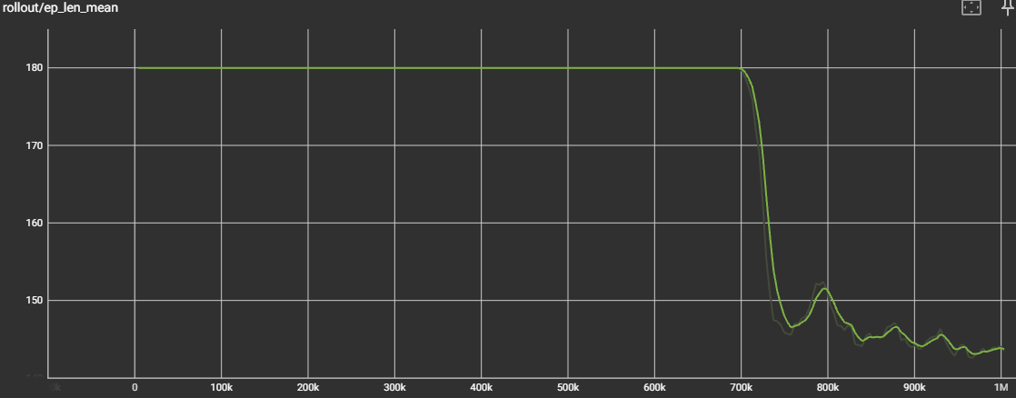
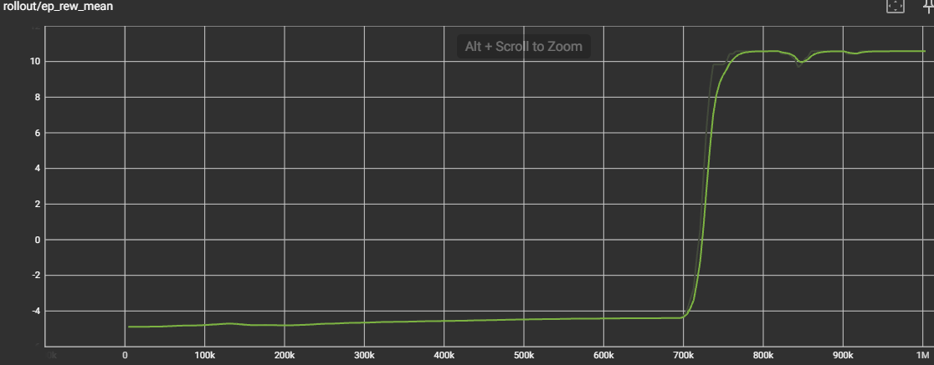
RESULTS
Seeker Results
Curriculum training across 3 stages
Key outcomes
Stage 0: Seeker reaches hider reliably from fixed positions
Stage 1: Generalises to random spawn positions
Stage 2: Navigates around walls to pursue hider
Mean ep. length dropped from 180 → ~140 steps
Reward increased steadily across all stages

Slide 7
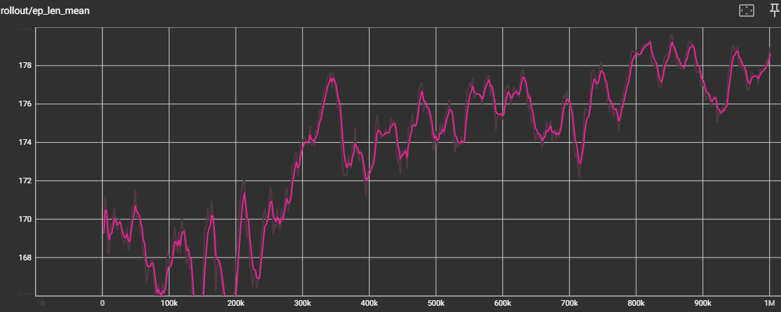
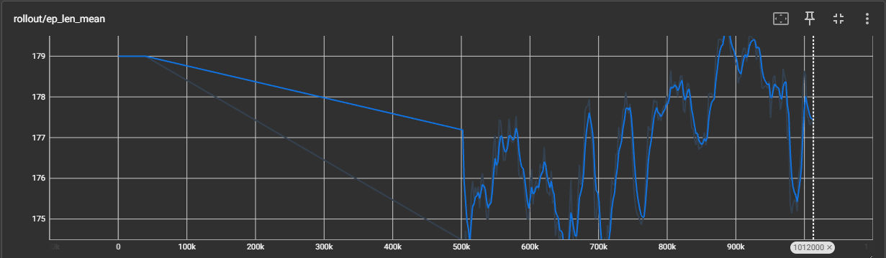
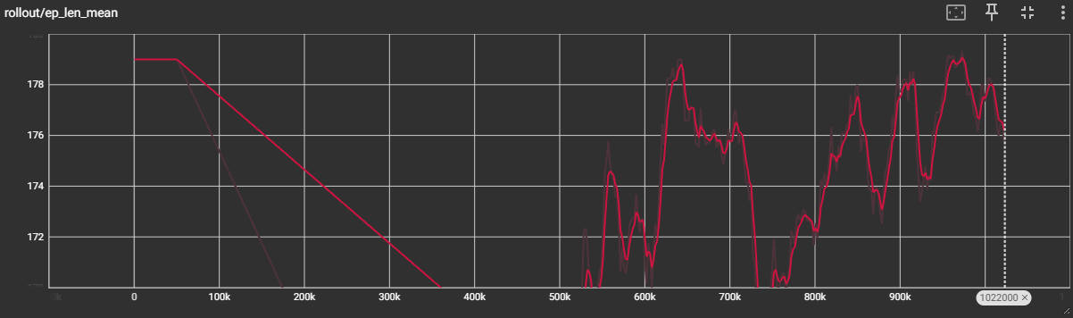
RESULTS
Hider & Dual Self-Play Results
Emergent competitive behaviour
Hider (left):
Survival rate improved against trained seeker
Learned to use walls and avoid open areas
Dual self-play (right):
Both agents continued improving - no dominant strategy emerged
Behaviours from reward signals alone - nothing hard-coded

Slide 8
CHALLENGES
Key Challenges Solved
Problems encountered and how they were fixed
PROBLEM
→ Godot RL Agents Sync node - 10× speed-up + 2× parallel envs
Training too slow
PROBLEM
→ Replaced static reward with per-step distance-delta shaping
Reward not working
PROBLEM
→ Assigned separate physics collision layers
Vision ray interference
PROBLEM
→ Removed strategic box use from scope - kept boxes as static cover
Boxes too complex
PROBLEM
→ Added penalty when outer wall touched to encourage movement
Seeker stuck on walls

Slide 9
CONCLUSION
What Was Achieved
Full end-to-end RL system built from scratch - Godot + TCP bridge + Python training
Seeker trained across 3 curriculum stages - generalises to walls and random spawns
Hider trained against frozen seeker - survival rate improved
Dual self-play produced competitive adversarial behaviour - no strategies hard-coded
30 automated tests, all passing - no Godot instance required
Future work: strategic box & ramp use - moveable objects already in the game engine

Slide 10
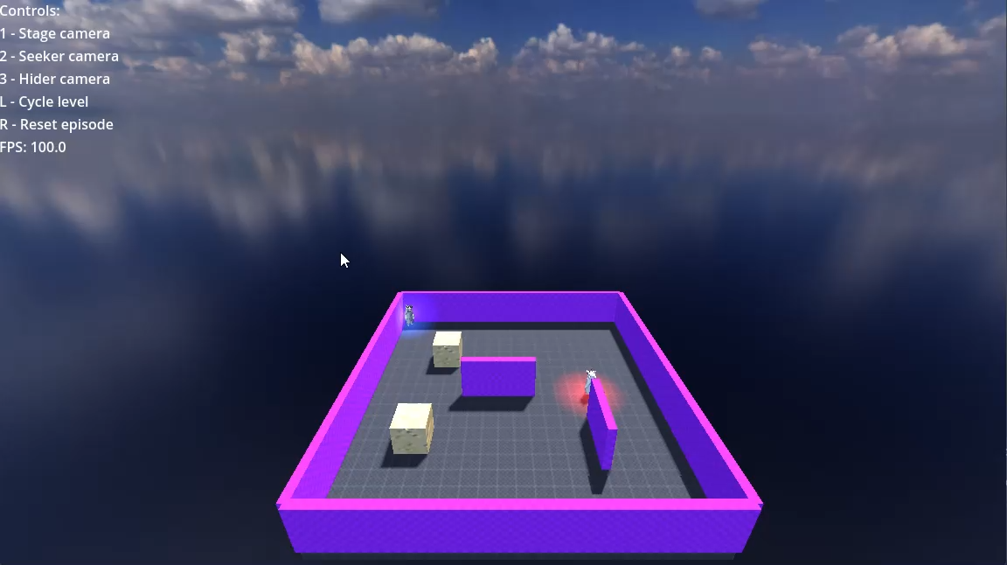
Demo
Reinforcement Learning for Hide-and-Seek | Cathal Hardy | G00424572

