Slide 1
Learning as We Go
Decomposing Dev Environments with Lando
hardy.pottinger@ucop.edu HardyPottinger post-conference workshop Friday March 26, 2021
https://git.io/JqLaG
This work is licensed under a Creative Commons Attribution 4.0 International License
Notes:
Hi, before we get too far along, I thought I’d point out that this workshop is being recorded. Thanks to everyone for coming to this workshop, and to everyone working behind the scenes to make it a success, I appreciate it.
My name is Hardy Pottinger, I am a Publishing Systems Developer with California Digital Library, and this workshop is called Learning as We Go, Decomposing Dev Environments with Lando. The link to all the workshop materials is on this slide, the git.io shortlink. I’m not going to make you follow along with me while I demonstrate Lando, but if you want to do so, go there and follow the readmes. I hope you have already done so, because we have 3 hours today, and I plan to fill them.

Slide 2
Decomposition: “Bringing Order to Chaos”
“When designing a complex software system, it is essential to decompose it into smaller and smaller parts, each of which we may then refine independently... ...to understand any given level of a system, we need only comprehend a few parts (rather than all parts) at once.”
-- Grady Booch, Object-Oriented Analysis and Design 2nd Edition, pg 14
Notes:
I promise I’m not going to fill this workshop with heavy quotes from computer science classics, but I *did* want to explain the title of the workshop a bit, because it’s important to me. ”Bringing Order to Chaos” is the title of the section from which I pulled this quote. “When designing a complex software system, it is essential to decompose it into smaller and smaller parts, each of which we may then refine independently... To understand any given level of a system, we need only comprehend a few parts (rather than all parts) at once.” Smaller and smaller parts, and you need only comprehend each part, rather than everything at once.

Slide 3
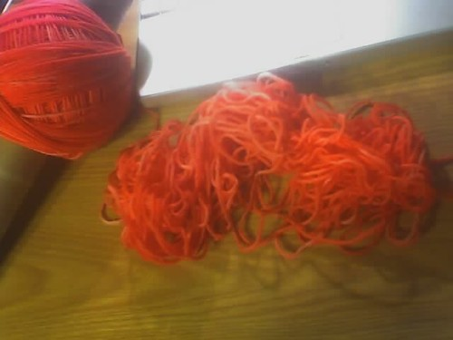
Dev Environment Chaos
Wiki page of detailed instructions,
Was working at time of writing
“Good luck, kid”
Wiki page of steps hastily written from memory, as yet untested
Vagrant
Docker
Docker-Compose
Lando
Notes:
What kind of chaos are we talking about? With dev environments, these are the options I’ve seen in use for various projects. On the left of the yarn, we have more ordered options, on the right, less so. I’m biased, so I put Lando at the base of the ordered side.

Slide 4
Parts: today’s agenda
Docker
The Perils of Cathedrals
Introducing Lando
Start Small, just a database
Let’s build: Omeka-S
Let’s build: Django
Let’s build something together!
about 30 minutes of intro
[5-minute breaks between each section]
about 140 minutes of building stuff
Notes:
Here are the parts of this workshop. For the first 30 minutes, we’ll go through this introduction, then we’ll take a quick break, and come back for 4 exercises. Don’t panic, you don’t need to follow along with any of the typing, you can just kick back and watch. I hope you’ll still get something out of this without typing commands.

Slide 5

Docker: containers are handy
Docker is a collection of products that work together to deliver software in packages called containers
Containers allow us to decompose a development environment into the parts we require
A Database
A Job Queue
A Search Index
An Application server
Notes:
We aren’t going to dive deeply into Docker, because we don’t need to, we just need to keep in mind that Docker is what enables Lando to help us build a development environment. The most important part to know is that Docker is software that helps us organize our project environments into the parts we need. Like a database and an app server.

Slide 6
Docker is both awesome, and awful
Awesome
it gives you the building blocks for a development environment
it can run on modest hardware
Awful
the commands required to do useful things with it are complicated
getting details right is hard, and requires deep knowledge of the system
Notes:
I don’t want to complain about Docker too much, and please don’t take offense if you’ve already invested the time in developing and using a Docker workflow. I want to honor that work and level of commitment, but getting a development environment running, so we can do some work, should not require that level of commitment. Awesome and Awful. You get building blocks, and it runs on most anything. But, it’s complicated, and hard.

Slide 7
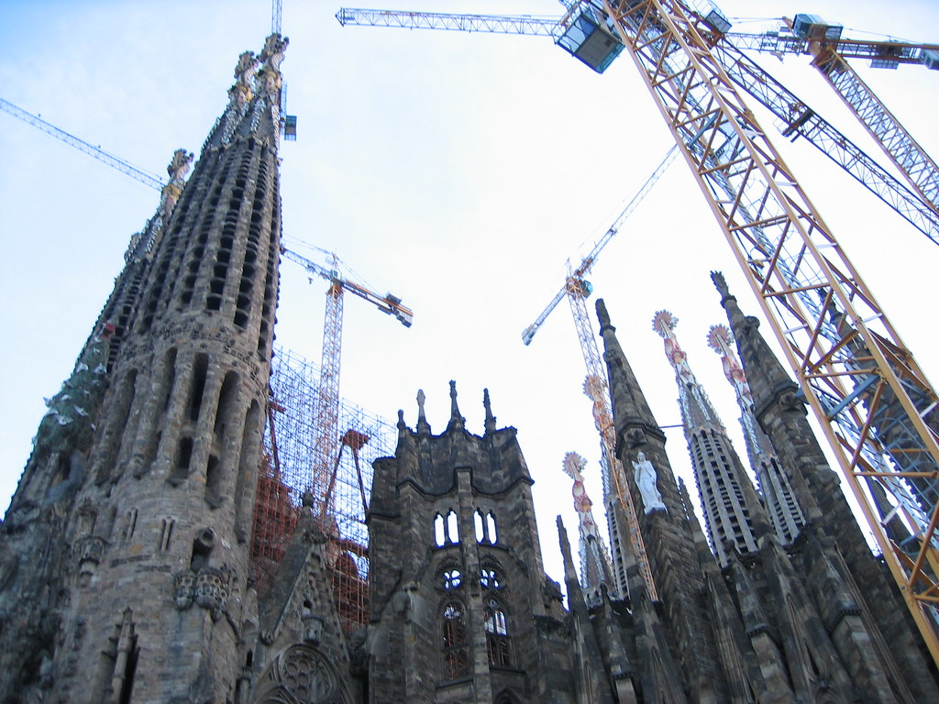
The Peril of Cathedrals
“Perfect” may not be attainable
Searching for perfection has a cost
Docker can be used to build cathedrals
We will not be building cathedrals
We will be building dev environments
Notes:
This is a famous cathedral in Barcelona, Sagrada Família ('Basilica of the Holy Family’), by Antoni Gaudí, it began construction in March of 1882. It’s still not done. I have a picture of this cathedral on my office wall, as a reminder that Perfect may not be attainable, and as a visual reminder of what the quest for perfection can look like. I have this picture in these slides to say, Docker can be used to build huge and beautiful worklfows. We won’t be doing anything like that today. We are going to be building dev environments, so we can get to work.

Slide 8
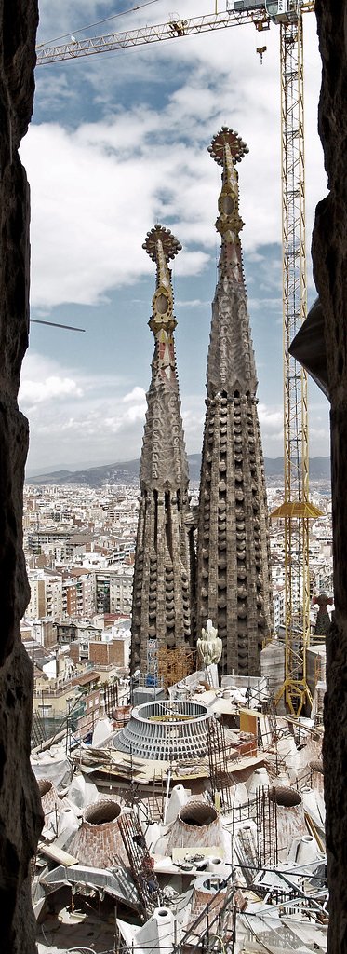
Docker Cathedrals
You can use the same docker image...
in a development environment
in staging
in prod
We will not be building production-ready containers
Please do not try to use Lando in production
If you want this, Lando is probably the wrong tool for you, but there are options
Notes:
The main Lando page makes it very clear that Docker containers built by Lando are not to be used in production. This warning applies to almost any community-supported container you might pull down from Docker Hub: they are built for other reasons, mostly for developer convenience. For example: the official Tomcat containers from Apache all run as root. You do not want to run Tomcat as root. In a development environment, it’s fine, you know, whatever, let’s just get cracking. But you want your production site to be secure.

Slide 9
What’s the point?
Wanting a container you can run in production and in development is scope creep
We’re here to build development environments
We should get to work
Notes:
If you can’t have a perfect workflow, using the same containers in dev as prod, why bother? Honestly, it’s scope creep. I’m here to talk about making some dev environments. You can work on your perfect ideal workflow on your own time. Let’s get to work.

Slide 10

Lando is
Per app, single config file, containerized everything, local dev tool
Simple in repo config file: .lando.yml
Use basic preconfigured stacks
Add in additional services eg solr
Add in additional tools eg node
Build and automation steps
Hosting integrations (Pantheon)
Docker compose abstraction layers
Cross platform
Local dev dependency management
Notes:
The Lando community declares Lando is a “per app, single config file, containerized everything, local dev tool.” Let’s break that down a bit.

Slide 11
Stacks on Stacks on Racks (docs.lando.dev)
Lando
Docker Compose
Docker
Containers
Your Operating System
Notes:
I should admit right now that I’ve borrowed, these intro slides from the Lando folks, they have a Google drive full of slide decks. Like a lot of opensource projects, they have a ton of resources and docs. The best place to start reading about Lando is docs.lando.dev. “Stacks on Stacks on Racks” is their explanation of Lando. It starts with your operating system, which includes tech for containers, and then Docker running on that, and Docker Compose on top of Docker, and then Lando.

Slide 12
Core services/languages supported
Ruby
PHP
Python
Node
Go
MySQL
PostgreSQL
Solr
Elasticsearch
Tomcat
Notes:
At its core, Lando prepackages docker images for various services and technologies. Here are a few.

Slide 13
More Services! (configurable and swappable)
Apache
Mailhog
Memcached
MongoDB
Nginx
PHPmyAdmin
Redis
Varnish
Notes:
And here are a few more. Each of these services is configurable, and you can swap in different ones (like use MySQL as a database, and then you can experiment using PostgreSQL instead)

Slide 14
Pre-baked recipe start states
Backdrop
LAMP/LEMP
MEAN
Drupal 6/7/8
Pantheon
Wordpress
Laravel
Joomla
Notes:
The Lando docs site makes a big deal about recipes, they’re flashy and can get you going quickly, but really, most of us are going to be working on stuff that is a bit more complicated than a Drupal site. (No offense, Drupal folks). We *will* use the LAMP recipe for Omeka, and IF you have a PHP app like Omeka or OJS, a Lando recipe a very fast way to get to work.

Slide 15
Installing Lando: one-click installers for Windows, OSX, Linux
Download: https://github.com/lando/lando/releases
Docs: https://docs.lando.dev/basics/installation.html
Installers include Docker and Docker-Compose
You do not have to reinstall Docker/Compose/Desktop
Check your version numbers!
Notes:
Installing is easy, just download the thing, click on the thing, agree to terms. If you already have Docker and Docker-Compose installed, you don’t need to reinstall Lando’s versions, but do verify that the versions you are running are at least the same as what Lando wants to install. If not, you may want to upgrade your docker setup.

Slide 16
.lando.yml (The Landofile)
One config file
Specifies all the services your app needs for development
Goes in your project code repository next to all your source code
It’s small and hidden, it won’t get in the way
Notes:
The Landofile is the heart of what tells Lando what to do. It goes into your project root, next to all of your source code.

Slide 17
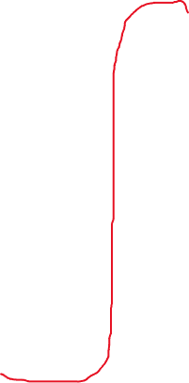
---
name: demo-project
env_file:
keys:
services:
appserver:
type: ruby:2.5
volumes:
ports:
- ‘3000:3000’
overrides:
command:
build_as_root:
build:
run:
run_as_root:
db:
type: mysql
portforward: true
creds:
user: dba
password: random
database: sample
tooling:
ruby:
service: appserver
Inside the .lando.yml file
Notes:
This is a sketch of a Landofile. It’s not complete, but gives you an idea of what one looks like. It’s yaml, so, you know, gotta start with three dashes. We’ll dig into the details through the rest of this workshop, but some things I want you to remember: you can specify environment variables in env files, you can provide as many as you need. SSH key management is mostly automatic with Lando (it copies your SSH keys for you), but you can control which key gets used by specifying it in the Landofile. Then you have SERVICES and TOOLING. Services are the pieces you need to develop your application. Tooling defines how you’ll interact with those services on the command line. Tooling is probably the most fun aspect of working with Lando, as the feedback loop is instantaneous. As soon as you add a new tooling config, you can use it, no reboot, no rebuild. Just dream it, write it, use it. I am skipping a few things with this sketch, such as recipe configuration. You don’t NEED to use a recipe with Lando, but I’ll show you one now.

Slide 18
---
name: demo-lamp-project
recipe: lamp
config: php: 5.6
webroot: web
database: mysql:5.7
Inside the .lando.yml file
(recipe version)
Notes:
Here’s a quick look at a Landofile that uses a recipe: this uses the Lamp recipe, so you specify what version of PHP you want to use, and what DB you want to use, and everything is auto-configured by convention. If a Lamp stack is what your app needs, this will get you going.

Slide 19
Lando Cheat Sheet: https://git.io/JqLaI
Notes:
After you start up Lando with your Landofile in place, what happens? I made you a Lando cheat sheet, you should check that URL and print it out, keep it handy. Thanks to the magic of Docker mounts, your project_root folder is mounted as /app in every service container you define in your Landofile. It’s in the DB, in Solr, in your Appserver. This is for convenience. And it *is* convenient, knowing where your application code is. So, I want you to have this mental model ready for later. Your project_root is at /app.

Slide 20
Is this even real? Who even uses Lando?
CDL https://github.com/eScholarship/jschol/blob/master/.lando.yml
Janeway https://github.com/BirkbeckCTP/janeway/blob/master/.lando.yml
Princeton https://github.com/pulibrary/pulfalight/blob/main/.lando.yml
Valkyrie https://github.com/samvera/valkyrie/blob/master/.lando.yml
Every Landofile in GitHub https://github.com/search?q=filename%3A.lando.yml&type=Code
Notes:
Here’s my name-dropping slide. The first two are cheating a bit, *I* wrote those files. I just found out that Princeton uses Lando for a project. The Valkyrie project uses Lando. And there’s the link to every Landofile in Github, if you want to explore more.

Slide 21
Questions?
Notes:
OK, before I do a demo of Lando, any questions? Do we need a quick break?

Slide 22
Demo: Using Lando
Notes:
Here’s a quick demo of Lando, to give you an idea of what working with it is like. I will use the environment I created to work on Jschol, which is the main UI for eScholarship, CDL’s portal to IR and Journal content.

Slide 23
Questions? Break?
Notes:
Any questions? Do we need a break before we start working on stuff together? Meet back here in 5 minutes.

Slide 24
Exercise 1: MySQL https://git.io/Jm1Uv
Let’s make a database and import a backup from prod.
Notes:
A database is often the heart of our applications, and this is a great way to get a feel for how Lando works. You also end up with something you can use: a copy of your production data, running locally on your notebook. Where you can run whatever unsafe query or update your heart might desire.
Workshop link: https://git.io/JqLaG Exercise link: https://git.io/Jm1Uv
1. Download a sample database
2. lando init –full
3. Delete the PHP stuff
4. Change portforward to 3306
5. Lando poweroff
6. Lando rebuild
7. Lando db-import
8. Lando mysql
9. Destroy some stuff
10. Rebuild the environment
11. Extra Credit: add PhpMyAdmin

Slide 25
Questions? Break?
Notes:
Any questions? Do we need a quick break? Meet back here in 5 minutes.

Slide 26
Exercise 2: Omeka-S https://git.io/Jm1Ub
OK, fine, it’s a LAMP application. Let’s use a recipe.
Notes:
Oh, cool, now we get to use a recipe. And, if you’ve never used Omeka-S, it’s pretty cool. I think you’ll like it. I hope we don’t lose you to it. Stay with us, there’s more we want to do today.

Slide 27
Questions? Break?
Notes:
Any questions? Do we need a quick break? Meet back here in 5 minutes.

Slide 28
Exercise 3: Django https://git.io/Jm1T0
Notes:
OK, final workspace I have prepared, let’s get Django running. And maybe, if we have time, we can try to start up a debugger.

Slide 29
Questions? Break?
Notes:
Any questions? Do we need a quick break? Meet back here in 5 minutes.

Slide 30
Exercise 4: Live Coding!
Let’s build a dev environment together!
Notes:
OK, this is going to be fun. I have an idea of what you all will suggest we build together, but let’s figure that out first. Then let’s build it.

Slide 31
Extra Credit
https://docs.lando.dev/guides/frontend.html Need grunt, gulp, etc? You can haz.
https://docs.lando.dev/guides/lando-101/lando-overview.html More Lando learning.
Interesting topics
Proxy (pick a domain name, or work offline)
Events (more automation)
Compose (custom) service (make your own service)
Notes:
Now that we’ve built a database, Omeka-S and Django dev environments, if you want to explore more, here are some things to check out. I haven’t tried the frontend tooling that Lando makes available, but it looks cool. I especially like that you can just slap on these front-end toolsets like grunt and gulp, to any other dev environment. And other places to play are, if you want to work offline, you can experiment with the proxy configuration options. Or if you want to automate more things, check out the Events configuration. Or, if you want to use Lando as a piece of your great Docker empire, check out the Compose/custom service. You *can* use your custom Docker images. It’ll just take more work on your part.

Slide 32
Questions?
Notes:
Any questions?

Slide 33
Credits
tangle by Trinity
sagrada família: more cranes by cygnoir
Temple Expiatori de la Sagrada Família by PHOTOGRAPHRdotNET
Computer created by Med Marki from the Noun Project
Container created by ProSymbols from the Noun Project
Folder created by Landon Lloyd from the Noun Project
File created by Ranah Pixel Studio from the Noun Project
Notes:
Here are the credits for the images I used in these slides.

