Slide 1
Learning as We Go
Decomposing Dev Environments with Lando
hardy.pottinger@ucop.edu HardyPottinger post-conference workshop Friday March 26, 2021
https://git.io/JqLaG

Slide 2
Decomposition: “Bringing Order to Chaos”
“When designing a complex software system, it is essential to decompose it into smaller and smaller parts, each of which we may then refine independently... ...to understand any given level of a system, we need only comprehend a few parts (rather than all parts) at once.”
-- Grady Booch, Object-Oriented Analysis and Design 2nd Edition, pg 14
Notes:
I promise I’m not going to fill this workshop with heavy quotes from computer science classics, but I *did* want to explain the title of the workshop a bit, because it’s important to me. ”Bringing Order to Chaos” is the title of the section from which I pulled this quote. [read quote] Smaller and smaller parts, and you need only comprehend each part, rather than everything at once.

Slide 3
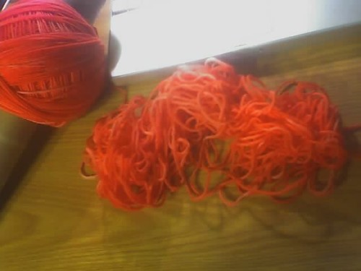
Dev Environment Chaos
Wiki page of detailed instructions,
Was working at time of writing
“Good luck, kid”
Wiki page of steps hastily written from memory, as yet untested
Vagrant
Docker
Docker-Compose
Lando
Notes:
What kind of chaos are we talking about? With dev environments, these are the options I’ve seen in use for various projects. On the left of the yarn, we have more ordered options, on the right, less so. I’m biased, so I put Lando at the base of the ordered side.

Slide 4
Parts: today’s agenda
Docker
The Perils of Cathedrals
Introducing Lando
Start Small, just a database
Let’s build: Omeka-S
Let’s build: Django
Let’s build something together!
about 30 minutes of intro
about 140 minutes of building stuff
Notes:
Here are the parts of this workshop. For the first 30 minutes, we’ll go through this introduction, then we’ll take a quick break, and come back for 4 exercises. Don’t panic, you don’t need to follow along with any of the typing, you can just kick back and watch. I hope you’ll still get something out of this without typing commands.

Slide 5

Docker: containers are handy
Docker is a collection of products that work together to deliver software in packages called containers
Containers allow us to decompose a development environment into the parts we require
A Database
A Job Queue
A Search Index
An Application server
Notes:
We aren’t going to dive deeply into Docker, because we don’t need to, we just need to keep in mind that Docker is what enables Lando to help us build a development environment. The most important part to know is that Docker is software that helps us organize our project environments into the parts we need. Like a database and an app server.

Slide 6
Docker is both awesome, and awful
Awesome
it gives you the building blocks for a development environment
it can run on modest hardware
Awful
the commands required to do useful things with it are complicated
getting details right is hard, and requires deep knowledge of the system

Slide 7
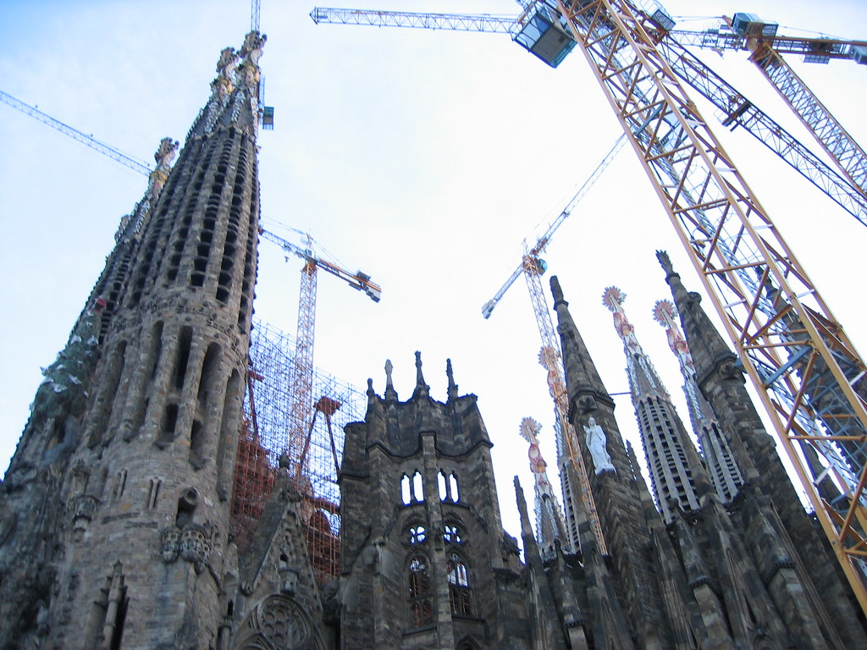
The Peril of Cathedrals
“Perfect” may not be attainable
Searching for perfection has a cost
Docker can be used to build cathedrals
We will not be building cathedrals
We will be building dev environments
Notes:
This is a famous cathedral in Barcelona, Sagrada Família ('Basilica of the Holy Family’), by Antoni Gaudí, it began construction in March of 1882. It’s still not done. I have a picture of this cathedral on my office wall, as a reminder that Perfect may not be attainable, and as a visual reminder of what the quest for perfection can look like. I have this picture in these slides as a way to say, Docker can be used to build huge and beautiful worklfows. We won’t be doing anything like that today. We are going to be building dev environments, so we can get to work.

Slide 8
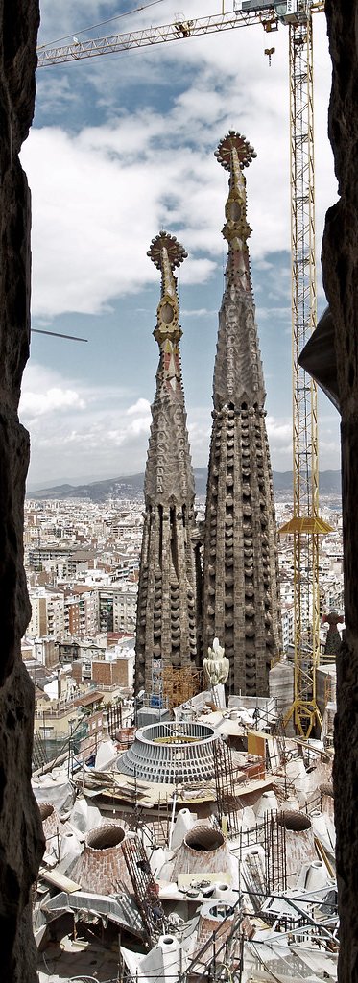
Docker Cathedrals
You can use the same docker image...
in a development environment
in staging
in prod
We will not be building production-ready containers
Please do not try to use Lando in production
If you want this, Lando is probably the wrong tool for you, but there are options
Notes:
The main Lando page makes it very clear that Docker containers built by Lando are not to be used in production. This warning applies to almost any community-supported container you might pull down from Docker Hub: they are built for other reasons, mostly for developer convenience. For example: the official Tomcat containers from Apache all run as root. You do not want to run Tomcat as root. In a development environment, it’s fine, you know, whatever, let’s just get cracking. But you want your production site to be secure.

Slide 9
What’s the point?
Wanting a container you can run in production and in development is scope creep
We’re here to build development environments
We should get to work

Slide 10

Lando is
Per app, single config file, containerized everything, local dev tool
Simple in repo config file: .lando.yml
Use basic preconfigured stacks
Add in additional services eg solr
Add in additional tools eg node
Build and automation steps
Hosting integrations (Pantheon)
Docker compose abstraction layers
Cross platform
Local dev dependency management

Slide 11
Stacks on Stacks on Racks (docs.lando.dev)
Lando
Docker Compose
Docker
Containers
Your Operating System
Notes:
I should admit right now that I’ve borrowed, these intro slides from the Lando folks, they have a Google drive full of slide decks. Like a lot of opensource projects, they have a ton of resources and docs. The best place to start reading about Lando is docs.lando.dev. Stacks on Stacks on Racks is their explanation of just what Lando is. It starts with your operating system, which includes tech for containers, and then Docker running on that, and Docker Compose on top of Docker, and then Lando.

Slide 12
Core services/languages supported
Ruby
PHP
Python
Node
Go
MySQL
PostgreSQL
Solr
Elasticsearch
Tomcat

Slide 13
More Services! (configurable and swappable)
Apache
Mailhog
Memcached
MongoDB
Nginx
PHPmyAdmin
Redis
Varnish

Slide 14
Pre-baked recipe start states
Backdrop
LAMP/LEMP
MEAN
Drupal 6/7/8
Pantheon
Wordpress
Laravel
Joomla
Notes:
The Lando docs site makes a big deal about recipes, they’re flashy and can get you going quickly, but really, most of us are going to be working on stuff that is a bit more complicated than a Drupal site. We *will* use the LAMP recipe for Omeka, and if you have a PHP app like Omeka or OJS, it’s a very fast way to get to work.

Slide 15
Installing Lando: one-click installers for Windows, OSX, Linux
Download: https://github.com/lando/lando/releases
Docs: https://docs.lando.dev/basics/installation.html
Installers include Docker and Docker-Compose
You do not have to reinstall Docker/Compose/Desktop
Check your version numbers!

Slide 16
.lando.yml
One config file
Specifies all the services your app needs for development
Goes in your project code repository next to all your source code
It’s small and hidden, it won’t get in the way

Slide 17
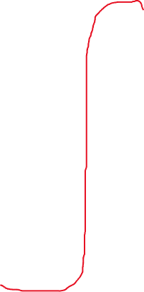
---
name: demo-project
env_file:
keys:
services:
appserver:
type: ruby:2.5
volumes:
ports:
- ‘3000:3000’
overrides:
command:
build_as_root:
build:
run:
run_as_root:
db:
type: mysql
portforward: true
creds:
user: dba
password: random
database: sample
tooling:
ruby:
service: appserver
Inside the .lando.yml file
Notes:
This is a sketch of a .lando.yml file, it’s not complete, but gives you an idea of what one looks like. It’s yaml, so, you know, gotta start with three dashes. We’ll dig into the details through the rest of this workshop, but some things I want you to remember: you can specify environment variables in env files, you can provide as many as you need. SSH key management is mostly automatic with Lando (it copies your SSH keys for you), but you can control which key gets used by specifying it in the Landofile. Then you have SERVICES and TOOLING. Services are the pieces you need to develop your application. Tooling defines how you’ll interact with those services on the command line. Tooling is probably the most fun aspect of working with Lando, as the feedback loop is instantaneous. As soon as you add a new tooling config, you can use it, no reboot, no rebuild. Just dream it, write it, use it. Oh, if you’ve used Lando before or you’ve been keeping notes, you’ll probably be wondering if I’ve missed something here, and you’d be right, I’m intentionally skipping RECIPES for now. Mostly because as a library developer, none of the recipes will be a good fit. And recipes are too much magic. I’ve skipped other things as well, we’ll talk about them later, if we have time.

Slide 18
---
name: demo-lamp-project
recipe: lamp
config: php: 5.6
webroot: web
database: mysql:5.7
Inside the .lando.yml file
(recipe version)
Notes:
Here’s a quick look at a Landofile that uses a recipe: this uses the Lamp recipe, so you specify what version of PHP you want to use, and what DB you want to use, and everything is auto-configured by convention. If a Lamp stack is what your app needs, this will get you going.

Slide 19
Lando Cheat Sheet: https://git.io/JqLaI

Slide 20
Questions?

Slide 21
Demo: Using Lando

Slide 22
Questions?

Slide 23
Exercise 1: MySQL
Let’s make a database and import a backup from prod.
Notes:
A database is often the heart of our applications, and this is a great way to get a feel for how Lando works. You also end up with something you can use: a copy of your production data, running locally on your notebook. Where you can run whatever unsafe query or update your heart might desire.

Slide 24
Questions?

Slide 25
Exercise 2: Omeka-S
OK, fine, it’s a LAMP application. Let’s use a recipe.

Slide 26
Questions?

Slide 27
Exercise 3: Django

Slide 28
Questions?

Slide 29
Exercise 4: Live Coding!
Let’s build a dev environment together!

Slide 30
Extra Credit
https://docs.lando.dev/guides/frontend.html Need grunt, gulp, etc? You can haz.
https://docs.lando.dev/guides/lando-101/lando-overview.html More Lando learning.
Interesting topics
Proxy (pick a domain name, or work offline)
Events (more automation)
Compose (custom) service (make your own service)

Slide 31
Questions?

Slide 32
Credits
“tangle” by Trinity is licensed with CC BY-SA 2.0. https://search.creativecommons.org/photos/c574d90e-753d-4be0-8658-ae1ff4109717
“sagrada família: more cranes” by cygnoir is licensed with CC BY-NC-ND 2.0. https://search.creativecommons.org/photos/c7d00256-b165-462c-837f-2c5f0cfb5ff9
“Temple Expiatori de la Sagrada Família” by PHOTOGRAPHRdotNET is licensed with CC BY-ND 2.0.

