Slide 1

Vagrant-DSpace Live Demo
Open Repositories 2015
Indianapolis, IN
Hardy Pottinger
@hardypottinger
http://lso.umsystem.edu/~pottingerhj/
slides:
This work is licensed under a Creative Commons Attribution-ShareAlike 4.0 International Public License.

Slide 2
Who is this guy, anyway?
I’m a repository developer, working in Missouri
I’m a DSpace Committer (since August 2011)
I really like to collaborate, not just with other developers
I complain, a lot
Notes:
I usually start my presentations with a map showing where Missouri is, but, I assume you all know, because you’re here.

Slide 3
Developing software does not need to be as hard as we have made it
I was overwhelmed
My boss said, “We’ll get you some help.”
We hired a student
I did my best to show him the way
Notes:
Let me tell you a story…

Slide 4
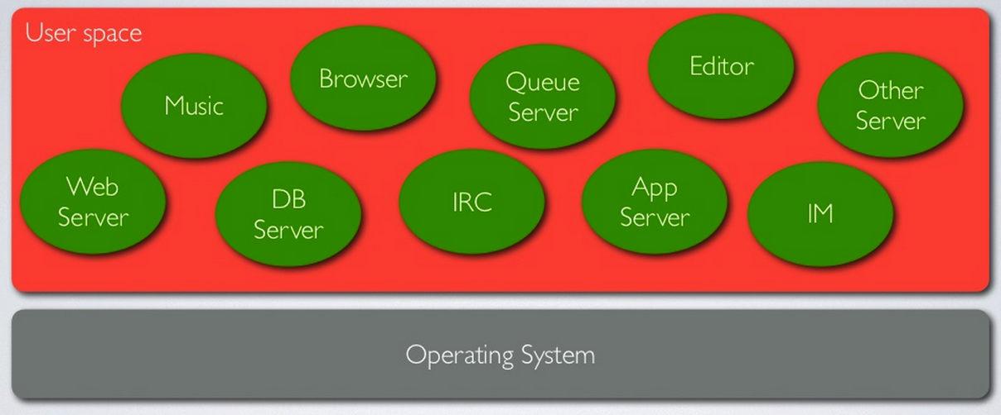
the traditional “everything in user space” way

Slide 5

We spent months, he did not get past this hurdle

Slide 6
I complained, again
Our sysadmin pointed me to Vagrant
http://www.vagrantup.com/
Go there now if you want, it’s cool with me.
“Development environments made easy.”

Slide 7
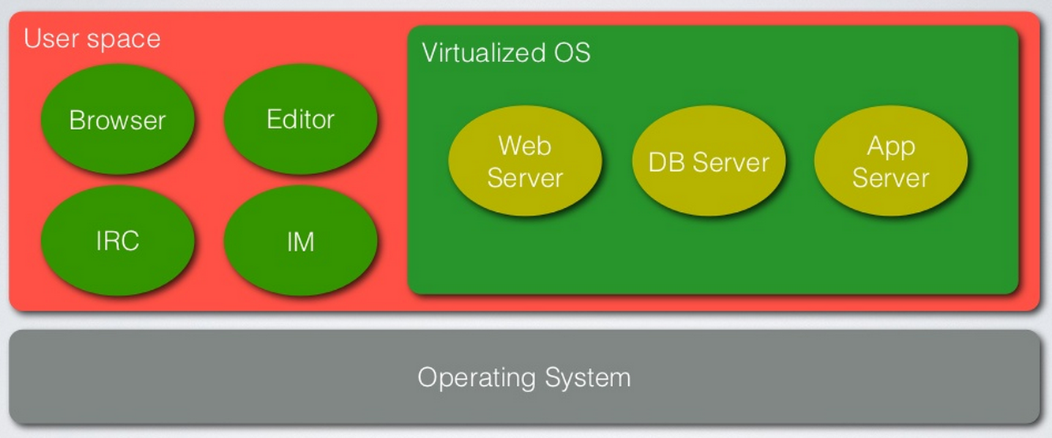
What is Vagrant?
Notes:
Vagrant is a tool for building Virtual Machines, tailored for use in development, in a repeatable, sharable way.

Slide 8
No, really, what is Vagrant?
“Vagrant is a tool for building complete development environments.”
Set up a development environment
Quickly
Reproducibly
In a way that is readily sharable with others
http://www.vagrantup.com/

Slide 9
Vagrant-DSpace is born
https://github.com/dspace/vagrant-dspace
A collaboration between myself and Tim Donohue, with some help from Luigi Andrea Pascarelli (thanks, Tim & Andrea, we owe you)
I knew Tim was working on Puppet modules for provisioning DSpace Direct, so I pestered him to share his modules with me
Vagrant has Puppet embedded, Tim shared what he had, we got it all working with Vagrant
Notes:
What is puppet? You can think of it as a “configuration language” for servers, a way of specifying and ensuring a server is set up in exactly the way you need.
This, incidentally, is how almost all open source software projects get their start…

Slide 10
What do I love about
Vagrant-DSpace?
https://github.com/dspace/vagrant-dspace
It lets me work off-line
I can quickly and easily switch hats:
  MOspace developer
    making our repository better
  DSpace committer
    making DSpace better
Notes:
What is puppet? You can think of it as a “configuration language” for servers, a way of specifying and ensuring a server is set up in exactly the way you need.
This, incidentally, is how almost all open source software projects get their start…

Slide 11
What do I love about
Vagrant-DSpace?
https://github.com/dspace/vagrant-dspace
We can add a new developer very quickly
We can easily upgrade our hardware without worrying about reconfiguration
We have options for testing provisioning and deployment improvements without involving operations staff
Notes:
What is puppet? You can think of it as a “configuration language” for servers, a way of specifying and ensuring a server is set up in exactly the way you need.
This, incidentally, is how almost all open source software projects get their start…

Slide 12
What do I love about
Vagrant-DSpace?
http://docs.vagrantup.com/v2/share/
Vagrant share is a really great way to get others involved in reviewing work
Vagrant share allows me to “pair program” with developers all over the world
Requires a login, it's free
Notes:
What is puppet? You can think of it as a “configuration language” for servers, a way of specifying and ensuring a server is set up in exactly the way you need.
This, incidentally, is how almost all open source software projects get their start…

Slide 13
Let's do something cool!
https://github.com/dspace/vagrant-dspace
Let's test a pull request!
If it looks fixed, let's merge the code!
Notes:
What is puppet? You can think of it as a “configuration language” for servers, a way of specifying and ensuring a server is set up in exactly the way you need.
This, incidentally, is how almost all open source software projects get their start…

Slide 14
Let's test a pull request!
https://github.com/dspace/dspace/pulls
DSPR#955
DS-2560
Did you mean option missing in Mirage2
https://github.com/dspace/dspace/pull/955
Notes:
What is puppet? You can think of it as a “configuration language” for servers, a way of specifying and ensuring a server is set up in exactly the way you need.
This, incidentally, is how almost all open source software projects get their start…

Slide 15
You mean I have to install something else?
https://github.com/dspace/vagrant-dspace
it's not that hard to install stuff
you'll be productive faster than you can imagine
working offline is totally worth it
Notes:
What is puppet? You can think of it as a “configuration language” for servers, a way of specifying and ensuring a server is set up in exactly the way you need.
This, incidentally, is how almost all open source software projects get their start…

Slide 16
Questions?
slides are at: http://hdl.handle.net/10355/41264

Slide 17
Images Used
Slides 18 & 23 from San Francisco DevOps: Introducing Vagrant,
used by permission of Mitchell Hashimoto
http://www.slideshare.net/mitchellh/sf-devops-introducing-vagrant
slides are at: http://hdl.handle.net/10355/41264

