Slide 1
TripleO Project Onboarding
OpenStack Summit Boston
9th May 2017
Steve Hardy (shardy@redhat.com)
Dan Prince (dprince@redhat.com)
James Slagle (jslagle@redhat.com)

Slide 2
Introduction, Overview

Slide 3
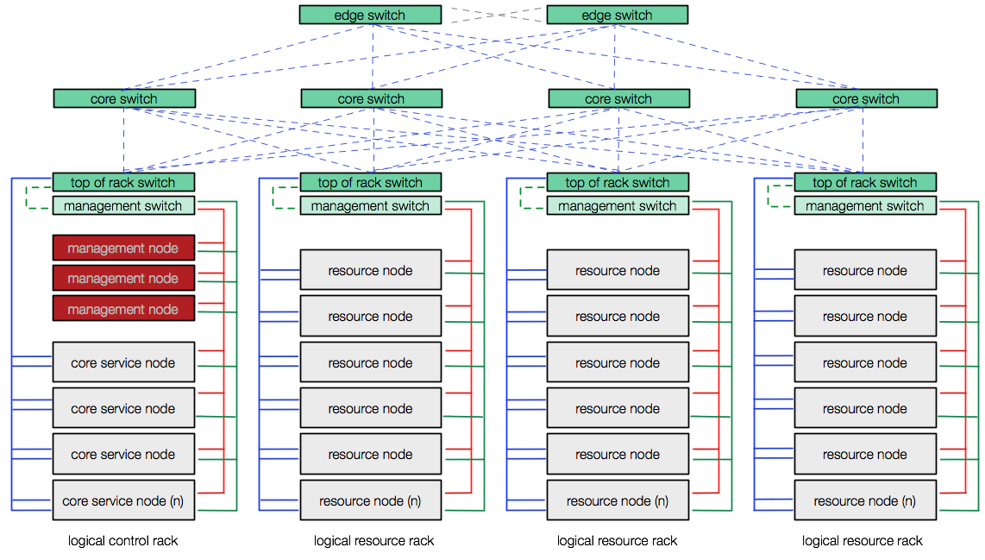


TripleO - Deployment
Deployment & Management App
OpenStack Production Cloud
OpenStack
OpenStack

Slide 4
TripleO - Deployment
Deployment & Management App
OpenStack Production Cloud
Undercloud
Overcloud

Slide 5
TripleO - Deployment
Deployment & Management App
OpenStack Production Cloud
Deployment,
Management
Openstack Production Cloud

Slide 6
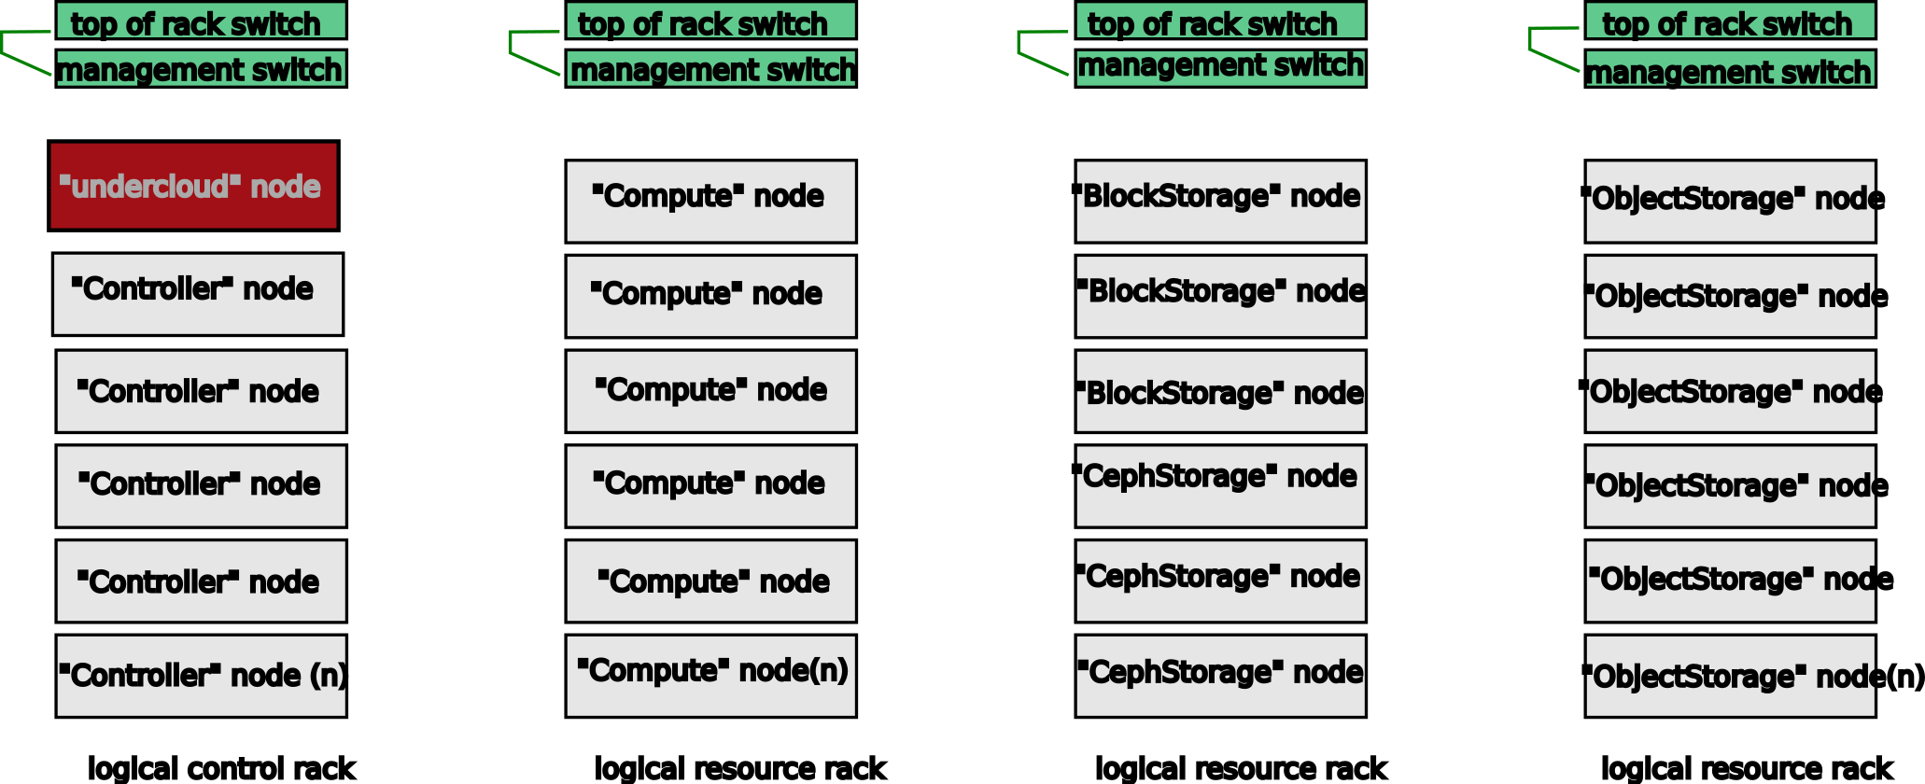
TripleO Logical View
Deployment and Management
OpenStack Services
  Ironic (provisioning)
  Heat (Orchestration)
  Mistral (Workflow)
UI/CLI
API (based on Mistral)
Used to deploy and manage
the nodes, defined by:
Images
Heat Templates
Puppet Manifests
Container images (WIP)

Slide 7
TripleO Logical View
Controller Nodes
OpenStack Services
RPC
Database
Pacemaker/Corosync
Ceph Monitor

Slide 8
TripleO Logical View
Compute Nodes
Nova Hypervisor services
Ceilometer agent
Neutron agent

Slide 9
TripleO Logical View
CephStorage Nodes
Ceph OSD
Can be backend for:
  Nova
  Cinder
  Glance
  Gnocchi

Slide 10
TripleO Logical View
BlockStorage Nodes
cinder-volume (LVM)

Slide 11
TripleO Logical View
ObjectStorage Nodes
Swift Object Store

Slide 12
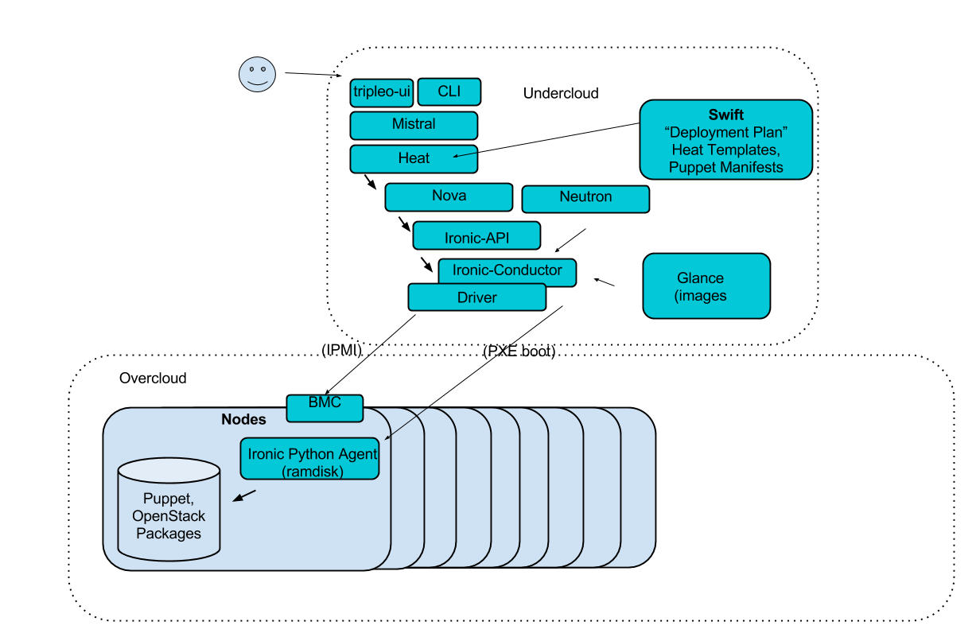
TripleO

Slide 13
Heat concepts, composability

Slide 14
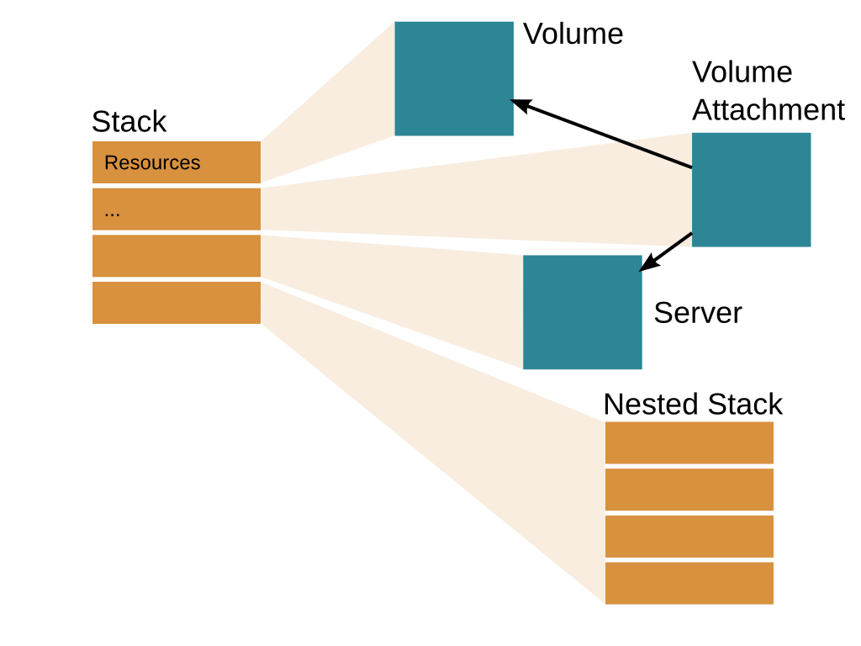
Heat “Stack”

Slide 15
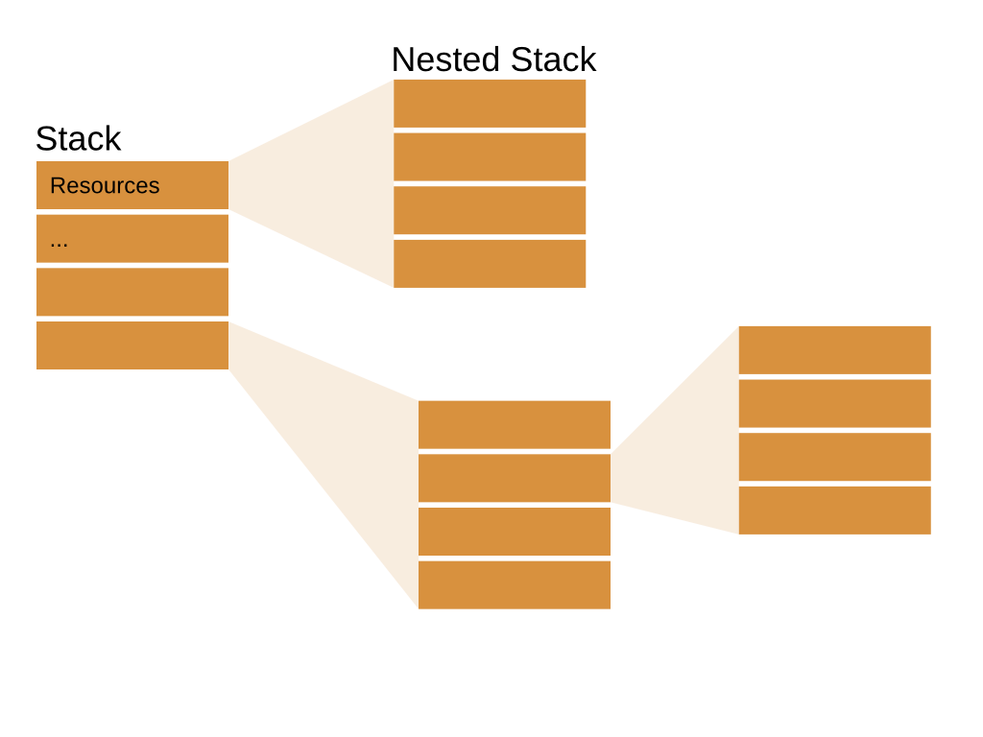
Composability
type: OS::TripleO::Controller
controller.yaml

Slide 16
Composability
Optional type aliases via “environment” file
resources:
Controller:
type: OS::TripleO::Controller
properties:
image {get_param: image_id}
...
--
resource_registry:
OS::TripleO::Controller: puppet/controller.yaml
heat stack-create mystack -f the_template.yaml -e the_environment.yaml

Slide 17
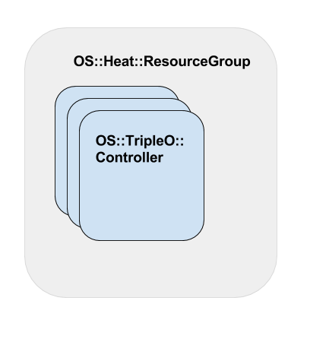
Grouping
resources:
Controller:
type: OS::Heat::ResourceGroup
properties:
count: {get_param: ControllerCount}
resource_def:
type: OS::TripleO::Controller

Slide 18
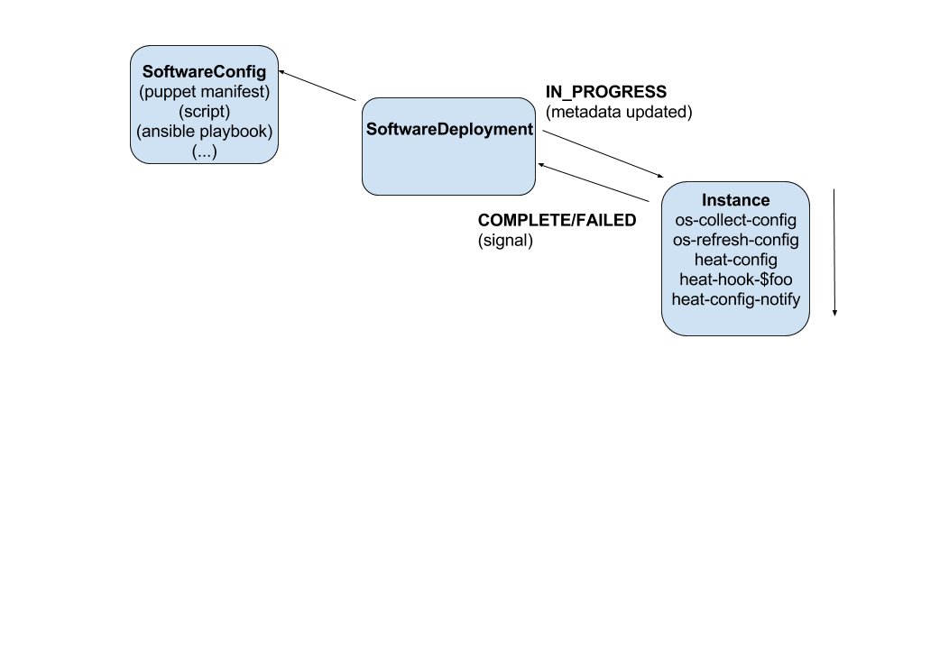
Software Configuration

Slide 19
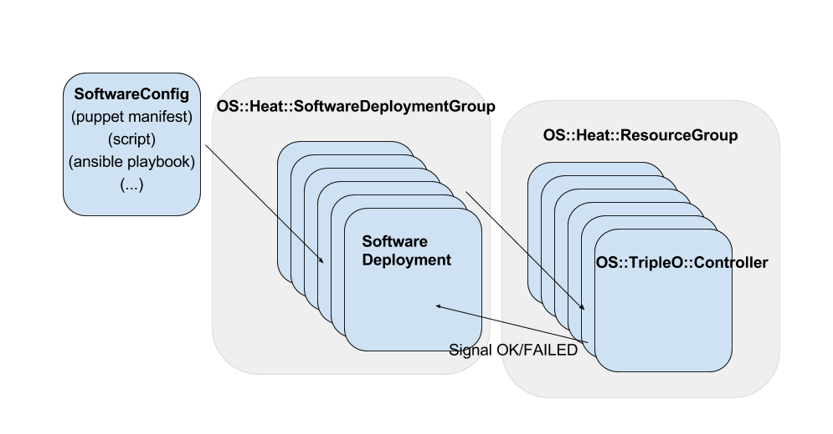
Cluster Configuration

Slide 20
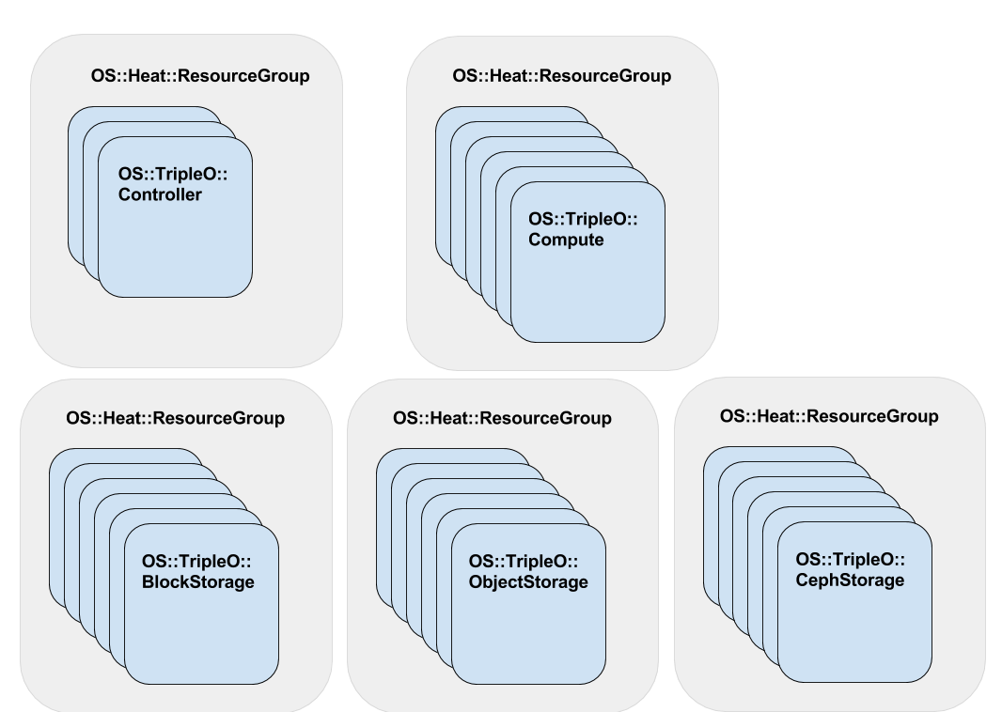
TripleO Roles

Slide 21
Developer Test Setups

Slide 22
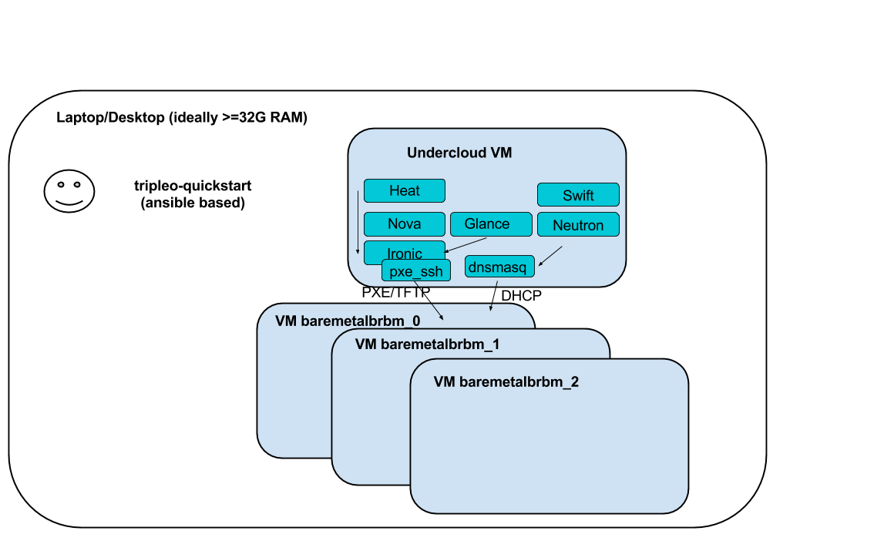
VM Setup

Slide 23
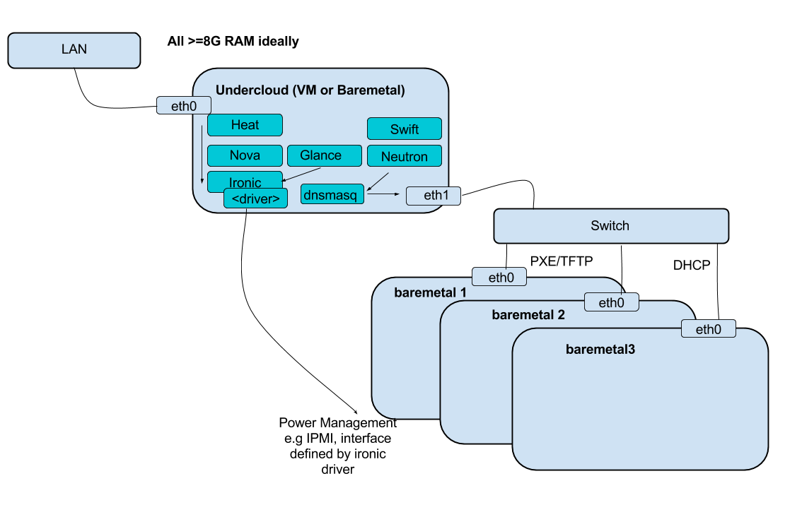
Baremetal Setup (minimal)

Slide 24
Deployment Workflow

Slide 25
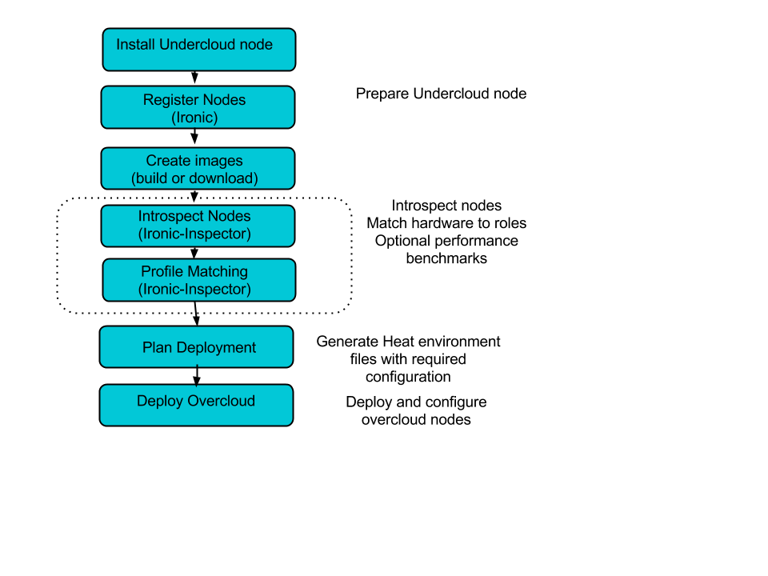

Slide 26
Development/test workflows
openstack overcloud deploy --templates <git checkout>
  Can re-run from a FAILED state!
  openstack stack delete overcloud
upload-puppet-modules -d <dir of local puppet modules>
  tripleo-common/scripts
openstack stack failures list overcloud

Slide 27
Development/test workflows
You can inspect/run the config on the nodes
  /var/lib/heat-config/heat-config-$hook

Slide 28
Developer Tools & Environment

Slide 29
TripleO Quickstart
http://git.openstack.org/cgit/openstack/tripleo-quickstart/
Ansible based
Automates dev VM setup
Used by CI and users
Creates VMs in libvirt unprivileged mode (su - stack!)

Slide 30
Basic environment, getting started
1. SSH onto your allocated node
2. Ensure the host is updated
yum -y update && /sbin/reboot
3. Configure SSH keys and check passwordless ssh is working
ssh-keygen
cat /root/.ssh/id_rsa.pub >> /root/.ssh/authorized_keys
ssh root@testhost uname -a

Slide 31
Basic environment, getting started
3. Install needed tools & clone/run tripleo-quickstart
yum -y install git vim-enhanced screen <your favourite tools here>
git clone https://github.com/openstack/tripleo-quickstart
bash tripleo-quickstart/quickstart.sh --install-deps
bash tripleo-quickstart/quickstart.sh --release master-tripleo-ci testhost
*Note* this only deploys two nodes by default, you can add -c config.yaml

Slide 32
Basic environment, getting started
4. SSH to installed undercloud and configure things
ssh -F /root/.quickstart/ssh.config.ansible undercloud
Then follow steps from the docs:
http://tripleo.org/basic_deployment/basic_deployment_cli.html#upload-images

Slide 33
Basic environment, getting started
5. Deploy overcloud (from undercloud)
. stackrc
openstack overcloud image upload
openstack baremetal import instackenv.json
openstack baremetal introspection bulk start # Optional
neutron subnet-list
neutron subnet-update <ID> --dns-nameserver 192.168.122.1 (or dns from virthost resolv.conf)
# The above steps are one-time, now we’re ready to deploy
openstack overcloud deploy --templates
Check out ironic node-list, nova flavor-list and glance image-list!

Slide 34
Basic deployment, passing parameters
Basic deployment
source stackrc
openstack overcloud deploy --templates -e my_params.yaml
my_params.yaml:
parameter_defaults:
NovaComputeLibvirtType: qemu
ControllerCount: 1
ComputeCount: 1
OvercloudControlFlavor: control
OvercloudComputeFlavor: compute

Slide 35
Basic environment, customizing
Quickstart only deploys two nodes by default, you can add -c config.yaml
overcloud_nodes:
- name: control_0
flavor: control
- name: compute_0
flavor: compute
- name: ceph_0
flavor: ceph
- name: swift_0
flavor: objectstorage
http://docs.openstack.org/developer/tripleo-quickstart/configuration.html

Slide 36
Where to find out more

Slide 37
Links & where to find out more
IRC (Freenode) #tripleo
https://docs.openstack.org/developer/tripleo-docs/
http://tripleo.org/planet.html (has links to blogs)
https://etherpad.openstack.org/p/tripleo-deep-dive-topics
  Has links to previous talks, we can do more if you request specific topics!

