Slide 1
Heat – Orchestration for OpenStack
Introduction to OpenStack Orchestration
Steven Hardy (shardy@redhat.com)
Zane Bitter (zbitter@redhat.com)
12th May 2014

Slide 2
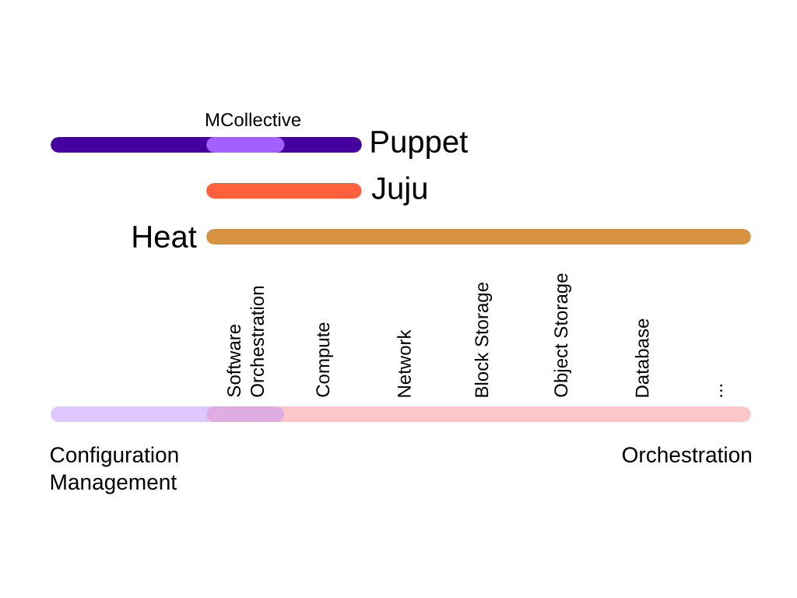
Orchestration
Notes:
KEY POINTS

Slide 3
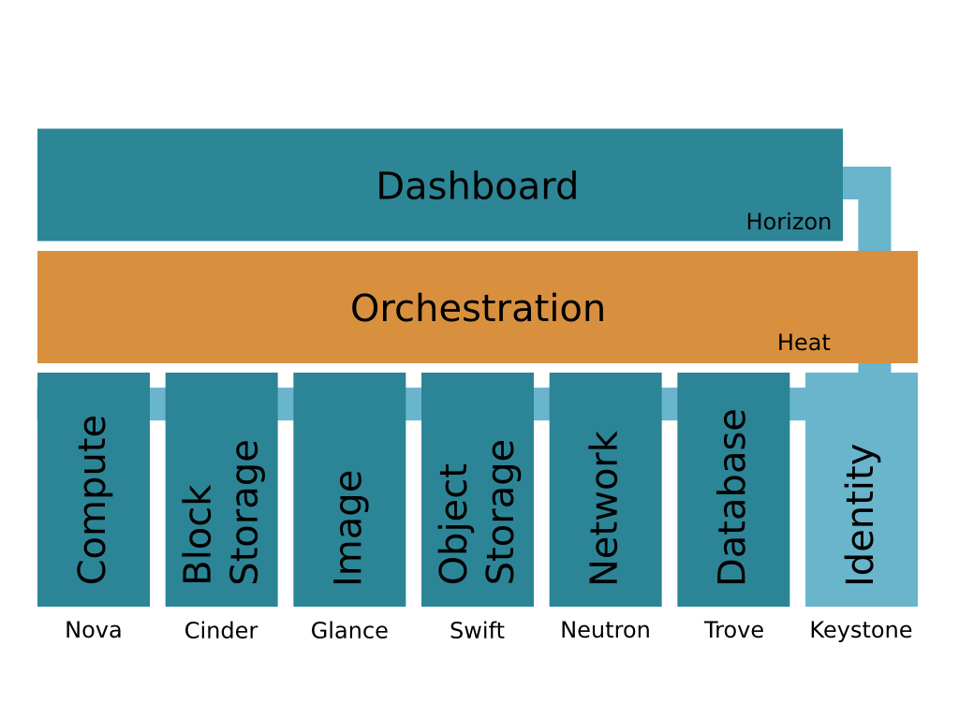
Heat Overview
Notes:
KEY POINTS

Slide 4
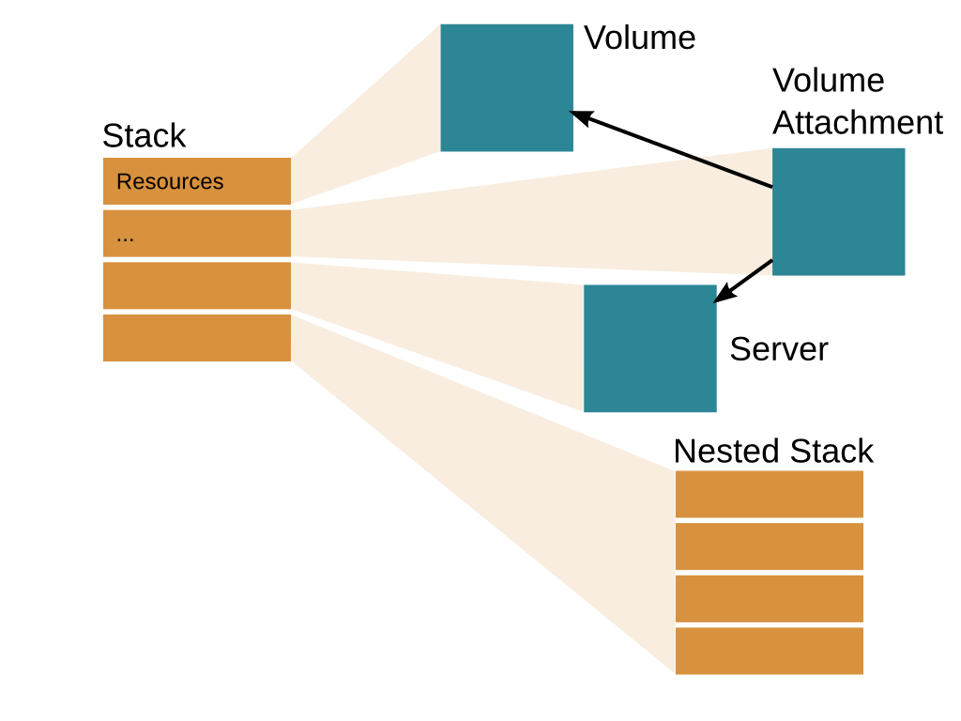
Notes:
KEY POINTS

Slide 5
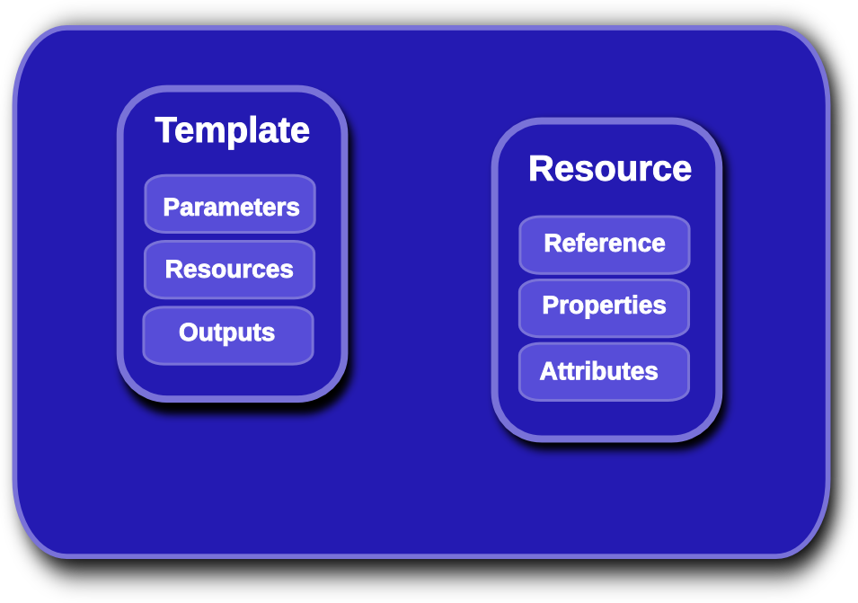
Heat Template Overview
Notes:
KEY POINTS
Lifecycle operations
Create creates a stack from a template
Delete deletes an existing instantiated stack
Update updates an existing instantiated stack
Introspection operations
List obtains a list of existing stacks
Describe obtains details of existing stacks
Events List obtains events that have occurred for a stack
List resources lists resources associated with a stack
Template describes a stack

Slide 6
Heat Orchestration Template
heat_template_version: 2013-05-23
parameters:
image:
type: string
resources:
my_instance:
type: OS::Nova::Server
properties:
flavor: m1.small
image: {get_param: image}
outputs:
networks:
description: my_instance network details
value: {get_attr : [my_instance, networks]}
Notes:
KEY POINTS
Lifecycle operations
Create creates a stack from a template
Delete deletes an existing instantiated stack
Update updates an existing instantiated stack
Introspection operations
List obtains a list of existing stacks
Describe obtains details of existing stacks
Events List obtains events that have occurred for a stack
List resources lists resources associated with a stack
Template describes a stack

Slide 7
Parameters/Constraints
heat_template_version: 2013-05-23
parameters:
image:
type: string
description: Image to use for the instance to be created.
default: cirros-0.3.2-x86_64-disk
constraints:
- allowed_values: ['cirros-0.3.2-x86_64-disk', 'fedora-20.x86_64']
volume_size:
type: number
description: Size of volume to attach to instance
default: 1
constraints:
- range: {min: 1, max: 10}
Notes:
KEY POINTS
Lifecycle operations
Create creates a stack from a template
Delete deletes an existing instantiated stack
Update updates an existing instantiated stack
Introspection operations
List obtains a list of existing stacks
Describe obtains details of existing stacks
Events List obtains events that have occurred for a stack
List resources lists resources associated with a stack
Template describes a stack

Slide 8
Heat Template Links
docs.openstack.org/developer/heat/template_guide
docs.openstack.org/developer/heat/template_guide/hot_spec.html
github.com/openstack/heat-templates
heat resource-type-list
heat resource-type-show OS::Nova::Server
https://github.com/hardys/demo_templates
Notes:
KEY POINTS
Lifecycle operations
Create creates a stack from a template
Delete deletes an existing instantiated stack
Update updates an existing instantiated stack
Introspection operations
List obtains a list of existing stacks
Describe obtains details of existing stacks
Events List obtains events that have occurred for a stack
List resources lists resources associated with a stack
Template describes a stack

Slide 9
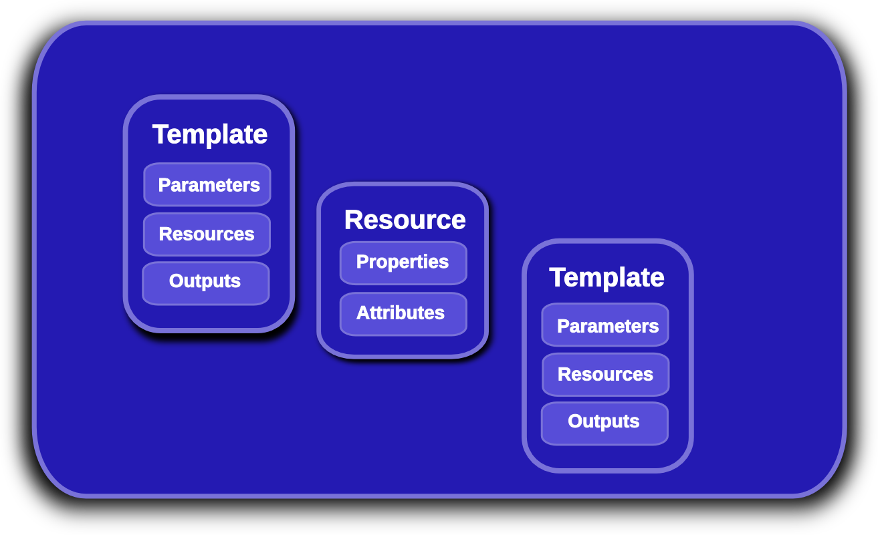
Heat Nested Stack Templates
Notes:
KEY POINTS
Lifecycle operations
Create creates a stack from a template
Delete deletes an existing instantiated stack
Update updates an existing instantiated stack
Introspection operations
List obtains a list of existing stacks
Describe obtains details of existing stacks
Events List obtains events that have occurred for a stack
List resources lists resources associated with a stack
Template describes a stack

Slide 10
Nested Stack Example
(my_nested.yaml)
heat_template_version: 2013-05-23
resources:
my_instance:
type: OS::Nova::Server
properties:
flavor: m1.small
image: my_image
heat_template_version: 2013-05-23
resources:
my_nested:
type: my_nested.yaml
Notes:
KEY POINTS
Lifecycle operations
Create creates a stack from a template
Delete deletes an existing instantiated stack
Update updates an existing instantiated stack
Introspection operations
List obtains a list of existing stacks
Describe obtains details of existing stacks
Events List obtains events that have occurred for a stack
List resources lists resources associated with a stack
Template describes a stack

Slide 11
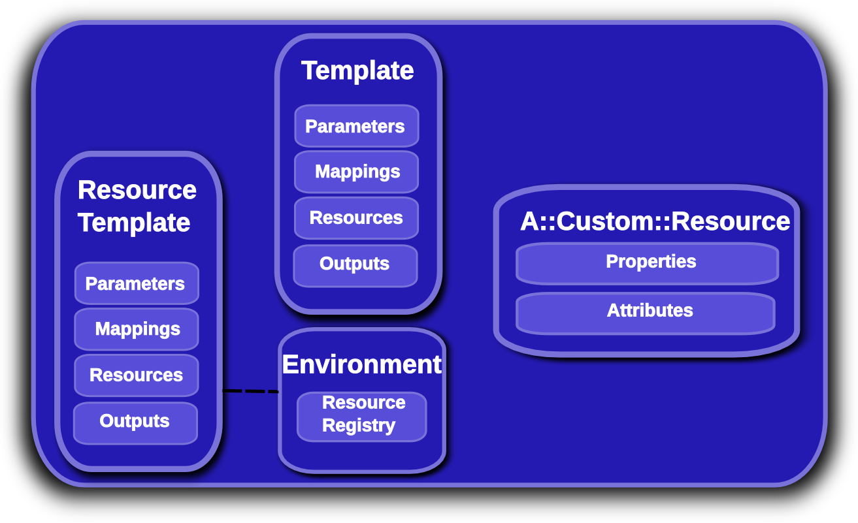
Provider Resources
Notes:
KEY POINTS
Lifecycle operations
Create creates a stack from a template
Delete deletes an existing instantiated stack
Update updates an existing instantiated stack
Introspection operations
List obtains a list of existing stacks
Describe obtains details of existing stacks
Events List obtains events that have occurred for a stack
List resources lists resources associated with a stack
Template describes a stack

Slide 12
Provider Resources
No hard-coded names/paths (in the template)
Staging workflow/testing much simplified
Allows deployer or user to define custom resource types
  /etc/heat/environment.d
  /etc/heat/templates
  Users heat stack-create –environment-file=foo.yaml
    Users can override default deployer resources!
resource_registry:
"My::Custom::Server": server.yaml
Notes:
KEY POINTS
Lifecycle operations
Create creates a stack from a template
Delete deletes an existing instantiated stack
Update updates an existing instantiated stack
Introspection operations
List obtains a list of existing stacks
Describe obtains details of existing stacks
Events List obtains events that have occurred for a stack
List resources lists resources associated with a stack
Template describes a stack

Slide 13
Environments
parameters:
key_name: mykey
resource_registry:
My::Custom::Server : my_server.yaml
OS::Nova::Server : override_nova.yaml
python-heatclient resolves local files and URLs
Files associated with environment are passed along with the stack-create/update API request
heat stack-create mystack -f template.yaml -e environment.yaml
Notes:
KEY POINTS
Lifecycle operations
Create creates a stack from a template
Delete deletes an existing instantiated stack
Update updates an existing instantiated stack
Introspection operations
List obtains a list of existing stacks
Describe obtains details of existing stacks
Events List obtains events that have occurred for a stack
List resources lists resources associated with a stack
Template describes a stack

Slide 14
Provider Resource Example
(my_nested.yaml)
heat_template_version: 2013-05-23
resources:
my_instance:
type: OS::Nova::Server
properties:
flavor: m1.small
image: my_image
(my_stack.yaml)
heat_template_version: 2013-05-23
resources:
my_nested:
type: My::Custom::Server
(environment.yaml)
resource_registry:
My::Custom::Server: my_nested.yaml
Notes:
KEY POINTS
Lifecycle operations
Create creates a stack from a template
Delete deletes an existing instantiated stack
Update updates an existing instantiated stack
Introspection operations
List obtains a list of existing stacks
Describe obtains details of existing stacks
Events List obtains events that have occurred for a stack
List resources lists resources associated with a stack
Template describes a stack

Slide 15
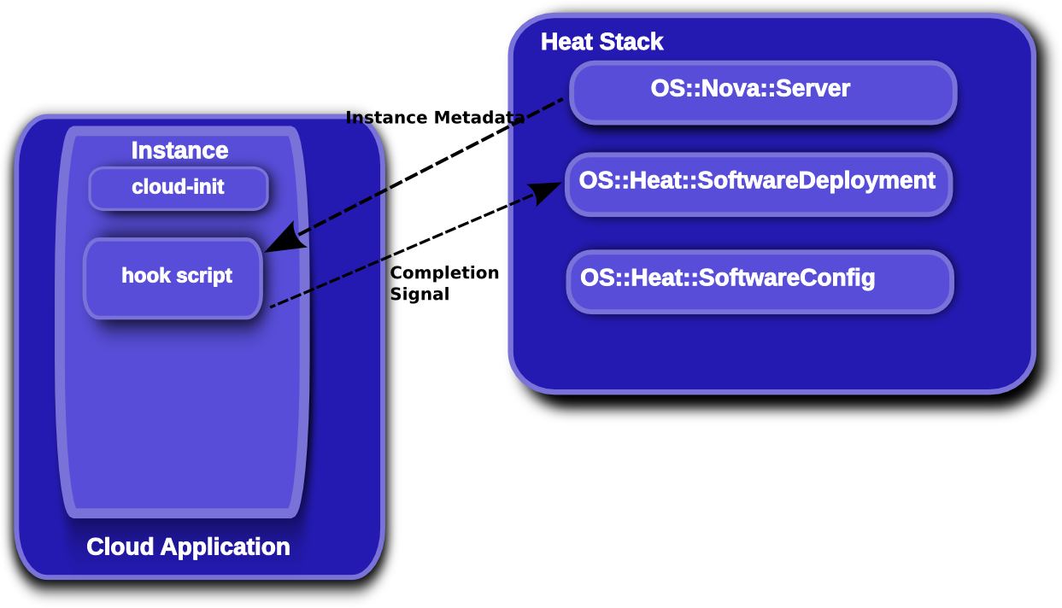
Software Config
Tuesday, May 13 • 3:40pm – 4:20pm
“Application Software Configuration Using Heat”
Notes:
KEY POINTS
Lifecycle operations
Create creates a stack from a template
Delete deletes an existing instantiated stack
Update updates an existing instantiated stack
Introspection operations
List obtains a list of existing stacks
Describe obtains details of existing stacks
Events List obtains events that have occurred for a stack
List resources lists resources associated with a stack
Template describes a stack

Slide 16
Icehouse key new features
HOT DSL feature-complete and declared stable
Software-config initial implementation complete
“stack domain users” (no more admin requirement)
Native auto-scaling resources
Pluggable parameter constraints
Pluggable template parser/functions
Scalable heat-engine
“management API” additions
Notes:
KEY POINTS
Provides orchestration service for openstack
Integrates all openstack core projects
Converts either a JSON or YAML template into an openstack cloud application

Slide 17
Juno Roadmap (tbc!)
Autoscaling hooks (scale-down cleanup)
Autoscaling parameters (choose victims)
Enable retry from failed states
Rolling updates
Stack check
Stack preview
Cancel stack update
Update preview
...
Notes:
KEY POINTS
Heat implements most functionality
Heat upstream has more work to do on network functionality

Slide 18
Questions?
https://wiki.openstack.org/wiki/Heat
http://docs.openstack.org/developer/heat/
https://github.com/hardys/presentations

